Slide 1
ML Surrogates for Agent-Based Transport Models
Uncertainty Quantification for GNN-Based Traffic Prediction
Thesis Defence Presentation
Supervisors: Dominik Natterer | Elena
Paris MATSim Dataset • 1,000 Scenarios • 31,635 Road Segments
March 2026

Slide 2
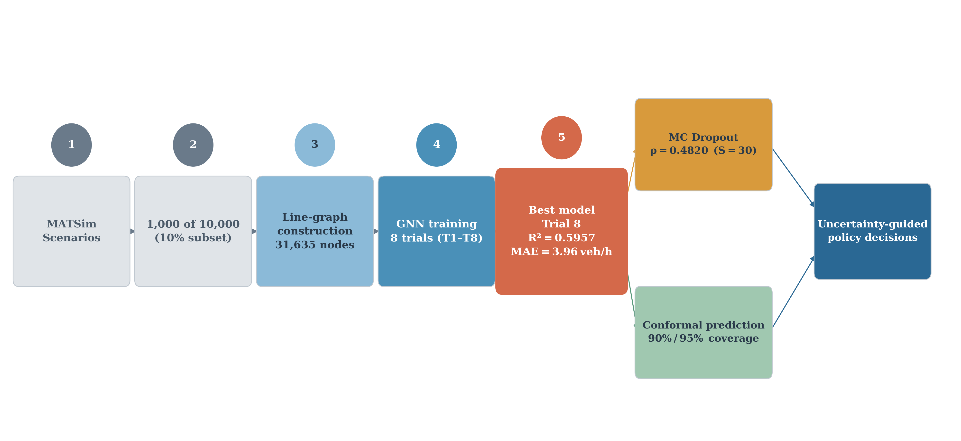
The Problem
2
Why do we need an ML surrogate?
Without Surrogate
• 1 MATSim scenario = 8+ hours
• Policy testing = weeks of compute
• Very few alternatives evaluated
With GNN Surrogate
• 1 scenario = seconds
• BUT: needs uncertainty estimates
• When can we trust the output?
Fig: 1. Overall thesis pipeline: MATSim simulations → GNN surrogate → uncertainty-guided decisions
Technical University of Munich | Chair of Urban Transport Systems
2

Slide 3
4 Research Questions
3
RQ1
MC Dropout Effectiveness
RQ2
MC Dropout vs Ensembles
How well does MC Dropout capture epistemic uncertainty in GNN traffic surrogates? (measured by Spearman ρ between predicted σ and actual error)
How does MC Dropout compare to ensemble-based UQ in terms of uncertainty quality and computational efficiency?
RQ3
Combining Identical Models
RQ4
Distribution-Free Coverage
Does combining uncertainty from architecturally identical models help? What role does diversity play?
Can conformal prediction & temperature scaling transform raw uncertainty into trustworthy intervals with formal coverage guarantees?
Technical University of Munich | Chair of Urban Transport Systems
3

Slide 4
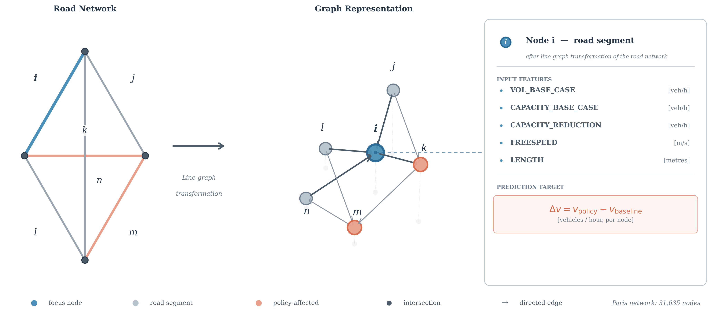
Dataset & Experimental Setup
4
Paris MATSim Road Network
Road segments (nodes)
31,635
Network edges
~85,000
Scenarios used
1,000 (10% of 10,000)
Training scenarios
800
Validation scenarios
100 (T7-T8)
Test scenarios
100 (T7-T8)
Total test predictions
3,163,500
GPU
NVIDIA T4 (Colab)
5 Input Features per node:
• VOL_BASE_CASE • CAPACITY_BASE_CASE
• CAPACITY_REDUCTION • FREESPEED • LENGTH
Fig: 2. Paris road network as directed graph. Coral nodes = capacity-reduced segments. Each node = one road segment. Target: Δv = volume change (veh/h).
Technical University of Munich | Chair of Urban Transport Systems
4

Slide 5
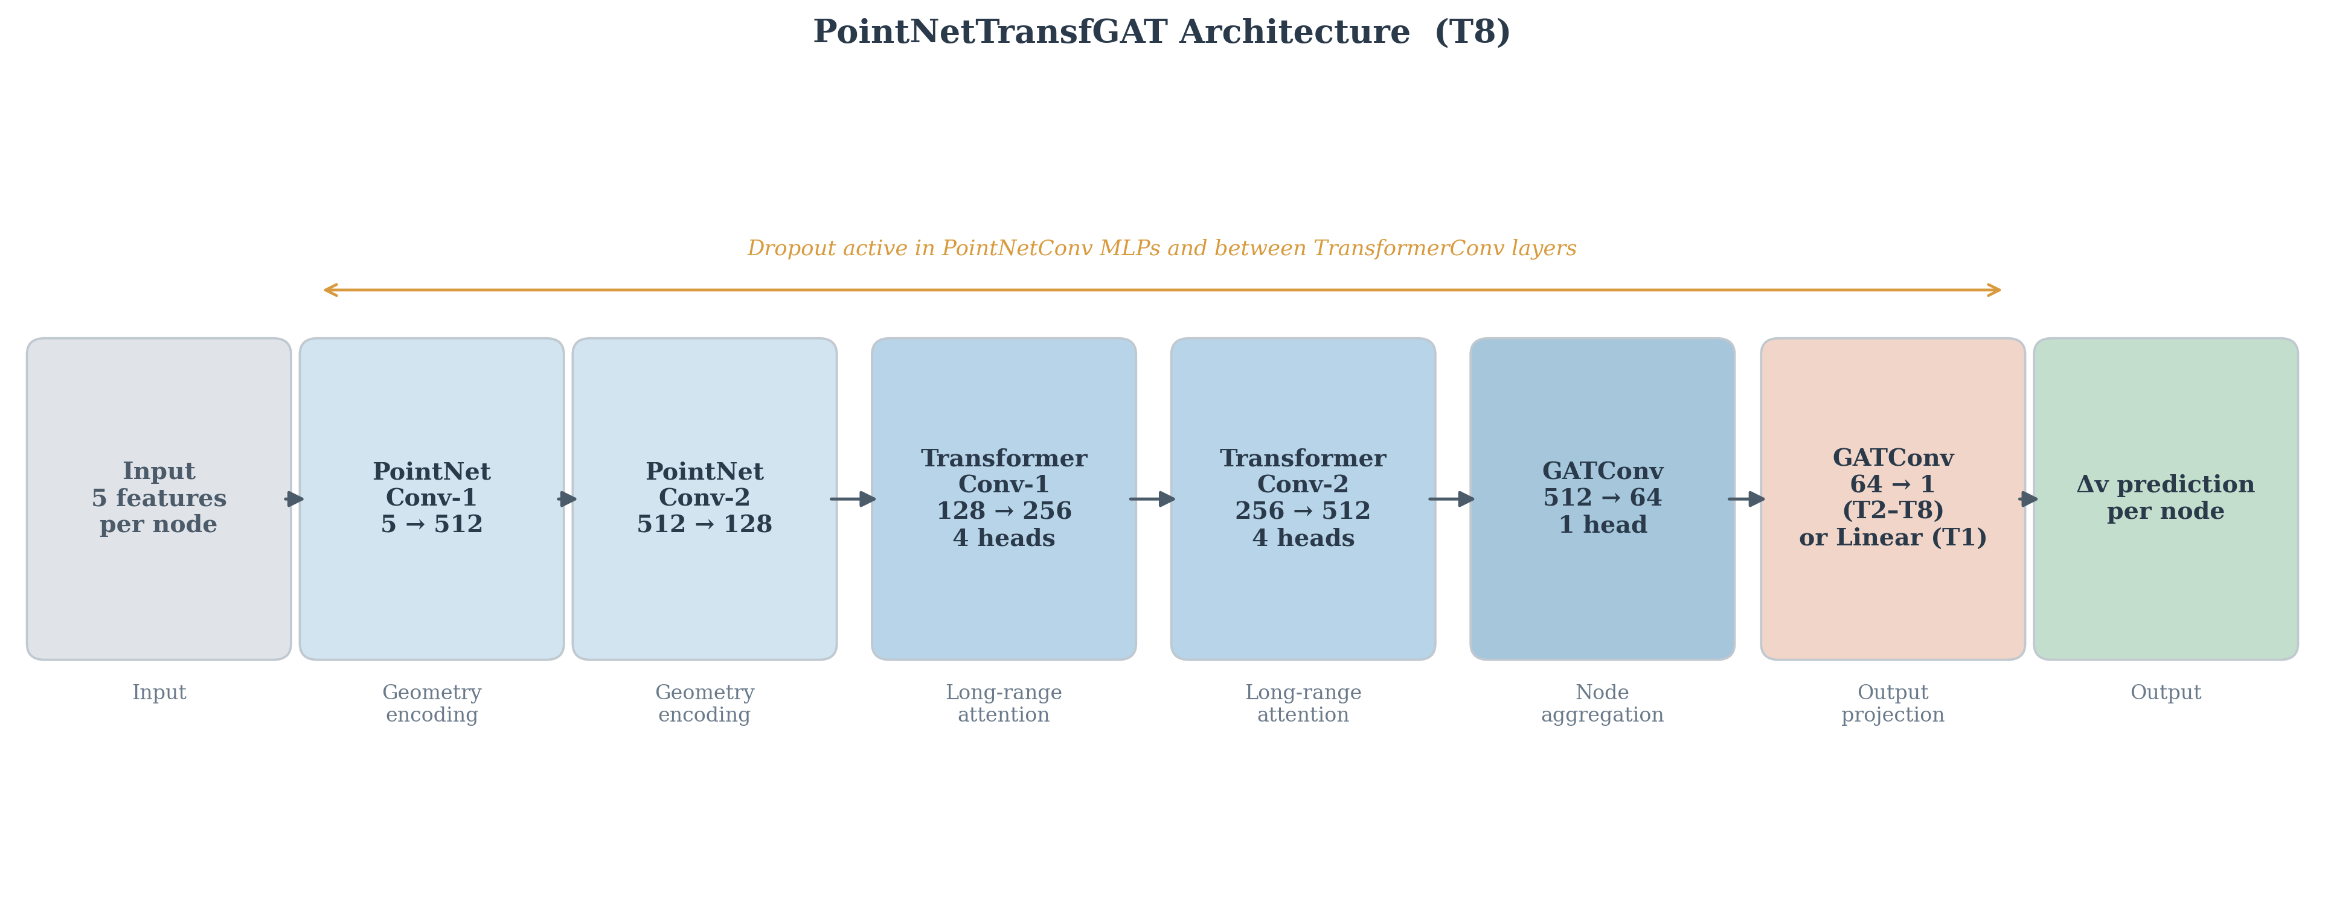
GNN Architecture: PointNetTransfGAT
5
6-layer graph neural network for node-level regression
Stage 1
PointNetConv-1
Start-point geometry encoding [5 → 512]
Stage 2
PointNetConv-2
End-point geometry encoding [512 → 128]
Stage 3
TransformerConv-1
4-head attention [128 → 256]
Stage 4
TransformerConv-2
4-head attention [256 → 512]
Stage 5
GATConv
Neighbourhood aggregation [512 → 64]
Stage 6
GATConv (final)
Scalar prediction (T2-T8) [64 → 1]
Dropout applied in PointNetConv & TransformerConv layers
Fig: 3. PointNetTransfGAT: PointNetConv (geometry) → TransformerConv (attention) → GATConv (output). Input: 5 features per node. Output: Δv per node (veh/h).
Technical University of Munich | Chair of Urban Transport Systems
5

Slide 6
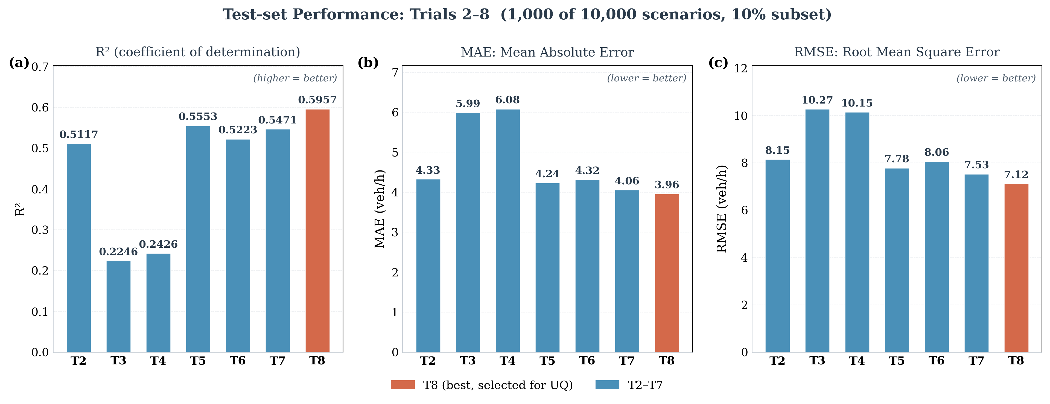
8 Training Trials: Performance Summary
6
Best model = T8 (R² = 0.5957)
Trial
R²
MAE
Dropout
UQ?
T1
0.786
2.97
0.0
❌
T2
0.512
4.33
0.3
partial
T3
0.225
5.99
0.0
❌
T4
0.243
6.08
0.0
❌
T5
0.555
4.24
0.3
✓
T6
0.522
4.32
0.3
✓
T7
0.547
4.06
0.3
✓
T8★
0.596
3.96
0.2
✓ Best
T1 excluded from UQ: zero dropout → σ=0 everywhere
Fig: 4. R², MAE, RMSE across Trials 2–8. T8 achieves best R²=0.5957, MAE=3.96 veh/h among UQ-compatible trials.
Technical University of Munich | Chair of Urban Transport Systems
6

Slide 7
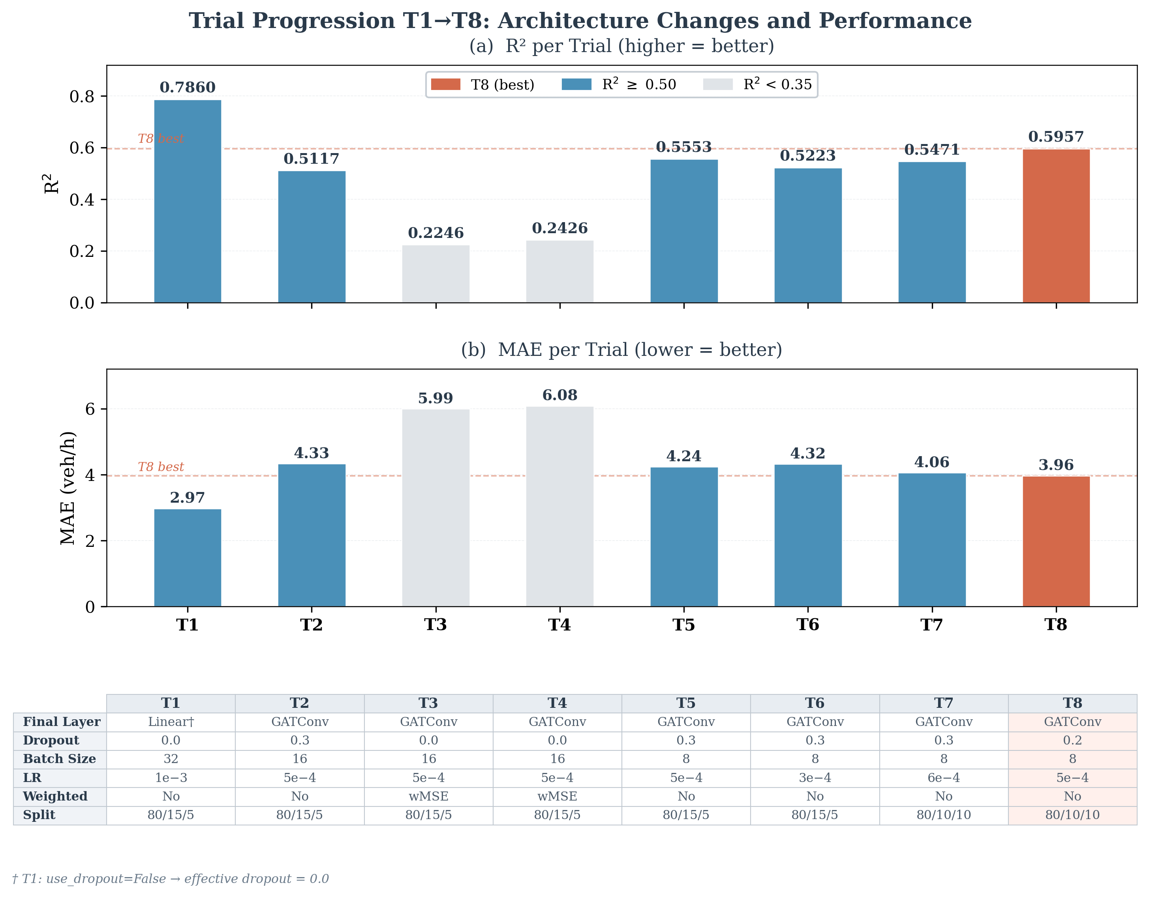
Why T1 is Excluded & T9 Failed
7
Understanding the boundaries of our UQ approach
T1 — Excluded from UQ
• Has highest R² = 0.786 and MAE = 2.97
• BUT: effective dropout = 0.0
• All S=30 passes give identical output
• σ = 0 everywhere → UQ undefined
• Architectural constraint, not a flaw
T9 — Heteroscedastic (Negative Result)
• Tried: predict mean AND variance directly
• Result: R² = 0.02 (target was ≥ 0.57)
• Model inflated variance to absorb errors
• Instead of improving mean predictions
• Known failure mode (Seitzer et al.)
Fig: 5. Trial progression T1→T8: R² (top) and MAE (bottom). T8 = best UQ-compatible trial.
Technical University of Munich | Chair of Urban Transport Systems
7

Slide 8
6 UQ Methods Evaluated
8
All post-hoc — no model retraining required
MC Dropout
Ensemble Variance
Combined UQ
S=30 stochastic passes at inference time
5 seeded runs, std of per-run means
√(σ²_MC + σ²_ens) quadrature sum
1
2
3
Conformal Pred.
Selective Pred.
Temp. Scaling
Distribution-free coverage guarantee
Filter by σ threshold, keep confident ones
Post-hoc calibration with scalar T
4
5
6
Technical University of Munich | Chair of Urban Transport Systems
8

Slide 9
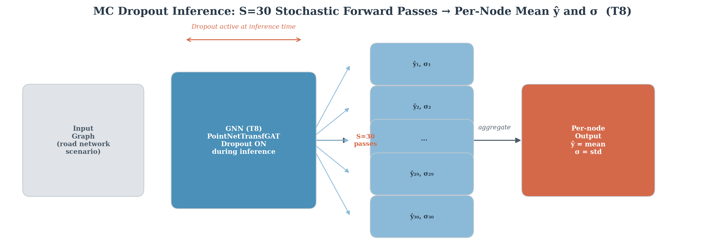
RQ1: What is MC Dropout?
9
Keeping dropout active at inference to estimate uncertainty
Step 1
Load trained model with dropout layers
Step 2
Enable dropout at inference time
Step 3
Run S=30 forward passes on same graph
Step 4
Compute per-node mean: μ = (1/S)Σŷₛ
Step 5
Compute per-node std: σ = std(ŷ₁...ŷ₃₀)
Step 6
High σ = model uncertain about this road
S=30 chosen: plateau reached at S≈25, S=50 gives only +1% ρ
Fig: 6. S=30 stochastic forward passes through T8. Per-node mean (ŷ) and std (σ) computed. σ serves as the uncertainty estimate. Spearman ρ=0.4820.
Technical University of Munich | Chair of Urban Transport Systems
9

Slide 10
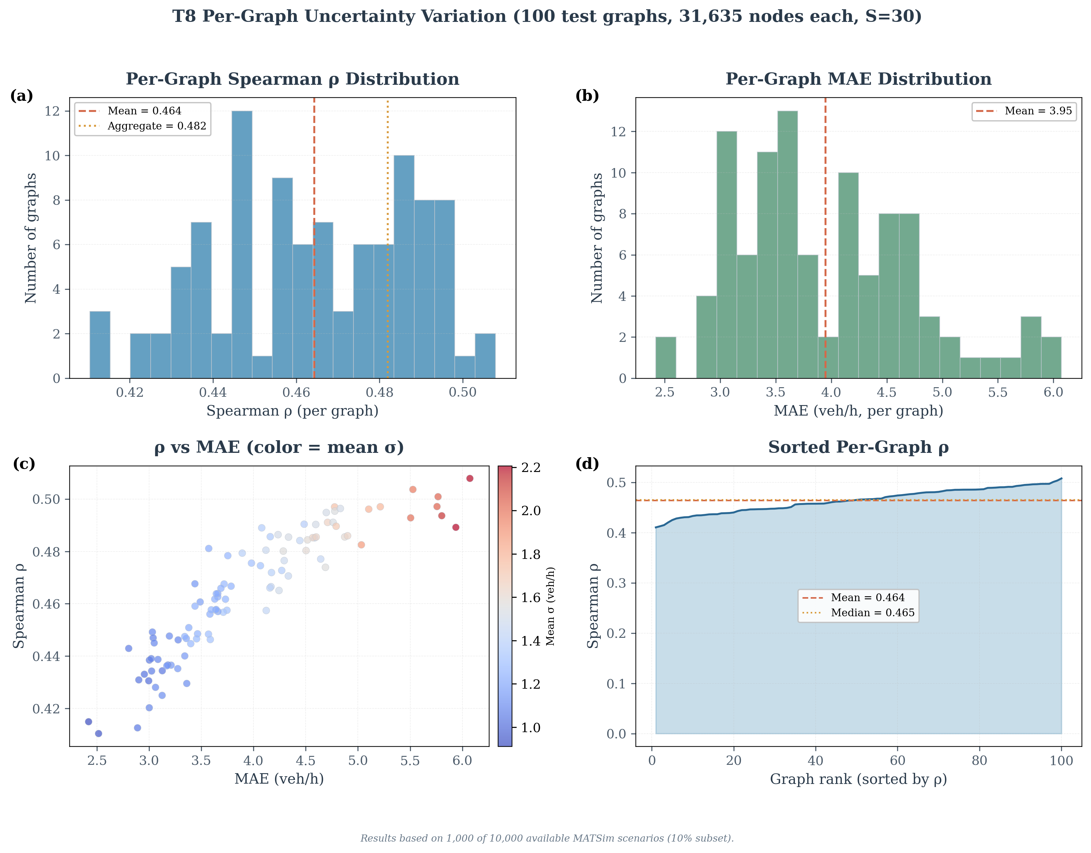
RQ1 Results: MC Dropout Uncertainty Quality
10
T8 achieves ρ = 0.4820 — best among all UQ-compatible trials
Trial
Dropout
Test Graphs
Spearman ρ
T5
0.3
50
0.4263
T6
0.3
50
0.4186
T7
0.3
100
0.4460
T8★
0.2
100
0.4820
ρ = 0.4820
AUROC = 0.76
ΔR² = −0.010
Uncertainty-Error Correlation
Error Detection (top-10% errors)
Accuracy Cost of Enabling Dropout
Fig: 7. Per-graph Spearman ρ across all 100 test scenarios. Mean=0.464, Std=0.023 — consistent quality, no outlier scenarios.
Technical University of Munich | Chair of Urban Transport Systems
10

Slide 11
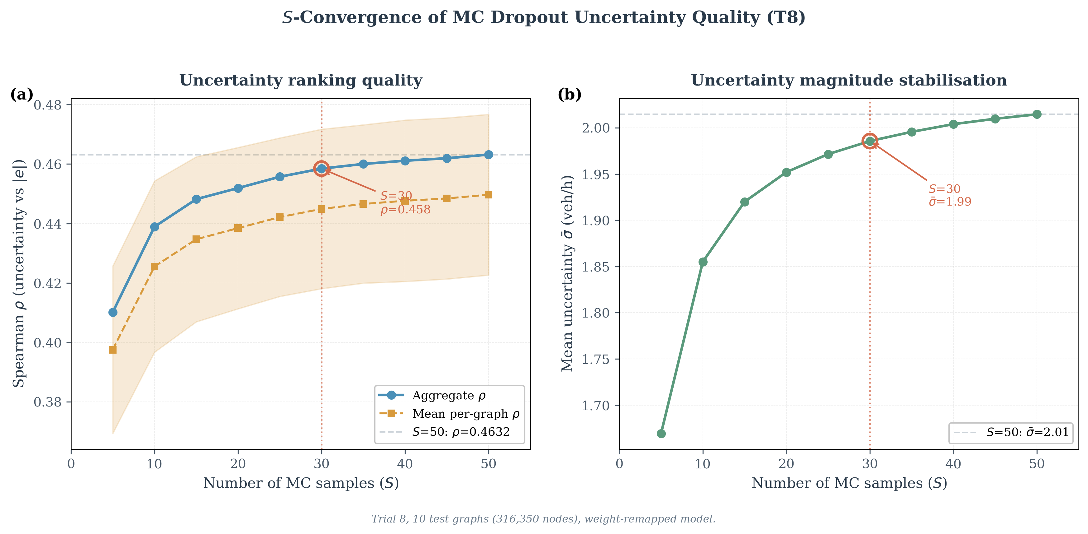
S = 30 Convergence Analysis
11
Choosing the right number of MC forward passes
Why S=30?
Convergence plateau:
• ρ flattens sharply after S≈25
• S=30 → ρ = 0.4584
• S=50 → ρ = 0.4632 (+1.0% only)
Compute cost:
• S=30: 228 min on T4 GPU
• S=50: ~380 min (+67% cost)
• Gain: only +1% improvement
Conclusion:
S=30 is on the plateau.
Optimal cost-quality trade-off.
Fig: 8. Spearman ρ vs number of MC samples S (T8, 10 test graphs). Both ρ and mean σ plateau at S≈25. Circled point = S=30 (chosen operating point).
Technical University of Munich | Chair of Urban Transport Systems
11

Slide 12
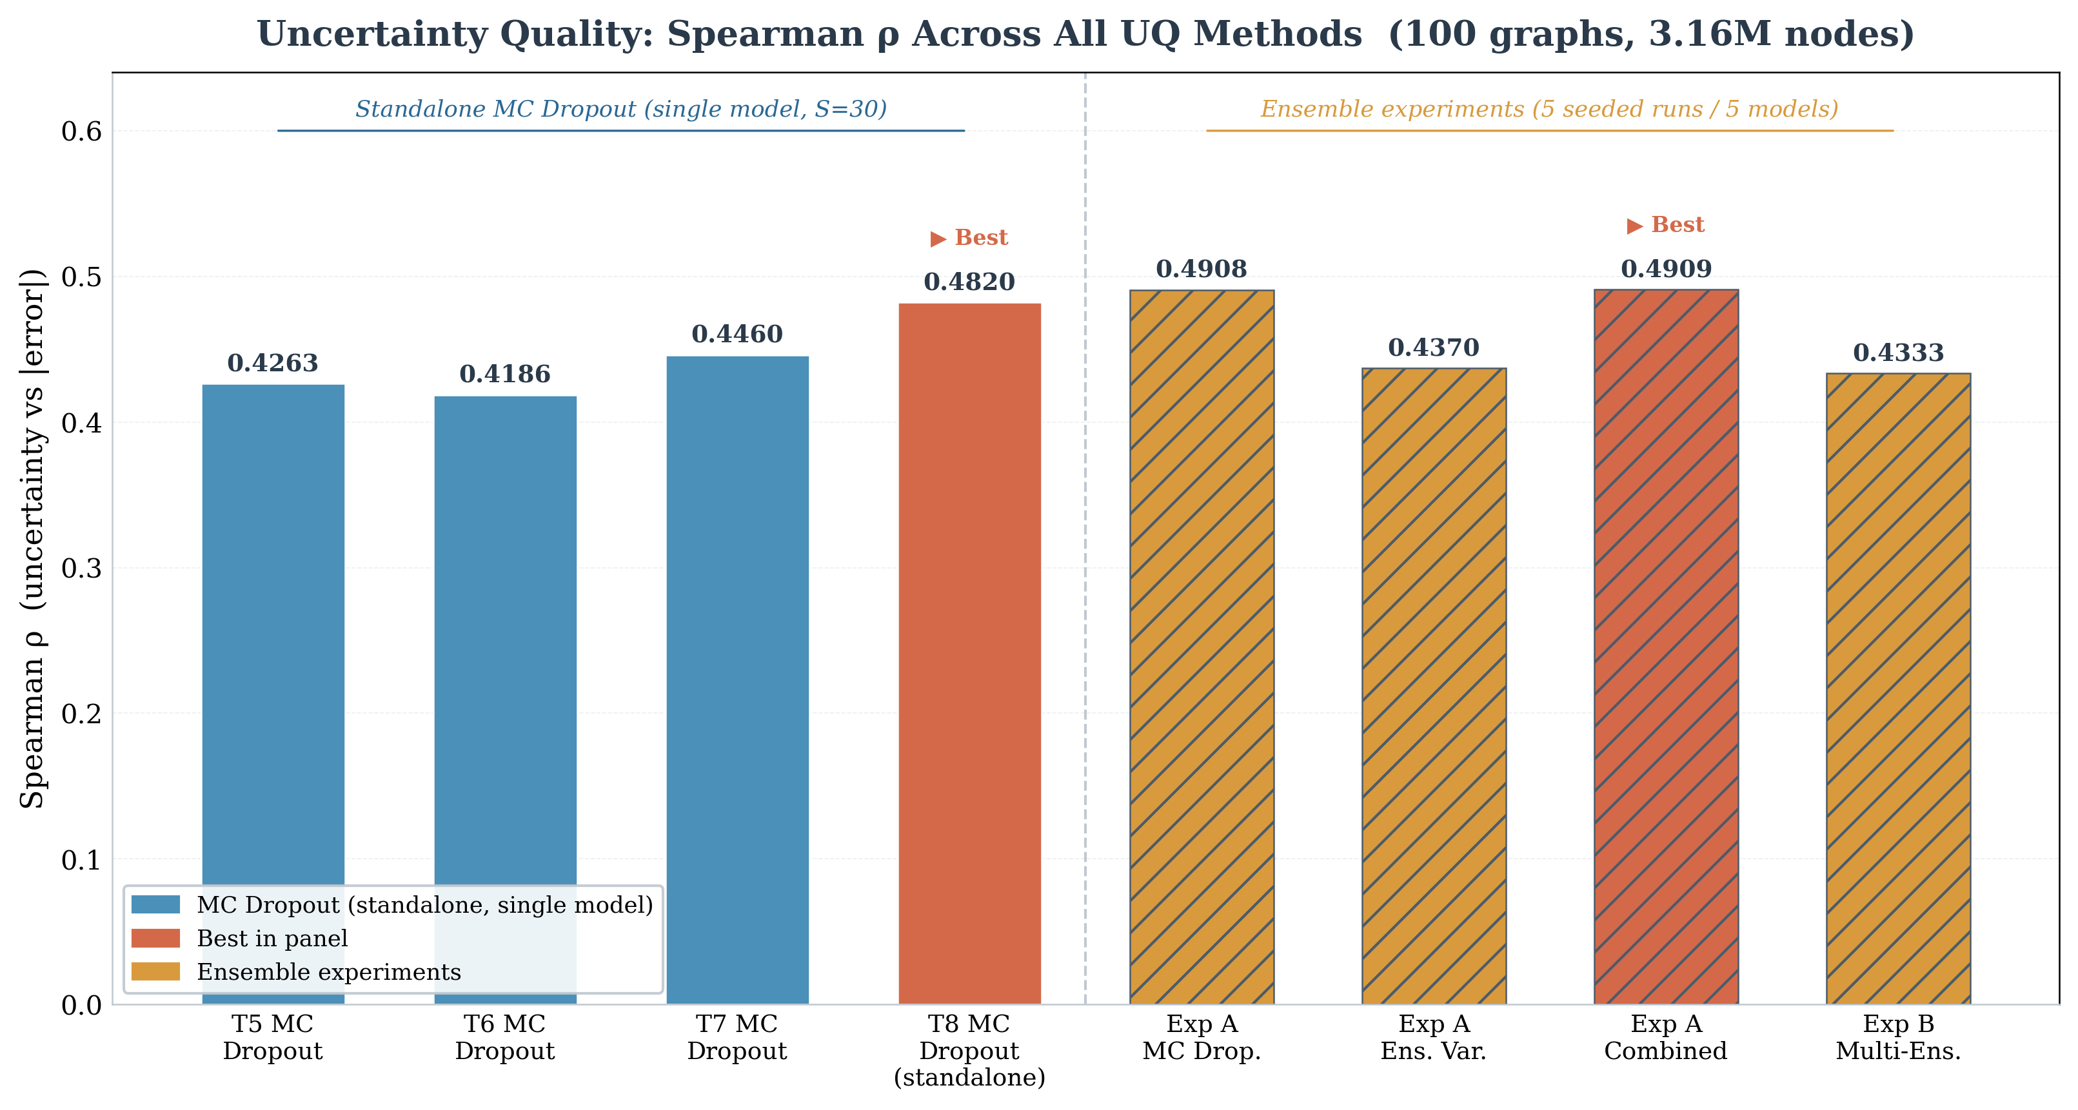
RQ2: MC Dropout vs Ensemble Variance (Exp A)
12
5 seeded runs on same T8 model
Experiment A Results
MC Dropout (S=30)
ρ = 0.4908
Ensemble Variance
ρ = 0.4370
Combined (MC+Ens)
ρ = 0.4909
Key Finding
• MC Dropout beats Ensemble Variance by +12.3%
• Combined adds negligible benefit (+0.01 ρ)
• Ensemble variance is largely redundant
Note: PyTorch Geometric API bug fixed before evaluation
Fig: 9. Spearman ρ for all evaluated UQ methods. MC Dropout (blue) outperforms ensemble variance (orange). Best = Exp A Combined (ρ=0.4909).
Technical University of Munich | Chair of Urban Transport Systems
12

Slide 13
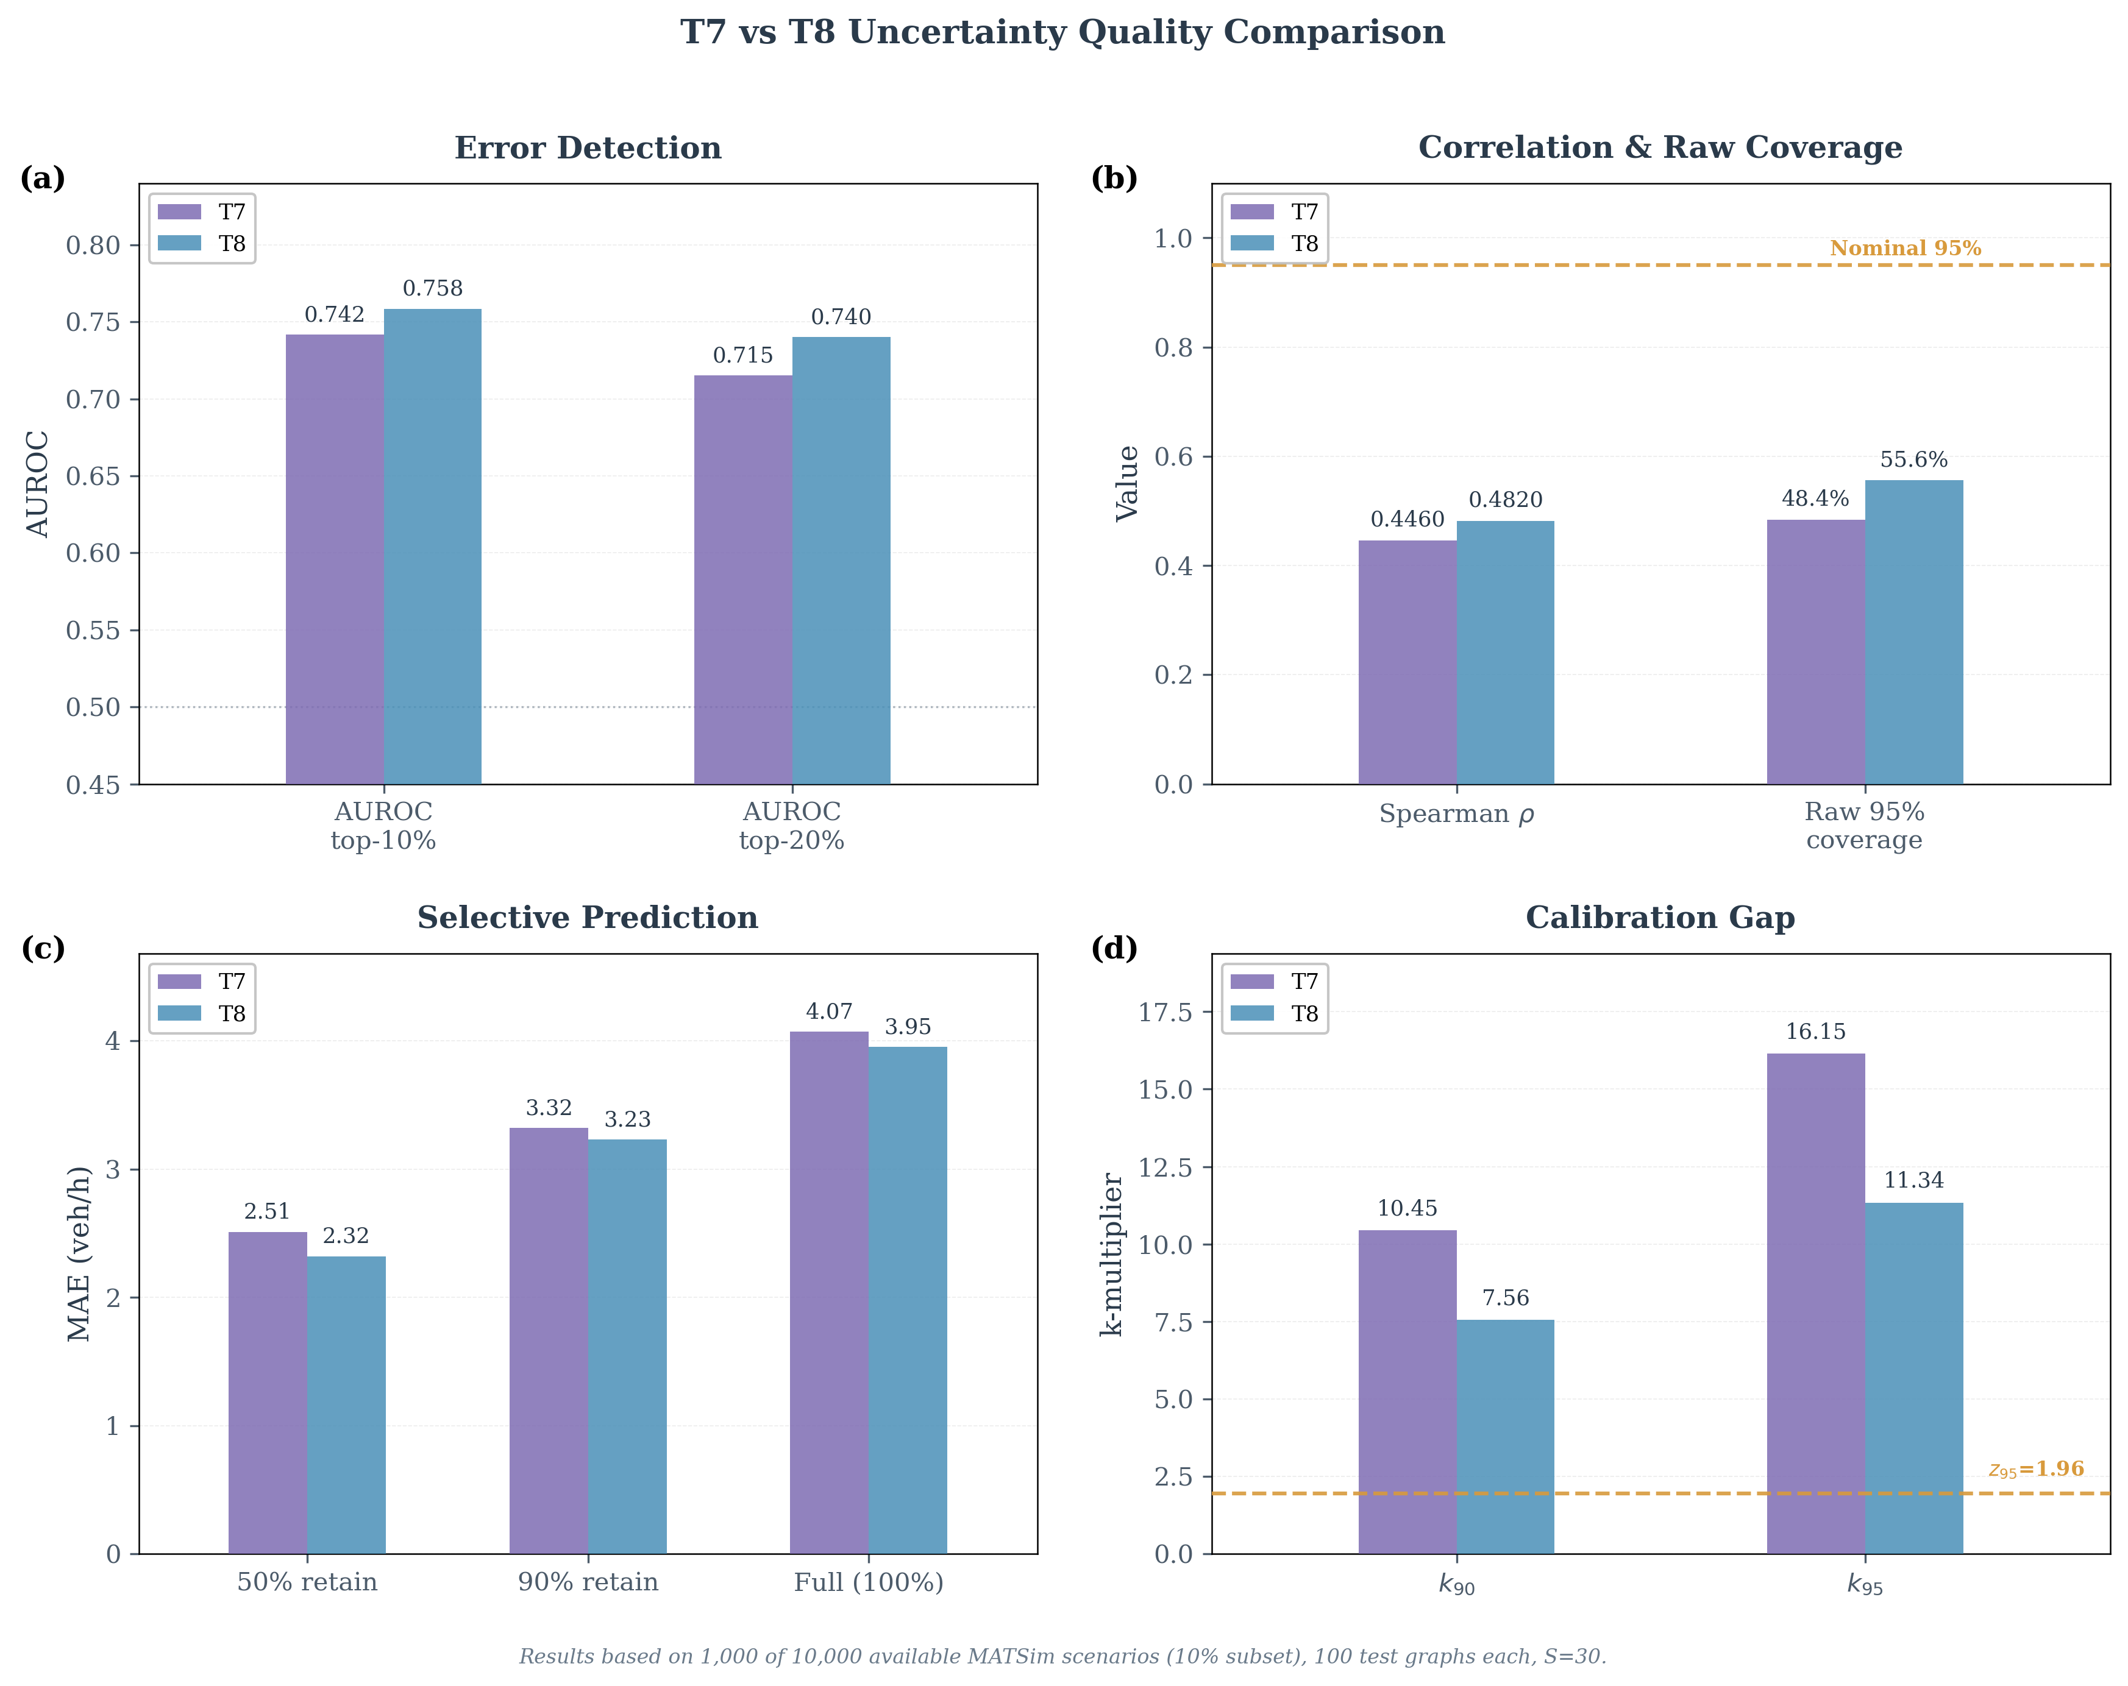
RQ3: Multi-Model Ensemble (Exp B)
13
T2 + T5 + T6 + T7 + T8 — weighted by individual R²
Experiment B: 5-Model Ensemble
Ensemble ρ
0.4333
Ensemble R²
0.5656
Best single (T8) R²
0.5957
MC Dropout ρ (T8)
0.4908
Why ensemble doesn't help accuracy
• Models span R² 0.51 (T2) to 0.60 (T8)
• Averaging weaker models dilutes T8
• Architectural diversity not tested here
• UQ-wise: ρ=0.4333 < MC Dropout 0.4908
Fig: 10. Comprehensive UQ comparison: T7 vs T8 across AUROC, Spearman ρ, k₉₅, MAE, and selective prediction.
Technical University of Munich | Chair of Urban Transport Systems
13

Slide 14
Technical Finding: PyTorch Geometric API Bug
14
Why ensemble results had to be corrected
Problem: Silent GATConv weight mismatch
Original ensemble scripts loaded checkpoints with strict=False. PyG 2.3.1 expected lin_src.weight / lin_dst.weight, but checkpoints stored lin.weight (older format). Weights silently dropped → R² dropped from ~0.59 to near-zero.
Before Fix (Corrupted)
After Fix (Corrected)
Ensemble R²: ~0.0
Ensemble ρ: ~0.0
Ensemble R²: 0.5656
Ensemble ρ: 0.4333
Fix: Remapped checkpoint keys before loading with strict=True
Impact: MC Dropout, conformal prediction, temperature scaling results are NOT affected — they used the matching PyG version.
Technical University of Munich | Chair of Urban Transport Systems
14

Slide 15
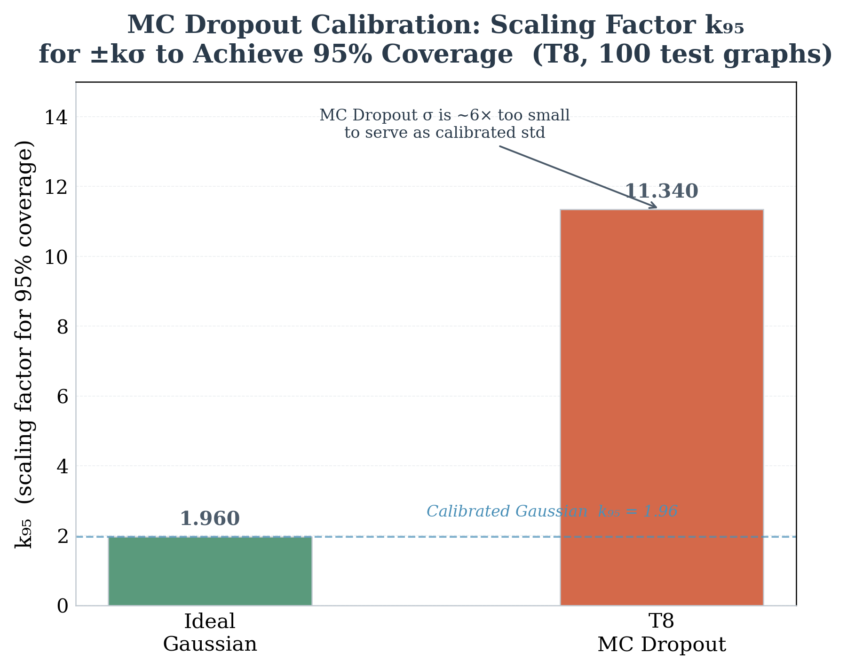
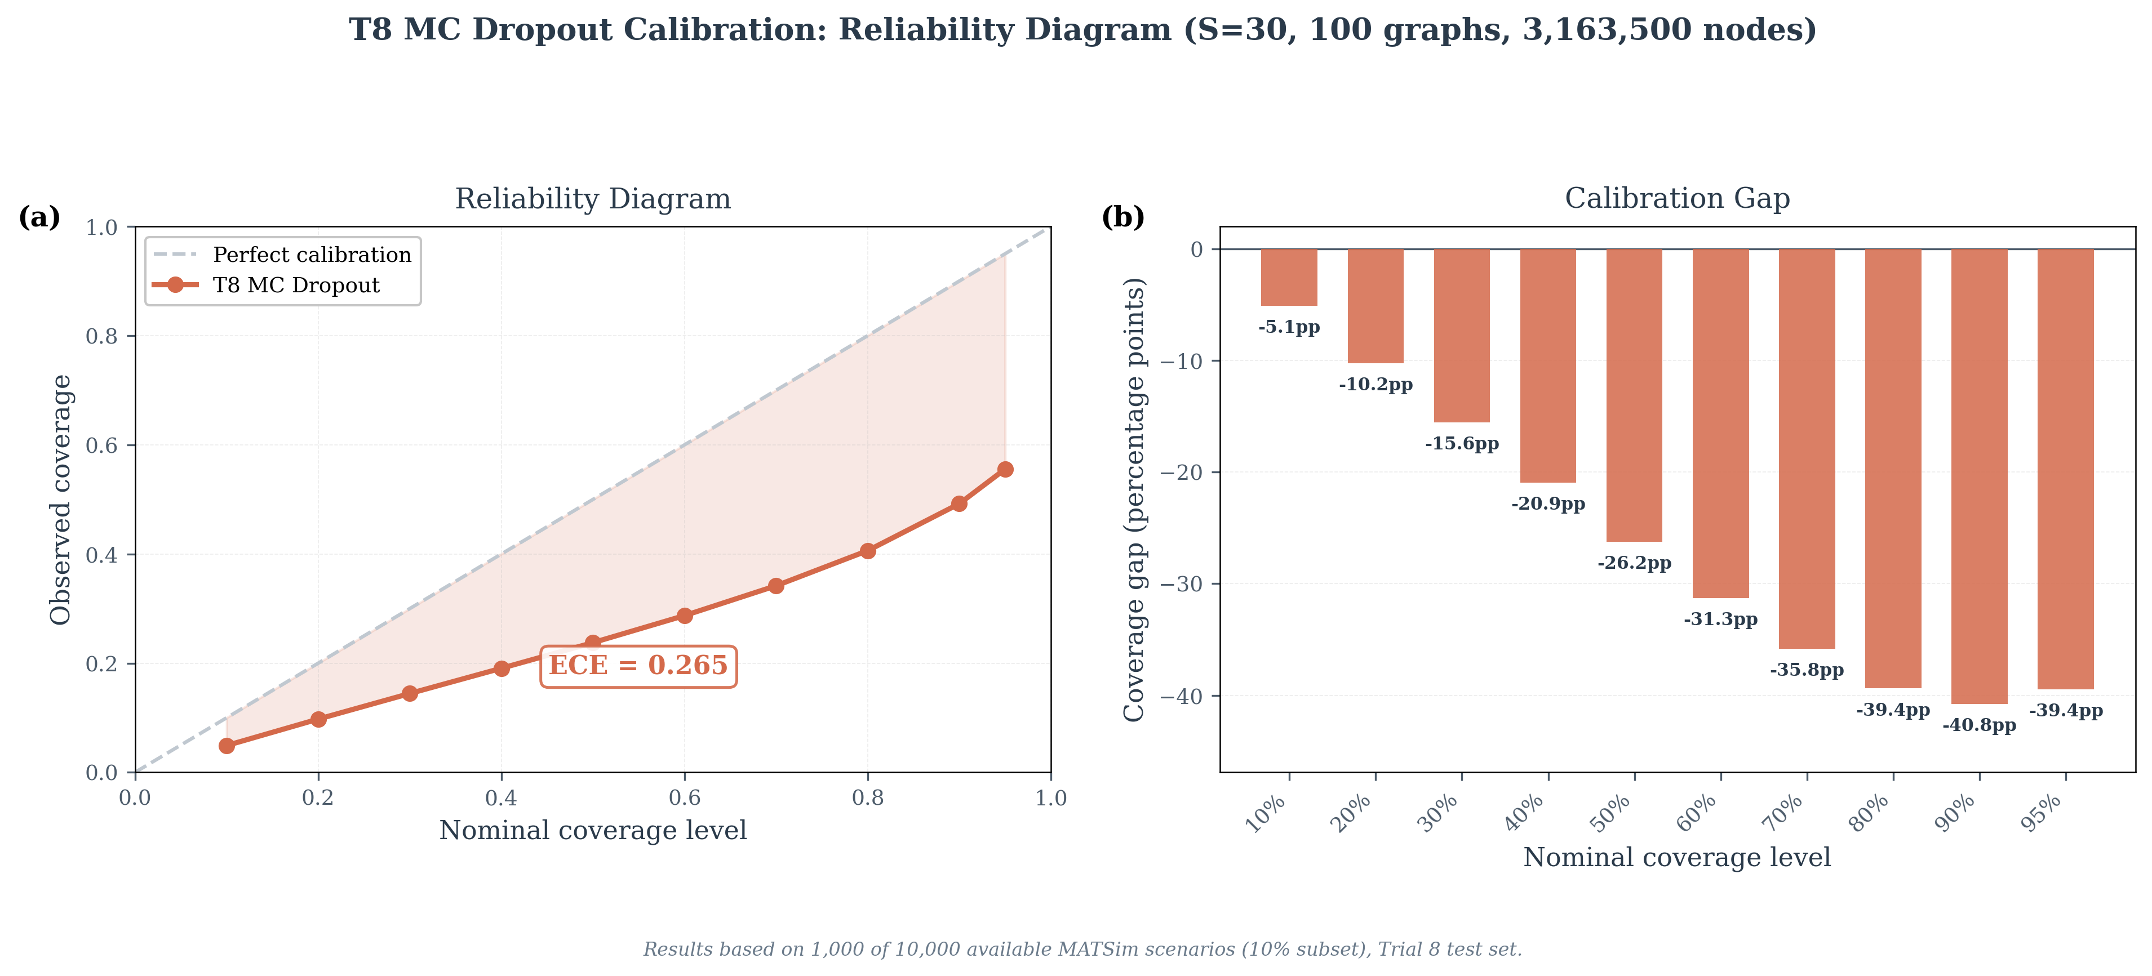
RQ4: The Calibration Problem
15
Raw MC Dropout σ is NOT a calibrated standard deviation
Fig: 11. Scaling factor k₉₅ needed for ±kσ to achieve 95% coverage. Ideal Gaussian: k=1.96. T8 MC Dropout requires k=11.34 — nearly 6× larger.
Fig: 12. Reliability diagram (left): observed coverage always below diagonal = systematic under-coverage. ECE = 0.265 means coverage deviates 26.5 pp on average.
Key insight: σ is a ranking signal — NOT a probability. Spearman ρ=0.4820 works perfectly. But ±1.96σ only gives 54.8% coverage (target: 95%).
Technical University of Munich | Chair of Urban Transport Systems
15

Slide 16
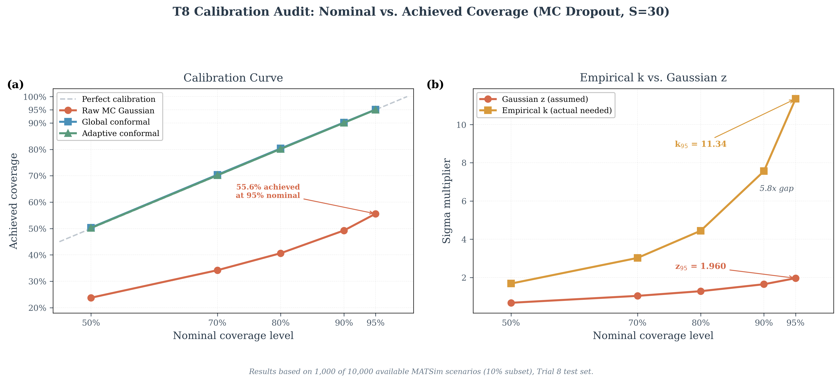
RQ4: Coverage — MC Dropout vs Conformal
16
Conformal prediction fixes the coverage gap
Coverage Comparison Table
Nominal
Raw MC Coverage
Conformal Coverage
50%
23.3%
50.0%
80%
40.1%
80.0%
90%
48.6%
90.0%
95%
54.8%
95.0%
Why conformal works
• Uses empirical calibration quantile
• Distribution-free — no assumptions
• Guaranteed by construction
• Cost: wider fixed intervals
Fig: 13. T8 calibration curve. Raw MC Dropout (blue) severely undercovers. Global conformal (orange) and adaptive conformal (green) both hit nominal targets.
Technical University of Munich | Chair of Urban Transport Systems
16

Slide 17
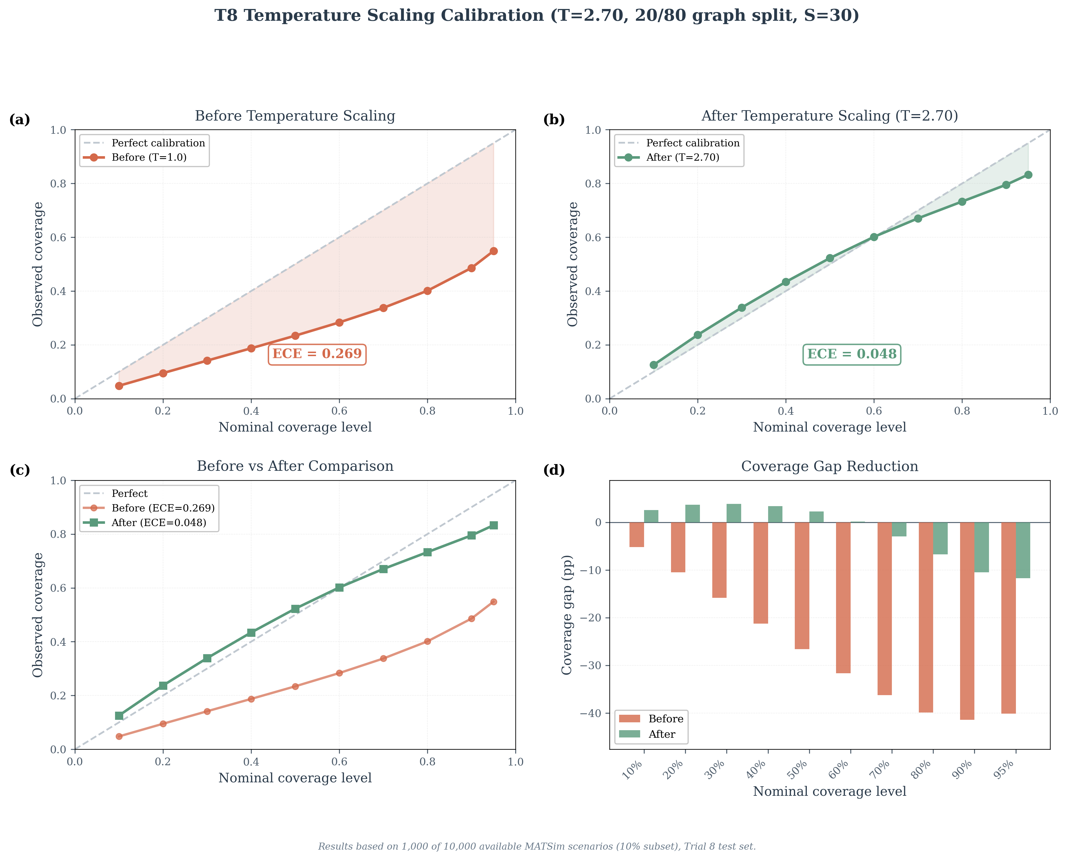
RQ4: Temperature Scaling — Post-Hoc Calibration
17
Single scalar T=2.70 reduces ECE by 82%
What is Temperature Scaling?
σ_scaled = σ_raw × T Optimal T learned on calibration set (20 graphs) by minimising ECE.
T = 2.70
Optimal scaling factor
ECE: 0.265 → 0.048
82% improvement
NLL: 21.65 → 4.75
78% improvement
KS stat: 0.245 → 0.104
PIT improvement
95% coverage: 83.3%
Not 95% — residual gap
Useful middle step. Residual gap at tails → conformal prediction still needed for guarantees.
Fig: 14. Top: reliability diagrams before (ECE=0.269) and after (ECE=0.048) scaling with T=2.70. Bottom: coverage gap reduction at each nominal level. Evaluated on 80 held-out graphs.
Technical University of Munich | Chair of Urban Transport Systems
17

Slide 18
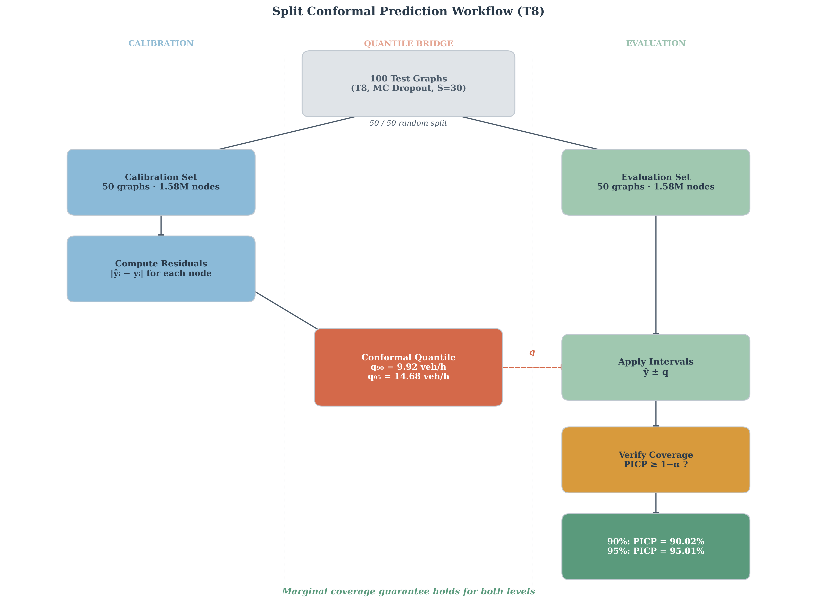
RQ4: Split Conformal Prediction
18
Distribution-free coverage guarantee — no model assumptions needed
How It Works
1
Split test data: 50 calibration + 50 evaluation graphs
2
On calibration set: compute residuals |y − ŷ| per node
3
Find quantile q at desired level (e.g. 90th or 95th)
4
Apply to eval set: interval = [ŷ − q, ŷ + q]
5
Coverage guaranteed: ≥90% or ≥95% by construction
Key: Guarantee holds regardless of model internals
Only assumption: data is exchangeable
Fig: 15. Conformal prediction workflow for T8. 100 test graphs → 50 calibration + 50 evaluation. Calibration residuals define quantile q. Intervals ŷ±q guarantee ≥90% or ≥95% coverage.
Technical University of Munich | Chair of Urban Transport Systems
18

Slide 19
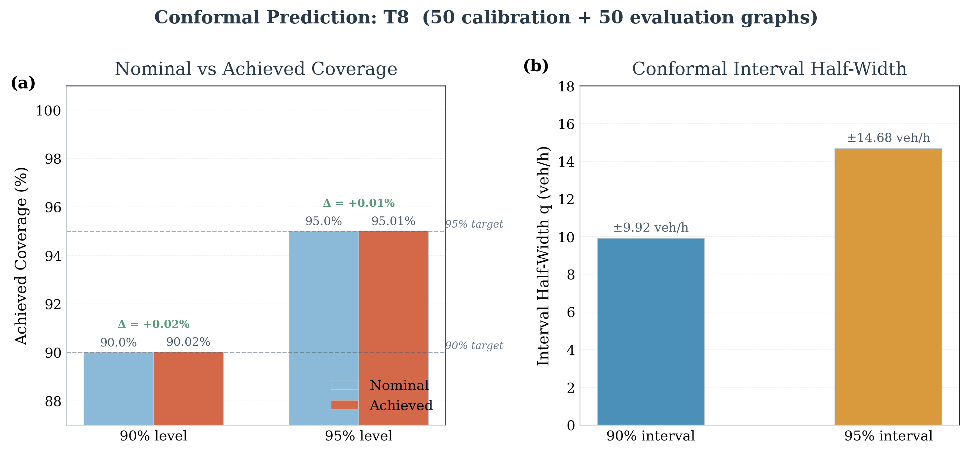
RQ4: Conformal Prediction Results
19
Near-exact coverage achieved at both levels
Coverage Results (T8)
90% level
q = 9.92 veh/h
Achieved: 90.02%
95% level
q = 14.68 veh/h
Achieved: 95.01%
What this means for planners
• At least 95% of true Δv values fall within ±14.68 veh/h
• This guarantee is mathematically proven
• Fixed-width: same interval for every road segment
• Cost: ~6× wider than raw MC Dropout interval
Fig: 16. Nominal vs achieved coverage (left) and interval half-widths (right). Both 90% and 95% levels meet targets within 0.02 percentage points. Evaluated on 50 graphs (1,581,750 nodes).
Technical University of Munich | Chair of Urban Transport Systems
19

Slide 20
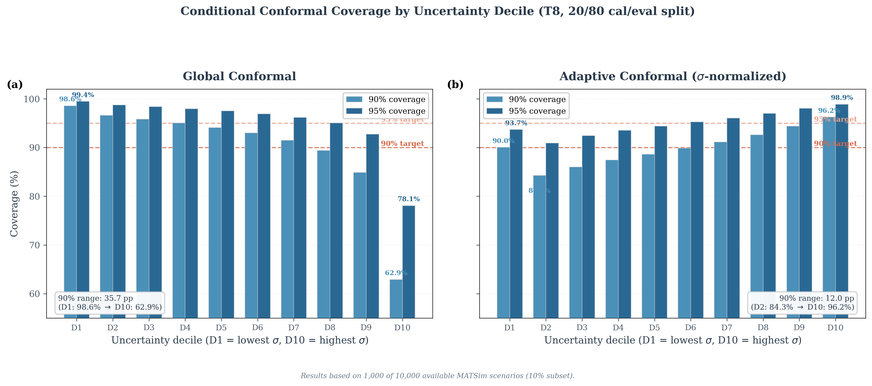
RQ4: Adaptive Conformal Prediction
20
Combining MC Dropout ranking with conformal guarantees
Standard vs Adaptive
Standard conformal:
• Fixed width ±q for all nodes
• D1 (low σ): 98.6% coverage
• D10 (high σ): 62.9% coverage
Adaptive conformal:
• Width = q_adapt × σ (node-specific)
• Wider where model is uncertain
• Narrows disparity → [90%, 96.2%]
Best of both worlds:
MC Dropout σ provides adaptive widths. Conformal guarantees marginal coverage.
Fig: 17. Left: standard conformal over-covers low-uncertainty nodes (98.6%) and under-covers high-uncertainty (62.9%). Right: adaptive conformal narrows this to [90.0%, 96.2%] — much more uniform conditional coverage.
Technical University of Munich | Chair of Urban Transport Systems
20

Slide 21
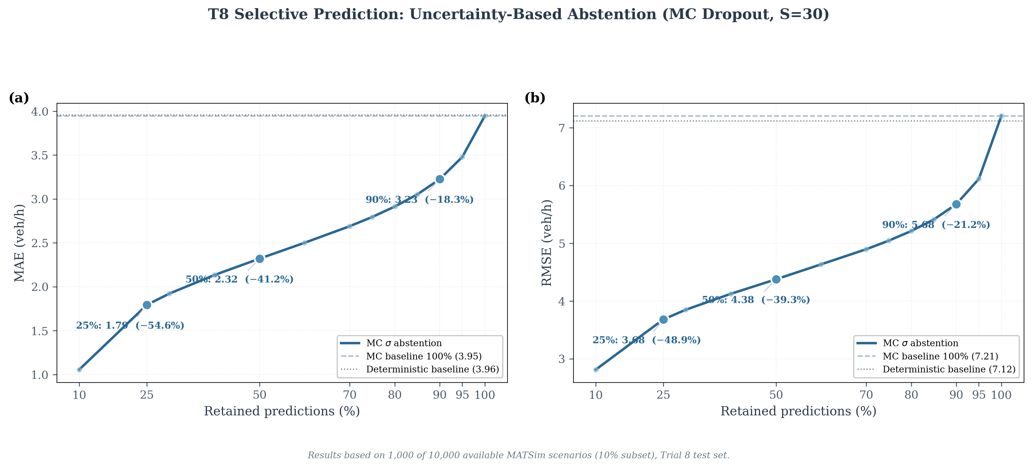
Selective Prediction: Filter by Uncertainty
21
Keep only confident predictions → dramatically lower MAE
Retained
MAE (veh/h)
Reduction
100%
3.95
—
90%
3.23
−18.3%
50%
2.32
−41.2%
25%
1.79
−54.6%
10%
1.06
−73.3%
Practical use for planners
Accept bottom 50% σ → expect MAE ≈ 2.32 veh/h
Run full MATSim only for top 10% most uncertain
Fig: 18. MAE as fraction of retained predictions (sorted by ascending σ) for T8. Retaining the 50% most certain predictions gives −41.2% MAE. Based on 100 test graphs (3,163,500 nodes).
Technical University of Munich | Chair of Urban Transport Systems
21

Slide 22
The 3-Layer UQ Hierarchy
22
Main practical recommendation of this thesis
LAYER 1
LAYER 2
LAYER 3
MC Dropout (S=30)
Temperature Scaling (T=2.70)
Conformal Prediction
Purpose: RANKING predictions by reliability
Purpose: CALIBRATE σ toward probability
Purpose: GUARANTEE coverage bounds
• σ = per-node uncertainty estimate
• Spearman ρ = 0.4820 with actual error
• AUROC = 0.76 for error detection
• Use: selective prediction, flagging
• σ_scaled = σ_raw × 2.70
• ECE reduced 82% (0.265 → 0.048)
• Better Gaussian approximation
• Use: when approximate probabilities needed
• 90.02% at 90% nominal ✓
• 95.01% at 95% nominal ✓
• Distribution-free — no assumptions
• Use: contractual / operational requirements
→
→
All three methods are post-hoc: no model retraining required. They can be applied to any trained GNN.
Technical University of Munich | Chair of Urban Transport Systems
22

Slide 23
UQ Methods: Summary Comparison
23
All 5 methods evaluated on T8 (100 test graphs, 3.16M predictions)
Method
Key Metric
Strength
Limitation
MC Dropout (S=30)
MC Dropout (S=30)
ρ=0.4820 CRPS/MAE=0.857
Node-specific ranking Selective pred. −41.2% MAE
Not calibrated (k₉₅=11.34) S-fold compute cost
Temp. Scaling (T=2.70)
Temp. Scaling (T=2.70)
ECE: 0.265→0.048 KS: 0.245→0.104
Single parameter No retraining
Gaussian assumption Residual miscal. at tails
Standard Conformal
Standard Conformal
PICP 90%: 90.02% PICP 95%: 95.01%
Coverage guarantee Distribution-free
Fixed-width intervals Poor conditional coverage
Adaptive Conformal
Adaptive Conformal
Cond. cov. [90.0%, 96.2%]
Node-specific widths Conditional coverage
Requires σ from MC Dropout
Multi-Model Ensemble
Multi-Model Ensemble
ρ=0.4333 R²=0.5656
Complementary signal No MC overhead
Weaker than MC Dropout No accuracy gain over T8 alone
Technical University of Munich | Chair of Urban Transport Systems
23

Slide 24
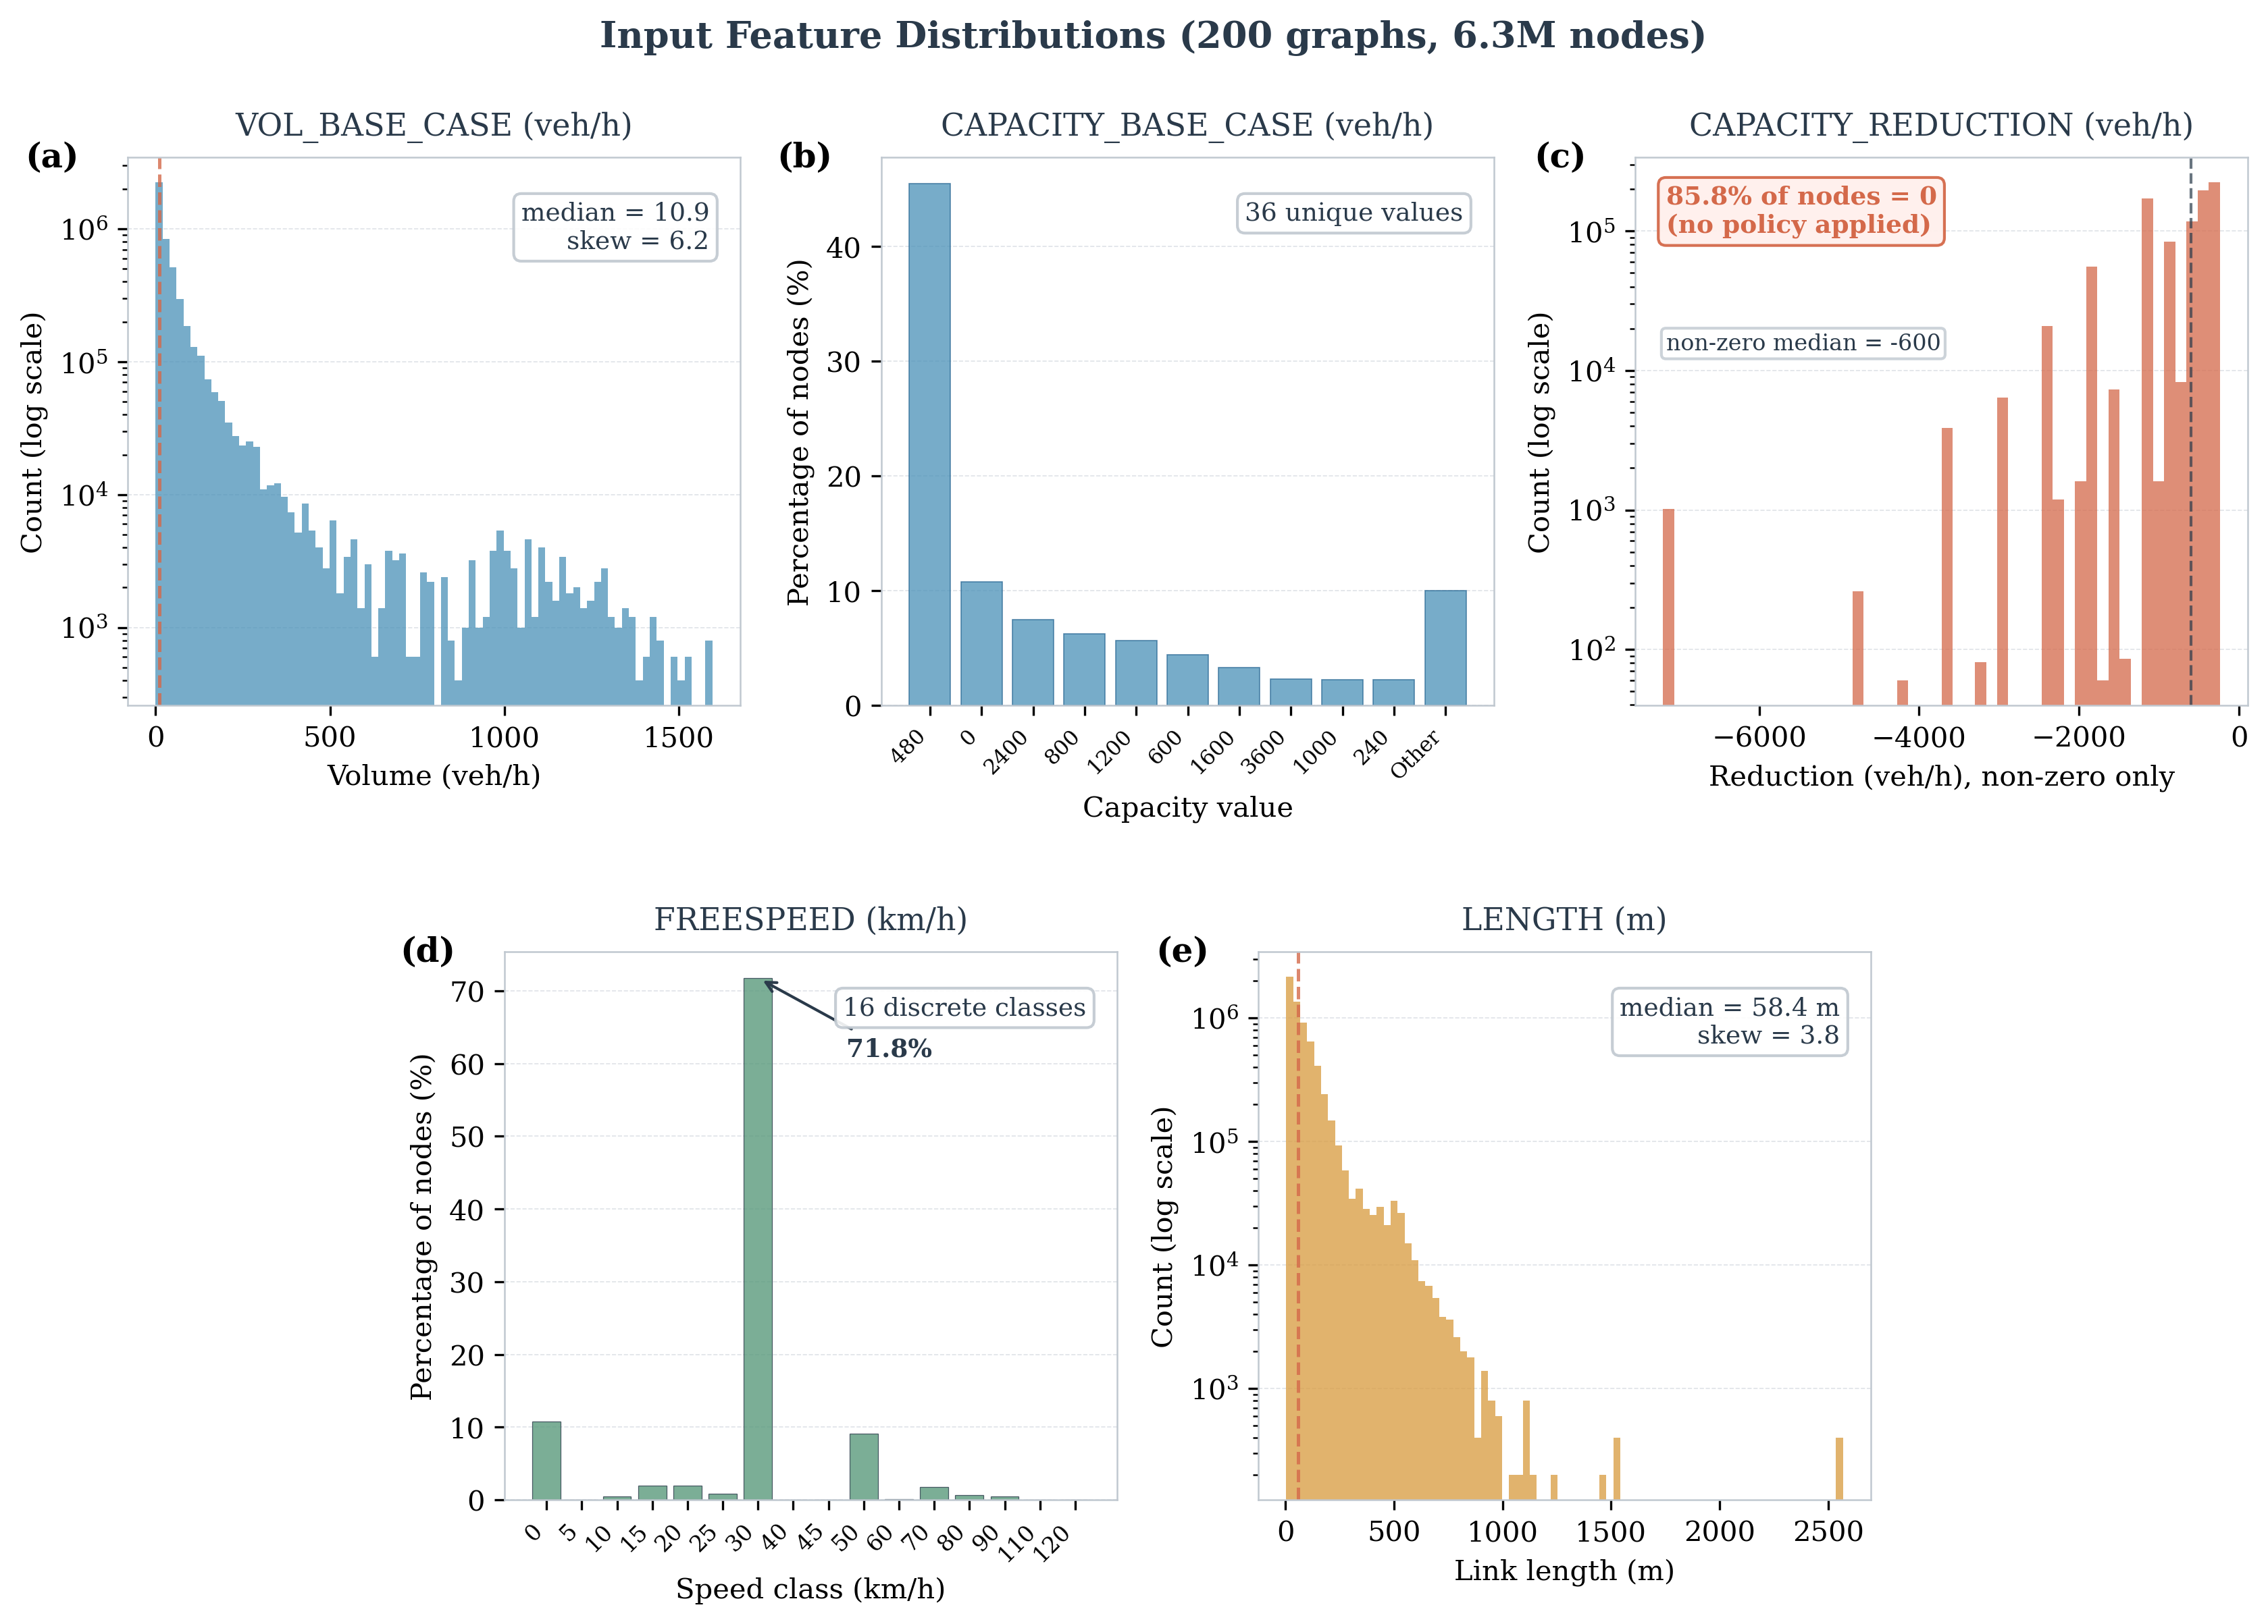
Traffic Context: What is Being Predicted?
24
Δv = change in traffic volume per road segment after policy intervention
What is Δv?
The change in traffic volume on each
road segment after a policy applies:
Δv = v_policy − v_baseline (veh/h)
Policy = capacity reduction:
• 10%–100% of road capacity reduced
• Applied to a random subset of roads
• Simulates: lane closures, traffic calming,
bus-only lanes, congestion pricing...
Why hard to predict?
• Traffic redistributes across network
• High-flow roads change most but vary most
• ρ ≈ 0.74–0.81 (low-flow) vs 0.26–0.41 (high-flow)
Fig: 19. Distribution of 5 input features across 200 training graphs (6.33M node observations). VOL_BASE_CASE and CAPACITY_BASE_CASE are right-skewed (heavy-tailed urban traffic). FREESPEED shows discrete speed limits. LENGTH spans several orders of magnitude.
Technical University of Munich | Chair of Urban Transport Systems
24

Slide 25
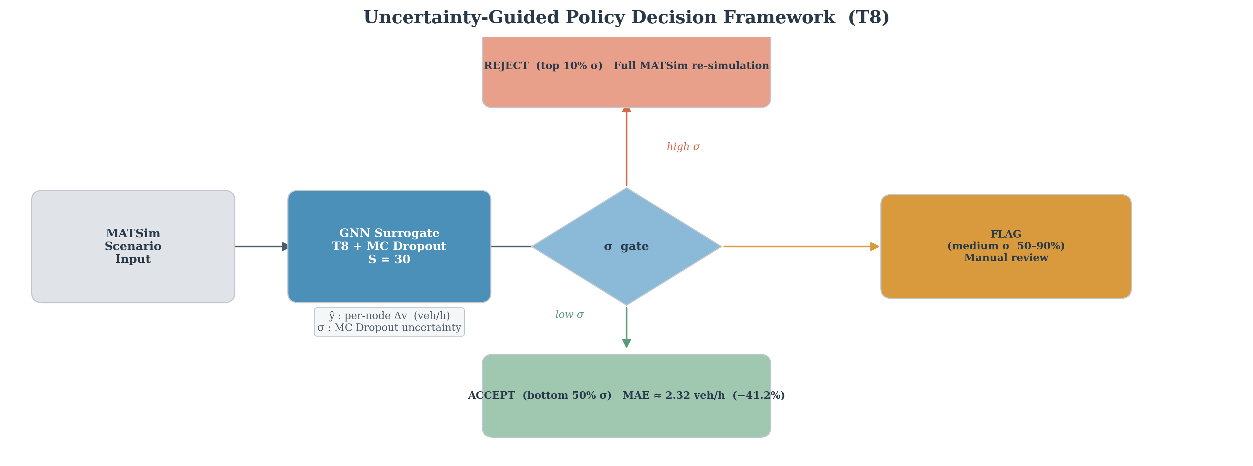
Traffic Policy: 3-Tier Decision Framework
25
Uncertainty-guided workflow for urban planners
Bottom 50% of σ
MAE ≈ 2.32 veh/h −41.2% error
Use surrogate output directly for policy decision
ACCEPT
50th–90th percentile
Some uncertainty present
Sensitivity analysis or cross-check needed
FLAG
Top 10% of σ
High uncertainty run full MATSim
Route to full 8-hr MATSim simulation
REJECT
Fig: 20. Uncertainty-guided decision framework. GNN surrogate (T8, S=30) routes each prediction based on MC Dropout σ. Bottom 50% = ACCEPT, 50–90% = FLAG, Top 10% = REJECT for re-simulation.
Technical University of Munich | Chair of Urban Transport Systems
25

Slide 26
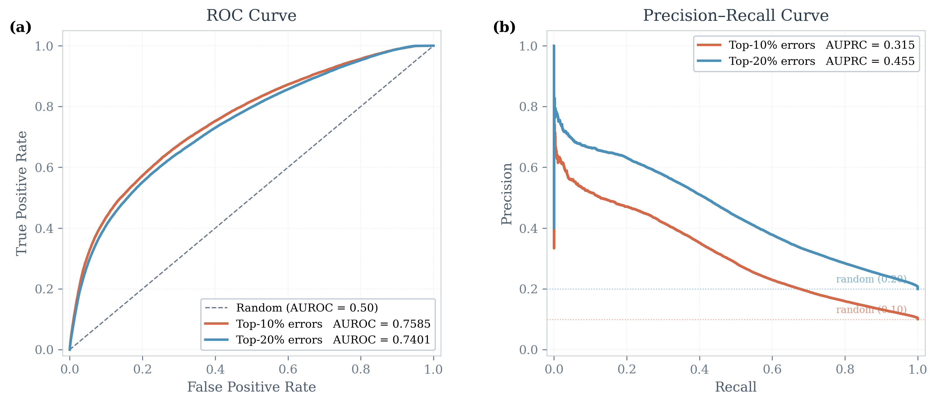
Impact for Urban Planning
26
How this thesis changes the policy evaluation workflow
Faster policy screening
Seconds per scenario instead of 8+ hours. Hundreds of alternatives evaluated in hours.
Reliable uncertainty scores
ρ=0.4820: high-σ roads reliably indicate where model may be wrong. AUROC=0.76 for flagging top-10% errors.
Smart resource allocation
Expensive MATSim re-simulation only for top-10% uncertain predictions. 90% of predictions can be accepted or flagged.
Statistically valid intervals
Conformal prediction gives ±14.68 veh/h interval with 95% coverage guarantee — suitable for formal planning documents.
Fig: 21. ROC curves for T8 MC Dropout as error detector. AUROC=0.76 (top-10% errors) and 0.74 (top-20% errors) — well above 0.5 random baseline. Model can identify unreliable predictions before a planner acts on them.
Technical University of Munich | Chair of Urban Transport Systems
26

Slide 27
Summary: Answers to All 4 Research Questions
27
RQ1
MC Dropout Effectiveness
RQ2
MC Dropout vs Ensembles
T8 achieves Spearman ρ = 0.4820 (100 test graphs, 3.16M predictions). Consistent per-graph ρ = 0.464 ± 0.023. AUROC = 0.76 for top-10% error detection. Enabling dropout costs only ΔR² = −0.010.
MC Dropout (ρ=0.4908) outperforms ensemble variance (ρ=0.4370) by +12.3% and multi-model disagreement (ρ=0.4333) by +13.3%. MC Dropout is best and most computationally efficient single method.
RQ3
Combining Identical Models
RQ4
Distribution-Free Coverage
Combined MC+Ensemble (ρ=0.4909) barely beats MC alone (ρ=0.4908): negligible gain. Multi-model ensemble R²=0.5656 < best single T8 R²=0.5957. Architectural diversity not tested — may unlock further benefits.
Yes. Conformal: 90.02% @ 90%, 95.01% @ 95% — guaranteed. Temperature scaling reduces ECE by 82%. Adaptive conformal narrows conditional coverage from [62.9%,98.6%] to [90%,96.2%].
Technical University of Munich | Chair of Urban Transport Systems
27

Slide 28
Limitations
28
Honest assessment of what this thesis does NOT show
10% Data Subset
Single Road Network
Only 1,000 of 10,000 available scenarios used. Natterer et al. achieved R²=0.91 with full dataset. Gap from R²=0.60 likely due to 10× less training data.
All experiments on Paris only. Generalisation to other cities, topologies, or policy types not tested. Feature correlation patterns may differ elsewhere.
Identical Architecture Ensembles
Epistemic Only
Ensemble experiments use only PointNetTransfGAT variants. True architectural diversity (GAT + GraphSAGE + GCN) not tested — may unlock further UQ benefits.
MC Dropout captures only epistemic (model) uncertainty. Aleatoric (data/noise) uncertainty not separated. T9 heteroscedastic attempt failed (R²=0.02 — variance inflation).
No Non-GNN Baselines
No comparison to random forests, GPs, or MLP ensembles. Unclear if ρ=0.4820 is specific to GNN or achievable by simpler models.
Technical University of Munich | Chair of Urban Transport Systems
28

Slide 29
Future Work
29
Six directions for extending this research
Full 10k Scenarios
Architecturally Diverse Ensembles
Conformal Risk Control
Train on complete 10,000-scenario dataset. Assess if R² and ρ scale with more data.
Combine GAT + GraphSAGE + GCN models. True diversity may improve UQ beyond ρ=0.4333.
Extend to arbitrary loss functions. Tighter adaptive intervals via conformal risk control.
Epistemic-Aleatoric Decomposition
Multi-City Validation
Active Learning
Evidential deep learning approach. Separate model uncertainty from data noise.
Test on London, Berlin, Munich networks. Check generalisability of UQ findings.
Use high-σ predictions to select new MATSim scenarios for training.
Technical University of Munich | Chair of Urban Transport Systems
29

Slide 30
Conclusion
ML Surrogates for Agent-Based Transport Models
1
MC Dropout works.
ρ=0.4820 on 3.16M predictions. Useful ranking signal with AUROC=0.76. Cost to enable: ΔR²=−0.010 (negligible).
2
Conformal prediction delivers guarantees.
90.02% and 95.01% coverage achieved by construction. Adaptive variant reduces conditional disparity from [62.9%,98.6%] to [90%,96.2%].
3
Use the 3-layer hierarchy in practice.
MC Dropout for ranking → temperature scaling for calibration → conformal prediction for formal guarantees. All post-hoc, no retraining.
Thank you | Questions welcome

