Slide 1
Uncertainty Quantification for GNN Surrogates of Agent-Based Transport Models
Mohd Zamin Quadri
TUM School of Computation, Information and Technology
Advisors: Dominik Fuchsgruber, M.Sc. & Elena Natterer, M.Sc. Supervisor: Prof. Dr. Stephan Günnemann
Master's Thesis — 2026

Slide 2
Presentation Outline
UQ Methods Covered
Further Experiments
P1 Ranking Uncertainty
• MC Dropout
• Selective Prediction
• Error Detection (AUROC)
P2 Calibration
• Why Gaussian intervals fail
• Temperature Scaling
• PIT + NLL
P3 Coverage Guarantees
• Global Conformal Prediction
• Adaptive Conformal Prediction
P4 Ensemble Experiments
• Exp A: Same architecture, 5 seeds
• Exp B: Multi-architecture ensemble
P5 Negative Results
• Trial 7: Cross-validation replication
• Trial 9: Heteroscedastic NLL (failure)
P6 Summary & Limitations
Total: 13 UQ experiments
All evaluated on Trial 8
Best GATConv model: R² = 0.596
Test set: 100 graphs · 3.16M road-segment nodes
Mohd Zamin Quadri | TUM CIT | Master's Thesis Defence 2026

Slide 3
Motivation: Why Do We Need Uncertainty Quantification?
The Problem with Point Predictions
What UQ provides:
Model predicts: Δflow = −3.2 veh/hr on road segment i
A traffic planner acts on this number.
But HOW RELIABLE is this prediction?
Output Value Use
─────────────────────────────────────
Point pred. ŷ −3.2 Forecast
Uncertainty σ 0.4 Trust score
Interval [−13.2, 6.8] Hard bound
Goal: Make the model say not just WHAT it
predicts, but HOW CONFIDENT it is.
Two road segments, same predicted value:
Segment A: model has seen many similar cases ✓
Segment B: unusual geometry, out-of-distribution ✗
A point prediction cannot distinguish them.
Mohd Zamin Quadri | TUM CIT | Master's Thesis Defence 2026

Slide 4
UQ Framework: Three Levels of Uncertainty
Level | Question answered | Method
1. Ranking | Which predictions are least reliable? | MC Dropout σ
1. Ranking | Can we improve quality by abstaining? | Selective Prediction
1. Ranking | Can σ detect large errors? | Error Detection (AUROC)
2. Calibration | Are confidence scores accurate? | Temperature Scaling
2. Calibration | Are probability distributions correct? | PIT, NLL
3. Guarantee | Guaranteed coverage interval? | Global Conformal
3. Guarantee | Conditional coverage interval? | Adaptive Conformal
Key Insight
Each level adds value:
Ranking → operational (decide when to trust)
Calibration → diagnostic (is σ meaningful?)
Guarantee → formal (provable bound)
Model
Trial 8: PointNet + Transformer + GATConv
R² = 0.596, MC S = 30
Test: 100 graphs, 3.16M nodes
Mohd Zamin Quadri | TUM CIT | Master's Thesis Defence 2026

Slide 5
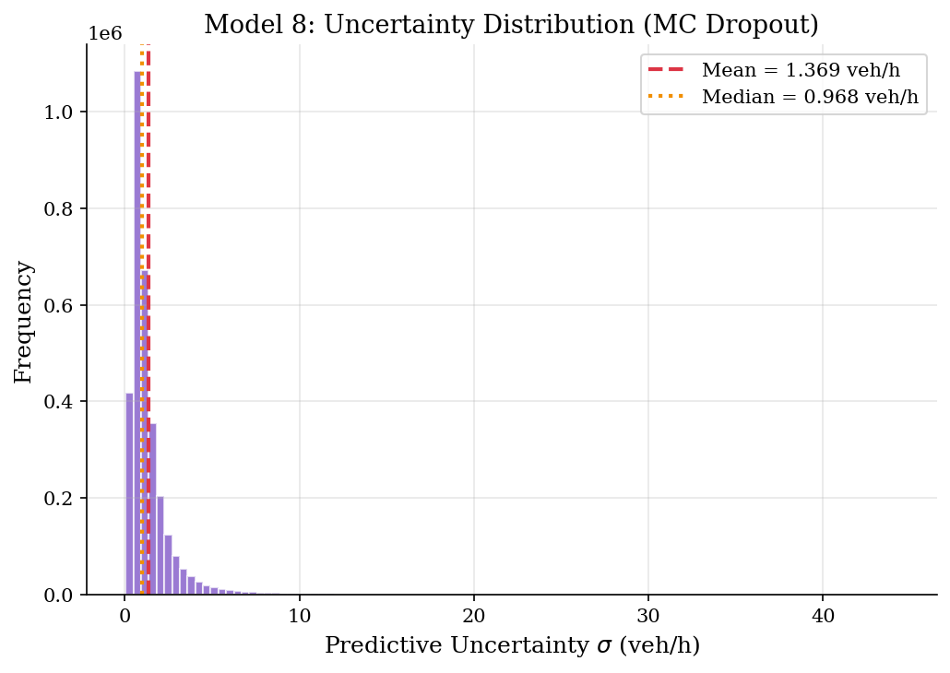
MC Dropout: Method
Part 1: Ranking Uncertainty
Standard Dropout (Training)
Randomly zero out neurons during training
→ acts as regularisation
MC Dropout (Inference) — Gal & Ghahramani 2016
KEEP dropout active at test time.
Run S = 30 forward passes.
ŷ = (1/S) Σ f_θs(x)
σ = std deviation across S passes
σ = epistemic uncertainty proxy
Interpretation
High σ → model disagrees with itself → LESS reliable
Low σ → model is consistent → MORE reliable
Distribution of σ across 3.16M test nodes. Heavy right tail = small fraction of hard cases.
Mohd Zamin Quadri | TUM CIT | Master's Thesis Defence 2026

Slide 6
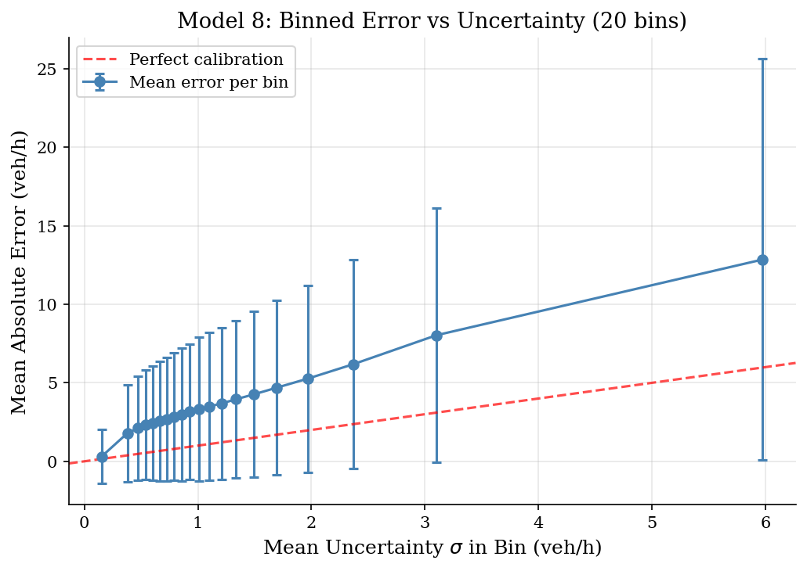
MC Dropout: Results — Is σ Informative?
Part 1: Ranking Uncertainty
Point Accuracy: Deterministic vs MC
Mode R² MAE RMSE
────────────────────────────────────────
Deterministic 0.5957 3.96 7.12
MC Dropout (S=30) 0.5857 3.95 7.21
Accuracy is comparable.
MC Dropout adds σ at marginal cost.
Ranking Result
Spearman ρ = 0.482 between σ and |error|
Moderate-to-strong correlation.
σ reliably identifies harder predictions.
Note: σ is a ranking signal, NOT a calibrated probability.
MAE increases monotonically with uncertainty bins. This is the key diagnostic for ranking validity.
Mohd Zamin Quadri | TUM CIT | Master's Thesis Defence 2026

Slide 7
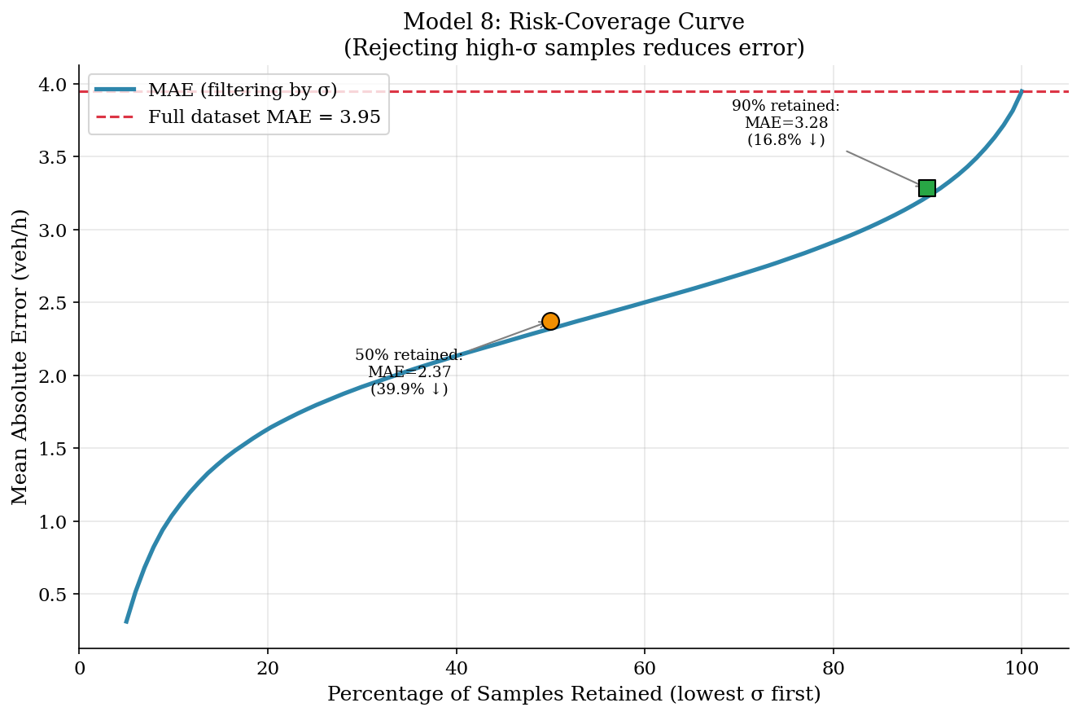
Selective Prediction: Abstaining on Uncertain Cases
Part 1: Ranking Uncertainty
Method
Sort all 3.16M predictions by σ (descending).
Reject top-k% most uncertain.
Measure MAE on remaining predictions.
Results
Retained MAE (veh/hr) Reduction
────────────────────────────────────
100% (baseline) 3.94 —
90% 3.22 −18.5%
50% 2.31 −41.6%
25% 1.77 −55.0%
MAE drops as we reject the most uncertain predictions. X-axis = fraction of predictions retained.
Practical Value
A planner can choose a confidence threshold.
At 90% retention: nearly 1-in-5 improvement in accuracy.
σ is operationally useful, not just diagnostic.
Mohd Zamin Quadri | TUM CIT | Master's Thesis Defence 2026

Slide 8
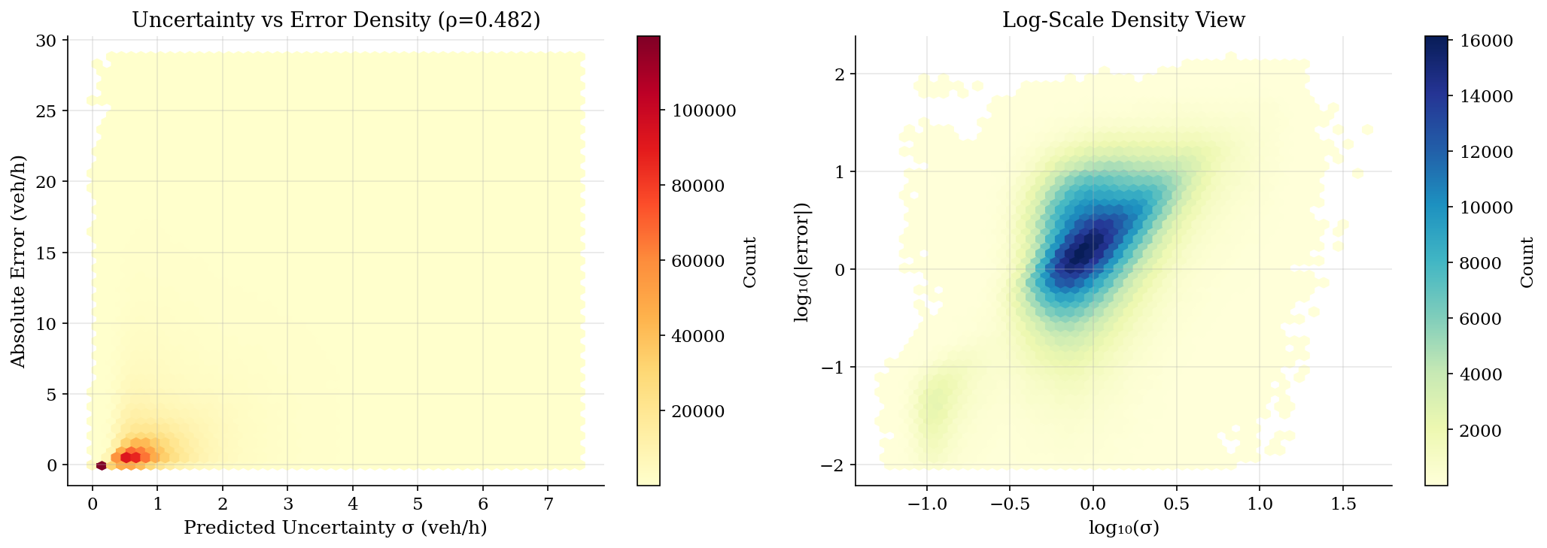
Error Detection: Can σ Flag Large Errors?
Part 1: Ranking Uncertainty
Binary Detection Task
Positive class: predictions in top-10% of errors
Score: MC Dropout σ
Question: Does high σ predict high error?
AUROC Results
Threshold AUROC AUPRC
────────────────────────────────
Top-10% errors 0.759 0.315
Top-20% errors 0.740 0.455
Random baseline 0.500 0.100
Interpretation
Joint density of σ vs. absolute error. High-error nodes (right) have elevated σ (top).
AUROC = 0.759:
σ ranks a bad prediction above a good one 75.9% of the time.
52% above random baseline — strong discrimination.
Mohd Zamin Quadri | TUM CIT | Master's Thesis Defence 2026

Slide 9
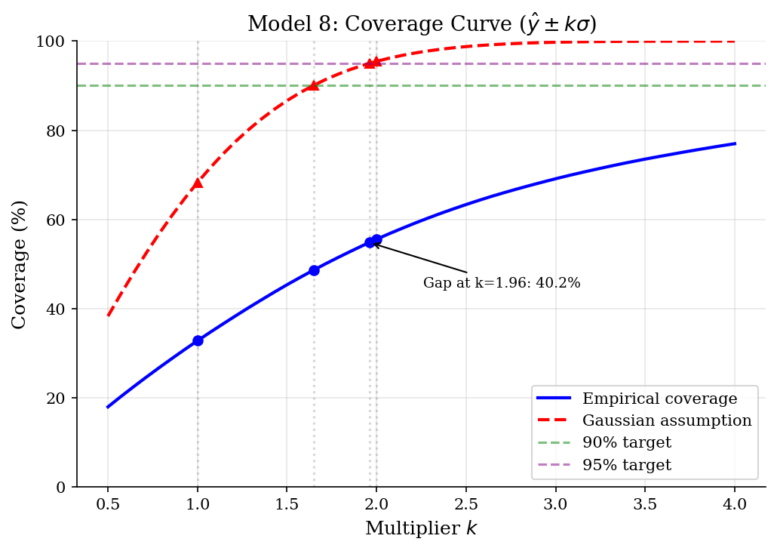
Why Naïve Gaussian Intervals Fail
Part 2: Calibration
Gaussian Assumption
Build interval: ŷ ± k·σ
Assume σ is a calibrated standard deviation.
k = 1.65 → 90% coverage (under Gaussian).
Reality: Severe Under-coverage
Nominal k Actual coverage
──────────────────────────────────
50% 0.67 23.3%
80% 1.28 40.1%
90% 1.65 48.6% ← 90% target!
95% 1.96 54.8%
Empirical coverage vs. multiplier k. Dashed = Gaussian ideal. Actual coverage far below.
Root Cause: Heavy-Tailed Residuals
Empirical k₉₅ = 11.34 vs. Gaussian z₉₅ = 1.96
Ratio = 5.79× heavier tails than Gaussian.
σ is a ranking signal, NOT a calibrated std dev.
Mohd Zamin Quadri | TUM CIT | Master's Thesis Defence 2026

Slide 10
Temperature Scaling: Calibrating Confidence Scores
Part 2: Calibration
Method (Guo et al., 2017)
Calibration Improvement
A single learnable scalar T scales the uncertainties:
σ_cal = T · σ_raw, T > 0
T is fitted on a held-out calibration set (minimise ECE or NLL).
T > 1 : model was overconfident → inflate σ
T < 1 : model was underconfident → shrink σ
T = 1 : already perfectly calibrated
Metric Before After Change
────────────────────────────────────
ECE 0.269 0.048 −82%
NLL 21.65 4.75 −78%
KS (PIT) 0.245 0.104 −57%
Residual Limitation
Even after scaling, slight overconfidence persists
at high prediction magnitudes (large |Δflow|).
→ Motivates Conformal Prediction which gives
hard guarantees without distributional assumptions.
Trial 8 Result: T = 2.70
Model was SEVERELY overconfident.
Scaling inflated σ by factor 2.70.
Mohd Zamin Quadri | TUM CIT | Master's Thesis Defence 2026

Slide 11
Calibration Diagnostics: PIT and NLL
Part 2: Calibration
PIT — Probability Integral Transform
NLL — Negative Log-Likelihood
If predictions ŷ ~ N(μ̂, σ̂²) are correct,
the PIT values u_i = Φ((y_i − μ̂_i) / σ̂_i)
should be Uniform[0,1].
Kolmogorov-Smirnov statistic measures deviation:
KS = sup_u | F_empirical(u) − u |
Raw MC: KS = 0.245
After scaling (T=2.70): KS = 0.104
Improvement: −57%
Measures how well the predicted distribution
covers the true targets:
NLL = mean_i [ (y_i−μ̂_i)² / (2σ̂_i²) + ½ log σ̂_i² ]
Raw MC: NLL = 21.65
After scaling: NLL = 4.75
Improvement: −78%
Summary of Calibration Evidence
ECE: −82% after T = 2.70 scaling
PIT/KS: −57%
NLL: −78%
All three metrics agree: SUBSTANTIAL improvement.
Mohd Zamin Quadri | TUM CIT | Master's Thesis Defence 2026

Slide 12
Conformal Prediction: Distribution-Free Coverage Guarantees
Part 3: Coverage Guarantees
Core Idea (Vovk et al., 2005)
Formal Guarantee
No assumptions about residual distribution.
Only requires: calibration & test data are EXCHANGEABLE.
Procedure:
1. Split test nodes into calibration (50%) and evaluation (50%)
2. Compute residuals on calibration: r_i = |y_i − ŷ_i|
3. Compute empirical quantile at level 1−α:
q_α = Quantile_{1−α}({ r_i }_{i ∈ D_cal})
4. Prediction interval for new point: ŷ ± q_α
P( y ∈ [ŷ − q_α, ŷ + q_α] ) ≥ 1 − α
This holds REGARDLESS of the error distribution.
No Gaussian assumption.
No calibration quality assumption.
Important Caveat
This is MARGINAL coverage — an average over all nodes.
Per-node conditional coverage is not guaranteed without
additional methods (e.g., conformalized quantile regression).
Why better than Gaussian?
Gaussian: assumes σ is calibrated. It is NOT.
Conformal: uses empirical residuals. NO assumption.
Mohd Zamin Quadri | TUM CIT | Master's Thesis Defence 2026

Slide 13
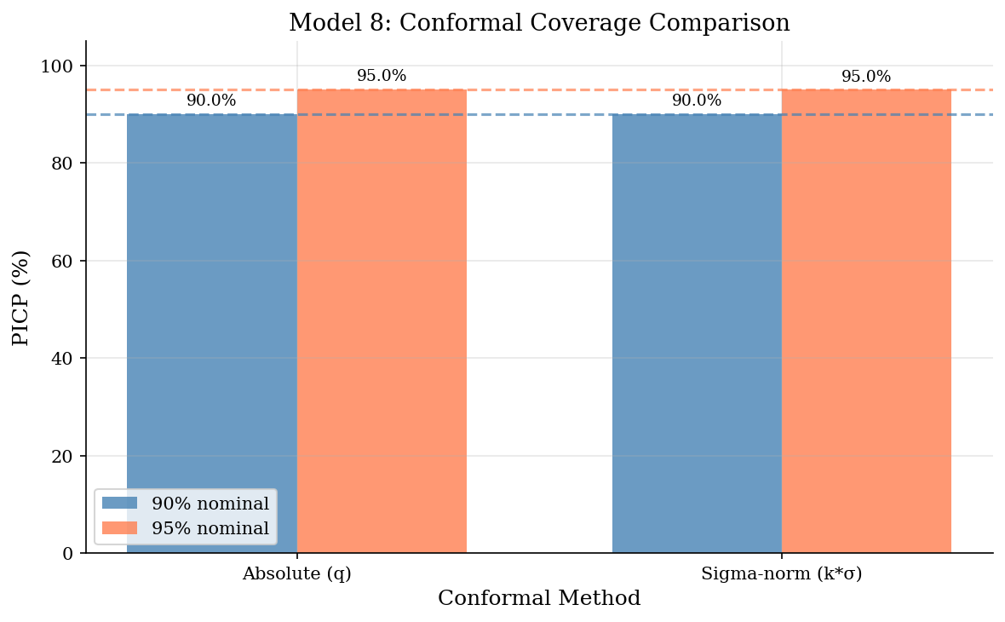
Global Conformal Prediction: Results
Part 3: Coverage Guarantees
Coverage at Nominal Levels
Target q (half-width) Coverage Width
────────────────────────────────────────────
50% 1.87 50.35% 3.75
80% 5.97 80.34% 11.94
90% 9.99 90.17% 19.99 ← used
95% 14.77 95.09% 29.54
All widths in veh/hr.
Key Comparison (at 90% target)
Gaussian kσ: actual coverage = 48.6%
Global Conformal: actual coverage = 90.17%
Difference: +41.6 percentage points
Conformal (blue) achieves nominal coverage. Gaussian kσ (red) severely under-covers.
Interpretation
For 1,000 road segments, conformal guarantees
≈900 have true Δflow inside the interval.
Mohd Zamin Quadri | TUM CIT | Master's Thesis Defence 2026

Slide 14
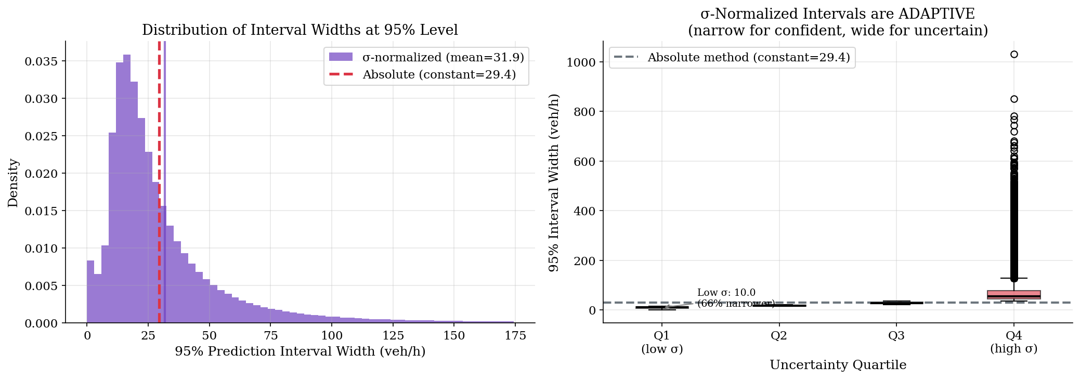
Adaptive Conformal Prediction: Uncertainty-Scaled Intervals
Part 3: Coverage Guarantees
Limitation of Global Conformal
Fixed width q_α for ALL predictions.
Confident predictions get the same wide interval
as uncertain ones.
Adaptive Method
Scale interval by MC Dropout σ:
r_i_scaled = |y_i − ŷ_i| / (σ_i + ε)
Compute quantile q_α_adapt on scaled residuals.
Final interval: ŷ ± q_α_adapt · σ
Narrow where σ is small
Wide where σ is large
Adaptive intervals adapt width to local uncertainty.
Conditional Coverage Improvement
σ bin Global Adaptive
────────────────────────────────
Low σ 62.9% 90.0%
High σ 98.6% 96.2%
Overall 90.2% 90.1%
Adaptive narrows the conditional coverage spread
from [62.9%, 98.6%] to [90.0%, 96.2%].
Mohd Zamin Quadri | TUM CIT | Master's Thesis Defence 2026

Slide 15
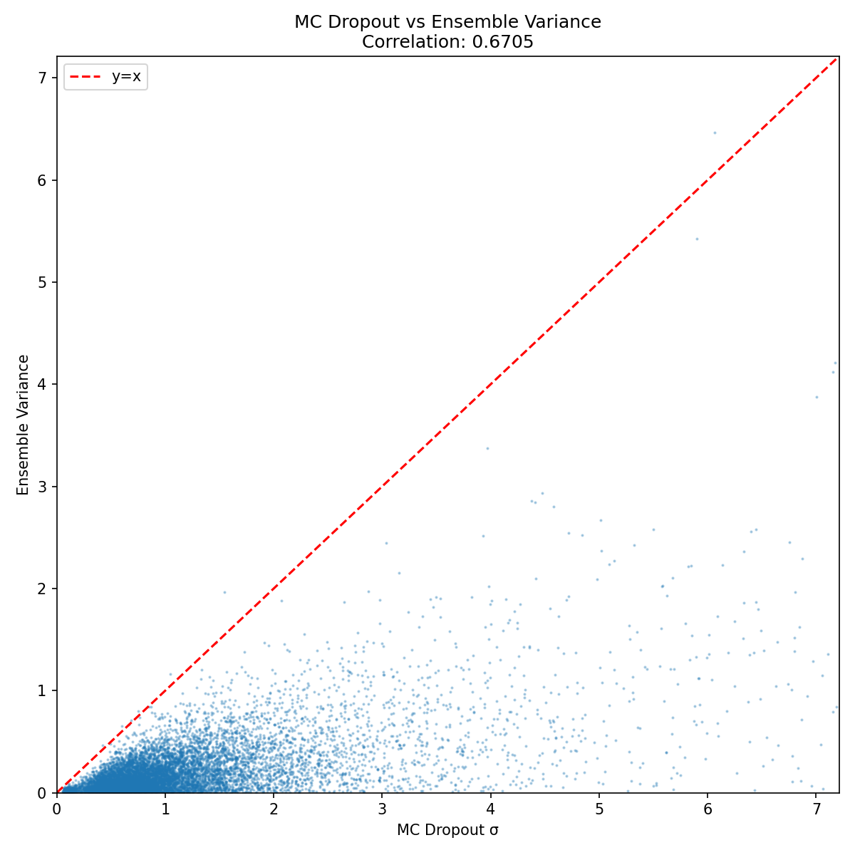
Ensemble Experiment A: Same Architecture, 5 Random Seeds
Part 4: Ensemble Experiments
Setup
5 instances of Trial 8, each trained with a different random seed.
Ensemble variance = variance across 5 model predictions.
Compare to MC Dropout σ from single model.
Results: Spearman ρ for uncertainty ranking
Method Spearman ρ
────────────────────────────────
MC Dropout σ 0.491
Ensemble Variance 0.307
Why ensemble variance is weaker here
Same architecture + same training data → CORRELATED errors.
Models fail TOGETHER on the same hard nodes.
Ensemble variance does not capture cases where all models
are simultaneously wrong.
MC Dropout with single model outperforms same-arch ensemble.
MC Dropout σ vs. ensemble variance as uncertainty proxies.
Mohd Zamin Quadri | TUM CIT | Master's Thesis Defence 2026

Slide 16
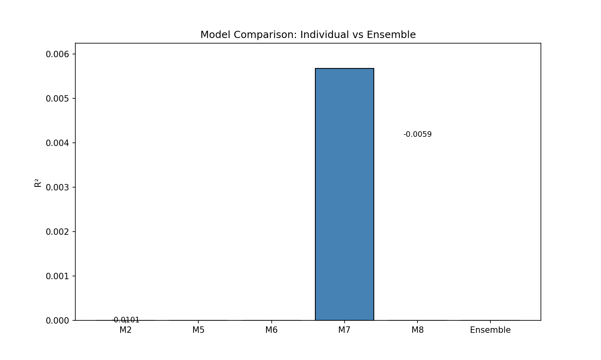
Ensemble Experiment B: Multi-Architecture Ensemble
Part 4: Ensemble Experiments
Setup
Weighted ensemble of 5 architecturally distinct trials:
T2 + T5 + T6 + T7 + T8
Weights proportional to individual R².
Result: Ensemble Underperforms Single Best Model
Method R²
───────────────────────────
Trial 8 alone (best) 0.596
Multi-arch ensemble 0.566
Ensemble uncertainty Spearman ρ = 0.433
vs. MC Dropout ρ = 0.491
Individual trial R² vs. weighted ensemble R².
Lesson: Why ensembles can fail
• Weaker models DILUTE the best model's signal
• All trained on same 1,000 scenarios → correlated predictions
• Ensemble diversity requires DATA diversity,
not just architecture diversity
Mohd Zamin Quadri | TUM CIT | Master's Thesis Defence 2026

Slide 17
Trial 7: Cross-Validation Replication
Part 5: Negative Results
Purpose
Key UQ Metrics — T7 vs T8
Trial 8 uses an 80/10/10 split with 100 test graphs.
Trial 7 uses the same split but different hyperparameters.
Goal: verify UQ patterns are not artefacts of Trial 8's specific test set.
Metric T8 T7
─────────────────────────────────
Spearman ρ 0.482 0.446
k₉₅ 11.34 16.15
Conformal q₉₀ 9.99 higher
Trial 7 Setup
Architecture: GATConv (same as T8)
Dropout: 0.3 (higher than T8's 0.2)
Test graphs: 100, LR: 0.0006
R² = 0.547
Interpretation
• Pattern REPLICATED: MC Dropout still informative (ρ = 0.446)
• k₉₅ = 16.15 vs T8's 11.34:
higher dropout = more uncertainty spread
• Gaussian intervals even more miscalibrated
• Confirms findings are model-independent
Mohd Zamin Quadri | TUM CIT | Master's Thesis Defence 2026

Slide 18
Trial 9: Heteroscedastic NLL — A Negative Result
Part 5: Negative Results
Motivation
Root Cause: Variance Inflation (Seitzer et al., 2022)
Instead of post-hoc UQ (MC Dropout), train the model to output
both mean AND variance directly.
Final layer: GATConv(64 → 2) outputs [μ̂, log σ̂²]
Loss (Kendall & Gal, 2017):
L = mean_i [ (y_i−μ̂_i)²/(2σ̂_i²) + ½ log σ̂_i² ]
The NLL loss has a shortcut:
If σ̂² → ∞, the first term → 0
regardless of μ̂.
The model learned to INFLATE σ̂² to minimise
loss WITHOUT improving μ̂.
Result: R² = 0.02 — Near-Total Failure
Lesson & Fix
The model learned to predict, but made completely unreliable predictions.
• Standard heteroscedastic NLL is INSUFFICIENT for this task
• Fix requires: variance head constraints,
evidential deep learning (Amini et al., 2020),
or decoupled mean/variance training
• Post-hoc UQ (MC Dropout + Conformal) is more robust
Mohd Zamin Quadri | TUM CIT | Master's Thesis Defence 2026

Slide 19
All UQ Experiments: Complete Summary
# | Method | Key Result | Verdict
1 | MC Dropout (S=30) | Spearman ρ = 0.482 | ✓ Useful ranking
2 | Gaussian kσ intervals | 90% nominal → 48.6% actual | ✗ Miscalibrated
3 | Temperature Scaling (T=2.70) | ECE −82%, NLL −78% | ✓ Calibrates σ
4 | PIT Diagnostic | KS 0.245 → 0.104 (−57%) | ✓ Confirms T.S.
5 | NLL Diagnostic | 21.65 → 4.75 | ✓ Confirms T.S.
6 | Global Conformal | 90.02% @ 90% target | ✓ Guaranteed
7 | Adaptive Conformal | Conditional [90%, 96.2%] | ✓ Better cond.
8 | Selective Prediction | −41.6% MAE @ 50% retain | ✓ Actionable
9 | Error Detection (AUROC) | AUROC = 0.759 | ✓ Detects errors
10 | Ensemble Exp A (5 seeds) | ρ = 0.307 < MC's 0.491 | ✗ Correlated
11 | Ensemble Exp B (multi-arch) | R² = 0.566 < T8's 0.596 | ✗ Diluted
12 | Trial 7 Replication | ρ = 0.446, pattern holds | ✓ Cross-validated
13 | Trial 9 Heteroscedastic | R² = 0.02 | ✗ Var. inflation
Mohd Zamin Quadri | TUM CIT | Master's Thesis Defence 2026

Slide 20
Three-Level UQ Hierarchy: Final Picture
Level 1: Ranking
Level 2: Calibration
Level 3: Guarantee
"Which predictions to trust less?"
MC Dropout: ρ = 0.482
AUROC: 0.759
Selective: −41.6% MAE at 50%
Use: Flag unreliable roads before
deploying model output
"Are confidence scores accurate?"
Temp. Scaling T = 2.70
ECE: −82%
NLL: −78%, PIT KS: −57%
Use: Meaningful probability statements
on individual predictions
"Hard provable bounds?"
Global conformal:
90.02% at 90%
95.09% at 95%
Adaptive: conditional [90%, 96.2%]
Use: Worst-case planning for
high-stakes decisions
← Increasing formal rigour →
Mohd Zamin Quadri | TUM CIT | Master's Thesis Defence 2026

Slide 21
Limitations
UQ-Specific Limitations
Model & Data Limitations
• Marginal vs. conditional coverage:
Conformal guarantees hold on AVERAGE over all nodes
— not per individual node
• Calibration uses test split:
Test pool was split 50/50 for conformal calibration.
Standard practice but worth noting.
• MC Dropout σ is epistemic only:
Does not capture aleatoric (data) uncertainty
• Heavy computational cost:
MC Dropout (S=30): ~228 min vs. deterministic ~3.4 min (67× overhead)
• Data scarcity:
1,000 of 10,000 available MATSim scenarios (10% subset)
Best GATConv model: R²=0.596 vs. Elena's R²=0.78 at 10,000 scenarios
• Architecture gap:
Trial 1 (Linear head) achieves R²=0.786 — bottleneck may be in GATConv
• Single city:
All results on Paris network. Generalisation to other cities untested.
• Heteroscedastic approach failed:
Trial 9 R²=0.02. Native uncertainty prediction requires future work.
Mohd Zamin Quadri | TUM CIT | Master's Thesis Defence 2026

Slide 22
Conclusion
What Was Achieved
Key Numbers
• Applied 13 UQ experiments on a GNN surrogate for Paris traffic
• Showed that MC Dropout provides a useful uncertainty signal
(ρ = 0.482, AUROC = 0.759)
• Demonstrated that Conformal Prediction gives hard coverage guarantees
(90.02% at 90% target) where Gaussian methods fail (48.6%)
• Selective prediction delivers actionable accuracy gains
(−41.6% MAE at 50% retention)
• Identified NEGATIVE results: ensemble failure due to correlation;
heteroscedastic NLL failure due to variance inflation
Metric Value
────────────────────────────────────────
MC Dropout Spearman ρ 0.482
Conformal coverage @ 90% 90.02%
Adaptive conditional range 90–96.2%
Selective MAE (50% retain) −41.6%
Error detection AUROC 0.759
ECE improvement (Temp. Scaling) −82%
Temperature scaling T 2.70
Core Message
A model that knows what it doesn't know
is more useful than a more accurate model
that doesn't.
Mohd Zamin Quadri | TUM CIT | Master's Thesis Defence 2026

Slide 23
Appendix A: Why k₉₅ = 11.34 Instead of 1.96?
Empirical k Definition
Why Heavy Tails?
Let k_p be the value such that exactly p% of test residuals satisfy:
|y_i − ŷ_i| ≤ k_p · σ_i
Under Gaussian assumptions: k₉₅ = z₀.₉₇₅ = 1.96
Under our heavy-tailed residuals: k₉₅ = 11.34
Ratio = 11.34 / 1.96 = 5.79 ×
• σ captures EPISTEMIC uncertainty (model disagreement)
• True residuals also contain ALEATORIC uncertainty
(data noise, unseen disruptions)
• MC Dropout σ has no mechanism to estimate
aleatoric uncertainty
• Therefore σ systematically underestimates
total uncertainty
What This Means
The residuals are much larger relative to σ than Gaussian predicts.
σ UNDERESTIMATES the spread of true errors by a factor of ~6.
This is why ŷ ± 1.96σ only covers 54.8% rather than 95%.
T7 Comparison
Trial 7 (dropout=0.3) has k₉₅ = 16.15
Higher dropout → more stochastic → larger σ...
but residuals grow even faster.
Conformal bypasses this entirely
by using empirical residuals.
Mohd Zamin Quadri | TUM CIT | Master's Thesis Defence 2026

Slide 24
Appendix B: Why Conformal Coverage is Guaranteed
Exchangeability Assumption
Finite-Sample Guarantee
Let (X₁,Y₁), …, (Xₙ,Yₙ), (Xₙ₊₁,Yₙ₊₁) be EXCHANGEABLE
— any permutation of indices has the same joint distribution.
This holds when calibration and test data are i.i.d. draws
from the same distribution.
With n calibration points:
P(Y ∈ C(X)) ≥ 1 − α − 1/(n+1)
For n = 1,581,750 (50% of test nodes):
The correction term 1/(n+1) ≈ 6×10⁻⁷ is negligible.
Proof Sketch (Angelopoulos & Bates, 2023)
The calibration residuals r₁, …, rₙ and the test residual rₙ₊₁
are exchangeable.
Therefore rₙ₊₁ is equally likely to be in any rank
among {r₁, …, rₙ, rₙ₊₁}.
P(rₙ₊₁ ≤ q_α) ≥ 1−α follows directly from
order statistics of exchangeable variables.
No Distributional Assumptions
• Works for any model
• Works for any residual distribution
• Works whether or not the model is well-calibrated
• Only fails if exchangeability is violated (covariate shift)
Mohd Zamin Quadri | TUM CIT | Master's Thesis Defence 2026

Slide 25
Appendix C: All Trial Results Overview
T# | Architecture | Key Change | Split | R² | MAE | RMSE
1 | Linear | Baseline, bs=32 | 80/15/5 | 0.786 | 2.97 | 5.40
2 | GATConv | First GATConv, bs=16 | 80/15/5 | 0.512 | 4.33 | 8.15
3 | GATConv | Weighted loss, no dropout | 80/15/5 | 0.225 | 5.99 | 10.27
4 | GATConv | Weighted loss + dropout | 80/15/5 | 0.243 | 6.08 | 10.15
5 | GATConv | Paper config, bs=8 | 80/15/5 | 0.555 | 4.24 | 7.78
6 | GATConv | Lower LR (0.0003) | 80/15/5 | 0.522 | 4.32 | 8.06
7 | GATConv | 80/10/10, LR=0.0006 | 80/10/10 | 0.547 | 4.06 | 7.53
8 | GATConv ★ | Lower dropout (0.2) | 80/10/10 | 0.596 | 3.96 | 7.12
9 | Heteroscedastic | NLL loss, output [μ, σ²] | 80/10/10 | 0.02 | — | —
Note on Trial 1
Elena's Reference
T1 uses LINEAR final layer — architecturally distinct from T2–T8 (GATConv).
T1 R²=0.786 is not directly comparable.
Best GATConv model = T8, R²=0.596.
Natterer et al. achieved R²=0.78 with 10,000 scenarios (10× more data).
Our T8 uses only 1,000 scenarios (10% subset).
Data gap explains most of the R² difference.
Mohd Zamin Quadri | TUM CIT | Master's Thesis Defence 2026

