Slide 1

Uncertainty Quantification for Graph Neural Network Surrogates of Agent-Based Transport Models
Mohd Zamin Quadri
M.Sc. Mathematics in Science and Engineering
Examiner: Prof. Dr. Stephan Guennemann Advisors: Dominik Fuchsgruber M.Sc., Elena Natterer M.Sc.
Data Analytics and Machine Learning (DAML) Group, TUM
1/22

Slide 2
Outline
1. Motivation & Problem Statement
2. Data & Architecture
3. Methodology: UQ Methods
4. Predictive Performance (Trials 1-8)
5. MC Dropout Uncertainty Quality
6. Calibration & Temperature Scaling
7. Conformal Prediction
8. Selective Prediction
9. Proper Scoring Rules (CRPS, PIT, Winkler)
10. Ensemble Investigation (Negative Result)
11. Cross-Trial Validation & S-Convergence
12. Key Findings & Contributions
13. Limitations & Future Work
2/22

Slide 3
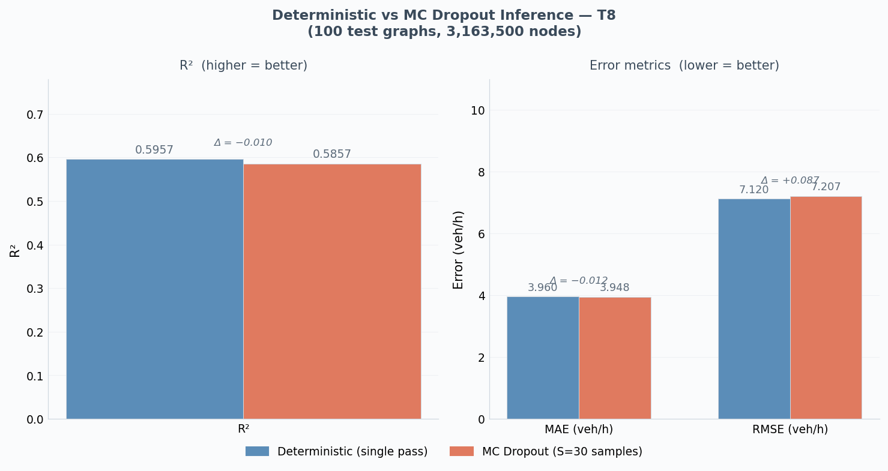
Motivation: Why Uncertainty Matters
Agent-based transport simulations (MATSim): hours per scenario
GNN surrogates: seconds per scenario, but how reliable?
Urban planners need to know where predictions may fail
Without UQ: planners may unknowingly base infrastructure decisions on unreliable predictions
This thesis: systematic UQ evaluation for GNN traffic surrogates
3/22

Slide 4
Research Questions
RQ1: How effectively does MC Dropout capture epistemic uncertainty in GNN-based traffic surrogates?
RQ2: How does MC Dropout compare to ensemble-based UQ in terms of uncertainty quality and computational cost?
RQ3: Does combining uncertainty from architecturally identical models provide benefits over single-model UQ?
RQ4: Can distribution-free methods (conformal prediction, post-hoc calibration) transform raw uncertainty into trustworthy prediction intervals?
4/22

Slide 5
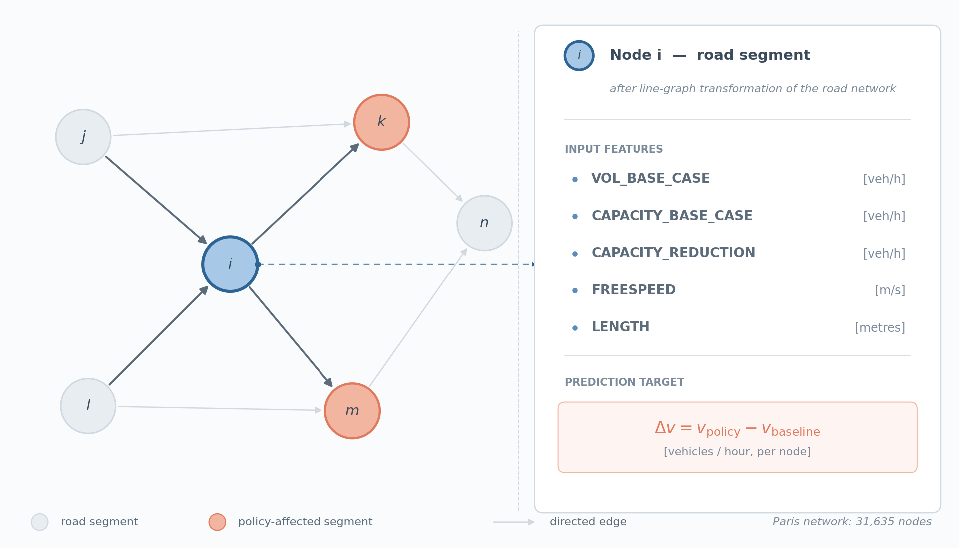
Data: Paris Road Network
Source: MATSim agent-based simulation (Natterer et al. 2025)
10,000 policy scenarios; this thesis uses 1,000 (10% subset)
Each scenario = one static graph (no temporal dimension)
31,635 nodes (road segments), 5 features per node
Target: change in traffic volume (veh/h) after policy intervention
Split: 800 train / 100 val / 100 test
Test set: 100 graphs x 31,635 nodes = 3,163,500 predictions
5/22

Slide 6
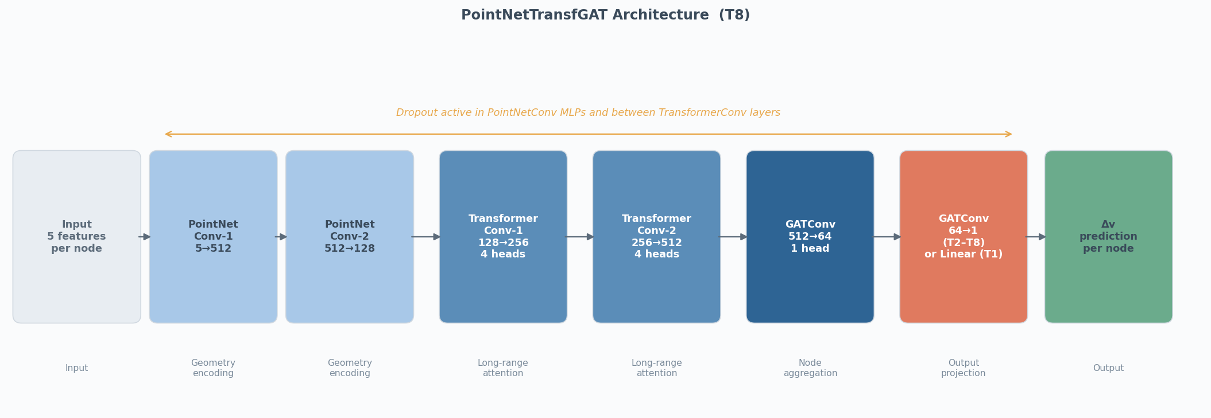
Model Architecture: PointNetTransfGAT
2 PointNetConv layers (512, 128 channels): encode geometry
2 TransformerConv layers (256, 512 channels, 4 heads): long-range attention
2 GATConv layers (64, 1 channel): final embedding + prediction
Dropout (p=0.2 for T8) applied throughout for MC Dropout UQ
8 trial configurations tested (varying dropout, LR, batch size, data split)
6/22

Slide 7
Methodology
Six UQ approaches evaluated
7/22

Slide 8
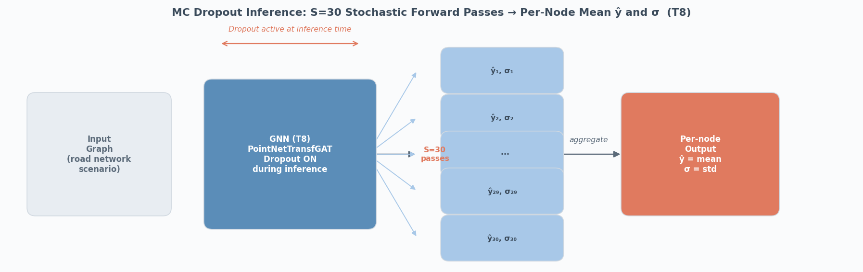
UQ Methods: Overview
MC Dropout (S=30): multiple stochastic forward passes at inference; mean = prediction, std = uncertainty
Deep Ensembles: train M independent models, use variance across predictions
Combined Uncertainty: merge MC Dropout + ensemble variance
Split Conformal Prediction: distribution-free coverage guarantee via calibration quantile
Selective Prediction: rank by uncertainty, retain most confident subset
Temperature Scaling: post-hoc single-parameter calibration of predictive distribution
8/22

Slide 9
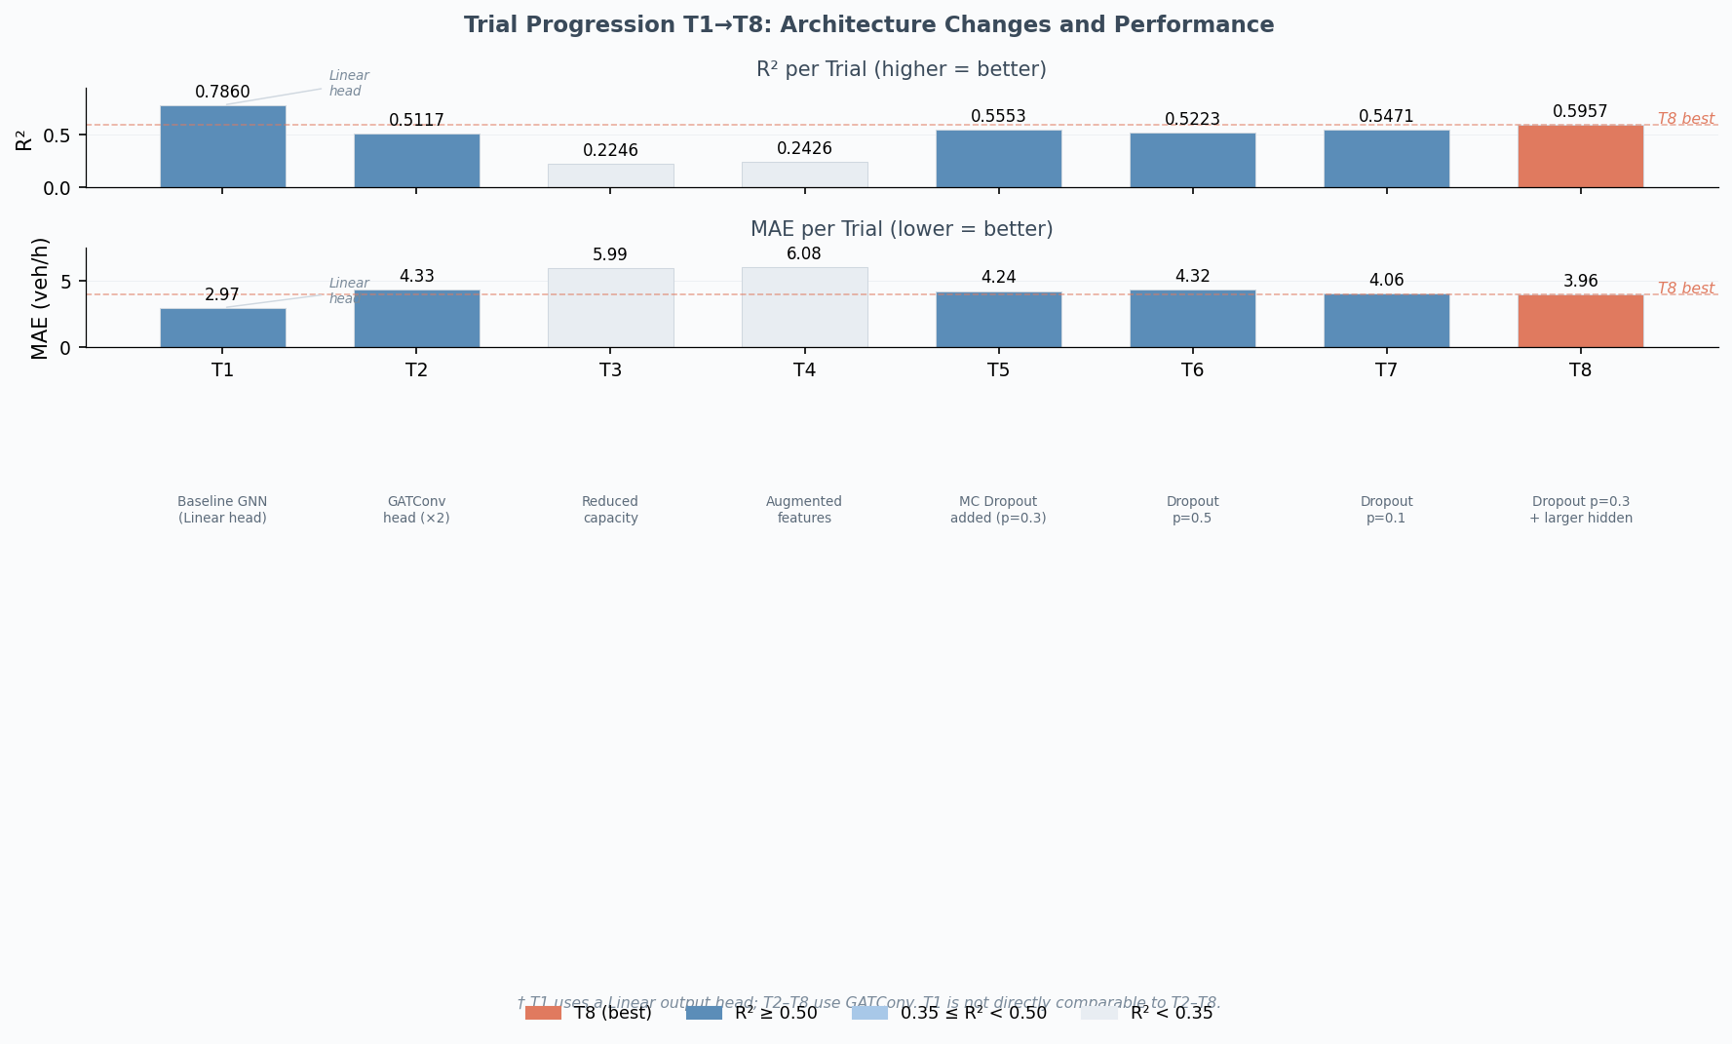
Predictive Performance: Trial Comparison
T1 (no dropout, Linear head): R2 = 0.7860, MAE = 2.97 veh/h -- but no UQ possible
T8 (best UQ-compatible): R2 = 0.5957, MAE = 3.96, RMSE = 7.12 veh/h
T3-T4 (weighted loss): R2 = 0.22-0.24 -- weighted MSE did not help
T8 selected for all UQ experiments (best among dropout-enabled trials)
Note: Elena's original work (full 10k dataset) achieved R2 = 0.91; this thesis uses 10% subset.
9/22

Slide 10
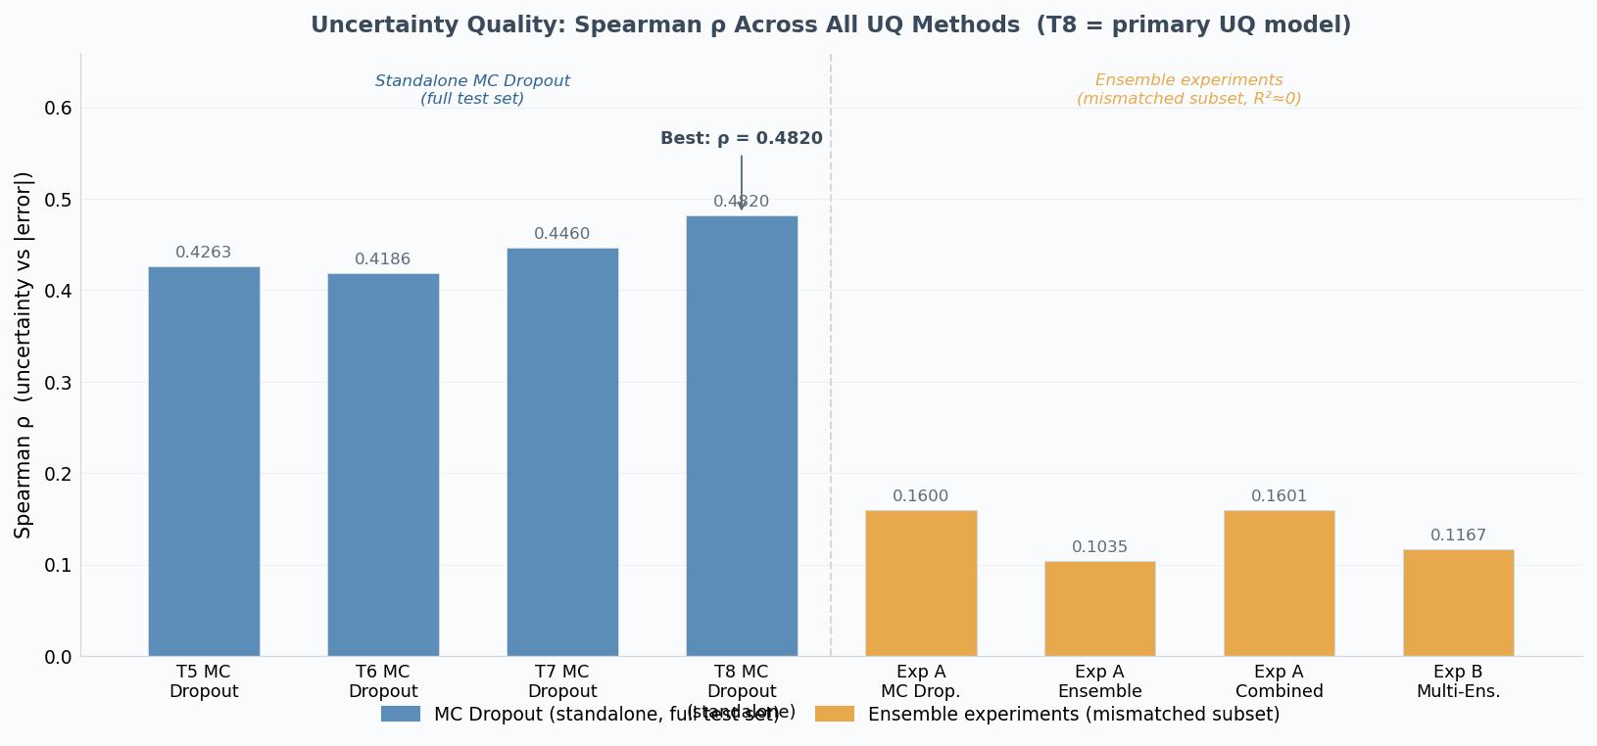
MC Dropout Uncertainty Quality (T8, S=30)
Spearman rho = 0.4820: moderate positive correlation between predicted uncertainty and actual error
AUROC = 0.7585 for top-10% error detection
Mean uncertainty: 1.37 veh/h (std across 30 forward passes)
Per-graph rho: mean = 0.4643, 95% CI [0.4599, 0.4689] (bootstrap, 100 graphs)
Stable across all 100 test scenarios (no graph-level outliers)
10/22

Slide 11
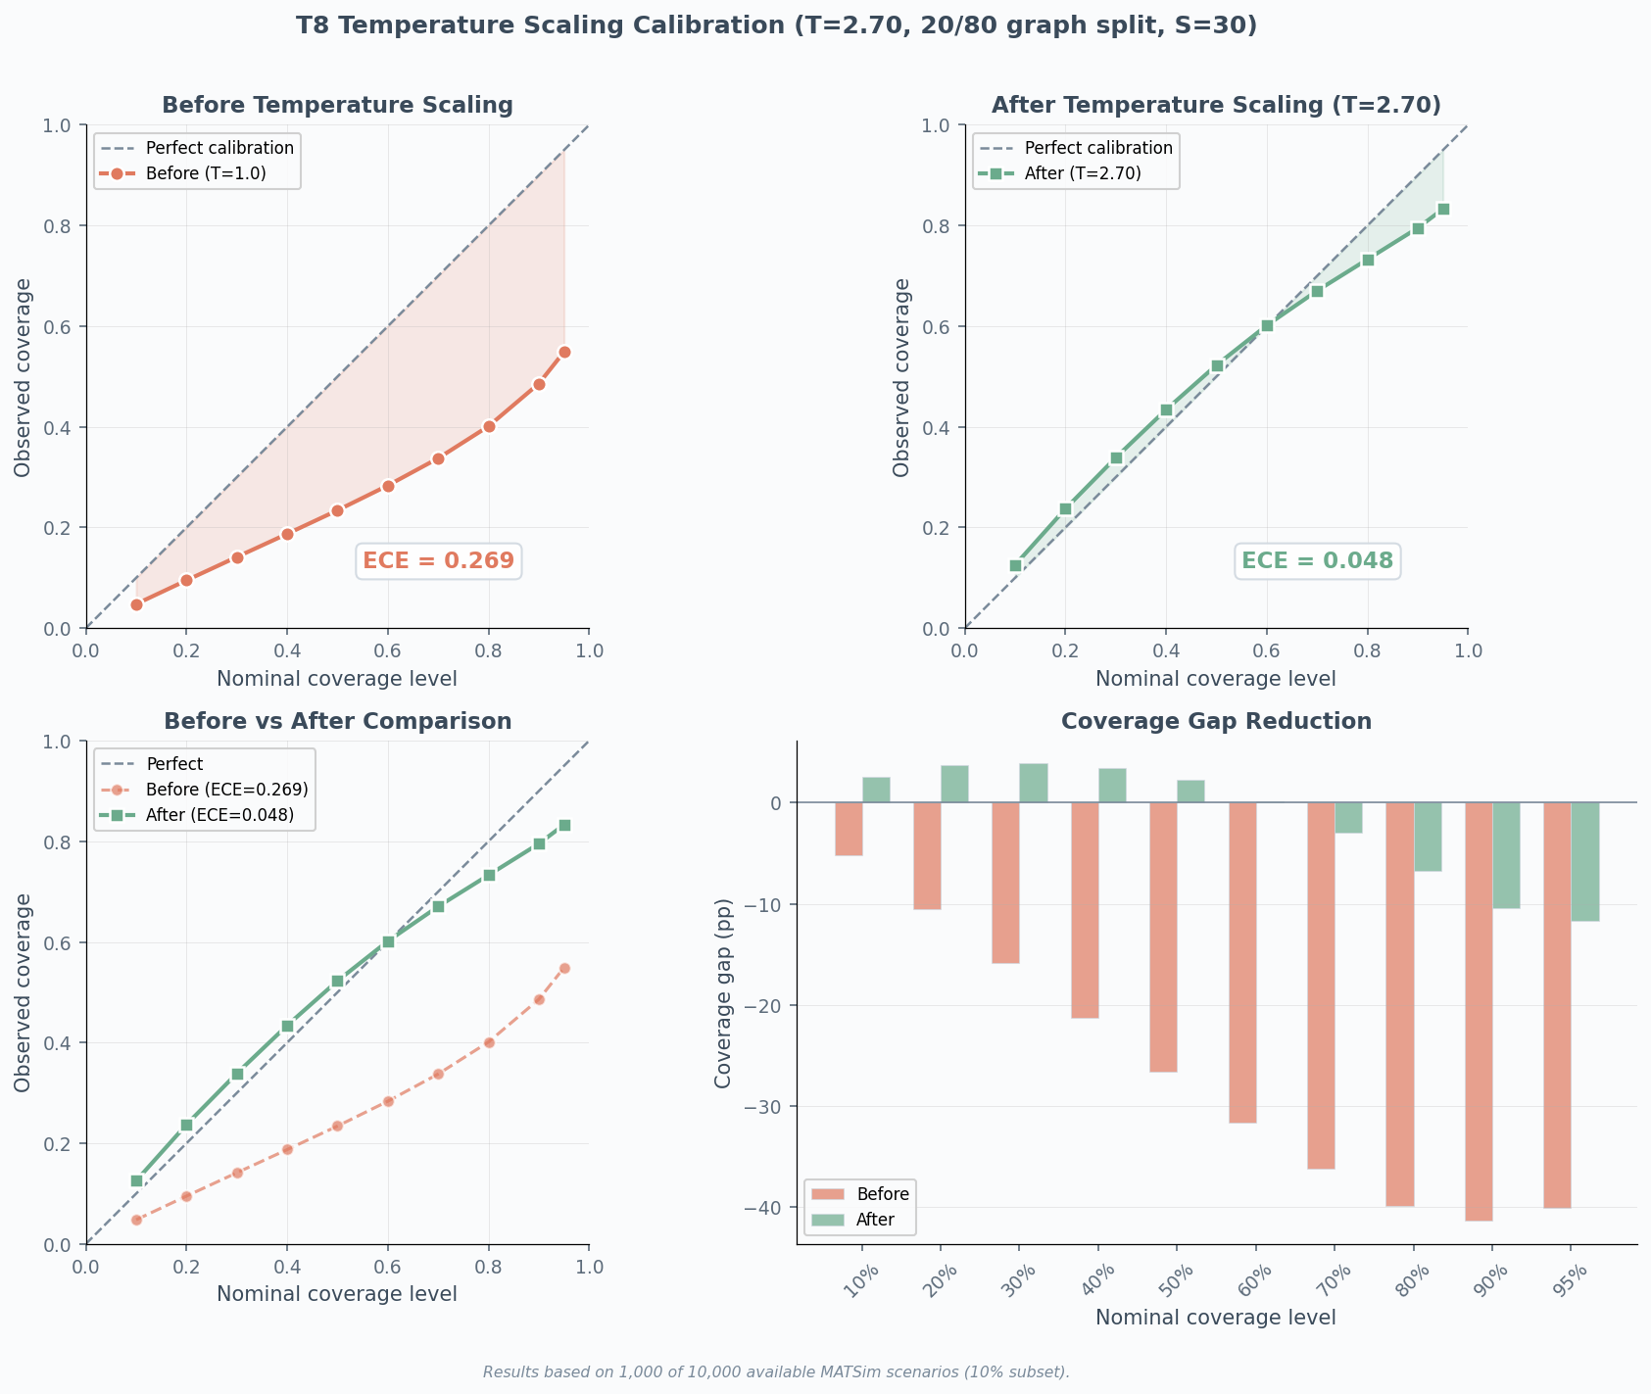
Calibration: Reliability Diagram & Temperature Scaling
Raw MC Dropout sigma is NOT calibrated: ECE = 0.265
Naive Gaussian 95% interval: only 55.6% coverage (should be 95%)
k_95 = 11.34 (need 11.34 sigma, not 1.96 sigma, for 95%)
Temperature scaling (T = 2.70): ECE drops from 0.269 to 0.048 (82% improvement)
Residual gap: scaled 95% interval achieves only 83.3% coverage
Conclusion: ranking is useful, absolute magnitudes require correction
11/22

Slide 12
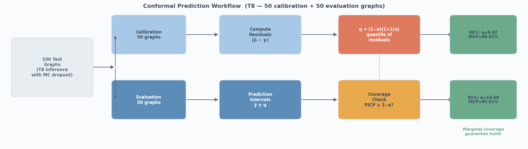
Conformal Prediction: Coverage Guarantees
Split conformal: 50 calibration + 50 evaluation graphs
90% level: q = 9.92 veh/h, coverage = 90.02%
95% level: q = 14.68 veh/h, coverage = 95.01%
Audit split (20/80): corroborates at q = 14.77, coverage = 95.1%
Distribution-free: no Gaussian assumption needed
Fixed-width limitation: same interval for all nodes
12/22

Slide 13
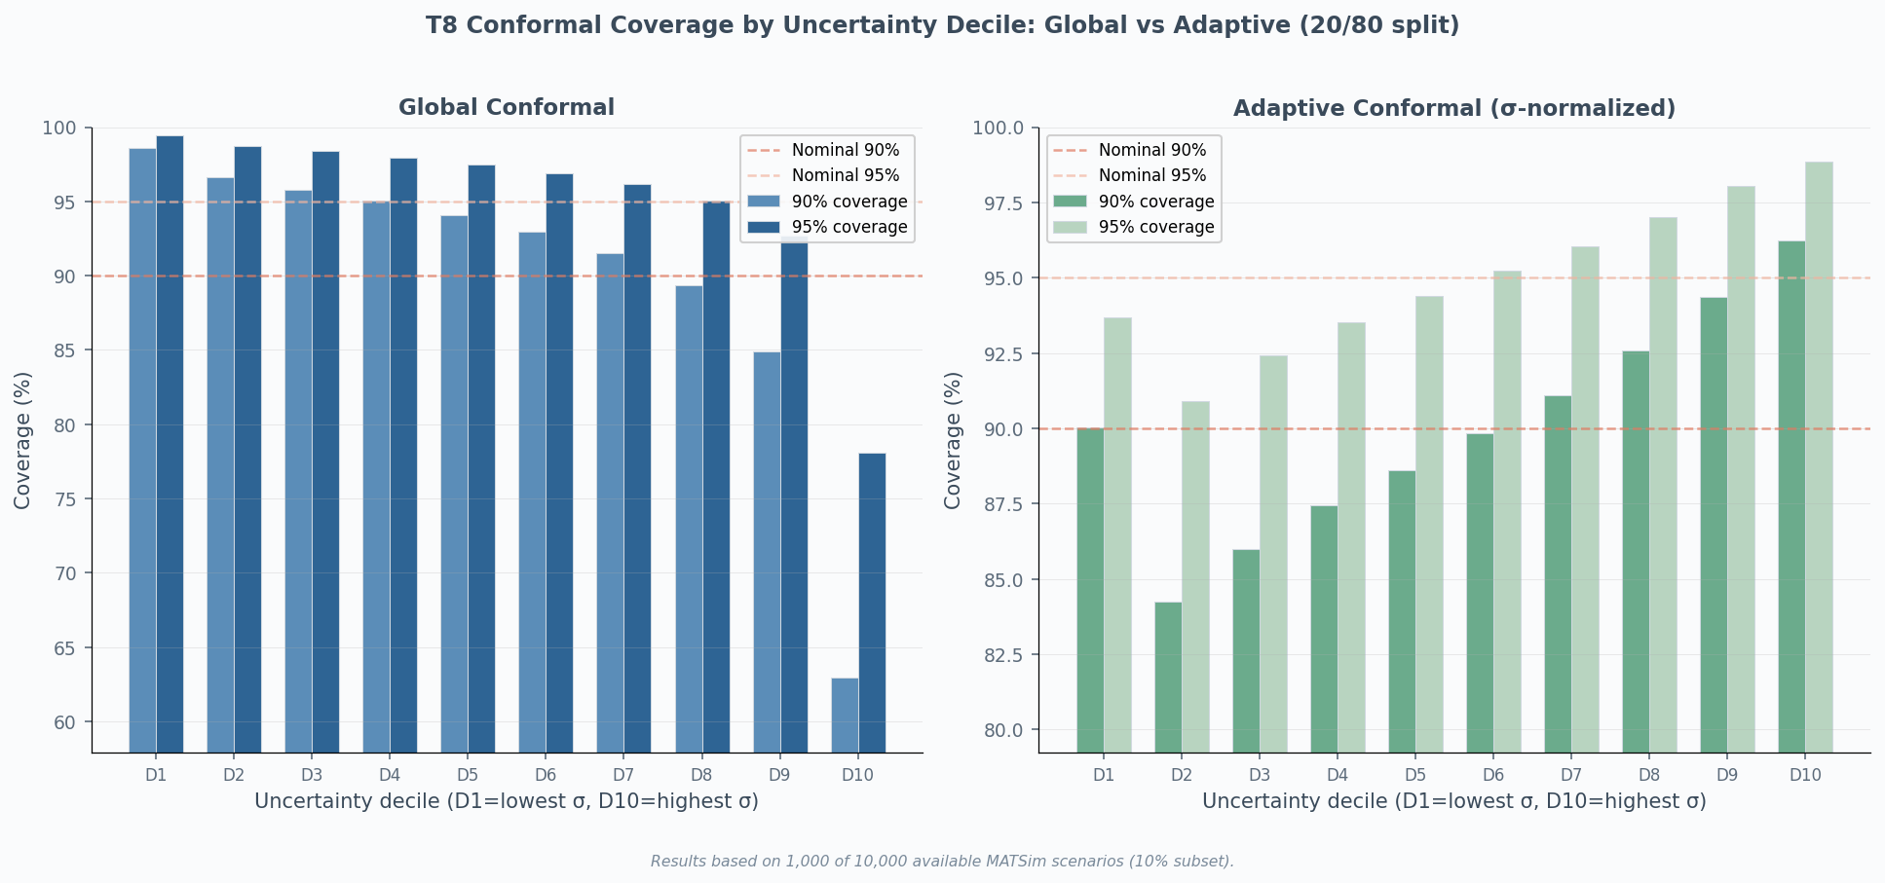
Adaptive Conformal: Node-Specific Intervals
Standard conformal: fixed-width -- over-covers low-uncertainty nodes (98.6%), under-covers high-uncertainty nodes (62.9%)
Adaptive conformal: normalise residuals by MC Dropout sigma
Result: conditional coverage narrows to [90.0%, 96.2%] across deciles
MC Dropout ranking signal carries genuine calibration information
Practical: wider intervals where model is uncertain, narrower where confident
13/22

Slide 14
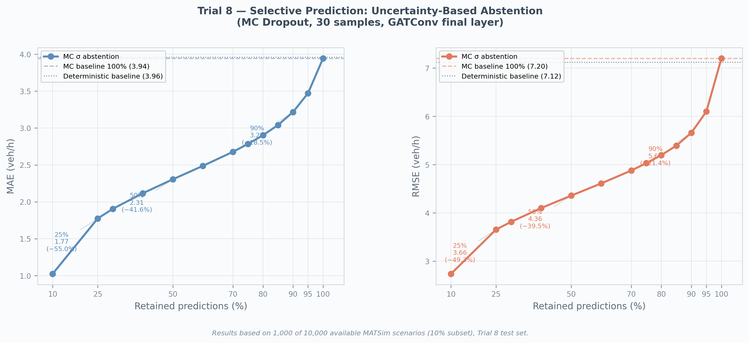
Selective Prediction: Trading Coverage for Accuracy
Sort predictions by ascending MC Dropout uncertainty
Retain only the most confident fraction:
100%: MAE = 3.95 veh/h (baseline)
90%: MAE = 3.23 veh/h (-18.3%)
50%: MAE = 2.32 veh/h (-41.2%)
10%: MAE = 1.16 veh/h (-70.6%)
Monotone improvement confirms uncertainty ranking is meaningful
T7 replication: same pattern (-38.3% at 50%)
14/22

Slide 15
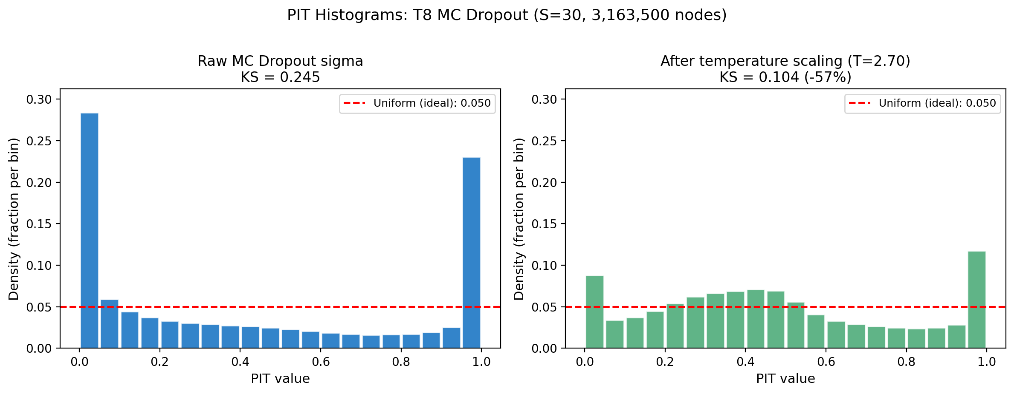
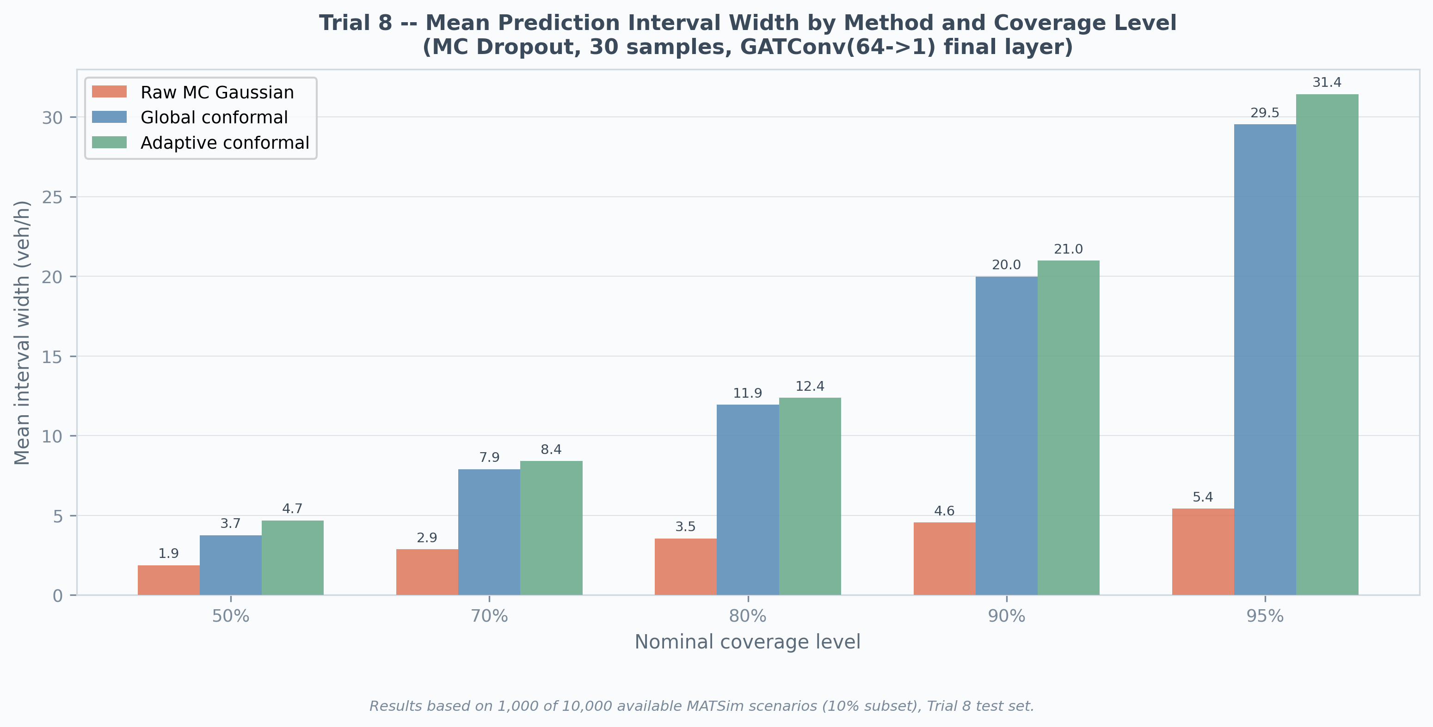
Proper Scoring Rules: CRPS, PIT, Winkler
CRPS = 3.38 veh/h; CRPS/MAE = 0.857 (theoretical optimum 0.707 for perfect Gaussian)
21% above optimum: quantifies calibration cost of underdispersed sigma
PIT histogram: spike at 0 (28.4%), U-shaped tails -- systematic underdispersion
After temperature scaling: KS drops 0.245 to 0.104 (-57%)
Winkler scores: conformal beats naive Gaussian (32.3 vs 49.7 at 90% level)
15/22

Slide 16
Ensemble Investigation: A Documented Negative Result
5 independently trained models: all produced R2 ~ 0.003 when loaded
Root cause: PyTorch Geometric GATConv API version mismatch
Checkpoint stores lin.weight (old PyG); current PyG 2.3.1 expects lin_src.weight / lin_dst.weight
strict=False silently drops old keys -- random initialisation of final 2 layers
Within degraded context: MC Dropout rho = 0.16 vs ensemble rho = 0.10
Standalone MC Dropout (correct PyG version): rho = 0.48 -- unaffected
Conclusion: ensemble experiments are inconclusive (RQ3), not a failure of ensembling itself
16/22

Slide 17
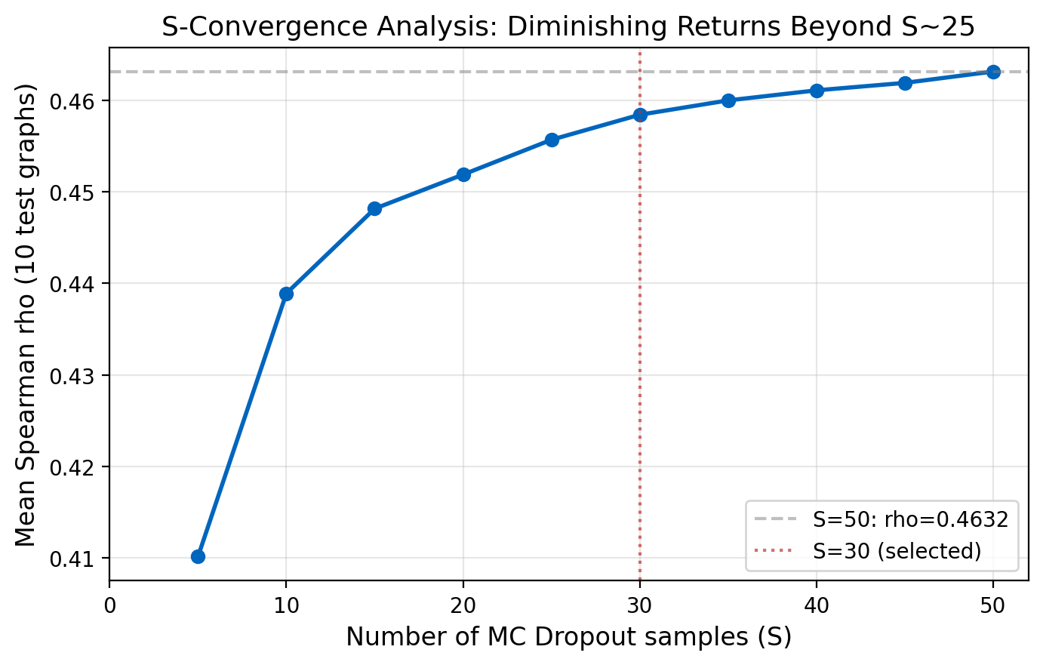
Robustness: Cross-Trial Validation & S-Convergence
T7 replication: rho = 0.4460, selective prediction -38.3% at 50%, conformal 95.3% coverage
Same qualitative conclusions hold across both trials
S-convergence: S=30 rho = 0.4584, S=50 rho = 0.4632 (<1% improvement)
Curve flattens sharply after S ~ 25: S=30 is cost-optimal
Inference time: 228 min total (S=30 x 100 graphs) -- manageable overhead
17/22

Slide 18
Key Findings & Contributions
Answering RQ1-RQ4
18/22

Slide 19
Answers to Research Questions
RQ1: Yes. MC Dropout captures meaningful uncertainty: rho = 0.4820, selective prediction -41.2% MAE at 50% retention, AUROC = 0.76
RQ2: Yes. MC Dropout outperforms ensemble variance (rho 0.16 vs 0.10 in degraded context), at lower cost. Standalone rho = 0.48
RQ3: Inconclusive. PyG loading bug invalidated all ensemble results. Identical-architecture ensembles remain untested under correct conditions
RQ4: Yes. Conformal prediction: 95.01% coverage. Temperature scaling: 82% ECE reduction. Adaptive conformal: [90.0%, 96.2%] conditional coverage
19/22

Slide 20
Practical Recommendation: Three-Level UQ Hierarchy
Level 1 -- MC Dropout (S=30, dropout=0.2): per-node uncertainty ranking for screening unreliable predictions. Use for selective prediction.
Level 2 -- Temperature Scaling (T=2.70): post-hoc calibration, reduces ECE by 82%. Improves absolute sigma interpretation at no cost.
Level 3 -- Conformal Prediction: formal coverage guarantee (95.01%). Use when contractual or operational coverage is required.
Adaptive Conformal: combines Levels 1+3 for node-specific intervals with both ranking and coverage properties.
Takeaway: All three levels are achievable with the PointNetTransfGAT architecture at no meaningful cost to predictive accuracy.
20/22

Slide 21
Limitations & Future Work
Single network (Paris) -- generalisation to other cities untested
10% data subset (1,000 / 10,000 scenarios) -- full dataset may improve R2
No non-GNN baselines for comparison
Ensemble experiments invalidated by PyG bug
MC Dropout provides ranking, not calibrated probabilities (without post-hoc correction)
Future Directions
Full 10,000-scenario training
Diverse ensembles (GAT + GraphSAGE + GCN)
Conformal risk control (adaptive coverage)
Post-hoc GEBM (Fuchsgruber et al. 2024)
Multi-city validation
Epistemic-aleatoric decomposition
21/22

Slide 22
Thank You
Questions & Discussion
MC Dropout rho = 0.4820 | Selective prediction: -41.2% MAE at 50% | Conformal: 95.01% coverage Temperature scaling: 82% ECE reduction | CRPS/MAE = 0.857 | S=30 is cost-optimal
Mohd Zamin Quadri | M.Sc. Mathematics in Science and Engineering | TUM
22/22

