Slide 1
Async RAG Results
Included
Comparison and ablation visualizations for large and long query settings
Large comparison
Large ablation
Large stage breakdown
Long comparison
Long ablation
Long stage breakdown
Async bucket mechanism

Slide 2
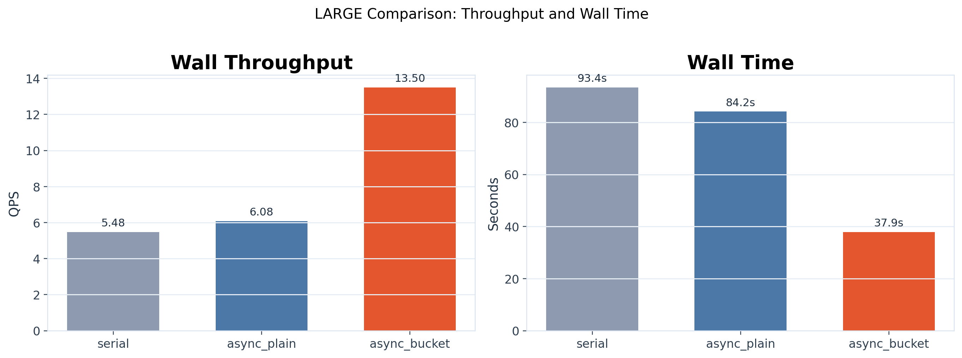
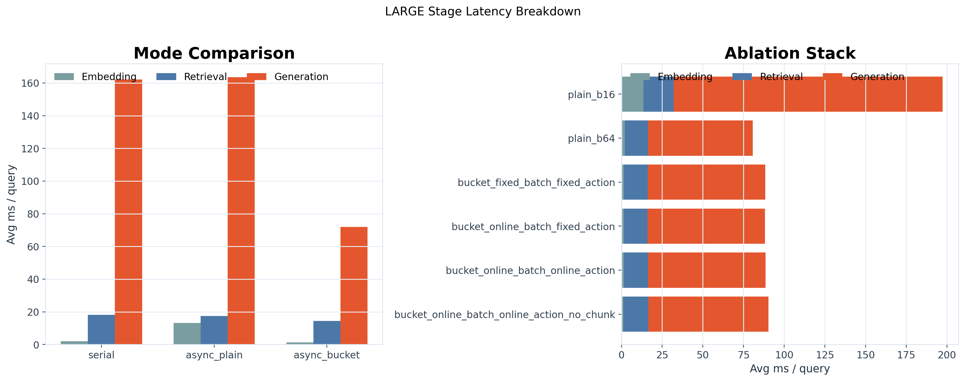
Large: Mode Comparison
serial vs async_plain vs async_bucket on the large-query result set
Throughput and wall time
Stage latency breakdown

Slide 3
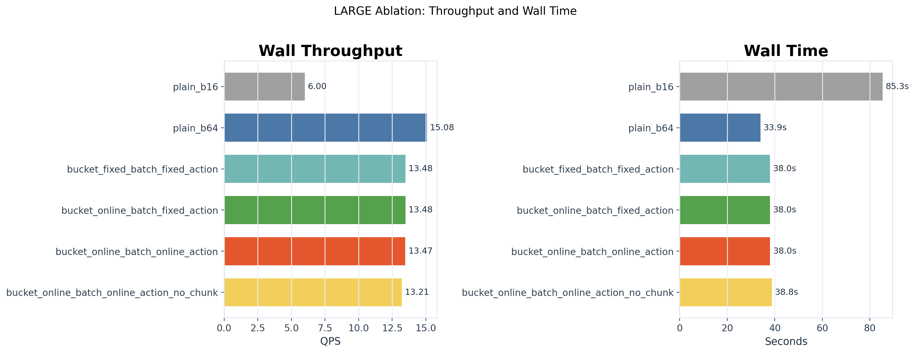
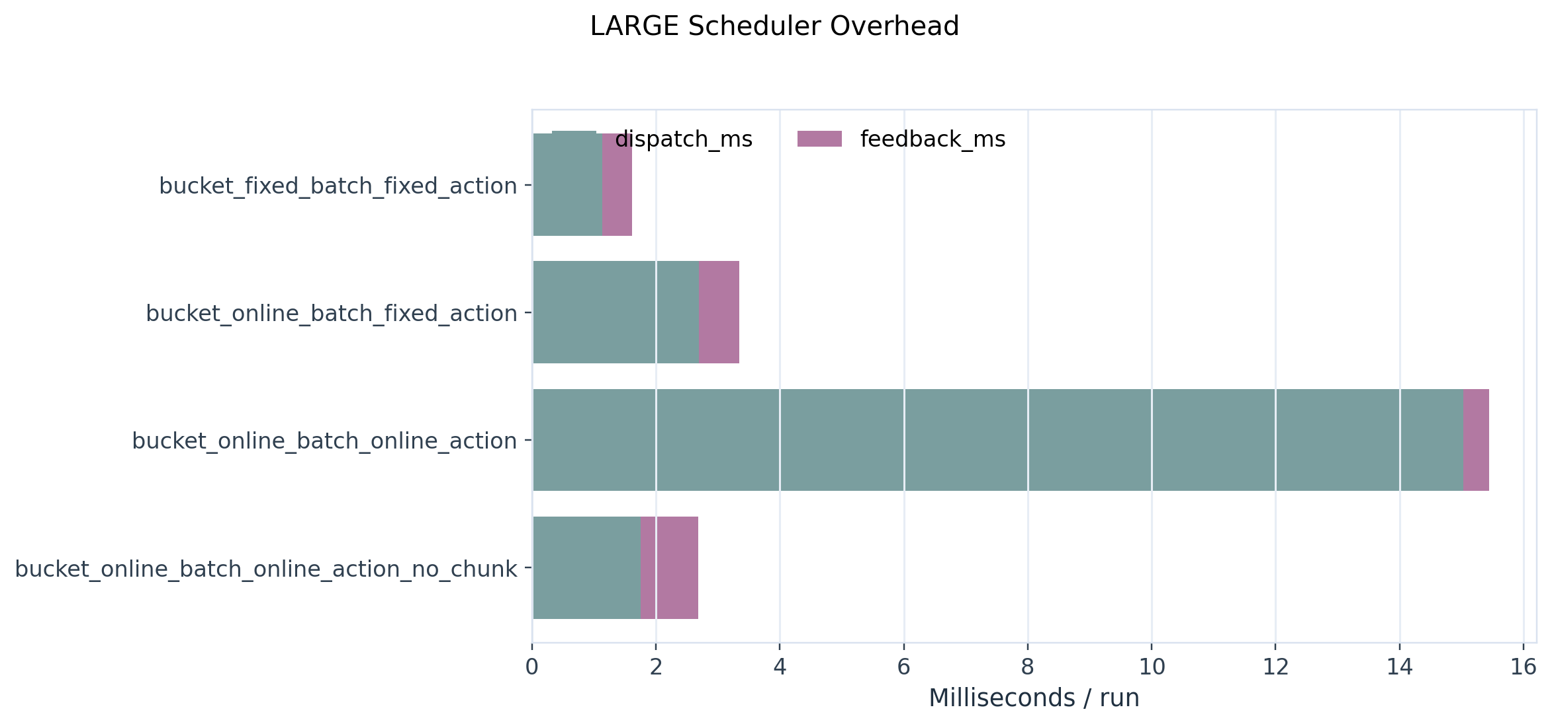
Large: Ablation
Effect of batch size, bucketing, online action selection, and chunking
Ablation throughput and wall time
Scheduler overhead

Slide 4
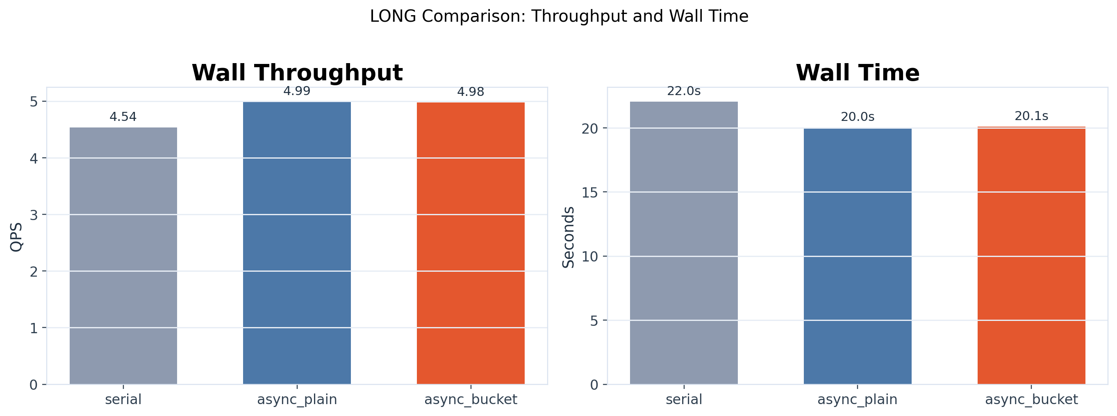
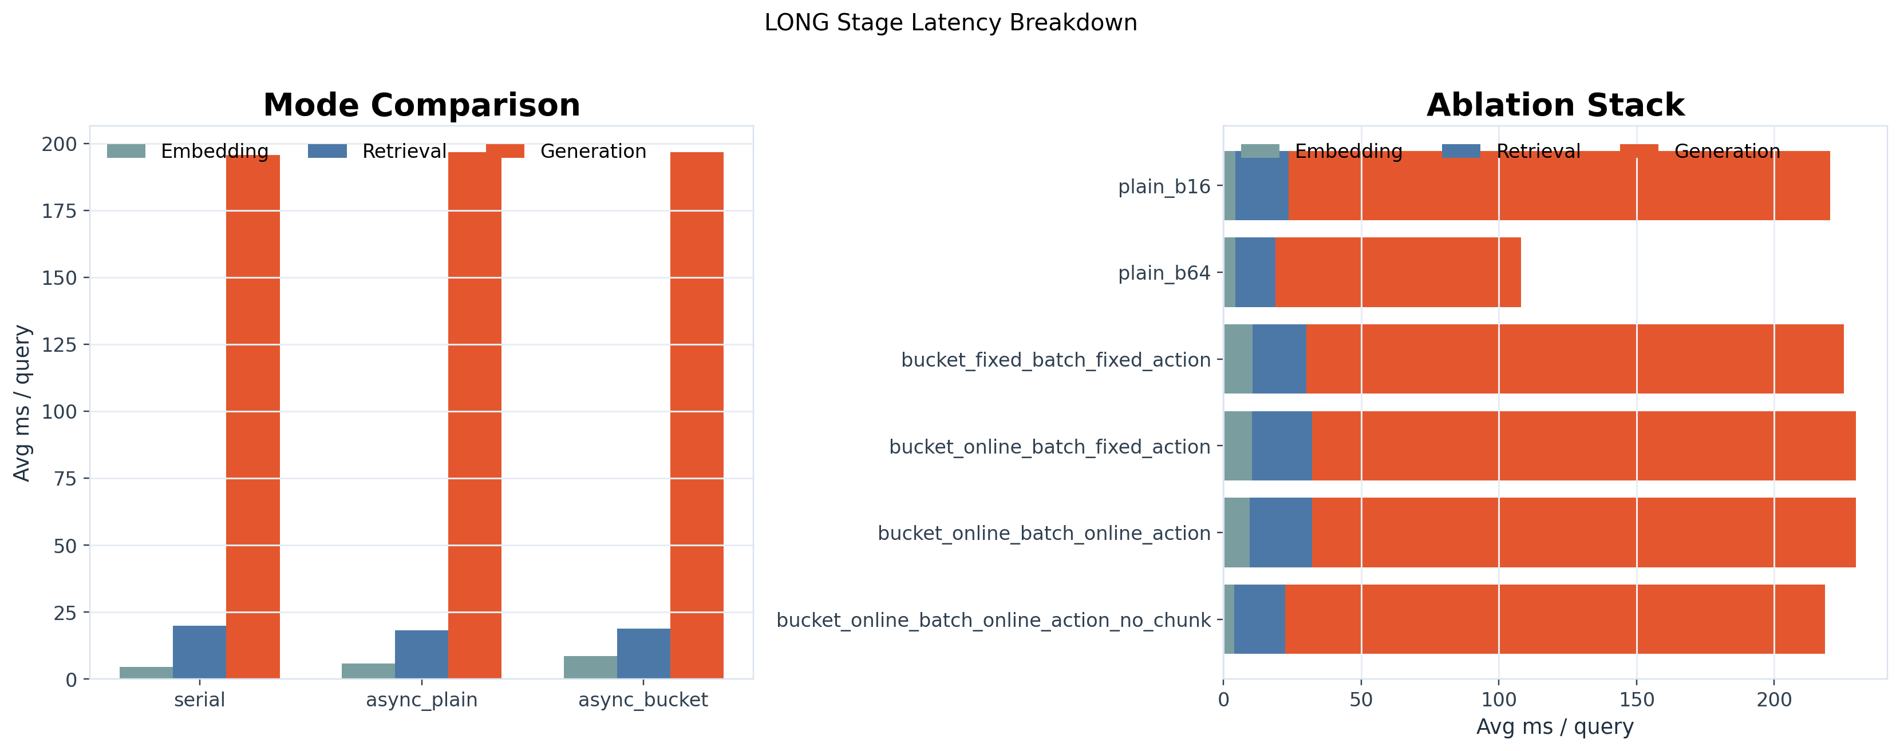
Long: Mode Comparison
serial vs async_plain vs async_bucket on the long-query result set
Throughput and wall time
Stage latency breakdown

Slide 5
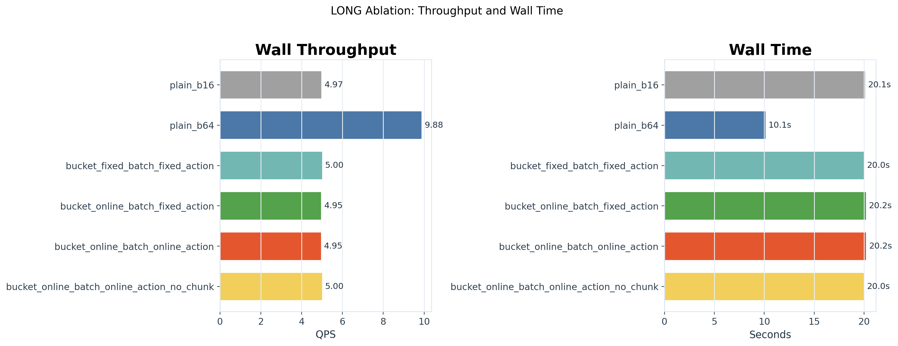
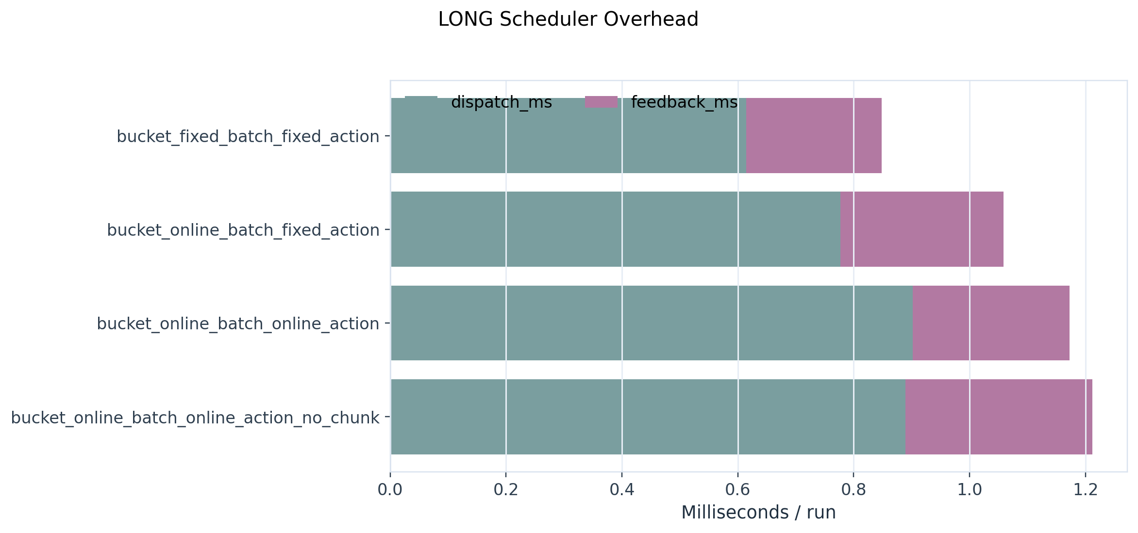
Long: Ablation
Long queries shift most cost into generation; scheduler overhead remains small
Ablation throughput and wall time
Scheduler overhead

Slide 6
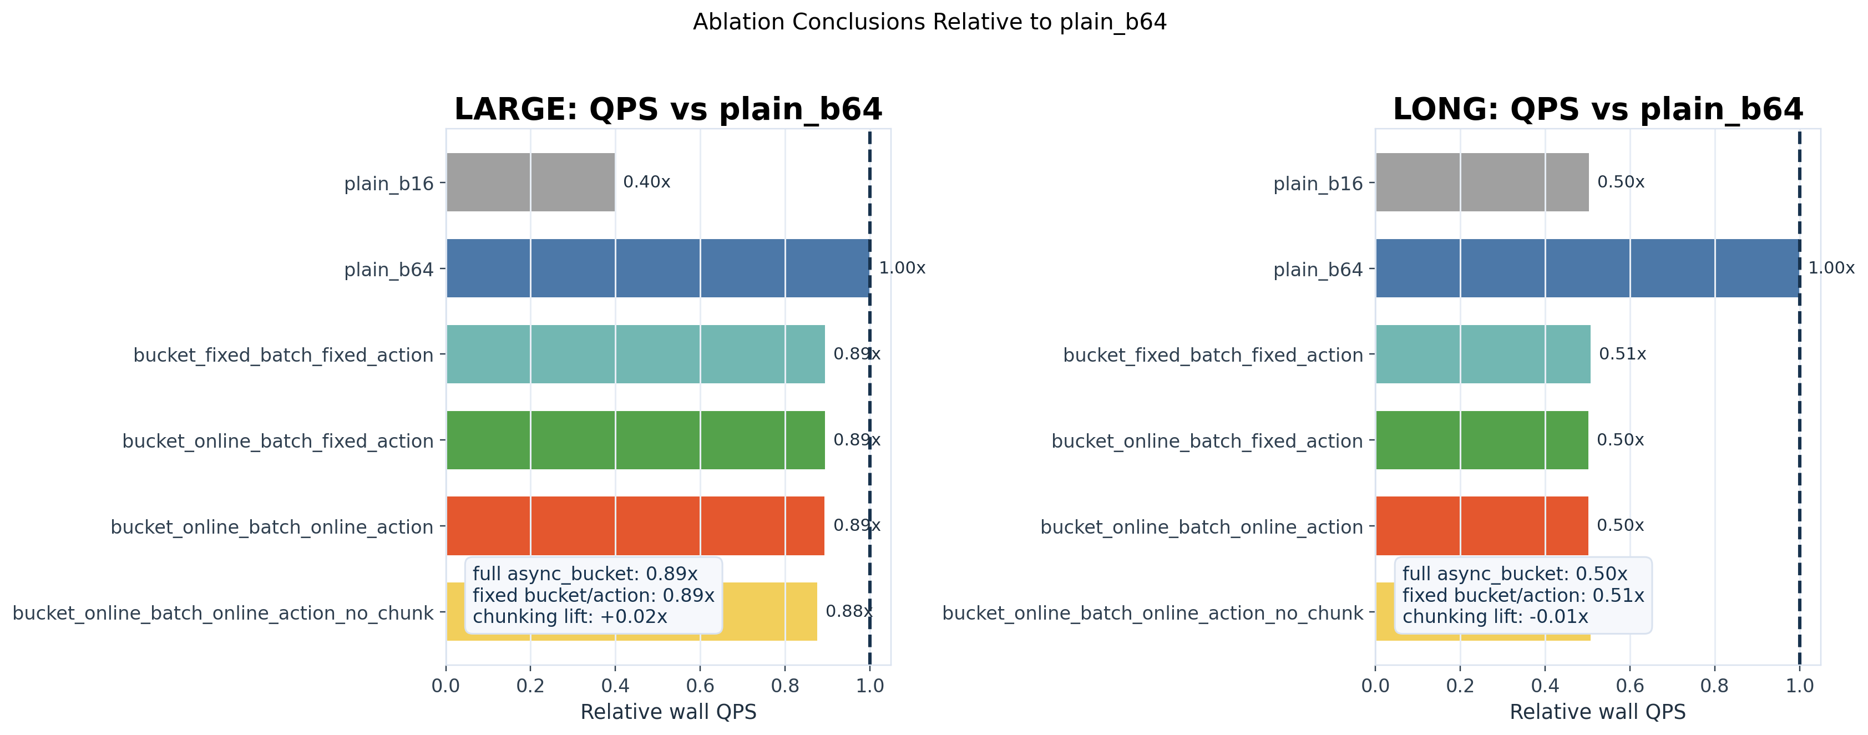
Ablation Conclusions
Relative to plain_b64, the large set loses modestly while the long set loses dramatically because bucketed batching shrinks generation batches.
Relative QPS summary
Long stage breakdown

Slide 7
Async Bucket Mechanism
Dispatch is online: the scheduler re-decides bucket, batch size, and xE/xR at every outgoing microbatch.
short
1. Query Pool
2. Length Estimation
3. Dispatch Choice
Embed
Retrieve
Generate
<= 48
Incoming queries
tokenized length cache
pick bucket + batch size + xE/xR
xE
xR
GPU
mid
49 - 128
long
> 128
4. EMA feedback
Embedding / retrieval / generation latencies are fed back into per-bucket EMA tables. The next dispatch uses these updated cost estimates, so the scheduler keeps adapting instead of replaying a fixed plan.

