Slide 1
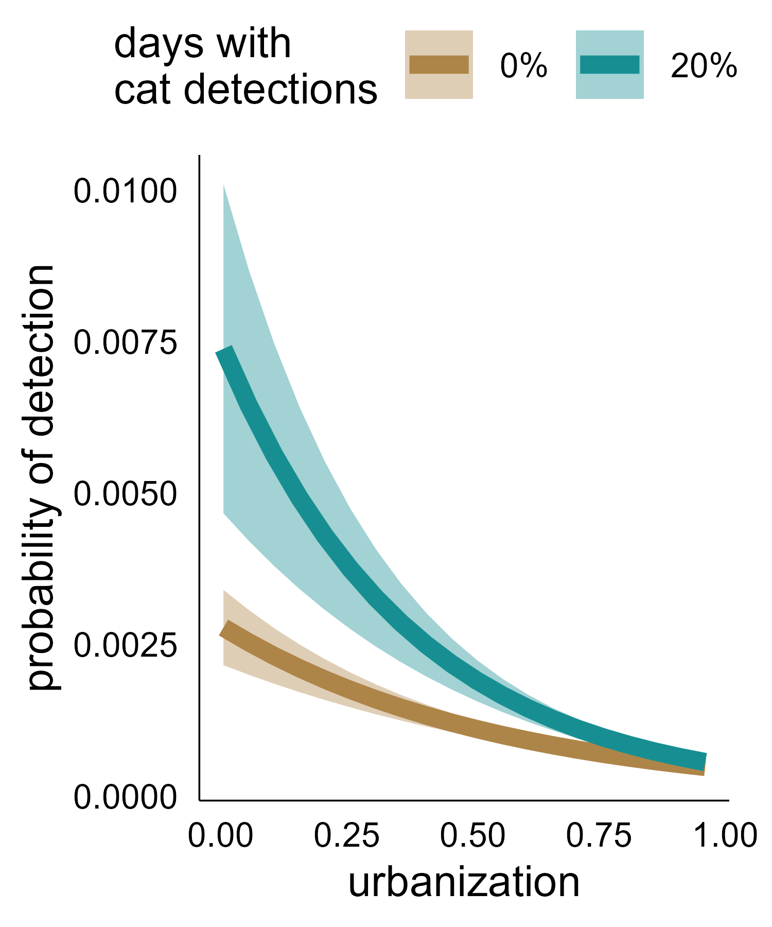
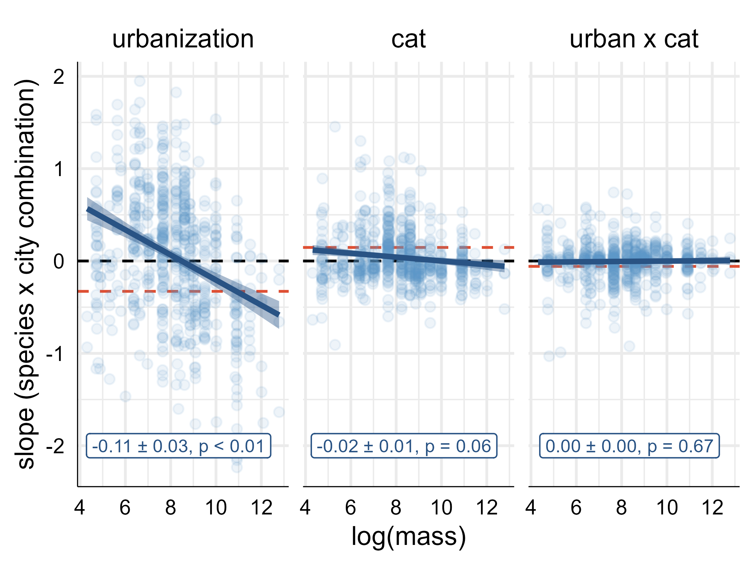
A
B
−92% change in probability of detection
−83% change in probability of detection

