Slide 1
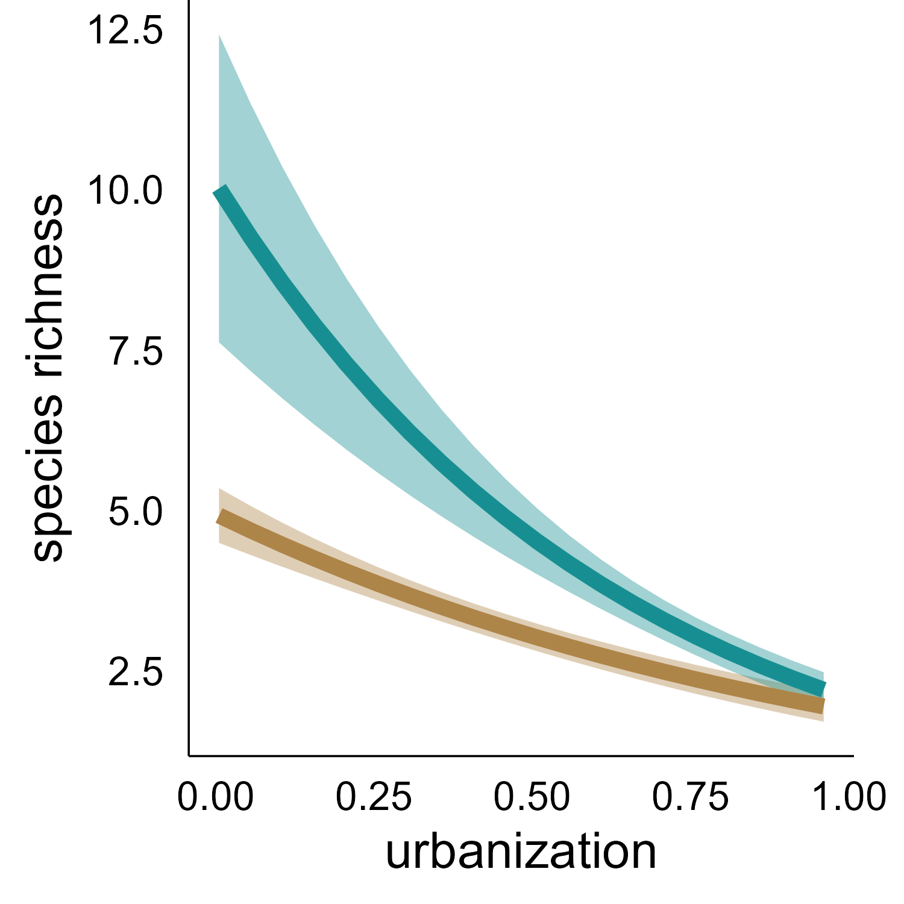
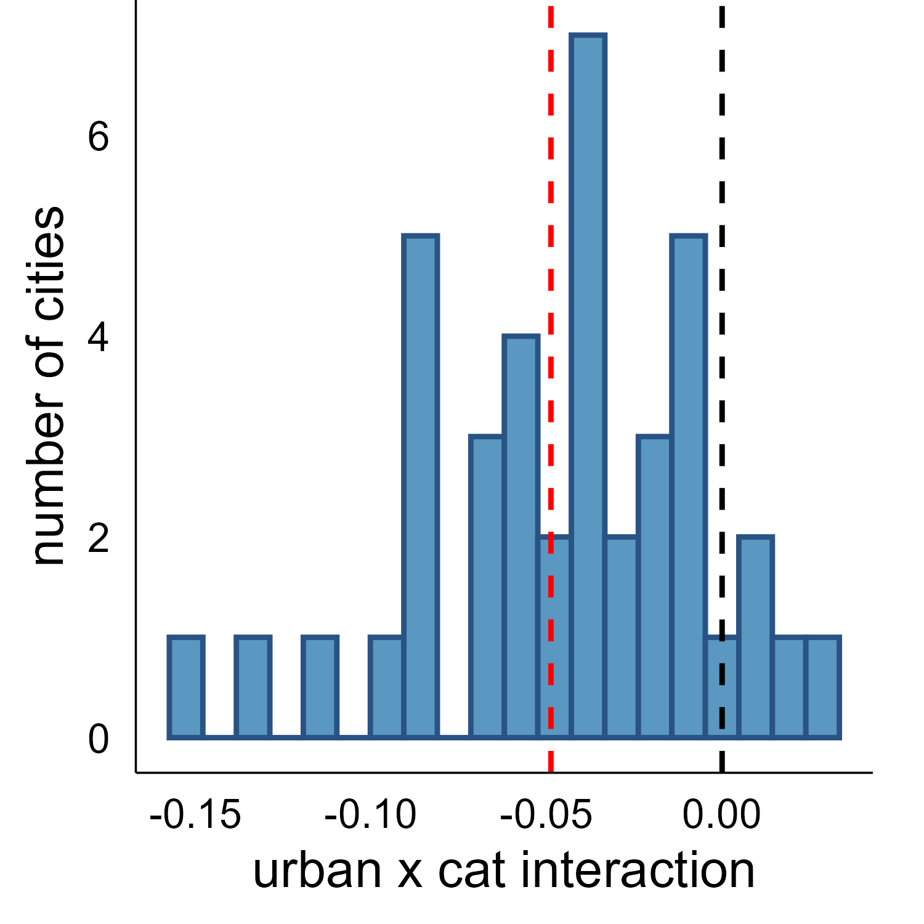
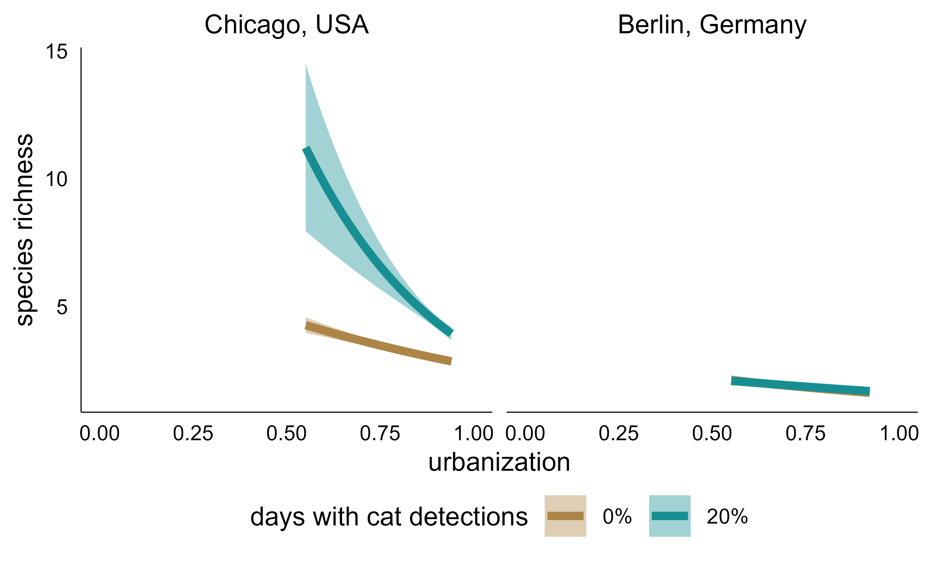
A
B
loss of 7.8 species
Chicago, USA
Berlin, Germany
loss of 3.0 species
C
loss of 7.3 species
loss of 0.4 species
loss of 1.4 species
loss of 0.5 species

