Slide 1
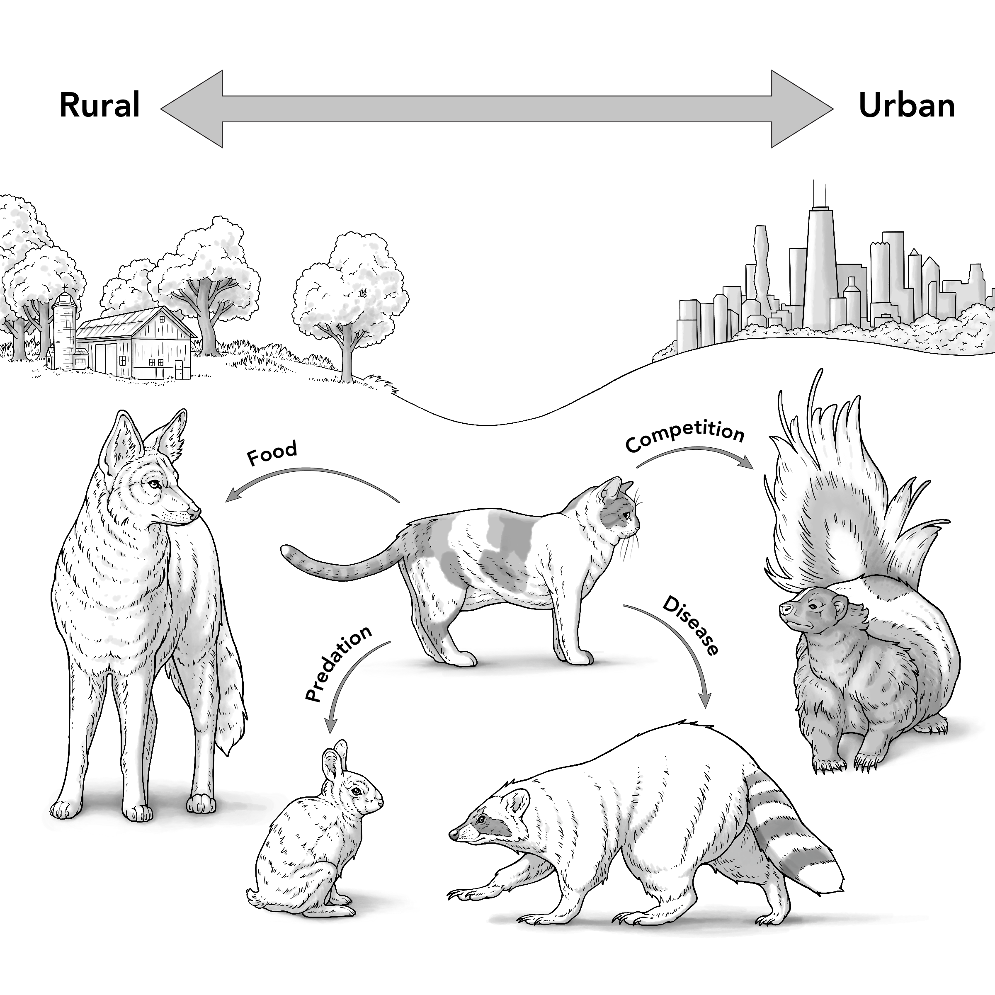
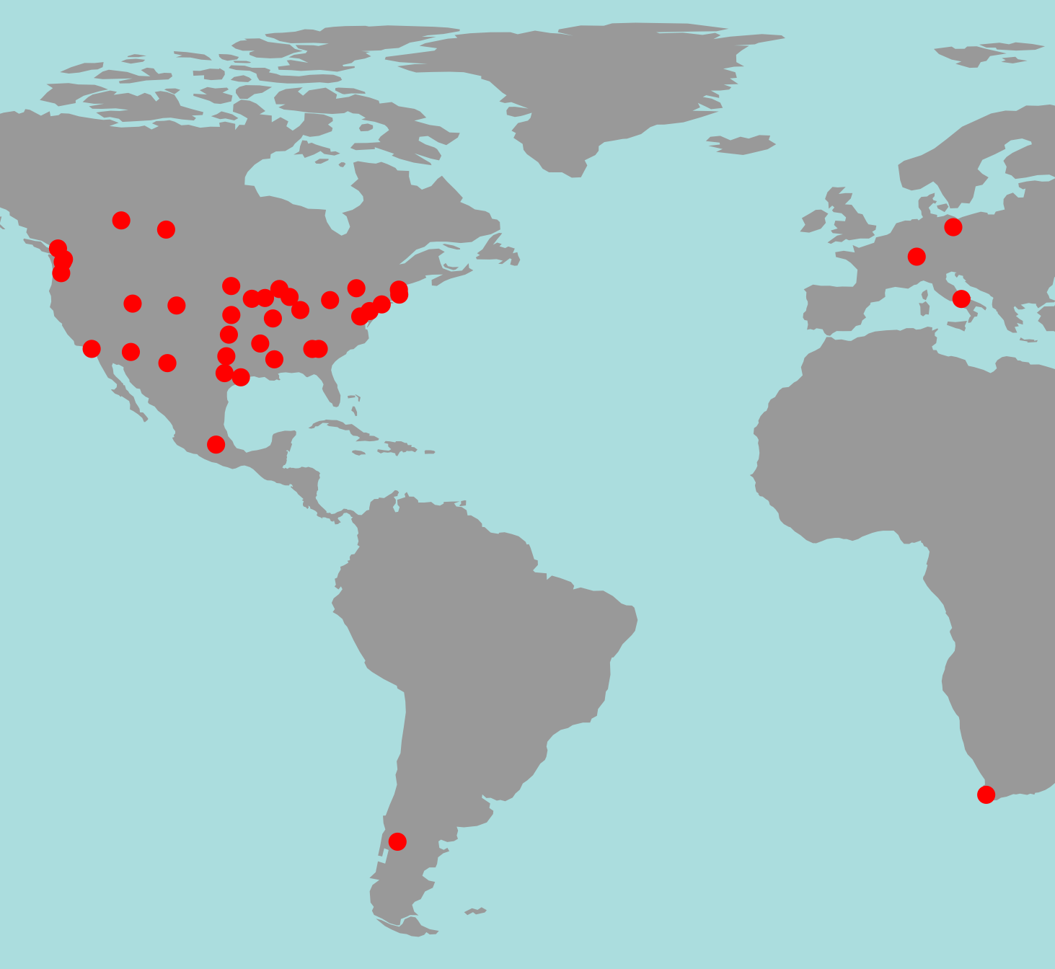
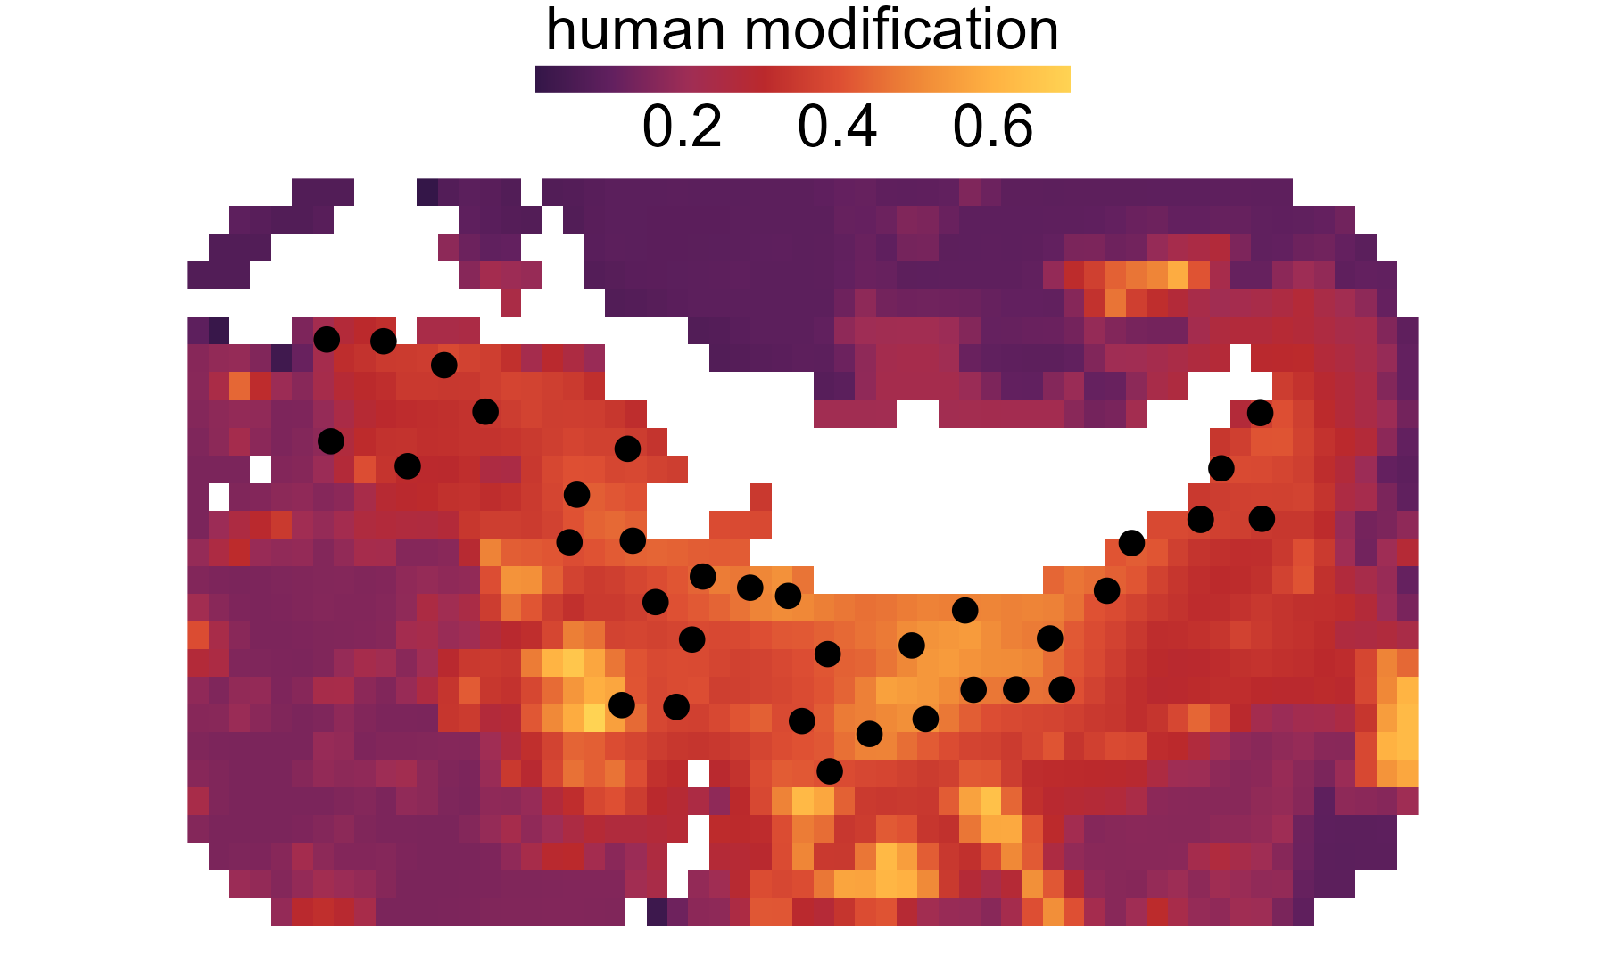
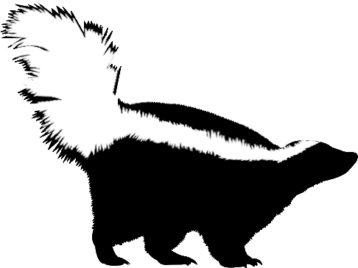
A
D
rural
urban
40 cities
55 species
prey
competitor
913,623 camera-days
disease
predator
Bariloche, Argentina
B
no cats
C
E
no cats
Lago Nahuel Huapi
cats
Lago Nahuel Huapi
cats
detection
richness
5 km
urbanization
urbanization
urbanization
camera
low
high

