Slide 1
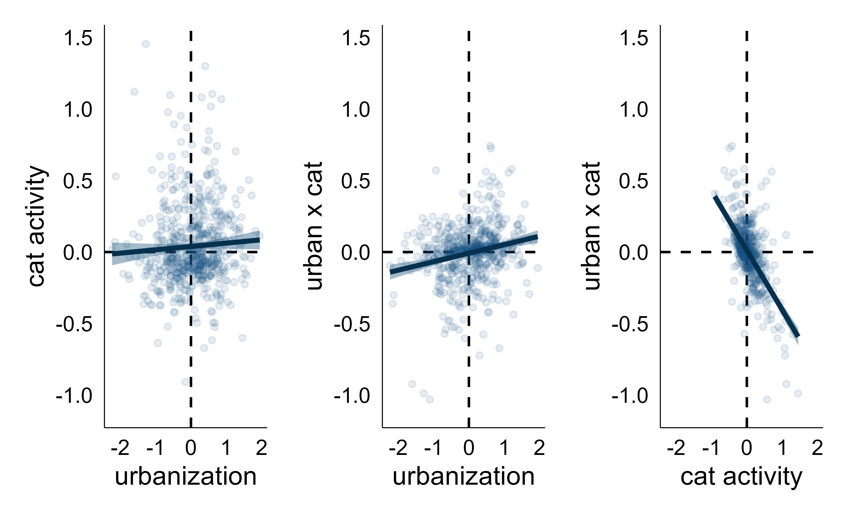
correlation: 0.02
correlation: 0.18
correlation: −0.60

