Slide 1
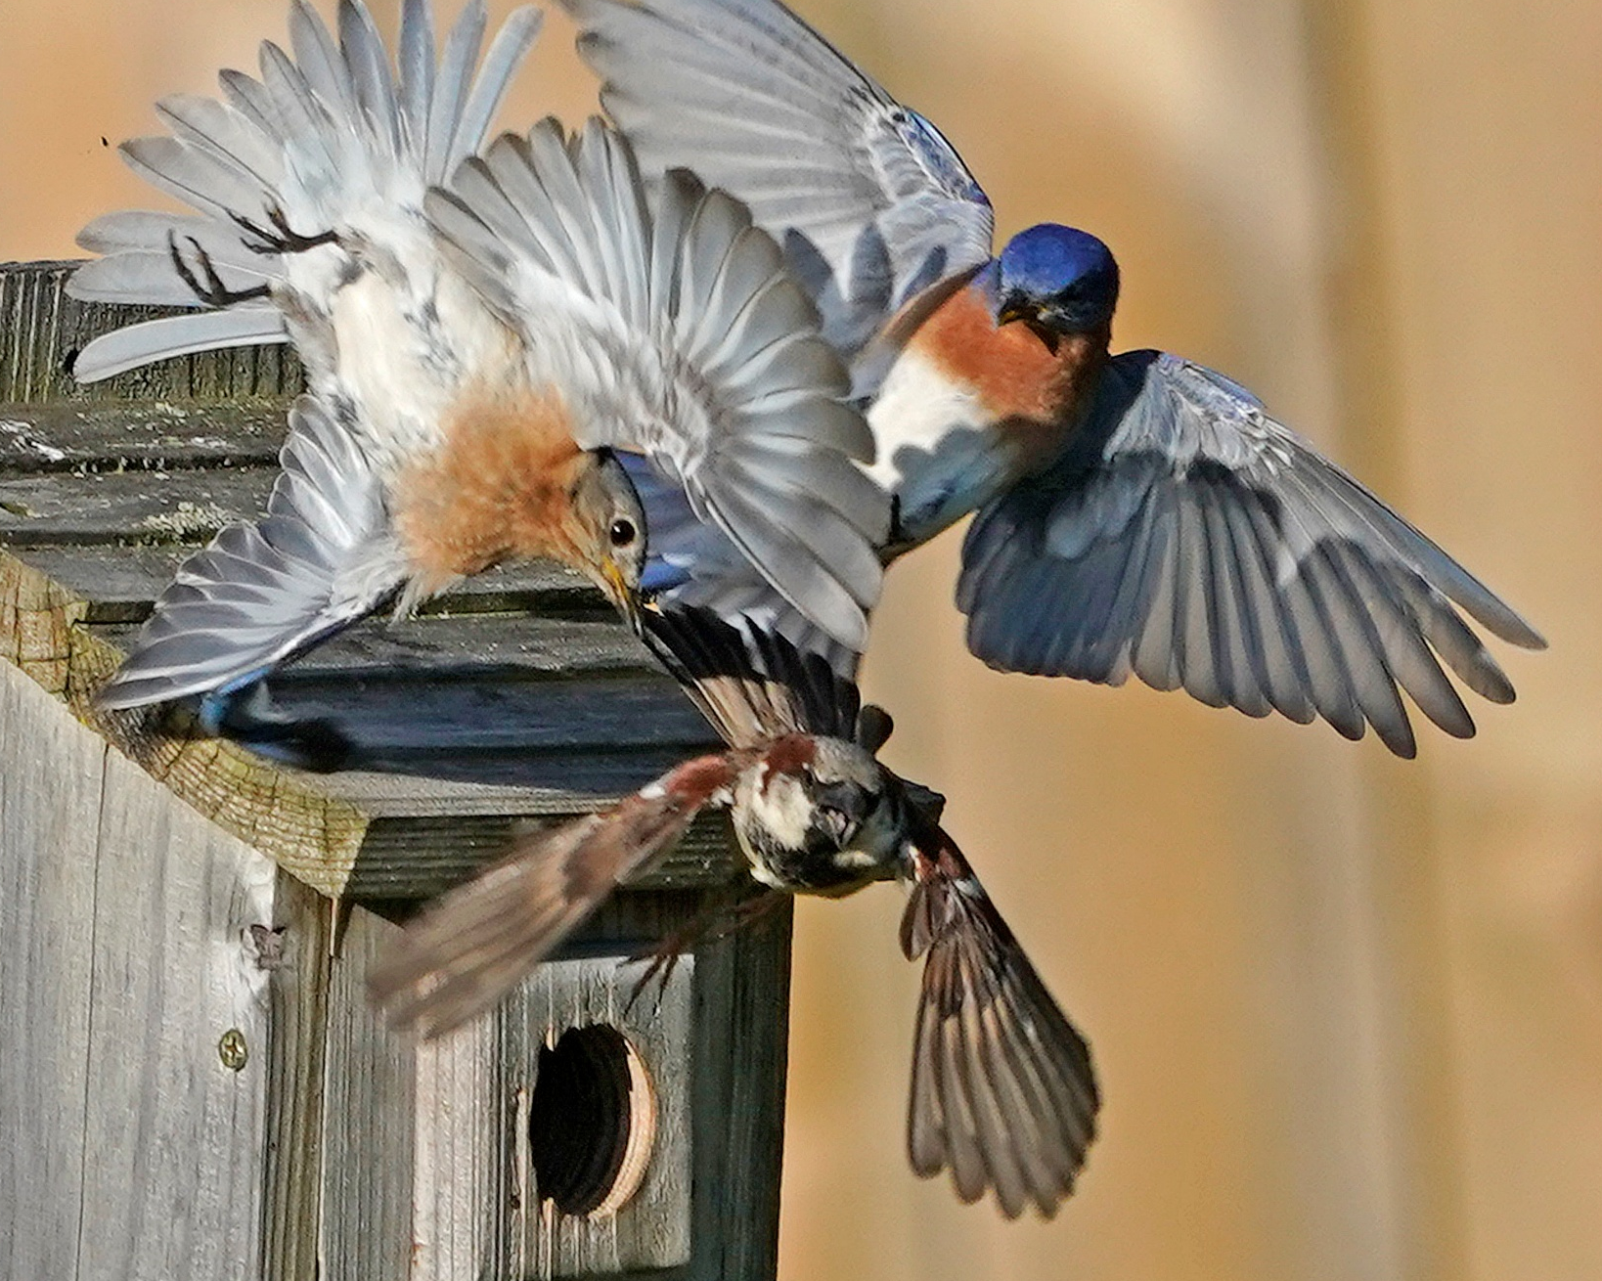
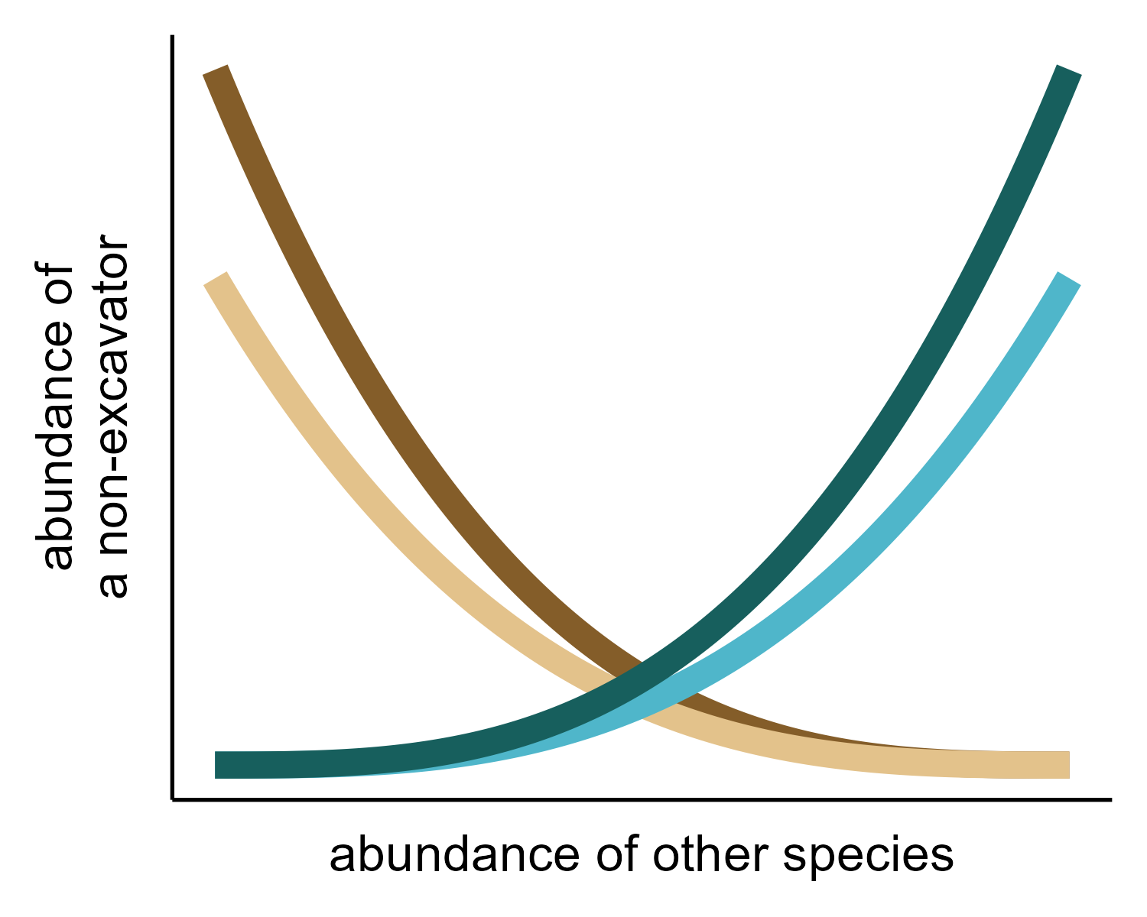
(a)
(b)
similar-sized non-excavators
similar-sized excavators
all non-excavators
all excavators

