Slide 1
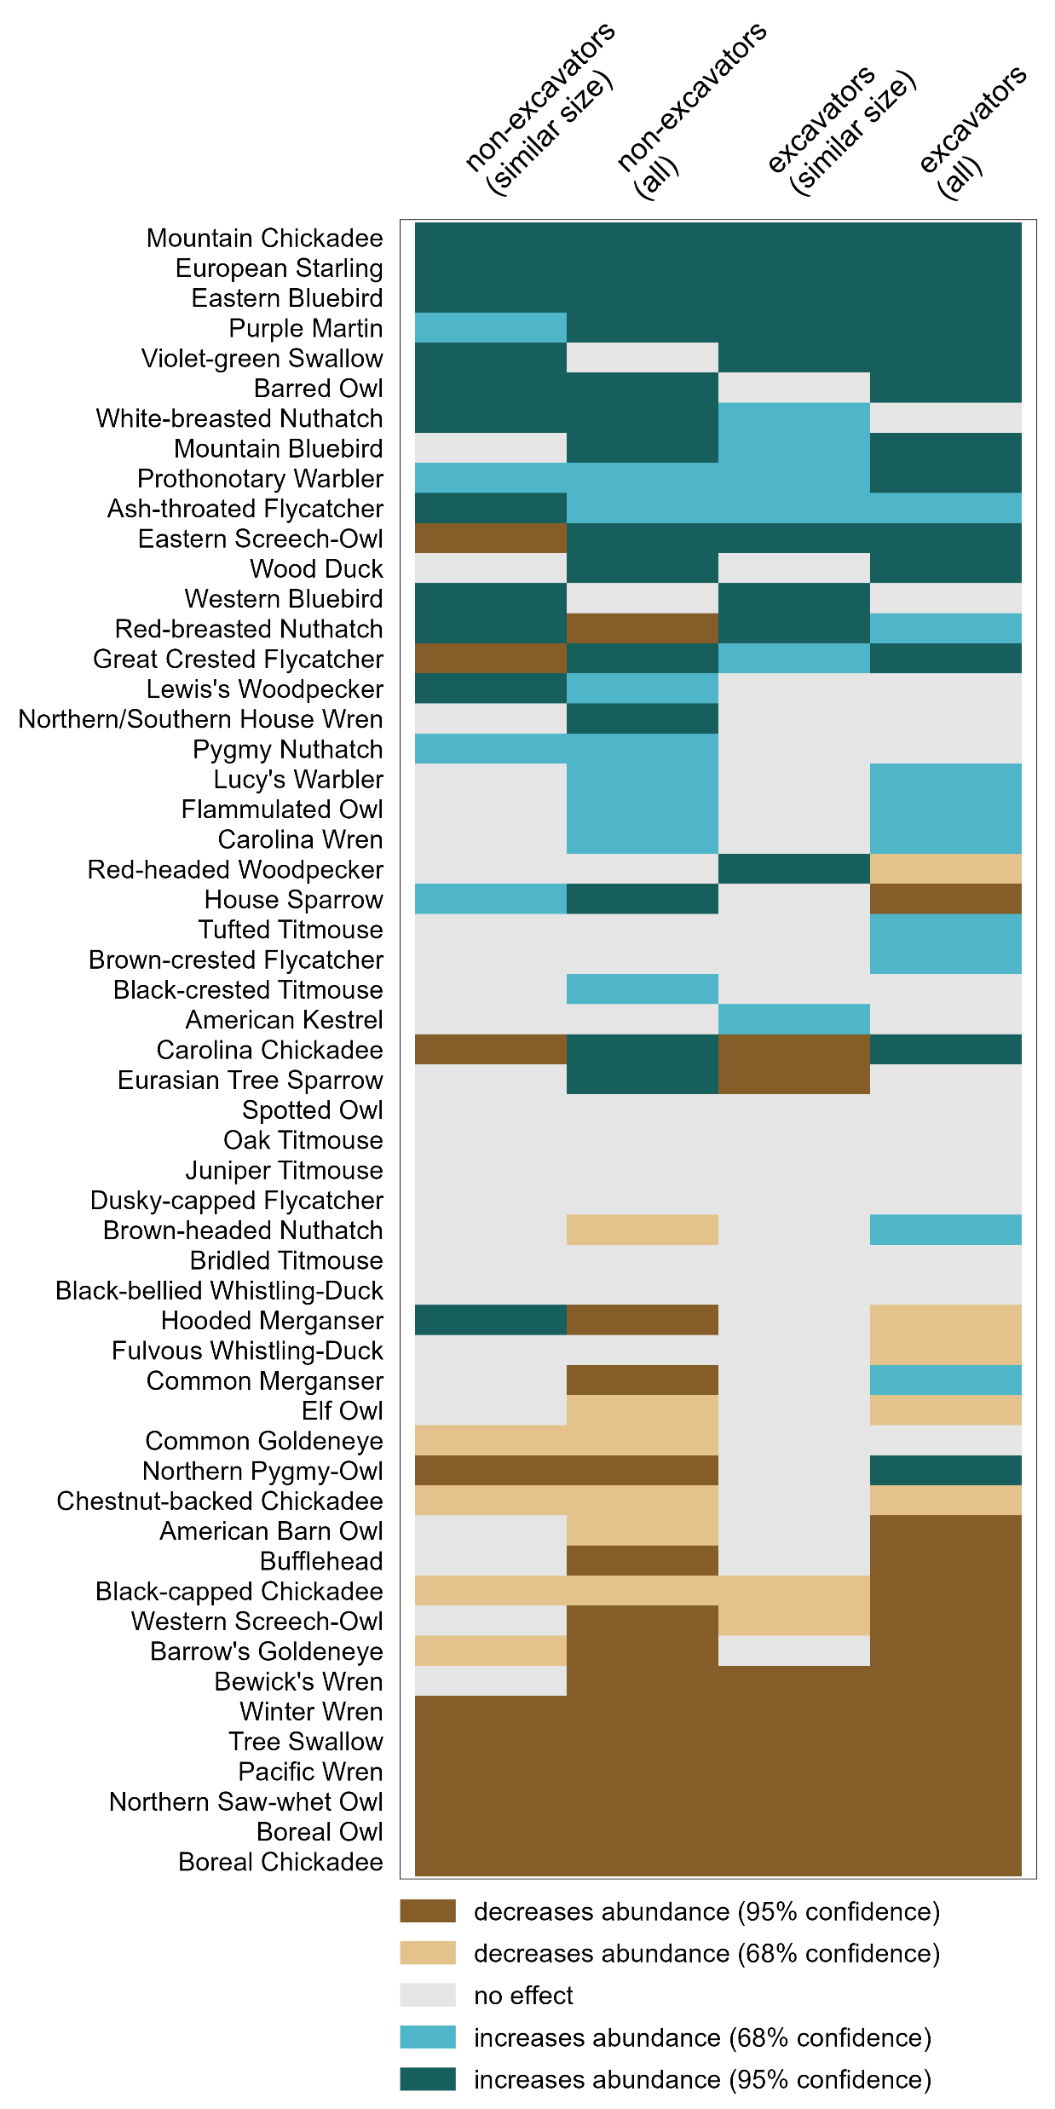
competition
facilitation
hypothesized pattern
strong
weak
strong
weak
effect of abundance of
non-excavators
(similar size)
non-excavators
(all)
non-excavators
(similar size)
non-excavators
(all)
competition
facilitation

