Slide 1
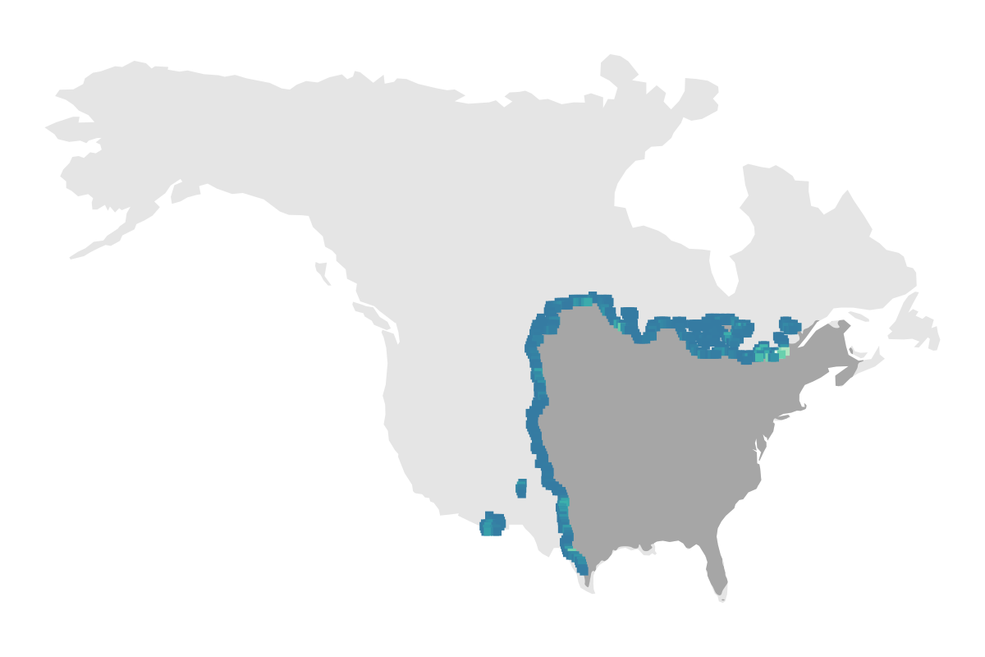
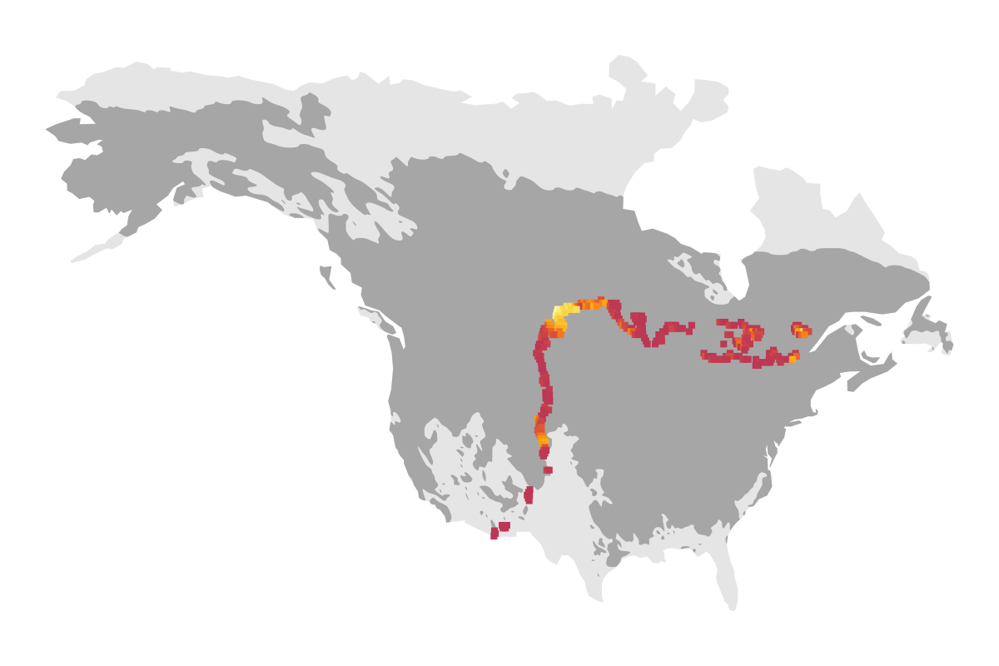
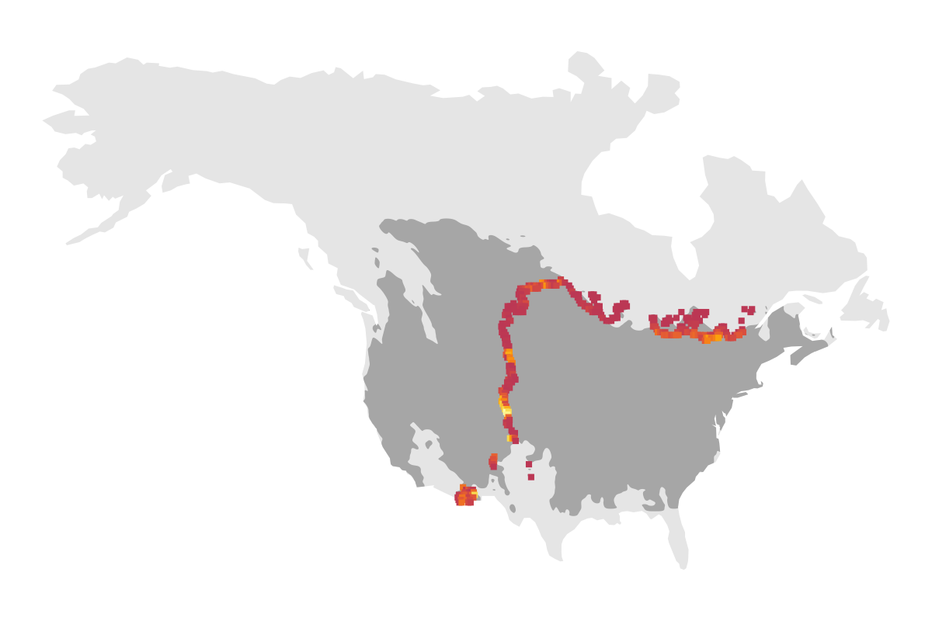
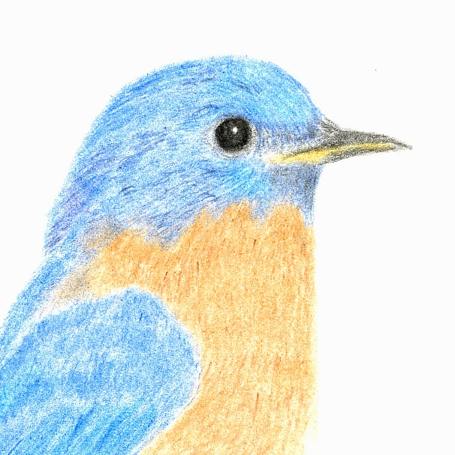
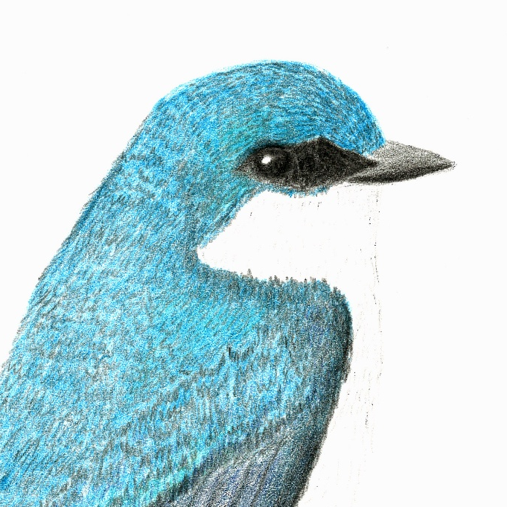
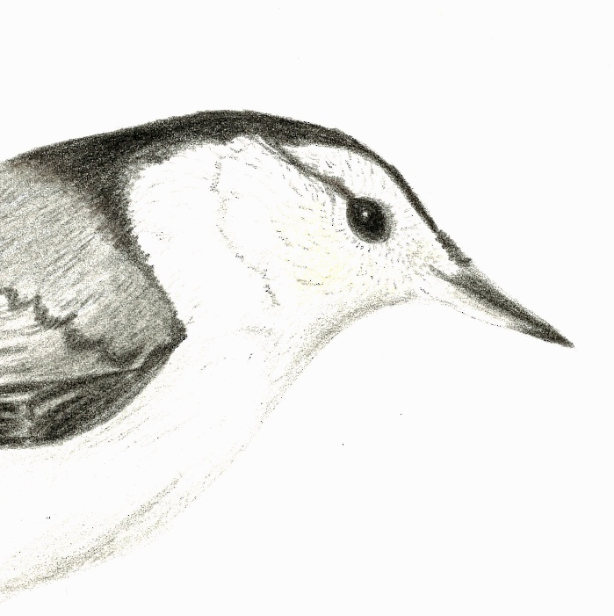
abundance of focal non-excavator
abundance of other non-excavator
abundance of other non-excavator
lo
hi
lo
hi
lo
hi
~
+
response: relative abundance of non-excavator within non-coastal range edges
predictor: summed abundances of heterospecifics (non-excavators and excavators); all and those within 50% of body mass

