Slide 1
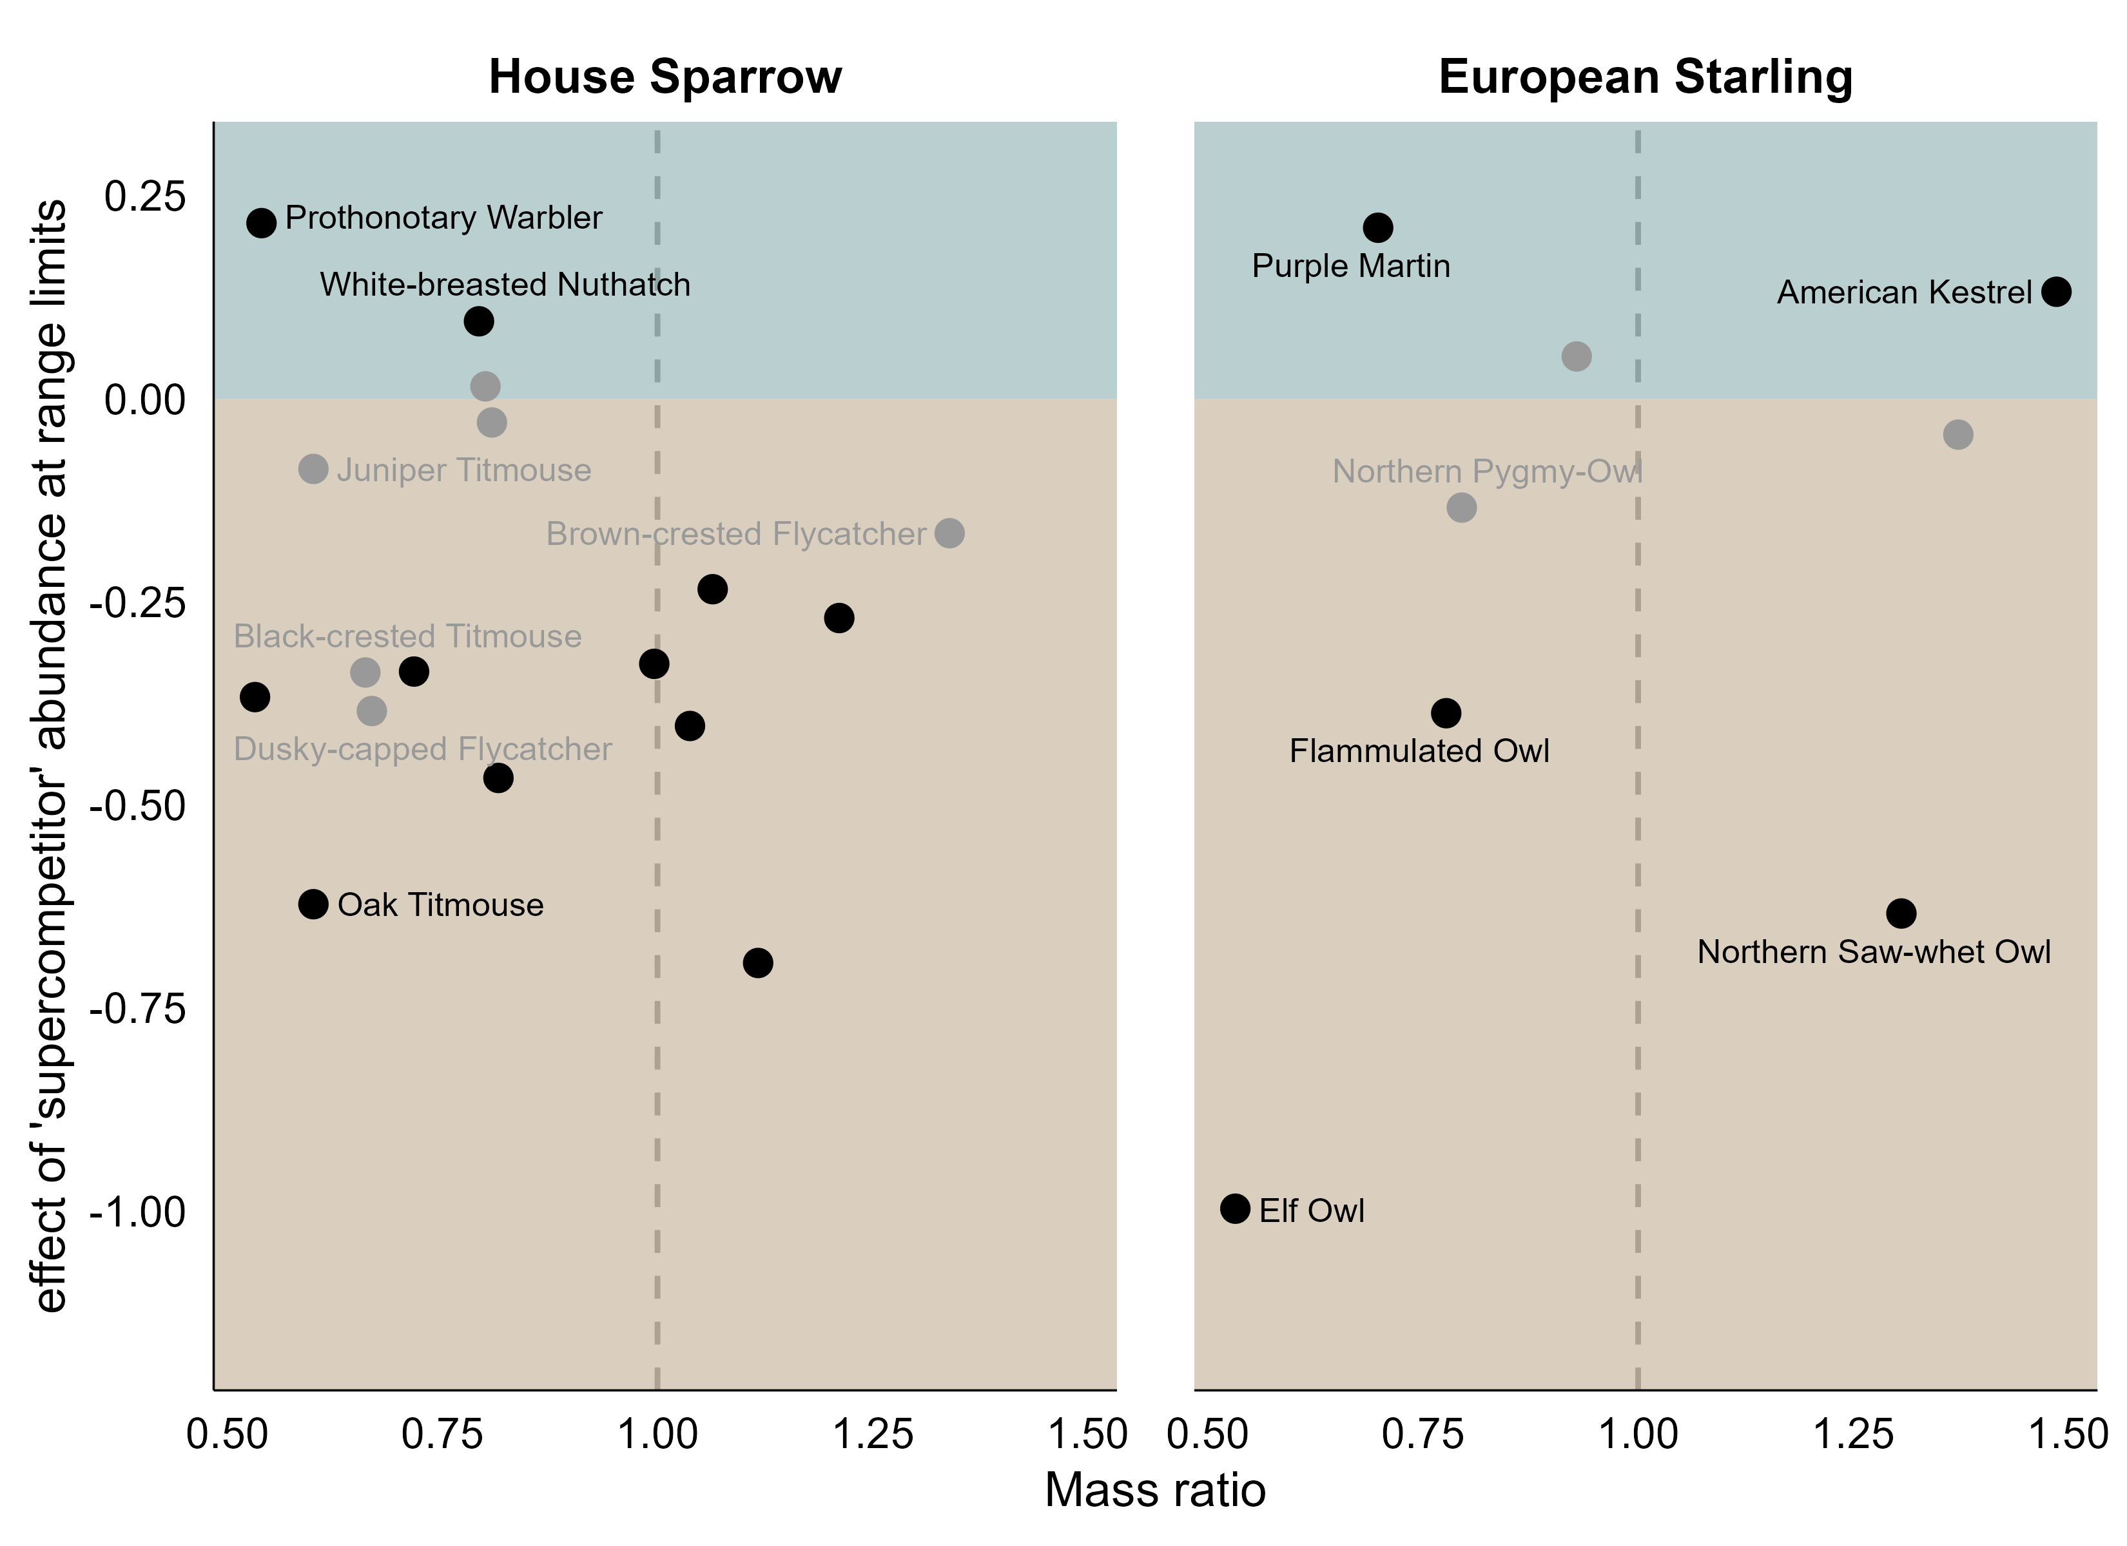
White-breasted Nuthatch
Red-headed Woodpecker
Tree Swallow
Eurasian Tree Sparrow
Northern Pygmy-Owl
Lewis’s Woodpecker
Brown-crested Flycatcher
Carolina Wren
Ash-throated Flycatcher
Great Crested Flycatcher
Western Bluebird
Eastern Bluebird
Tufted Titmouse
Violet-green Swallow
Mountain Bluebird
species’ size relative to sparrow
species’ size relative to starling
smaller
larger
smaller
larger

