Slide 1
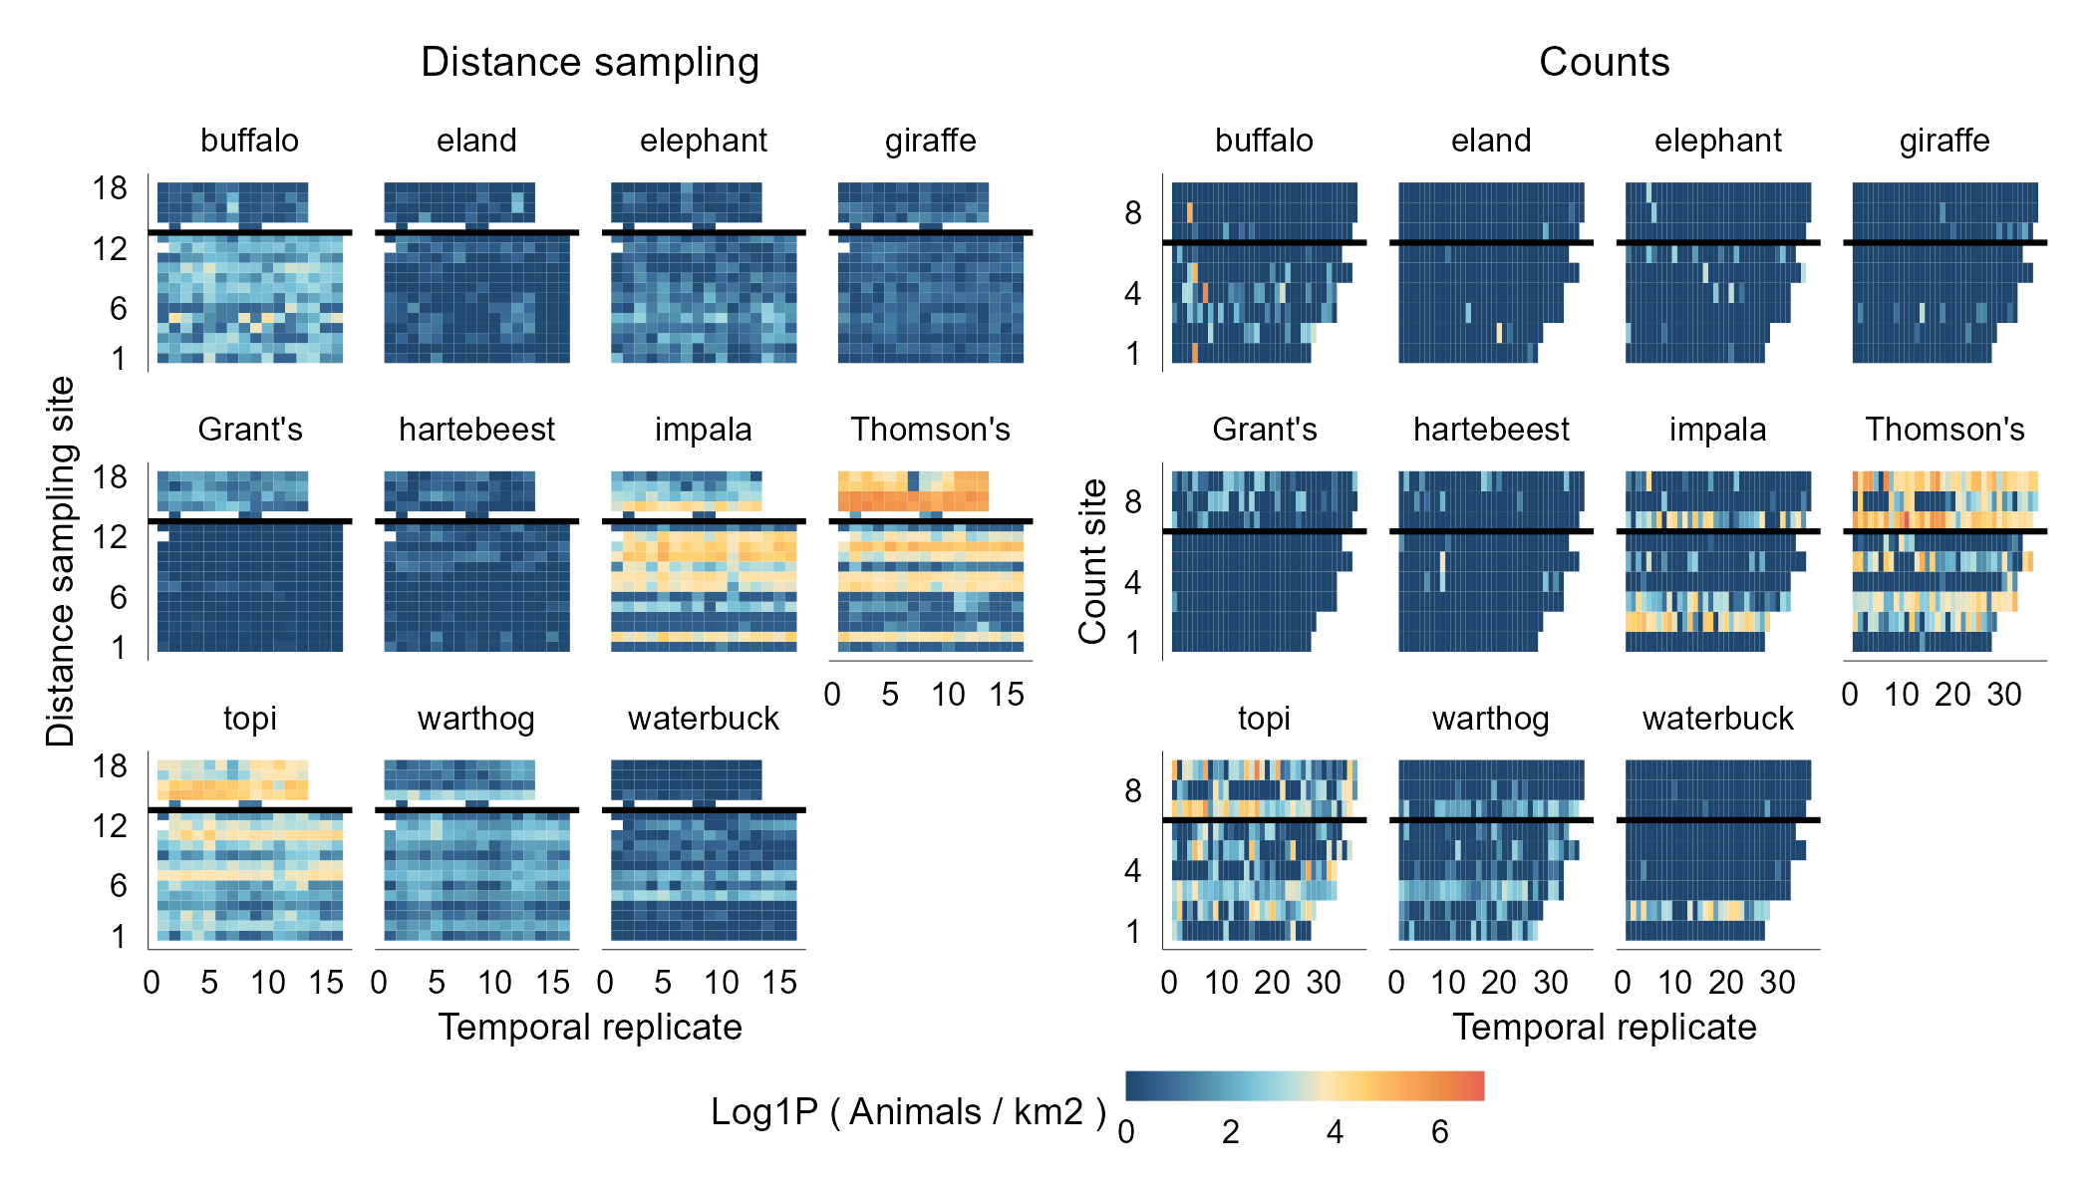
Talek
Talek
Mara Triangle
Mara Triangle

Slide 2
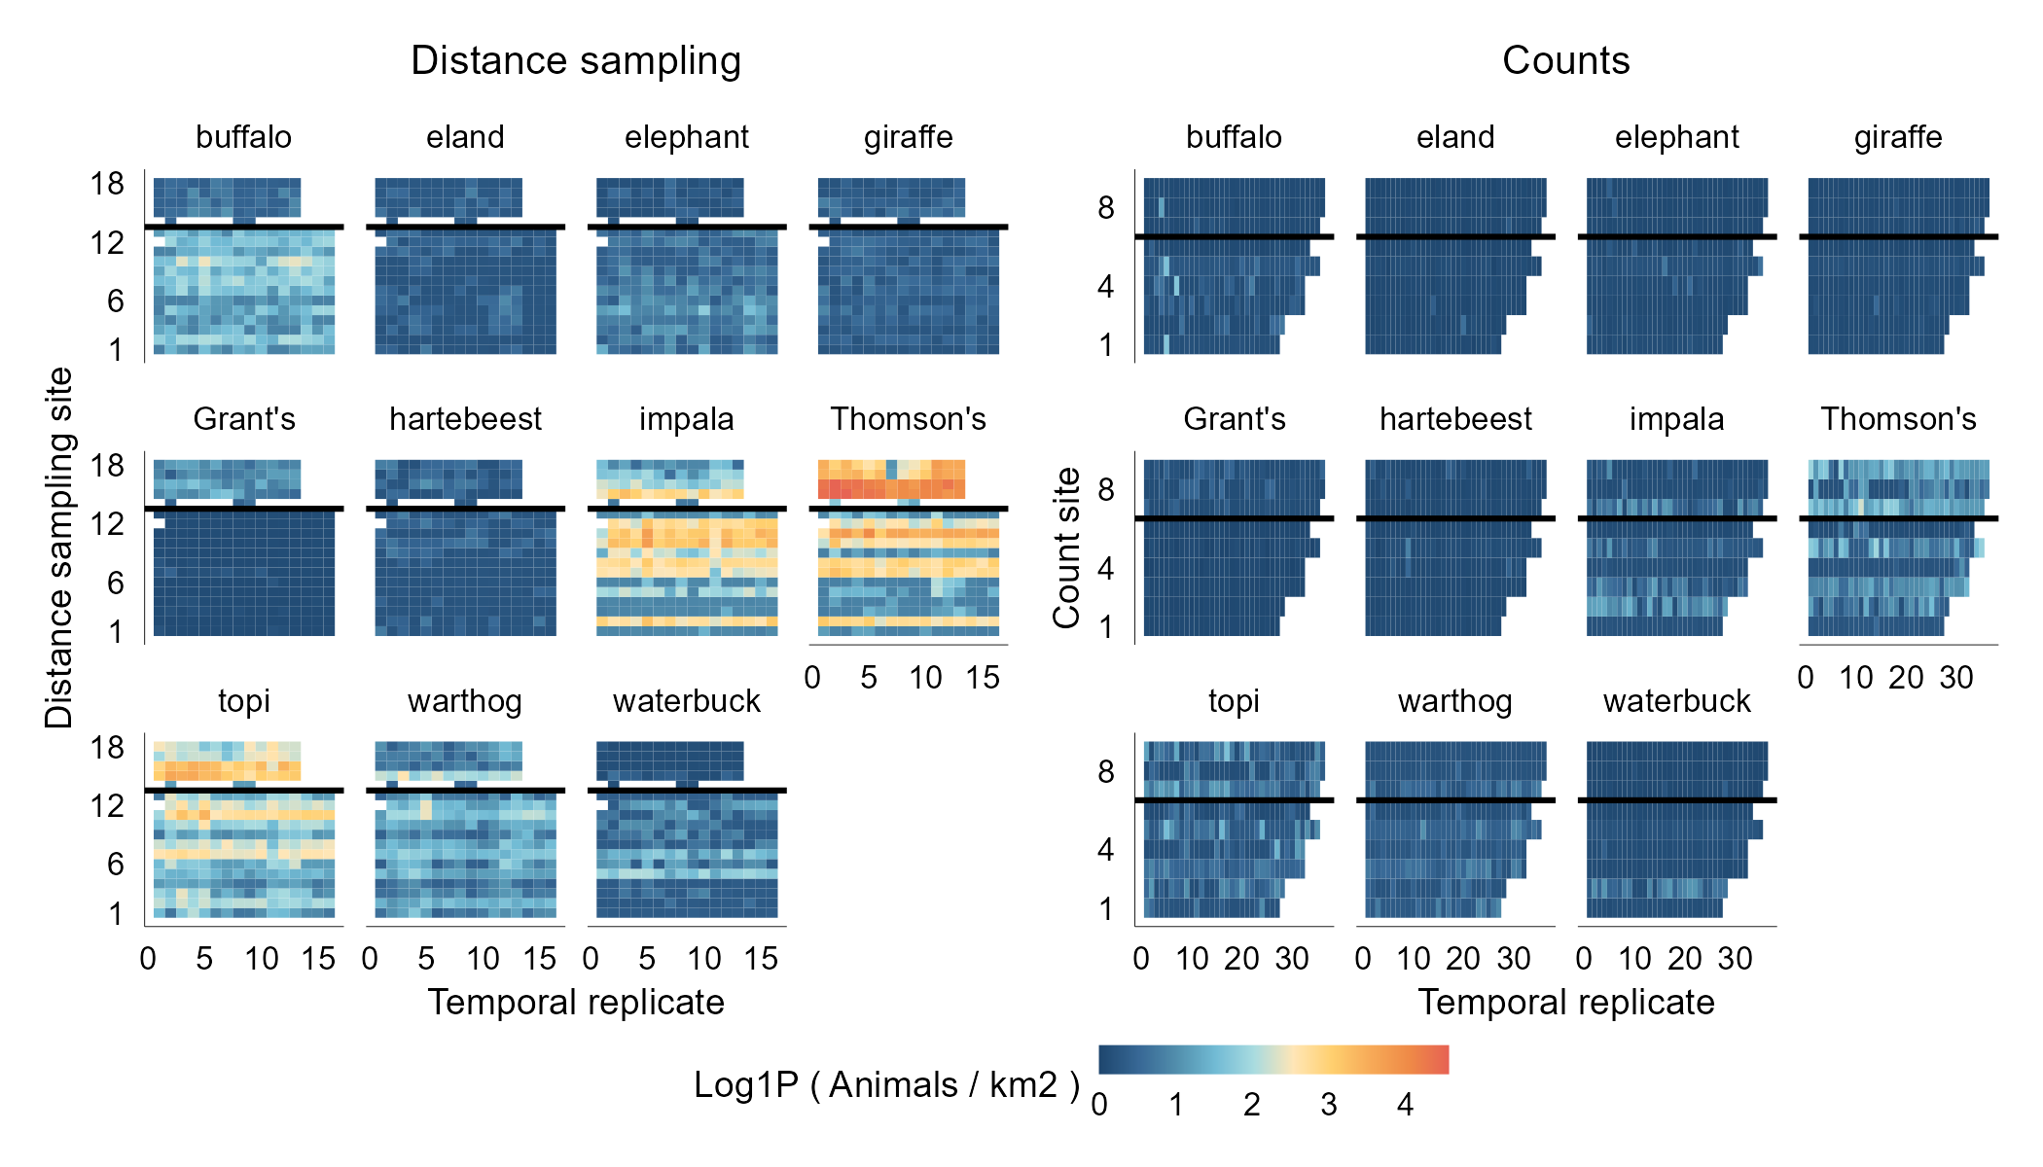
Talek
Talek
Mara Triangle
Mara Triangle

