Slide 1
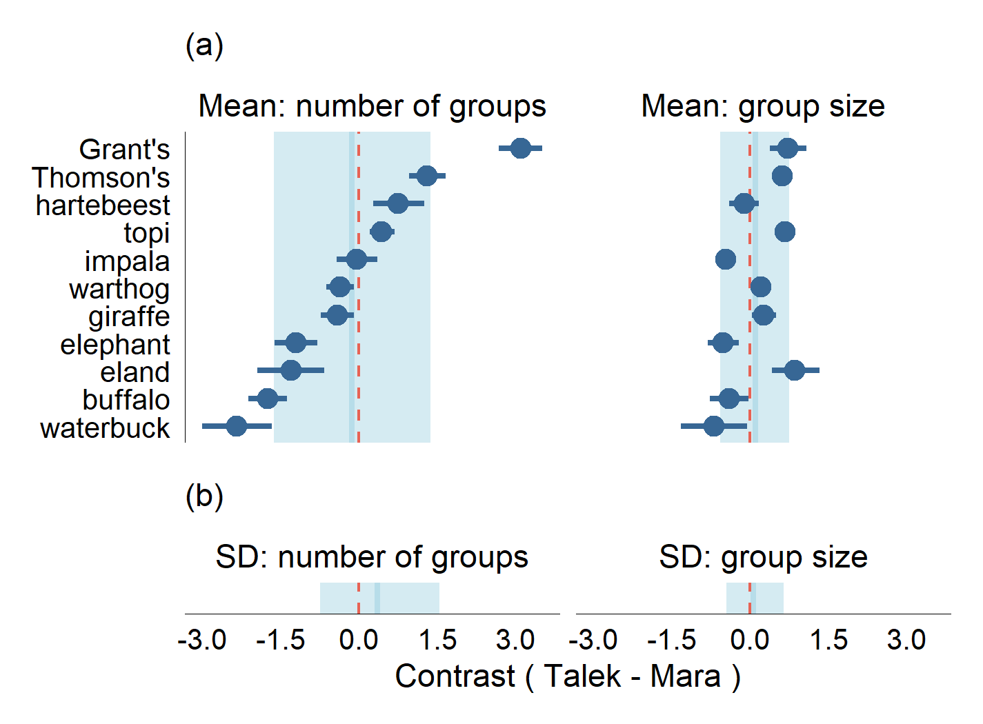
More groups in Talek
Larger groups in Talek

