Slide 1
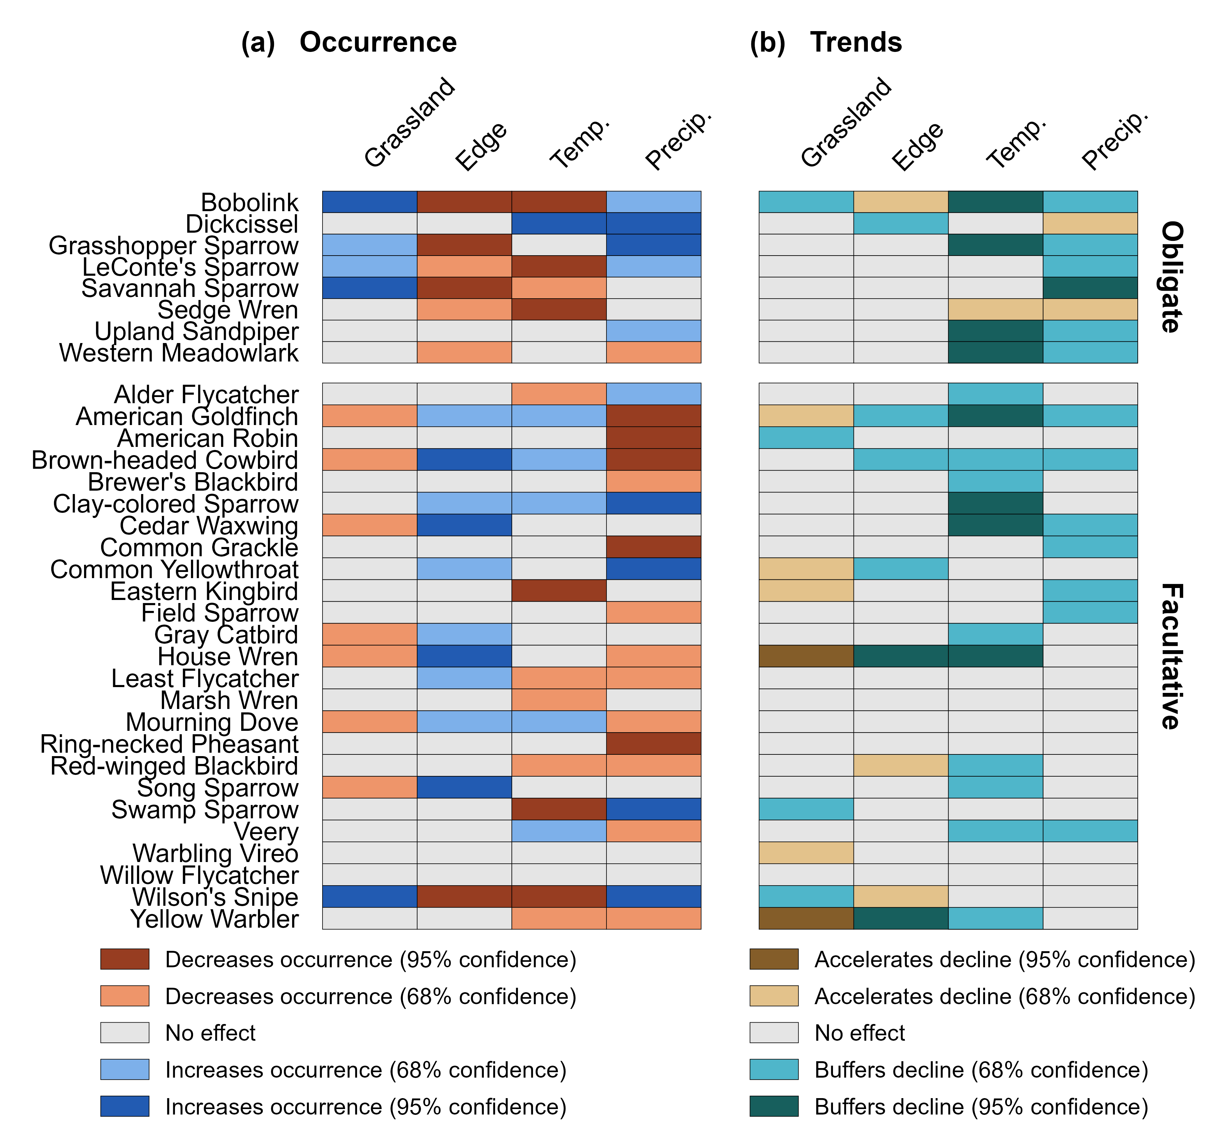
(a) Occurrence
(b) Trends
Proportion grassland
Grassland edge density
Temperature anomaly (°C)
Precipitation anomaly (mm)
Proportion grassland
Grassland edge density
Temperature anomaly (°C)
Precipitation anomaly (mm)

