Slide 1
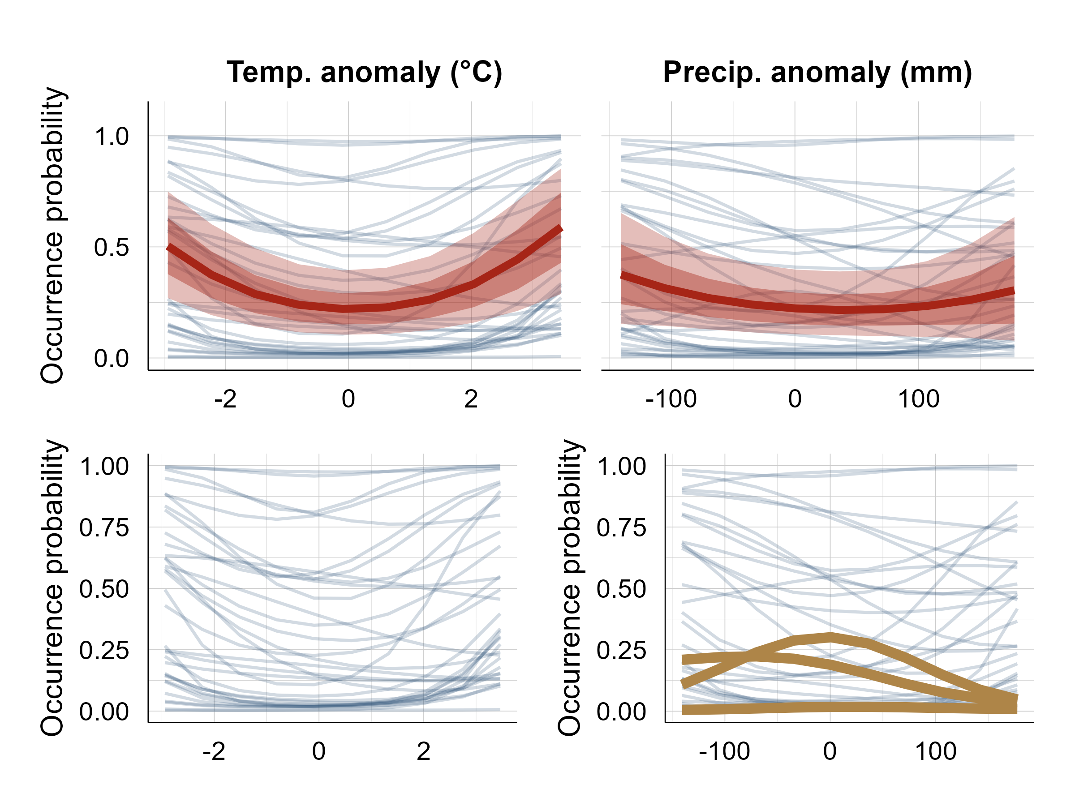
WEME
SAVS
LESP
Covariate value
Covariate value
Species
Assemblage
‘Just Right’ Hypothesis supported

