Slide 1
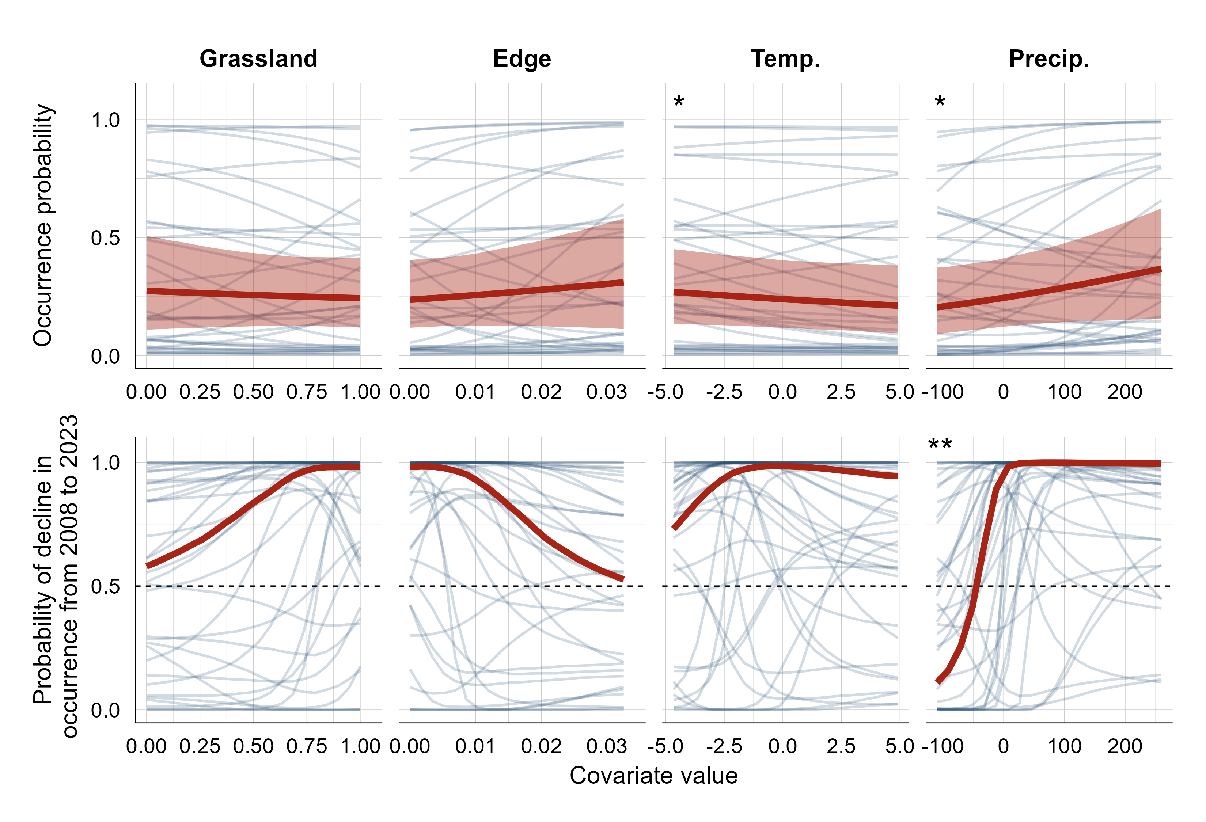
(a)
Proportion grassland (250 m)
Grassland edge density (250 m)
Temperature anomaly (°C)
Precipitation anomaly (mm)
(b)
0.0
0.5
1.0
0.0
0.5
1.0
Species-level effect
Assemblage average

