Slide 1
Working
Visualization of Convolution layers: We can either
Visualizing intermediate convnet outputs
Visualizing convnets filters
Visualizing heatmaps of class activation in an image
CAM (Class Activation Mapping): explanation of image classification by CNN
Grad-CAM (Gradient-weighted Class Activation Mapping): Gradient-based Localization
Visualizing input important for prediction

Slide 2
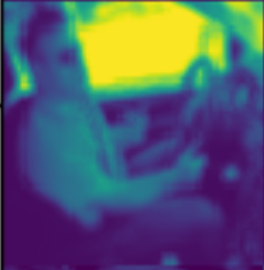
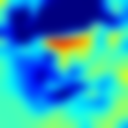
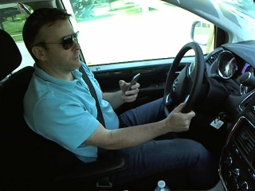
CAM (Class Activation Mapping)
Predicted class score is mapped back to previous (last in network) convolutional layer
Weighted sum of the feature maps of last convolutional layer
.
.
.
.
W1 *
+ …………. =
…………
Input (3 dimensional image)
Feature map visualized
Class Activation Map
Last Convolution layer
Predicted class score
Learning Deep Features for Discriminative Localization
https://www.cv-foundation.org/openaccess/content_cvpr_2016/papers/Zhou_Learning_Deep_Features_CVPR_2016_paper.pdf

Slide 3
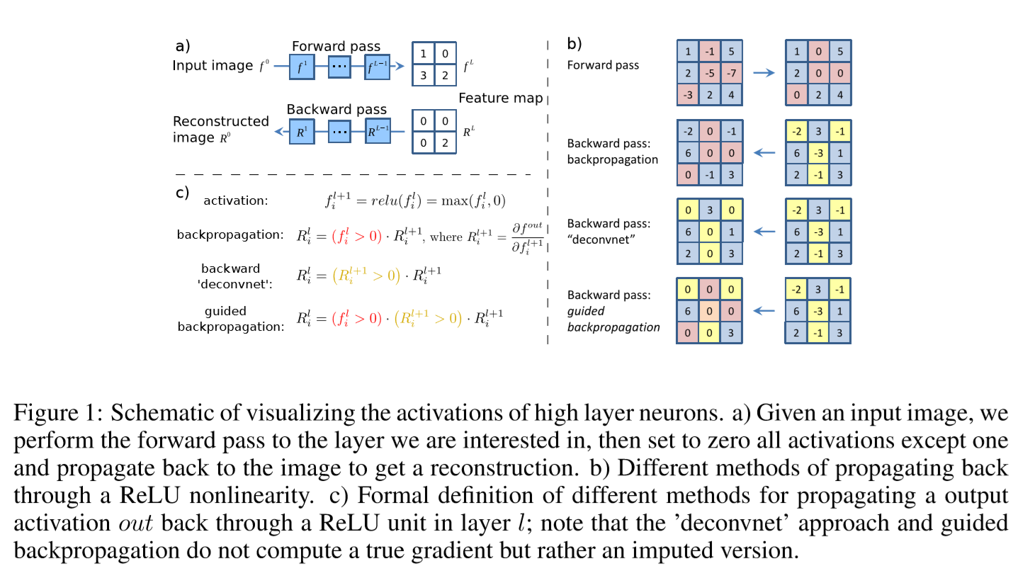
Guided backpropagation
Source: STRIVING FOR SIMPLICITY: THE ALL CONVOLUTIONAL NET
STRIVING FOR SIMPLICITY: THE ALL CONVOLUTIONAL NET
https://arxiv.org/pdf/1412.6806.pdf%20(http://arxiv.org/pdf/1412.6806.pdf)

Slide 4
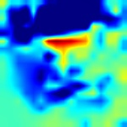
Grad-CAM (Gradient-weighted Class Activation Mapping)
Similar to CAM
Difference is: gradients for class of interest is set to 1, and rest are set to 0.
Weighted sum of the feature maps of last convolutional layer
.
.
.
.
.
.
.
W1 *
+ …………. =
…………
Input (3 dimensional image)
Feature map visualized
Grad-CAM
Last Convolution layer
Predicted class score
Gradient set to 1

Slide 5
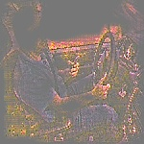
Guided Grad-CAM (Guided Gradient-weighted Class Activation Mapping)
Combine the guided Grad-CAM and the guided back propagation to obtain Guided Grad-CAM
.
.
.
.
.
.
.
W1 *
+ …………. =
…………
Feature map visualized
Grad-CAM
Input (3 dimensional image)
Gradient set to 1
+
Guided Backpropagation
=
Last Convolution layer
Guided Backpropagation
Guided Back propagation
Predicted class score
Grad-CAM: Why did you say that? Visual Explanations from Deep Networks via Gradient-based Localization
https://arxiv.org/pdf/1610.02391v1.pdf
Guided Grad CAM

