Slide 1
Working
Visualization of Convolution layers: We can either
Visualizing intermediate convnet outputs
Visualizing convnets filters
Visualizing heatmaps of class activation in an image
https://github.com/fchollet/deep-learning-with-python-notebooks/blob/master/5.4-visualizing-what-convnets-learn.ipynb

Slide 2
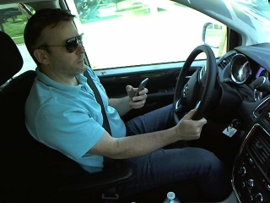
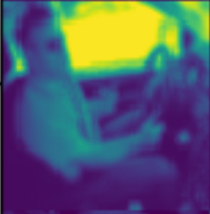
Visualizing intermediate convnet outputs
Feature maps: output of convolution/pooling layers
Plotting content of every feature map as 2-D image to visualize it
Input (3 dimensional image)
Convolution layer
Feature map visualised
Pooling layer

Slide 3

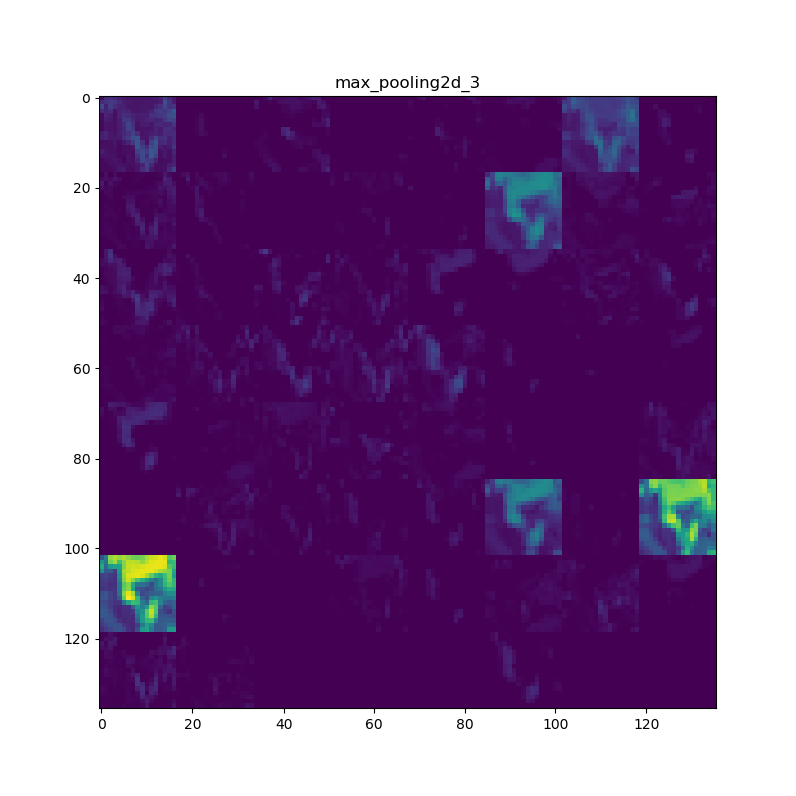

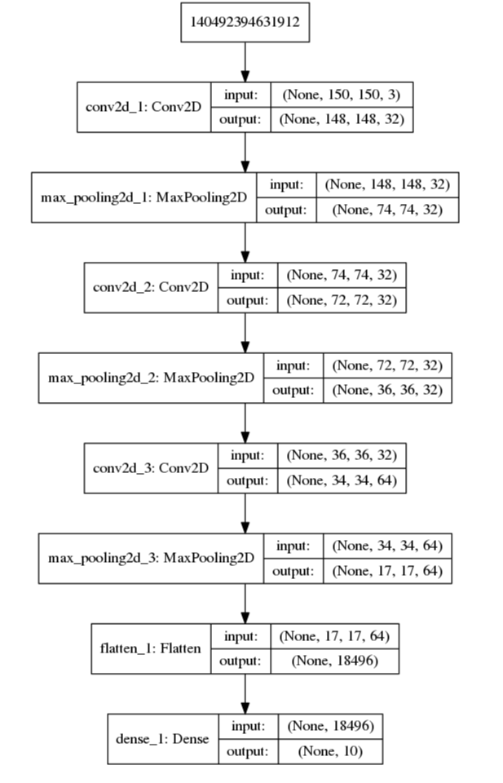
Visualizing intermediate convnet outputs
Input
https://github.com/fchollet/deep-learning-with-python-notebooks/blob/master/5.4-visualizing-what-convnets-learn.ipynb

