Slide 1
Persona Profiles
For users interacting to the system

Slide 2

Persona 1: Irina – The Curious Parent
Demographics:
Date of Birth: February 20, 1985
Gender: Female
Location: Botosani, Romania
Workplace: Primary school teacher
School: “Liceul Pedagogic Nicolae Iorga“
Technology Level: Medium (familiar with educational apps, first-time MR user)
Main Points:
Enjoys spending creative weekends with her 12-year-old son
Loves the educational potential of LEGO mixed with new technologies
Goals:
Use LEGO AR to support learning through play
Balance physical interaction and digital engagement

Slide 3
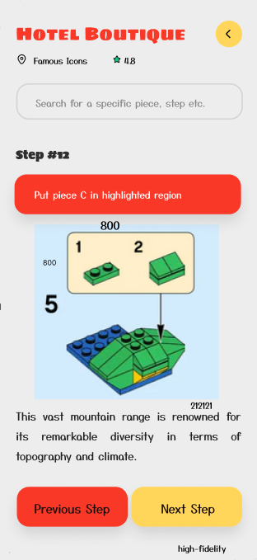
Scenarios:
User Flow Path: Main Screen → Build LEGO set → Connect MR Glasses → Use without MR glasses → Build LEGO (No MR) → LEGO Piece
Irina uses the mobile app while helping her son follow MR build instructions. She double-checks steps and encourages her son to explore AR-only content after building.
Frustrations & Pain Points:
Concerned MR glasses might be too advanced
Prefers Romanian language support in instructions
Other Details:
Strong advocate for parent-child bonding time
Likes the AR stats feature that shows remaining steps and estimated build time

Slide 4

Persona 2: Vlad – The Young Tech Enthusiast
Demographics:
Date of Birth: August 12, 2009
Gender: Male
Location: Botosani, Romania
Workplace: Student
School: “Liceul Mihai Eminescu“
Technology Level: High (familiar with VR games and mobile building apps)
Main Points:
Primary LEGO builder in the family
Unlock hidden AR features and animations
Goals:
Finish builds with minimal help
Balance physical interaction and digital engagement

Slide 5
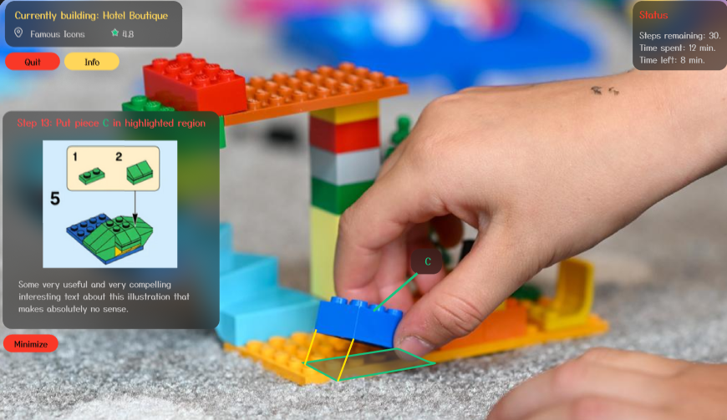
Scenarios:
User Flow Path: Main Screen → Build LEGO set → Connect MR Glasses → Finish Connection → Build LEGO (MR) → Play with LEGO (MR)
Vlad uses MR view to place bricks, checks progress via mini-map, and plays AR LEGO games after completion. Shares builds with friends.
Frustrations & Pain Points:
Gets annoyed if the MR tracking glitches
Dislikes repeated app logins or device re-pairing
Other Details:
Likes the time tracking feature, sees it as a challenge
Wants multiplayer LEGO co-op modes in AR

Slide 6

Persona 3: Doru – The Retired Hobbyist
Demographics:
Date of Birth: November 1, 1957
Gender: Male
Location: Iasi, Romania
Workplace: Retired mechanical engineer
School: “Liceul Regina Maria Dorohoi“
Technology Level: Low-Medium (prefers simple interfaces, dislikes headsets)
Main Points:
Loves architecture sets and nostalgic builds
Enjoys constructing sets alone, with classical music
Goals:
Stay mentally sharp and relaxed through building
Explore historical models like castles or landmarks

Slide 7
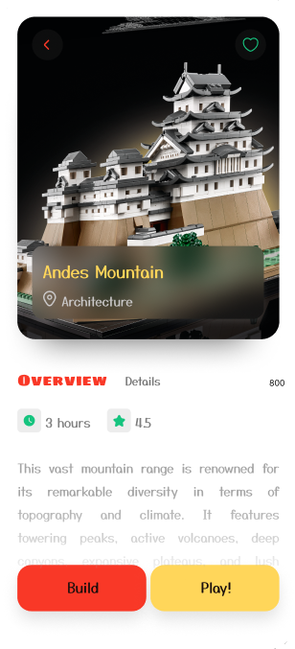
Scenarios:
User Flow Path: Main Screen → Build LEGO set → Connect MR Glasses → Use without MR glasses → Build LEGO (No MR) → LEGO Piece
Doru uses the mobile app to follow written steps, zooms into diagrams, and checks for missing parts online. Sometimes asks his granddaughter to assist with QR codes.
Frustrations & Pain Points:
UI font size too small at times
Doesn’t trust MR glasses or wearable tech
Other Details:
Appreciates clean design and no distractions
Would like a printable or exportable instruction guide

Slide 8
Research
- Tactics Used -

Slide 9
User Interviews
We conducted informal interviews with three target participants:
A parent of a 12-year-old student (Botosani)
A 14-year-old student (Botosani)
A retired hobbyist LEGO fan (Iasi)
Goal: To understand motivations, tech comfort, device preferences, and expectations for AR integration in LEGO building.
Insights gathered:
Parents value screen-time moderation and want mobile-first control
Teens demand fast, gamified AR guidance
Older adults desire readable UIs and non-AR support
Some of the questions asked:
What do you enjoy most about building LEGO?
Have you ever used a mobile app or headset while building?
What would make LEGO building easier or more fun for you?
How comfortable are you with AR or wearable devices?
Notable observations:
Irina: “If my son could follow the steps in AR and I could check progress on my phone, that would be amazing.”
Vlad: “I’d love if I could compete against friends while building.”
Doru: “I don’t want to wear anything on my head — I prefer printed instructions and simple apps.”

Slide 10
Competitive Analysis
Competitor Analysis Sheet : https://docs.google.com/spreadsheets/d/1db8BrcEUeQRn3oBzaJ4lJ8roCntTZu5mRIIfiXznaAo/edit?usp=sharing
Competitive Audit:
https://docs.google.com/spreadsheets/d/1_796_-ZXE3fC_RS2nuEiqIksuk6GEkEqd8B8mTLOO9U/edit?usp=sharing
Observations Summary:
App | What we liked | What’s missing
LEGO Builder | Easy to follow, high quality visuals | No AR/MR integration
Merge EDU | Great headset-based walkthrough | No game-like feedback, less playful
JigSpace | AR build steps with visual depth | Limited to certain platforms (IOS)

