Slide 1


PROJECT TITLE
Domain:
Team Members:
1.
2.
3.
4.

Slide 2

Problem Statement

Slide 3
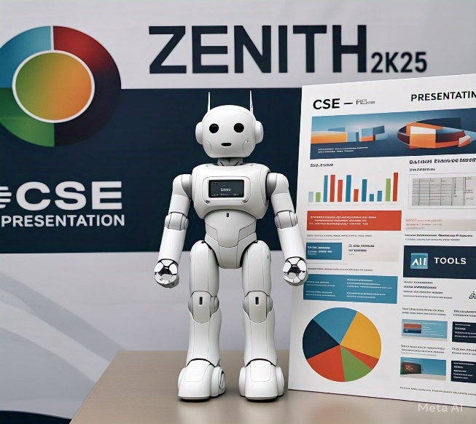
Proposed Solution

Slide 4
Technology Used
Details of Programming Languages, Frameworks and Hardware used

Slide 5
Methodology & Process
Block diagram/Flow Charts/Images/Working prototype

Slide 6
Impact on Society
Benefits of the solution

Slide 7
Conclusion & References
Research & Reference of Data and Existing models

Slide 8
IMPORTANT INSTRUCTIONS
Please ensure below points are met while submitting PPT
Kindly keep the maximum slides limit up to six (6). ( Including the title slide)
Try to avoid paragraphs and post your idea in Points/Diagrams/Infographics /pictures.
Keep your explanation precise and easy to understand.
Idea should be unique and novel.
You can only use provided template for making the PPT without changing the idea details.
If needed additional Slides can be included.
You need to send the PPT and the abstract to this Idea submission link:- https://forms.gle/ZiRPy3mB9wNb48hv9 before the mentioned deadlines.
Note : You can delete this slide.

