Slide 1

HACKATHON PROJECT · BUILT WITH IBM BOB
Cyber Fraud
Network Analyzer
AI-powered investigation support that turns fragmented fraud data into an evidence-backed, FIR-ready case brief.
Team Memebers:
Aishwarya Walimbe
Tanushree Kadgi
Naincy
Vidhita Arolkar
Notes:
Introduce CFNA: a platform that helps cybercrime investigators see the hidden network behind fraud cases.

Slide 2






The problem: evidence lives in silos
Transaction records
Call logs
1
Manual cross-referencing
Analysts stitch spreadsheets, logs and statements by hand.
Phone / SIM details
Device IDs
2
Hidden connections
Shared devices, SIMs and mule chains go unnoticed in flat tables.
UPI / bank accounts
Suspect / victim data
3
Slow, hard-to-defend notes
Case write-ups take time and rarely trace back to evidence.
Six disconnected sources. One investigator.
Notes:
Fraud investigation data arrives from many sources that do not talk to each other. Connections that matter are invisible in flat tables.

Slide 3



Why we chose this problem
Real, growing harm
Built for graphs + AI
Less Manual effort
Digital payment fraud hits everyday victims, and stolen money often moves on through several accounts quickly.
Fraud is relational. Accounts, devices and SIMs form networks that graph analytics expose far better than tables.
Less manual effort, faster discovery of links, and explainable output that can stand up to review.
Hackathon fit: ingest a batch of mock data, detect coordination signals, and deliver a time-stamped brief with recommended next steps.
Notes:
We picked a problem where graph analytics and AI give an immediate, explainable advantage.

Slide 4





How CFNA works, end to end
Ingest
Extract
Connect
Detect
Explain
Report
Mock transactions, call logs, SIM, device, UPI/bank and party data
NLP and Pandas pull out entities and relationships
Entities become an interactive Neo4j fraud graph
NetworkX flags mule chains, fan-in/out, shared SIMs and devices
Every indicator links back to its source evidence
FIR-ready case brief with recommended next steps
The investigator stays in the loop at every step.
Notes:
Walk through the pipeline left to right. Emphasise that output is explainable and the human decides.

Slide 5





Implementation: the tech stack
Frontend
React + Vite + Tailwind CSS
Backend API
Python + FastAPI, secured with JWT and RBAC
Data processing
Python + Pandas for ingestion and entity extraction
Graph & analytics
Neo4j graph database + NetworkX network analytics
AI assistant
LLM-based, evidence-grounded: answers stay tied to case data
Reports & delivery
ReportLab PDFs · Docker + Compose · Pytest
Notes:
Layered stack: React frontend, FastAPI backend, Pandas for processing, Neo4j and NetworkX for graph work, LLM assistant grounded in evidence, ReportLab for PDFs, Docker for deployment.

Slide 6




What the detection engine looks for
Money-mule chains
Rapid fund movement
Fan-in / fan-out
Funds hopping through a series of intermediary accounts.
Credits followed by near-immediate debits.
Many accounts feeding one, or one dispersing to many.
Shared devices / SIMs
SIM-swap indicators
Coordination hubs
One device or SIM tied to multiple accounts or identities.
A SIM change followed by sudden account activity.
High-connectivity nodes that tie clusters together.
Notes:
Six signal families that investigators care about. Each is detected with graph and pattern analytics.

Slide 7


Explainable, never accusatory
WHY WAS THIS FLAGGED?
Victim
Source of reported loss
Fan-in pattern detected
Evidence
Intermediary
Several inbound UPI transfers to one account in a short window
Linked transaction IDs and timestamps
Same device ID seen across the sending accounts
Passes funds along the chain
Coordination hub
Connects many accounts or devices
Illustrative example
Notes:
Every flag shows its evidence. Network roles are indicators to guide investigators, not accusations.

Slide 8


What investigators can do
Interactive network graph
Transaction flow tracing
Investigation timeline
FIR-ready case brief
Explore entities and relationships; drill into any node.
Follow money hop by hop from victim to destination.
See calls, SIM events and transfers in chronological order.
Evidence-backed PDF with findings and next steps.
Evidence-grounded AI assistant: ask questions in plain language; answers stay tied to case data.
Notes:
Four core investigator capabilities plus the grounded assistant.

Slide 9
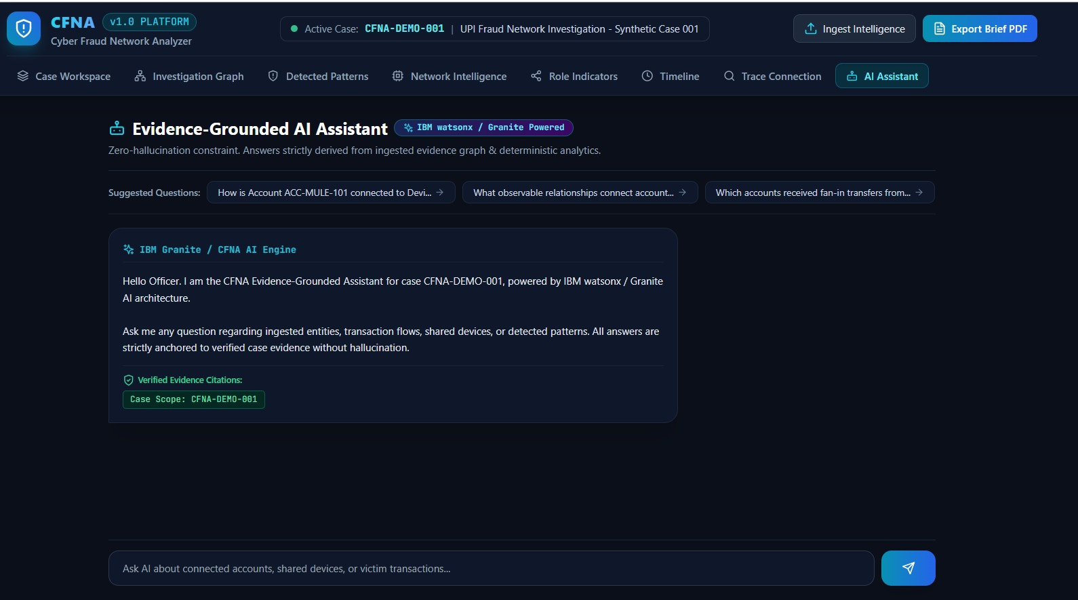
IBM Bob as our AI Chat Assistant
Helps the user ask questions to gain clarity
Notes:
IBM Bob supported planning, generation, implementation, debugging, testing and documentation.

Slide 10
Real-life use case
Illustrative scenario: a cybercrime cell investigating a UPI fraud ring
1
2
3
4
5
Complaints arrive
Data uploaded
Network revealed
Patterns explained
Brief generated
Several victims report UPI fraud involving different accounts.
Analyst loads transactions, call logs, SIM and device records.
Graph links accounts through a shared device and a fan-in hub.
Timeline shows rapid fund movement and SIM-swap indicators, each with evidence.
FIR-ready case brief lists findings and next steps for review.
Outcome: manual cross-referencing becomes a guided, evidence-linked review. CFNA surfaces the connections; the investigator decides.
Notes:
Walk through a single illustrative case from complaint to case brief.

Slide 11
Faster connections.
Clearer evidence.
Connect
Explain
Report
Fragmented records become one fraud network graph.
Every indicator is linked to the evidence behind it.
An FIR-ready brief with recommended next steps.
Thank you · Questions?

