Slide 1
Chapter 10
Entropy and the Second Law of Thermodynamics

Slide 2
Question
How much heat is added to the system when
ΔE = −43 J and w = +34 J ?
+ 9 J
+ 77 J
− 77 J
10²³ J
cannot be determined with the information

Slide 3
Question
How much heat is needed to raise the temperature of 85 g of liquid water from 15 °C to 35 °C, when the specific heat of liquid water = 4.184 J / g ° C?
+ 12400 J
+ 5300 J
−7100 J
+7100 J
cannot be determined with the information

Slide 4
Question
For a defined system, Hess’ law relates
the heat of combustion.
the amount of work done.
changes in internal energy.
changes in enthalpy.
the heat of vaporization.

Slide 5
Spontaneity
Some processes or reactions proceed in only one direction.
  Gasoline reacts spontaneously with oxygen to form carbon dioxide and water, but water and carbon dioxide never spontaneously react to reform gasoline.
A spontaneous process takes place without continuous intervention, according to thermodynamics.
  Spontaneous processes are not necessarily rapid processes.
  The combustion of diamond is thermodynamically spontaneous, but diamonds are considered to last forever.

Slide 6
Spontaneity
Some spontaneous reactions only occur after they are initiated.
  The combustion of gasoline is a spontaneous reaction but only occurs when the reaction is initiated with a spark.
Nonspontaneous reactions only occur with a continual input of energy.

Slide 7
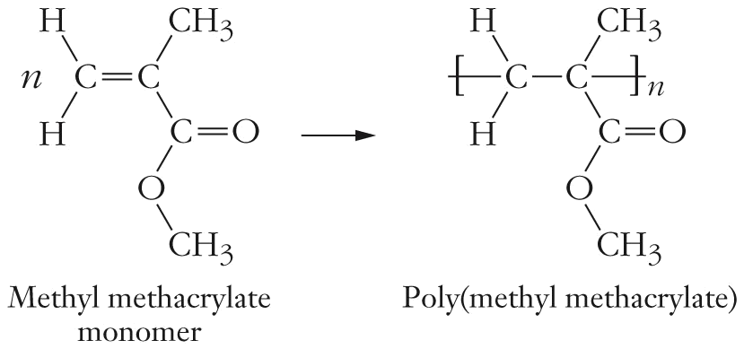
Spontaneity
Once initiated, the spontaneous reaction between methyl methacrylate monomer to produce poly(methyl methacrylate) polymer, PMMA, occurs rapidly.
The reverse reaction, production of methyl methacrylate monomer, only occurs with a continual input of heat energy.

Slide 8
Enthalpy and Spontaneity
Generally more exothermic reactions are spontaneous than endothermic reactions.
  Melting water ice is an endothermic process but occurs spontaneously.
  Enthalpy is not the determinant of spontaneity.

Slide 9
Entropy
Entropy is a state function and was first introduced in considering the efficiency of steam engines.
  The Carnot cycle uses a combination of two adiabatic processes (no heat is exchanged with the surroundings) and two isothermal processes (temperature is constant).

Slide 10
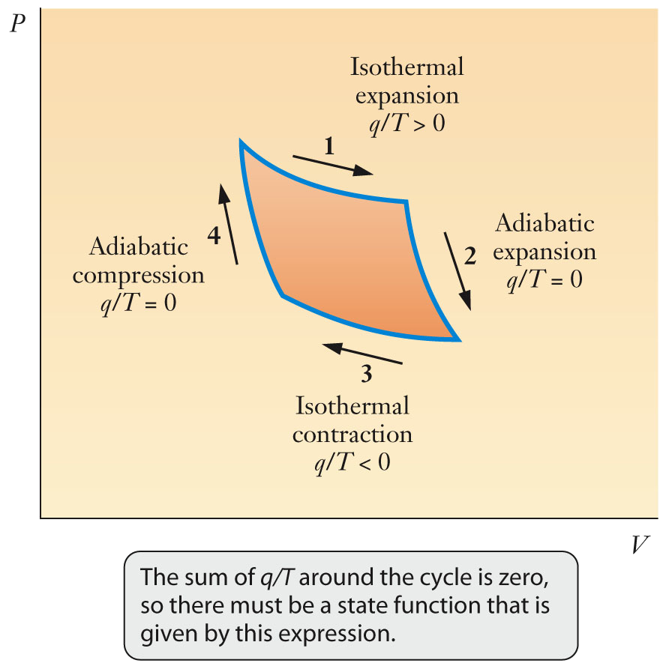
Entropy
For the Carnot cycle, the sum of q/T around the closed path is equal to zero and therefore defines the state function.
  The state function is entropy.

Slide 11
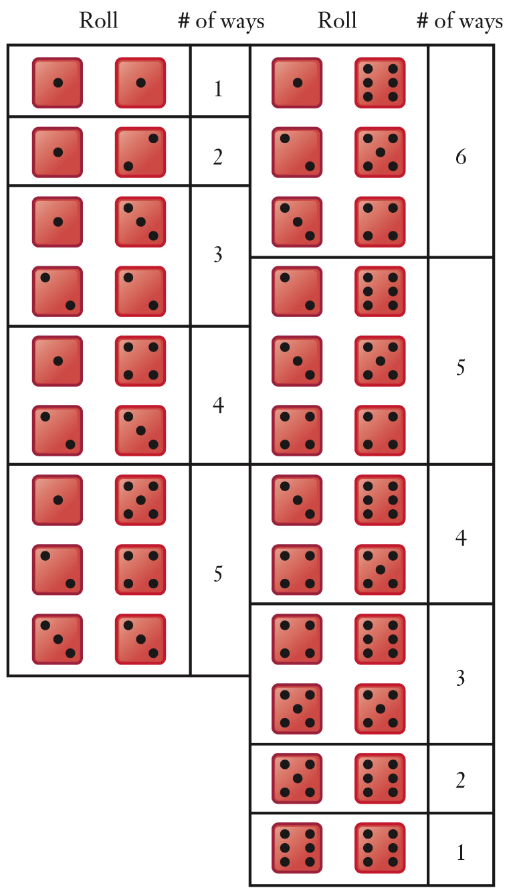
Probability and Spontaneous Change
Probability has important uses in science.
  The fundamentals of probability can be explained using the rolling of dice.
  The probability of rolling a 4 for one die is 1 in 6.

Slide 12
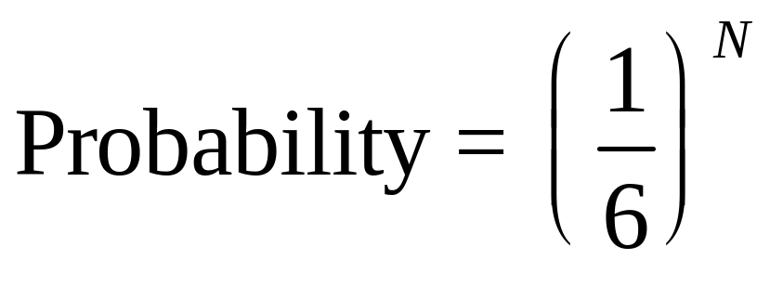
Probability and Spontaneous Change
As the number of dice increases, the probabilities of a set of fours decreases.
  N is the number of dice being thrown.
The chance of a highly specified arrangement in a collection of molecules with ~10²³ particles is very small.

Slide 13
Definition of Entropy
Entropy can be tentatively defined as a measurement of the randomness, or disorder, of a system.
  For large numbers of particles, probability favors random arrangements.
  Statistical mechanics or statistical thermodynamics provides a quantitative basis and molecular perspective to entropy using probability.

Slide 14
Definition of Entropy
For entropy, the probability for the number of ways in which particles can achieve the same energy is used.
  The way by which a collection of particles can assume a given energy is a microstate.
  The number of possible microstates is designated by Ω.
  The number of microstates increases as the “randomness” of the system increases.

Slide 15
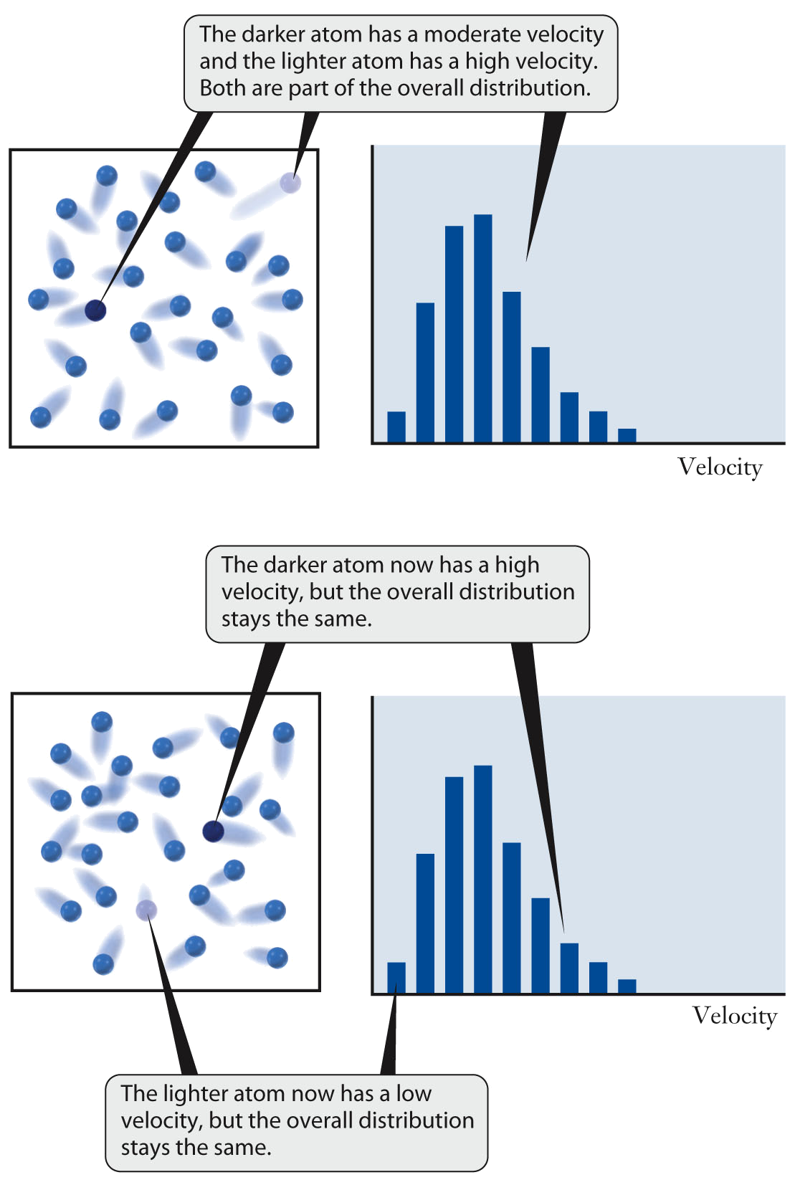
Defining Entropy
The Maxwell-Boltzmann distribution indicates the overall collection of molecular speeds but not the speed of individual particles.
Energy is exchanged during molecular collisions, without disrupting the overall distribution of speeds.

Slide 16
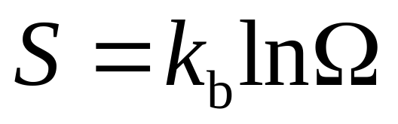
Defining Entropy
As the number of microstates for a system increases, the entropy of the system increases. This relationship is defined by the equation:
  S is entropy
  k_{b} is the Boltzmann constant.
  Ω is the number of microstates.

Slide 17
Entropy Changes in Processes
Certain types of changes will result in increased entropy:
  Some phase changes.
  An increase in the number of particles present.
  An increase in the temperature of a substance.

Slide 18
Entropy Changes in Processes
When a solid melts to form a liquid, entropy increases.
  In solids, the particles are held in place rigidly, limiting the number of ways a specific energy can be obtained.
  In liquids, the particles move past each other, increasing the number of ways a specific energy can be obtained.
  The number of microstates increases during melting.

Slide 19
Entropy Changes in Processes
A chemical reaction that generates two moles of gas when only one mole of gas was initially present will increase the entropy of a sample.
  The number of possible microstates increases as the number of particles increases.
When a sample is heated, the temperature of the sample increases.
  As temperature increases, the number of possible velocities increases.
  The number of ways to distribute the kinetic energy of the sample increases, resulting in an increase in the number of microstates.

Slide 20
The Second Law of Thermodynamics
Whenever energy is converted from one form to another, some energy is “lost” or “wasted”.
  Not all of the energy available is directed into the desired process.
  Entropy provides the key to understanding that “loss” of useful energy is inevitable.

Slide 21
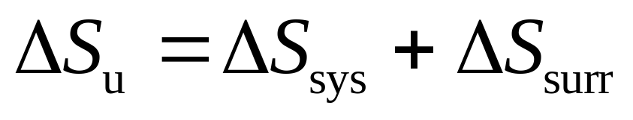
The Second Law of Thermodynamics
The second law of thermodynamics: in any spontaneous process, the total entropy change of the universe is positive:
  ΔS_{u} > 0
    ΔS_{u} = entropy of the universe
    ΔS_{sys} = entropy of the system
    ΔS_{surr} = entropy of the surroundings
  It is impossible to convert heat completely to work, since work is a process that involves moving random motions into more ordered ones.

Slide 22
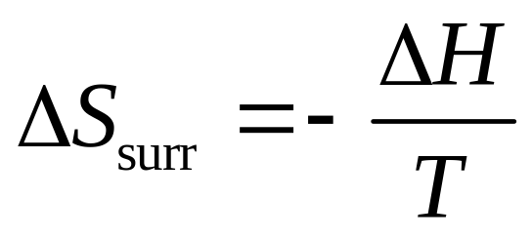
Applications of the Second Law
The entropy change for the surroundings can be calculated from the heat flow from the system, which is equal to –ΔH
  For an exothermic reaction, the entropy of the surroundings increases.

Slide 23
Applications of the Second Law
The formation of poly(methyl methacrylate), PMMA, is a spontaneous process.
  The formation of PMMA is exothermic, which favors spontaneity.
  The entropy change for the formation of PMMA is negative, which does not favor spontaneity.

Slide 24
Applications of the Second Law
For the formation of PMMA, ΔS_{u} is greater than zero only if the ΔS_{surr} is greater than the absolute value of ΔS_{sys}
ΔS_{u} = ΔS_{sys} + ΔS_{surr}
  Above some temperature T, the ΔS_{u} is less than zero, and the formation of PMMA becomes nonspontaneous.
    The reverse reaction, the thermolysis of PMMA back into monomer, will be spontaneous.
    The thermolysis of PMMA is one method to recycle PMMA.
ΔS_{u} = ΔS_{sys} + ΔS_{surr} > 0

Slide 25
The Third Law of Thermodynamics
The third law of thermodynamics states that the entropy of a perfect crystal of any pure substance approaches zero as the temperature approaches absolute zero.
The entropy of one mole of a chemical substance under standard conditions is the standard molar entropy, Sº
The entropy change for a reaction can be calculated from the standard molar entropies of the reactants and products. This law allows for the quantification of entropy.
ΔS° = Σν_{i} S°(products)_{i} − Σ ν_{j} S°(reactants)_{j}

Slide 26
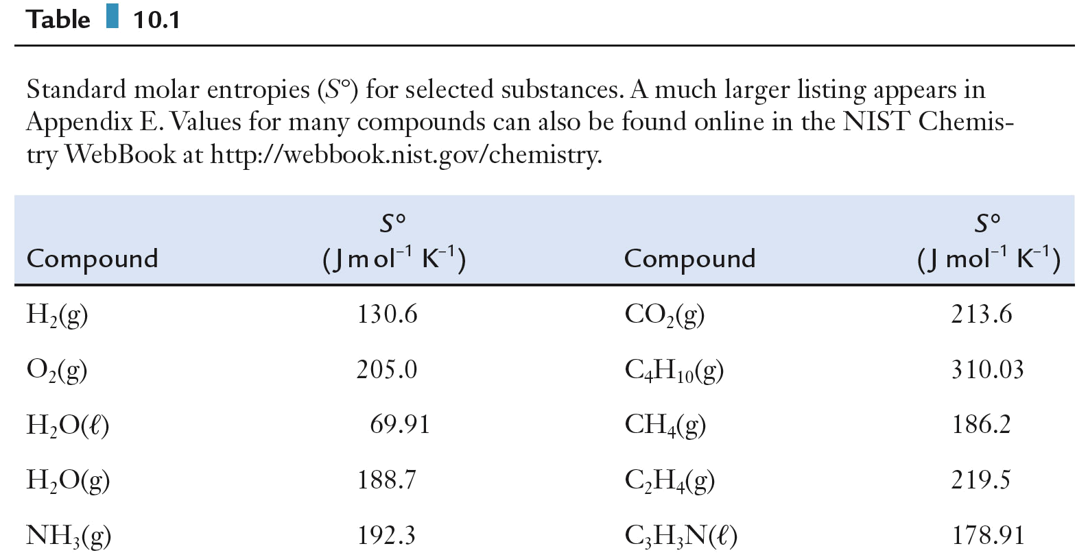
The Third Law of Thermodynamics
Standard molar entropies for selected substances.

Slide 27
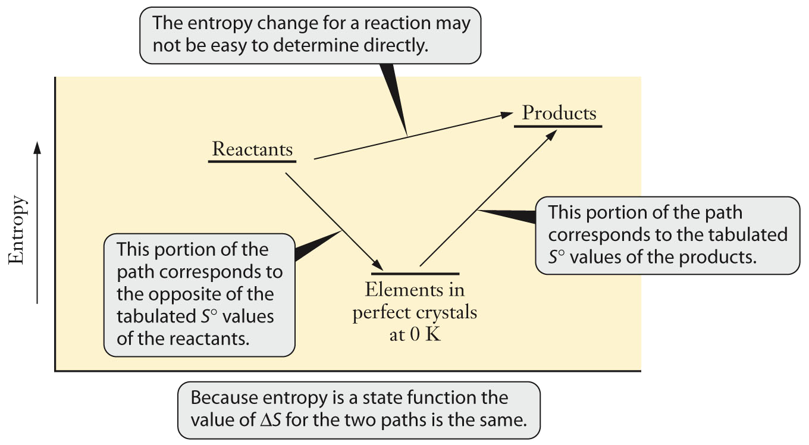
The Third Law of Thermodynamics
Entropy is a state function, so the value of ΔS must be independent of the path taken from reactants to products.

Slide 28
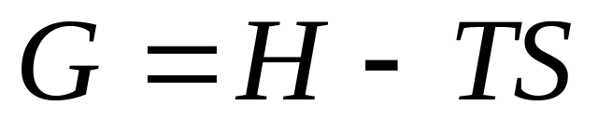
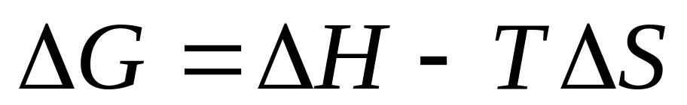
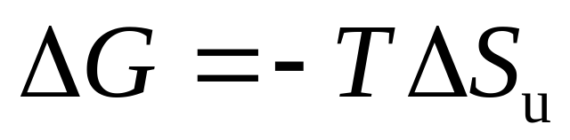
Gibbs Energy
The Gibbs (free) energy function, G, is defined as:
Changes in Gibbs energy can predict whether or not a process is spontaneous under conditions of constant pressure and temperature.

Slide 29
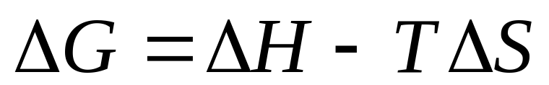
Gibbs Energy and Spontaneous Change
For a spontaneous reaction, the Gibbs energy change must be negative.
For a negative ΔH and a positive ΔS, the ΔG will always be negative and the reaction spontaneous.
For a positive ΔH and a negative ΔS, the ΔG will always be positive and the reaction nonspontaneous.

Slide 30
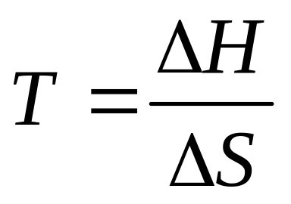
Gibbs Energy and Spontaneous Change
For a positive ΔH and a positive ΔS, the value for ΔG depends on the temperature.
For a negative ΔH and a negative ΔS, the value for ΔG depends on the temperature.
  The temperature at which a reaction changes from spontaneous to nonspontaneous can be calculated.

Slide 31
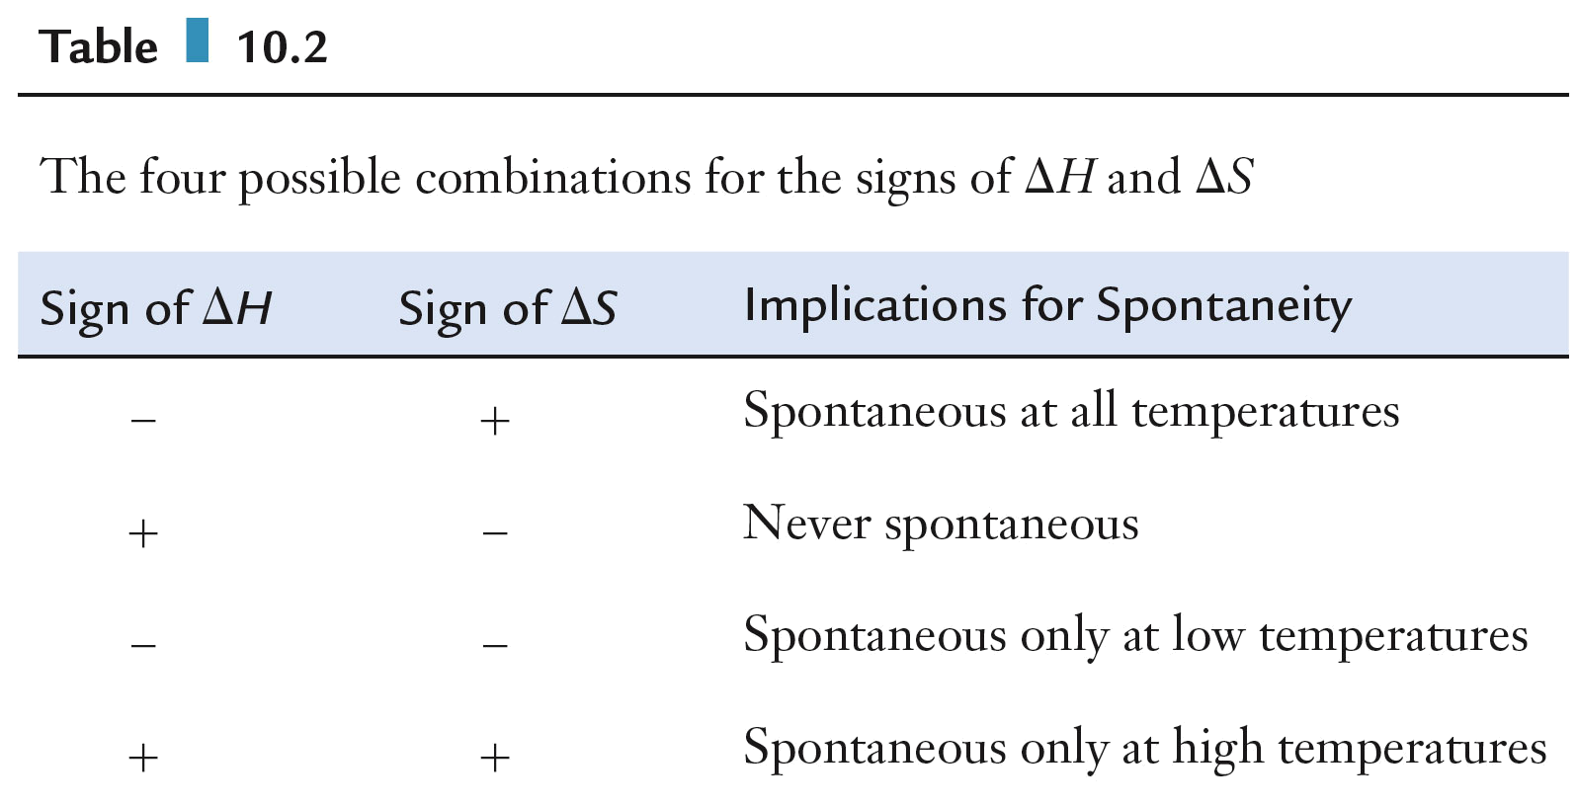
Gibb’s Energy and Spontaneous Change
The four possible combinations for the signs of ΔH and ΔS used to determine spontaneity for a chemical reaction.

Slide 32
Gibb’s Energy and Spontaneous Change
For a spontaneous reaction with a negative ΔH and a negative ΔS, the reaction only occurs at low temperature.
  These reactions are referred to as enthalpy driven because the negative value for the enthalpy is responsible for the negative value of the Gibbs energy change.
For a spontaneous reaction with a positive ΔH and a positive ΔS, the reaction only occurs at high temperature.
  These reactions are referred to as entropy driven because the product of the positive entropy change and the absolute temperature is responsible for the negative value of the Gibbs energy change.

Slide 33
Gibb’s Energy and Spontaneous Change
Use the signs of ΔH and ΔS to explain why ice spontaneously melts at room temperature but not outside on a freezing winter day.

Slide 34
Gibb’s Energy and Spontaneous Change
The heat of fusion of polyethylene is approximately 7.7 kJ/mol, and the corresponding entropy is 19 J/mol K. Use these data to estimate the melting point of polyethylene.

Slide 35
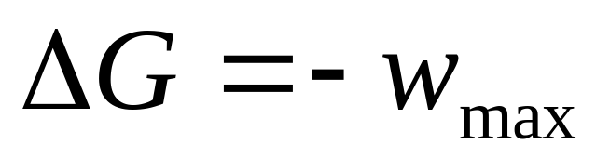
Gibb’s Energy and Work
It can be shown that the Gibbs energy change is equal to the maximum useful work done by the system.
  Work is not a state function.
  Maximum work realized only if the reaction or process is carried out along a very specific path.

Slide 36
Energy and Work
A reversible path is the specific path required for maximum useful work.
  For systems with a reversible path, the system is near equilibrium and a small incremental change in a variable will bring the system back to its initial state.
In an irreversible change, a small incremental change in any variable does not restore the initial state.
  The amount of work available is always less than maximum for an irreversible change.

Slide 37
Gibbs Energy and Chemical Reactions
The Gibbs energy change establishes the upper bound to the amount of work obtained from a given process.
  The actual work produced in any real application may be considerably less.
Reactant mixtures are generally very far from equilibrium.
  Systems that are far from equilibrium often change rapidly, and rapid changes tend to be irreversible.

Slide 38
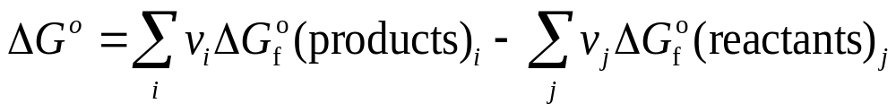
Energy and Chemical Reactions
The standard Gibbs energy change, ΔGº, can be calculated from Gibbs energies of formation, ΔG_{f}º
  ΔG_{f}º = 0 for elements in their free standard state.
  This equation provides an alternative method to calculate ΔG, without entropy or enthalpy.

Slide 39
Implications of ΔGº for a Reaction
Gibbs energy changes indicate the spontaneity of a chemical reaction.
For the formation of PMMA at 298 K, ΔHº = –56 kJ and ΔSº = –117 J/K
  ΔGº = –21 kJ at 298K for the formation of PMMA.
  The negative value of Gibbs energy indicates that the formation of PMMA is spontaneous at 298 K.

Slide 40
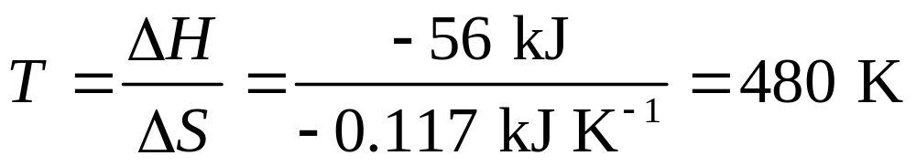
Implications of ∆Gº for a Reaction
The reverse reaction, the thermolysis of PMMA to form methyl methacrylate monomer, has a ΔGº = +21 kJ at 298 K
  The positive value indicates that the thermolysis of PMMA is nonspontaneous at 298 K
The temperature at which the thermolysis of PMMA becomes spontaneous is 480 K
The thermolysis of PMMA above 480 K is an entropy-driven process.

Slide 41
The Economics of Recycling
Almost 50% of all aluminum cans were recycled in 2001 compared to 22% of all PET bottles.
The difference in recycling rates is based in economics.
When an aluminum can is recycled, the paint and other coatings are removed and the aluminum can melted down to make new cans.
  The energy required to recycle 4 aluminum cans equals the energy required to produce 1 can from aluminum ore.

Slide 42
The Economics of Recycling
When plastic bottles are recycled, the different types of plastic must be hand sorted.
  Hand sorting increases the cost of recycling plastics.
The recycling process leads to a degraded polymer.
  Recycled plastics have shorter polymer chain lengths than virgin materials and different physical properties.
  Recycled aluminum has the same physical properties as aluminum extracted from ore.

Slide 43
The Economics of Recycling
The cost of producing virgin plastics is lower than costs associated with recycled plastics.
Recycling of plastics are economically favored when the cost of producing virgin plastics increases, the cost of recycling plastics decreases, or both.

