Slide 1
Chapter 12
Chemical Equilibrium

Slide 2
Chemical Equilibrium
For complex chemical reactions, there are several variables that must be considered.
The nature of the reactants, including the equilibrium that ultimately dictates the efficiency of the reaction, is the first issue that must be considered.
Water in an open system, such as a glass, will slowly evaporate, decreasing the amount of liquid water over time.
Water in a closed system, such as a covered glass, will establish a dynamic equilibrium, where the amount of liquid water present does not decrease over time.

Slide 3
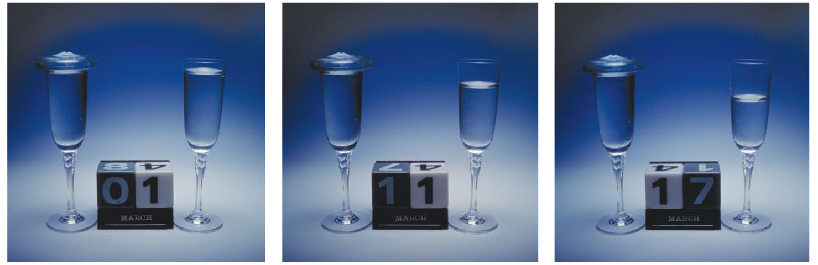
Forward and Reverse Reactions
This photo sequence shows the water level in two glasses over the course of 17 days. The glass on the left is covered.

Slide 4
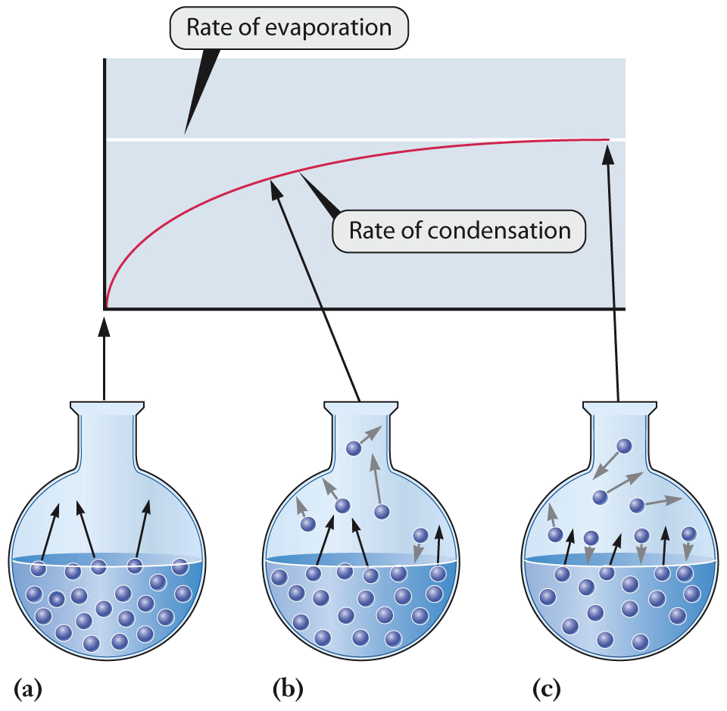
Forward and Reverse Reactions
The equilibrium between liquid and vapor in a closed container is governed by the kinetics of evaporation and condensation.
  In (c), the two rates are equal.

Slide 5
Forward and Reverse Reactions
At the start of a chemical reaction, the reactant concentrations decrease over time, with a corresponding decrease in rate of the forward reaction.
As the reactants are being consumed, the product concentration increases, with a corresponding increase in the rate of the reverse reaction.
When the rate of the forward reaction equals the rate of the reverse reaction, the reaction has reached equilibrium.
  Reactants form products at the same rate the products reform the reactants.
  The concentrations of reactants and products do not change over time at equilibrium.

Slide 6
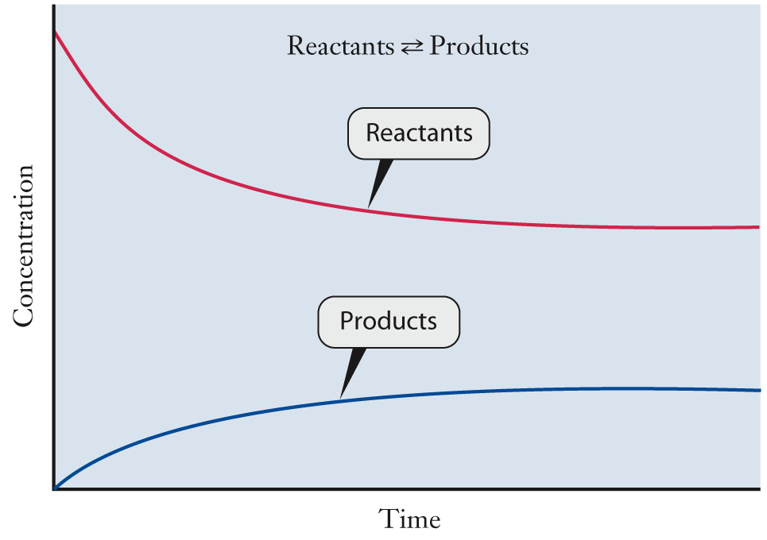
Forward and Reverse Reactions
A chemical system reaches equilibrium when the rate of the forward reaction equals the rate of the reverse reaction.
The concentration of products and reactants does not change at equilibrium.

Slide 7
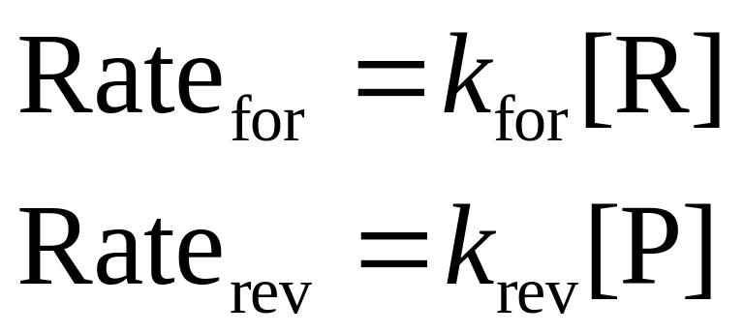
Mathematical Relationships
For any reaction involving reactants, R, and products, P, the chemical reaction is written at equilibrium with a double arrow.
reactants ↔ products
Rate laws for the forward and reverse reaction can be written.

Slide 8
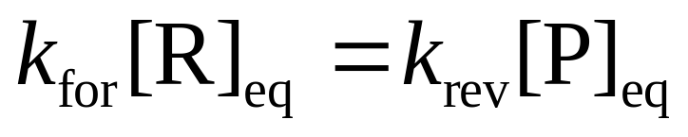
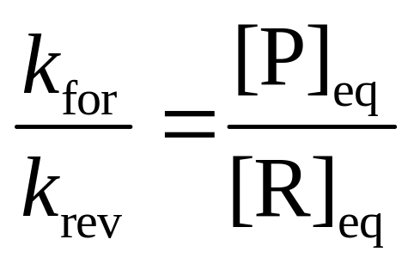
Mathematical Relationships
At equilibrium, Rate_{for} = Rate_{rev}
  Therefore,
  or

Slide 9
Le Châtelier’s Principle
Le Châtelier’s principle - When a system at equilibrium is stressed, it responds by reestablishing equilibrium to reduce the stress.
There are three common means to introduce a stress to an equilibrium.
  Changes in concentration
  Changes in pressure
  Changes in temperature

Slide 10
Effect of a Change in Concentration
For a reaction at equilibrium, a change in concentration for one or more of the reactants and/or products will disturb the equilibrium.
  The system will react to re-establish equilibrium.
For a reaction at equilibrium, increasing the concentration of one of the reactants will shift the equilibrium toward the products.
  The reactant concentration will decrease as reactant is converted to product, and the product concentration will increase until equilibrium is re-established.

Slide 11
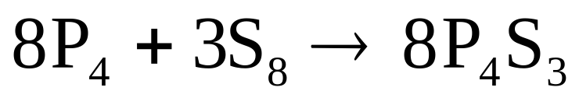
Effect of a Change in Concentration
Disturb the equilibrium.
  The system will react to re-establish equilibrium.

Slide 12
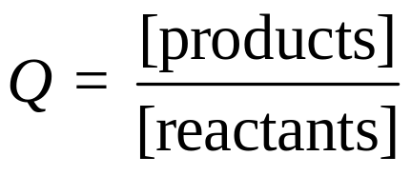
Effect of a Change in Concentration
The increase in product concentration for a reactant concentration increase can be rationalized by examining the reaction quotient.
  The reactant quotient, Q, is defined as the ratio of the product to the reactants.
  For a reaction at equilibrium, K = Q

Slide 13
Effect of a Change in Pressure
For reactions involving gases, if the number of moles of gas differs between reactants and products, a shift in pressure (due to a volume change) will result in a change in equilibrium position.
  For an increase in pressure, the equilibrium will shift toward the side of the equation with fewer moles of gas.
  For a decrease in pressure, the equilibrium will shift toward the side of the equation with more moles of gas.

Slide 14
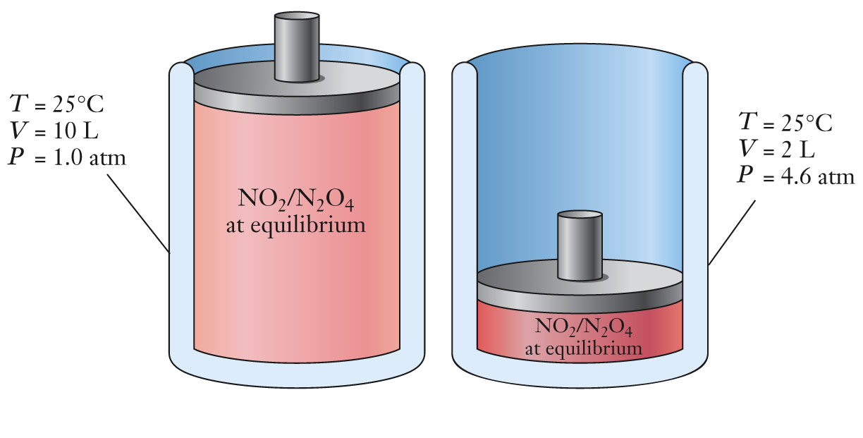
Effect of a Change in Pressure
For the equilibrium between NO₂ and N₂O₄, the increase in pressure is offset by reducing the moles of gas present by forming N₂O₄.
Decreasing the volume to 2 L initially increases the pressure to 5.0 atm.
  Equilibrium is re-established when the pressure is reduced to 4.6 atm by reacting 2 NO₂ to form N₂O₄

Slide 15
Effect of a Change in Temperature
During a temperature change, heat flows in or out of the reacting system.
  Heat is treated as a product for an exothermic reaction.
  Reactants ↔ products + heat
  Heat is treated as a reactant for an endothermic reaction.
  Reactants + heat ↔ products
  • Increase the temperature, equilibrium shifts away from the side with the heat.
Decrease the temperature, equilibrium shifts toward the side with the heat.

Slide 16
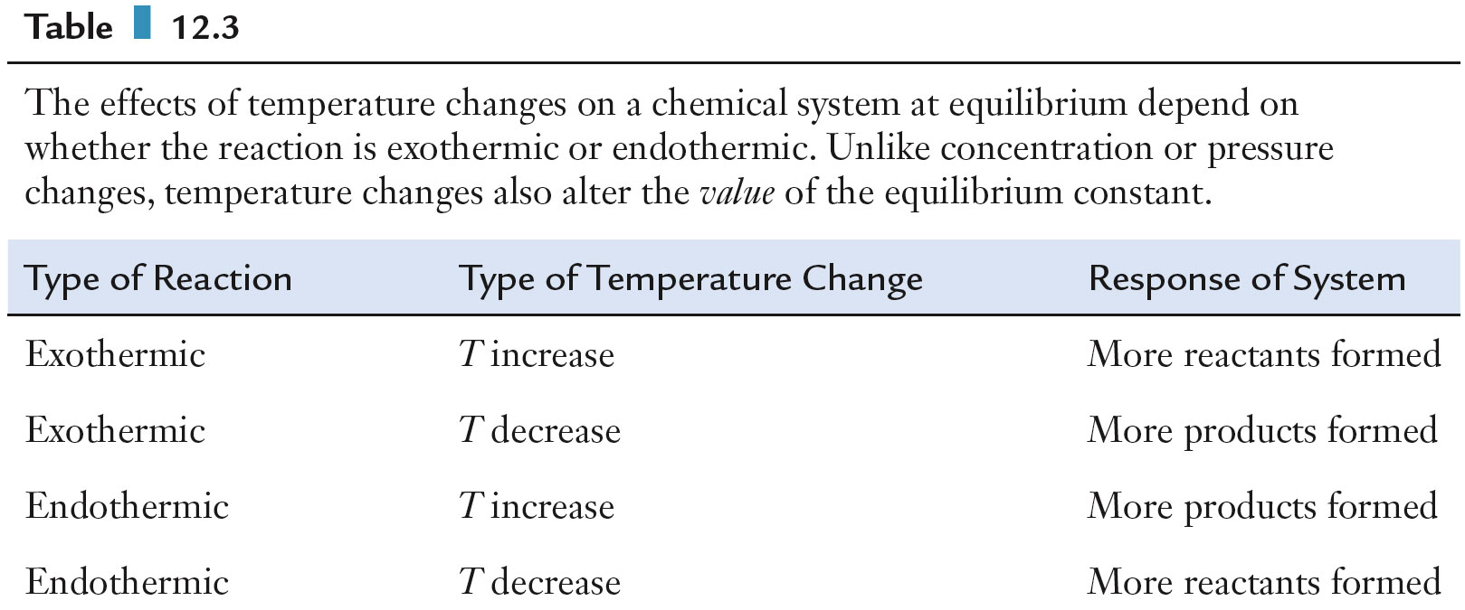
Effect of a Change in Temperature
Summary of the effects a temperature change will have on exothermic and endothermic reactions at equilibrium.

