Slide 1
Chemistry
Chemistry is the study of matter and the changes that material substances undergo.
Chemistry is extensively connected to other scientific disciplines.
Practical applications of chemistry are everywhere.

Slide 2
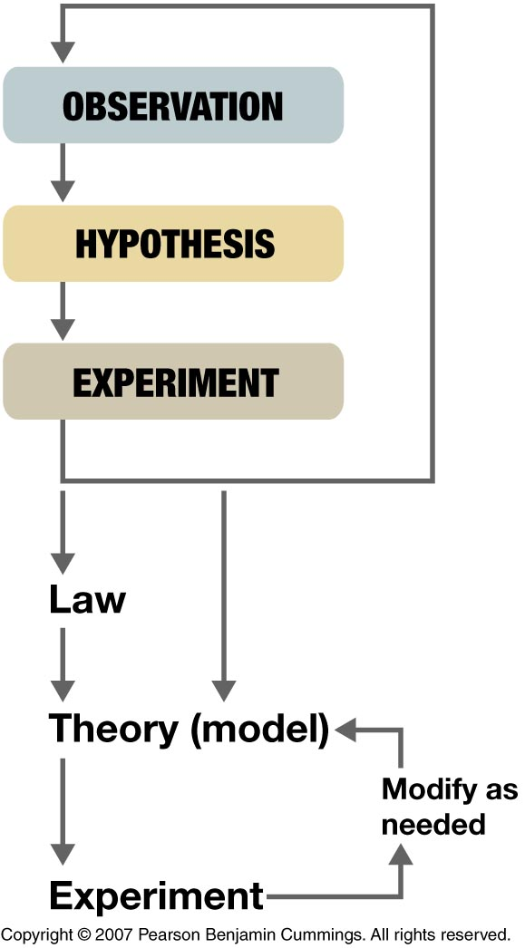
The Scientific Method
A procedure that searches for answers to questions and solutions to problems
Consists of making observations, formulating hypotheses, and designing experiments, which leads to additional observations, hypotheses, and experiments in repeated cycles

Slide 3
The Scientific Method
Science has five key characteristics.
Science is:
    Testable
    Reproducible
    Explanatory
    Predictive
    Tentative

Slide 4
Observations
Can be qualitative or quantitative
Qualitative observations
Describe properties or occurrences in
ways that do not rely on numbers
Quantitative observations
Measurements that consist of both a
number and (usually) a unit

Slide 5
Hypothesis
A tentative explanation for the observations
May not be correct, but it puts the understanding of the system being studied into a form that can be tested

Slide 6
Experiments
Test the validity of the hypothesis
Are systematic series of observations or measurements made under controlled conditions, in which the variable of interest is clearly distinguished from any others
If enough experimental results are reproducible, they can be summarized in a law
E.g., Coulomb’s law

Slide 7
Scientific Framework
Many scientific laws can be stated mathematically.
  e.g., Boyle’s Law for Gasses:
  pressure • volume = k [k is a constant]
Laws are sufficiently refined, well tested, and widely accepted. They are usually expressed as an equation.
Scientific theories are large-scale descriptions of natural phenomena, summarizing a large number of observations.
(e.g., Theory of Gravity, Conservation of Mass/Energy, Cellular Theory of Life, Theory of Evolution, Theory of Relativity, Atomic Theory of Matter, …)

Slide 8
Scientific Framework
Law
– A verbal or mathematical description of a phenomenon that allows for general predictions
  – Describes what happens and not why
  – Unlikely to change greatly over time unless a major experimental error is discovered
Theory
  – Attempts to explain why nature behaves as it does
  – Is incomplete and imperfect, evolving with time to explain new facts as they are discovered
  – Quite different from its meaning to the general population

Slide 9
Models
The study of chemistry involves three levels of understanding.
  Macroscopic
  Microscopic
  Symbolic

Slide 10
Description of Matter
Matter — anything that occupies space and possesses inertia (resistance to acceleration)
Mass — the quantity of matter an object contains
— does not depend on location of the object
• Weight — a force caused by the gravitational
attraction that operates on the object
— depends on the location of an object

Slide 11
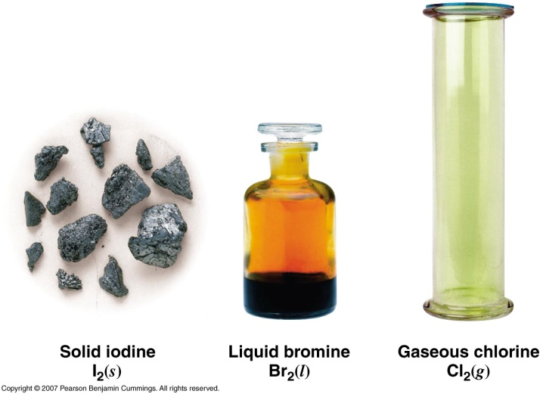
States of Matter
Three distinct states of matter:
  Solids — relatively rigid and have fixed shapes and volumes
  — volumes of solids vary little with temperature and pressure
  Liquids — have fixed volumes but flow to assume the shape of their containers
  — volumes of liquids vary little with temperature and pressure
  Gases — have neither fixed shapes nor fixed volumes and expand to fill their containers completely
  — depend strongly on temperature and pressure

Slide 12
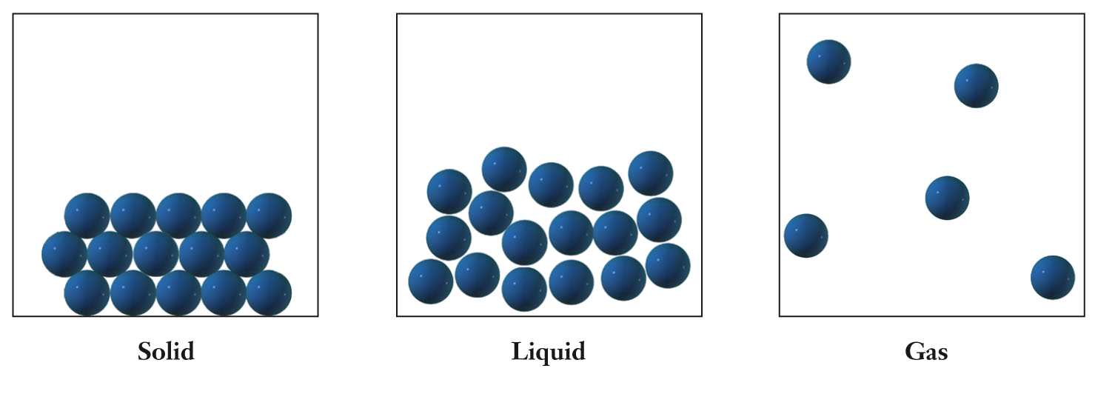
States of Matter
Solid: particles maintain a regular ordered structure; maintains size and shape regardless of container.
Liquid: particles remain close but are no longer ordered; takes the shape of a container.
Gas: particles are widely separated and move independently of one another;
fills the available volume of a container.

Slide 13
Properties of Matter
Properties used to describe matter can be classified as either physical or chemical.
Physical properties:
Characteristics that can be measured without changing the composition of the sample under study (e.g., mass, weight, color, density, taste, smell, boiling temperature, melting temperature, volume, hardness, strength, elastic modulus, refractive index, viscosity). No change in composition.
Chemical properties:
Characteristic abilities of a substance to react to form new substances (e.g., combustion, corrosion, rusting) or fails to react. Involves a change in composition.

Slide 14
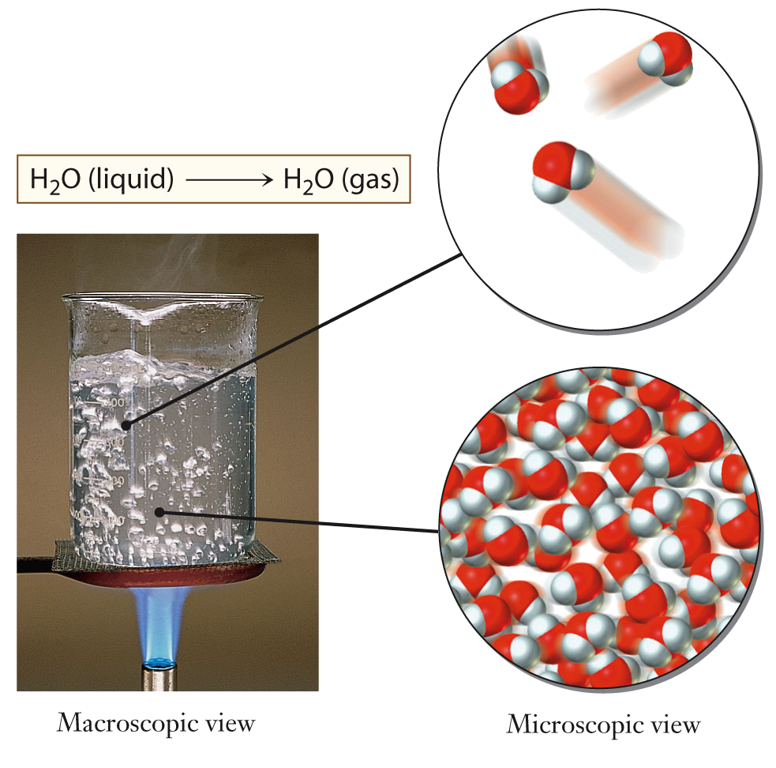
Physical Change
During a physical change, the chemical composition does not change.
  E.g., heating liquid water to make gaseous water (steam)

Slide 15
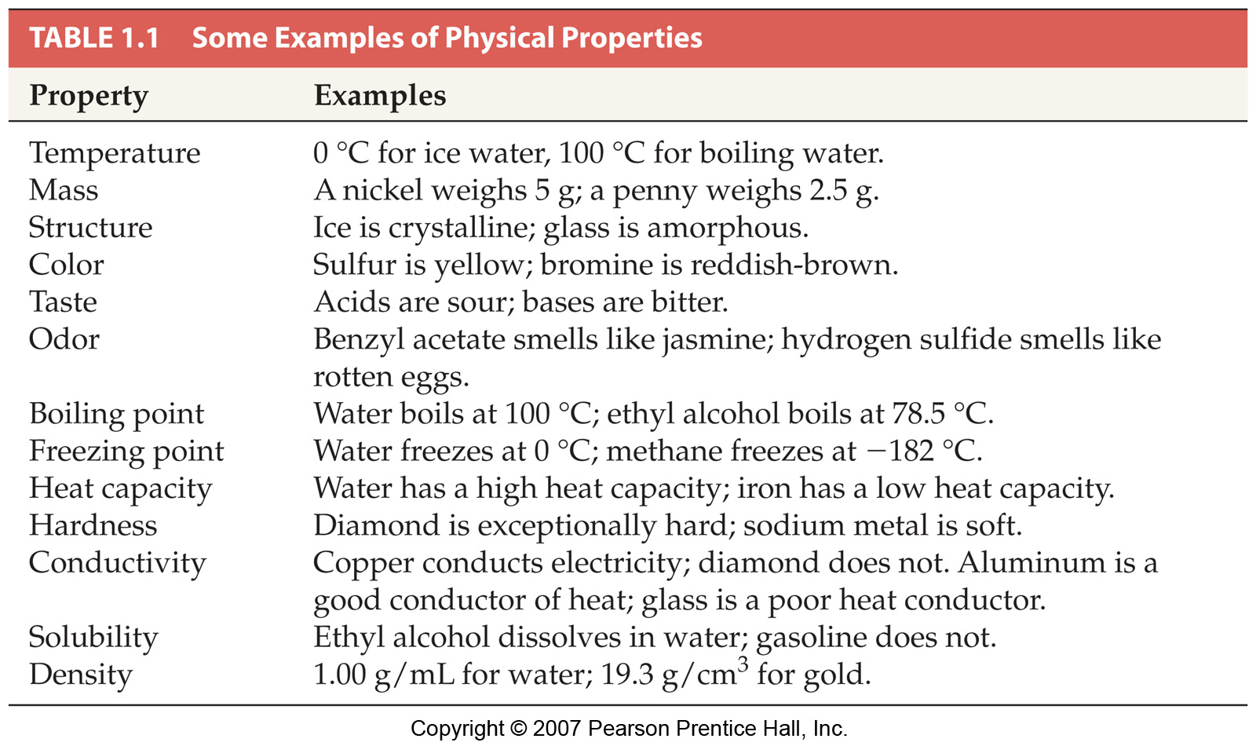
Physical Properties

Slide 16
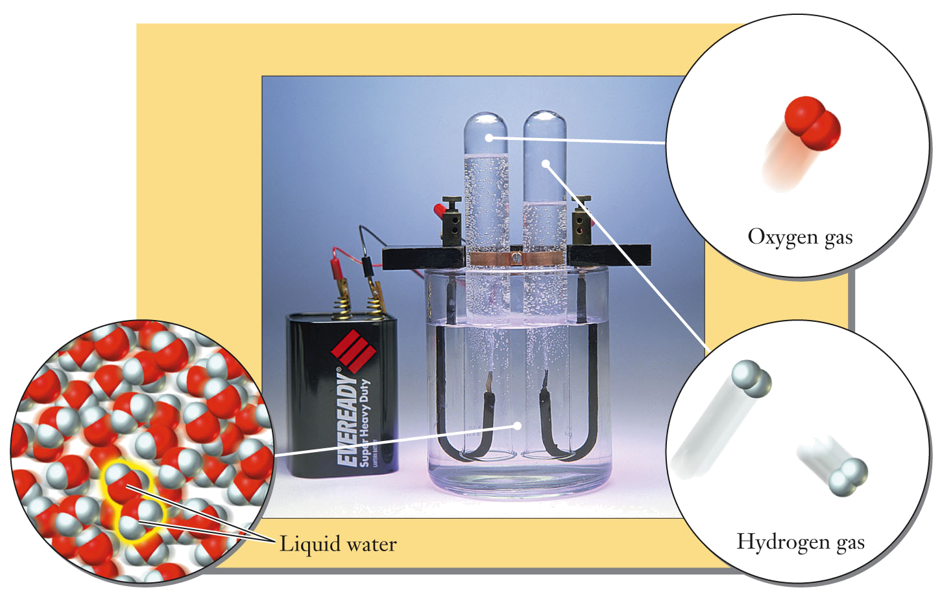
Chemical Change
During a chemical change, a chemical reaction occurs that changes the chemical composition of the matter involved.
  E.g., using electricity to separate water into oxygen and hydrogen molecules

Slide 17
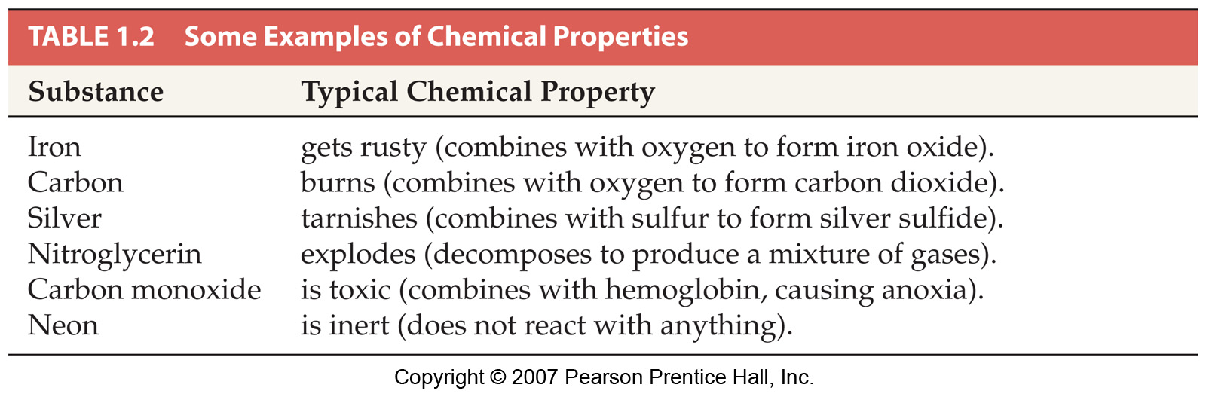
Chemical Properties

Slide 18
Pure Substances and Mixtures
Mixtures — can be separated into pure substances that are either elements or compounds. Mixtures can have a variable composition in any ratio. E.g., seawater.
• Element — a pure substance that cannot be broken down into simpler ones by physical or chemical changes. E.g., gold.
Compound — contains two or more elements chemically bonded together. A compound has a constant composition. Has chemical and physical properties that are different from those of the elements of which it is composed. Can be broken down into elements by chemical changes (reactions). E.g., water.
Molecules — groups of atoms held together by attractive forces whose properties are distinguishable from those of the individual elements. E.g., sugar.

Slide 19
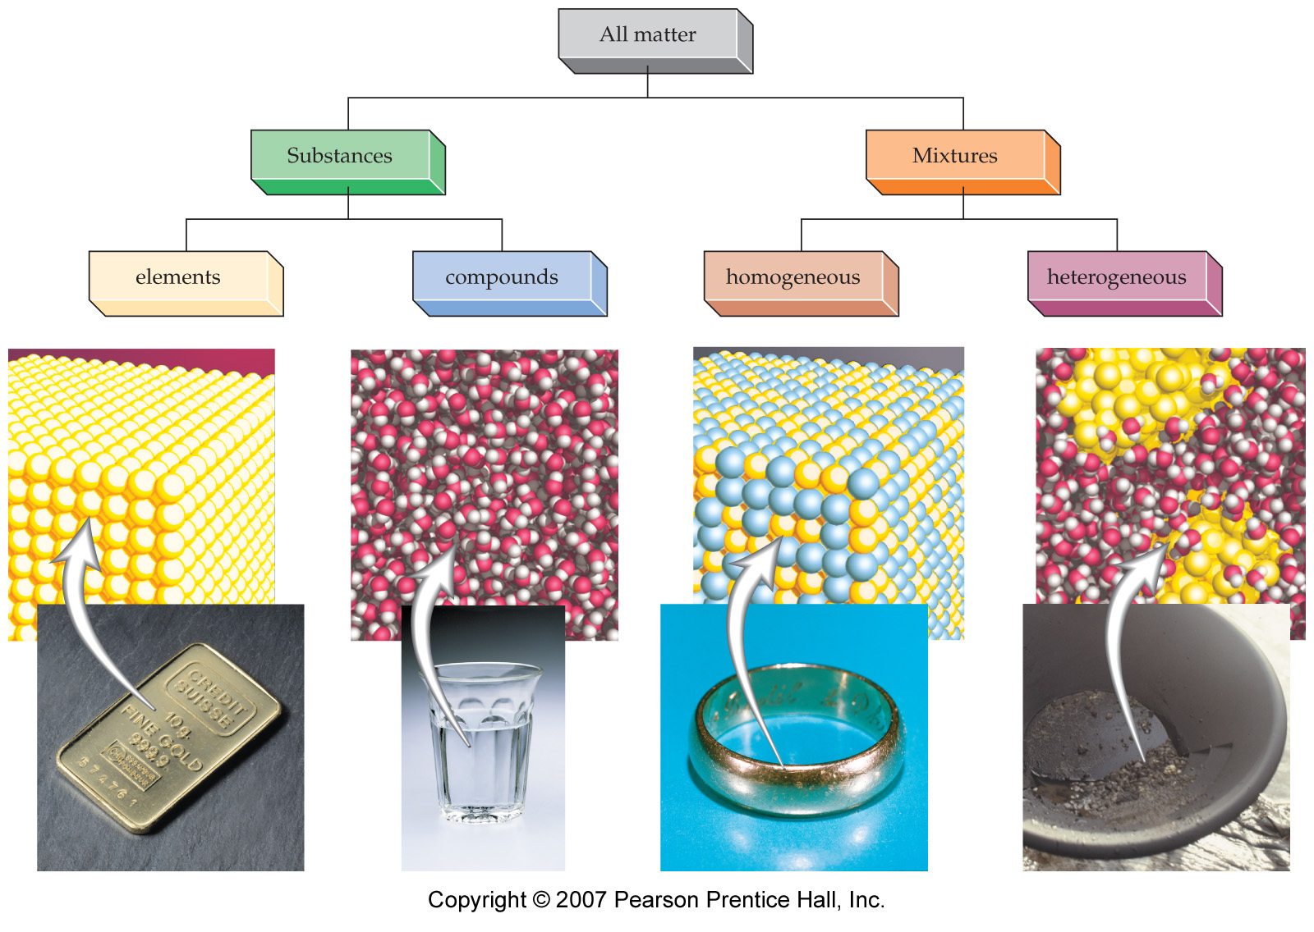
Pure Substances and Mixtures

Slide 20
Accuracy and Precision
Observations are recorded via measurements.
  Accuracy - how close the observed value is to the “true” value.
  Precision - the spread in values obtained from a series of measurements; the reproducibility of a measurement.

Slide 21
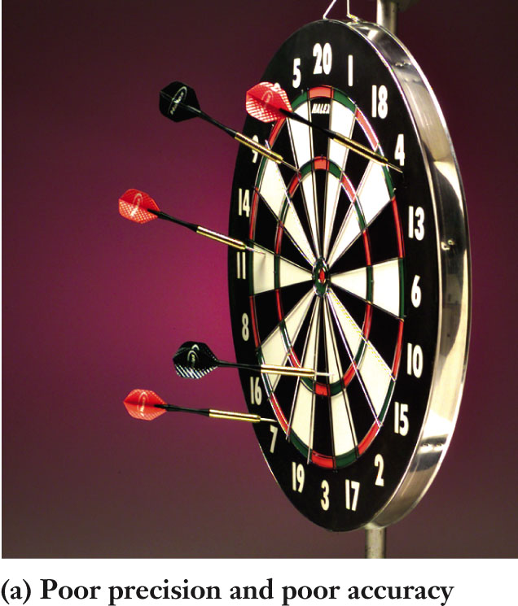
Accuracy and Precision
Measurements can have poor precision and poor accuracy.
    Darts are scattered evenly across the board.

Slide 22
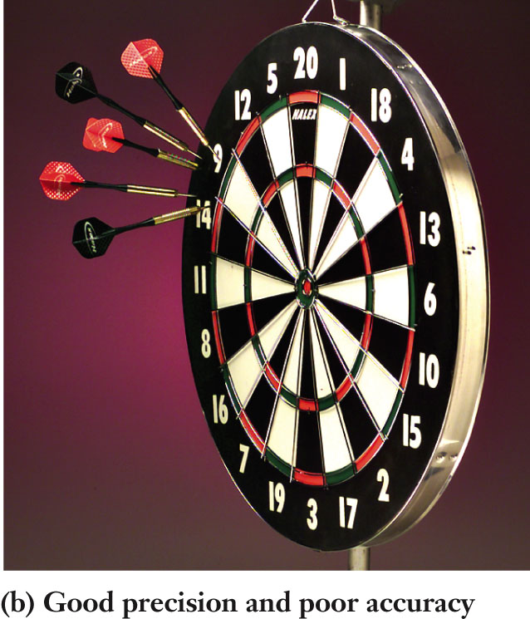
Accuracy and Precision
Measurements can have good precision and poor accuracy.
    Darts are clustered together
    But darts are clustered far from the bulls-eye

Slide 23
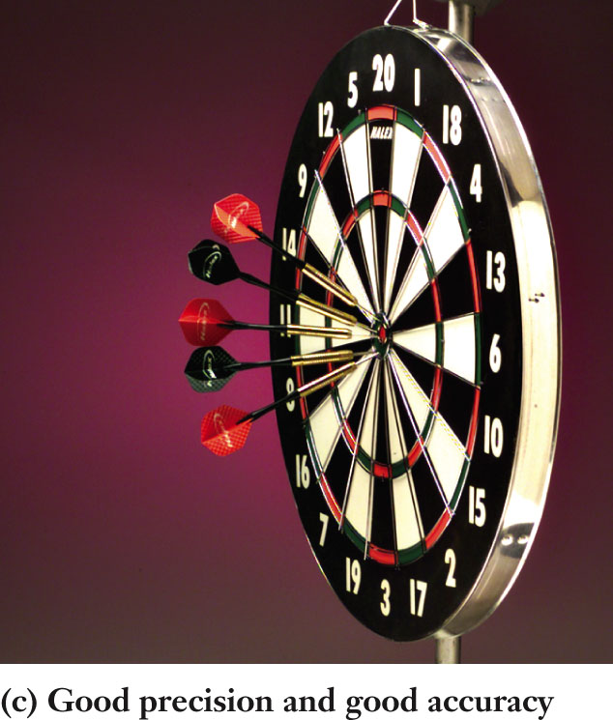
Accuracy and Precision
Measurements can have good precision and good accuracy.
    Darts are clustered together, and
    Darts are clustered close to the bulls-eye.

Slide 24
Measurement Errors
Measurements can contain two types of errors:
  Random error - may make a measurement randomly too high or too low. (E.g., variation associated with equipment limitations)
  Systematic error - may make a measurement consistently too high or too low. (E.g., the presence of an impurity, or an incorrect methodology)

Slide 25
Measurements
Scientists and engineers quantify data, expressing collected data with units and significant figures.
  Units - designate the type of quantity measured.
  Prefixes - provide scale to a base unit.
  Significant figures - indicate the amount of information that is reliable when considering a measurement.

Slide 26
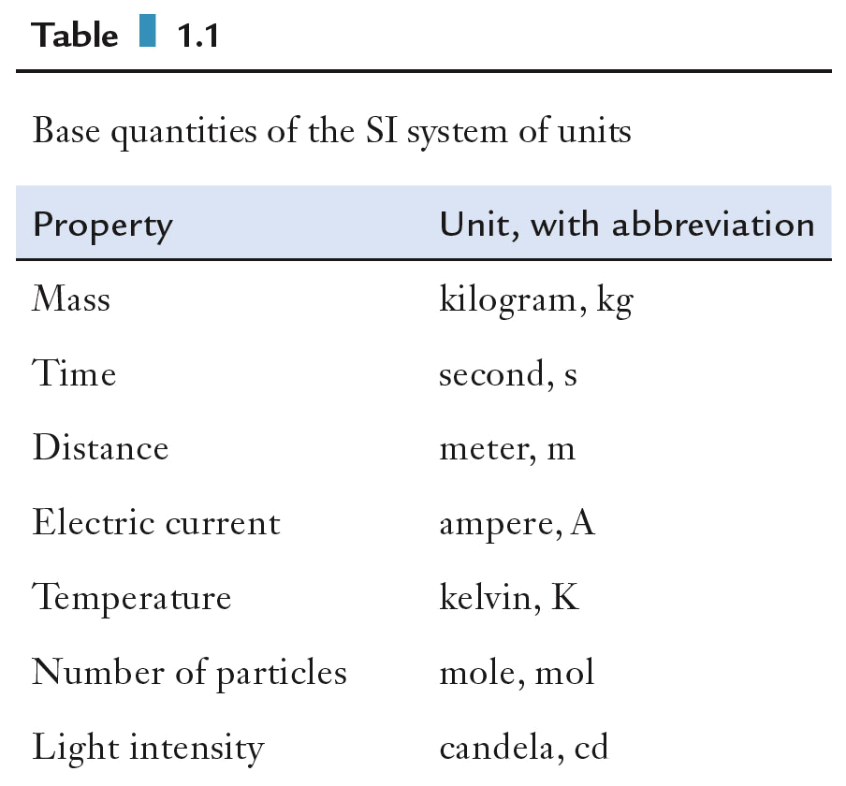
SI System of Units
The base unit designates the type of quantity being measured.
SI units (from the French Système International) are the base units of science.
Some units comprise combinations of these base units and are termed derived units
  1 J (Joule) = 1 kg m² s⁻²

Slide 27
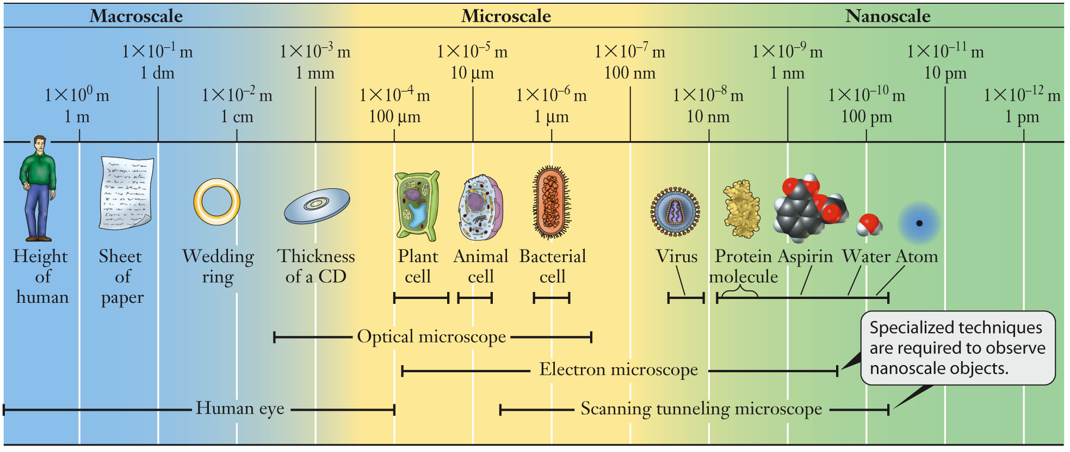
Units
Prefixes are used with base units to report and understand quantities of any size.
For distance:

Slide 28
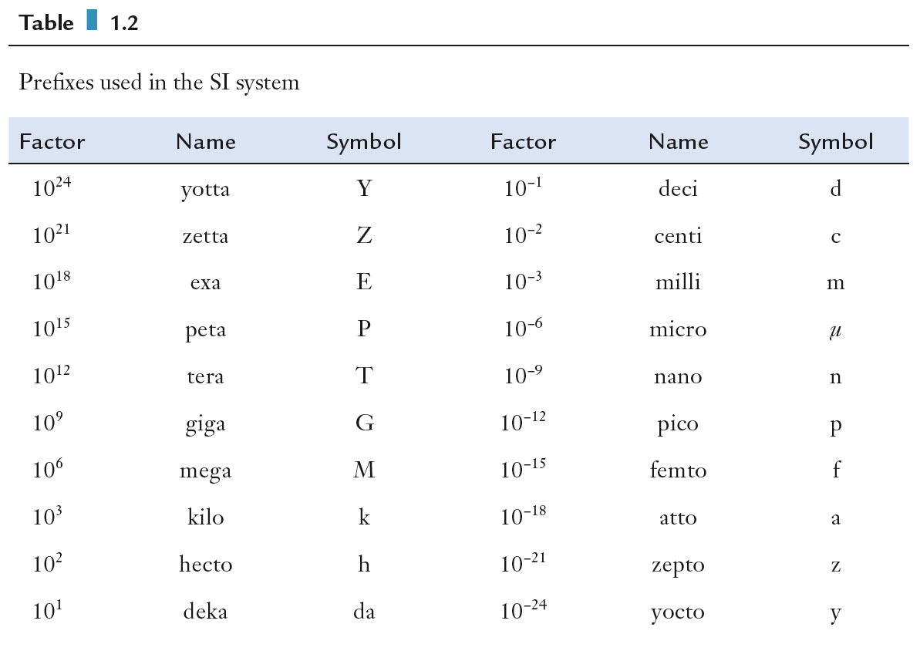
Prefixes
Prefixes are based on multiples of 10.

Slide 29
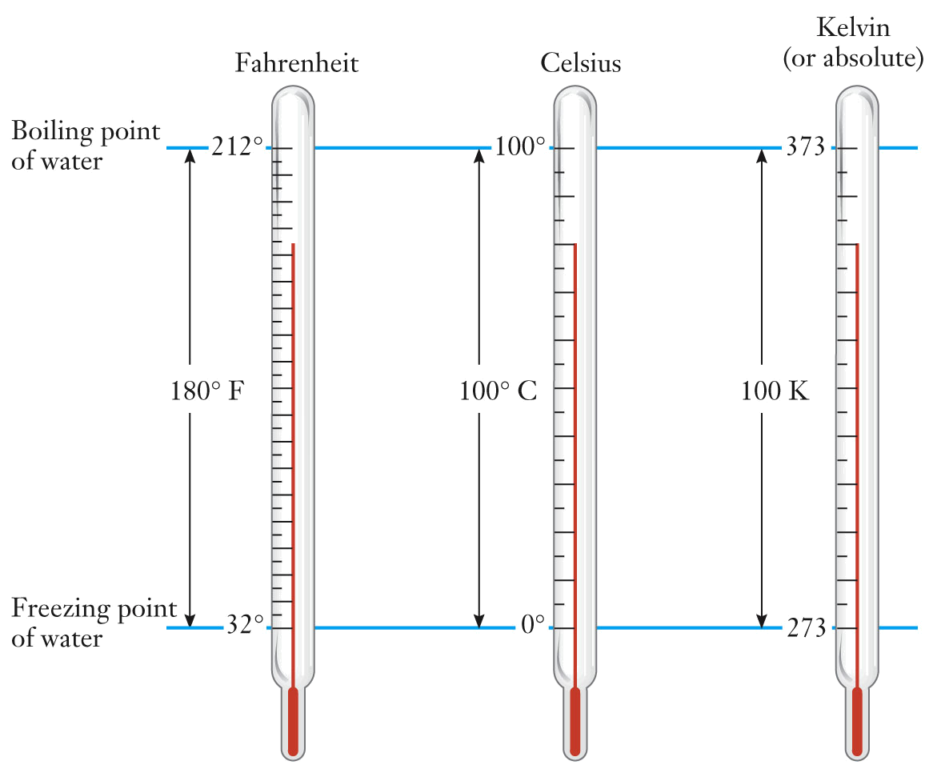
Temperature Scales
Temperature is measured using the Fahrenheit, Celsius, and Kelvin (absolute) temperature scales

Slide 30
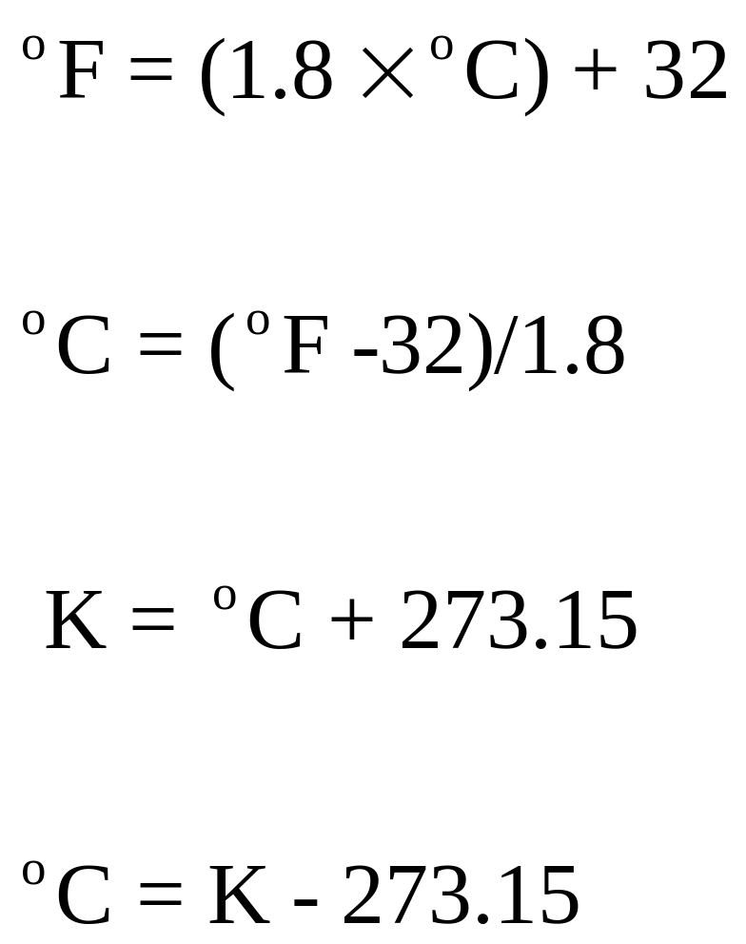
Temperature Conversions

Slide 31
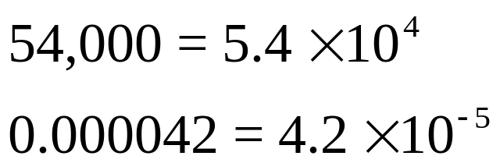
Scientific Notation
Scientific notation is used to conveniently write very small and very large numbers.
  Factor out powers of ten

Slide 32
Significant Figures
All digits reported for measurements are considered significant except for certain types of zeros.
  When a zero establishes the decimal place, it is not significant.
    51,300 m (3 significant figures)
    0.043 g (2 significant figures)
  A zero is significant when it follows a decimal point or when it occurs between other significant figures.
    4.30 mL (3 significant figures)
    304.2 kg (4 significant figures)
  All numbers are significant when written in correct scientific notation.

Slide 33
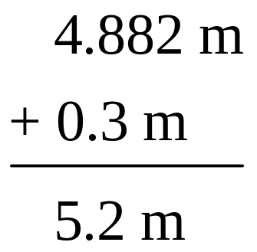
Calculations with Significant Figures
For values calculated from measurements, the number of significant figures should be consistent with the data used in the calculation.
  For multiplication and division, the number of significant figures in a result must be the same as the number of significant figures in the factor with the fewest significant figures.
  For addition and subtraction, the number of significant figures are determined from the position of the first uncertain digit.

Slide 34
Calculations with Significant Figures
Report the result for the indicated arithmetic operations using the correct number of significant figures. Assume all values are measurements and not exact numbers.
  4.30 × 0.31
  4.033 + 88.1
  5.6 / 17.32

Slide 35
Significant Figures
When counting discrete objects, the result has no ambiguity. Such measurements are exact numbers. They have infinite significant figures.
  two pennies would be 2.000000…
  one dozen would be 12.000000…
Exactly defined terms, such as metric prefixes or π, are also considered exact numbers.

Slide 36
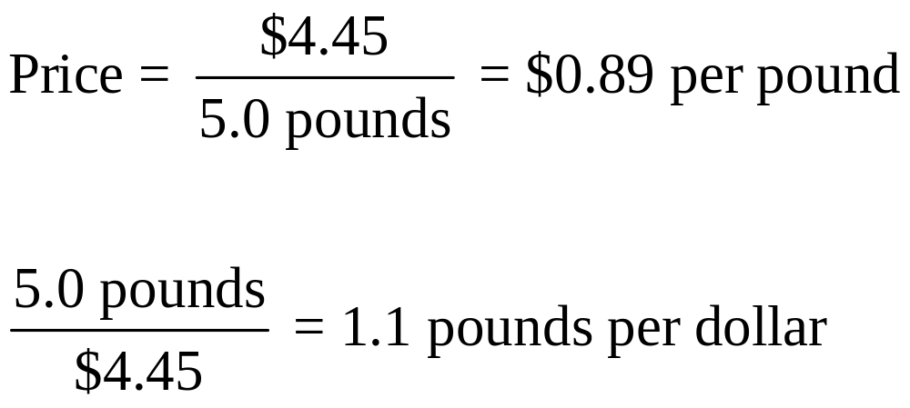
Problem Solving
Ratios represent the relationship between two quantities and can be expressed two ways:

Slide 37
Problem Solving
Suppose that your supermarket is offering 25-count shrimp for $4.99 per pound. How much should you expect to pay for one dozen shrimp?

Slide 38
Properties of Matter
Physical properties can be extensive or intensive
  1. Extensive properties
  a. vary with the amount (extent) of the substance
  b. include mass, weight, and volume
  2. Intensive properties
  a. do not depend on the amount of the substance
  b. include color, melting and boiling points, electrical conductivity, thermal conductivity, refractive index, hardness, odor, and physical state at a given temperature,
  c. determine a substance’s identity
  d. An example of an important intensive property is density (d or ρ), a ratio of two extensive properties, mass and volume
  density = mass ρ = m
  volume V

Slide 39
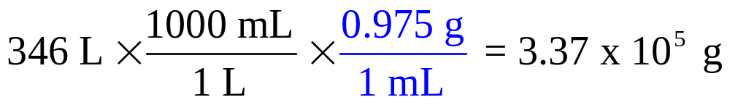
Problem Solving
Mass density - ratio of an object’s mass to its volume
  Temperature- and compound-specific
  Allows conversion between mass and volume
  Units of measurement can be used to determine how to write the appropriate ratio by “canceling” out;
  called the dimensional analysis or the factor-label method.

Slide 40
Problem Solving
The density of water at 25 ºC is 0.997 g/mL. A child’s swimming pool holds 346 L of water at this temperature. What mass of water is in the pool?

Slide 41
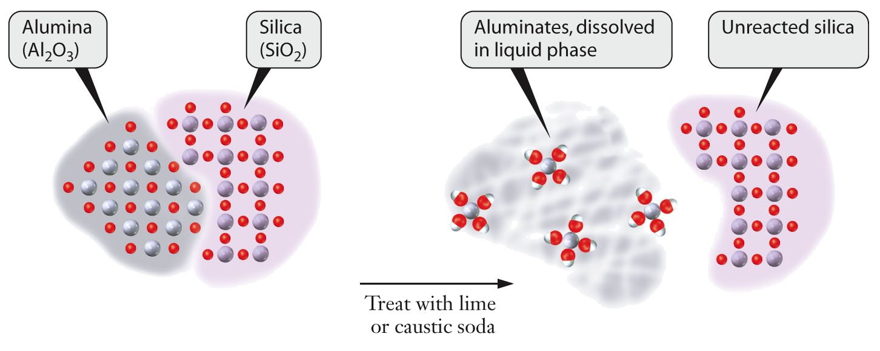
Problem Solving
Depictions of atoms and molecules provide an important tool in chemistry.
Digestion of bauxite ore with aqueous caustic soda, separating the alumina from silica in the ore.

Slide 42
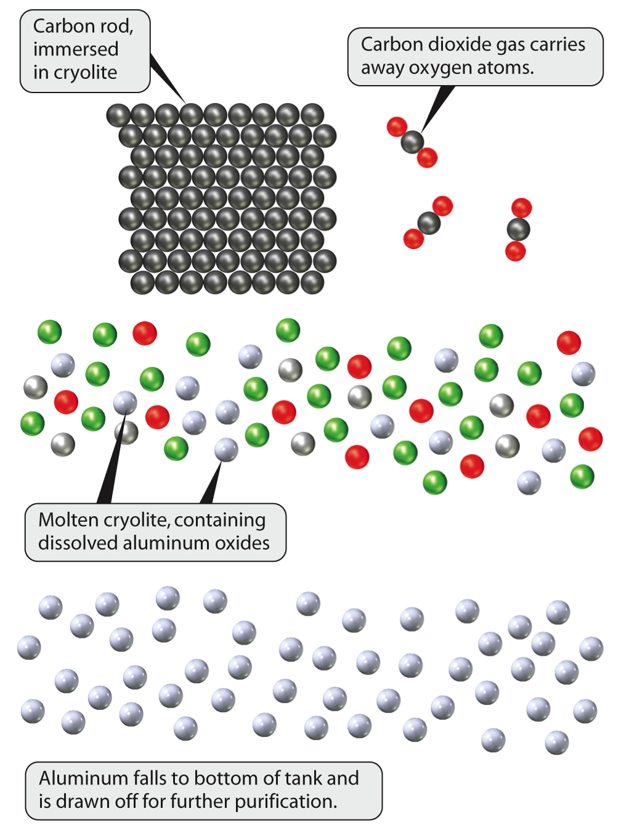
Problem Solving
A simplified view of the atomic scale process involved in smelting aluminum.

Slide 43
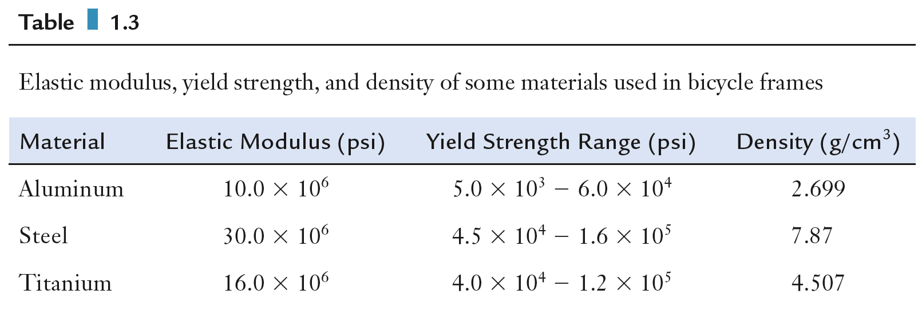
Problem Solving
Elastic modulus (a substance’s tendency to be deformed in a nonpermanent manner), yield strength (point at which deformation becomes permanent), and density of some materials used in bicycle frames.

