Slide 1
Chapter 2
Atoms and Molecules

Slide 2
Atomic Structure and Mass
Matter is composed of atoms.
  Atoms have a nucleus which contains protons and neutrons.
  The nucleus is surrounded by a cloud of electrons.
  The nucleus is a very small fraction of the volume of an atom.

Slide 3
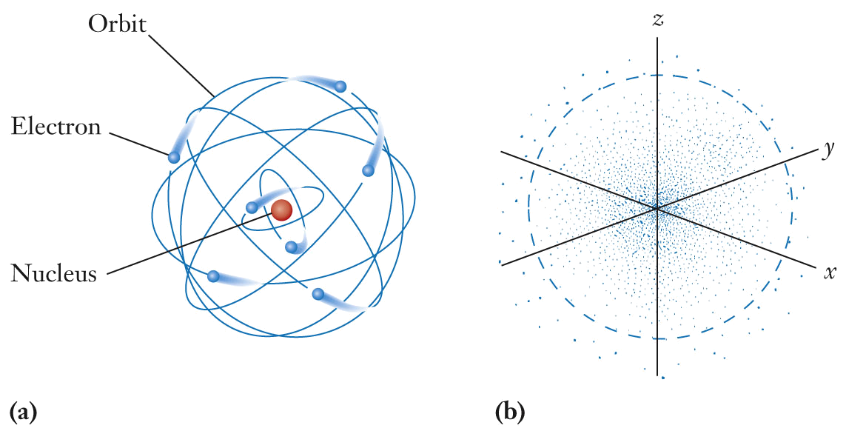
Fundamental Concepts of the Atom
Solar system depiction of atomic structure.
  Emphasizes proton, neutron and electron distribution; does not accurately depict the currently accepted model of atomic structure

Slide 4
Fundamental Concepts of the Atom
Electrons are depicted as clouds of negative charge surrounding the nucleus.
  The density of the small dots is related to the probability of finding an electron at a particular location.

Slide 5
Atomic Number and Mass Number
The atomic number, Z, is the number of protons in a nucleus.
  identifies the element
The mass number, A, is the sum of the number of protons and number of neutrons in a nucleus.

Slide 6
Atomic Number and Mass Number
1 amu = 1.6605 x 10⁻²⁴ g
Protons and neutrons are nearly 2000 times more massive than electrons
Particle | Mass (amu) | Charge
Proton | 1.007 | +1
Neutron | 1.009 | 0
Electron | 0.00055 | –1

Slide 7
Isotopes
Isotopes are atoms of an element that differ in the number of neutrons in their nucleus.
Isotopic abundance is the mass percentage of an isotope in a naturally occurring element.
Isotopes have the same atomic number but different mass number (the same number of protons but a different number of neutrons).

Slide 8
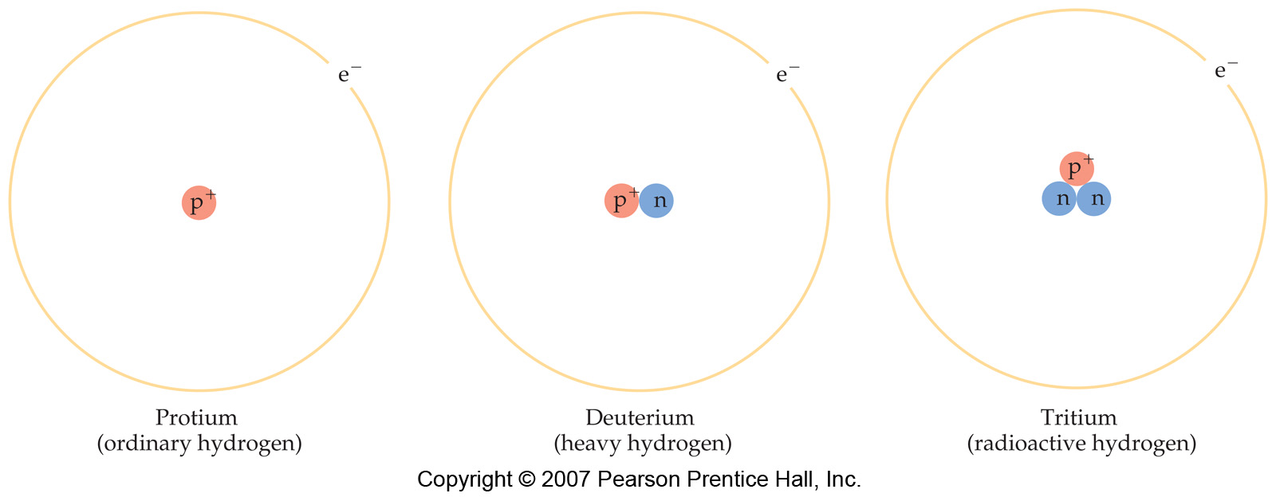
Isotopes of Hydrogen

Slide 9
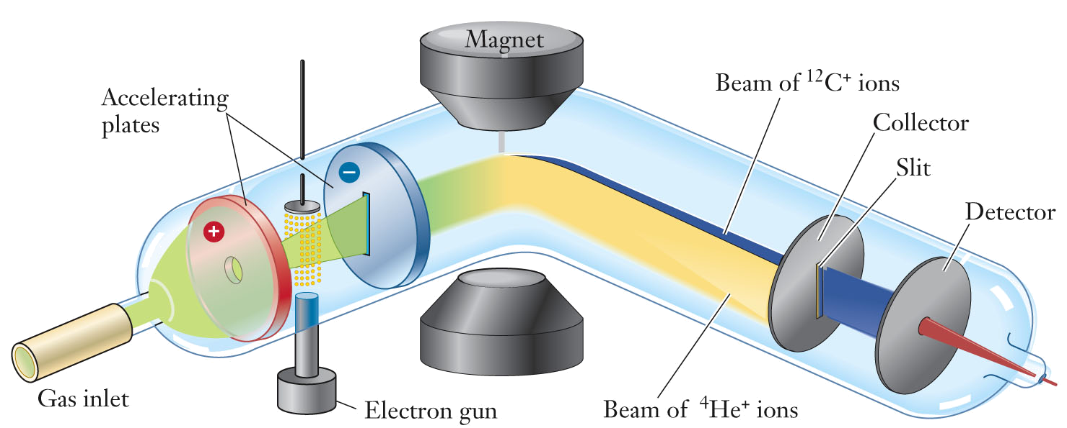
Isotopes
Mass spectrometers are used to measure the masses of atoms, isotopes, and molecules.

Slide 10
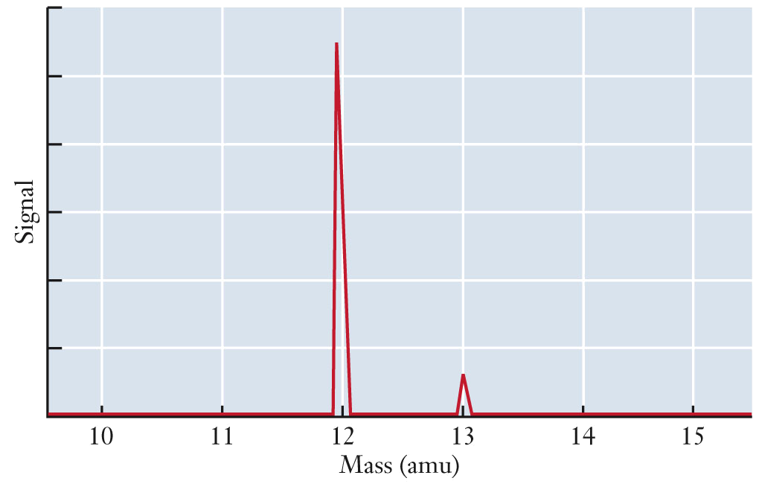
Isotopes
Mass spectrum showing carbon isotopes.

Slide 11
Atomic Symbols
Information regarding atomic structure is written in scientific shorthand called the atomic symbol.
  X represent the atomic symbol for an element
        A = mass number
        Z = atomic number
        A
        X
        Z

Slide 12
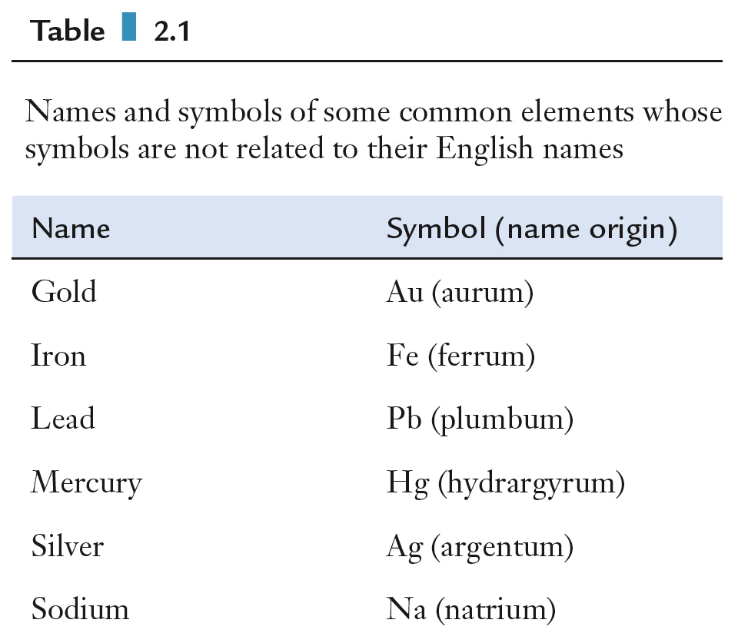
Atomic Symbols

Slide 13
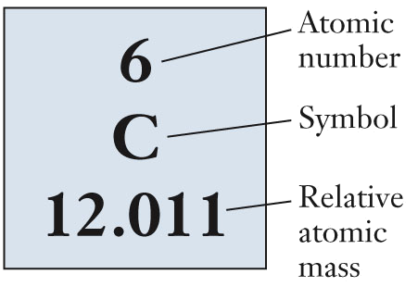
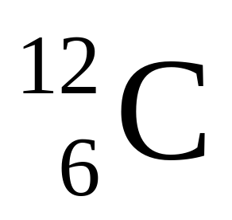
Atomic Masses
Carbon on the periodic table.
  Z = 6
  Relative atomic mass = 12.011 amu
  (~99% carbon-12)
  Element symbol: C

Slide 14
Atomic Masses
Relative atomic mass for an element is a weighted average of the atomic masses for the naturally occurring isotopes for an element.
  ¹²₆C = Carbon-12 = 12.0000 x 0.9893 = 11.87 amu
  ¹³₆C = Carbon-13 = 13.0036 x 0.0107 = 0.139 amu
  Average mass = 11.87 + 0.139 = 12.01 amu

Slide 15
Atomic Masses
Chlorine has two stable isotopes:
³⁵₁₇Cl, with a mass of 34.97 amu, and 75.77% abundance; and
³⁷₁₇Cl, with a mass of 36.95 amu, and 24.23% abundance.
What is the relative atomic mass of chlorine?

Slide 16
Ions
Ions are formed when the number of protons and electrons in an atom are not equal.
  Ions with more protons than electrons are called cations.
    net positive charge
  Ions with more electrons that protons are called anions.
    net negative charge
A monatomic ion is derived from a single atom.
A polyatomic ion is derived from a group of atoms with an overall charge.

Slide 17
Ions
Ion:
an atom or a group of atoms bonded together (a polyatomic ion) with an electrical charge
Anion: a negatively charged ion
- attracted toward the anode
Cation: a positively charged ion
- attracted toward the cathode

Slide 18
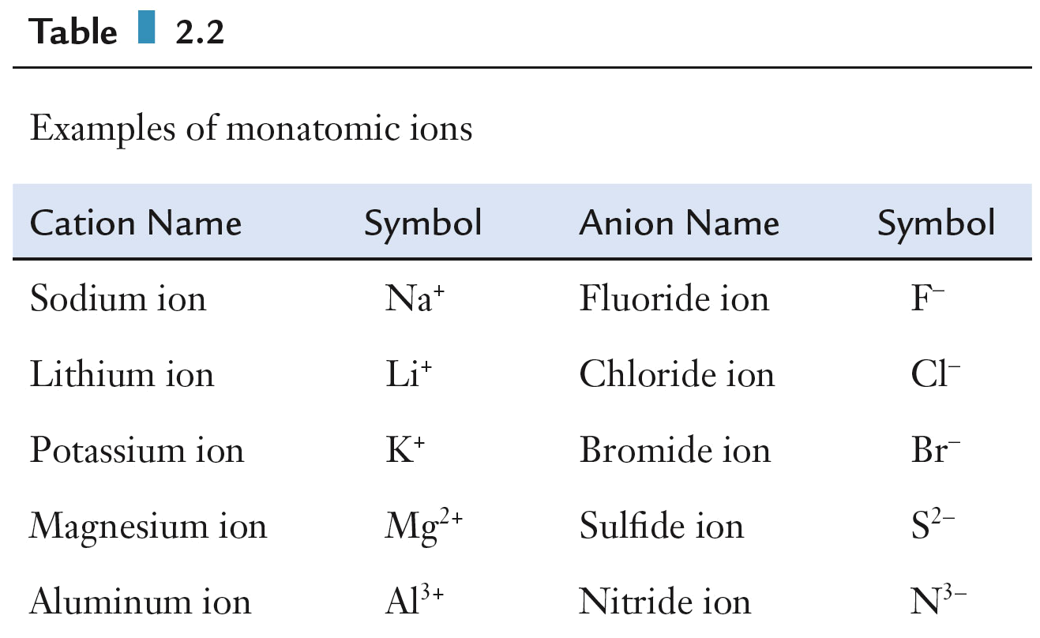
Monatomic Ions

Slide 19
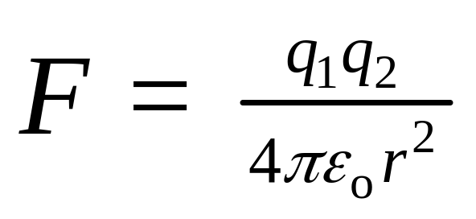
Ionic Forces
Coulombs’ Law states that the force between ions is proportional to the product of the ion charges divided by distance squared.
  Opposite charges attract and like charges repel.
    q₁ and q₂ are charges;
    ε₀ and π are constants;
    r is the distance between the charges
  Electric charge is conserved.

Slide 20
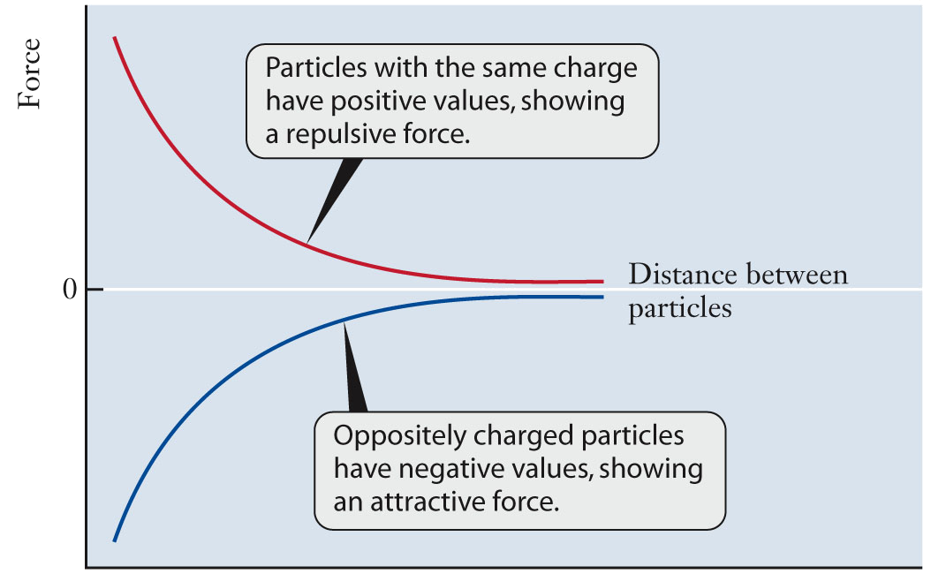
Ionic Forces
The electrical force varies inversely with the distance, r², between charged particles.

Slide 21
Ionic Forces
An element and its ion have nearly the same chemical symbol but different properties.
  Sodium metal atoms lose an electron to form sodium cations.
    Sodium metal reacts violently with water.
  Chlorine gas molecules gain electrons to form chlorine anions (chloride ions).
    Chlorine gas reacts violently with sodium metal.
  Ionic compounds containing sodium cations and chlorine anions dissolve in water without reacting.

Slide 22
Chemical Formulas
Chemical formulas describe a compound in terms of the elements the compound contains.
  The number of atoms for each element is indicated by a subscript to the right of the chemical symbol.
    Groups of atoms can be designated using parentheses. Subscripts outside these parentheses mean that all atoms enclosed in the parentheses are multiplied by the value indicated by the subscript.
    Water molecules associated with certain compounds, called hydrates, are indicated separately from the rest of the compound.

Slide 23
Chemical Formulas
Chemical formulas describe a compound in terms of the elements the compound contains.
  The number of atoms for each element is indicated by a subscript to the right of the chemical symbol.
    Groups of atoms can be designated using parentheses. Subscripts outside these parentheses mean that all atoms enclosed in the parentheses are multiplied by the value indicated by the subscript.
    Water molecules associated with certain compounds, called hydrates, are indicated separately from the rest of the compound.

Slide 24
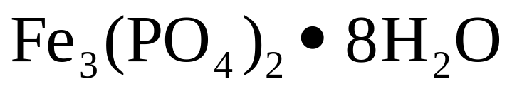
Chemical Formulas
    This compound contains:
    3 atoms of iron
    2 atoms of phosphorus
    16 atoms of oxygen
    16 atoms of hydrogen

Slide 25
Chemical Formulas
One polymerization initiator is diethylaluminum chloride, Al(C₂H₅)₂Cl
How many of each type of atom are in a molecule of this compound?

Slide 26
Chemical Formulas
Compounds have different properties than their constituent atoms.
Ionic compounds contain cations and anions, usually arranged in a lattice.
Molecular formulas for covalent compounds indicate the elements and number of atoms of each element actually contained in a discrete unit of a compound.
Empirical formulas indicate the smallest whole number ratio between the number of atoms of each element in a molecular formula. Ionic compounds are written as empirical formulas.

Slide 27
Chemical Bonds
All bonds are created by either the exchange or the sharing of electrons.
  The exchange or sharing of electrons results in a lower potential energy for the compound relative to the separate atoms.
    Ionic: exchange; cations and anions present
    Metallic: sharing by forming a mobile “sea of electrons”
    Covalent: sharing between atoms

Slide 28
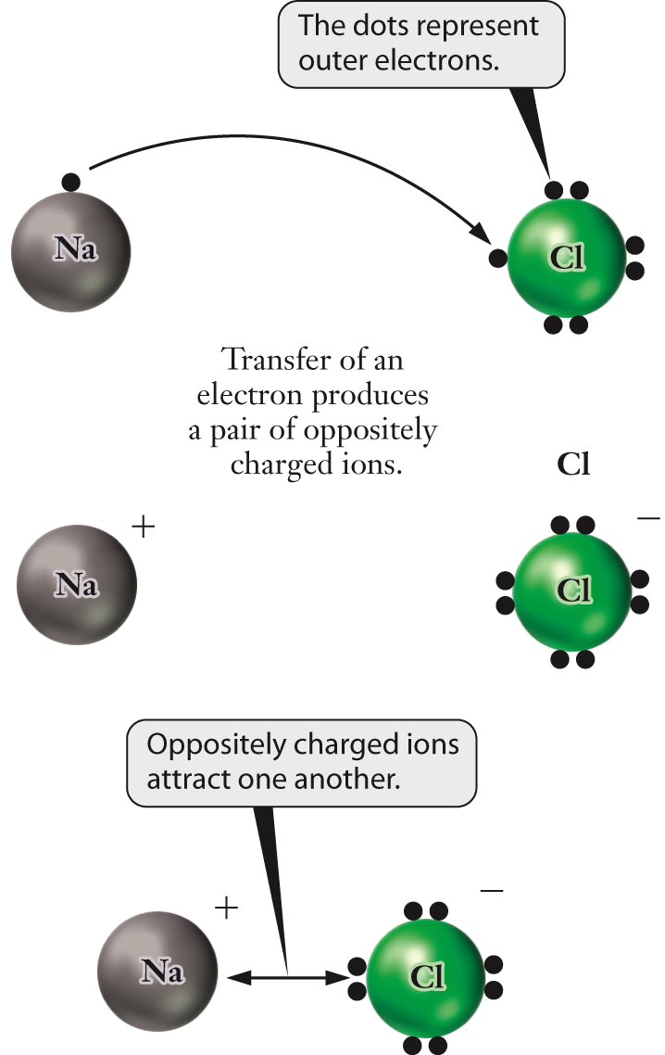
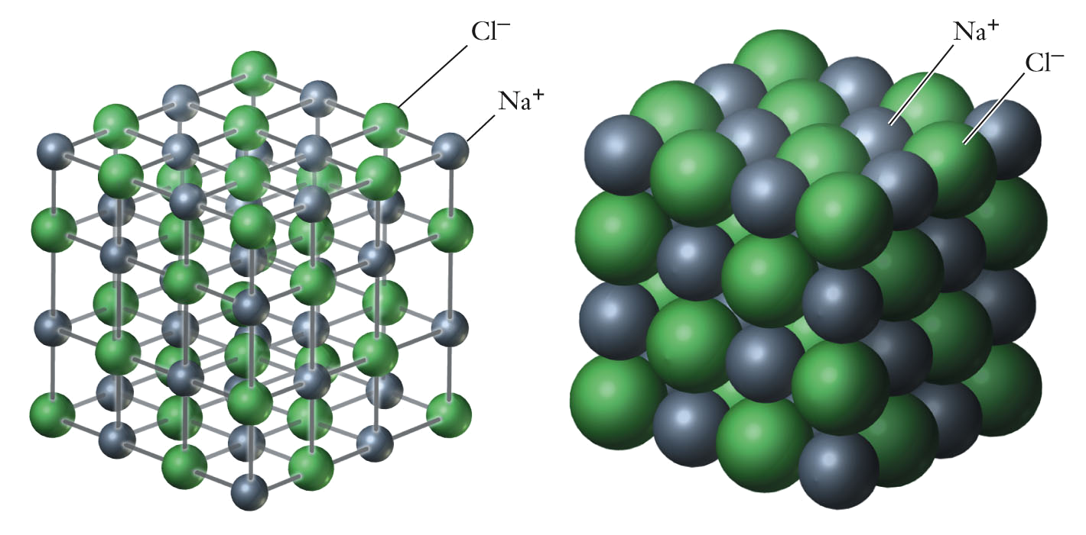
Ionic Bonds
Ionic bonding occurs when ions assemble into an extended array called a lattice and are held together by the attraction between oppositely charged ions.

Slide 29
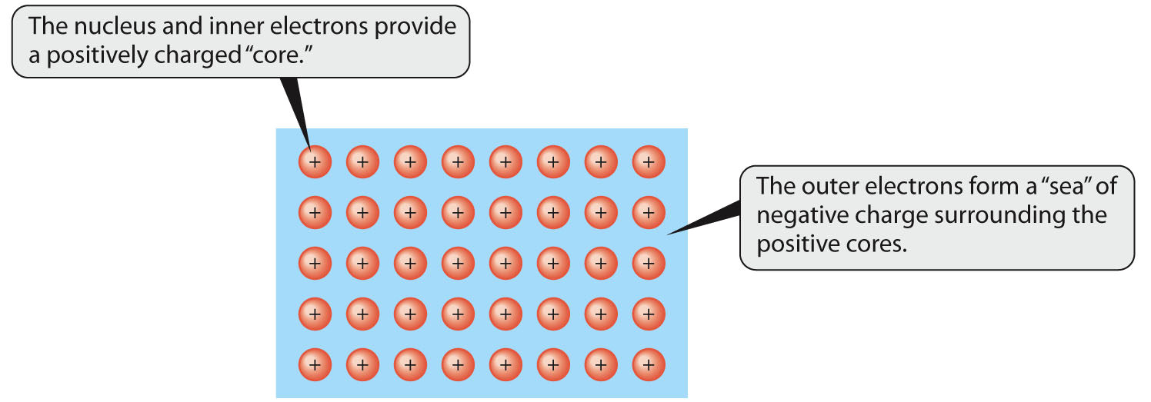
Metallic Bonds
Positively charged metal nuclei arranged in a lattice. Electrons move, more or less, freely throughout the whole lattice.
  Free movement allows metals to conduct easily heat and electricity

Slide 30
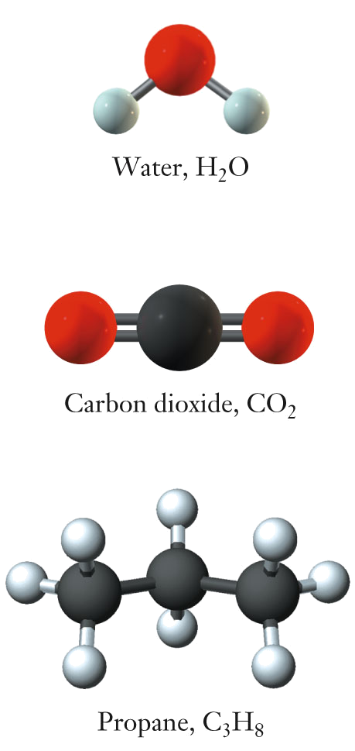
Covalent Bonds
In covalent bonds, electrons are shared, usually in pairs.
  One pair (single bond), two pairs (double bond), or three pairs of electrons (triple bond) can be shared between two nuclei.
    One pair of electrons is shared between each atoms within water and propane
    Two pairs are shared between atoms in carbon dioxide.

Slide 31
The Periodic Table
The Periodic Table is considered to be the most predictive tool in all of chemistry.
It is composed vertical columns called groups (or families) and horizontal rows called periods.

Slide 32
The Periodic Table
Groups: vertical column in the periodic table. Groups contain elements with similar chemical properties.
Periods: horizontal rows of the periodic table. Elements in a period demonstrate a range of properties from metallic on the left to nonmetallic on the right.

Slide 33
The Periodic Table
1. Elements in a column, called a group, have similar chemical properties.
2. Metals, non-metals, and the noble gases occupy their own regions.
3. Chemical properties are periodic.
A chemical reaction involves the rearrangement of atoms to form new compounds.

Slide 34
The Periodic Table
Elements are arranged in order of increasing atomic number and by similar properties.
NOT arranged in order of atomic mass.
7. Atoms can be subdivided into subatomic particles: protons, electrons, and neutrons.
8. The atomic number corresponds to the number of protons in the nucleus of the atom.
9. The atomic mass of each element is shown on the periodic table. The mass is measured in atomic mass units.

Slide 35
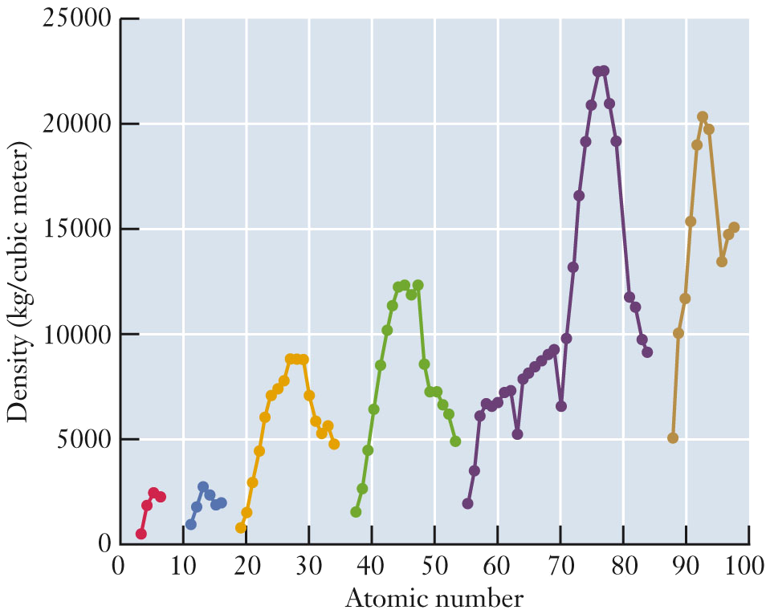
The Periodic Table
Plot of density versus atomic number.
  colors represent periods
  note trends within periods

Slide 36
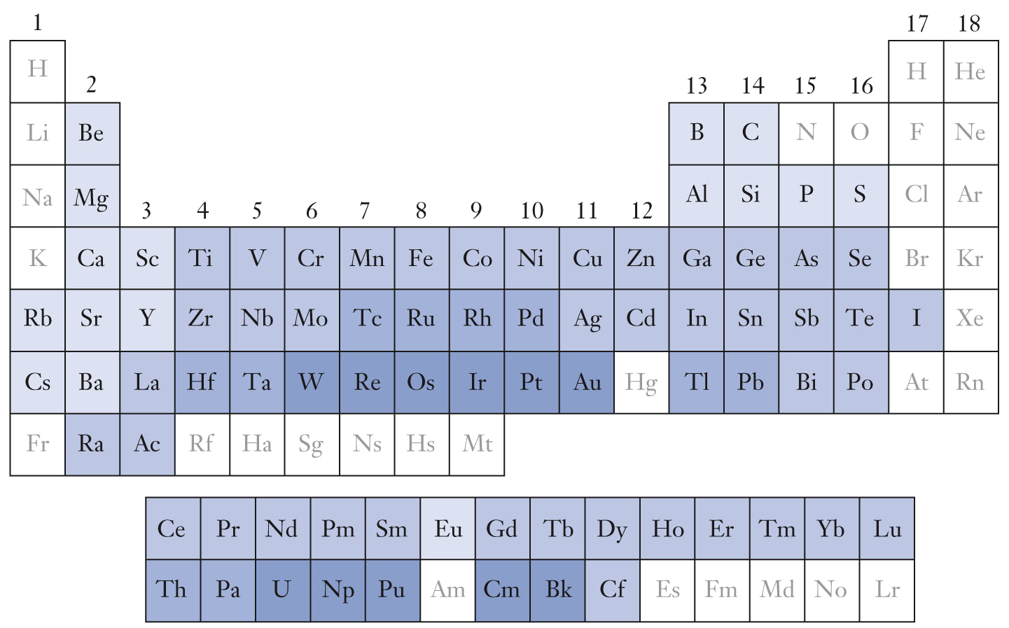
Periodic Trends
Density data represented with shading

Slide 37
The Periodic Table
Common names of specific groups
  Group 1: alkali metals
  Group 2: alkaline earth metals
  Group 17: halogens
  Group 18: noble gases
Table regions
  Groups 1 - 2 and 13 - 18 are main group elements
  Groups 3 - 12 are transition metals
  Lanthanides and actinides are below the rest of the table

Slide 38
The Periodic Table
Metals are generally toward the left and bottom of the periodic table. They are shiny, malleable, and ductile. They conduct current and heat very well, and easily form cations. Most metal names have the –ium ending.
Nonmetals occupy the upper right-hand portion of the periodic table. They are not shiny, malleable, nor ductile. They do not conduct current nor heat very well, and easily form anions.
Metalloids, or semimetals, have chemical properties intermediate between metals and nonmetals. Metalloids are clustered along a diagonal line on the periodic table between the metals and nonmetals.

Slide 39
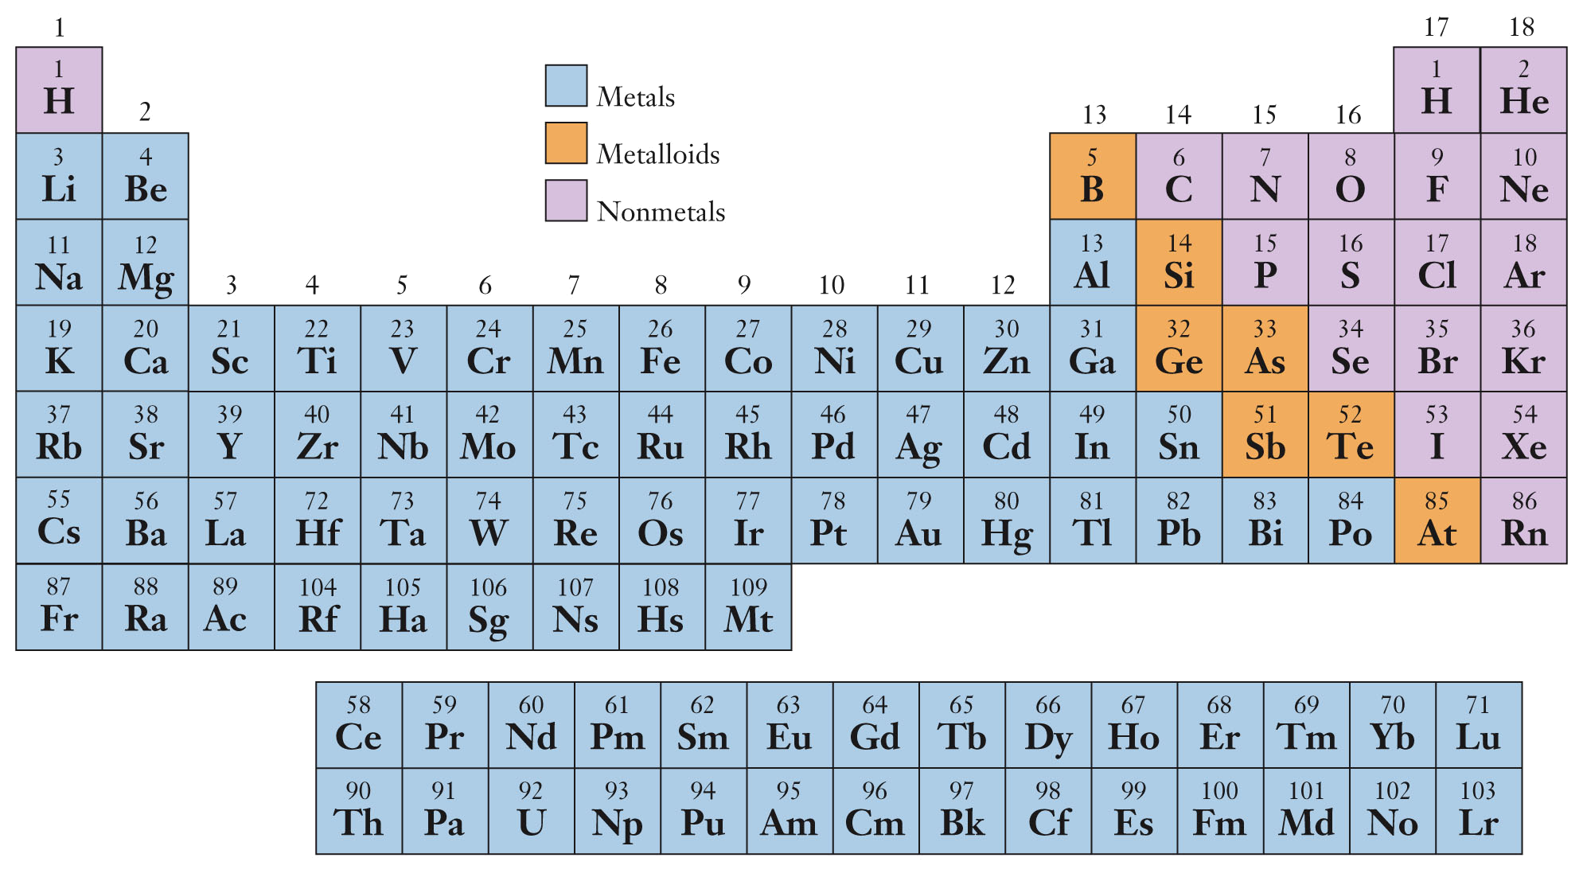
The Periodic Table
blue = metals, orange = metalloids, purple = nonmetals

Slide 40
Inorganic and Organic Chemistry
Organic chemistry is the study of the compounds of the element carbon, usually with oxygen, nitrogen, and hydrogen.
  More than 18 million organic compounds have been prepared
  Includes biological molecules and nearly all synthetic polymers.
  Isomers: Different organic molecules that have the same formula but are connected differently.
Inorganic chemistry is the study of all other elements and their compounds.

Slide 41
The Periodic Table
blue = metals, orange = metalloids, purple = nonmetals

Slide 42
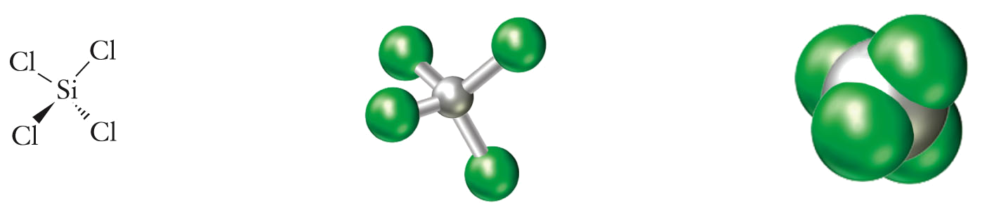
Inorganic Compounds
Many main group inorganic compounds exist as relatively small molecules whose atoms are joined together through covalent bonds.
Other main group compounds form extended ionic structures, such as that of NaCl.

Slide 43
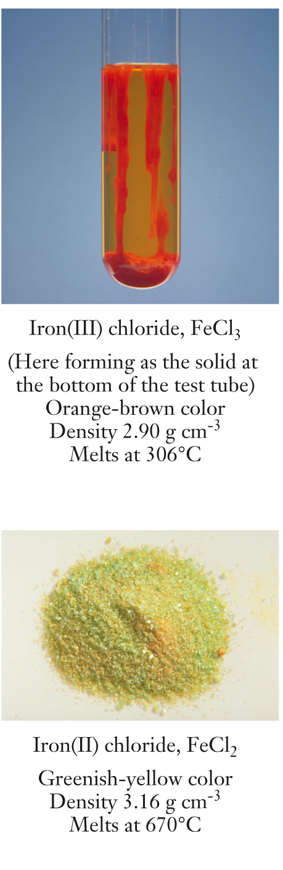
Transition Metals
Transition metal cations have variable charge, resulting in a variety of compounds with different chemical and physical properties. Because of the variable charge, the ion’s charge has to be indicated.
Transition metal chemistry is more complicated than main group metal chemistry

Slide 44
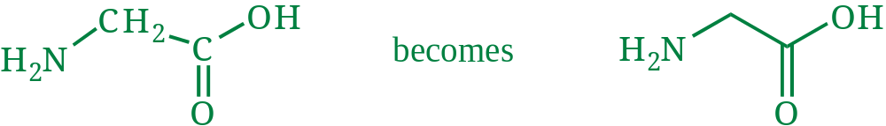
Line Structures
Because carbon compounds can become quite large, organic compounds are described simply and unambiguously using line structures, where carbons and hydrogens are not explicitly shown.
  Each corner or end of a line is a carbon.
  Hydrogen atoms on carbon atoms are implied. Carbon makes four bonds, “missing” bonds go to hydrogen atoms. Hydrogen can only make one covalent bond to another atom.
  Hydrogen atoms on any other element are shown
  All other elements are shown

Slide 45
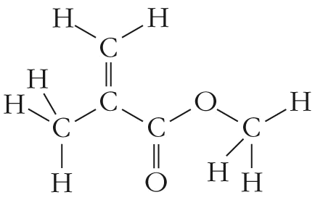
Line Structures
The structural formula for methyl methacrylate, the monomer unit of Plexiglas®, is shown below. What is the corresponding line structure for this compound?

Slide 46
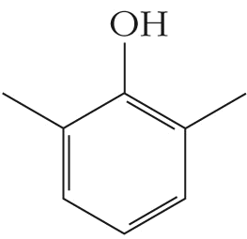
Line Structures
The line structure below represents 2,6-dimethylphenol. What is its molecular formula?

Slide 47
Nomenclature
Chemical nomenclature is a systematic means of assigning unique names to chemical compounds.
Binary compounds contain only two elements.
  Covalent binary compounds are named differently from ionic binary compounds.
  Recognizing a compound as ionic or covalent assists in naming.
    A metal and a nonmetal generally combine to form ionic compounds.
    Two nonmetals generally combine to form a covalent compound.
    The presence of polyatomic ions indicates ionic bonding.

Slide 48
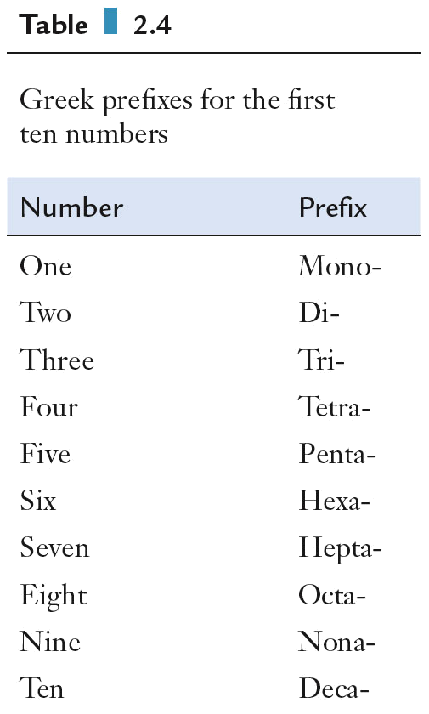
Nomenclature for Covalent Compounds
The first element in the formula retains its full name.
The second element is named by replacing the ending from its name with the suffix -ide.
Both elements are preceded by a number-designating prefix, except when there is only one atom of the first element, which will not use the prefix mono-.

Slide 49
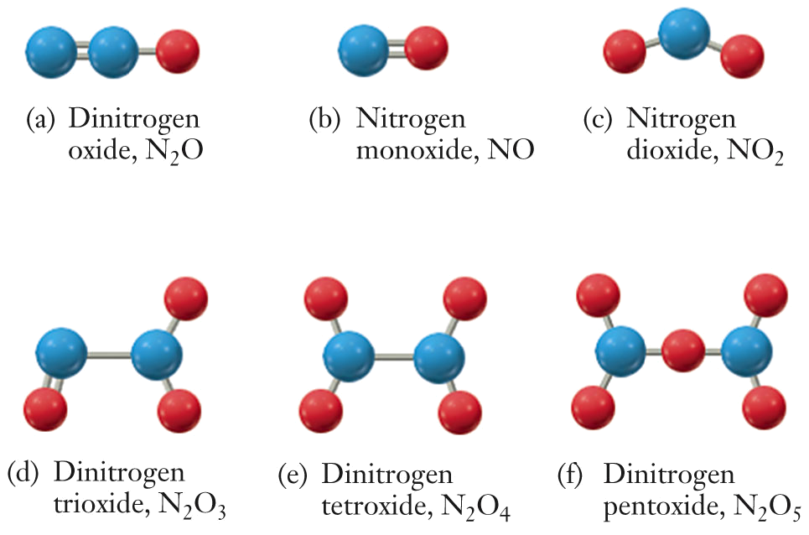
Covalent Compounds

Slide 50
Covalent Compounds
What are the systematic names of the following compounds?
  N₂O₅
  PCl₃
  P₄O₆

Slide 51
Nomenclature for Ionic Compounds
Ionic compounds are electrically neutral and are named in order of “cation anion”, as in sodium chloride.
  The cation retains its full name.
    Monoatomic cation charge can usually be found by position in the periodic table.
    Cations with more than one charge (e.g., transition metals) are named using Roman numerals indicating the charge, e.g., iron(II)
  Monatomic anions are named by replacing the ending of the element name with the suffix -ide, e.g., bromide
  A polyatomic cation or anion is named using its common name.

Slide 52
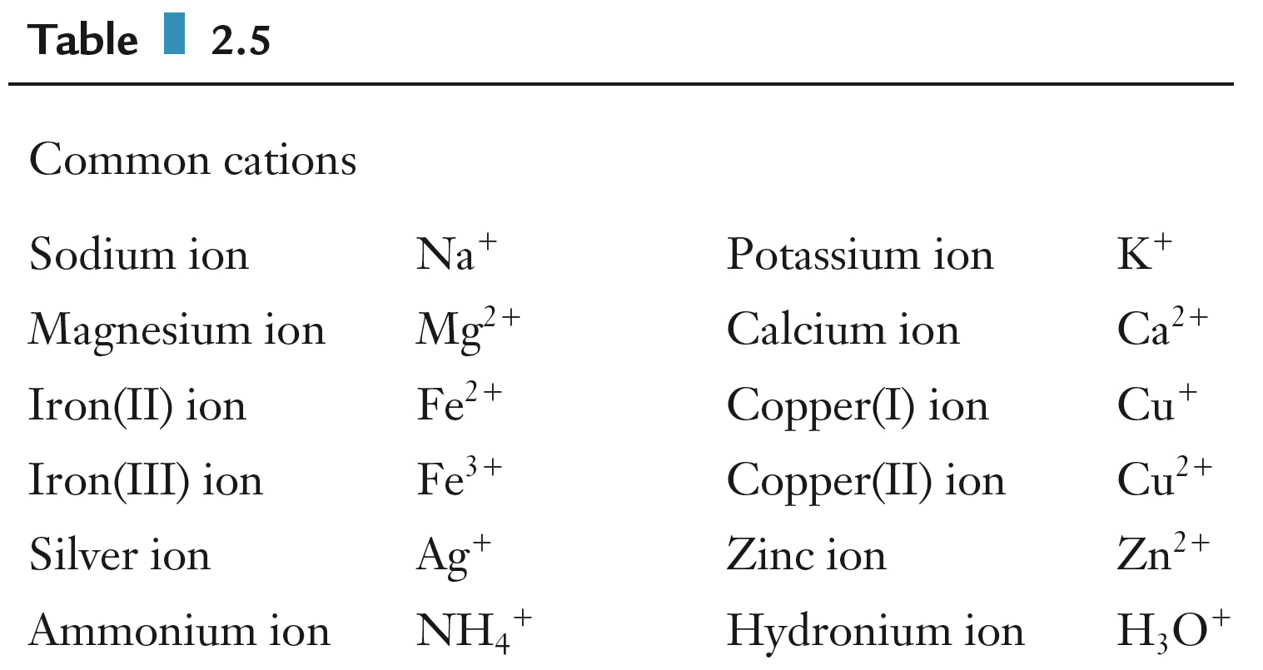
Cations

Slide 53
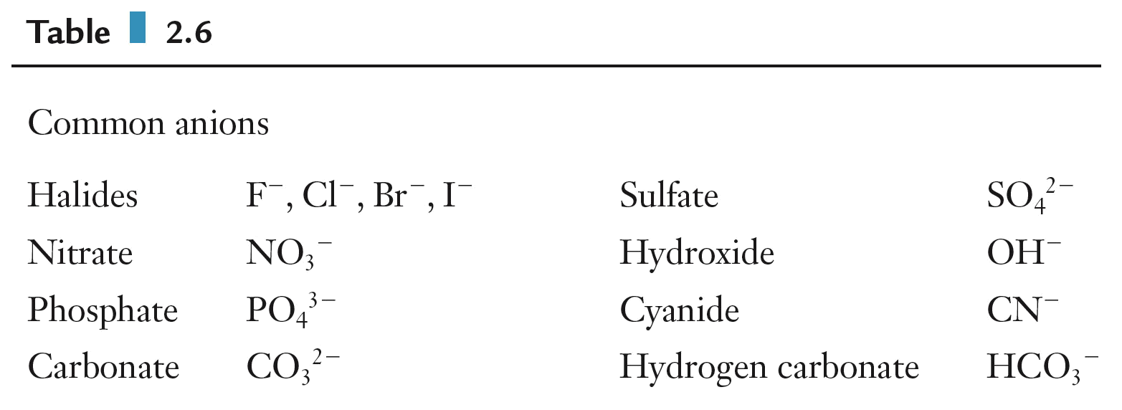
Anions
The charge and chemical formula for the polyatomic ions should be memorized.

Slide 54
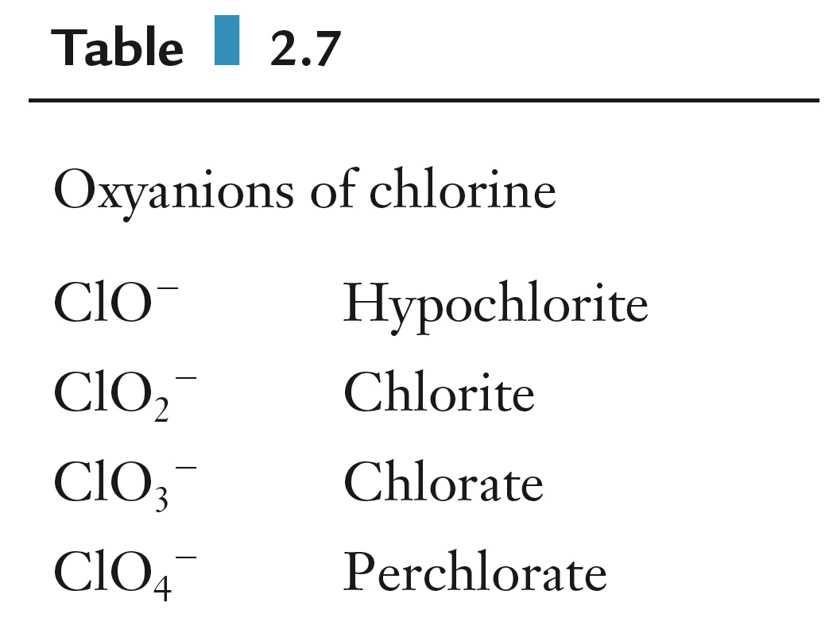
Oxyanions
Polyatomic ions containing oxygen and another element are oxyanions.
  Base name provided by element that is not oxygen.

Slide 55
Ionic Compound Nomenclature
Determine the names of the following ionic compounds:
  Fe₂O₃
  Na₂O
  Ca(NO₃)₂

