Slide 1
Chapter 3
Molecules, Moles, and Chemical Equations

Slide 2
Question
What is the name for P₄O₁₀
phosphorus decoxide
tetrapotassium decoxide
tetraphosphorus decoxide
phosphorus oxide
potassium oxide

Slide 3
Question
What is the name for CuBr₂
copper bromide
copper dibromide
cobalt(II) dibromide
copper(II) bromide
copper dibromine

Slide 4
Question
What is the name of the group which contains Cl ?
alkaline earth metal
noble gas
halogen
alkaline metal
lanthanoid

Slide 5
Chemical Formulas and Equations
Chemical formulas provide a concise way to represent chemical compounds.
  E.g., nitroglycerin is C₃H₅N₃O₉
  water is H₂O
  table salt is NaCl
A chemical equation builds upon chemical formulas to concisely represent a chemical reaction.

Slide 6
E
Chemical Equations
Chemical equations represent the transformation of one or more chemical species into new substances.
  Reactants are the original materials and are written on the left-hand side of the equation.
  Products are the newly formed materials and are written on the right-hand side of the equation

Slide 7
Chemical Equations
Chemical formulas represent reactants and products.
Phase labels follow every chemical formula.
  solid = (s)
  liquid = (ℓ)
  gas = (g)
  aqueous (substance dissolved in water) = (aq)
Some reactions require an additional symbol placed over the reaction arrow to specify reaction conditions.
  Thermal reactions: heat (Δ)
  Photochemical reactions: light (hν)

Slide 8
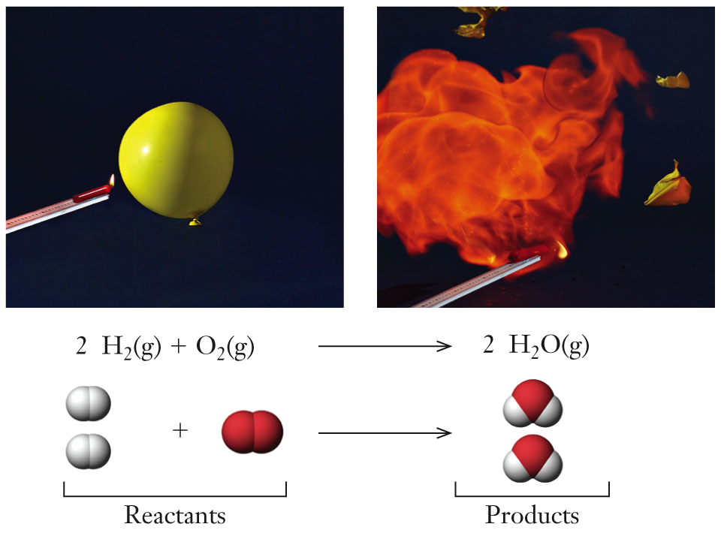
Chemical Equations
Different representations for the reaction between hydrogen and oxygen to produce water.

Slide 9
Conservation of Matter
The law of conservation of matter:
Matter is neither created nor destroyed;
It just gets rearranged.
  Chemical reactions must obey the law of conservation of matter.
    The same number of atoms for each element must occur on both sides of the chemical equation.
    A chemical reaction rearranges the atoms into new compounds.

Slide 10
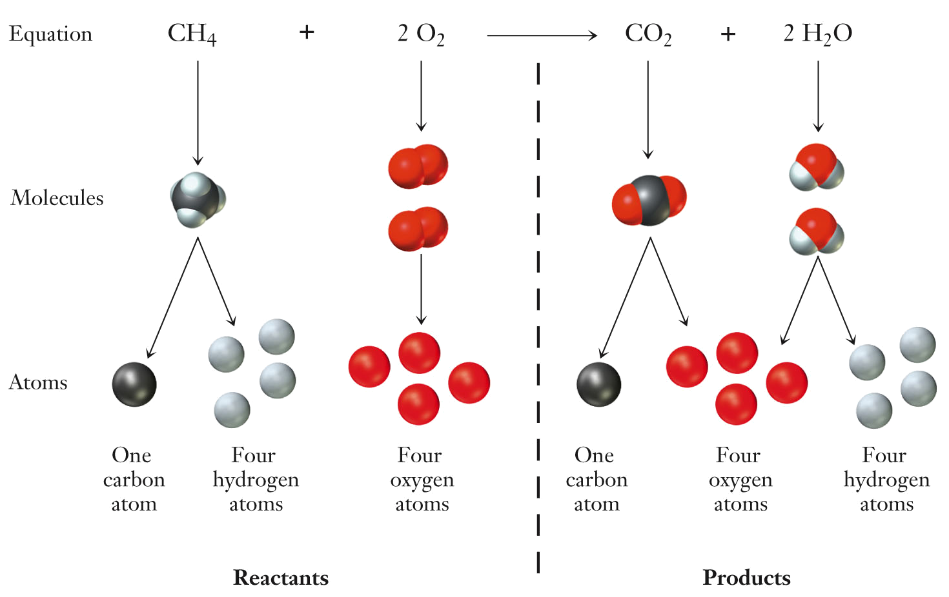
Balancing Chemical Equations
The balanced chemical equation for the combustion of methane:

Slide 11
Balancing Chemical Equations
Chemical equations may be balanced by inspection, which really means by trial and error.
  Numbers used to balance chemical equations are called stoichiometric coefficients.
    The stoichiometric coefficient multiplies the number of atoms of each element in the formula unit of the compound that it precedes.
  Stoichiometry is the various quantitative relationships between reactants and products.

Slide 12
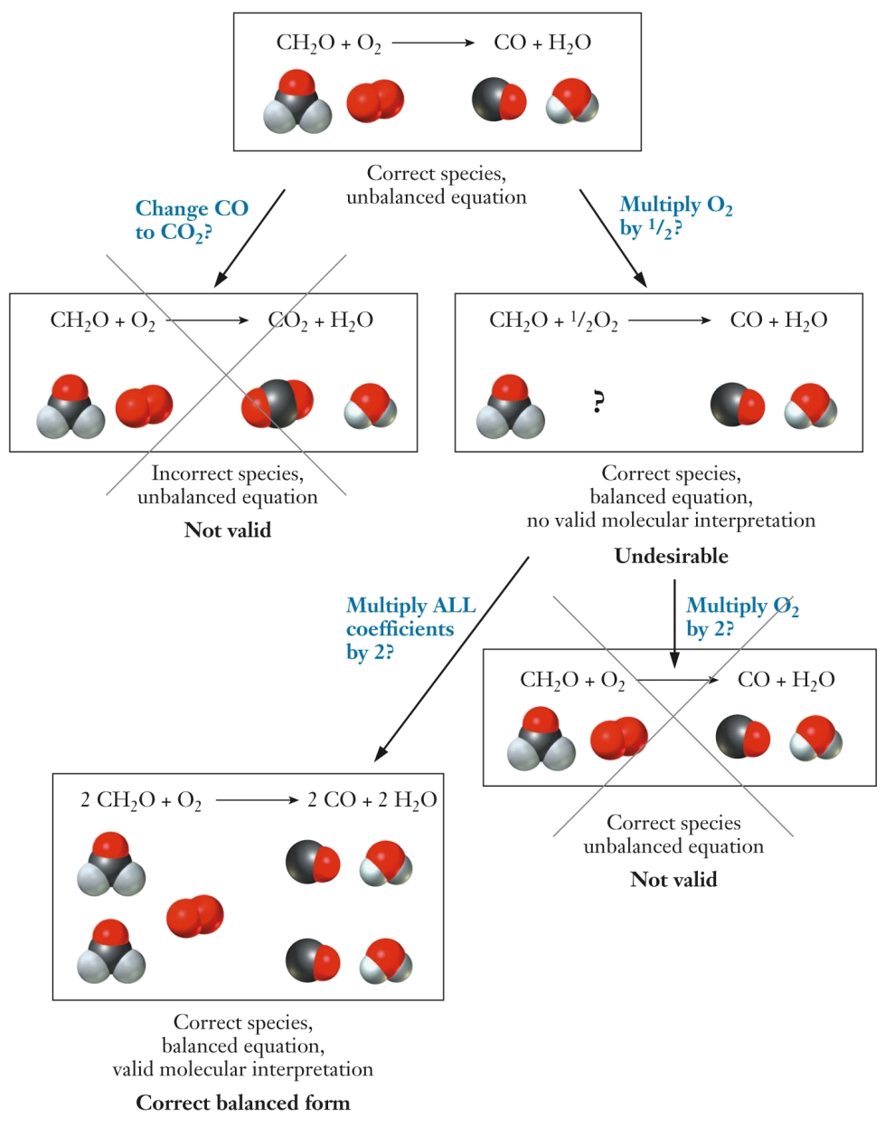
Balancing Chemical Equations
Pay attention to the following when balancing chemical equations:
  Do not change chemical formulas.
  Do not use fractions (cannot have half a molecule).
  Make sure you have the same number of atoms of each element on both sides.

Slide 13
Balancing Chemical Equations
Write a balanced chemical equation describing the reaction between propane, C₃H₈, and oxygen, O₂, to form carbon dioxide and water.

Slide 14
Aqueous Solutions
Reactions that occur in water are said to take place in aqueous solution.
  Solution: homogeneous mixture of two or more substances.
    Solvent: the solution component present in greatest amount.
    Solute: the solution component present in lesser amount.
    The preparation of a solution is a common way to enable two solids to make contact with one another.

Slide 15
Solutions, Solvents, and Solutes
For solutions, the concentration is a key piece of information.
  Concentration: relative amounts of solute and solvent.
  Concentrated solution: many solute particles are present.
  Dilute solution: few solute particles are present.

Slide 16
Solutions, Solvents, and Solutes
Compounds can be characterized by their solubility.
  Soluble compounds dissolve readily in water.
  Insoluble compounds do not readily dissolve in water.
  This is a continuum rather than discrete categories.
Solubility can be predicted using solubility guidelines.

Slide 17
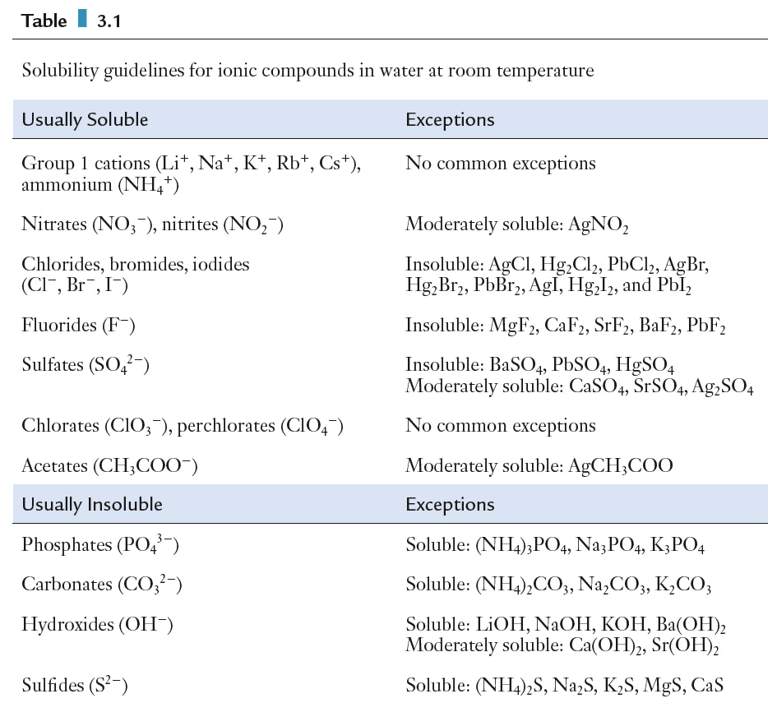
Solutions, Solvents, and Solutes
Solubility guidelines for soluble salts:

Slide 18
Solutions, Solvents, and Solutes
Solubility guidelines for insoluble salts:

Slide 19
Electrolytes
Electrolytes are soluble compounds that conduct current when dissolved in water.
  Weak electrolytes dissociate partially into ions in solution.
  Strong electrolytes dissociate completely into ions in solution.
Nonelectrolytes do not dissociate into ions in
solution.

Slide 20
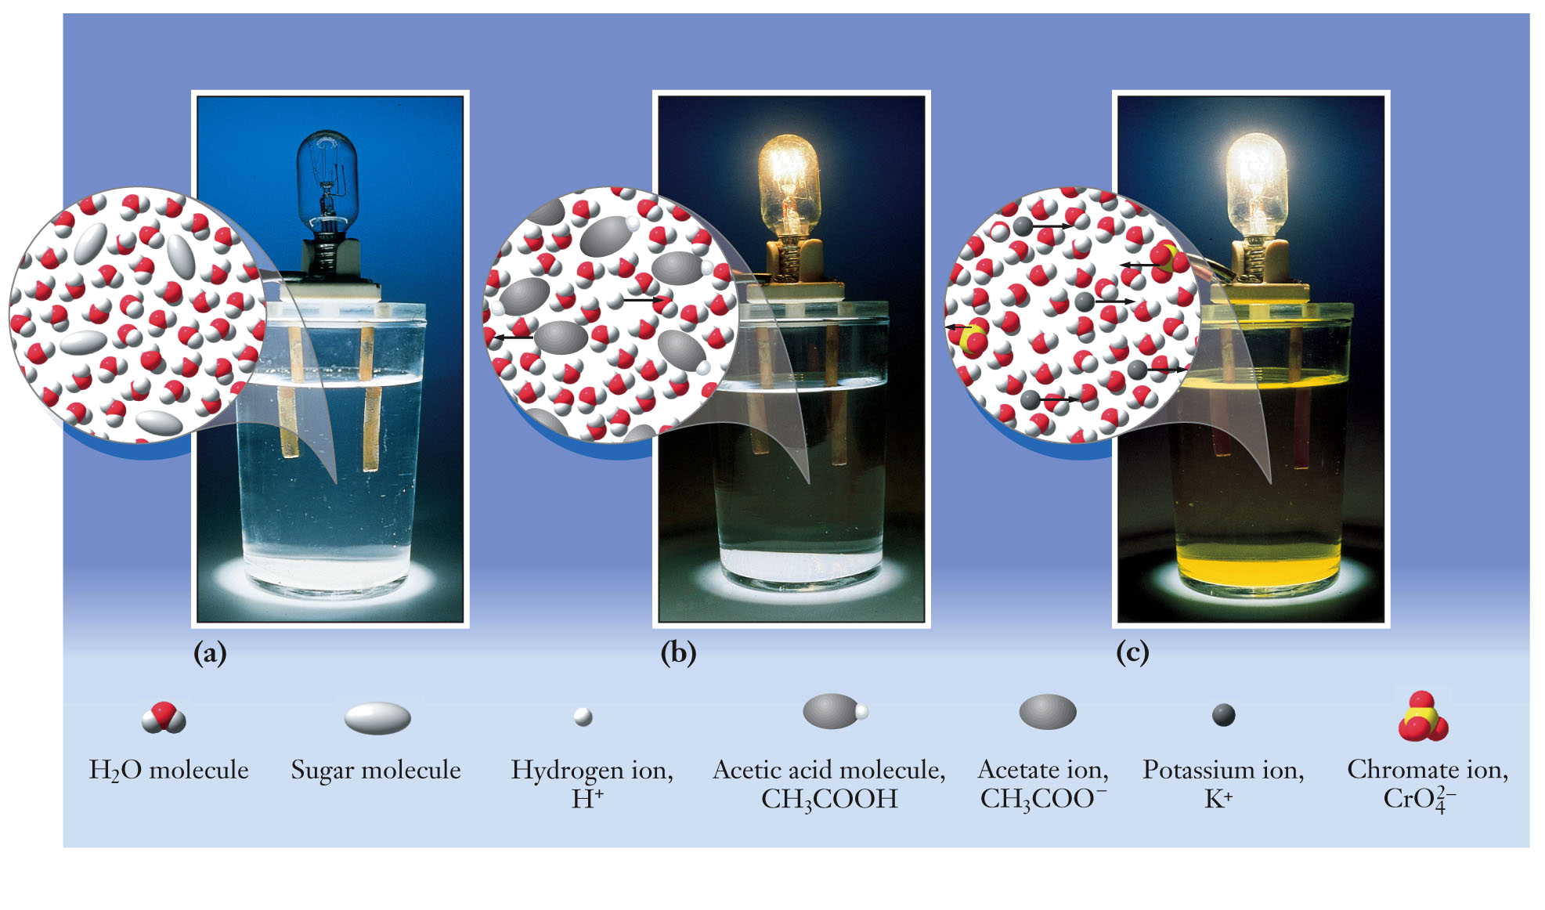
Electrolytes
Sugar, a nonelectrolyte, does not conduct current when dissolved in water.
Acetic acid (the ingredient in vinegar) is a weak electrolyte, which weakly conducts current when dissolved in water.
Potassium chromate, a strong electrolyte, strongly conducts current when dissolved in water.

Slide 21
Questions
What are the coefficients when this chemical equation is balanced ?
x H₂(g) + y CO(g) → z CH₃OH(ℓ)
x = 1, y = 1, z = 1
x = 2, y = 2, z = 2
x = 2, y = 1, z = 1
x = 1, y = 2, z = 1
x = 2, y = 1, z = 1

Slide 22
Questions
What is the carbonate ion?
NO₃⁻
CO₃²⁻
SO₄²⁻
CH₃CO₂⁻
E. Cl⁻

Slide 23
Questions
What ionic compound is made from the following ions: Mg²⁺ and PO₄³⁻
Mg(NO₃)₂
Mg(PO₄)₂
Mg₂(PO₄)₃
Mg₃(PO₄)₂
(PO₄)₂Mg₃

Slide 24
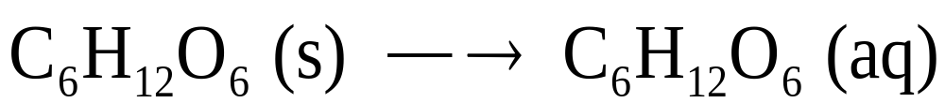
Chemical Equations for Aqueous Reactions
When a covalently bonded material dissolves in water and the molecules remain intact, they do not conduct current. These compounds are nonelectrolytes.
  The water molecules are not shown explicitly, although their presence is indicated by the “(aq)” on the product side.

Slide 25
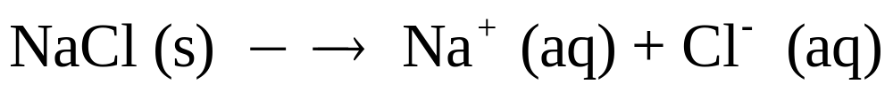
Chemical Equations for Aqueous Reactions
When an ionic solid dissolves in water, it breaks apart into its constituent ions. This is called a dissociation reaction. These compounds conduct electric current and are strong electrolytes.

Slide 26
Chemical Equations for Aqueous Reactions
Aqueous chemical reactions can be written as a molecular equation. The complete formula for each compound is shown.
  Note: not all of the species may be molecules.

Slide 27
Chemical Equations for Aqueous Reactions
Dissociation of reactants and products is emphasized by writing a total ionic equation.
Note: HNO₃ (nitric acid) is a strong acid and, therefore, it dissociates completely. NH₃ (ammonia) is a weak base and it does not dissociate.

Slide 28
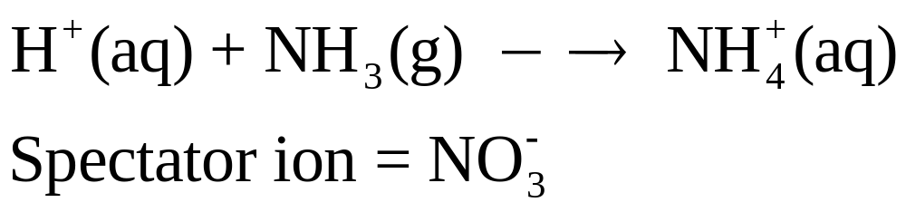
Chemical Equations for Aqueous Reactions
Spectator ions are ions not involved in the chemical reaction. When spectator ions are removed, the result is the net ionic equation.
  The total ionic equation:
  The net ionic equation:

Slide 29
Acid-Base Definitions
Arrhenius definitions of acid and base
Acids are substances that dissolve in water to produce H⁺ (or H₃O⁺) ions.
  Examples: HCl, HNO₃, H₃PO₄, HCN
Bases are substances that dissolve in water to produce OH– ions.
  Examples: NaOH, Ca(OH)₂, NH₃

Slide 30
Hydronium Ion
H⁺(ℓ) (a lone proton) does not exist in aqueous solution. Instead it forms a hydronium ion:
H⁺(aq) + H₂O(ℓ) → H₃O⁺(aq)
Chemists are often lazy and just write H⁺(aq)

Slide 31
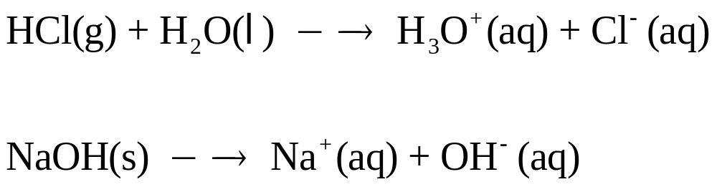
Strong Acids and Bases
Strong acids and bases completely dissociate in water.

Slide 32
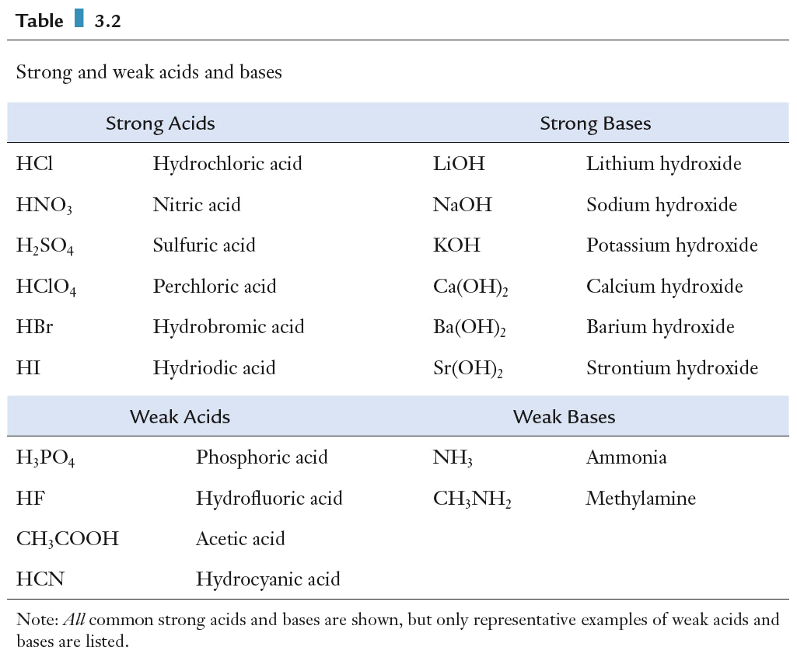
Strong Acids and Bases
All common strong acids and bases.

Slide 33
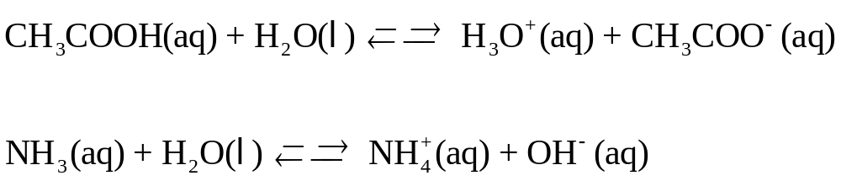
Weak Acids and Bases
Weak acids and bases partially dissociate in water.
  Notice the two-way arrows, which emphasize that the reaction does not proceed completely from left (reactants) to right (products). The two-way arrows indicate an equilibrium.

Slide 34
Weak Acids and Bases
Some common weak acids and bases.

Slide 35
Acid−Base Reactions
Mixing an acid and a base leads to a reaction known as neutralization, in which the resulting solution is neither acidic nor basic.
  The net ionic equation for the neutralization of a strong acid and a strong base:

Slide 36
Chemical Equations
When aqueous solutions of acetic acid and potassium hydroxide are combined, a neutralization reaction will occur. Write the following equations:
  molecular equation
  total ionic equation
  net ionic equation

Slide 37
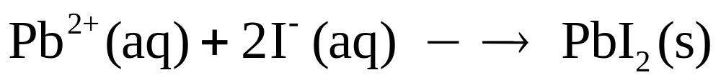
Precipitation Reactions
A precipitation reaction is an aqueous reaction that produces a solid, called a precipitate.
  This is the net ionic reaction for the precipitation of lead(II) iodide.

Slide 38
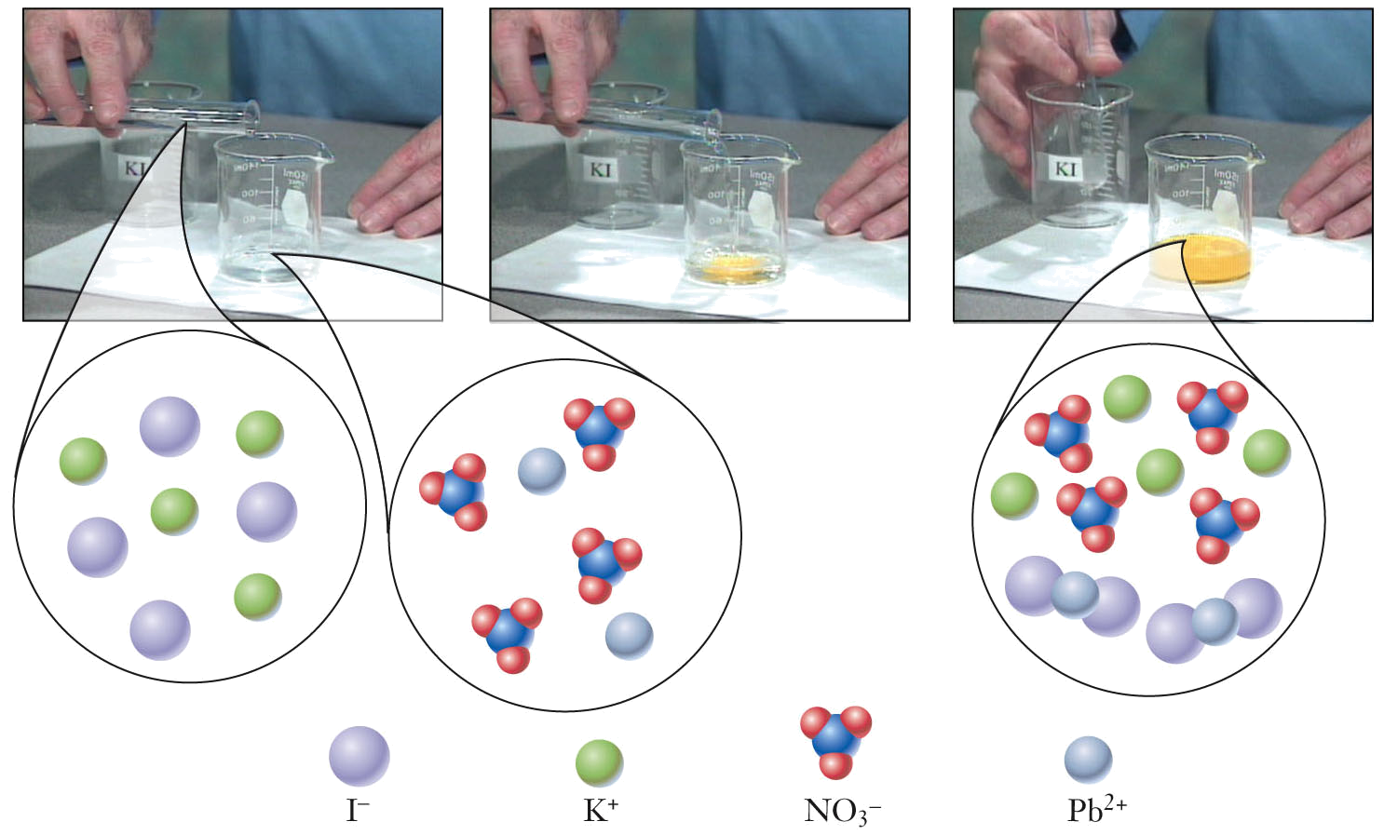
Precipitation Reactions
The precipitation reaction between aqueous solutions of KI and Pb(NO₃)₂, which are both colorless.
The bright yellow solid, PbI₂, is produced.
PbI₂ is insoluble as predicted by the solubility guidelines.

Slide 39
Precipitation Reactions
When aqueous sodium carbonate and aqueous barium chloride are combined, the solution becomes cloudy white with solid barium carbonate. Write the following chemical equations:
  molecular equation
  total ionic equation
  net ionic equation

Slide 40
Chemical Equations
Balanced chemical equations are interpreted on both the microscopic and macroscopic level.
  The microscopic interpretation visualizes reactions between molecules.
  The macroscopic interpretation visualizes reactions between bulk materials.

Slide 41
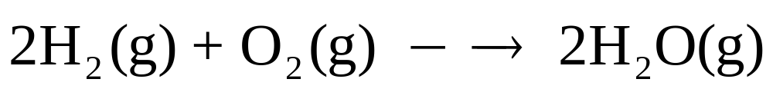
Stoichiometry
Balanced chemical reactions provide stoichiometric ratios between reactants and products. Ratios relate relative numbers of particles.
  2 molecules H₂ : 1 molecule O₂ : 2 molecules H₂O
  100 molecules H₂ : 50 molecule O₂ : 100 molecules H₂O

Slide 42
Avogadro’s Number
Avogadro’s number is defined as the number of atoms in a 12.00… g sample of the isotope carbon-12 (¹²₆C) and is:
6.022 x 10²³

Slide 43
Avogadro’s Number and the Mole
A mole is a way of counting the large number of particles in samples.
  One mole is the number of atoms in exactly 12.00… grams of ¹²C (carbon-12).
  1 mole contains Avogadro’s number (6.022 x 10²³ particles/mole) of particles.
  The mass of 6.022 x 10²³ atoms of any element is the molar mass of that element.

Slide 44
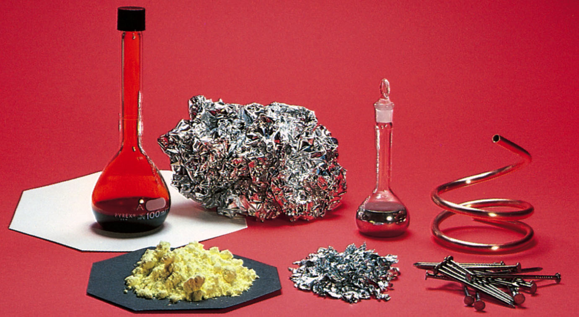
The Mole
One mole samples of various elements. All have the same number of particles.

Slide 45
Avogadro’s Number and the Mole
Balanced chemical reactions also provide mole ratios between reactants and products.
  2 moles H₂ : 1 mole O₂ : 2 moles H₂O

Slide 46
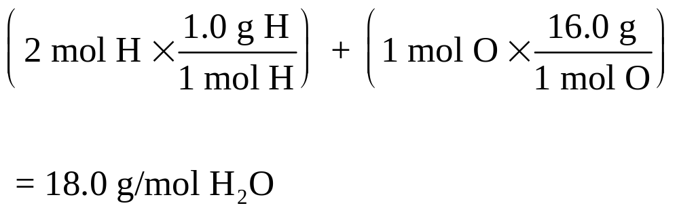
Calculating the Molar Mass
The molar mass of a compound is the sum of the molar masses of all the atoms in a compound.

Slide 47
Calculating the Molar Mass
Determine the molar mass of each of the following compounds:
  PbN₆
  C₃H₅N₃O₉
  Hg(ONC)₂

Slide 48
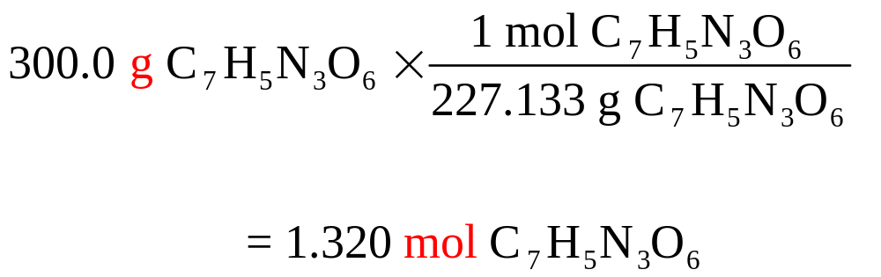
Moles and Molar Mass
The molar mass allows conversion between mass and the number of moles, like a unit conversion.
  1 mol C₇H₅N₃O₆ = 227.133 g C₇H₅N₃O₆

Slide 49
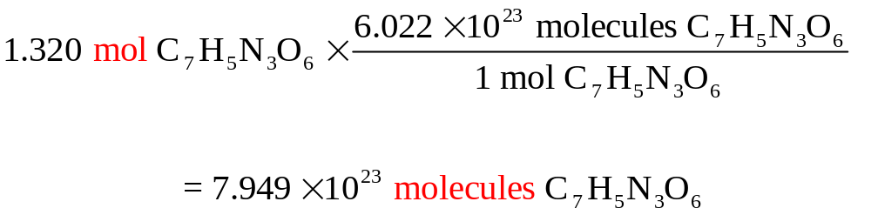
Avogadro’s Number
Avogadro’s number functions as a unit conversion from moles to the number of particles.
  1 mol C₇H₅N₃O₆ =
  =6.022 × 10²³ C₇H₅N₃O₆ molecules
  How many molecules are in 1.320 moles of nitroglycerin?

Slide 50
Moles and Avogadro’s Number
A sample of the explosive TNT (C₇H₅N₃O₆) has a mass of 650.5 g
  How many moles of TNT are in this sample?
  How many molecules are in this sample?

Slide 51
Moles and Avogadro’s Number
How many grams of ethylenedinitramine (C₂H₆N₄O₅) correspond to 315 moles?

Slide 52
Question
How many items are in one mole?
23 x 10^{6.022}
6.022 x 10⁻²³
1.008 x 10¹⁴
6.022 x 10²³
-6.022 x 10²³

Slide 53
Question
What would NOT be found in a net ionic equation?
a base
spectator ions
an acid
H₂O
a precipitate

Slide 54
Question
In the periodic table, where would you find elements that form strong bases?
transition metals
halogens
alkali metals
noble gases
semi-metals

Slide 55
Elemental Analysis: Determining Empirical and Molecular Formulas
Empirical formulas can be determined from an elemental analysis.
  An elemental analysis measures the mass percentage of each element in a compound.
  The formula describes the composition in terms of the number of atoms of each element.
  The molar masses of the elements provide the connection between the elemental analysis and the formula.

Slide 56
Elemental Analysis: Determining Empirical and Molecular Formulas
1. Assume a 100 gram sample size
2. Percentage of element × sample size = mass of element
in compound. (e.g., 16.1% carbon = 16.1 g carbon)
3. Convert the mass of each element into moles using the
molar mass of the element.
4. Divide by the smallest number of moles to get the mole
to mole ratios for empirical formula.
5. When division by the smallest number of moles results in
small rational fractions, multiply all the ratios by an
appropriate integer to give whole numbers.
  2.5 × 2 = 5, 1.33 × 3 = 4, etc.

Slide 57
Elemental Analysis: Determining Empirical and Molecular Formulas
The explosive known as RDX contains 16.22% carbon, 2.72% hydrogen, 37.84% nitrogen, and 43.22% oxygen by mass. Determine its empirical formula.

Slide 58
Elemental Analysis: Determining Empirical and Molecular Formulas
A molecular formula is a whole number multiple of the empirical formula.
  The molar mass for the molecular formula is a whole number multiple of the molar mass for the empirical formula.
  E.g., if the empirical formula of a compound is CH₂ and its molar mass is 42 g/mol, what is its molecular formula?

Slide 59
Elemental Analysis: Determining Empirical and Molecular Formulas
An alloy contains 70.8 mol % palladium and 29.2 mol % nickel. Express the composition of this alloy as weight percentage (wt %).

Slide 60
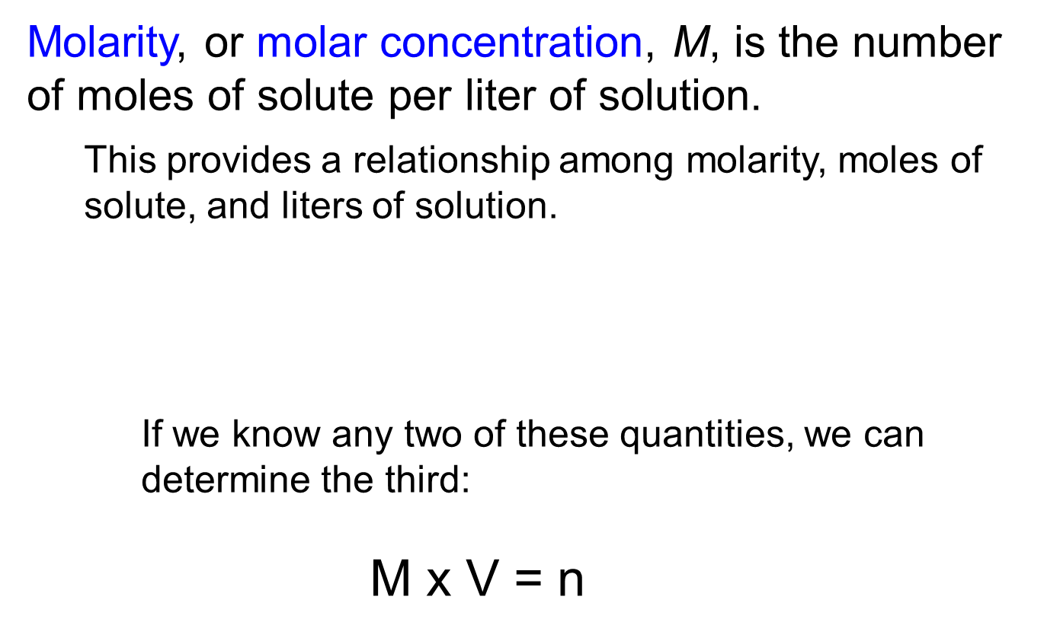
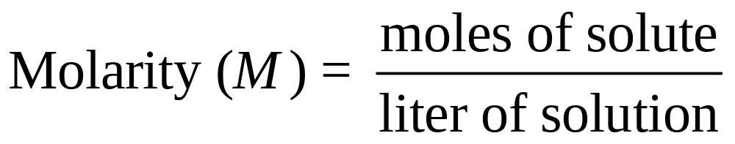
Molarity

Slide 61
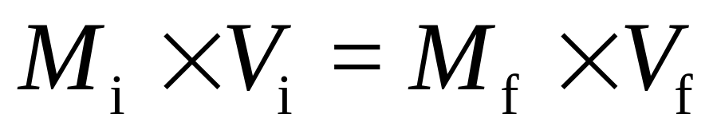
Dilution
Dilution is the process in which solvent is added to a solution to decrease the concentration of the solution.
  The number of moles of solute is the same before and after dilution.
  Since the number of moles of solute equals the product of molarity and volume (M × V), we can write the following equation, where the subscripts denote initial and final values.

Slide 62
Molarity
A chemist requires 1.5 M hydrochloric acid, HCl, for a series of reactions. The only solution available is 6.0 M HCl. What volume of 6.0 M HCl must be diluted to obtain 5.0 L of 1.5 M HCl?

