Slide 1
Chapter 4
Stoichiometry:
Chemical Accounting

Slide 2
Stoichiometry
Stoichiometry is a term used to describe quantitative relationships in chemistry.
  “How much?” of a product is produced or reactant is consumed.
  A balanced chemical equation needed.
  Conversion between mass or volume to number of moles frequently needed.

Slide 3
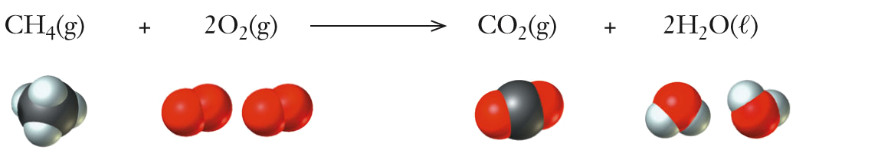
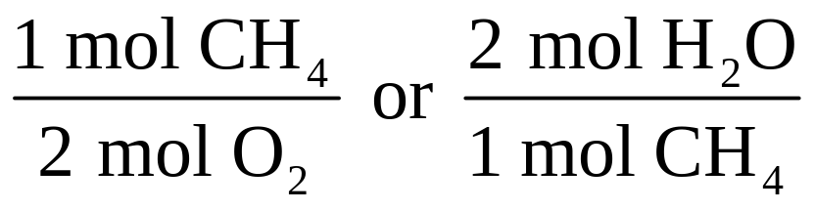
Ratios from a Balanced Chemical Equation
Mole ratios are obtained from the coefficients in the balanced chemical reaction.
  1 mol CH₄ : 2 mol O₂ : 1 mol CO₂ : 2 mol H₂O
These ratios can be used in solving problems:

Slide 4
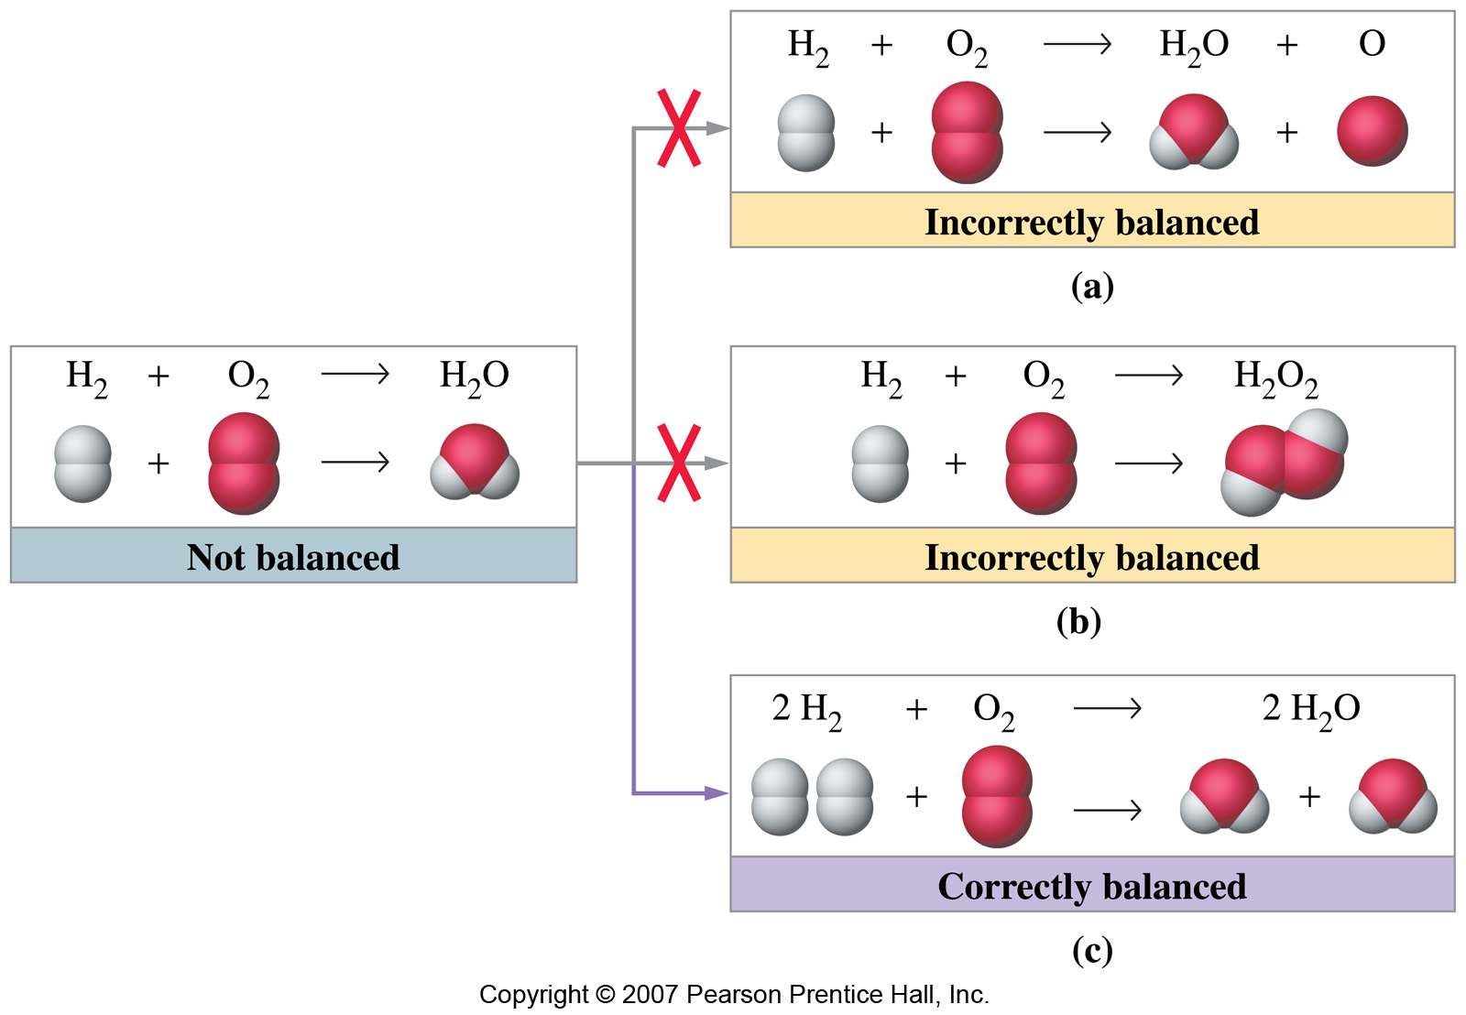
Chemical Equations
Coefficients are numbers used to balance a chemical equation. Never change the subscripts.

Slide 5
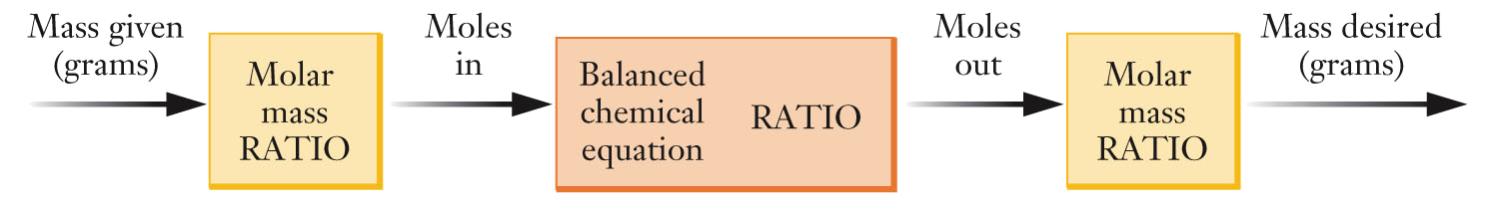
Stoichiometry Problems
This flow diagram illustrates the various steps involved in solving a typical reaction stoichiometry problem.
  No different than unit conversion
  Usually more than one conversion is necessary
  Write all quantities with their complete units

Slide 6
Stoichiometry Problems
How many grams of water can be produced if excess hydrogen reacts with 26.0 g of oxygen?

Slide 7
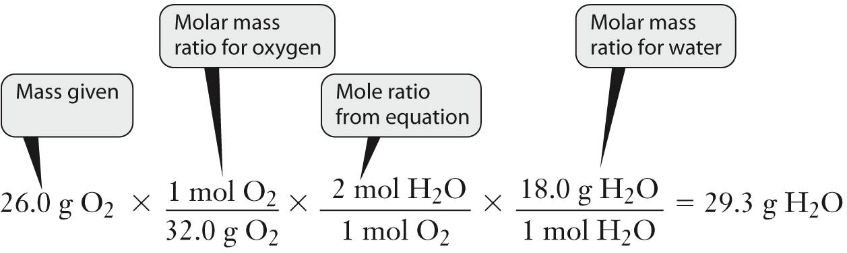
Stoichiometry Problems

Slide 8
Stoichiometry Problems
In the combustion of methane, how many moles of O₂ are required if 6.75 mol of CH₄ are to be completely consumed?

Slide 9
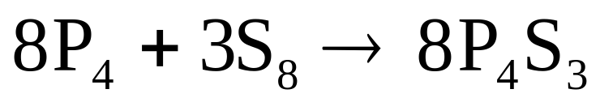
Stoichiometry Problems
If we have 153 g of S₈ and excess phosphorus, what mass of P₄S₃ can be produced in the reaction shown?

Slide 10
Question
Which equation illustrates the balanced reaction of ethyl alcohol with an excess of oxygen to form carbon dioxide and water?
A. C₂H₅OH(ℓ) + 3 O₂(g) → 2 CO₂(g) + 3 H₂O(ℓ)
B. 3 C₂H₅OH(ℓ) + 7 O₂(g) → 6 CO₂(g) + 9 H₂O(ℓ)
C. C₂H₅OH(ℓ) + 2 O₂(g) → 3 CO₂(g) + 3 H₂O(ℓ)
3 C₂H₅OH(ℓ) + 3 O₂(g) → 2 CO₂(g) + 6 H₂O(ℓ)
2 C₂H₅OH(ℓ) + 6 O₂(g) → 4 CO₂(g) + 6 H₂O(ℓ)

Slide 11
Question
How many oxygen atoms are present in 5 molecules of CuSO₄•5H₂O ?
45
40
35
25
6.022 x 10²³

Slide 12
Question
What volume of a 1.00 M HCl solution is required to create 300. mL of a 0.250 M HCl solution?
30.0 mL
25.0 mL
60.0 mL
75.0 mL
E. 100.0 mL

Slide 13
Limiting Reactant
In many chemical reactions, one reactant is often exhausted before the other reactants. This reactant is the limiting reactant.
  Limiting reactant is determined using stoichiometry.
  The limiting reactant limits the quantity of product produced.

Slide 14
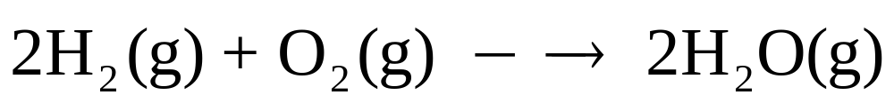
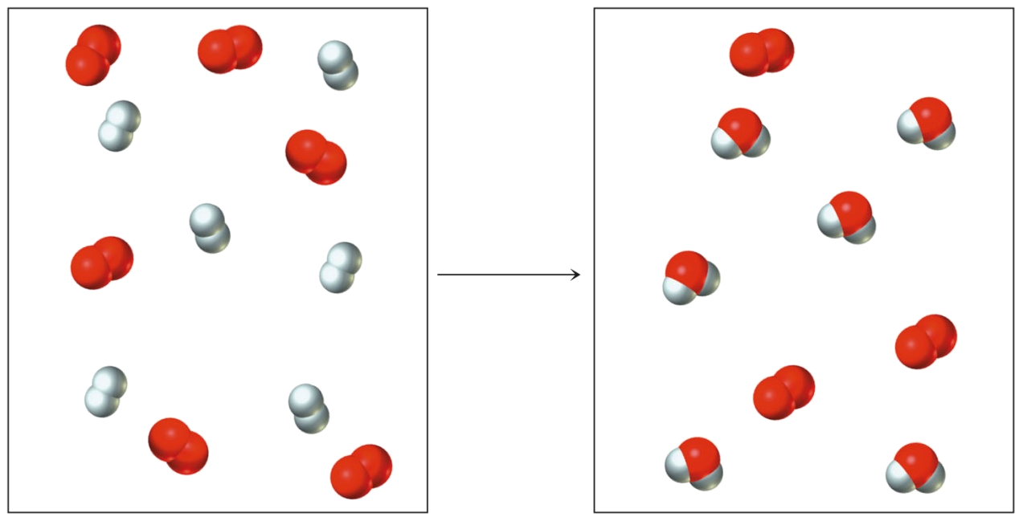
Limiting Reactant
Reaction between 6 H₂ and 6 O₂ will produce 6 H₂O.
  6 H₂ can produce 6
  H₂O.
  6 O₂ can produce 12
  H₂O.
  H₂ is the limiting
  reactant.
  3 O₂ left over.

Slide 15
Limiting Reactant
In many cases, we manipulate the amounts of reactants to ensure that one specific compound is the limiting reactant.
  For example, an expensive or scarce reagent is usually chosen to be the limiting reactant.
Other times, it is best to have a stoichiometric mixture (equal ratio of moles) to prevent waste.
  For example, rocket fuel is designed so that no mass is left over, which would add unnecessary weight to the rocket.

Slide 16
Limiting Reactant
A solution of hydrochloric acid contains 5.22 g of HCl. When it is allowed to react with 3.25 g of solid K₂CO₃, the products are KCl, CO₂, and H₂O. Which reactant is in excess?

Slide 17
Limiting Reactant
If 28.2 g of P₄ is allowed to react with 18.3 g of S₈, which is the limiting reactant?

Slide 18
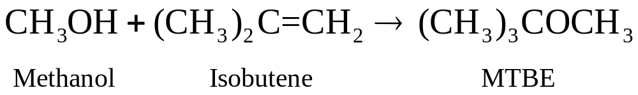
Limiting Reactant
If 45.0 kg of methanol is allowed to react with 70.0 kg of isobutene, what is the maximum mass (theoretical yield) of MTBE that can be obtained?

Slide 19
Limiting Reactant
The solid fuel rockets of the space shuttle are based on the following reaction between ammonium perchlorate and aluminum:
If either reactant is in excess, unnecessary mass will be added to the shuttle, so a stoichiometric mixture is desired. What mass of each reactant should be used for every kilogram of the fuel mixture?

Slide 20
Theoretical Yield
The maximum mass of a product that can be obtained in a reaction is determined by the limiting reactant.
  Determine which reactant is the limiting reactant.
  Calculate the mass of product that can be made from the limiting reactant. This mass is the theoretical yield.
  In stoichiometric mixtures, however, both reactants are consumed completely, so either (or both) could be considered the limiting reactant.

Slide 21
Theoretical and Percent Yields
Many factors determine the amount of desired product actually produced in a reaction.
  Temperature of the reaction
  The possibility of side reactions
  Further reaction of the product
  Time

Slide 22
Question
Which of the following may be classified as an example of an acid-base reaction?
a. HCl(aq) + NaOH(aq) → H₂O(ℓ) + NaCl(aq)
b. Ca(NO₃)₂(aq) + H₂SO₄(aq) → CaSO₄(aq) + HNO₃(aq)
c. KClO₄(aq) + NaF(aq) → NaClO₄(aq) + KF(s)
d. HCO₂H(aq) + NH₄Cl(aq) → NH₄CO₂H(aq) + HCl(aq)

Slide 23
Question
How many helium atoms are present in
7.4 • 10⁻³ moles of He gas?
a. 5.6 • 10²¹
b. 1.8 • 10²²
c. 4.5 • 10²¹
d. 1.2 • 10⁻²⁶

Slide 24
Question
Zinc reacts with oxygen to form ZnO. How many moles of ZnO will form from a reaction of 4.43 moles of Zn and 3.05 moles of oxygen?
a. 3.05
b. 4.43
c. 6.10
d. 9.65

Slide 25
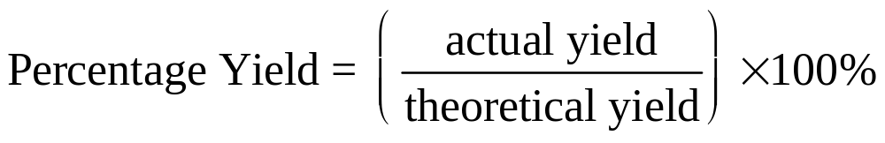
Theoretical and Percentage Yields
Reaction efficiency is measured with percentage yield.
  The mass of product obtained is the actual yield.
  The ideal mass of product obtained from calculation is the theoretical yield.

Slide 26
Percentage Yield
In a laboratory experiment, a student heats 42.0 g of NaHCO₃ and determines that 22.3 g of Na₂CO₃ is formed. What is the percentage yield of this reaction?

Slide 27
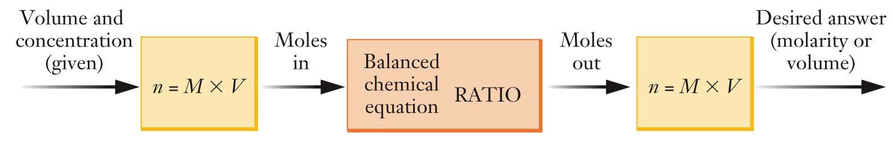
Solution Stoichiometry
For reactions occurring in solution, the concentration and volume of reactants and products are often used instead of mass to solve solution stoichiometry problems.
  n = number of moles; M = mol/L;
  V = volume(L)

Slide 28
Solution Stoichiometry
If 750. mL of 0.806 M NaClO is mixed with excess ammonia, how many moles of hydrazine can be formed?
If the final volume of the resulting solution is 1.25 L, what will be the molarity of hydrazine?

Slide 29
Solution Stoichiometry
A titration is a common laboratory technique that uses solution stoichiometry.
  A solution-phase reaction is carried out under controlled conditions so that the amount of one reactant can be determined with high precision.
  An indicator is a dye added to a titration to indicate when the reaction is complete.

Slide 30
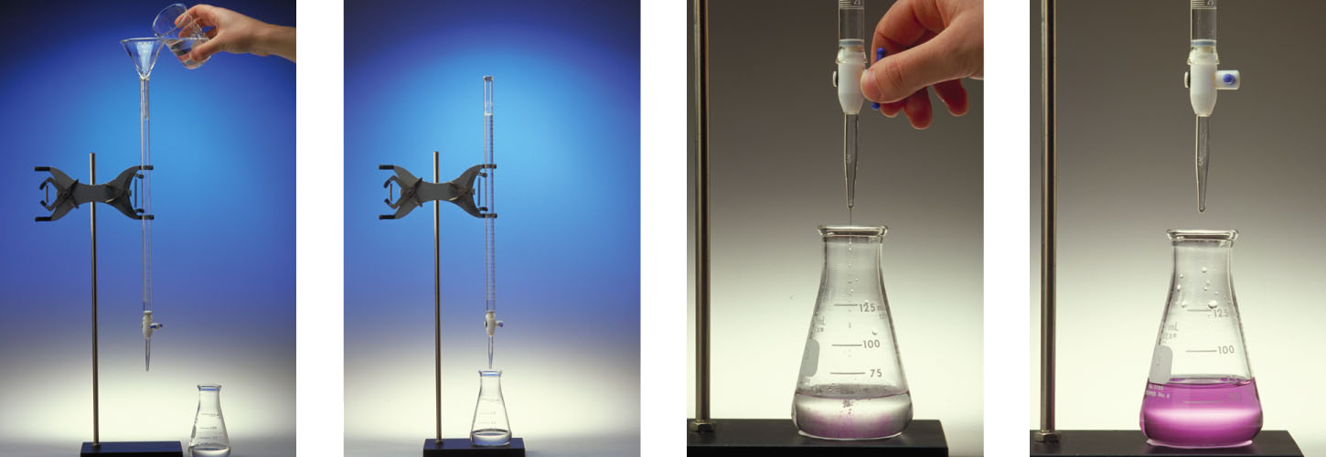
Solution Stoichiometry
A solution of one of the reactants (A) is added to a buret.
The buret is positioned above a flask containing the second reactant (B).
The buret is used to add A to the flask in a controlled manner; volume is determined from initial and final burette readings.
The reaction is complete when the indicator changes color.

Slide 31
Solution Stoichiometry
If 24.75 mL of 0.503 M NaOH solution is used to titrate a 15.00 mL sample of sulfuric acid, H₂SO₄, what is the concentration of the acid?

Slide 32
Fuels and Fuel Additives
Gasoline is a very complex mixture of compounds, but contains predominantly alkanes.
  Alkanes are hydrocarbons where the carbon atoms are linked together with single bonds.
  Hydrocarbons are compounds composed only of hydrogen and carbon.

Slide 33
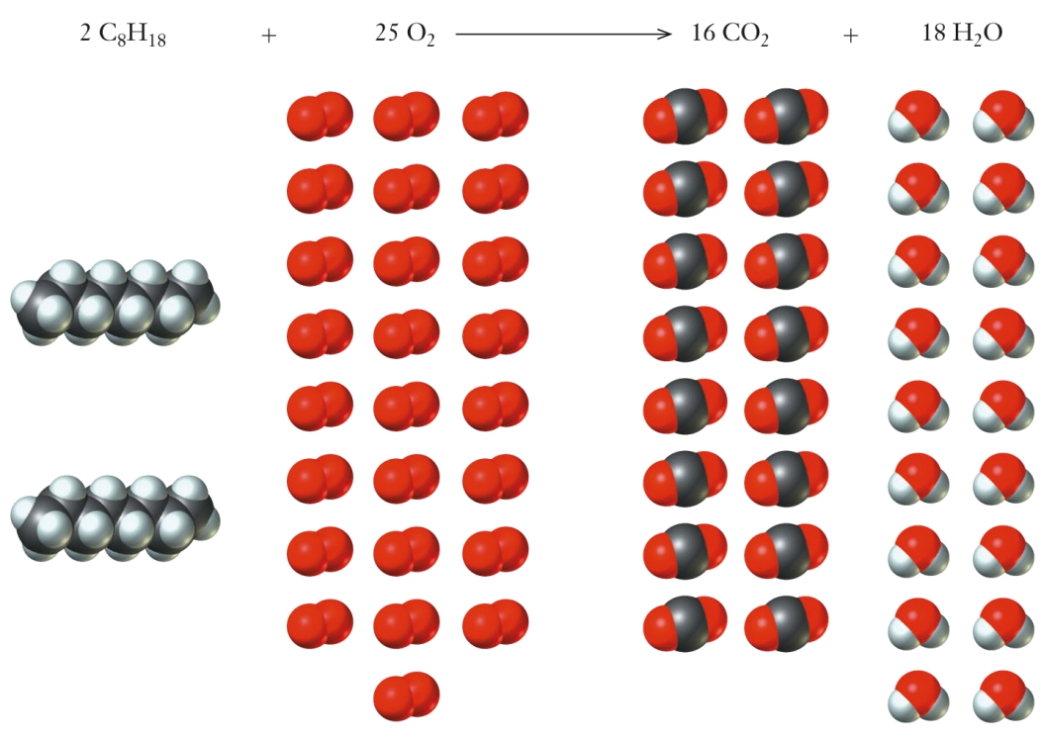
Fuels and Fuel Additives
Octane is used as a simplified model for gasoline.
  Complete combustion of octane with excess oxygen produces carbon dioxide and water.
The stoichiometric ratio between octane and oxygen is 2:25.
The stoichiometric ratio between carbon dioxide and water is 16:18.

Slide 34
Fuels and Fuel Additives
Fuel additives are added to gasoline to improve engine performance, reduce undesirable engine emissions, and reduce dependence on imported petroleum products.
  Some additives, oxygenates , increase the oxygen content of gasoline and gasoline containing them is called an oxygenated fuel.
    They ensure more complete combustion by reducing emitted carbon monoxide, hydrocarbons, and soot.
  Gasoline containing at least 2% oxygen by weight is call reformulated gasoline (RFG), which is mandatory in some areas with severe pollution.

Slide 35
Fuels and Fuel Additives
Additives improve engine performance by improving the octane rating.
  Higher octane rating delivers better performance and has lower “knocking”.
  Knock is the result of premature cylinder ignition when gasoline-air mixture is compressed.

Slide 36
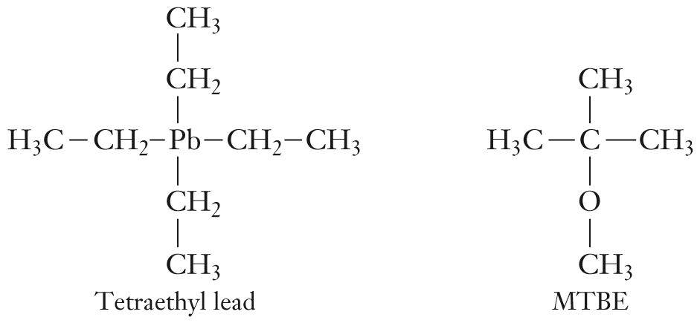
Fuels and Fuel Additives
Tetraethyl lead, used until the 1970s, increased octane rating.
  But, it poisoned the surfaces of catalytic converters.
  Discontinued due to the toxicity of lead.

Slide 37
Fuels and Fuel Additives
MTBE, methyl tert-butyl ether, is an oxygenate.
  As much as 15% MTBE can be used in gasoline.
  Possible health concerns have led to it being banned in some areas.

Slide 38
Fuels and Fuel Additives
Ethanol is another oxygenate.
  Produced from crops such as corn, barley, and wheat.
  Gasoline containing 10% ethanol can be burned in modern automobiles.
  Gasoline containing 85% ethanol can be burned in specially designed engines. At this concentration, it is considered an alternative fuel rather than an oxygenate.

