Slide 1
Chapter 5
Gases

Slide 2
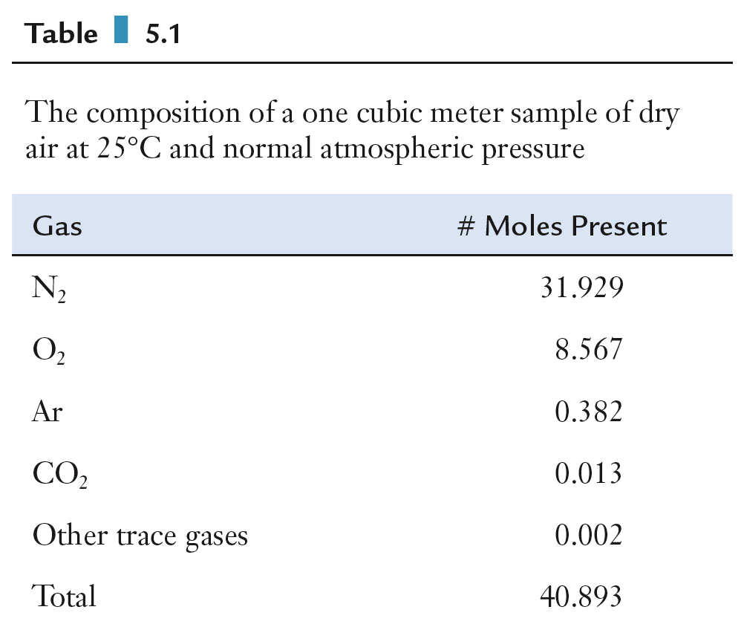
Atmosphere
Clean air is a mixture of several gases.
  Nitrogen and oxygen are major components
  Water vapor (humidity) varies with place, time, and temperature.
  Dry air is a convenient reference point

Slide 3
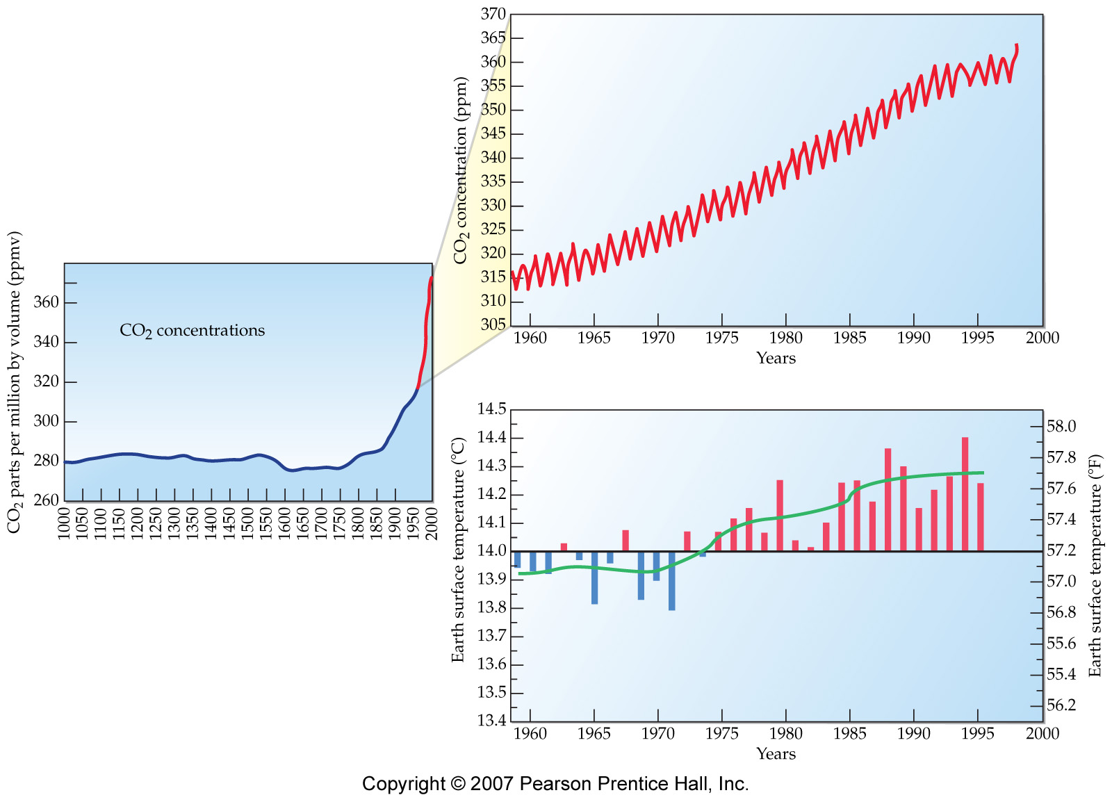
Carbon Dioxide and the Greenhouse Effect

Slide 4
Properties of Gases
Expand to fill the volume of any container.
Have much lower densities than solids or liquids.
Have highly variable densities, depending on temperature and pressure conditions.
Mix with one another readily and thoroughly.
Change volume dramatically with changing temperature

Slide 5
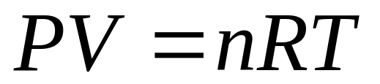
Ideal Gas Law
The ideal gas law is the quantitative relationship between pressure (P), volume (V), moles gas present (n), and the absolute temperature (T).
R is the universal gas constant.
  R = 0.08206 L atm mol⁻¹ K⁻¹
  used in most gas equations
  R = 8.314 J mol⁻¹ K⁻¹
  used in equations involving energy

Slide 6
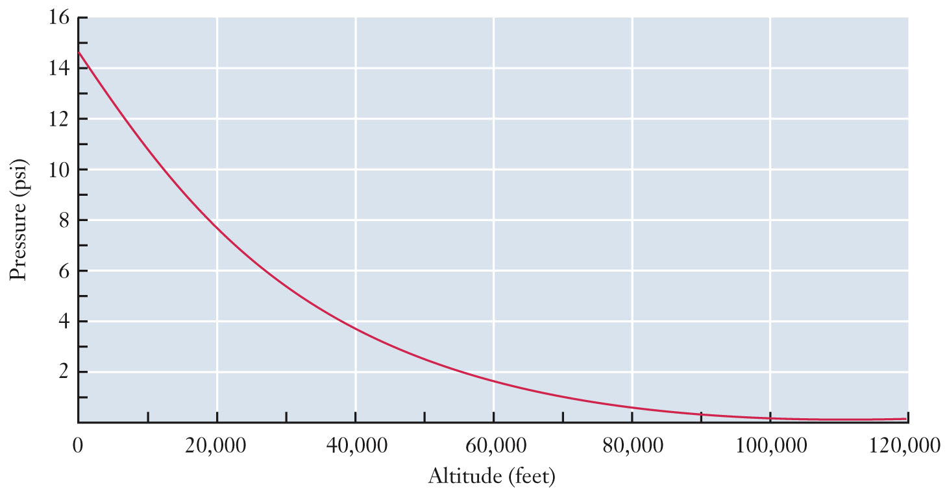
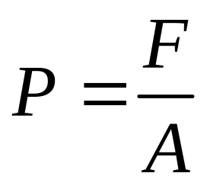
Pressure
Pressure is force per unit area.
  Atmospheric pressure is the force attributed to the weight of air molecules attracted to Earth by gravity.
  As altitude increases, atmospheric pressure decreases.

Slide 7

Pressure
Pressure results from molecular collisions between gas molecules and container walls.
  Each collision imparts a small amount of force.
  Summation of the forces of all molecular collisions produces the macroscopic property of pressure.

Slide 8
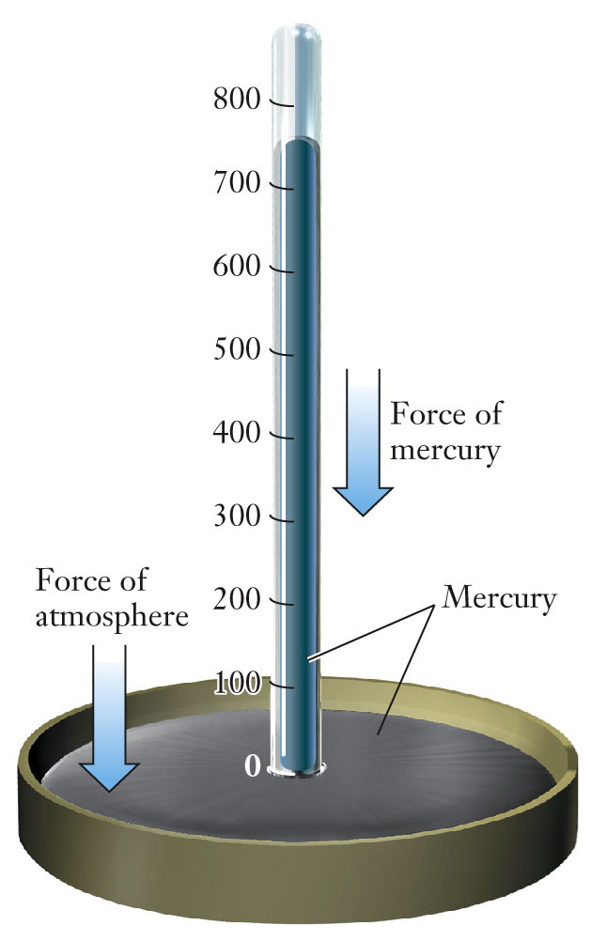

Pressure Measurements
A barometer is used to measure atmospheric pressure.
  The height of the mercury column is proportional to atmospheric pressure.
Units of pressure:
  1 torr = 1 mm Hg
  1 atm = 760 torr (exactly)
  1 atm = 101,325 Pa (exactly)
  760 torr = 101,325 Pa (exactly)

Slide 9
Applications of the Gas Law
Gases change significantly when the conditions in which they are found are changed.
These changes are determined empirically using several gas laws.
  Charles’ Law: relationship between T and V
  Boyle’s Law: relationship between P and V
  Avogadro’s Law: relationship between n and V
These empirical gas laws led to the ideal gas law.

Slide 10
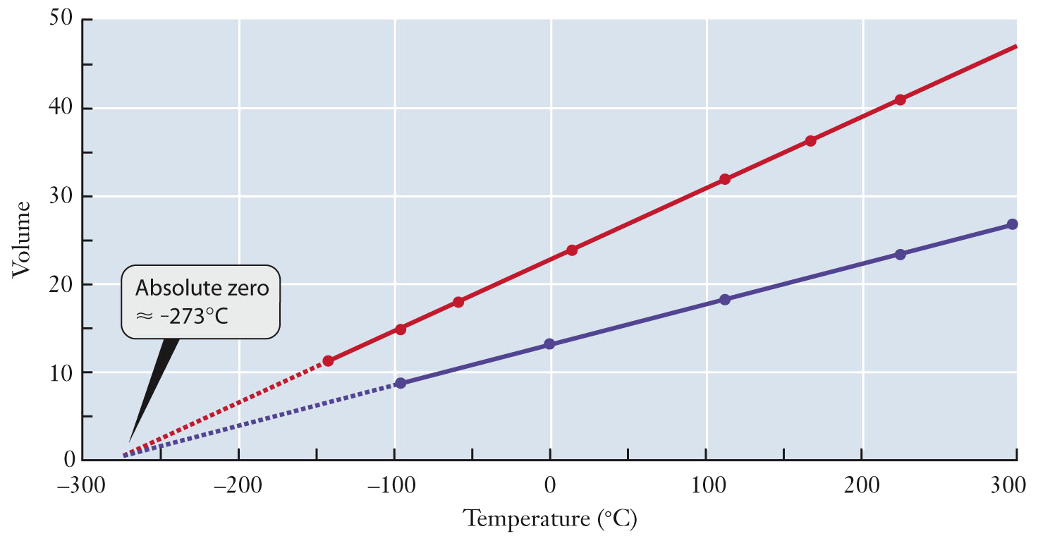
Charles’ Law
Jacques Charles studied the relationship between volume and temperature.
  Plots of V versus T for different gas samples converged to the same temperature at zero volume.
    - The basis of the Kelvin temperature scale.

Slide 11
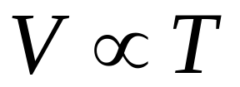
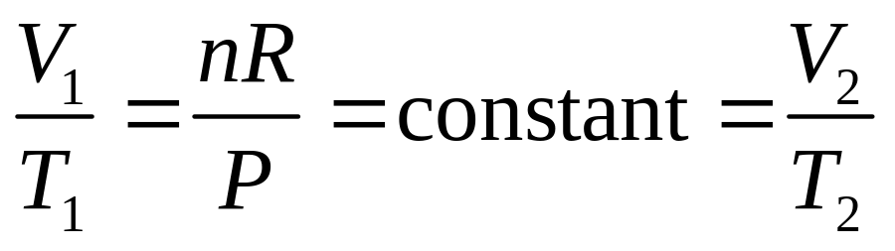
Charles’ Law
For fixed pressure and fixed number of moles of gas, the volume and the absolute temperature of a gas are directly proportional.
All of the fixed variables can be factored out of the ideal gas law as a new constant that can be used to relate two sets of conditions:

Slide 12
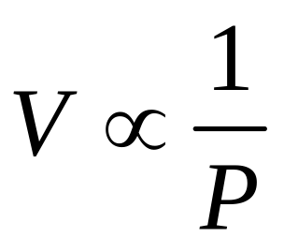
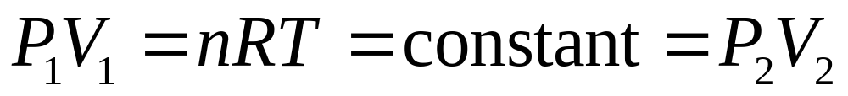
Boyle’s Law
Pressure and volume are inversely proportional.
All of the fixed variables can be factored out as a new constant that can be used to relate two sets of conditions

Slide 13
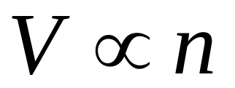
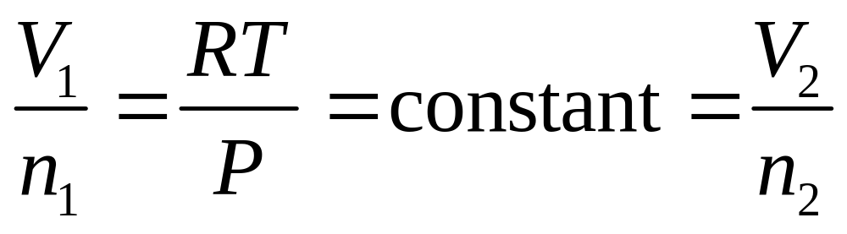
Avogadro’s Law
Avogadro’s Law states that for fixed pressure and temperature, the volume and moles of a gas are directly proportional.

Slide 14
Applications of Gas Laws
A container of methane has a volume of 49.0 L and is filled to a pressure of 154 atm. If that all of the CH₄ from this cylinder is released and expands until its pressure falls to 1.00 atm, what volume would the CH₄ occupy?

Slide 15
Applications of Gas Laws
A balloon is filled with helium and its volume is 2.2 L at 298 K. The balloon is then dunked into a thermos bottle containing liquid nitrogen. When the helium in the balloon has cooled to the temperature of the liquid nitrogen (77 K), what will the volume of the balloon be?

Slide 16
Question
A blimp is filled with helium in Chicago and its volume is 22 kL at 298 K. The blimp is then flown to the arctic where the temperature is 253 K. What will the volume of the blimp be?
36 kL
19 kL
22 kL
4 kL
128 kL

Slide 17
Applications of Gas Laws
Temperature must be expressed in Kelvin for all gas calculations!
  Negative temperatures would result in negative pressures, negative volumes, and negative moles.
  In some engineering fields, the Rankine temperature scale is used, which is another absolute temperature scale.
    0 °R = 0 K; 1 °R = 1.8 K
The unit for moles is always mol
The units for measuring pressure and volume can vary. In gas calculations, the units of the gas constant must agree with them.
  R = 8.314 J mol⁻¹ K⁻¹
  R = 0.08206 L atm mol⁻¹ K⁻¹
  R = 62.37 L torr mol⁻¹ K⁻¹

Slide 18
Applications of Gas Laws
A sample of CO₂ gas has a volume of 575 cm³ at 752 torr and 72 °F. What is the mass of carbon dioxide in this sample?

Slide 19
Partial Pressure
Air is a mixture of gases.
  The gas laws do not depend on identity of gases.
  Pressure is due to the total moles of gas present.
The pressure exerted by a single component of a gas mixture is called the partial pressure for the component gas.

Slide 20
Dalton’s Law of Partial Pressures
Dalton’s law of partial pressures: The total pressure (P) of a mixture of gases is the sum of the partial pressures of the component gases (P_{i}).
Dalton’s Law can be expressed in terms of mole fractions.
  The mole fraction (X_{i}) for a gas in a gas mixture is the moles of the gas (n_{i}) divided by the total moles of gas present.
  The partial pressure of each gas is related to its mole fraction.

Slide 21
Partial Pressures
An engineer tries to generate a mixture of gases similar to a volcano by introducing 15.0 g of water vapor, 3.5 g of SO₂, and 1.0 g of CO₂ into a 40.0 L vessel held at 120.0 °C. Calculate the partial pressure of each gas and the total pressure.

Slide 22
Partial Pressures
Given a mixture that has the mole fractions given in the following table:
Sum of all the mole fractions must add up to 1
If the desired pressure is 750. torr, what should the partial pressures be for each gas?
If the gas is to be in a 15.0 L vessel held at 30. °C, how many moles of each gas are needed?
Gas | N₂ | O₂ | H₂O | SO₂
Mole Fraction (unitless) | 0.751 | 0.149 | 0.080 | 0.020

Slide 23
Stoichiometry of Reactions Involving Gases
For reactions involving gases, the ideal gas law is used to determine the moles of gas involved in the reaction.
  Use mole ratios (stoichiometry)
  Connect the number of moles of a gas to its temperature, pressure, or volume with the ideal gas law:

Slide 24
Stoichiometry of Reactions Involving Gases
When an experiment required a source of carbon dioxide, a student combined 1.4 g of sodium bicarbonate (NaHCO₃) with excess hydrochloric acid (HCl). If the CO₂ gas produced is collected at 722 torr and 17 °C, what volume will the gas occupy?

Slide 25
Question
An automated welder is using an oxyacetylene torch and burns 2.00 mol of acetylene, C₂H₂, with excess oxygen. If the CO₂ gas produced is collected at 760. torr and 170. °C, what volume will the CO₂ gas occupy?
2 C₂H₂(g) + 5 O₂(g) → 4 CO₂(g) + 2 H₂O(g)
  R = 62.37 L torr mol⁻¹ K⁻¹
A. 72.5 L B. 55.8 L
C. 27.9 L D. 145 L

Slide 26
Standard Temperature and Pressure
Standard temperature and pressure, STP, for a gas is 0 °C (273.15 K) and 1 atm.
  For one mole of gas at STP, the standard molar volume is 22.41 L (calculated using the ideal gas law)
  This number provides a conversion factor for stoichiometric problems that include gases, provided the STP conditions are maintained.

Slide 27
STP Calculations
Carbon dioxide can be removed from a stream of gas by reacting it with calcium oxide to form calcium carbonate. If we react 5.50 L of CO₂ at STP with excess CaO, what mass of calcium carbonate will form?

Slide 28
Ideal versus Real Gases
In many important practical settings, gases do not always behave ideally, especially at very high pressure and/or very low temperature.
  Nonideal gas behavior can be explained using the Kinetic Molecular Theory.
    The theory provides connections between observed macroscopic properties of gases, the gas law equation, and the behavior of gas molecules on a microscopic scale.

Slide 29
Kinetic-Molecular Theory of Gases
Gases are made up of large collections of particles, which are in constant, random motion.
Gas particles are infinitely small and occupy negligible volume.
Gas particles move in straight lines except when they collide with other particles or with the container walls. These collisions are elastic, so the kinetic energy of particles is conserved.
Particles interact with each other only when collisions occur.

Slide 30
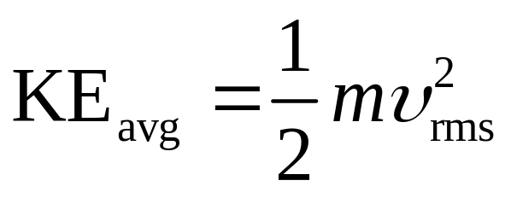
Kinetic-Molecular Theory of Gases
The average kinetic energy of a gas is proportional to the absolute temperature of the gas but does not depend upon the identity of the gas
  As temperature increases, the average speed for gas molecules increases.
  Faster moving molecules collide more often and with greater force, exerting a higher pressure.

Slide 31
Kinetic-Molecular Theory of Gases
At a given temperature, gas molecules in a sample can be characterized by an average speed.
  Some gas molecules move faster than average, some move slower than average.
  The distribution function that describes the speeds of a collection of gas particles is known as the Maxwell-Boltzmann distribution of speeds.

Slide 32
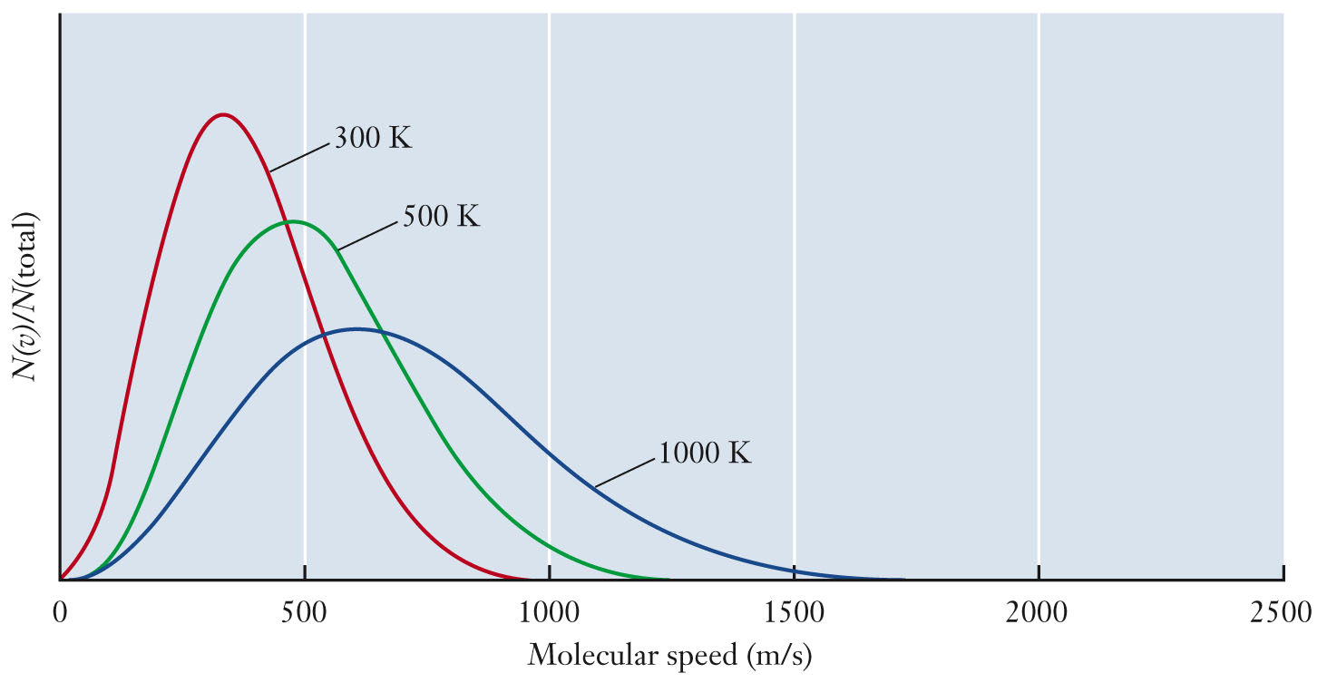
Kinetic-Molecular Theory of Gases
As temperature increases, the average speed increases.
  As temperature increases, the fraction of molecules moving at higher speeds increases.

Slide 33
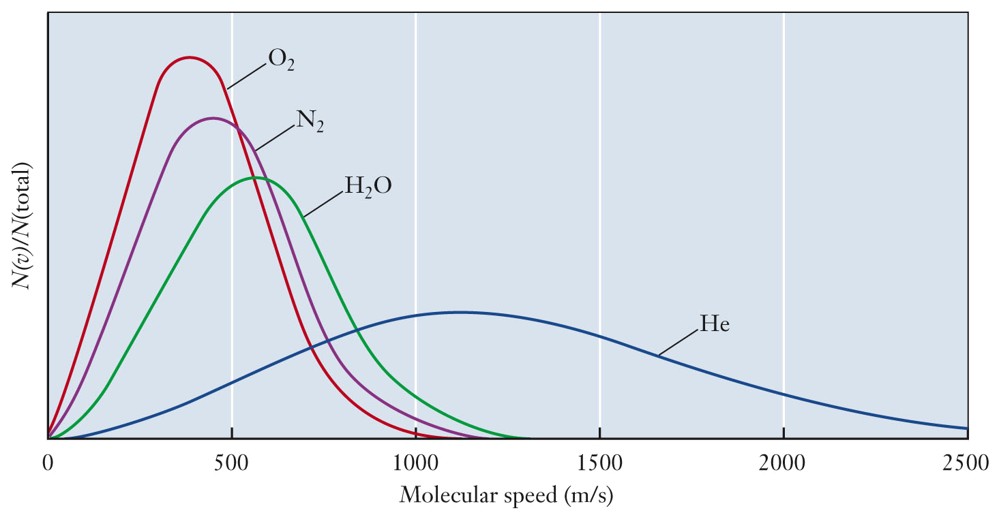
Kinetic-Molecular Theory of Gases
For a fixed temperature, as the molecular weight increases, the average speed for the gas molecules decreases.

Slide 34
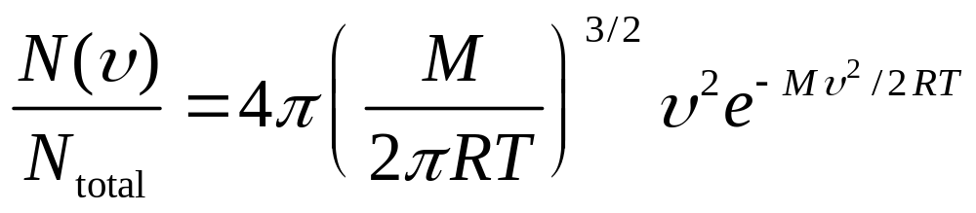
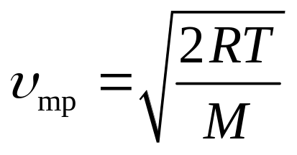
Maxwell-Boltzmann Distribution
The equation for the Maxwell-Boltzmann distribution describes N(υ), which is the number of molecules moving with speeds close to υ.
Most gas molecules move at the most probable speed, which is the peak of the curve in the Maxwell-Boltzmann plot.

Slide 35
Maxwell-Boltzmann Distribution
The Maxwell-Boltzmann distribution can be described in terms of the average speed or root-mean-square speed.
  Average speed, υ_{avg}, is 1.128 times υ_{mp}
    The existence of the “tail” on the distribution curve at high speeds will pull the average to a speed higher than the most probable value.
  υ_{rms} = 1.085 times υ_{avg}
    The root-mean-square speed is useful because the average kinetic energy is given by

Slide 36
Limitations of the Kinetic Theory
Kinetic molecular theory implies that the volume of a gas molecule is insignificant compared to the “empty space” volume for a gas sample.
  The mean free path is used to test validity of this assumption.
    The average distance a particle travels between collisions with other particles is the mean free path.
    The mean free path for air at room temperature and atmospheric pressure is 70 nm.
      This value is 200 times larger than the typical radius of a small molecule like N₂ or O₂.
    The volume of empty space in a gas is 1 million times that of gas particle volume.

Slide 37
Limitations of the Kinetic Theory
The volume of a gas particle is significant compared to the “empty space” volume under high pressure conditions.
  The mean free path decreases as pressure increases.
  Gas molecules get very close together.
  Therefore, volume of the gas particles becomes significant.

Slide 38
Limitations of the Kinetic Theory
Kinetic molecular theory states that gas molecules move in straight lines and interact only through perfectly elastic collisions:
  Gas molecules neither attract nor repel.
  Strength of attractive forces small compared to kinetic energy of gas molecules.
Attractive and repulsive forces are significant under conditions of low temperature:
  Kinetic energy decreases with temperature.
  Gas molecules experience “sticky” collisions.
  Collision rate decreases, decreasing the pressure.

Slide 39
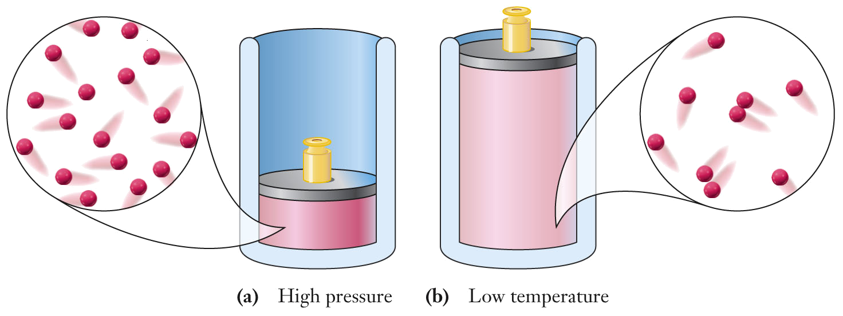
Limitations of the Kinetic Theory
The ideal gas model breaks down at high pressures and low temperatures.
  high pressure: volume of particles no longer
  negligible
  low temperature: particles move slowly enough to
  interact

Slide 40
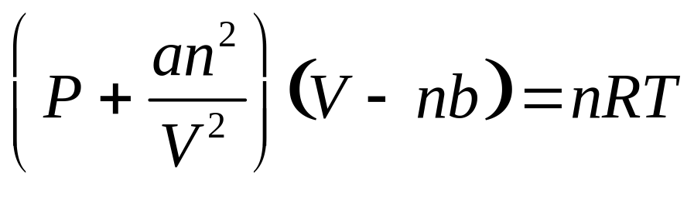
van der Waals Equation
van der Waals equation is commonly used to describe the behavior of real gases
  a corrects for attractive forces.
    Molecules with stronger attractive forces have larger a values.
  b corrects for the volume occupied by gas molecules.
    Large molecules have larger b values.

Slide 41
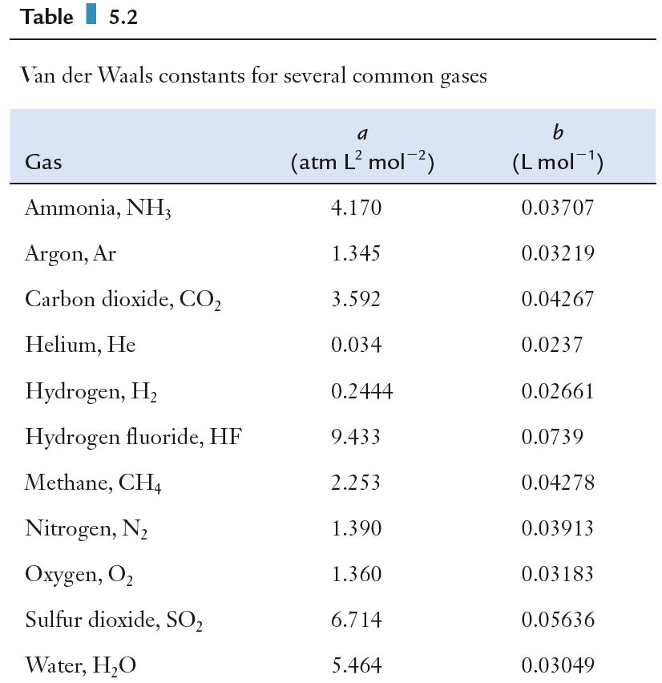
Correcting the Ideal Gas Equation
The van der Waals constants a and b are compound specific.
  Both are zero in gases behaving ideally.

Slide 42
Correcting the Ideal Gas Equation
An empty 49.0 L methane storage tank has an empty mass of 55.85 kg and, when filled, has a mass of 62.07 kg. Calculate the pressure of CH₄ in the tank at 21 °C using both the ideal gas equation and the van der Waals equation.

Slide 43
Gas Sensors
The concentration of air pollutants is monitored by the EPA.
  The concentration of a gas is proportional to the partial pressure of the gas.
Gas pressure sensors are used to monitor changes in partial pressure or concentration of gases.

Slide 44
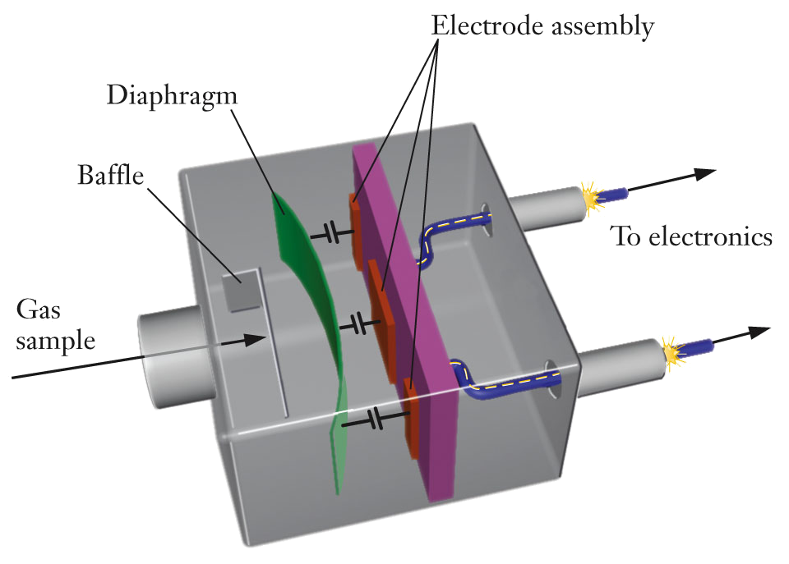
Capacitance Manometer
Changes in pressure cause deflections in the diaphragm, changing the capacitance.
  Used to measure pressures from 0.001 - 1000 torr

Slide 45
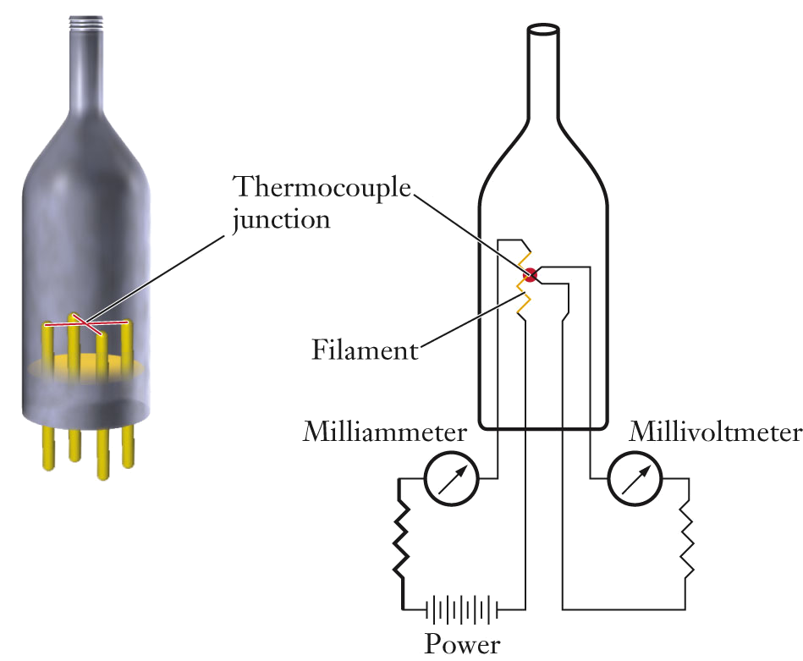
Thermocouple Gauge
Measures pressure by the cooling effect of colliding gas molecules.
  Higher pressure, more collisions with heated filament, lowers filament temperature.
  Used to measure pressures from 0.01 to 1.0 torr

Slide 46
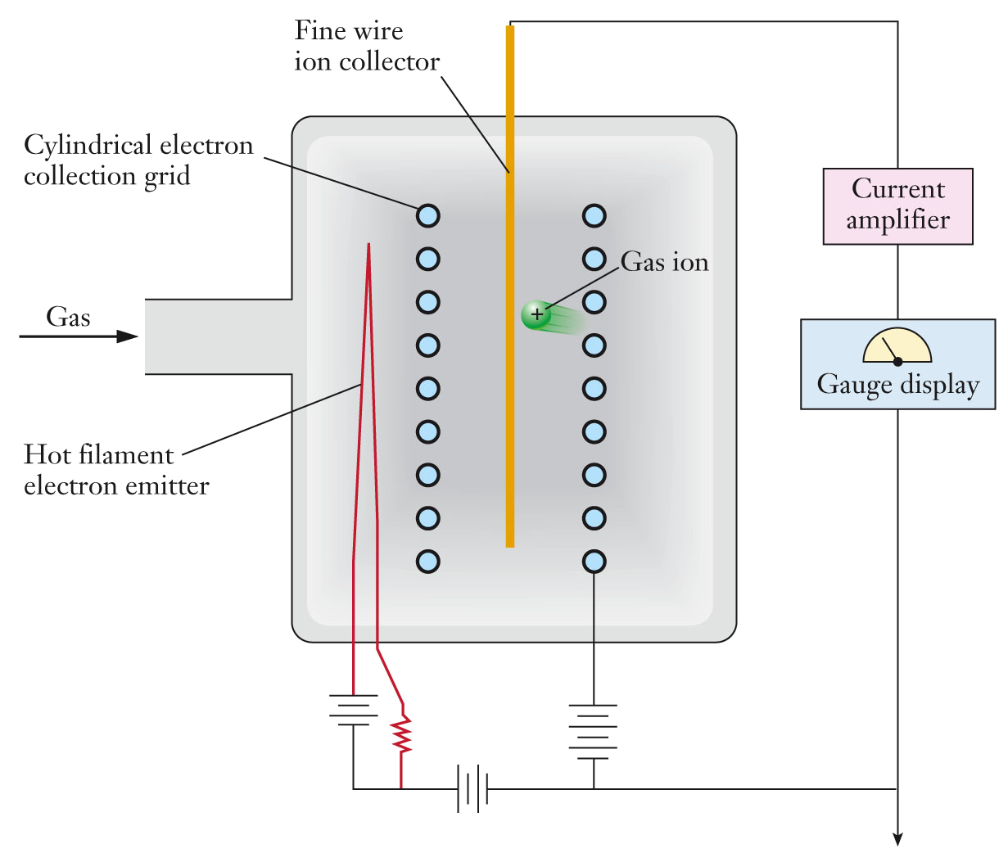
Ionization Gauge
Pressure measured by producing gaseous cations with the electrons emitted from a hot filament.
  Higher pressure, more gas cations, more current collected at the grid.
  Used to measure pressures as low as 10⁻¹¹ torr.

Slide 47
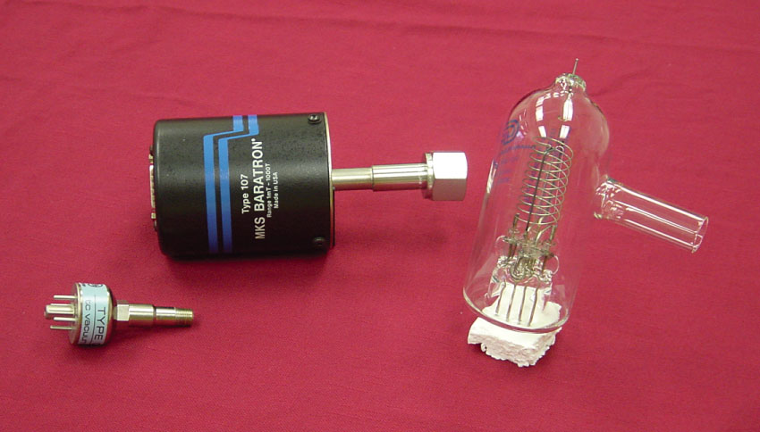
Gas Sensors
A thermocouple gauge, a capacitance manometer, and an ionization gauge.

Slide 48
Gas Sensors
Mass spectrometers can be used to measure partial pressures for gas mixtures.
  Mass spectrometers ionize gas like an ionization gauge, but can select the mass of the gas being analyzed with the use of a magnetic field.
  Several masses can be scanned simultaneously allowing for multiple gas analyses.
  The current generated can be used to determine the partial pressure of gas.

