Slide 1
Chapter 9
Energy and Chemistry

Slide 2
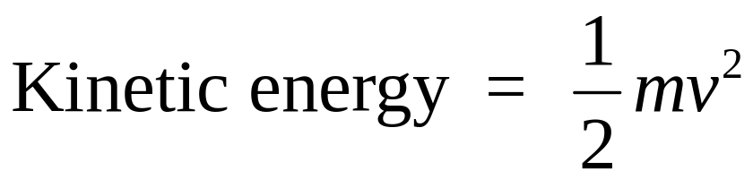
Forms of Energy
Two broad categories of energy: potential energy and kinetic energy
  Potential energy - associated with the relative position of an object.
  Kinetic energy - associated with motion.

Slide 3
Forms of Energy
Internal energy - the combined kinetic and potential energies of atoms and molecules that make up an object or system.
Chemical energy - energy released or absorbed during a chemical reaction.
Other forms of energy include radiant, mechanical, thermal, electrical, and nuclear.
Thermochemistry - the study of the energetic consequences of chemical reactions

Slide 4
Heat and Work
Heat is the flow of energy between two objects because of a difference in temperature.
  Heat flows from the warmer object to the cooler object.
Work is the transfer of energy accomplished by a force moving a mass some distance against resistance.
  Pressure-volume work (PV-work) is the most common type of work in chemistry.
    Releasing an inflated balloon before it is tied off illustrates an example of PV-work.

Slide 5
Energy Units
The Joule is the SI unit of energy.
  1 Joule = 1 kg m² / s² = 1 N m
Other energy units include the Btu and the calorie.
  1 Btu is the energy required to raise 1 lb of water by 1 ºF
  1 Btu = 1055 J
  1 calorie is the energy required to raise 1 g water from 14.5 to 15.5 ºC 1 calorie = 4.184 J

Slide 6
Energy Transformation and Conservation of Energy
During energy transformation, the total energy must be conserved.
  The sum of all energy conversions and energy transfers must equal the total energy present, which must remain constant.
To account for energy transformations and conversions, the system and surroundings must be specified.
  System - the part of the universe being considered.
  Surroundings - the remainder of the universe.
  System + Surroundings = Universe
  System and surroundings are separated by a boundary.

Slide 7
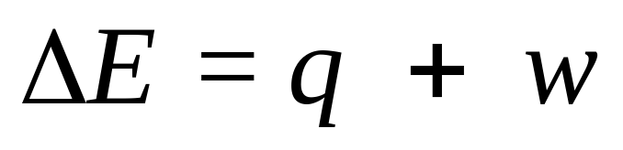
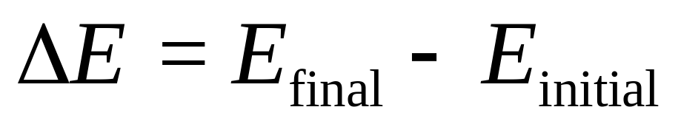
Energy Transformation and Conservation of Energy
For any system or surroundings, the only possible forms of energy flow are heat, q, and work, w
The delta, Δ, means “change in” and is defined as the difference in the final and initial states (for the system and for the surroundings).

Slide 8
Heat and Work
If 515 J of heat is added to a gas that does 218 J of work on the surroundings as a result, what is the change in the energy of the system?

Slide 9
Question
If 273 J of heat is removed from a system and the surroundings does 182 J of work on the system, what is the change in the energy of the system?
+91 J
-91 J
+455 J
-455 J

Slide 10
Energy Transformation and Conservation of Energy
The sign resulting from the difference in the final and initial states indicates the direction of the energy flow.
  Negative values indicate energy is being released by the system.
  Positive values indicate energy is being absorbed by the system.

Slide 11
The Zeroth Law of Thermodynamics
The zeroth law of thermodynamics states that energy flows spontaneously from a hot source to a colder sink.

Slide 12
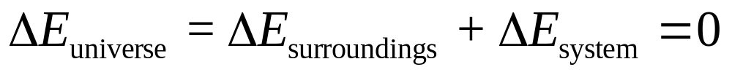
The First Law of Thermodynamics
The first law of thermodynamics states that energy can be transformed from one form to another, but cannot be created or destroyed.

Slide 13
Waste Heat (Energy)
A common way to obtain work from a system is to heat the system. Heat flows in and is converted to work.
  It is impossible to completely convert all heat to work.
  Heat not converted to work is considered waste energy, which contributes to thermal pollution.
    Thermal pollution is the temperature change in a body of water from hot or cold waste streams resulting in temperatures different from normal seasonal ranges.
The efficiency of conversion from heat to work can be expressed as a percentage.
  Increases in energy consumption can be offset by increasing energy efficiencies.

Slide 14
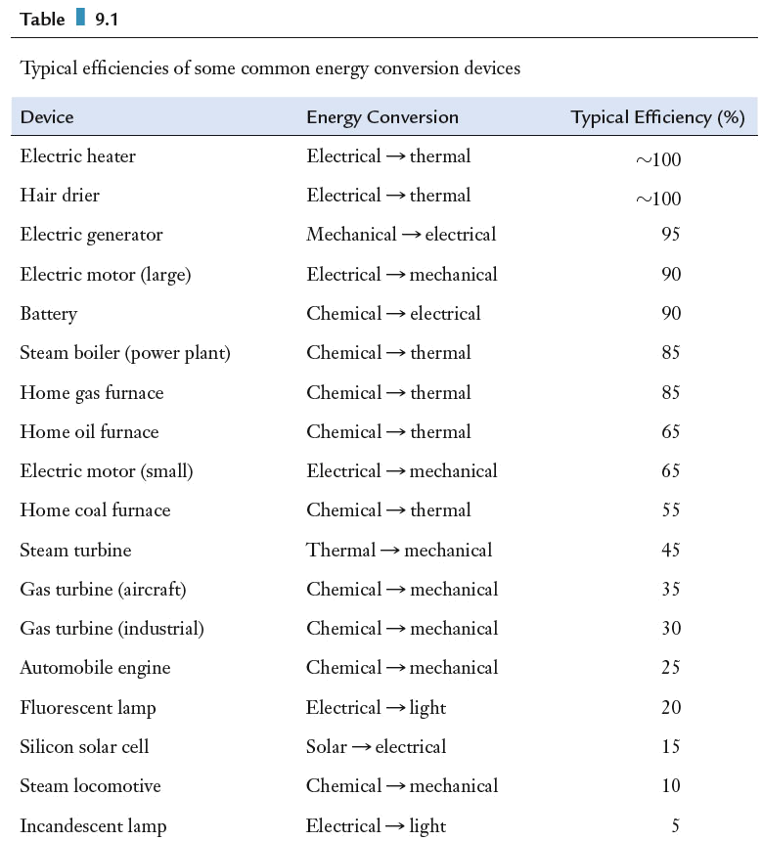
Waste Energy
Typical efficiencies of some common energy conversion devices.

Slide 15
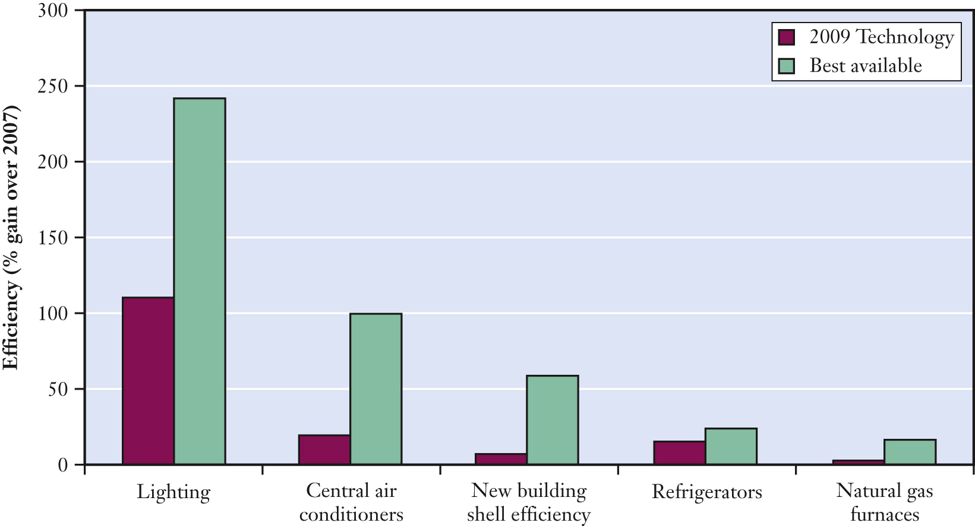
Waste Energy
Predicted efficiency gains by the year 2030 for various technologies.

Slide 16
Heat Capacity and Calorimetry
Calorimetry is a laboratory method for observing and measuring the flow of heat into and out of a system.
Systems will absorb different amounts of energy based on three main factors.
  The amount of material, m or n, where
    m is mass and n is number of moles
  The type of material, as measured by c or C_{p}
    c is the specific heat capacity, or specific heat, and C_{p} is the molar heat capacity.
  The temperature change, ΔT

Slide 17
Heat Capacity and Specific Heat
The specific heat capacity, or specific heat, is a physical property of a substance that describes the amount of heat required to raise the temperature of one gram of a substance by 1 ^{º}C
  Represented by c
  Specific heat is compound and phase specific.
The molar heat capacity is a physical property of a substance that describes the amount of heat required to raise the temperature of one mole of a substance by 1 ^{º}C
  Represented by C_{p}
  Molar heat capacity is compound and phase specific.

Slide 18
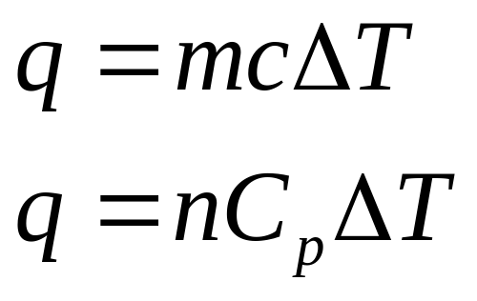
Heat Capacity and Specific Heat
The amount of heat energy absorbed can be quantified.

Slide 19
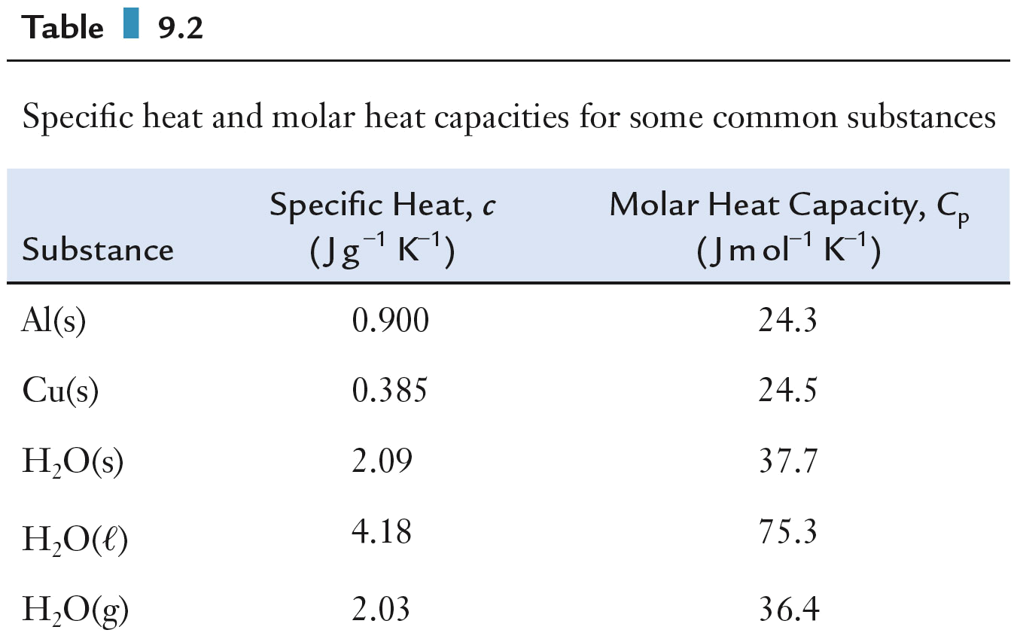
Heat Capacity and Specific Heat
Specific heat and molar heat capacities for some common substances.

Slide 20
Heat Capacity and Specific Heat
Heating a 24.0 g aluminum can raises its temperature by 15.0 ^{º}C. Find the value of q for the can.

Slide 21
Heat Capacity and Specific Heat
The molar heat capacity of liquid water is 75.3 J/mol K. If 37.5 g of water is cooled from 42.0 to 7.0 ^{º}C, what is q for the water?

Slide 22
Question
The molar heat capacity of water ice is 37.7 J/mol K. If 80.5 g of water ice is heated from -45.0 to 0.0 ^{º}C, what is q for the ice?
3790 J
7580 J
5690 J
11.4 kJ

Slide 23
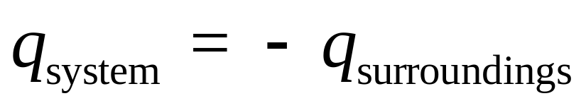
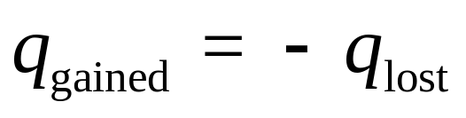
Calorimetry
Heat flow is measured using a calorimeter.
A calorimeter measures the heat evolved or absorbed by the system of interest by measuring the temperature change in the surroundings.

Slide 24
Calorimetry
A glass contains 250.0 g of warm water at 78.0 ^{º}C. A piece of gold at 230.0 ^{º}C is placed in the water. The final temperature reached by this system is 79.9 ^{º}C. What was the mass of gold? The specific heat of water is 4.184 J/g ^{º}C, and that of gold is 0.129 J/g ^{º}C.

Slide 25
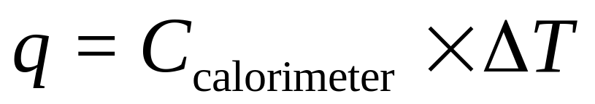
Calorimetry
There are two steps in a calorimetric measurement.
  Calibration - the calorimeter constant, C_{calorimeter}, is determined by dividing the known amount of heat released in the calorimeter by the temperature change of the calorimeter.

Slide 26
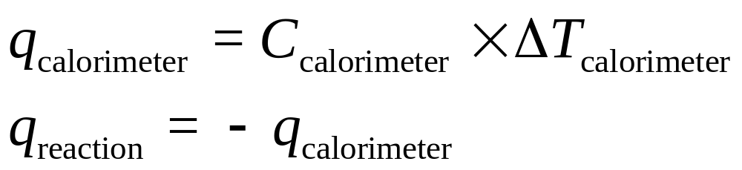
Calorimetry
  Measurement – the temperature change for the calorimeter and the calorimeter constant are used to determine the amount of heat released by a reaction. The heat released or absorbed in a reaction of known quantity of material is measured.

Slide 27
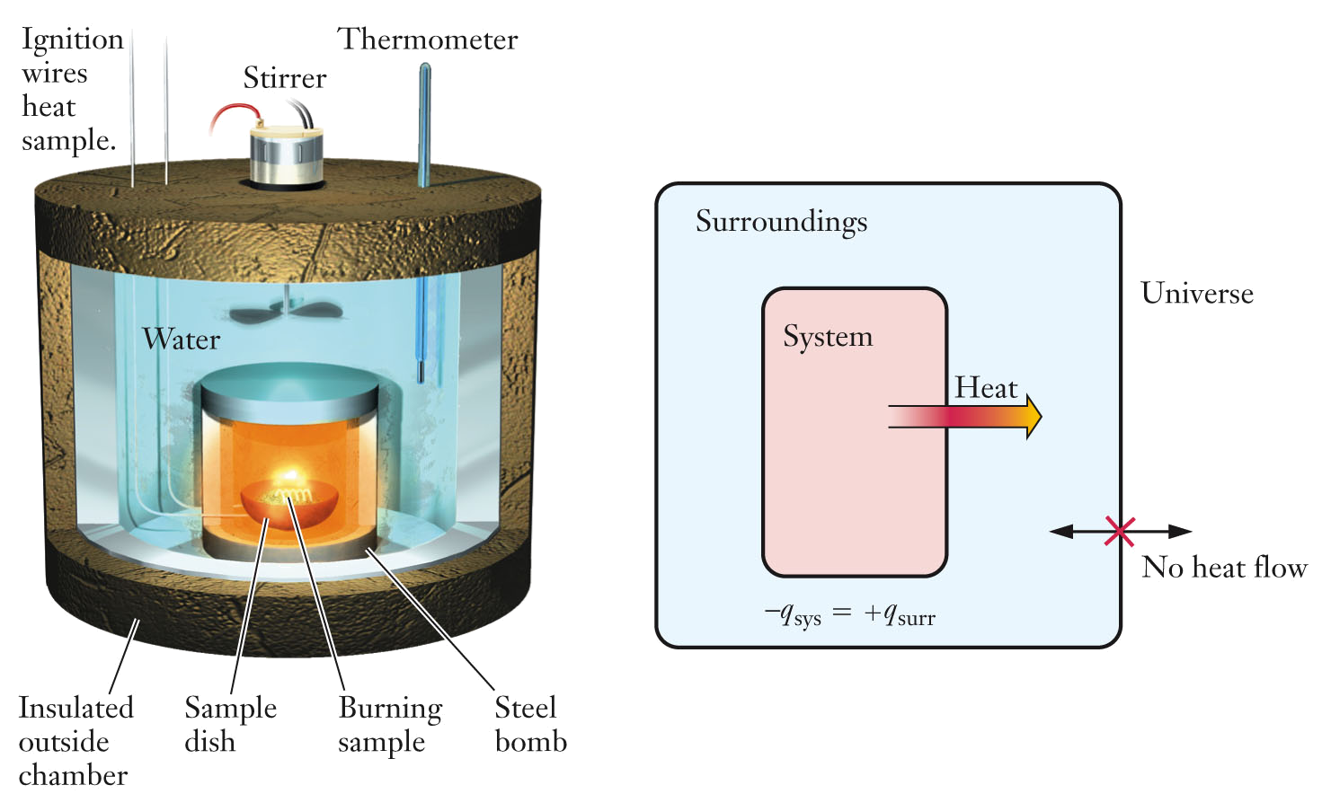
Calorimetry
Diagram of a bomb calorimeter and standard choice for system and surroundings in a bomb calorimetry experiment.

Slide 28
Calorimetry
In the calibration of a calorimeter, an electrical resistance heater supplies 100.0 J of heat and a temperature increase of 0.850 ^{º}C is observed. Then, 0.245 g of a particular fuel is burned in this same calorimeter and the temperature increases by 5.23 ^{º}C. Calculate the energy density of this fuel, which is the amount of energy liberated per gram of fuel burned.

Slide 29
Enthalpy
The conditions under which heat flow, q, occurs will have an impact on the measurement that is made.
  Combustion of octane releases 5.45 x 10³ kJ under constant volume conditions, represented as q_{v}
  Combustion of octane releases 5.48 x 10³ kJ under constant pressure conditions, represented as q_{p}

Slide 30
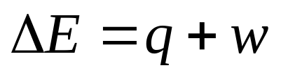
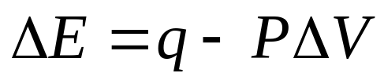
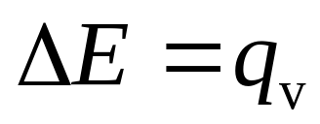
Internal Energy (constant volume)
The internal energy change for a reaction equals the sum of the heat flow and the work.
  During an expansion, w = –PΔV.
  Under constant volume conditions, ΔV = 0, and ΔE = q_{v.}

Slide 31

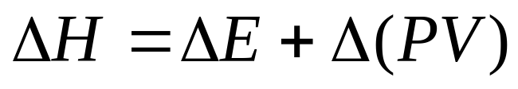
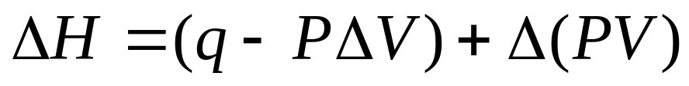
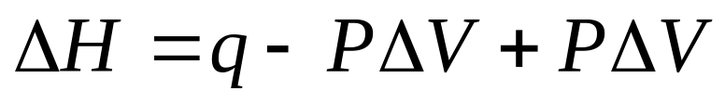
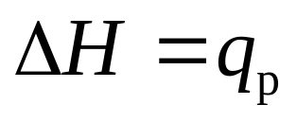
Enthalpy (constant pressure)
Enthalpy, H, is the heat flow under conditions of constant pressure.
  The enthalpy change can be expressed as

Slide 32
Enthalpy
When a system releases heat, the process is said to be exothermic.
  The value of ΔH is less than zero; the sign on ΔH is negative.
When a system absorbs heat, the process is said to be endothermic.
  The value of ΔH is greater than zero; the sign on ΔH is positive.

Slide 33
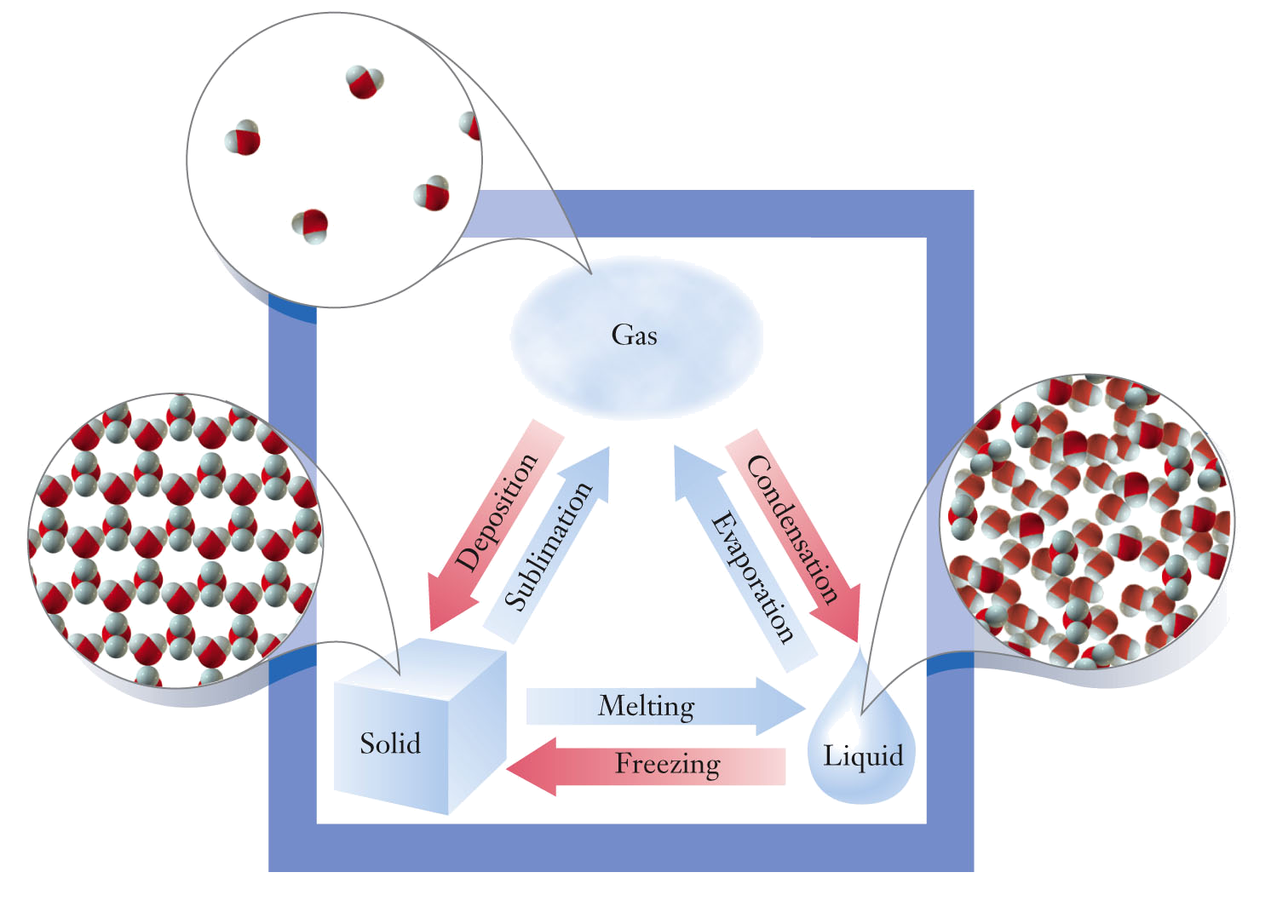
ΔH of Phase Changes
Phase changes occur under constant pressure conditions.
  The heat flow during a phase change is an enthalpy change.
  During a phase change, temperature does not change. Heat flow is due to the formation or breaking of intermolecular attractive forces.

Slide 34
∆H of Phase Changes
The heat required to convert a liquid to a gas is the heat of vaporization, ΔH_{vap}
    ΔH_{vap} is endothermic with a positive value.
The heat released to convert a gas to a liquid is the heat of condensation, ΔH_{cond}
    ΔH_{cond} is exothermic with a negative value.
ΔH_{cond} = –ΔH_{vap}
  The values of enthalpy changes in opposite directions have equal numeric values and differ only in their signs.
  The magnitude of enthalpy change depends on the substance involved.

Slide 35
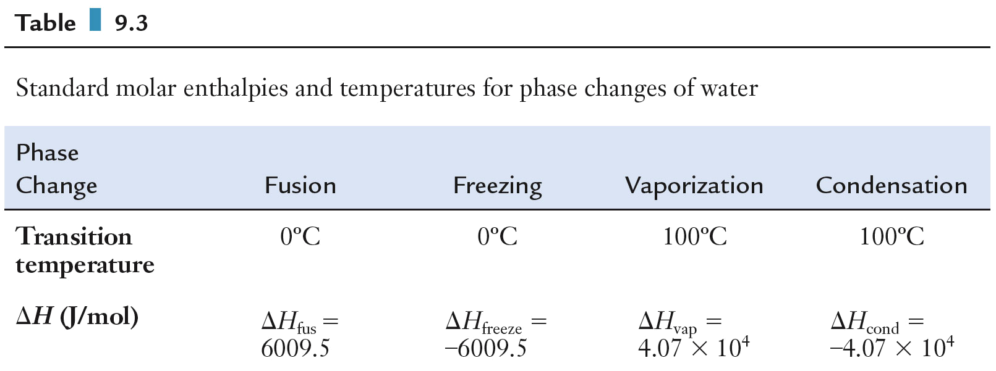
∆H of Phase Changes
Standard molar enthalpies and temperatures for phase changes of water.

Slide 36
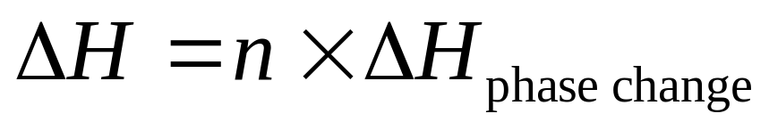
∆H of Phase Changes
The value of ΔH for a phase change is compound specific and has units of kJ/mol.
  The total heat flow can be calculated using the number of moles of substance, n, and the value of the enthalpy change.

Slide 37
∆H of Phase Changes
Calculate the enthalpy change when 240. g of ice melts.

Slide 38
Question
Calculate the enthalpy change when 120. g of water is boiled (converted from liquid to gas).
−2.71 x 10⁵ J B. +2.71 x 10⁵ J
C. +3.20 x 10⁵ J D. −3.20 x 10⁵ J

Slide 39
Question
When 120. g of water is boiled (converted from liquid to gas), is this
exothermic B. endothermic

Slide 40
∆H of Phase Changes
The total enthalpy change for the conversion of ice to liquid and then to steam can be calculated.
  A heat curve breaks the calculation down into specific heat calculations (sections of the heat curve where temperature changes) and phase change enthalpy calculations (sections of the heat curve where temperature does not change).

Slide 41
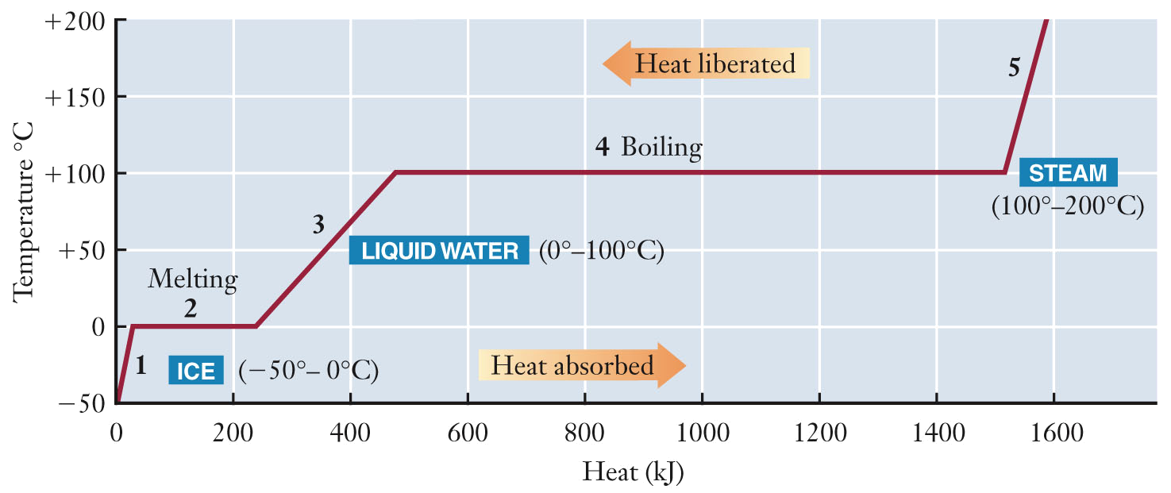
∆H of Phase Changes
Heat curve for the heating of 500. g of ice at -50 ºC to 200 ºC

Slide 42
Vaporization and Electricity Production
The large amount of energy required to convert water from a liquid to a gas is exploited in converting chemical energy into electricity.
  The goal of a power plant is to convert as much chemical energy as possible into electricity.
  The large heat of vaporization for water is ideal for “trapping” the heat energy given off in the combustion reaction.

Slide 43
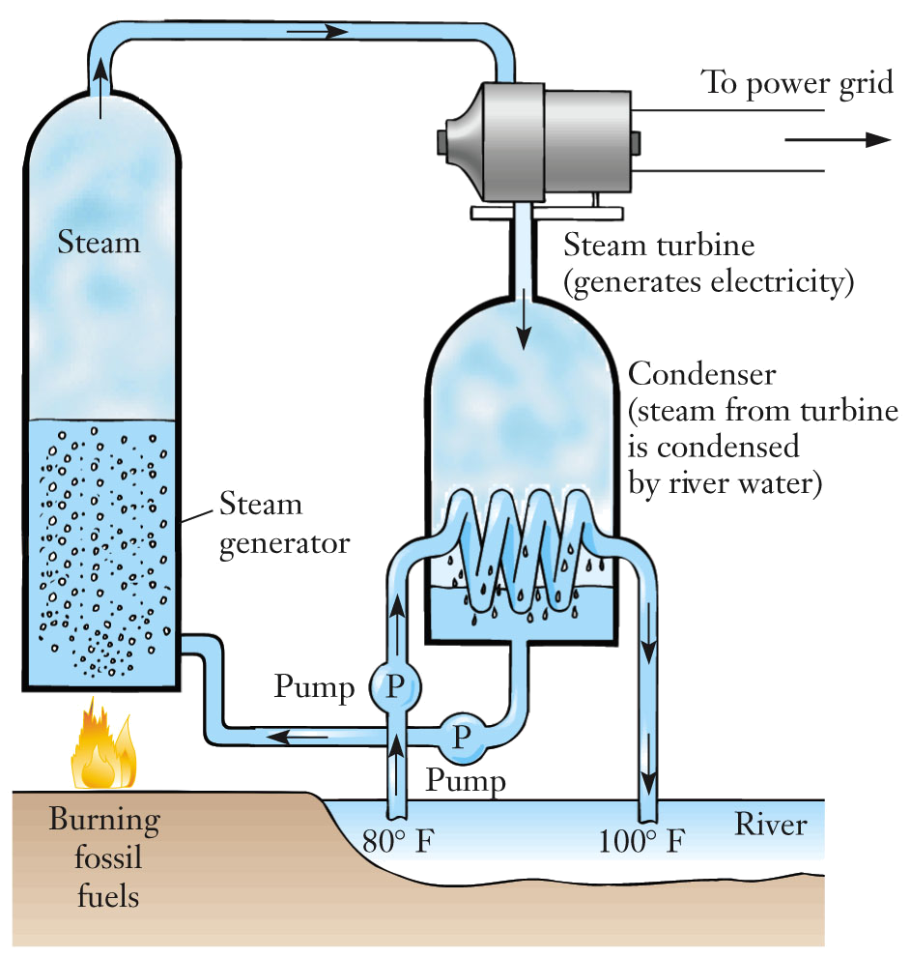
Vaporization and Electricity Production
Schematic diagram of the important elements of a standard electric power plant.

Slide 44
Heat of Reaction
Enthalpy changes can be calculated for chemical reactions, in addition to temperature changes and phase transitions.
  The enthalpy change for a chemical reaction is commonly referred to as the heat of reaction.

Slide 45
Bonds and Energy
The enthalpy change for a reaction can be estimated using bond energies.
During a chemical reaction, reactant bonds are broken and product bonds are made.
  Breaking bonds requires energy.
  Making bonds releases energy.
If the amount of energy released making product bonds is greater than the amount of energy required to break reactant bonds, the reaction is exothermic. If the energy released is less than the energy required, the reaction is endothermic.

Slide 46
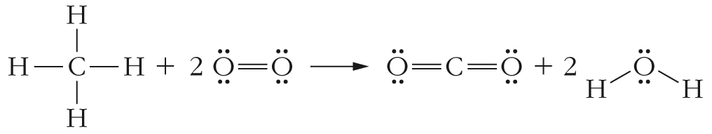
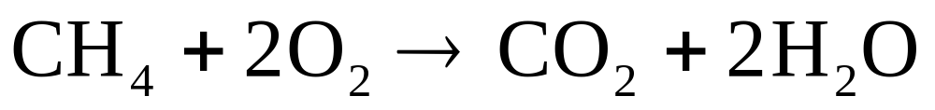
Bonds and Energy
The combustion of methane breaks 4 C-H bonds and 2 O=O bonds. 2 C=O bonds and 4 O-H bonds are made.

Slide 47
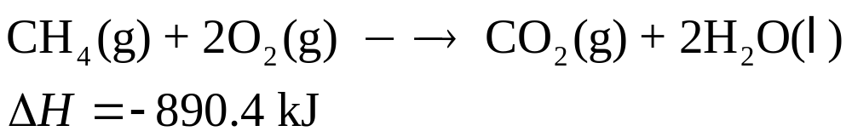
Bonds and Energy
A thermochemical equation summarizes the overall energetics for a chemical reaction.
  The sign on the ΔH indicates whether the reaction is endothermic or exothermic

Slide 48
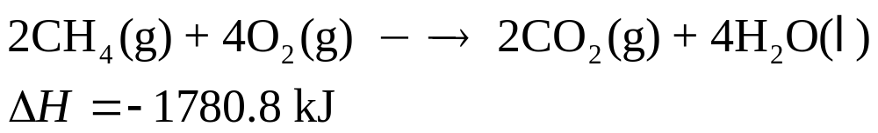
Bonds and Energy
The combustion of methane is an exothermic reaction and releases 890.4 kJ of heat energy when 1 mole of methane reacts with 2 moles of oxygen.
For thermochemical equations, if the stoichiometric coefficients are multiplied by some factor, the heat of reaction must also be multiplied by the same factor.

Slide 49
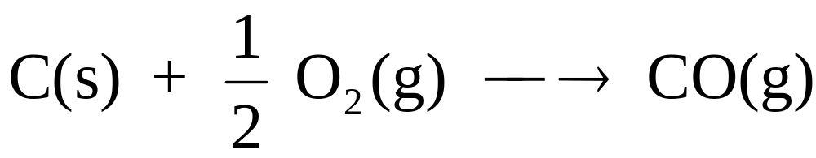
Heats of Reaction for Some Specific Reactions
Some classes of chemical reactions are given their own labels for heats of reactions.
  Heat of combustion, ΔH_{comb}
  Heat of neutralization, ΔH_{neut}
  Heat of formation, ΔH_{f}, is the heat of reaction for formation of substances from the elements.
    Fractional coefficients are allowed for formation reactions because only one mole of product can be formed.

Slide 50
Heats of Reaction for Some Specific Reactions
A formation reaction is the chemical reaction by which one mole of a compound is formed from its elements in their standard states.
The standard state is the most stable form of an element at room temperature, 25 ºC, and pressure, 1 atm, indicated with a superscript º
ΔH_{f}º = 0 for an element in its standard state.
A large number of ΔH_{f}º are tabulated on the NIST website and in your Appendix E.

Slide 51
Hess’ Law
Direct calorimetric determinations of some reactions may be difficult or dangerous to perform.
  An indirect method is used to obtain heats of reaction.
Hess’ law: the enthalpy change for any process is independent of the particular way the process is carried out.
  Enthalpy is a state function.
  A state function is a variable whose value depends only on the state of the system and not its history.

Slide 52
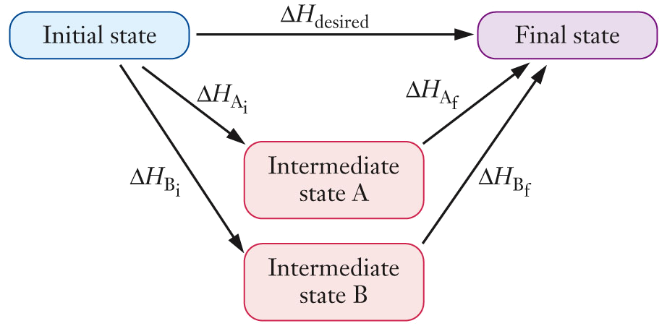
Hess’ Law
Conceptual diagram representing Hess’ law. Enthalpy is a state function, so any convenient path can be used to calculate the enthalpy change.

Slide 53
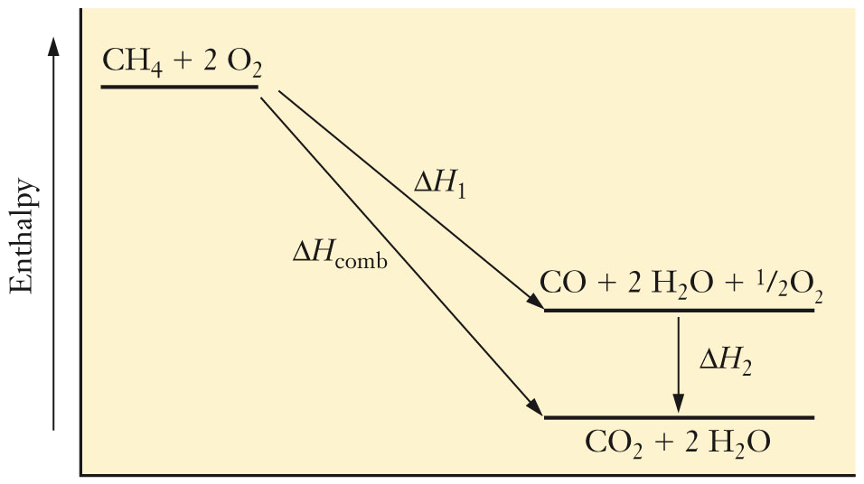
Hess’ Law
Enthalpy diagram for the combustion of methane. The CH₄ is converted to CO, then the CO is converted to CO₂. The ΔH for each step is used to calculate the ΔH for the overall reaction. The total ΔH will be the same for both paths.

Slide 54
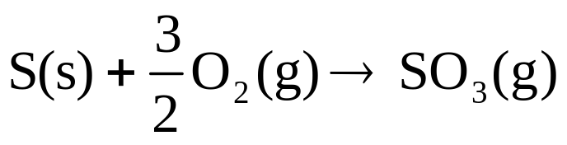
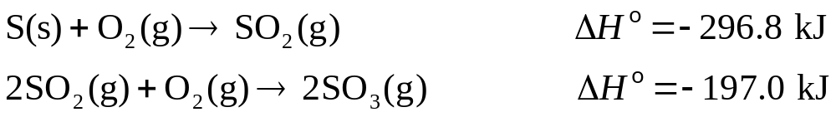
Hess’ Law
One origin of SO₃ is the combustion of sulfur, which is present in small quantities in coal, according to the following equation.
Given the thermochemical information below, determine the heat of reaction for this reaction.

Slide 55
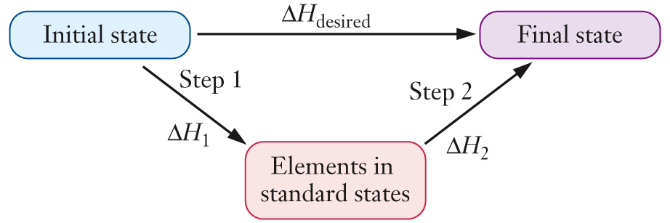
Hess’ Law
Conceptual diagram showing how to use tabulated enthalpies of formation to calculate the enthalpy change for a chemical reaction.

Slide 56
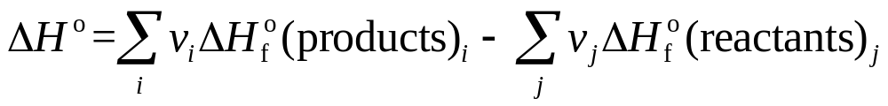
Formation Reactions and Hess’ Law
The enthalpy change for a reaction can be calculated using Hess’ law and heats of formation.

Slide 57
Formation Reactions and Hess’ Law
Use tabulated data to find the heat of combustion of one mole of propane, C₃H₈, to form gaseous carbon dioxide and liquid water.
Appendix E has the ΔH_{f}º values:
ΔH_{f}º(CO₂(g)) = −393.5 kJ/mol
ΔH_{f}º(H₂O(ℓ)) = −285.8 kJ/mol
ΔH_{f}º(C₃H₈(g)) = −103.8 kJ/mol

Slide 58
Formation Reactions and Hess’ Law
Ethanol, C₂H₅OH, is used to introduce oxygen into some blends of gasoline. It has a heat of combustion of 1366.8 kJ/mol. What is the heat of formation of ethanol?

Slide 59
Energy and Stoichiometry
A thermochemical equation allows for the stoichiometric treatment of energy.
  For an exothermic reaction, energy is treated as a product.
  For an endothermic reaction, energy is treated as a reactant.
The thermochemical equation is used to convert between the number of moles of a reactant or product and the amount of energy released or absorbed.
  The stated value of ΔH for a thermochemical equation corresponds to the reaction taken place exactly as written, with the indicated numbers of moles of each substance reacting.

Slide 60
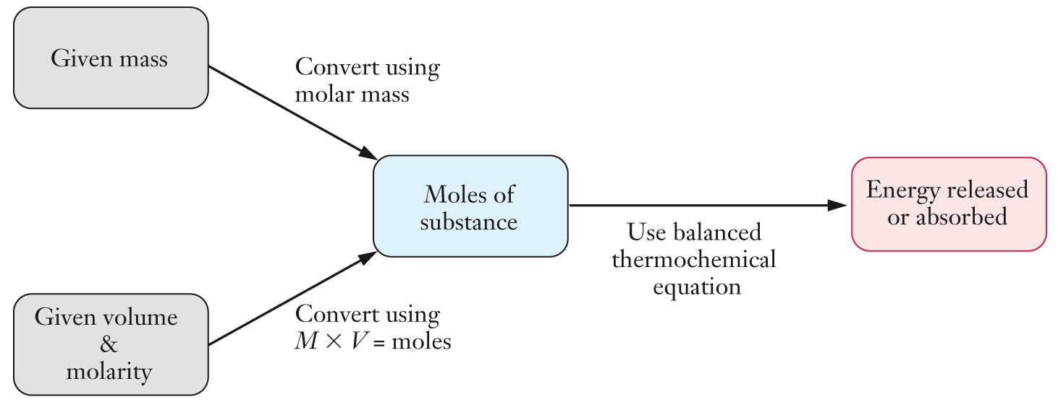
Energy and Stoichiometry
Flow chart detailing the sequence of steps needed to calculate the amount of energy released or absorbed when a chemical reaction is carried out using a given amount of material.

Slide 61
Energy and Stoichiometry
An engine generates 15.7 g of nitric oxide gas during a laboratory test. How much heat was absorbed in producing this NO?
N₂ (g) + O₂(g) → 2 NO(g) ΔHº = 180.5 kJ

Slide 62
Energy Density and Fuel
When deciding the economic merits of a fuel, several factors must be considered.
  The technology available to extract the fuel.
  The amount of pollution released by its combustion.
  The fuel’s relative safety.
  The ease of transporting the fuel.
  The fuel’s energy density.

Slide 63
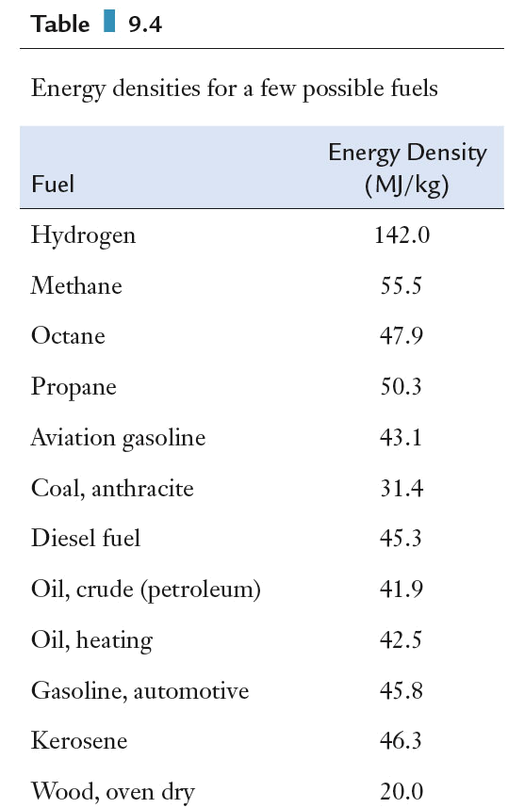
Energy Density and Fuel
Energy density is the amount of energy that can be released per gram of fuel burned.
  The higher the energy density of a fuel, the less fuel that must be transported to the customer.

Slide 64
Batteries
Many reactions interconvert between chemical energy and forms of energy other than heat.
  Energy can be released as light.
  Energy can be released as electrical energy.
    Electrical energy arises from moving a charge.
Reduction-oxidation or redox reactions convert chemical energy to electrical energy by transferring electrons between chemical species.
Batteries are constructed such that electrons flow through an external circuit as they are transferred from one chemical species to another.

Slide 65
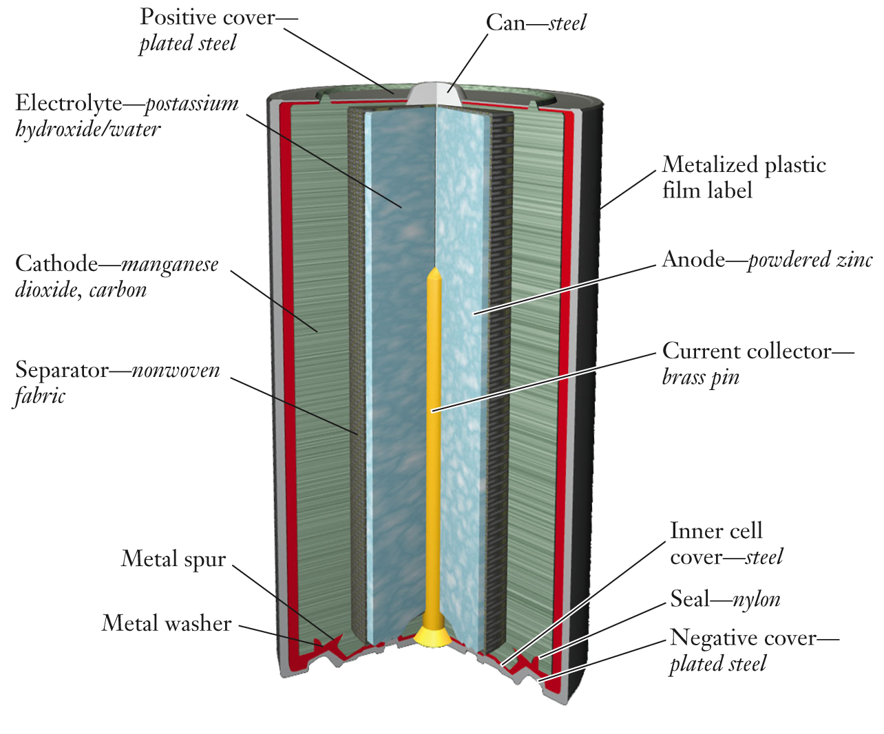
Batteries
The construction of a typical alkaline battery.
  Zn gets oxidized from 0 to 2+
  Mn gets reduced from 4+ to 2+

Slide 66
Batteries
Batteries can be classified as either primary or secondary.
  Primary batteries become useless once the redox reaction has run its course. An alkaline battery is a primary battery.
    The lifetime of a primary battery is determined by the amounts of reactants present.
  Secondary batteries can be recharged

Slide 67
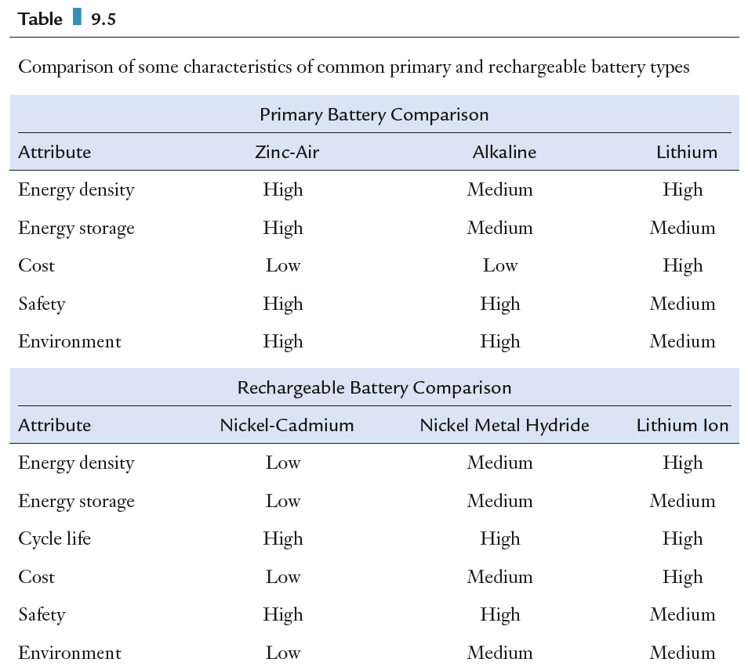
Batteries
Comparisons of energy density, energy storage, cost, safety, and environmental characteristics for various primary batteries.

Slide 68
Batteries
Comparisons of energy density, energy storage, cost, safety, and environmental characteristics for various rechargeable batteries.

