Slide 1
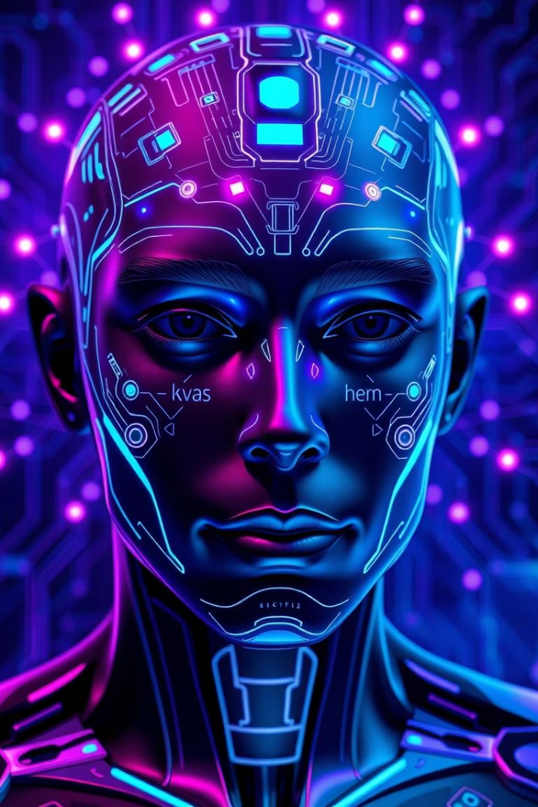
AI-based Face Recognition Assistant
This project explores the development of a sophisticated AI-based face recognition assistant designed to provide enhanced security and seamless user interaction. It integrates advanced neural networks and state-of-the-art digital recognition technologies to achieve accurate and efficient identification.
As the project lead, I am responsible for coordinating research, system design, and implementation to ensure that the assistant meets the highest standards of performance and user experience.
N BHARATH
U23IA22S0068

Slide 2
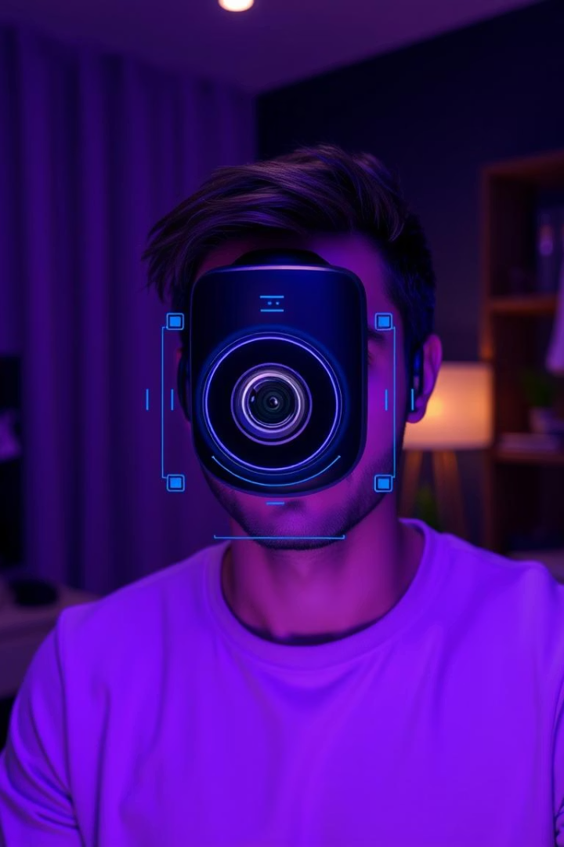
Introduction
Problem Statement
Lack of intuitive real-time personal assistants
Motivation
Enhance interaction through face recognition and voice

Slide 3
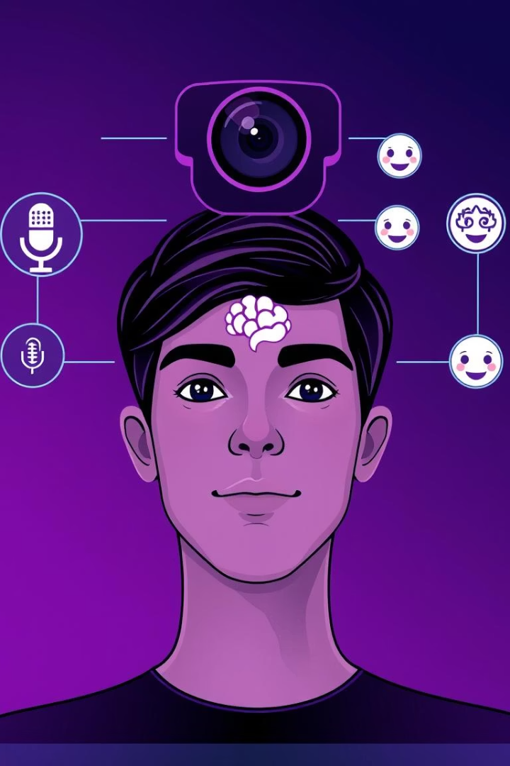
Project Objectives
Real-time Face Detection
Natural Language Greetings
Voice Command Interaction
Dynamic Model Retraining

Slide 4
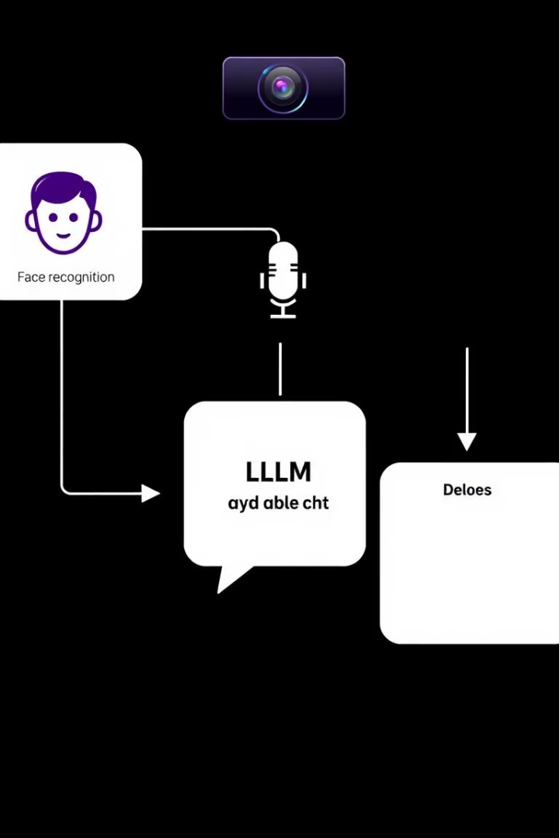
System Architecture
IP Webcam
Captures real-time video feed
Face Recognition
Detects and identifies known faces
Voice Engine
Processes and responds to user voice
Local LLM (Ollama)
Generates natural language responses

Slide 5
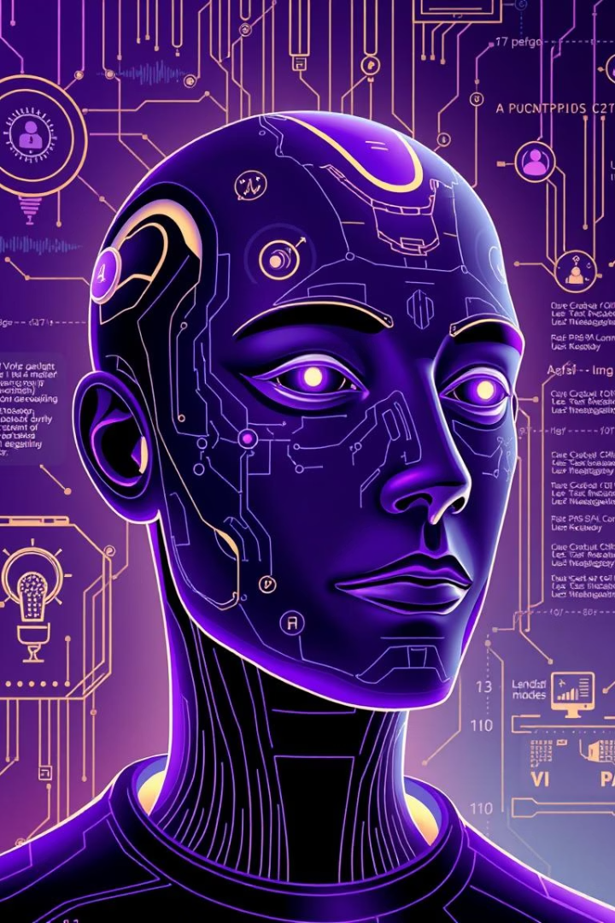
Technologies Used
OpenCV for image processing
face_recognition library for detection
speech_recognition for voice input
pyttsx3 for speech synthesis
Ollama for Local Large Language Model (LLM)
Python for development

Slide 6
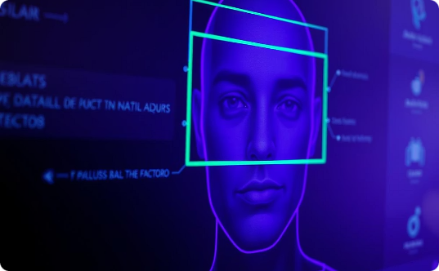
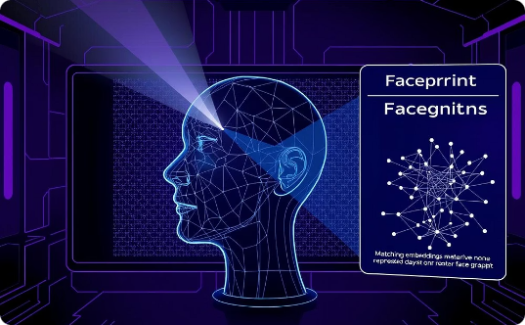
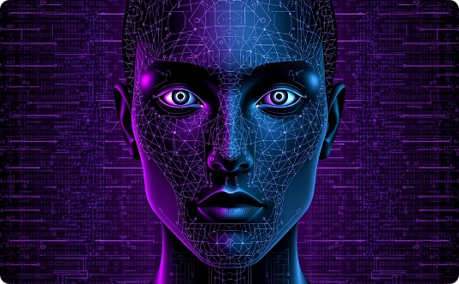
Face Recognition Module
Detection
Recognition
Dynamic Retraining
Extracts faces from webcam frames using OpenCV
Matches detected faces with known identities via embeddings
Updates model in real-time with new faces introduced

Slide 7

Voice Assistant Workflow
Capture Voice Input
Using microphone and speech_recognition library
Process Commands
Convert speech to text for interpretation
Respond
Generate audio reply with pyttsx3 text-to-speech

Slide 8




Local LLM Integration with Ollama
Initialize Model
Load Ollama LLM once at startup
Send Prompts
Forward recognized face and command context
Receive Responses
Generate natural language replies dynamically

Slide 9
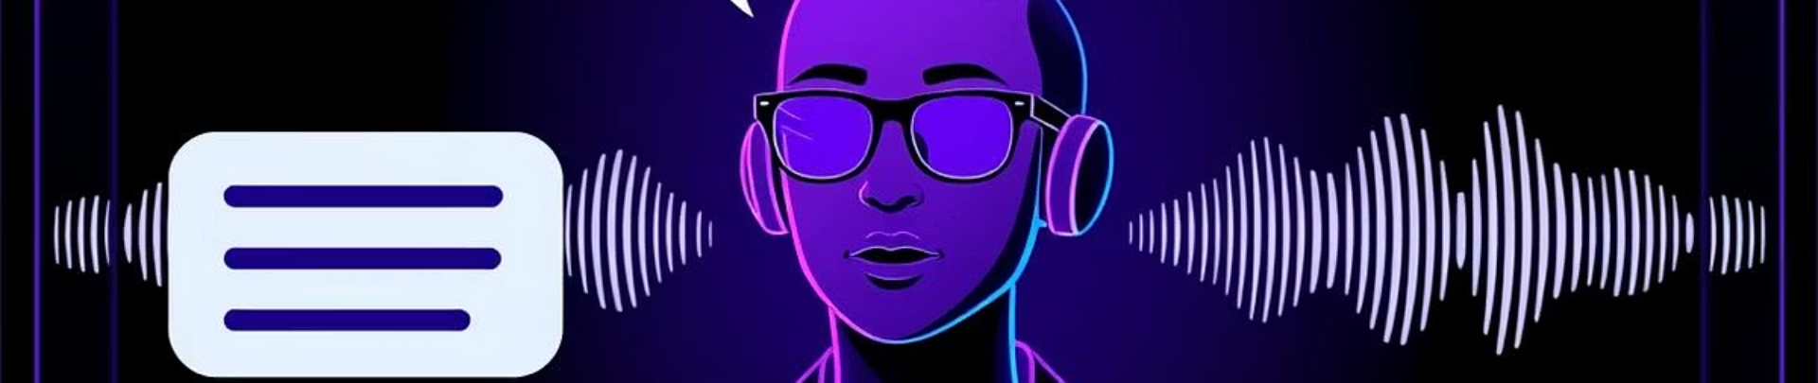




Key Features
Boss Mode Greeting
Real-Time Voice Commands
Model Optimization & Retraining
Retry Logic for Robustness

Slide 10

Challenges & Solutions
Challenge:
Handling real-time video processing latency
Solution:
Optimized OpenCV pipelines for efficiency
Challenge:
Accurately recognizing new faces dynamically
Solution:
Implemented live model retraining mechanisms

Slide 11
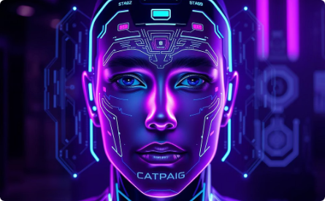
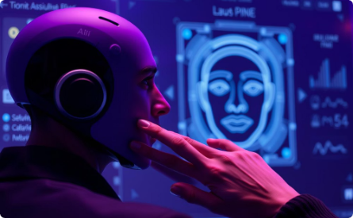

Conclusion & Future Scope
Transformative AI-based face recognition with a voice-powered
interface for seamless user interaction.
Live demo highlights personalized assistance through intuitive
Voice commands and accurate face identification.
Local language model integration ensures privacy, data
sovereignty, and a future-proof assistant architecture.

