Slide 1
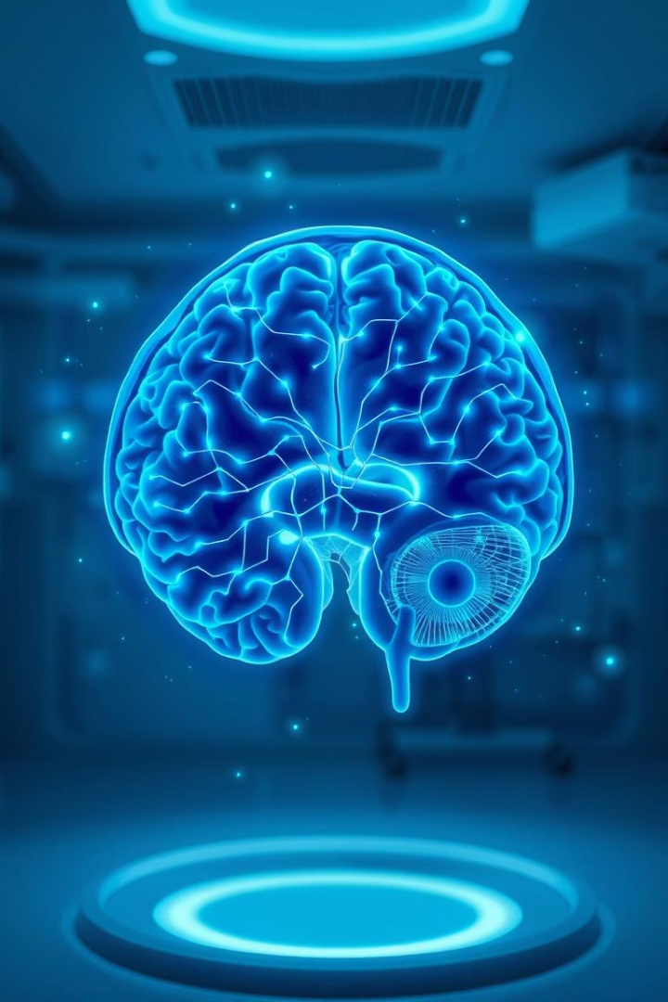
Brain Stroke Detection Using Deep Learning
Revolutionizing Early Diagnosis with AI
Md Ather Ali

Slide 2
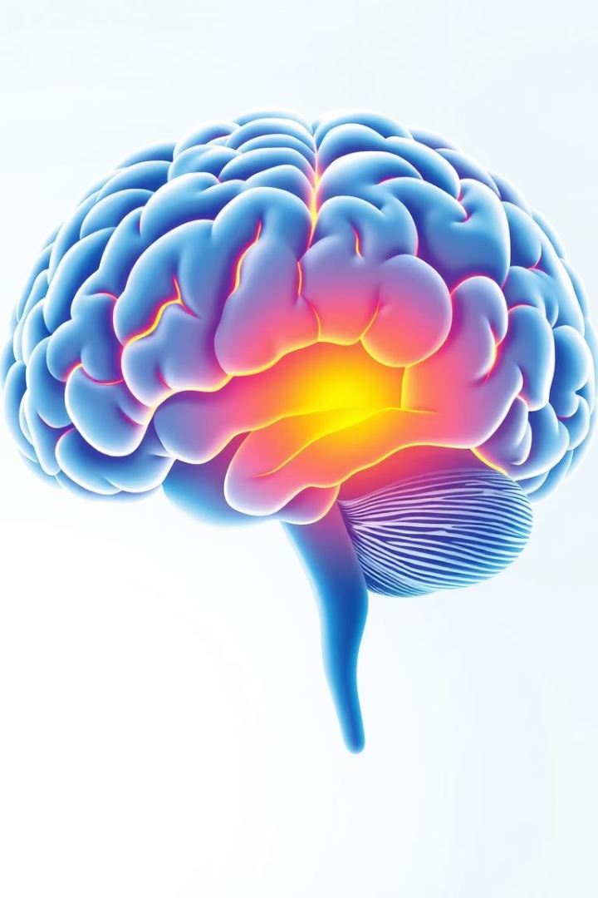
Introduction to Brain Stroke and Impact
What is a Brain Stroke?
Critical Health Impact
Causes long-term disability and high mortality rates worldwide.
Disruption of blood flow causing brain tissue damage.
Importance of Early Detection
Early diagnosis improves treatment outcomes and saves lives.

Slide 3
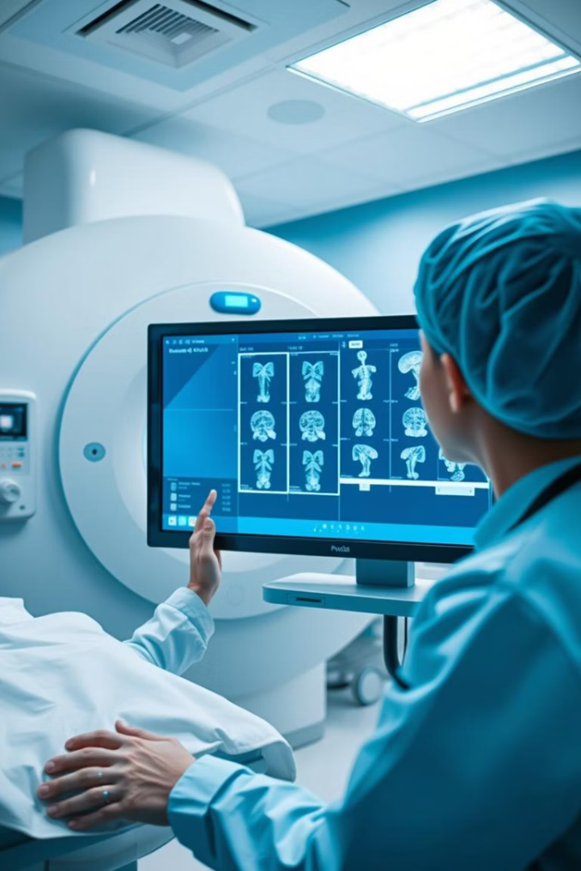
Challenges in Traditional Stroke Diagnosis
Time-Consuming Process
Expertise Dependent
Manual evaluations delay crucial treatment decisions.
Relies heavily on specialized radiologists for accuracy.
Human Error Risks
Fatigue and variability cause potential misdiagnoses.

Slide 4
Existing Diagnostic Methods and Their Limitations
Manual MRI Evaluation
Computed Tomography (CT) Scans
Detailed but slow and expertise-heavy process.
Widely used but less sensitive to early ischemic changes.
Subjective interpretation
Lower resolution for soft tissue
Time intensive
Radiation exposure concerns

Slide 5
Proposed Deep Learning Approach
Deep Learning Models
MRI Image Analysis
Convolutional Neural Networks (CNNs)
Accurate detection and classification of stroke lesions.
Multiscale CNNs for feature extraction
Automated workflow to reduce diagnosis time.
Hybrid ensemble models combining strengths

Slide 6
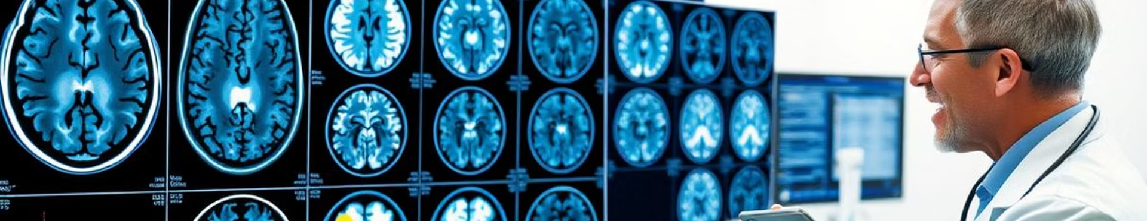
Dataset Details and Preprocessing
Dataset Sources
Data Augmentation
Class Balance & Preprocessing
Public hospitals and research databases with labeled MRIs.
Rotation, scaling, and flipping to improve model robustness.
Normalization, skull stripping, and balancing stroke vs. control images.

Slide 7





Model Architecture Explained
Convolutional Layers
Activation Functions
Optimization
Innovations
Adam optimizer with hybrid learning rate schedule.
Multiscale feature fusion enhances detection accuracy.
Extract spatial features from MRI scans effectively.
ReLU for non-linearity, softmax for final classification.

Slide 8
Training Strategy and Evaluation Metrics
Training Metrics
Loss & Validation
Accuracy
Cross-entropy loss optimized with early stopping.
Dice Similarity Score
5-fold cross-validation for robust evaluation.
Precision and Recall

Slide 9
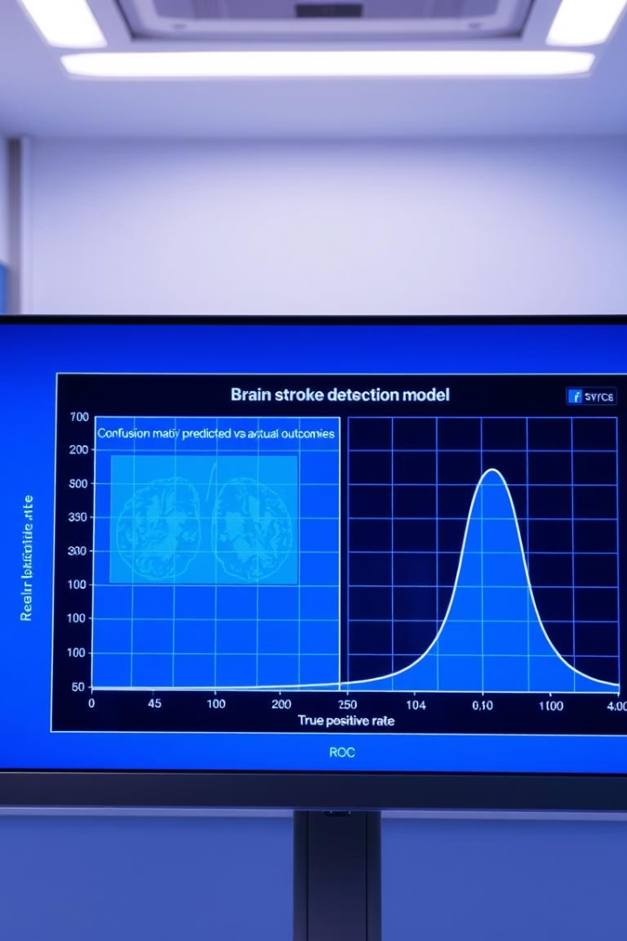
Results and Performance Comparison
Superior Accuracy
Robust Classification
Achieved over 92% accuracy on test datasets.
Effective across ischemic and hemorrhagic stroke types.
Better than Existing Methods
Outperforms traditional manual and CT-based diagnosis.

Slide 10
Advantages, Challenges, and Future Directions
Advantages
Challenges & Future Work
Higher accuracy and faster diagnosis
Limited dataset size and MRI variability
Robust across diverse stroke types
Need for extensive clinical validation
Reduces reliance on human expertise
Integration of explainable AI for transparency

Slide 11
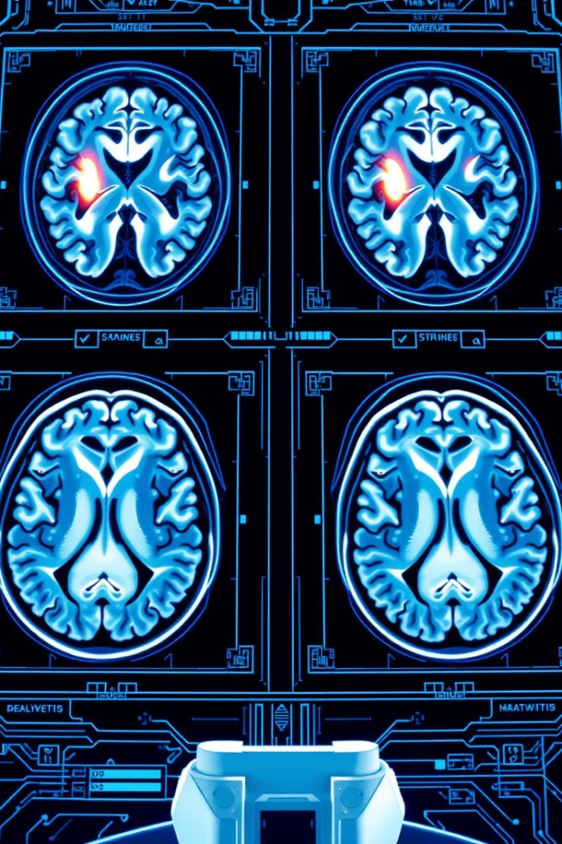
Conclusion
In this presentation, we've explored the use of deep learning techniques for early and accurate detection of brain strokes. We discussed the significant impact of strokes, the limitations of traditional diagnostic methods, and how our proposed deep learning approach can overcome these challenges.
By leveraging advanced neural network architectures and a curated dataset, we demonstrated the potential of this technology to provide rapid, reliable, and cost-effective stroke diagnosis. The promising results highlight the advantages of this approach, including improved patient outcomes through timely intervention.
However, we also acknowledged the ongoing challenges and the need for further research and development to refine the models and address practical deployment considerations. With continued advancements in deep learning and medical imaging, we are optimistic about the future of this technology in revolutionizing stroke care.
In conclusion, this presentation has outlined a compelling vision for the future of brain stroke detection, where deep learning can empower healthcare professionals to make more informed decisions and deliver better patient care. We hope this inspires further exploration and collaboration in this critical field.

