Slide 1

Crime Scene Detection Using Deep Learning
Real-Time Video Surveillance for Automatic Crime Classification
SHUSHIL KUMAR PULSE
U23IA22S0089

Slide 2

Introduction
Crime Rise
Manual Limits
AI Model
Increasing crime rates need smarter surveillance
Manual monitoring prone to errors and delays
Accepts live video, classifies 4 crime types

Slide 3

Problem Statement
Reactive Systems
Existing systems respond after crimes occur
Real-Time Analysis
Challenge to analyze video instantly
Behavior Detection
Complex human actions hard to detect
Accurate Classification
Need precise crime category identification

Slide 4
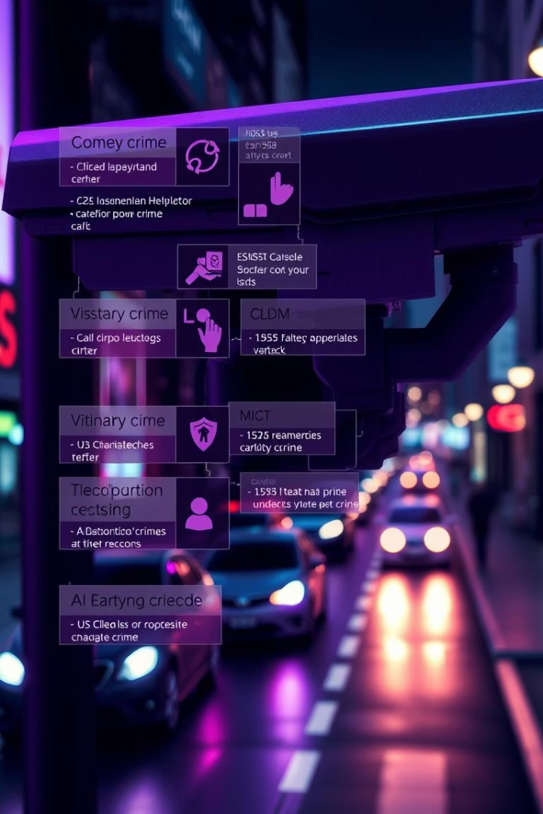
Objectives
Automate Detection
Classify Crimes
Arrest, Abuse, Arson, Assault
Real-Time Display
Reduce Manual Effort

Slide 5
Methodology
Data Collection
Model
Labeled crime scene videos
CNN + LSTM hybrid for spatial & temporal features
Preprocessing
Training
Frame extraction, resizing, normalization
Large crime-related video dataset
Output
Real-time crime category prediction

Slide 6





Model Architecture
Input Video
Frame Extraction
CNN Feature Extraction
LSTM Temporal Analysis
Dense Layer Output

Slide 7

Implementation
Tools
Processing
TensorFlow & OpenCV
Frame-by-frame in real-time
UI Overlay
Training
Displays predicted crime type
GPU used for faster convergence

Slide 8
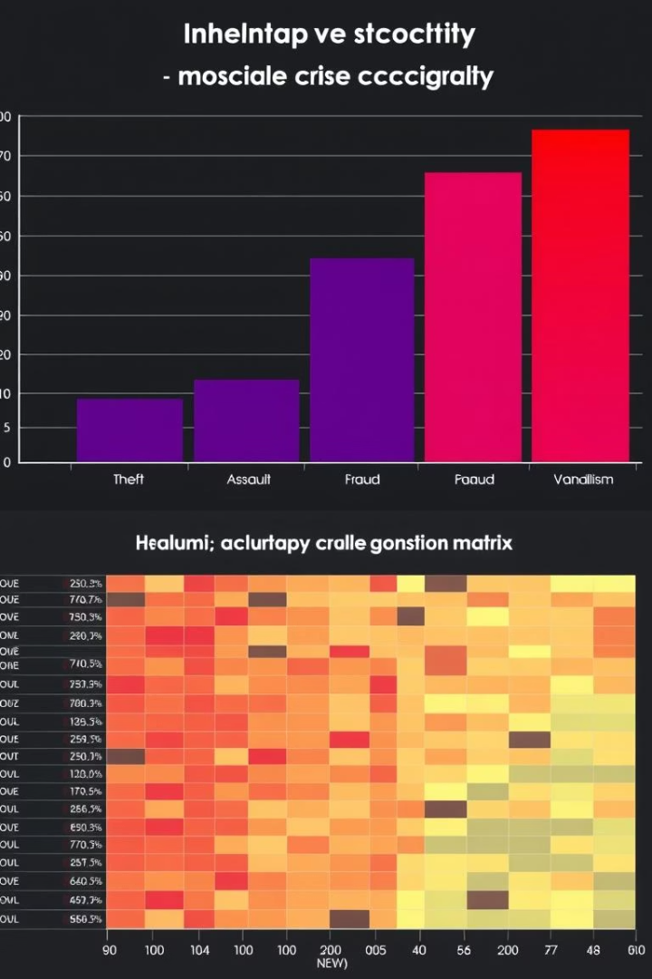
Results & Accuracy
Accuracy
Confusion Matrix
~92% overall
Strong performance on all classes
Latency
<1.5 sec/frame CPU, <0.5 sec GPU

Slide 9

Future Scope
More Crime Types
Theft, Burglary, etc.
Advanced Models
YOLO, Transformer-based video models
Deployment
Smart cities real-world use
Live Alerts
Instant law enforcement notification

Slide 10

Conclusion
AI-Driven System
Successful crime classification via video
Enhanced Safety
Reduces human error in surveillance
Scalable Security
Real-time intelligent systems future
Final Thought
Machines can help prevent crimes early

