Slide 1

AI-Powered Deepfake Face Detection: Combating Synthetic Media Threats
This presentation explores AI techniques for detecting synthetic deepfake media. We focus on CNNs and attention-based models to tackle evolving threats. The project blends technical depth with practical insights, ideal for academic evaluation in computer science.
GANESH
U23IA22S0011

Slide 2

The Rise of Deepfakes
Rapid Growth
Accessible Tools
Deepfakes leverage generative AI to create hyper-realistic fake videos.
Open source tools make creating deepfakes easy and widespread.
Challenging Detection
Traditional methods struggle with increasingly sophisticated synthetic media.

Slide 3

Threats Posed by Deepfakes
Misinformation
Deepfakes can spread false news undermining public trust.
Privacy Violation
Fake media can misuse personal images for harassment or defamation.
Security Risks
Manipulated videos threaten identity verification and cybersecurity.
Political Interference
Synthetic media may disrupt democratic processes and elections.

Slide 4
AI-Based Deepfake Detection Techniques
Convolutional Neural Networks (CNNs)
Attention-Based Models
Capture spatial features from face images for manipulation cues.
Focus on critical facial regions enhancing detection precision.
Edge inconsistencies
Learn long-range dependencies
Texture anomalies
Highlight subtle irregularities
Blending artifacts
Adapt to new forgery styles

Slide 5
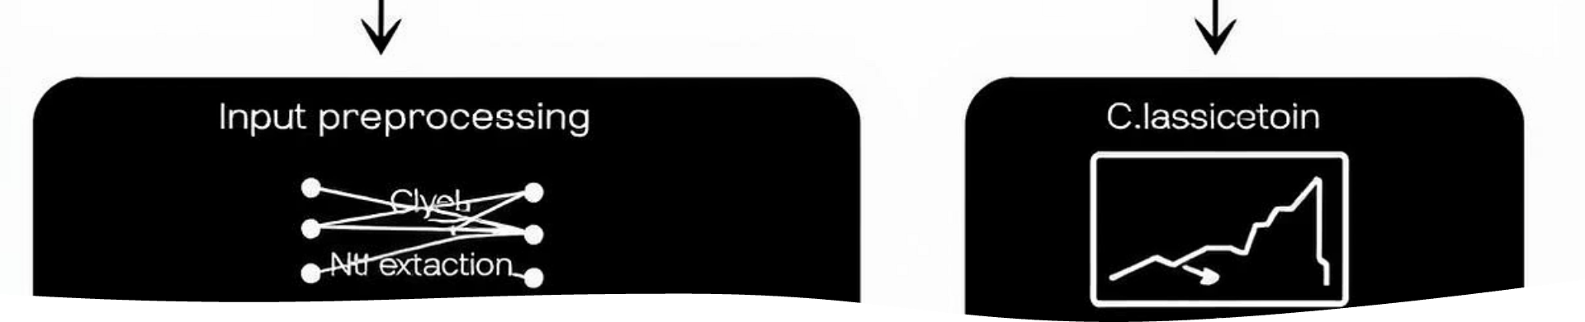
System Architecture Overview
The system processes video frames through preprocessing, feature extraction by CNNs, attention modules for region focus, and a classifier for final detection.

Slide 6
Dataset and Preprocessing
Source Datasets
Preprocessing Steps
Used large public datasets: FaceForensics++, Celeb-DF, and DeepFakeDetection.
Face detection and alignment
Normalizing pixel intensities
Augmentation: rotation, scaling, brightness adjustment

Slide 7
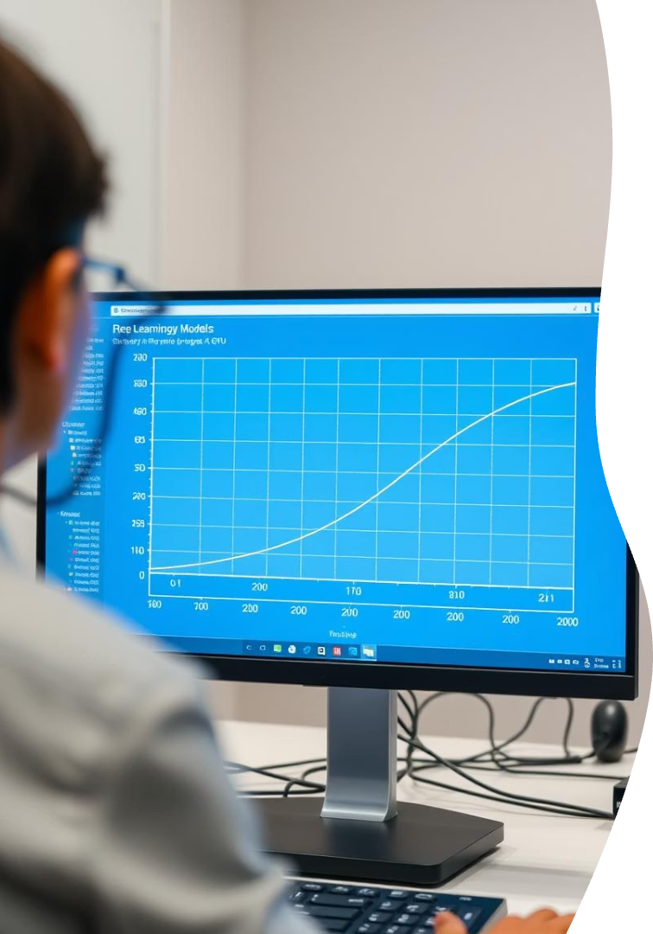




Model Training Details
Model Initialization
Used pretrained CNN backbone for faster convergence.
Fine-Tuning
Trained attention modules to refine feature focus.
Optimization
Adam optimizer with learning rate decay and early stopping.
Validation
Used stratified k-fold cross-validation for robustness.

Slide 8
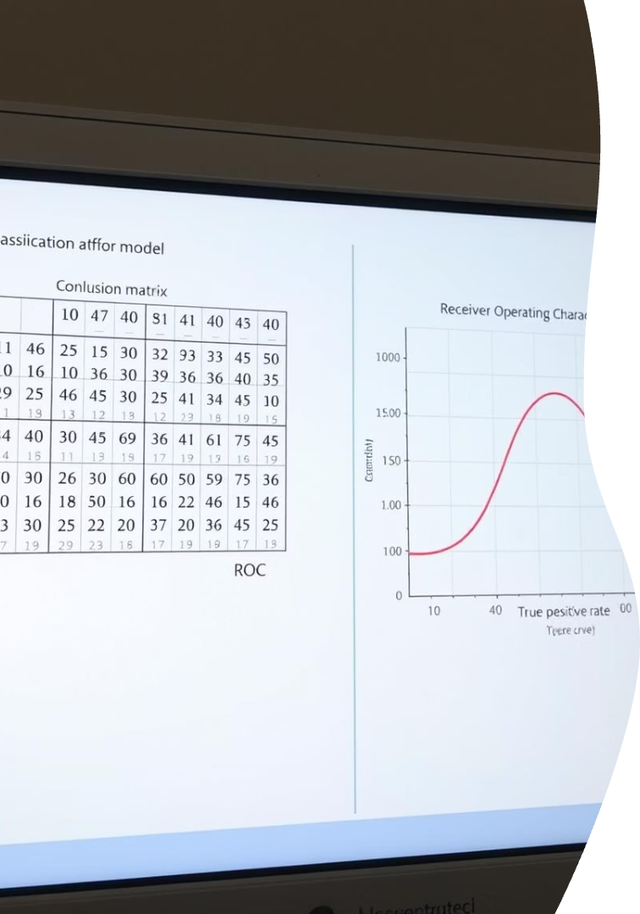
Results and Evaluation
Metric
Value
Accuracy
96.5%
Precision
95.8%
Recall
97.2%
F1-Score
96.5%
The approach effectively detects state-of-the-art deepfakes with high precision.

Slide 9





Real-World Use Cases
Online Platform Security
Government and Law Enforcement
Academic Research
Prevent fake content distribution on social media and video platforms.
Authenticate videos for investigations and public safety.
Study and develop countermeasures for synthetic media threats.
Corporate Compliance
Secure video interviews and identity verification processes.

Slide 10

Key Takeaways and Next Steps
Deepfakes pose serious societal risks
AI techniques like CNNs and attention models excel
Ongoing training and data diversity are essential
Future work: real-time detection and cross-modal analysis
Continued innovation will strengthen defenses against synthetic media threats.

Slide 11
Thank you

