Slide 1

Fake Currency Detection Using Deep Learning
Combining Computer Vision and Neural Networks for Reliable Banknote Authentication
Presented by: [Your Name], [Institution], [Date]
In this presentation, we will explore the challenges of counterfeit currency detection and how deep learning techniques can enhance the reliability and efficiency of banknote authentication. Using advanced computer vision methods coupled with neural networks, we aim to build models capable of distinguishing fake currency notes from genuine ones with high accuracy.
The approach leverages image preprocessing, feature extraction, and convolutional neural networks to analyze subtle patterns and textures unique to legitimate currency. This work has significant implications for financial institutions and governments aiming to reduce fraud and maintain economic integrity.
Fareeda Begaum
U23IA22S0016

Slide 2

Problem Statement & Motivation
Counterfeit Rise
Increasing circulation of fake currency notes worldwide.
Manual Detection Limits
Human error common, especially at large scale.
Socio-Economic Risks
Supports black market, terrorism, and inflation.
Need for Automation
Scalable, real-time system essential for reliability.

Slide 3






System Workflow
Image Input
Scanner or mobile camera captures banknote image.
Preprocessing
Align and filter images for clarity.
Feature Extraction
Deep CNN extracts key currency features.
Classification
Model predicts real or fake label.
Confidence & UI
Score displayed on user interface.

Slide 4
Dataset Preparation
Structure
Sources
Challenges
Organized into folders by denomination and authenticity for efficient processing.
Collected from publicly available currency image datasets to ensure diversity.
Class imbalance due to fewer counterfeit samples compared to genuine notes.
Each folder contains images labeled as either genuine or fake notes.
Manual labeling was performed by experts to ensure data accuracy and reliability.
Variations in lighting conditions affect image quality and feature detection.
This hierarchy enables easy access and balanced sampling during training.
Background noise and clutter in some images introduce additional complexity.
Additionally, self-curated images were captured using scanners and mobile cameras under various settings.
Ensuring consistency in image resolution and aspect ratio across datasets.
Maintaining up-to-date datasets to include newly emerging counterfeit designs.

Slide 5
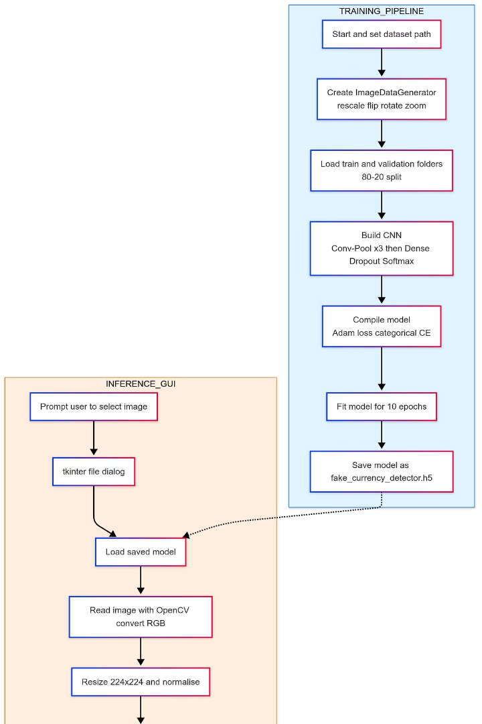
Image Preprocessing
Resize & Convert
Each input image is resized to a fixed dimension of 224×224 pixels to maintain uniformity across the dataset. Optionally, images are converted to grayscale to reduce computational complexity while preserving essential features.
Noise Reduction
To enhance image quality, noise reduction techniques such as Gaussian blur and median filtering are applied. These filters help smooth the image by removing unwanted noise and preserving important edges.
Data Augmentation
Various data augmentation methods including rotation, zooming, and brightness adjustments are used to artificially expand the dataset. This increases model robustness by simulating real-world variations in banknote appearance.
Edge Detection
Advanced edge detection algorithms like Sobel and Canny filters are employed to accentuate fine details and contours in the banknote images. This assists the model in extracting distinctive features critical for classification.

Slide 6
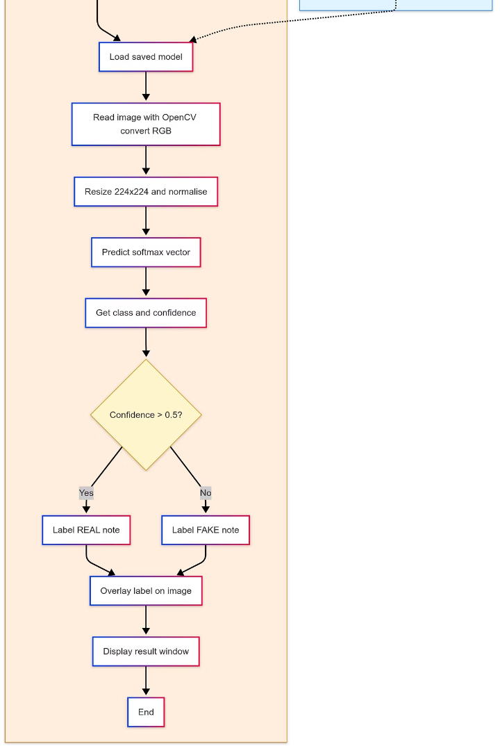
Model Architecture
Core Layers
The backbone of our model consists of convolutional layers that automatically learn spatial hierarchies of features. Each convolutional layer is followed by Batch Normalization to stabilize and accelerate training, then a ReLU activation introduces non-linearity.
Output Layers
Our network ends with fully connected (dense) layers that transform the extracted features into predictions. A Softmax activation function in the final layer converts raw outputs into probability distributions for classification.
Transfer Learning
We leverage pre-trained base models to benefit from generalized feature extraction learned on large datasets. These base layers are often frozen during initial training rounds to preserve foundational knowledge.
Loss Function
The model optimizes using either Categorical Crossentropy for multi-class classification or Binary Crossentropy for binary detection scenarios.

Slide 7
Training Methodology
Framework
Parameters
Training Setup
Implemented in widely used deep learning frameworks such as PyTorch, TensorFlow, or Keras to leverage their robust libraries and GPU acceleration capabilities. These frameworks allow for flexible model building, debugging, and efficient training procedures.
Optimizer: Adam or Stochastic Gradient Descent (SGD) chosen based on convergence speed and performance.
The dataset is split into training and validation sets to monitor the model's performance and prevent overfitting. Data augmentation techniques are used to artificially expand the dataset with variations such as rotations and brightness adjustments. Callbacks like early stopping and learning rate schedulers help optimize training efficiency and model generalization.
Epochs: The number of full training cycles over the dataset; tuned to avoid overfitting.
Batch size: Number of samples processed before the model is updated, balancing speed and memory usage.
Learning rate: Controls how much the model is adjusted during training; fine-tuned for optimal accuracy.

Slide 8

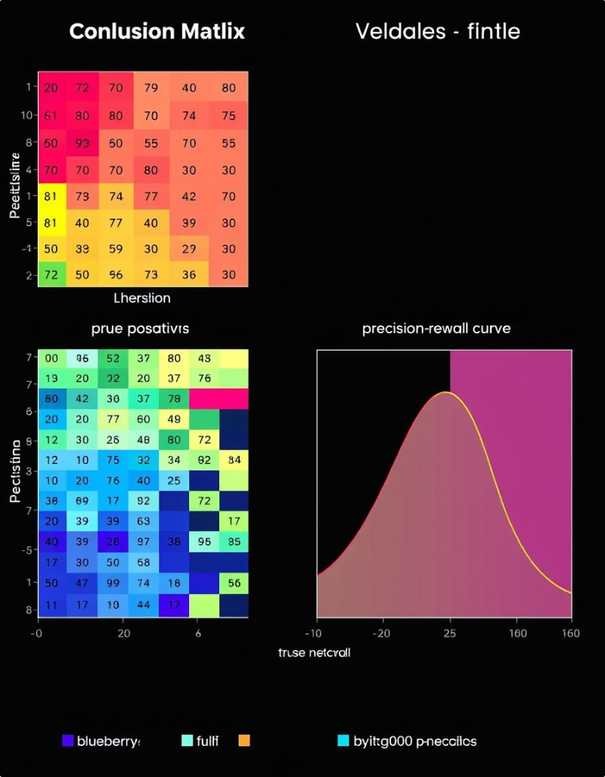
Performance Metrics
Metrics
Accuracy: The overall correctness of the model, measuring the proportion of true results (both true positives and true negatives) among total cases.
Precision, Recall, F1-score: Key indicators for model quality; precision measures the correctness of positive predictions, recall assesses the identification of all relevant instances, and F1-score provides a balanced harmonic mean between precision and recall.
Confusion Matrix
A detailed summary of prediction outcomes showing true positives, true negatives, false positives, and false negatives. This helps identify types of errors the model makes, which is crucial for improving classification accuracy, especially in imbalanced datasets.
ROC-AUC Curve
The Receiver Operating Characteristic - Area Under Curve evaluates the model's ability to distinguish between classes across different threshold settings. A higher AUC indicates better performance in correctly ranking positive instances over negatives.
Inference Time
Measures the speed at which the model processes input data to make predictions. Optimizing inference time is vital for real-time applications and deployment on devices with limited computational resources, such as mobile or embedded systems.

Slide 9

Deployment & Application
Real-Time Integration
Web Application
Utilizes the mobile camera combined with a lightweight, optimized on-device deep learning model to offer instant counterfeit detection. Enables users to verify currency authenticity anytime and anywhere without needing an internet connection, ensuring high convenience and security.
Supports uploading currency images or files through web frameworks like Streamlit or Flask. This flexible interface allows accessibility from any device with a browser, facilitating batch processing and remote verification with centralized model hosting for continuous updates and improvements.
Output
Displays classification results clearly, including a confidence score that quantifies the model's certainty regarding authenticity. This helps users make informed decisions, providing transparency and trust in the detection system's predictions.

Slide 10
Conclusion & Future Scope
Achievements
Limitations
Future Enhancements
Our deep learning model has demonstrated reliable and accurate counterfeit currency detection, consistently surpassing traditional manual inspection methods and ultraviolet (UV) techniques. The system has proven effective in identifying subtle features that are often missed by human examiners, contributing to enhanced security and fraud prevention. These results highlight the potential of AI-driven solutions in modern financial authentication processes.
Currently, the dataset used for training and evaluation is limited exclusively to Indian currency notes, which restricts the model’s applicability to other currencies worldwide.
Incorporation of multimodal detection combining both UV and visible light imaging to improve the accuracy and robustness of counterfeit identification.
The model’s sensitivity to variations in image quality, including poor lighting, blurriness, and background noise, can sometimes lead to reduced detection accuracy.
Integration of Optical Character Recognition (OCR) technology for serial number verification to add an additional layer of security and validation.
Expanding support to include multiple foreign currencies, enabling the system to operate effectively in international settings and aid global financial institutions.
Additionally, the system may face challenges in real-world deployment scenarios where images are captured with diverse devices under uncontrolled environments.
Implementation of advanced image enhancement and noise reduction techniques to mitigate the impact of poor image quality on detection results.
Exploration of real-time mobile application deployment with optimized lightweight models for accessible on-the-go currency authentication.

