Slide 1

Image Captioning with AI & Speech Output
Introduction:
Generating Contextual Descriptions for Images Using Deep Learning.
Image captioning with AI and speech output is a cutting-edge technology that combines
computer vision, natural language processing, and text-to-speech synthesis to generate
Audio descriptions of images.
This innovative solution has far-reaching applications in accessibility, content creation,
And user experience.
By utilizing deep learning models, such as CNNs and or transformers, AI can
Analyze images and generate captions that are then converted to natural-sounding
Audio using advanced speech synthesis algorithms.
SHAIKH SUFFI NAAZ
U23IA22S0069

Slide 2
Content:
Introduction to image captioning
Algorithm
Problem statement
Project objectives
Dataset and preprocessing
Model architecture
System workflow
System design
Implementation and tools
Results and accuracy
Challenges and future enhancement

Slide 3




Introduction to Image Captioning
Visual Understanding
Assistive Tech
Automation
Aids visually impaired users
Automates content tagging
AI understands visual content

Slide 4
Algorithm
CONVOLUTIONAL NEURAL NETWORKS (CNN)
A Convolutional Neural Network (CNN) is a deep learning architecture specifically designed for image processing and feature extraction. It is widely used in image captioning to extract meaningful features from an image before passing them to a language model for caption generation. CNNs work by applying convolutional filters to detect patterns, edges, textures, and objects within an image
LONG SHORT-TERM MEMORY (LSTM)
Long Short-Term Memory (LSTM) is a type of Recurrent Neural Network (RNN) designed to handle sequential data and overcome the limitations of standard RNNs, such as vanishing gradients. In image captioning, LSTM plays a crucial role in generating natural language descriptions from the extracted image features.
ATTENTION MECHANISM
The Attention Mechanism is a powerful deep learning concept that enhances image captioning models by enabling them to focus on specific regions of an image while generating descriptions. Instead of treating the entire image as a single feature vector, attention selectively highlights important visual elements at each step of the caption generation process. This approach significantly improves accuracy, relevance, and coherence in generated captions.
.

Slide 5
WORD EMBEDDINGS - TEXT REPRESENTATIONS
In image captioning, the AI model not only processes images but also generates text descriptions. To ensure that the model understands the relationships between words, we use word embeddings, a technique that transforms words into numerical representations that capture their meaning, context, and semantic relationships.
Word Embeddings are vector representations of words that preserve semantic relationships. Instead of treating words as discrete tokens, embeddings map them to a high-dimensional space, where similar words have similar vector representations
BEAM SEARCH – CAPTION GENERATION OPTIMIZATION
Beam Search is a search algorithm used in sequence generation tasks like image captioning, machine translation, and speech recognition. In image captioning, it is employed to generate the most probable caption by considering multiple possible word sequences instead of just choosing the most probable word at each step. This helps in producing more meaningful, coherent, and grammatically correct captions.
Variants of Beam Search
🔹Length Normalization: Adjusts scores to avoid shorter captions being favored. 🔹Diverse Beam Search: Encourages diversity by penalizing repetitive words. 🔹Stochastic Beam Search: Introduces randomness to explore more variations
EVOLUTION METRICS – CAPTION QUALITY ASSESSMENT
Evaluating the quality of generated image captions is essential to ensure accuracy, fluency, and relevance. Since image captioning is a sequence generation task, traditional classification metrics like accuracy and precision are insufficient. Instead, we use specialized natural language processing (NLP) metrics that compare the generated caption with human-written references.

Slide 6
Problem Statement
Manual Captioning
Automatic Solutions
Meaningful Captions
Time-consuming and subjective
Need for AI-based solutions
Generate relevant descriptions

Slide 7

Project Objectives
1
BLIP Model
2
Text-to-Speech
Utilize for caption generation
Convert captions into speech
3
End-to-End System
Automated image understanding

Slide 8
Dataset & Preprocessing
Images
Captions
Preprocessing
Collection of diverse images
Corresponding text descriptions
Resizing, normalization, tokenization

Slide 9
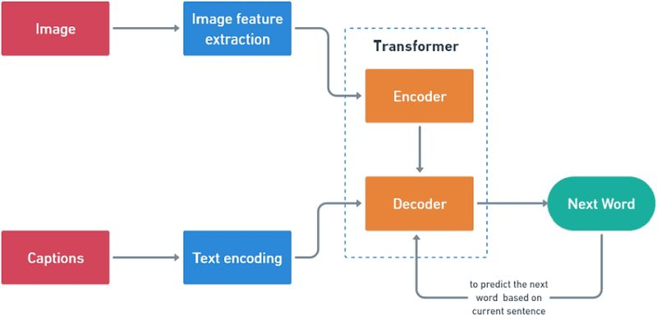
Model Architecture

Slide 10
Encoder
An encoder is a deep learning model component that:
Anlayzes images: Process input images to extract relevant features.
Extracts visual features: Identifies objects, scenes, and actions within the image.
The encoder typically uses:
CNN[convolutional neural networks]:effective for image feature extraction.

Slide 11
Decoder
A decoder is a deep learning model component that:
Generates captions: A transformer generates text captions based on image features.
Produces coherent text: creates a meaningful and grammatically correct caption.

Slide 12
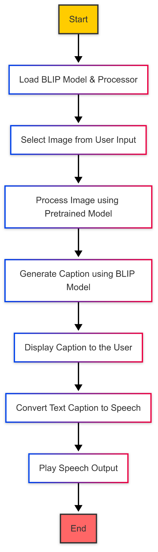
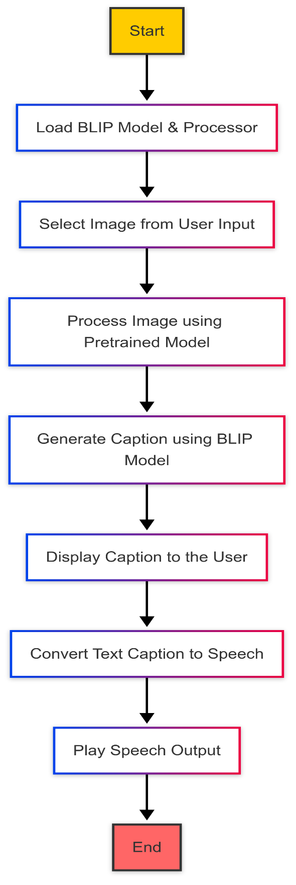
SYSTEM DESIGN
System design

Slide 13






System Workflow
Load BLIP Model
Pretrained model ready
Upload Image
User input image
Process Image
Analyze visual content
Generate Caption
AI creates description
TTS Conversion
pyttsx3 generates speech
Speech Output
Audio is played

Slide 14
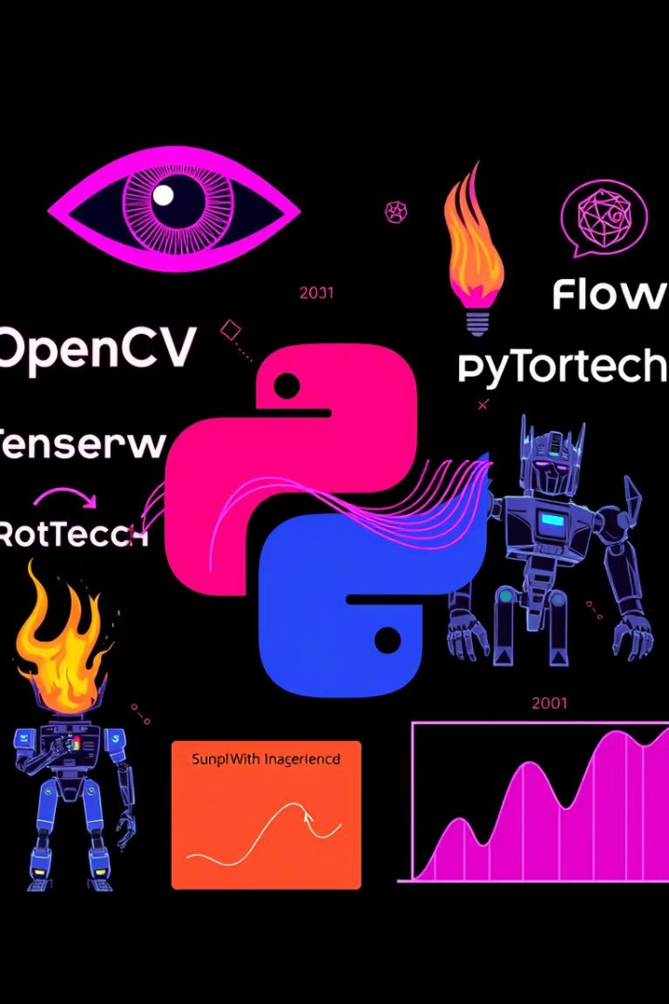




Implementation & Tools
Python
PyTorch
Transformers
Primary programming language
Deep learning framework
Hugging Face library
OpenCV
Image processing

Slide 15

Results & Accuracy
Metric
Value
BLEU Score
0.75
CIDEr
1.2
ROUGE
0.68
High scores indicate good performance

Slide 16

Challenges & Future Enhancements
Training Data
Multilingual
Limited data, biased captions
Support more languages
Real-time
Process live video streams

Slide 17
Thank you

