Slide 1
Retinopathy detection using machine learning.
Rithika David
u23ia22s0022

Slide 2
content
Introduction.
Understanding Diabetic Retinopathy .
Project Objectives.
Algorithm.
Problem statement.
Dataset
Model Architecture.
Training process.
Detection and results.
Challenges and future scope.

Slide 3

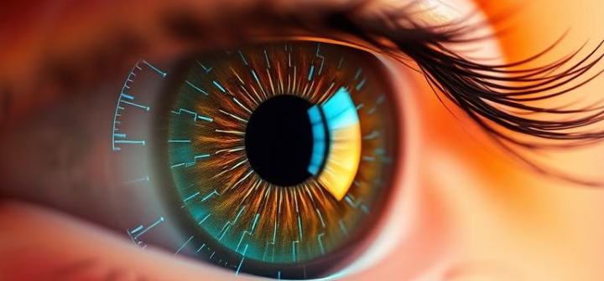

Introduction
Retinopathy is a disease that damages the retina, the light –sensitive tissue at the back of the eye. It can cause vision problems and even blindness if left untreated.
Types of Retinopathy:
Diabetic retinopathy.
Hypertensive retinopathy.
Retinopathy of prematurity.

Slide 4
Diabetic retinopathy:
Diabetic Retinopathy is a complication of diabetes that damages the blood vessels in the retina. And can result in irreversible blindness if not detected early.
Manual diagnosis is time consuming through retinal scans and also requires expert ophthalmologist.
But through the Deep learning techniques that can be used to detect diabetic retinopathy from fundus images.
The model used for detection is CNN [convolutional neural network] for detecting diabetic retinopathy from retinal images.

Slide 5
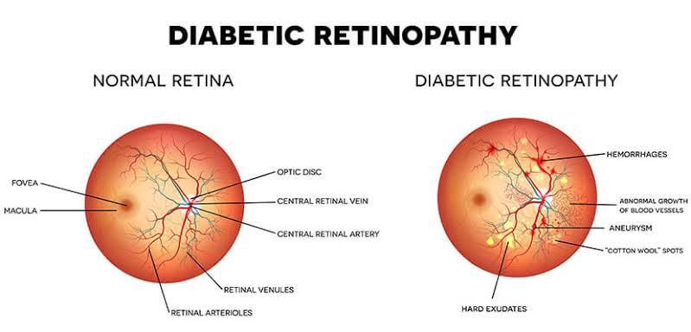
Understanding diabetic retinopathy

Slide 6
Why early detection?
Machine learning diagnosis:
Prevents vision loss: Timely treatment can prevent or delay vision loss.
Reduces time complexity: Early-stage disease is easier to treat.
Improves treatment outcomes: Early detection enables timely treatment, preventing vision loss.
Early detection: Timely treatment and prevention of vision loss.
Improved accuracy: Enhanced diagnostic accuracy.
Automated screening: Streamlined screening process.

Slide 7
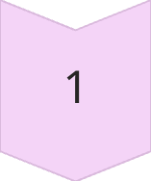
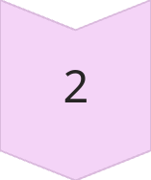
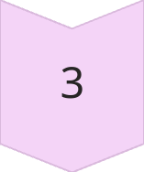
Project Objectives
Develop ML Model
Detect DR from fundus images
Improve Accuracy
Enhance early detection
User-Friendly System
Provide accessible diagnosis

Slide 8
CONVOLUTIONAL NEURAL NETWORKS (CNN) A Convolutional Neural Network (CNN) is a deep learning architecture designed for image processing and feature extraction, making it highly effective for retinopathy detection. In this project, CNNs analyze retinal fundus images to identify key patterns associated with diabetic retinopathy (DR), such as microaneurysms, hemorrhages, and exudates. The extracted features help classify the severity of DR, aiding in early diagnosis and treatment.
machine learning ALGorithm
LONG SHORT-TERM MEMORY (LSTM)
Image processing plays a crucial role in diabetic retinopathy (DR) detection, helping to enhance retinal images, extract important features, and improve classification accuracy. These techniques preprocess retinal fundus images, making it easier for deep learning models to detect abnormalities like microaneurysms, hemorrhages, and exudates.

Slide 9
Sparse Categorical Crossentropy Loss Function
The Sparse Categorical Crossentropy loss function is widely used in multi-class classification problems, such as diabetic retinopathy (DR) detection, where the model classifies retinal images into different severity levels (e.g., No DR, Mild, Moderate, Severe, Proliferative DR). This loss function helps in training deep learning models by measuring how well the predicted class probabilities align with the actual labels.
Activation Functions (ReLU & Softmax)
Activation functions play a crucial role in deep learning models for diabetic retinopathy (DR) detection, helping neurons learn complex patterns from retinal images. ReLU (Rectified Linear Unit) and Softmax are commonly used activation functions in CNN-based classification models
Tkinter (GUI for Image Selection)
Tkinter is a built-in Python library used for reating graphical user interfaces (GUIs). In the Retinopathy detection project, Tkinter provides a simple and interactive way for users to select MRI images for analysis. Instead of manually providing file paths, users can browse and upload images through a user-friendly interface.

Slide 10
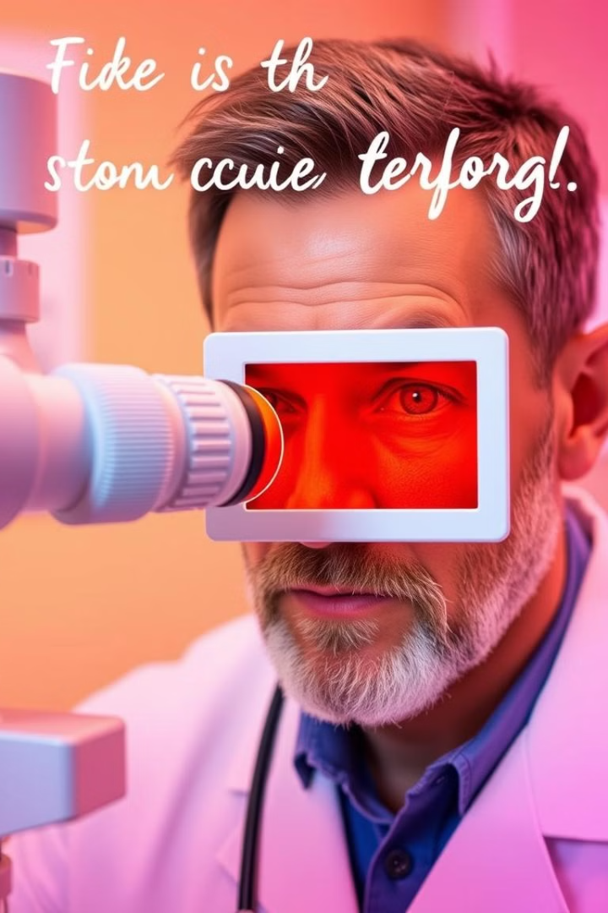



The Problem: Manual Diagnosis
High Cost
Human Error
Expensive specialist consultations
Subjectivity in manual interpretation
Limited Availability
Lack of specialists in remote areas

Slide 11
Dataset Details
The datasets used—APTOS, EyePACS, and Messidor—provide over 1900 fundus images annotated for diabetic retinopathy severity. To address class imbalance, a weighted loss function was applied during training, improving model performance across all severity levels. All images were standardized in resolution, color, and format to ensure consistent model input and enhance robustness.
Class 0: No Diabetic Retinopathy (healthy fundus, no signs of disease
Class 1: Mild DR (presence of microaneurysms only)
Class 2: Moderate DR (more than just microaneurysms but less than severe signs)
Class 3: Severe DR (extensive hemorrhages, venous beading, and intraretinal microvascular abnormalities)
Class 4: Proliferative DR (neovascularization and) potential vision loss risk

Slide 12
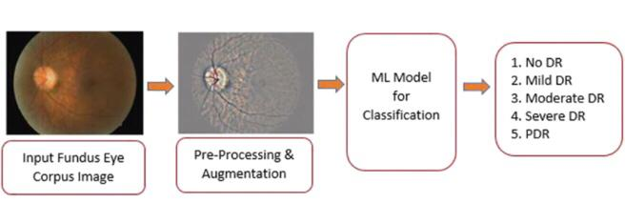
Model Architecture:

Slide 13
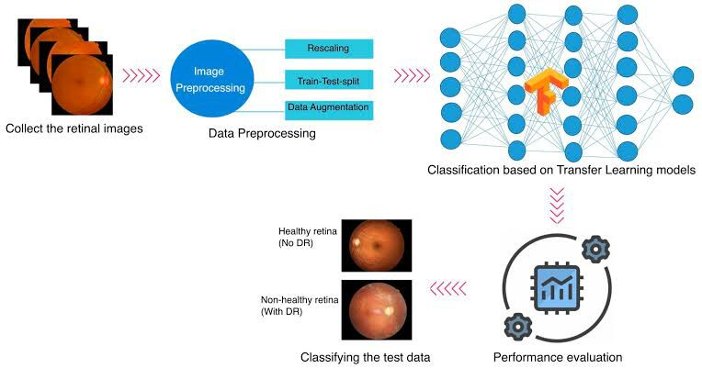
Training process

Slide 14
Detection and Results
Performance Metrics
Sample Output
Confusion Matrix
Accuracy: overall correctness of the model.
Healthy vs. Diseased eye detection.
Visualize classification performance
True positive(TP): correctly identified
DR cases.
True negative(TN):correctly identified
normal cases.
False positive(FP):incorrectly identified
normal cases as DR.
False negative(FN):missed DR cases.
Precision: accuracy of DR predictions.
Recall: Ability to detect all Dr cases.
F1-score: Balance between precision
and recall.

Slide 15

Challenges and future scope
Challenges:
Data quality: Ensuring high-quality images and accurate labels.
Variabilty : Accounting for difference in image quality, lighting, and patient demographics.
Class imbalance: Dealing with unequal numbers of positive and negative cases.
Explainability: understanding how models make predictions.

Slide 16
Future scope:
Improved accuracy: developing more accurate models.
Integration with healthcare: Implementing models in clinical practice.
Early detection: Detecting retinopathy at earlier stages.
Expanding applications: Applying machine learning to other eye diseases.

Slide 17
Thank you

