Slide 1

AI-Powered Security Scanning Systems
Explore how AI transforms security scanning for faster, smarter protection.
Ashwini U23IA22S0017

Slide 2

Understanding AI in Security Systems
AI Overview
Importance
AI analyzes complex data to identify threats instantly.
Integrating AI enhances security effectiveness and efficiency.

Slide 3
Key Features of the AI Security Scanner
Real-time Threat Detection
Intelligent Anomaly Detection
Identifies and responds instantly to emerging risks.
Machine learning detects unusual patterns automatically.
Automated Reporting
Seamless Integration
Generates detailed security analysis and actionable reports.
Works smoothly with existing infrastructure and tools.

Slide 4
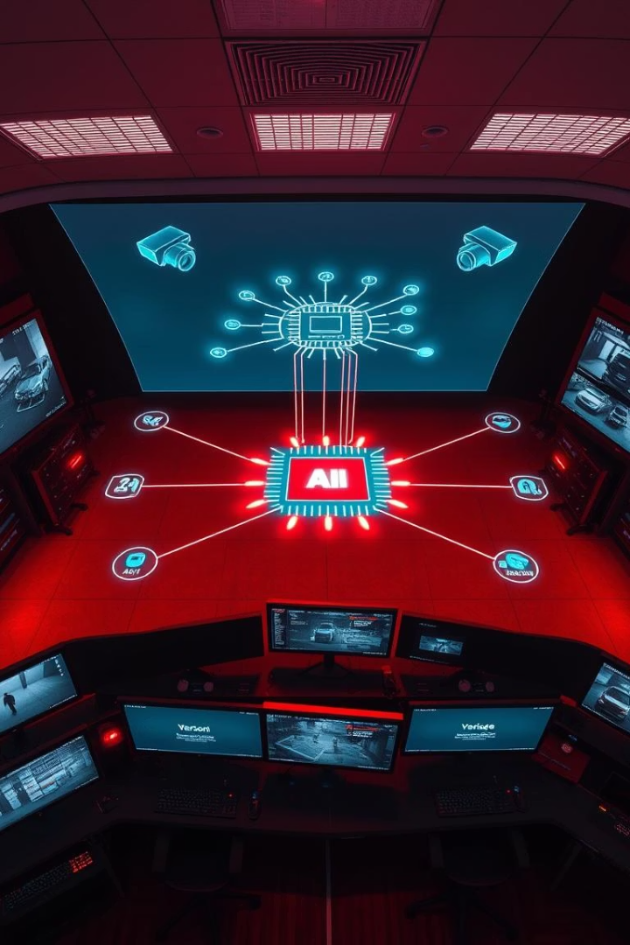
How the System Operates
1
Data Collection
Sensors and cameras feed security data continuously.
2
Machine Learning Analysis
Models identify threats by learning from patterns.
3
Alert & Action
Real-time alerts trigger automated security responses.

Slide 5

Benefits of AI-Powered Security
Higher Accuracy
Detects threats with precision beyond human capabilities.
Lower False Alarms
Reduces unnecessary alerts, saving resources.
Faster Responses
Accelerates decision-making during critical situations.
Cost-Efficient
Minimizes operational costs versus traditional methods.

Slide 6
Use Cases of AI Security Scanning
Public Surveillance
Corporate Security
Critical Infrastructure
Enhances monitoring in airports and malls effectively.
Protects office premises with intelligent scanning.
Secures vital facilities against advanced threats.

Slide 7

Implementing AI Security Systems
Integration Planning
Assess hardware and software compatibility.
Installation & Setup
Deploy AI modules and connect to existing devices.
Training & Support
Educate teams on system use and maintenance.

Slide 8




Challenges and Mitigations
Data Privacy
Data Volume
System Robustness
Use encryption and anonymization to protect data.
Implement efficient storage and processing techniques.
Regular updates and security audits to ensure reliability.

Slide 9





Future Trends in AI Security
Advanced Threat Prediction
AI-Driven Incident Response
Expanded IoT Security
Continuous Learning Systems

Slide 10

Conclusion & Next Steps
1
Recap
AI boosts detection, reduces false alarms, and accelerates responses.
2
Transformation
AI systems reshape security management for the future.
3
Implementation
Plan integration carefully to maximize benefits.
4
Stay Informed
Adapt to evolving AI security innovations.

