Slide 1
Logical Proving in PVS
Aaron Dutle
NASA Langley Research Center
aaron.m.dutle@nasa.gov

Slide 2
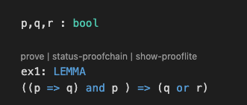
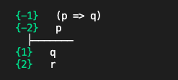
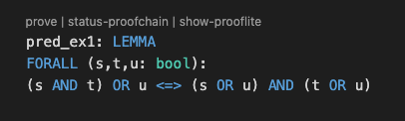
Basics of the prover Propositional logic Predicate logic
Outline

Slide 3
PVS uses sequents to represent proof goals. A sequent is composed of (numbered) formulas. Read a sequent as “the conjunction (and) of the antecedents implies the disjunction (or) of the consequents” The goal in the prover is to manipulate sequents using (logically sound) commands into something that is obviously true to PVS. * FALSE in the antecedent * TRUE in the consequent * Same formula in antecedent and consequent
PVS prover structure
Antecedent
Antecedent
Turnstile
Consequent
Consequent
“p => q and p implies either q or r”

Slide 4

The proof process generates sequences or (usually) trees of sequents.
Trees of sequents
S₁
S₁
S₁
Non-branching case:
Generates a sequence S₀, S₁,…, S_{n}
Proof rules ensure that S_{i+1} => S_{i}
Implication is transitive, so S_{n} => S₀
Branching case:
Splits a sequent S_{i} into S_{i+1,1}, S_{i+1,2},…, S_{i+1,k}
The branches conjunctively prove the previous step, i.e. S_{i+1,1}, S_{i+1,2},…, S_{i+1,k} => S_{i}
If each leaf is valid, then the original sequent is also
S_{1.1}
⋀
S_{1.2}
⋀
S_{1.3}
S_{1.1}
S_{1.2}
S_{1.3}
S_{1.1}
S_{1.2}
S_{1.3.1}
⋀
S_{1.3.2}
S_{1.1}
S_{1.3.1}
S_{1.3.2}
Notes: PVS only adds numbering to branching steps, as on the right. A “file-system” like tree can be viewed in the proof-explorer, or a more graphical version is shown using the button in the menu bar.
S_{1.3.2}

Slide 5
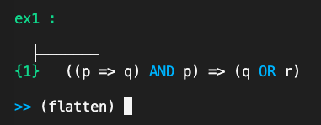
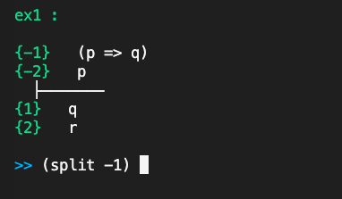
Manipulating Sequents: Basics
Proof commands are entered as Lisp S-expressions:
Examples: (flatten), (split -1), (expand “factorial”)
Commands are proof rules, control rules, or strategies.
Arguments to the rules are generally numbers or strings
Parentheses can be omitted for single line commands
Formulas are referred to by number (or label, coming soon):
Positive numbers in the consequent
Negative numbers in the antecedent
Sometimes multiple formulas: (-2 -1 3 4)
Special ones: + (entire consequent), - (entire antecedent), * (all formulas)

Slide 6
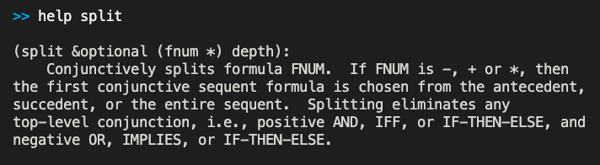
Manipulating Sequents: Help
Help with commands:
Begin typing a command, and VSCode shows abbreviated help below the prover
From the prompt, type (help command_name)
Provides the syntax of the command, and a description
Reading the syntax:
Shows the command, required, and optional inputs
Optional arguments have the forms (<arg> <dflt>) or just <arg> with nil as default
Syntax
Command syntax | Some instances
(copy fnum) | (copy 2) (copy -3)
(skeep &optional (fnum + -) preds?) | (skeep) (skeep -3) (skeep + t)
(induct var &optional (fnum 1) name) | (induct “n”) (induct “n” 2) (induct “n” :name “NAT_induction”)
(hide &rest fnums) | (hide 2) (hide -) (hide -3 -4 1 2) (hide -2 +)

Slide 7
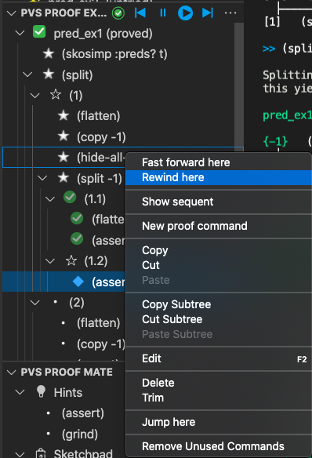
Manipulating Sequents: Navigating
There are commands to control the place in the proof.
Exiting the prover: (quit) brings a Save Proof prompt. Note: Yes saves and quits, No discards and quits, Cancel returns to the proof
Switching Branches: (postpone) moves to the next open branch
Undo/Redo: In Proof Explorer, right-click to fast-forward or rewind steps. Alternative:(undo) move you backward through proof steps, (undo n) moves back n steps (undo undo) cancels ONE undo step.
Whether using (undo) or rewind, undoing a branch step undoes ALL of the siblings to the head (but Proof Explorer can replay them)
Navigate a proof with the buttons at top, or right-click to get to rewind or fast-forward to a chosen step.

Slide 8
Manipulating Sequents: Two Propositional Rules
Sequent flattening:
Syntax: (flatten &rest fnums)
Usually applied to the whole sequent, although formula numbers can be specified
Sequent splitting:
Syntax: (split &optional (fnum *) depth)
Splits the goal into two (or more) subgoals
These goals become branches in the proof tree
Note: complete steps common to all branches prior to splitting
Related Commands: (case “branch”) (splash)
What should I use?
Location | Logical Connective
 | OR, IMPLIES | AND, IFF
Antecedent | (split) | (flatten)
Consequent | (flatten) | (split)
Remember: a sequent is the AND of the antecedents implies the OR of the consequent
If the connective matches the side, use flatten
If the connective opposes the side, use split
From logic class:
P => Q is also (NOT P) OR Q
P <=> Q is also (P => Q) AND (Q => P)

Slide 9
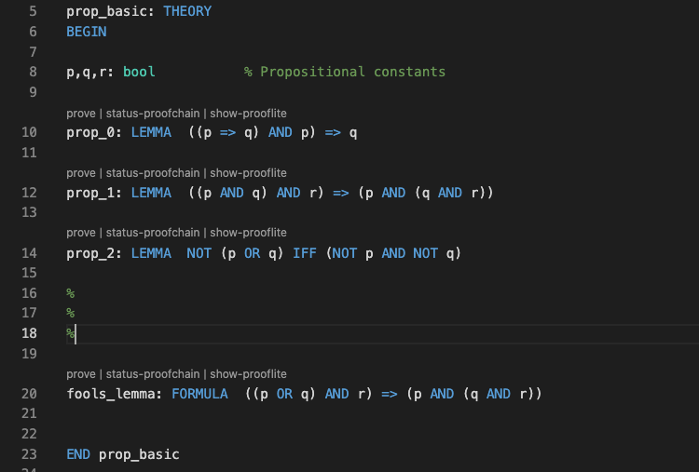
A Short Proof
From this basic theory, prove prop_0 with just split and flatten

Slide 10
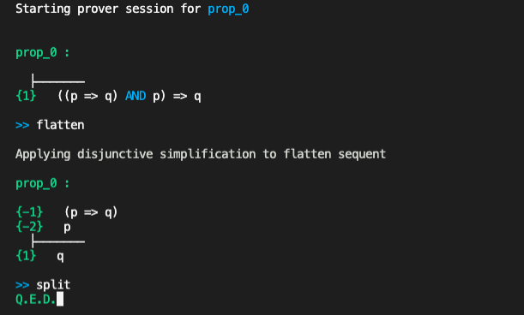
A Short Proof
IMPLIES (=>) is the outermost connective, and in the consequent
(flatten) transforms the original sequent to the second
(split) then creates 2 (obviously true) branches to finish the proof

Slide 11
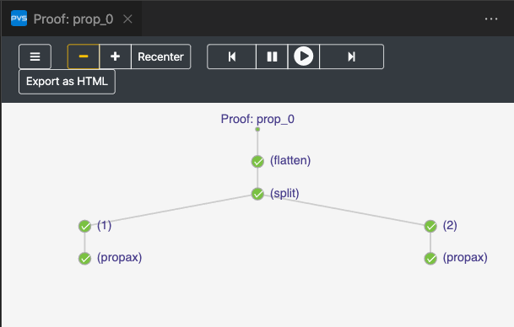
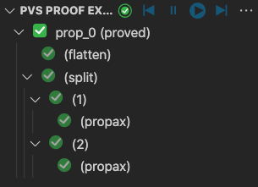
Two views of “A Short Proof”
The completed proof in “Proof Explorer”
The completed proof from “Show Proof Tree”

Slide 12
Other important commands
(prop)
“Black-box” rule for propositional logic
Will complete most propositional-only proofs in one step
(iff &rest fnums)
Example Syntax: (iff 2)
Converts equalities on Booleans to IFF so that propositional reasoning applies
Example: (a<b) = (c=>d) becomes (a<b) IFF (c=>d)
(expand name &optional (fnum *))
Example Syntax: (expand “factorial” 1)
Rewrites a defined function or constant using the definition
(lemma name &optional subst)
Example Syntax: (lemma “floor_plus_int”)
Adds an antecedent with the lemma
Free variables bound with FORALL
Related Commands: use and forward-chain
(rewrite name &opt (fnums *) (target-fnums *) (dir lr))
Where to get the inputs to the lemma
Where to apply the actual rewrite
Which direction to rewrite in
Example Syntax:
(rewrite “floor_plus_int” -2 :target-fnums 3 :dir rl)
Matches constants from formula -2
Puts them in “floor_plus_int”
Rewrites things in formula 3
Using the equality reading left-to-right

Slide 13
Three more commands
(replace fnum &optional (fnums *) (dir lr) …)
Example Syntax: (replace -1 3)
Replaces using an equality formula inside target formulas, with the direction specified
(lift-if &optional fnums)
Example Syntax: (lift-if -2)
IF – THEN – ELSE expressions must be on the outermost part of a formula to use (split)
This command lifts such expressions one level
Example: … f(IF a THEN b ELSE c ENDIF) … becomes … IF a THEN f(b) ELSE f(c) ENDIF …
Alternative: Use (case “a”)
(case &rest formulas)
Example Syntax: (case “n<0”)
Separates the proof into two cases: “formula” is true in the first, and ”formula” is false in the second.
Allows for the user to decide where a split should occur.
Multiple formulas be input for more branching

Slide 14
Put them to work
Try the commands out on some Exercises!

Slide 15



Quantified Formulas
Formulas are often declared that use quantifiers over free variables
Examples:
Note that free (previously declared) variables in formulas are treated as universally quantified, so
inside the prover
Skolemization and Instantiation are used to eliminate quantifiers

Slide 16

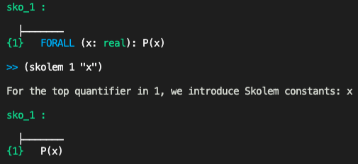
Skolemization
Suppose you have a property P, and you want to show all real numbers possess it.
In the PVS prover, this looks like
In math, a proof would start with “Let x be an arbitrary real number…”
In the PVS logic, this is called Skolemization

Slide 17

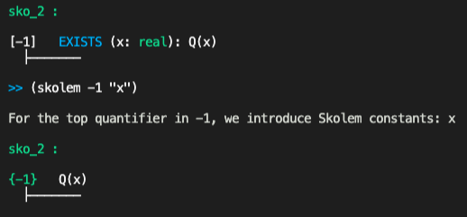
Skolemization
Similarly, suppose you have a property Q, and you know some real number possesses it.
In the PVS prover, you would see
In math, a proof would start with “Let x be an arbitrary real number with property Q…”
This is still Skolemization!!!

Slide 18
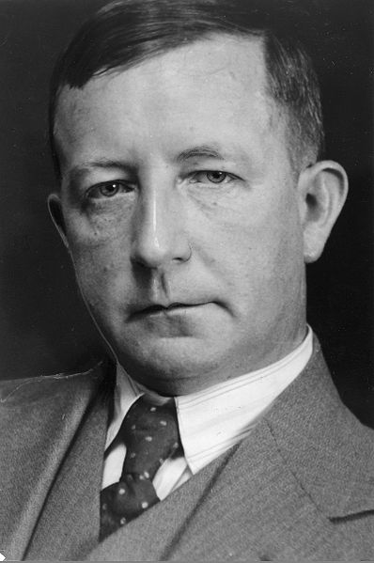

Skolemization
Skolemize:
Universal quantifiers in the consequent
Existential quantifiers in the antecedent
For example: both formulas here
Skolemization introduces a fresh (not previously used in the proof) constant, called a skolem constant, representing a fixed but arbitrary representative.
Thoralf Skolem (1887-1963), Norwegian mathematician who worked in mathematical logic and set theory.
Skolem image from http://www.oslobilder.no/OMU/OB.F06426c, in public domain.

Slide 19

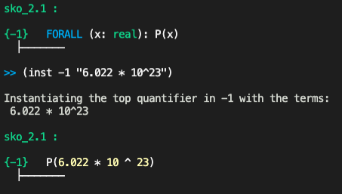
Instantiation
Instantiation is the dual process to skolemization
Suppose you have a property P, and you know that all real numbers possess it.
In the PVS prover, this looks like
Since it’s true for all real numbers, you can choose your favorite one
This is Instantiation

Slide 20

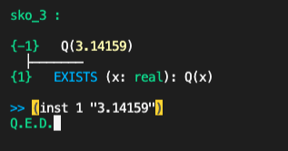
Instantiation
Similarly, suppose you have a to prove the existence of a real number with property Q, and somehow, you’ve discovered one.
In the PVS prover, this looks like
To finish this proof, you simply need to supply the witness to formula 1.
Again, Instantiation does the trick.

Slide 21


Instantiation
Instantiate:
Existential quantifiers in the consequent
Universal quantifiers in the antecedent
For example: both formulas here
Instantiation replaces a quantified variable with some previously declared constant.
Note: Instantiation doesn’t have to involve numerical or externally declared constants, skolem constants are great.
In the example above, three commands:
(skolem -2 “x”)
(inst -1 “x”)
(inst 1 “2 * x”)
will complete the proof.

Slide 22
Skolemization and Instantiation Commands
(skeep)
Example Syntax: (skeep -1)
Skolemize and “keep” variable names (when possible)
Applies (flatten) after skolemizing, usually helpful
(skolem fnum names)
The basic skolemization command
Uses constants “names” in the quantified formula “fnum”
(skolem! &opt fnum)
Skolemizes a formula, optionally specified
A variable x becomes x!1 or x!2
(skosimp*)
Applies (skolem!) then (flatten)
(inst fnum &rest terms)
Example Syntax: (inst -1 “pi/2”)
The basic instantiation command
(inst? &opt fnum)
If fnum is given, PVS tries to choose an appropriate instantiation for it
If no fnum, PVS chooses a formula and an instantiation
(inst-cp fnum &rest terms)
Works like (inst), but keeps a copy of the quantified formula
Note: Be careful when instantiating. PVS will typecheck any instantiations, and may stop instantiation, or produce TCC branches.
Example: If you have and instantiate it with “0.5” you’ll get an (unprovable) TCC branch asking to prove that 0.5 is a nat.
Note: When specifying names, use “_” to leave a variable uninstantiated (useful when only some values change).

Slide 23
Commands to make the sequent look good
(hide &rest fnums)
Example Syntax: (hide -1 -2 +)
Removes formulas from the sequent
Removed formulas are NOT used for deduction, or affected by commands
Useful if the sequent is complicated
Alternate: (hide-all-but &opt (fnums *))
(reveal &rest fnums)
Example Syntax: (reveal 2)
Brings hidden formulas back to the current sequent
Need to know the right number (or label)! Get it with (show-hidden-formulas)
(label name fnums)
Example Syntax: (label “ind_hyp” -3)
Allows labelling of formulas with strings
Hide a labeled formula early in a proof, and reveal it at the end when you need it
Note: hide and reveal both accept labels!

Slide 24
Commands to make life easier
The prover has a collection of (increasingly aggressive) simplification commands.
(prop)
Repeated flatten and split
(bddsimp)
Propositional simplification with Binary Decision Diagrams (BDDs)
(assert)
Applies type-specific decision procedures and auto-rewrites
(ground)
Propositional simplification plus decision procedures
(smash)
Repeatedly tries bddsimp, assert, and lift-if
(grind)
All of the above, plus definition expansion and inst?
Note: (grind) can take a long time, get stuck in a loop, or leave the sequent unfamiliar. Sometimes it needs to be interrupted or undone to get back to normal.

Slide 25
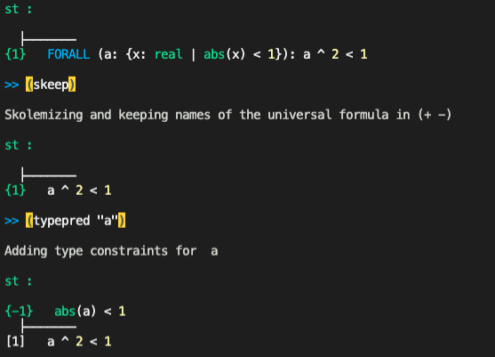
What’s your type?
The prover can be asked to reveal information about the TYPE of an expression.
(typepred &rest exprs)
Example Syntax: (typepred “a”)
Causes type constraints for expressions to be added to the sequent
Subtype predicates are often recalled this way
Alternate: When skolemizing, use the :preds? T option at the end of (skeep)
An example using typepred

Slide 26
Put them to work
Try the commands out on some Exercises!

Slide 27
Getting more help
PVS website: https://pvs.csl.sri.com/
PVS prover guide: https://pvs.csl.sri.com/doc/pvs-prover-guide.pdf (locally at <pvs_folder>/doc/prover/prover.pdf)
PVS google group: https://groups.google.com/g/pvs-group

Slide 28
Further help
Try the commands out on some Exercises!

