Slide 1

Representing and Formally Verifying Flight Trajectories as Hybrid Programs
Bernny Velasquez, Nicolas Crespo
bernny.velasquez@vikings.berry.edu ncrespo@ucla.edu
Mentors: Lauren White, Cesar Munoz
NASA Langley Research Center
Hampton, VA, USA

Slide 2
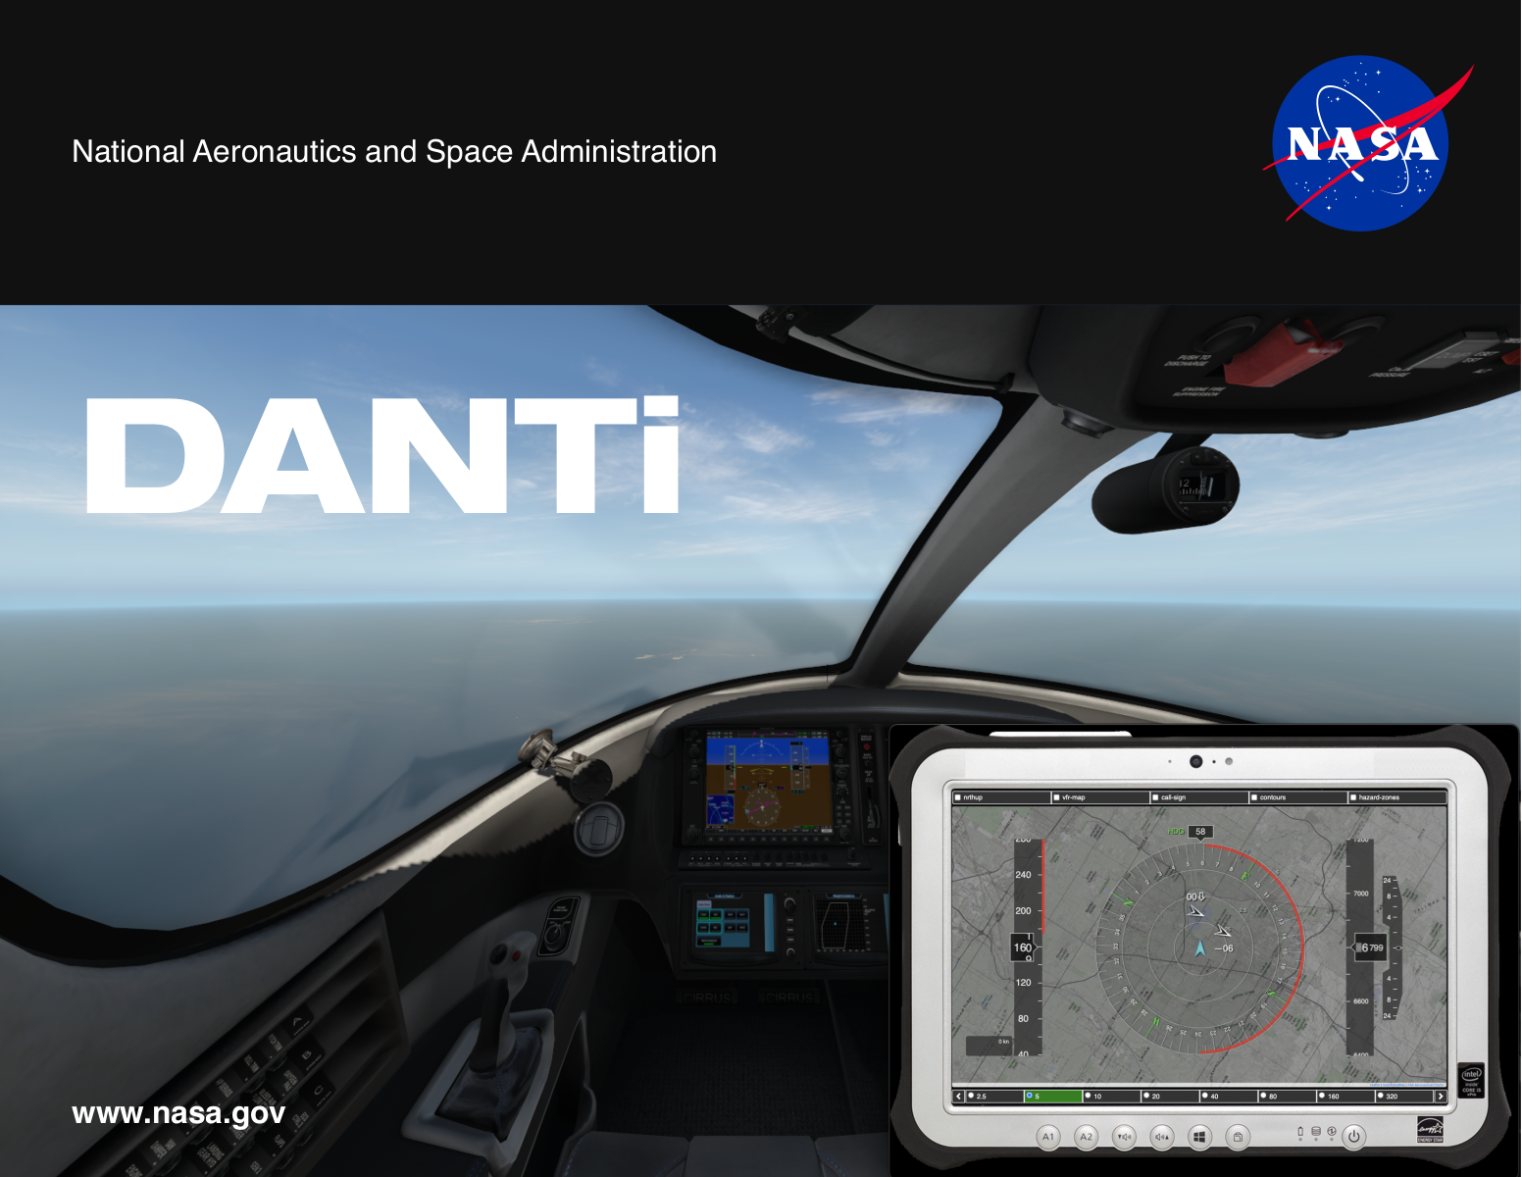
Detect and Avoid (DAA)
See and Avoid is a legal requirement for human pilots to see and avoid other aircraft while flying under some operational conditions.
The FAA recently created a similar requirement for autonomous/unmanned aircraft called Detect and Avoid (DAA).
NASA LaRC has developed several DAA technology, e.g., DANti to ensure UAS satisfy certain safety properties.
We would like to describe the motion of and reason about aircraft flights, but historical data needed for testing is lacking.
So, how can we generate aircraft encounters for testing DAA technology?
[1]: NASA Langley Formal Methods Program DANTi https://shemesh.larc.nasa.gov/fm/DANTi/

Slide 3

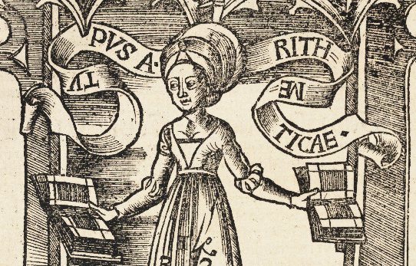
How we apply formal methods
PVS: General Purpose Theorem Prover
Plaidypvs: Differential Logic (dL) in PVS
Hybrid Programs: Discrete + Continuous Assignments
Flight Programs: A flyable Hybrid Program
Prototype Verification System (PVS)
Plaidypvs^{[1]}
Hybrid Programs (HP)
Flight Programs (FP)
[2]: Properly Assured Implementation of Differential Dynamic Logic for Hybrid Program Verification and Specification (too large to fit in graphic) https://shemesh.larc.nasa.gov/fm/Plaidypvs/

Slide 4
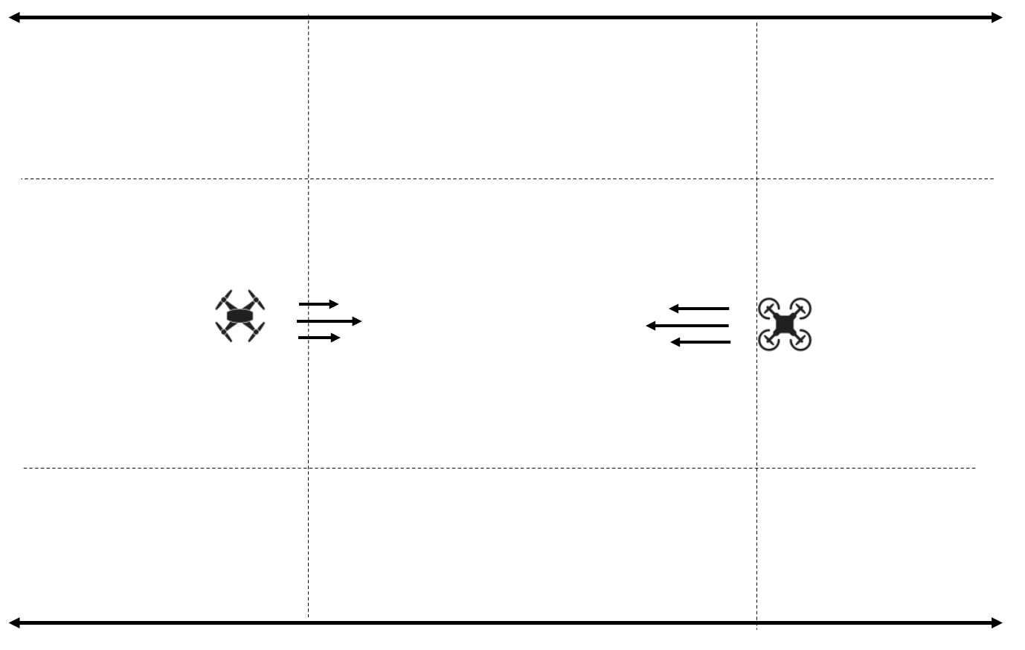

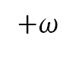
Building Blocks of a Flight Program
1. Initialization (x position, y position, ground speed, track)
2. Linear (time)
3. Acceleration (rate of acceleration, time)
4. Turn (turn rate, time)
$$−ω$$
$$+ω$$

Slide 5
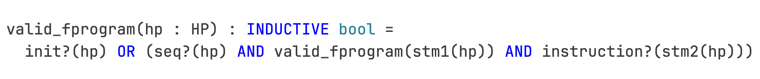
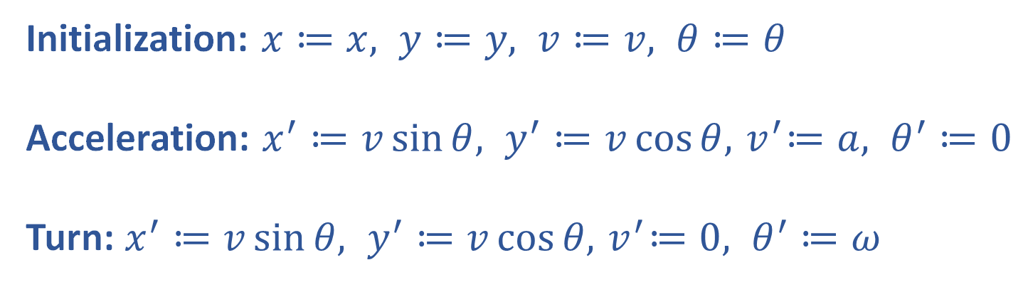
Definition of a Flight Program (ValidFP)
Initialization: $x≔x, y≔y, v≔v, θ≔θ$
Acceleration: $x^{′}≔v\sin{θ, y^{′}≔v\cos{θ, { v}^{′}≔a, θ^{′}≔0}}$
Turn: $x^{′}≔v\sin{θ, y^{′}≔v\cos{θ, { v}^{′}≔0, θ^{′}≔ω}}$

Slide 6
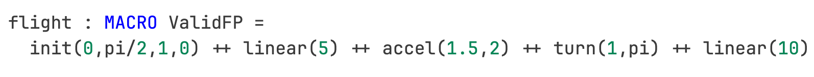
Example of a Flight Program
Example*:
* Not drawn to scale
Notes:
Talk about the ... and how what the first two function actually take is a variable with its assignment as a tuple
explain what ++is
“continuous”
we can talk about any time steps

Slide 7
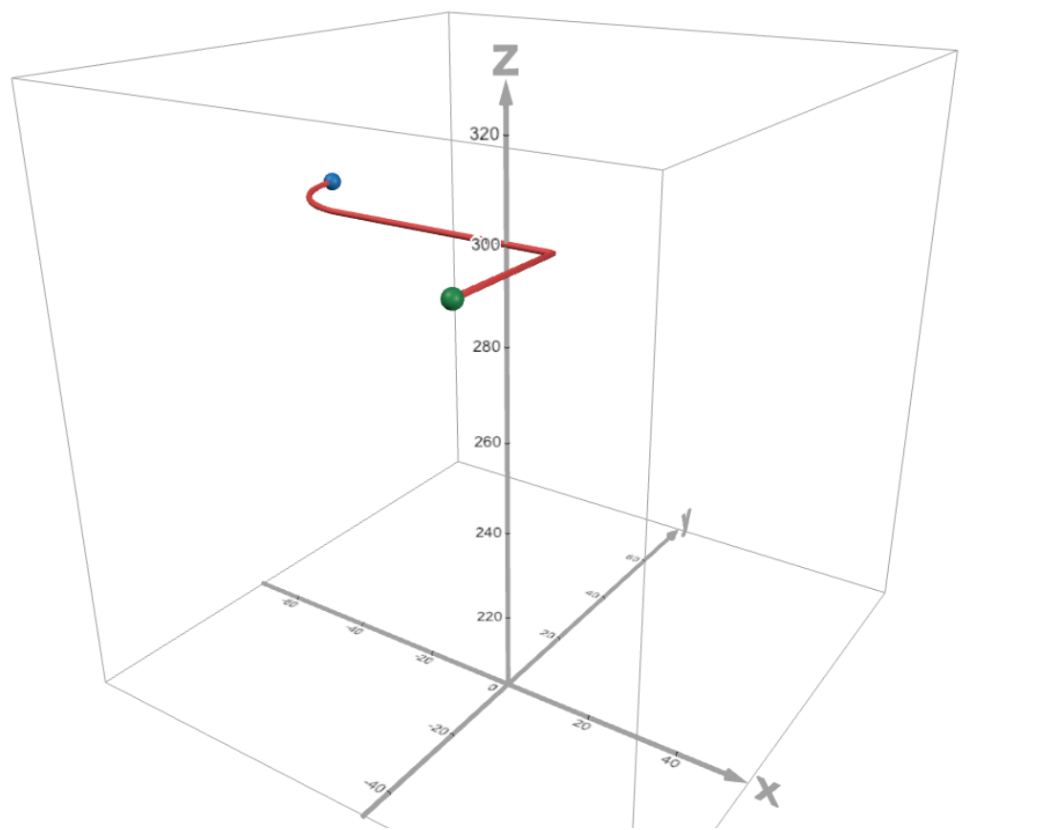
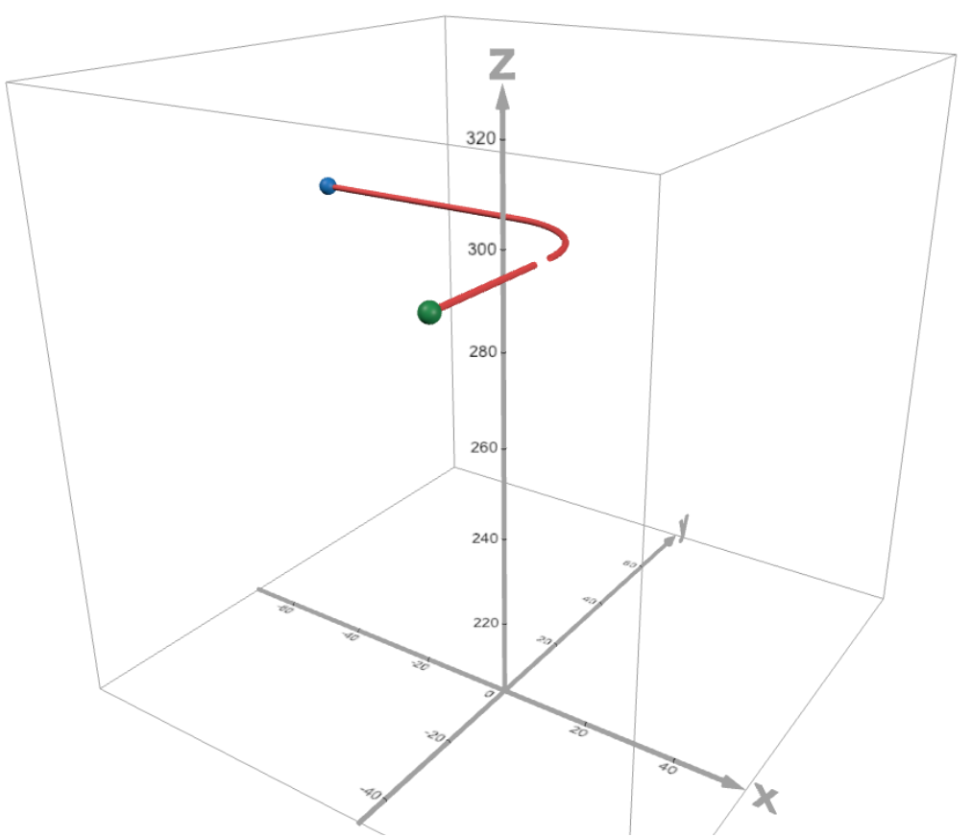
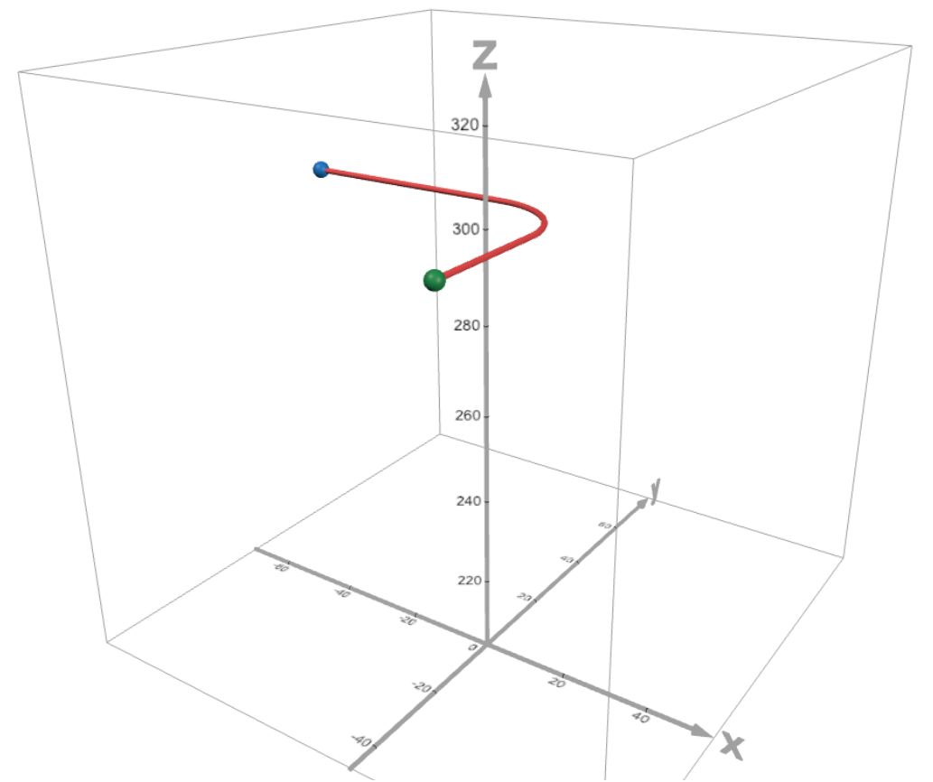
What does “flyable” mean?
Flyable means that our position function is differentiable and our velocity is continuous
Notes:
-First part of the slide ask "Why do we want to represent flight paths this this way"

Slide 8
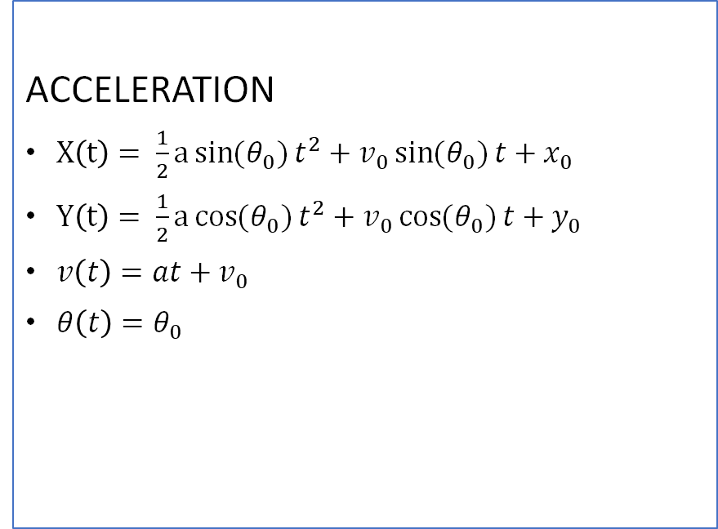
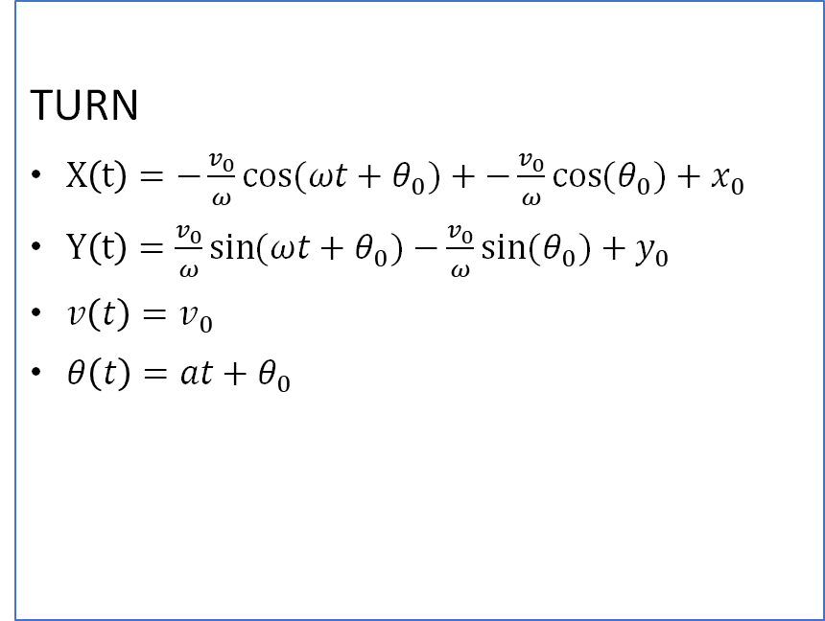
How we show “flyability”
Since we could not execute the hybrid programs there was not a way to reason about the intermediate states between the way points to show these flyable properties
What we did…
ACCELERATION
$X\left(t\right)= \frac{1}{2}a\sin{(θ_{0})}t^{2}+v_{0}\sin{(θ_{0})}t+x_{0}$
$Y\left(t\right)= \frac{1}{2}a\cos{(θ_{0})}t^{2}+v_{0}\cos{(θ_{0})}t+y_{0}$
$v\left(t\right)=at+v_{0}$
$θ\left(t\right)=θ_{0}$
TURN
$X\left(t\right)=−\frac{v_{0}}{ω}\cos{({ωt+θ}_{0})}+−\frac{v_{0}}{ω}\cos{(θ_{0})}+x_{0}$
$Y\left(t\right)=\frac{v_{0}}{ω}\sin{({ωt+θ}_{0})}−\frac{v_{0}}{ω}\sin{(θ_{0})}+y_{0}$
$v\left(t\right)=v_{0}$
$θ\left(t\right)={at+θ}_{0}$
Notes:
-First part of the slide ask "Why do we want to represent flight paths this this way"

Slide 9



How we show “flyability”(cont)
  Developed a function dl_state_t(hp : ValidFP)(t : real) : AircraftState
  What we need to reason about differentiability and continuity on piecewise function in PVS
    Continuity and Differentiability properties on functions define on the reals
    Where the breakpoints happen according to time in these if statements
    “If … then …” continuity property
    “If … then …” differentiability property
A piecewise function of time
Time (s)
Notes:
-First part of the slide ask "Why do we want to represent flight paths this this way"

Slide 10
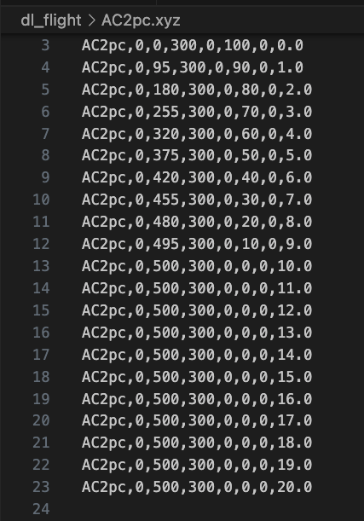
PVSIO Example
AC2 : void = dl_writer_states("AC2pc",init(0,0,100,0)++accel(-10,15)++linear(10), 1)
init(0,0,100,0)
accel(-10,15)
linear(10)
Notes:
-First part of the slide ask "Why do we want to represent flight paths this this way"

Slide 11
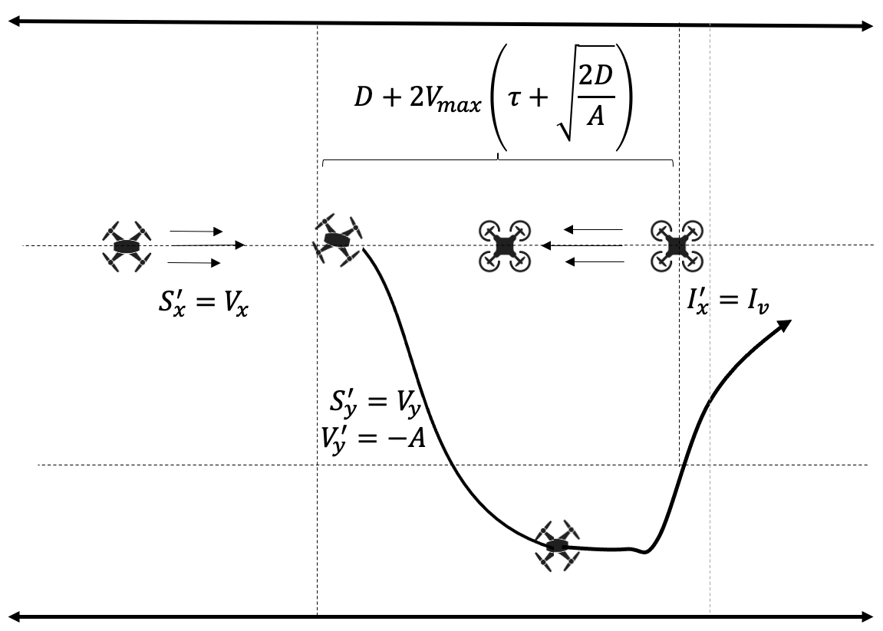
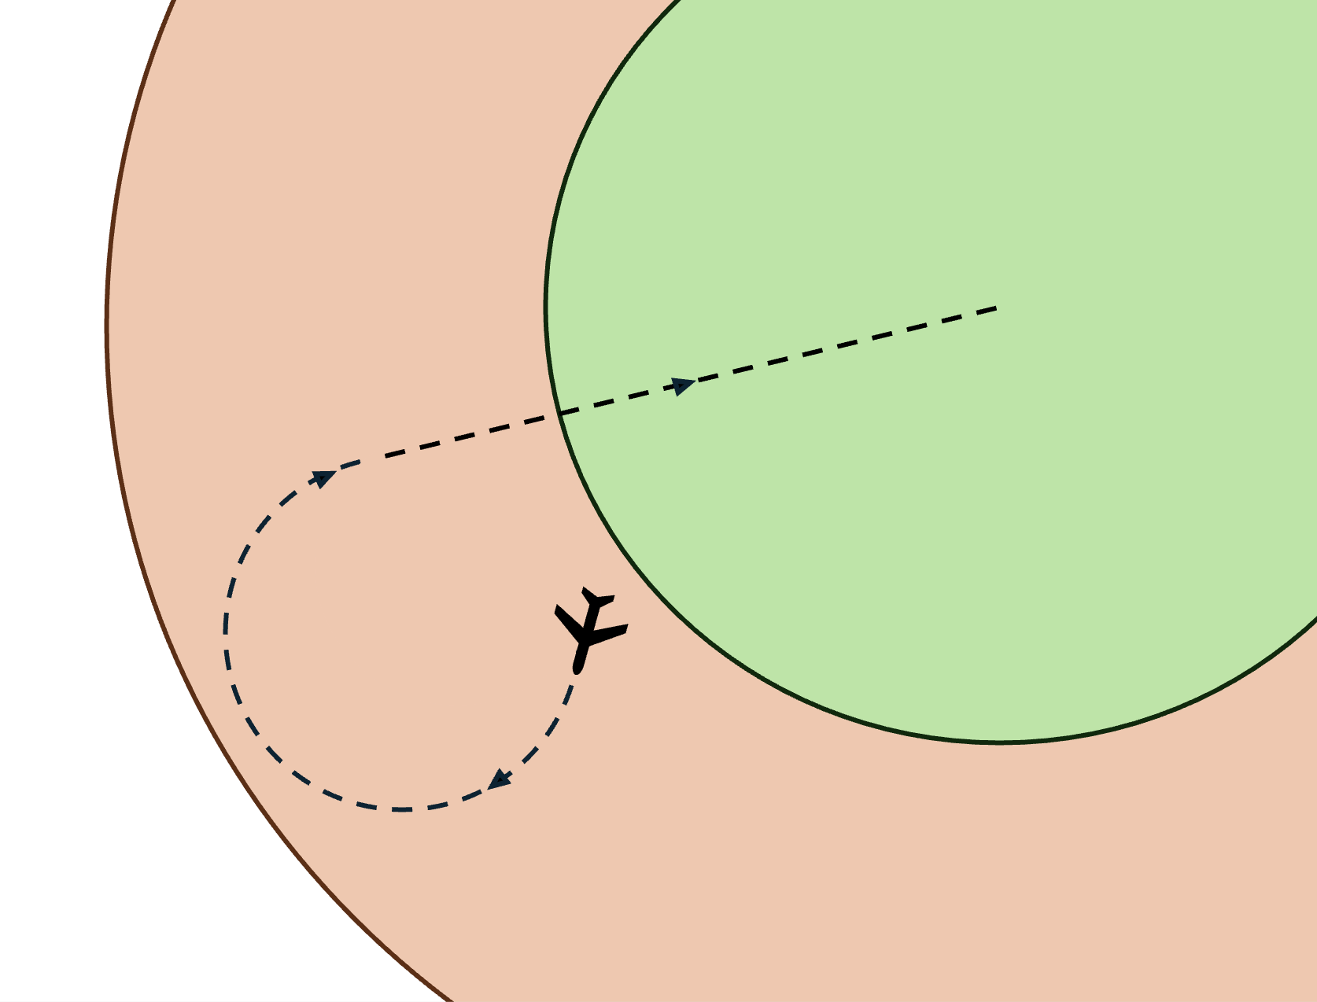
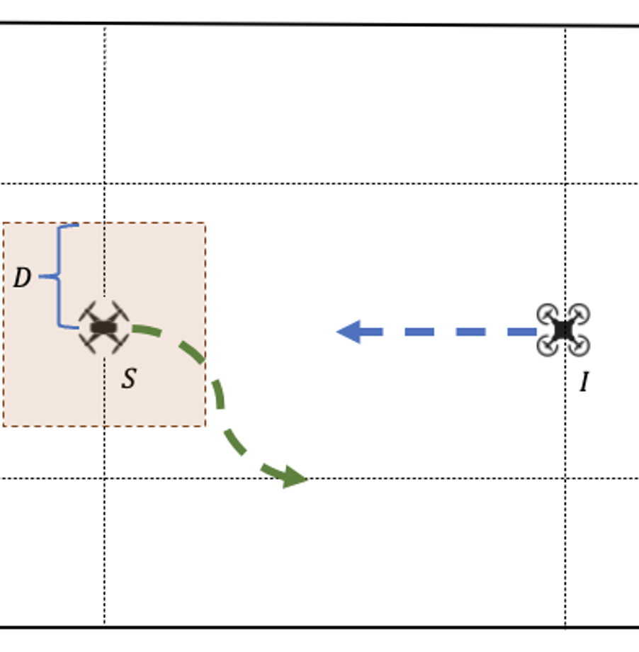
Why Represent Flights This Way?
Once we do, we can prove properties about them!
Ex.
  inclusion/exclusion zone
  obstacle avoidance
  restriction of aircraft parameters
  operational volume (rectangle)
We build proofs in dL with the following shape →
[3]: Pictures from A Verification Framework for Runtime Assurance of Autonomous UAS
[4]: https://shemesh.larc.nasa.gov/fm/Plaidypvs/
Notes:
-First part of the slide ask "Why do we want to represent flight paths this this way”
we have this description of a trajectory
now we want to prove properties
one important one is that the aircraft operates within some safe region (in our case, a rectangle)

Slide 12
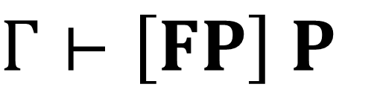
The dL Sequent
The Flyable Program
$Γ⊢\left[FP\right] P$
Some Property
Assumptions
The Sequent
The “ALLRUNS” quantifier
Notes:
-First part of the slide ask "Why do we want to represent flight paths this this way”
we have this description of a trajectory
now we want to prove properties
one important one is that the aircraft operates within some safe region (in our case, a rectangle)

Slide 13
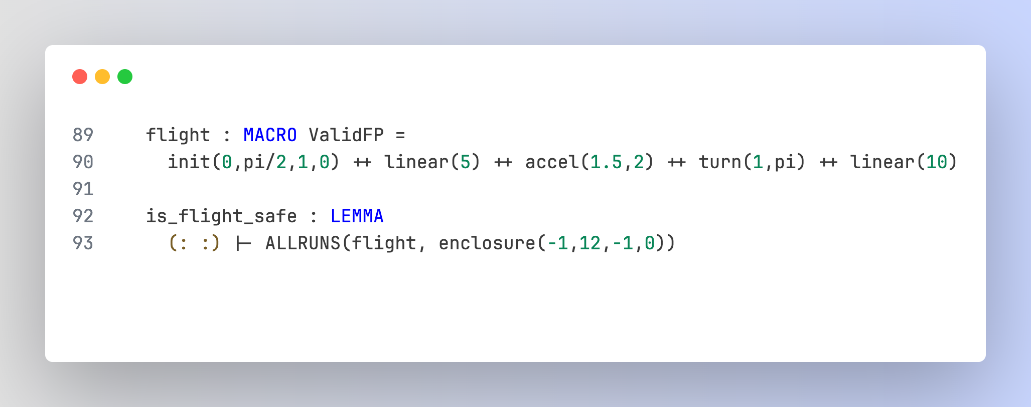
How it looks in PVS
Example*:
* Not drawn to scale

Slide 14


Proving Safety Properties of Flights
FP
Action
Want to Show: $Γ⊢\left[HP\right] P$
Instead… $Γ⊢\left[FP \text{++} action\right] P$
Notes:
what is gamma?
specify we need to provide the P’ that must be proven

Slide 15
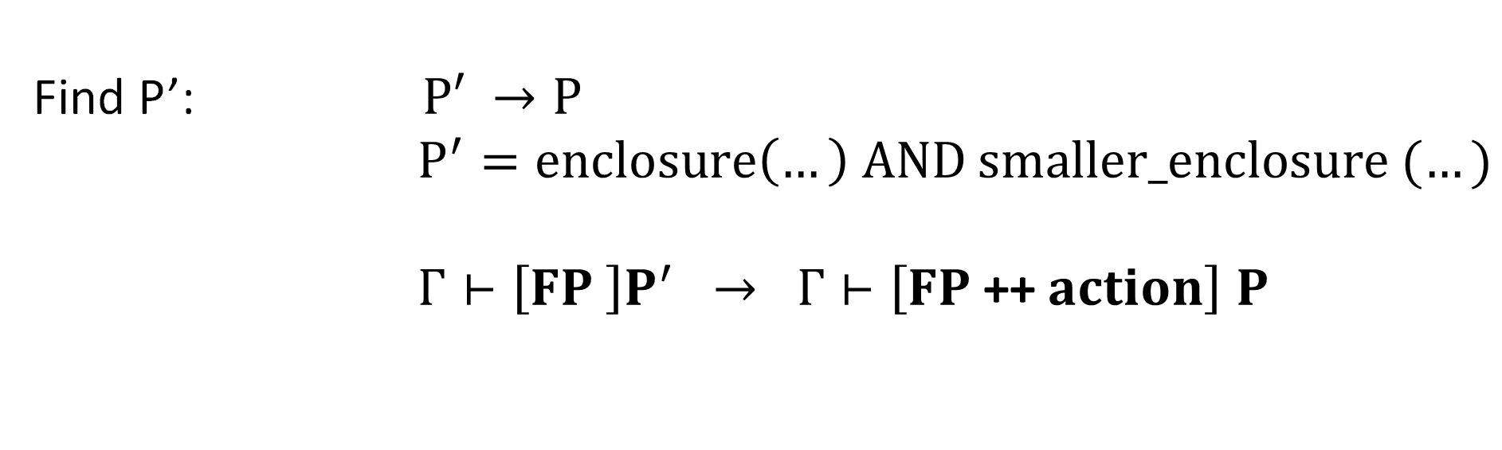
Proving Safety Properties of Flights
Want to Show: $Γ⊢\left[FP \text{++} action\right] P$
Find P’: $\text{P}′ →\text{P}$
$P^{′}=enclosure\left(…\right) AND smaller_enclosure (…)$
$Γ⊢\left[FP \right]P^{′} → Γ⊢\left[FP \text{++ }action\right] P$
Simplify the problem: … and repeat!
Notes:
what is gamma?
specify we need to provide the P’ that must be proven

Slide 16



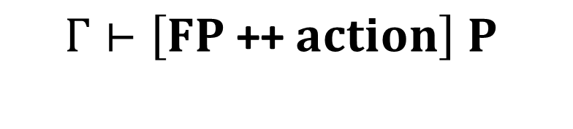
Using the lemma
We just did: $Γ⊢\left[FP \text{++} action\right] P$
$$Γ⊢\left[FP\right] \text{P} \text{Λ} Q$$
But the lemma expects: $Γ⊢\left[FP \text{++ }action\right] P$
$Γ⊢\left[FP \right]P^{′}$
$$Γ⊢\left[FP \text{++ }action\right] P$$
$$Γ⊢\left[FP\right] \text{P} \text{Λ} Q$$
Notes:
what is gamma?
specify we need to provide the P’ that must be proven

Slide 17


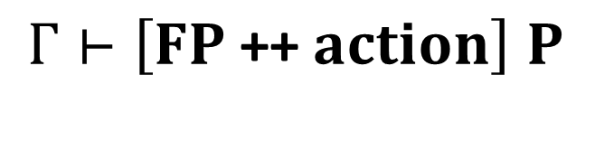



How we overcome this
We have:
We want:
$$Γ⊢\left[FP\right] P^{′}\text{Λ} P$$
$$Γ⊢\left[FP \text{++ }action\right] P$$
$$Γ⊢\left[FP \text{++ }action\right] P^{′}\text{Λ} P$$
$$Γ⊢\left[FP \text{++ }action\right] P$$
Notes:
what is gamma?
specify we need to provide the P’ that must be proven

Slide 18
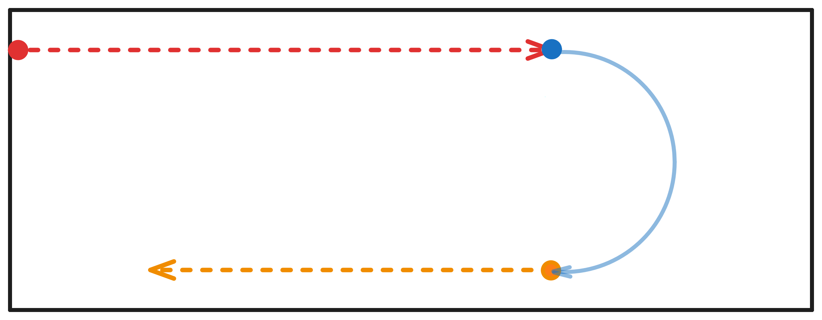
Example: A Simple Path

Slide 19
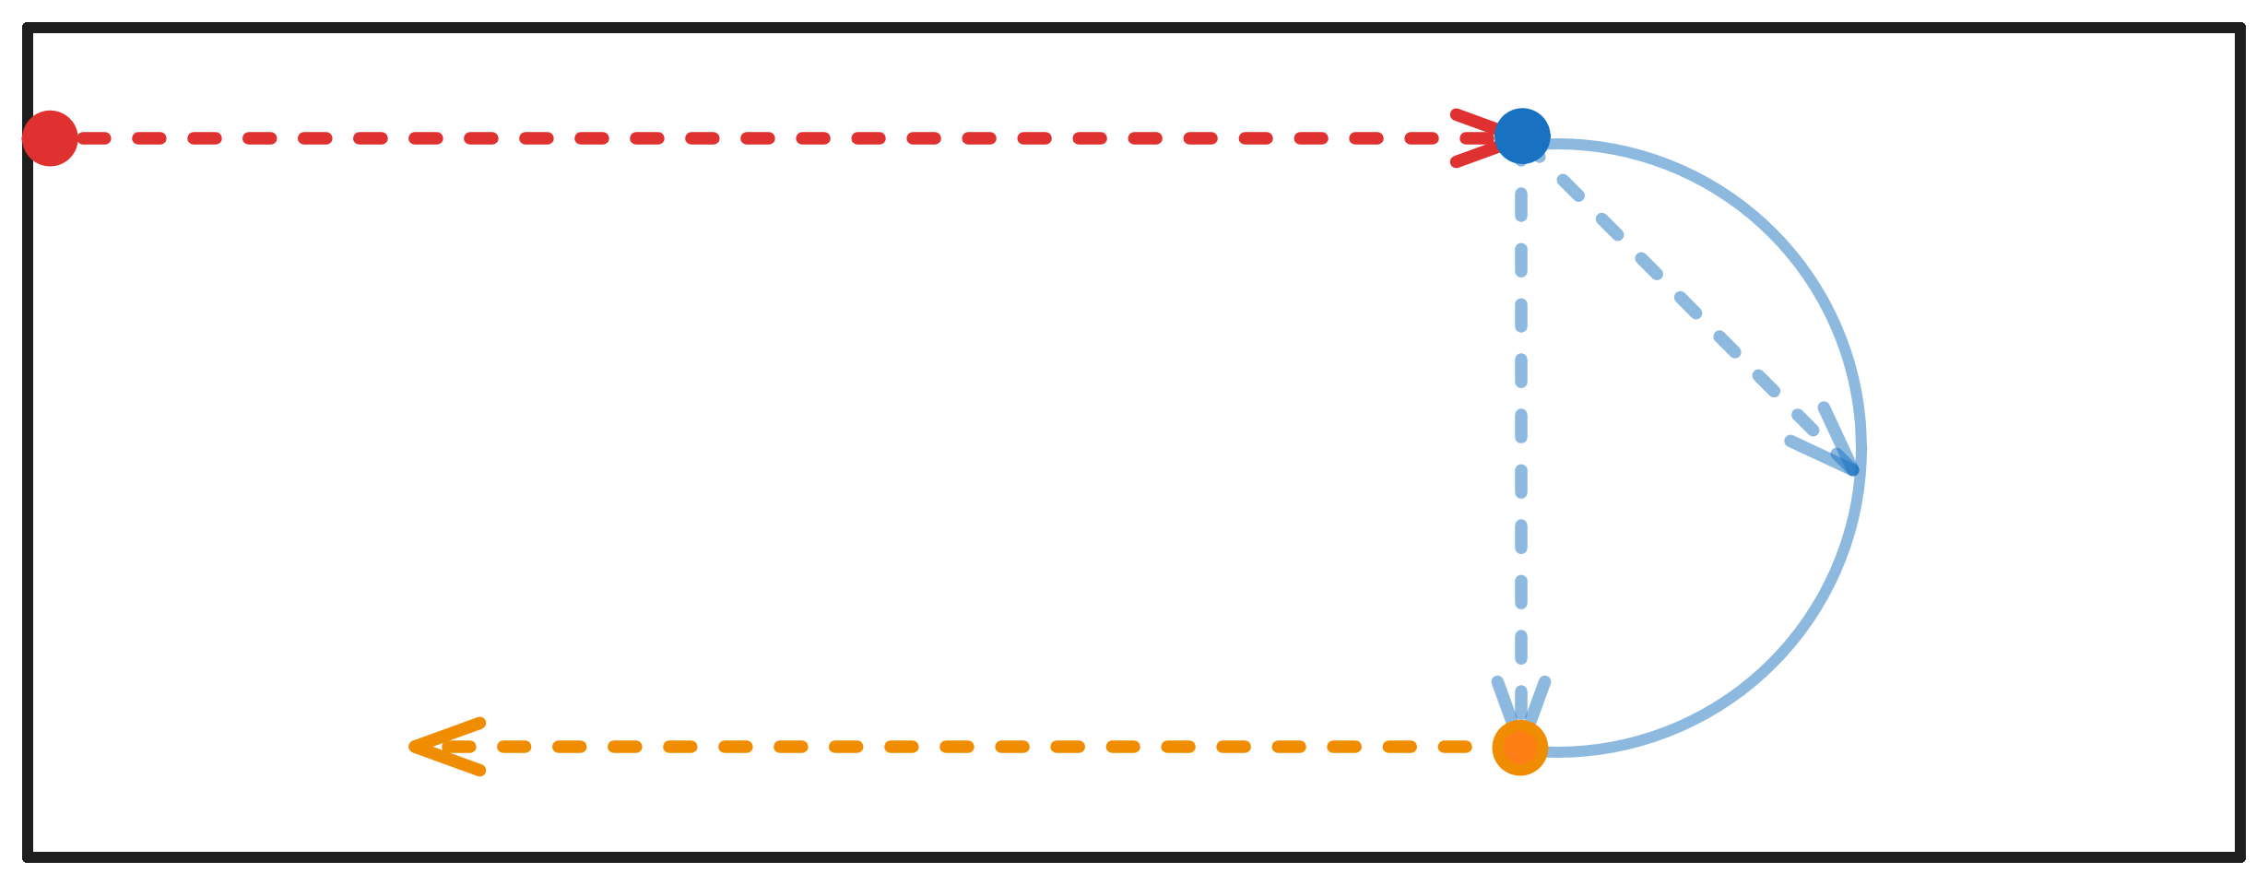
Example: A Simple Path

Slide 20
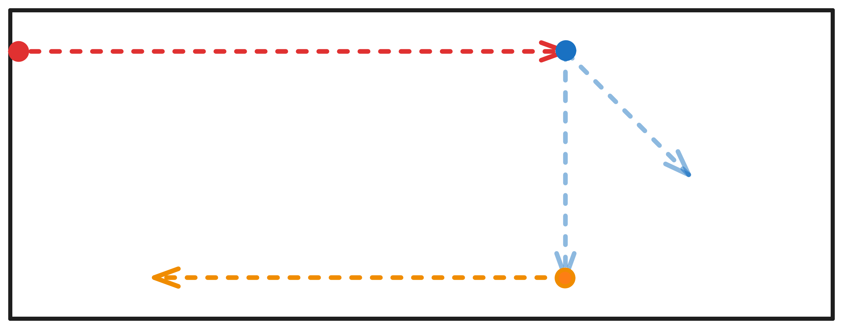
Example: A Simple Path

Slide 21
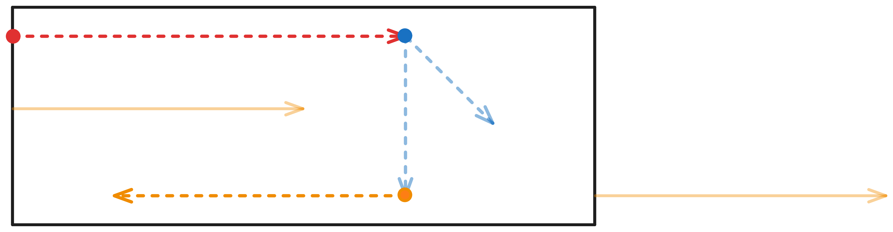
Example: A Simple Path

Slide 22
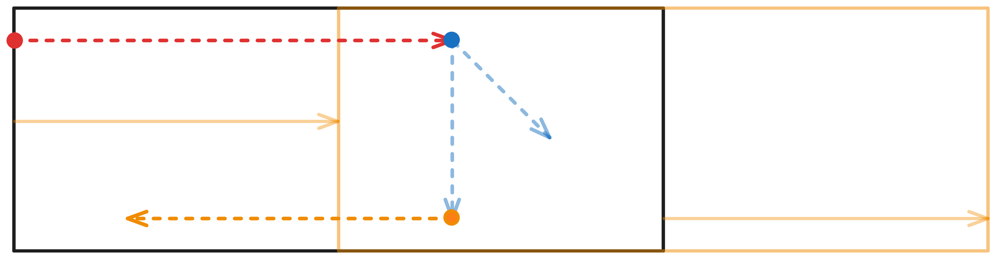
Example: A Simple Path

Slide 23
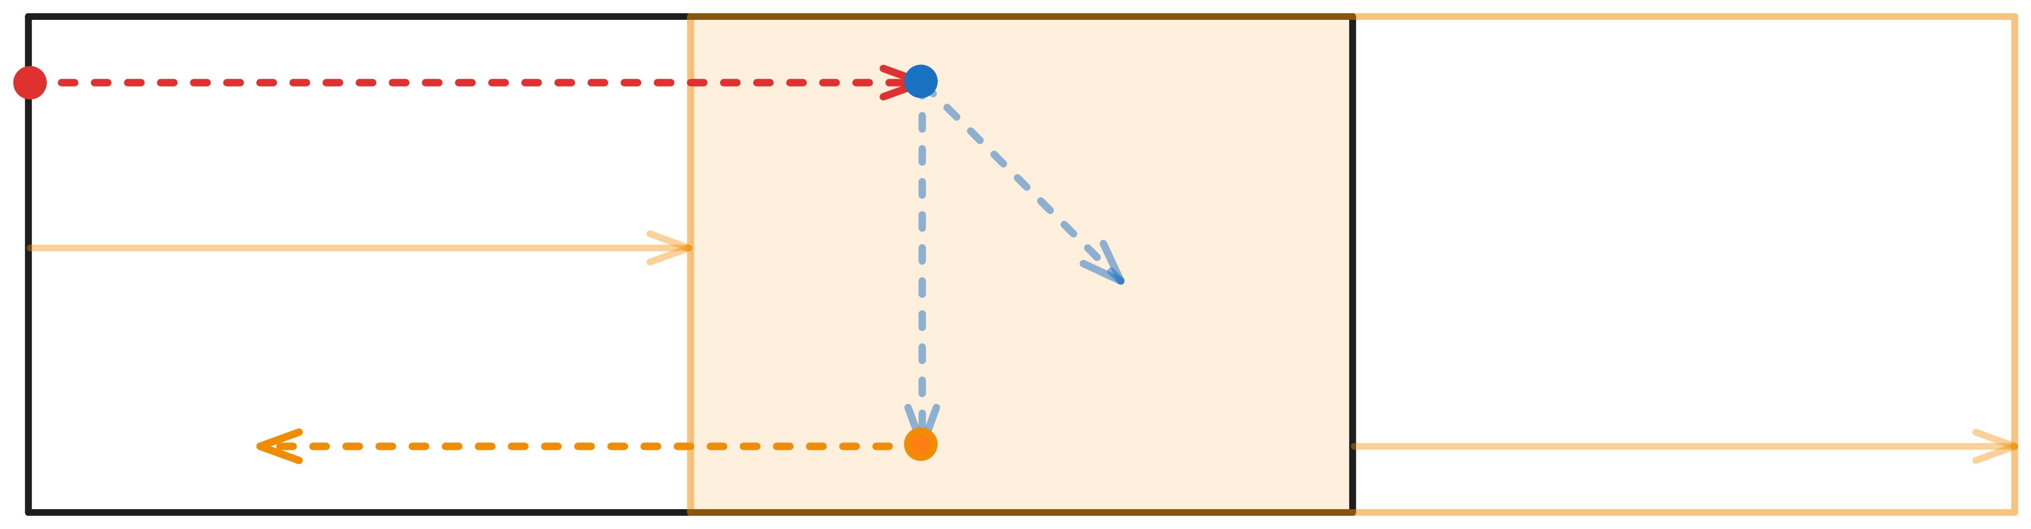
Example: A Simple Path

Slide 24
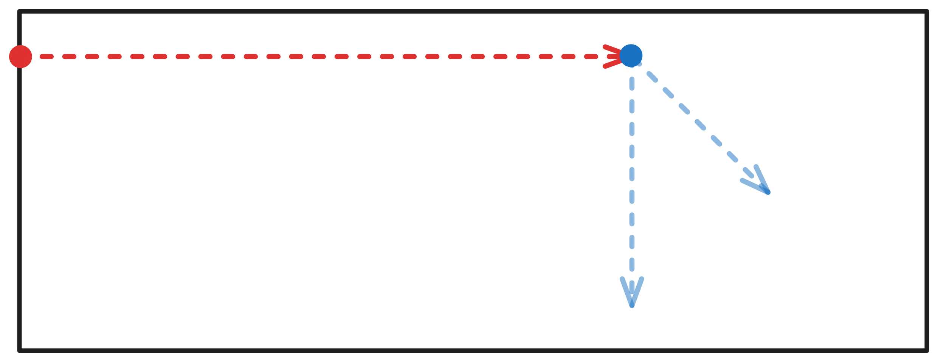
Example: A Simple Path

Slide 25
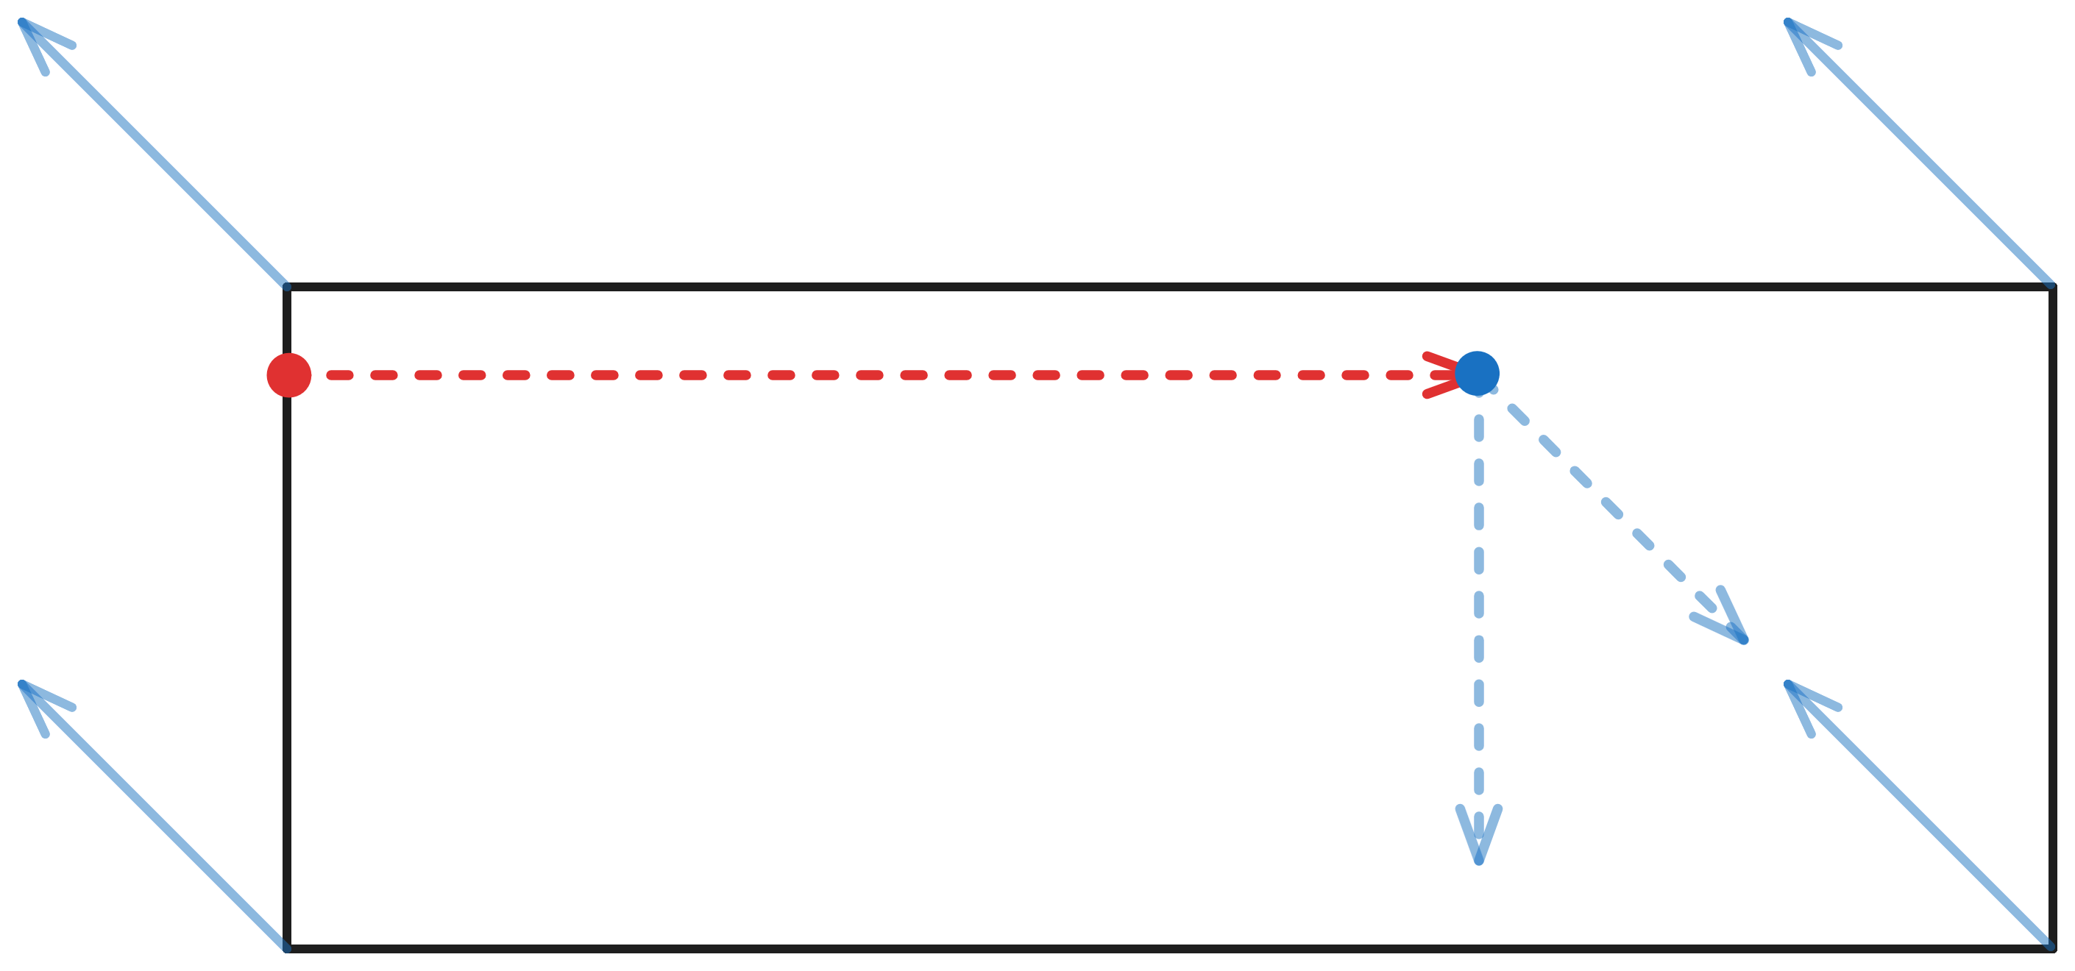
Example: A Simple Path

Slide 26
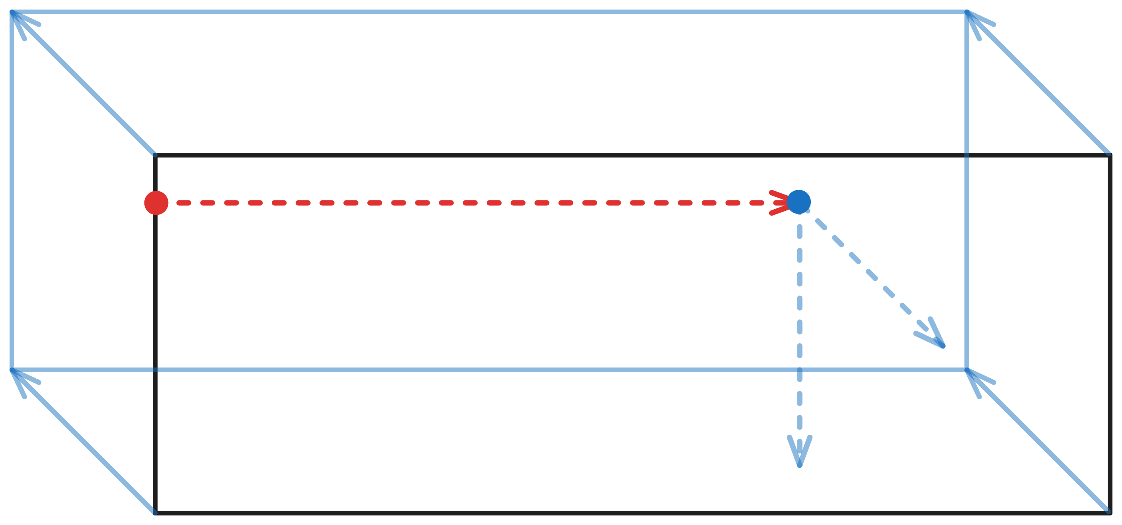
Example: A Simple Path

Slide 27
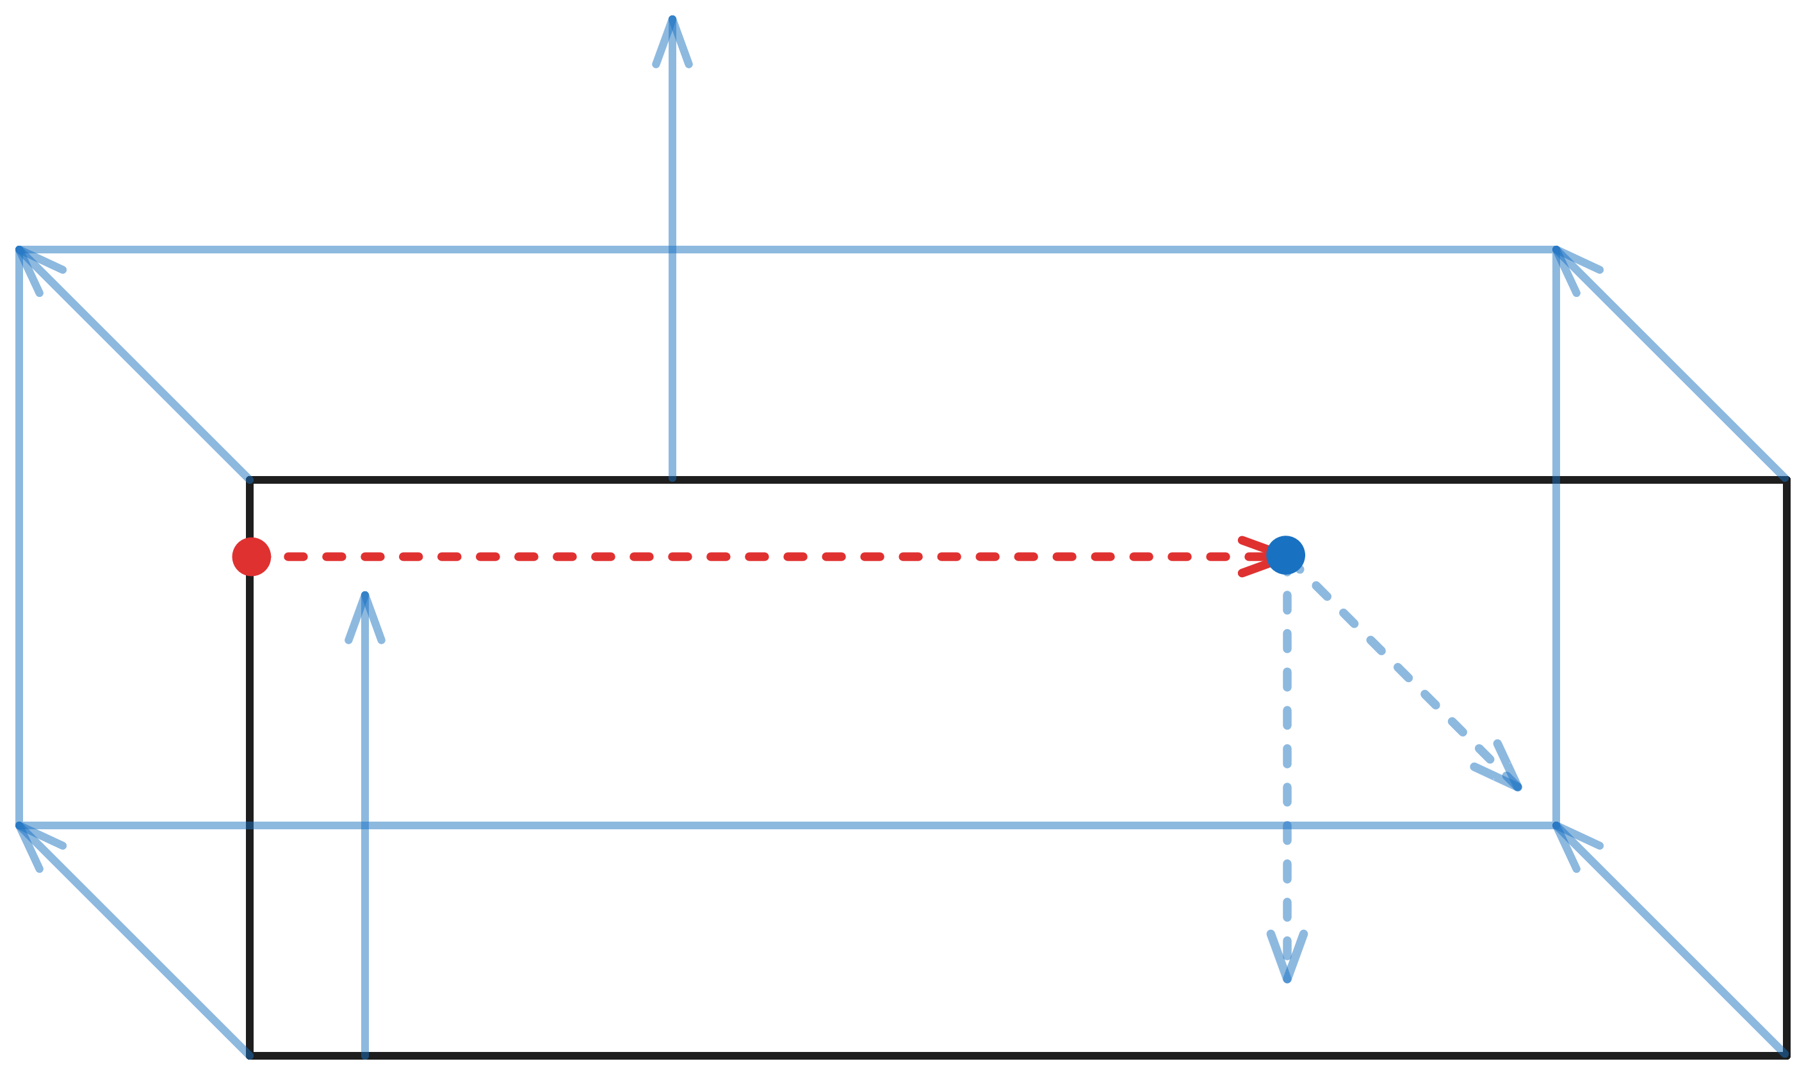
Example: A Simple Path

Slide 28
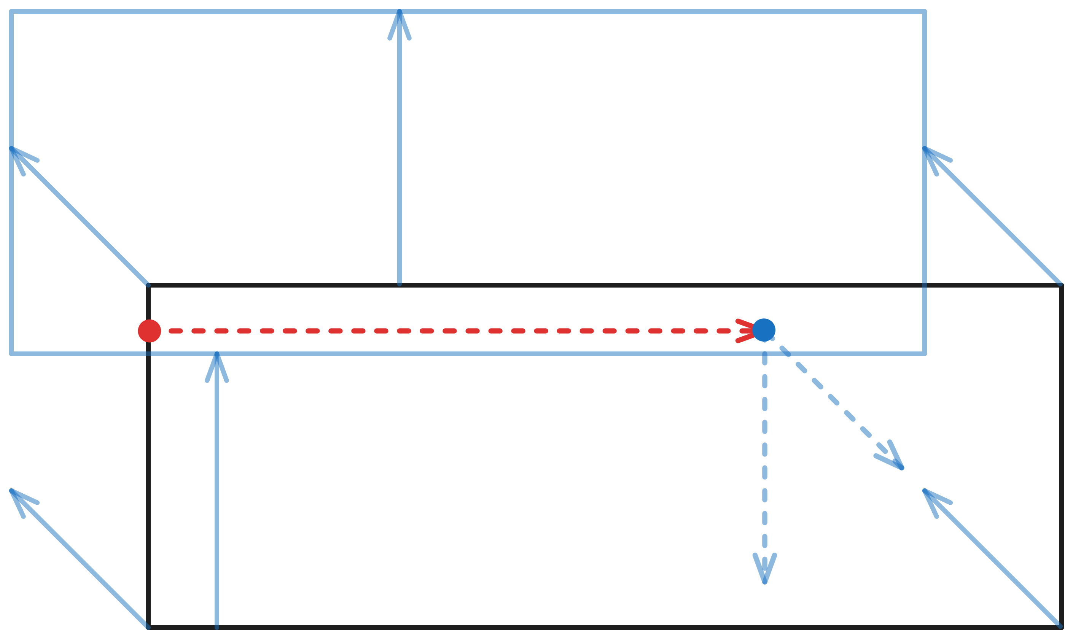
Example: A Simple Path

Slide 29
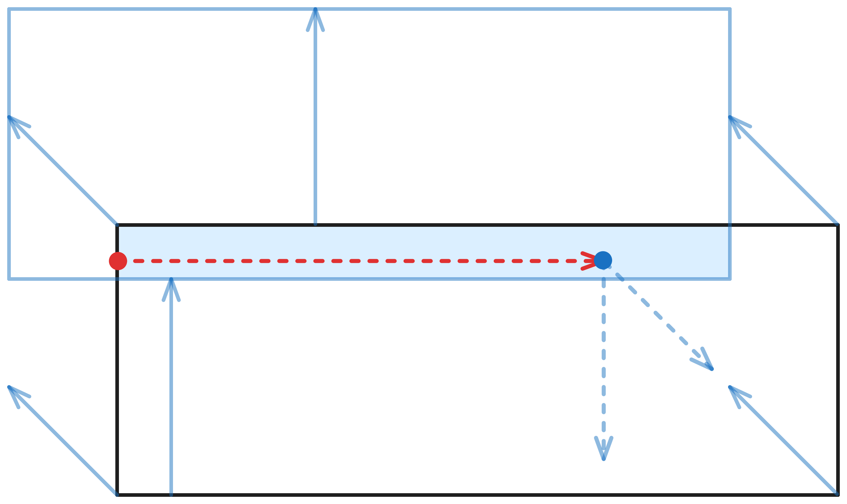
Example: A Simple Path

Slide 30
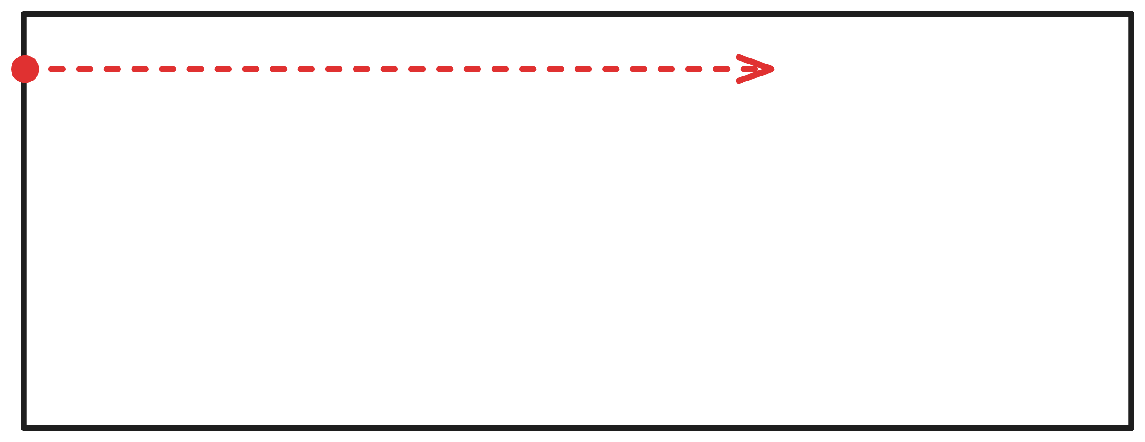
Example: A Simple Path

Slide 31
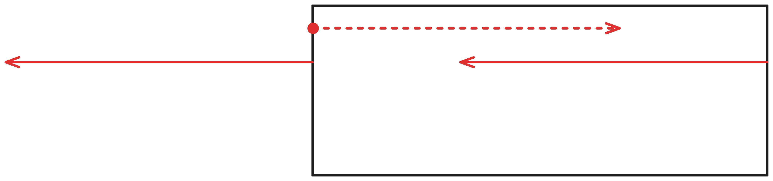
Example: A Simple Path

Slide 32
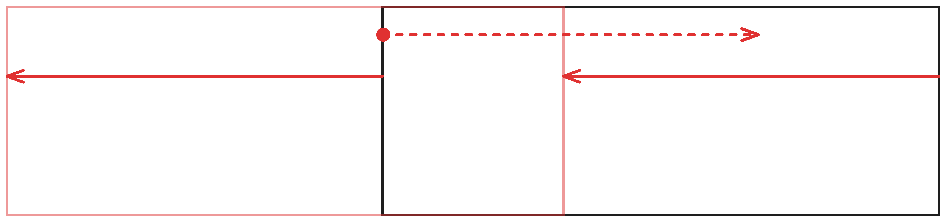
Example: A Simple Path

Slide 33
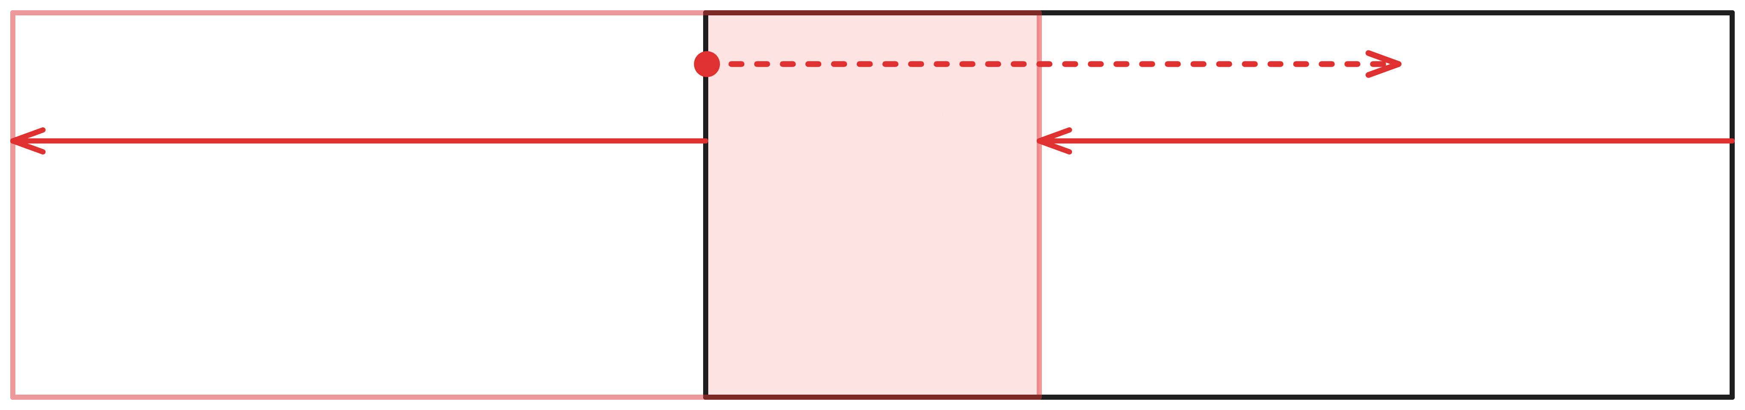
Example: A Simple Path
We’re safe!
(The aircraft’s trajectory is always inside the provided enclosure)

Slide 34
Future Work
Expand to 3 dimensions
Implement more specific flight actions
Expand scope of current lemmas or show different safety properties

Slide 35
Summary
This summer we…
Developed a subtype of Hybrid Programs in PVS to represent flight trajectories and formally reason about them
Proved that this definition only creates flyable paths
Created functions to query the state of an aircraft at any point in time during a flight
Designed a lemma and automated strategy to show that a given flight is within some enclosure

Slide 36
Thank You!
Questions?
A big thank you to:
Cesar Munoz, Lauren White, Mariano Moscato,
Laura Gambao, and the NASA Formal Methods Team

