Slide 1

Winter Holiday Lodges
SQL Project - ck22ukds4
Nikita Dudhaiya

Slide 2
Background
30 luxury lodges and treehouses in England
Mix of 1 – 8 bedrooms
Equipped with log burners, hot tubs, pools and saunas
Plenty of festive activities including ‘Wreath Making’ and ‘Meet & Greet with Santa’

Slide 3
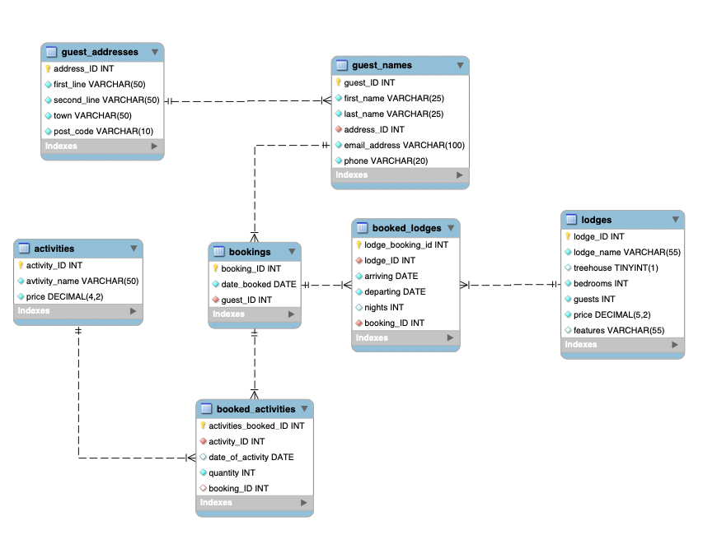
ER Diagram

Slide 4





Views
Stored Procedures
Stored Functions

Slide 5
Requirements
Core Requirements
Advanced Options
P
Relational DB with min. 5 tables
P
Create a stored procedure
P
Primary & Foreign Keys
?
Create a trigger
P
Use joins to create views
P
View that uses 3-4 tables
P
Create a stored function
P
Example group by query
P
Query with a subquery
P
Create DB diagram
Let’s take a look….

