Slide 1

Hyperdimensional Computing for Noninvasive Brain–Computer Interfaces: Blind and One-Shot Classification of EEG Error-Related Potentials
Abbas Rahimi, Pentti Kanerva, José del R. Millán, Jan M. Rabaey
EECS Department, UC Berkeley
IBI-STI, EPFL

Slide 2
Outline
Architecture for Brain-Computer Interface (BCI)
Electroencephalogram (EEG) error-related potentials
Hyperdimensional Computing Basics
Mapping to hypervectors and arithmetic
Hyperdimensional computing examples
Mapping EEG Electrodes to Hypervectors
Temporal-Spatial Hyperdimensional Encoder
Experimental Results
Summary

Slide 3
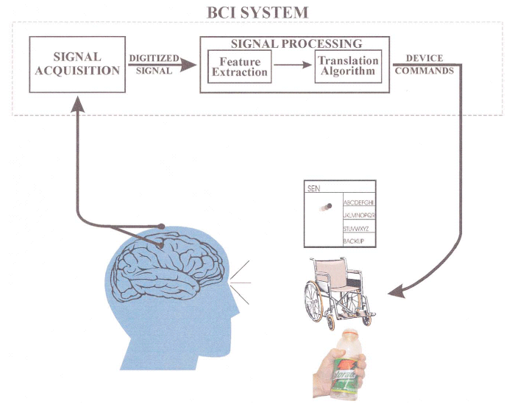
General Architecture for Brain-Computer Interface (BCI)
Hyperdimensional Computing
64 electrodes
Two classes
Goal: Using a brain-inspired computing model—hyperdimensional computing— to understand brain signals!

Slide 4

EEG Error-Related Potentials
Error-related potential (ERP) as a backseat driver!
A user monitors the performance of an external agent upon which the user has no control
User provides no commands, but only monitors the agent's performance.
To classify EEG ERPs:
Baseline: spatial CAR preprocessing, per-subject selective electrodes, and statistical Gaussian model [Chavarriaga, et al, TNSRE’10]
Our work: brain-inspired hyperdimensional computing
Less preprocessing (no CAR filter)
Blindly using all electrodes (no prior domain expert knowledge)
Faster learning
CAR: Common Average Reference
Notes:
is a passenger in a vehicle who is not controlling the vehicle but who excessively comments on the driver's actions and

Slide 5
Experimental Protocol of ERPs
t
Start
t+1
Correct move
t+2
Wrong move
2000 ms
Red square as target location
Green square as moving cursor
Dotted square as cursor location at the previous time step
At each trial the cursor moves horizontally to reach the target
The probability of moving in the wrong direction is ~0.2

Slide 6
Brain-inspired Hyperdimensional Computing
Hyperdimensional (HD) computing [P. Kanerva, Cognitive Computation’09]:
Emulation of cognition by computing with high-dimensional vectors as opposed to computing with numbers
Information distributed in high-dimensional space
The algebra of hypervectors leads to a powerful model of computing
Superb properties:
General and scalable model of computing
Well-defined set of arithmetic operations
Fast and one-shot learning (no need of back-prop)
Memory-centric with embarrassingly parallel operations
Extremely robust against most failure mechanisms and noise
Our aim is to develop an efficient and fast learning method based on HD computing to blindly operate with all electrodes and with raw data.

Slide 7
What Are Hypervectors?
Distributed pattern–based data representations and arithmetic in contrast to computing with numbers!
Hypervectors are:
high-dimensional (e.g., 10,000 dimensions)
(pseudo)random with i.i.d. components
holographically distributed (i.e., not microcoded)
Hypervectors can:
use various coding: dense or sparse, bipolar or binary
be combined using arithmetic operations: multiplication, addition, and permutation (MAP)
be compared for similarity using distance metrics, e.g., Hamming distance

Slide 8
Mapping to Hypervectors
Each “symbol” (e.g., a channel in EEG) is represented by a 10,000−D hypervector chosen at random:
N₁ = [−1 +1 −1 −1 −1 +1 −1 −1 ...]
N₂ = [+1 −1 +1 +1 +1 −1 +1 −1 ...]
N₃ = [−1 −1 −1 +1 +1 −1 +1 −1 ...]
N₄ = [−1 −1 −1 +1 +1 −1 +1 −1 ...]
...
N₆₄ = [−1 −1 +1 −1 +1 +1 +1 −1 ...]
Every hypervector is dissimilar to others, e.g., ⟨N₁, N₂⟩ = 0
This assignment is fixed throughout computation
Item Memory (iM)
‘Fp1’
N₁
6
10,000

Slide 9
HD Arithmetic
Addition (+) is good for representing sets, since sum vector is similar to its constituent vectors.
⟨A+B, A⟩=0.5
Multiplication (*) is good for binding, since product vector is dissimilar to its constituent vectors.
⟨A*B, A⟩=0
Permutation (ρ) makes a dissimilar vector by rotating, it is good for representing sequences.
⟨A, ρA⟩=0

Slide 10
Its Algebra is General: Architecture Can Be Reused
S₁
S₂
S₃
S₄
Letter
5-bit
5-bit
5-bit
5-bit
8-bit
Item memory
Item memory
Item memory
Item memory
Item memory
10K-bit
10K-bit
10K-bit
10K-bit
10K-bit
Encoder: MAP operations
Encoder: MAP operations
10K-bit
10K-bit
Associative memory
Associative memory
Hand gestures: 5 classes
Languages: 21 classes
Applications | n-grams | HD | Baseline
Language identification [ISLPED’16] | n=3 | 96.7% | 97.9%
Text categorization [DATE’16] | n=5 | 94.2% | 86.4%
EMG gesture recognition [ICRC’16] | n∈ [3,5] | 97.8% | 89.7%
EEG brain-machine interface [BICT’17] | n∈ [16,29] | 74.5% | 69.5%

Slide 11
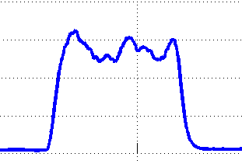
Mapping an EEG Electrode to Hypervectors
Item Memory (iM) maps channels to orthogonal hypervectors.
Continuous iM (CiM) maps quantities continuously to hypervectors.
Quantization: 100 levels
CiM
value
Fp1
name
‘Fp1’
iM

Slide 12
Temporal HD Encoder for one EEG Electrode
1st Electrode
*
Preprocessing
Temporal Encoder
BPF
mean
Quant 100
CiM
L_{1,n}
ρ
…
L_{1,3}
ρ
L_{1,2}
ρ
L_{1,1}
level
G₁
Fp1
*
R₁
name
‘Fp1’
iM
N₁
CiM contains 100 hypervectors for continuous mapping (2 orthogonal hypervectors)
iM contains 64 orthogonal hypervectors, one per electrode
Temporal Encoder:
Rotate (ρ) a signal level to capture its history producing a temporal n-gram (G₁)
Bind an electrode name (e.g., N₁) to its temporal n-gram: N₁ * G₁
This binding produces a record R₁ describing the electrode of interest

Slide 13
Temporal-Spatial HD Encoder
1st Electrode
*
Preprocessing
Temporal Encoder
BPF
mean
Quant 100
CiM
L_{1,n}
ρ
…
L_{1,3}
ρ
L_{1,2}
ρ
L_{1,1}
level
Spatial
Encoder
G₁
Fp1
*
R₁
name
‘Fp1’
iM
N₁
… …. …
64th Electrode
*
+
E
Preprocessing
Temporal Encoder
BPF
mean
Quan 100
CiM
L_{64,n}
ρ
…
L_{64,3}
ρ
L_{64,2}
ρ
L_{64,1}
level
G₆₄
O2
name
*
R₆₄
‘02’
iM
N₆₄
Generate a temporal-spatial hypervector across 64 electrodes by addition

Slide 14

Class Prototypes in Associative Memory
“correct”/”wrong”
Fp1
Temporal-Spatial Encoder
Associative Memory
E
?+
W
Cosine
…
?+
C
O2
for $each trial$: if $label == “correct”$then $C+=E \left(\cos\left(C,E\right)<0.5\right)$
if $label=="wrong"$ then $W+=E \left(\cos\left(W,E\right)<0.5\right)$
HD computing shares the same structure for both training and testing!

Slide 15
Fast and One-shot Learning
Training with only 2.6% of the total non-redundant trials:
HD accuracy reaches to 79.3% (higher than the baseline using all training trials).

Slide 16
Fast and One-shot Learning by 6 Subjects
HD classifier learns faster: it uses only 0.3% of the non-redundant training trials for S6, and up to 96% for S1.
On average, HD classifier meets the target accuracy of 70% when trained with only 34% of non-redundant training trials.

Slide 17
Blindly Using All Electrodes w/o Preprocessing
Compared to baseline:
Using the same setup: HD has 5% higher accuracy
Using all electrodes w/o CAR filter: HD has 2.2% higher accuracy

Slide 18
Summary
An application of HD computing to the classification of error-related potentials from EEG recordings
Classification of EEG error-related potentials is comparable to the baseline classifier crafted by a skilled professional:
HD algorithm does the classification without requiring prior knowledge about the important channels for this task; HD uses all 64 channels while baseline selectively uses 1 or 2 channel(s) based on the subject
HD algorithm uses lighter preprocessing (no CAR filter)
HD achieves this task with fewer training data
Open source HD code: https://github.com/abbas-rahimi/HDC-EEG-ERP

Slide 19



Acknowledgment
This work was supported in part by
Systems on Nanoscale Information fabriCs (SONIC), one of the six SRC STARnet Centers, sponsored by MARCO and DARPA
Intel Strategic Research Alliance (ISRA) program on Neuromorphic Architectures for Mainstream Computing

