Slide 1


Slide 2
Where we Started

Slide 3
35 days
2 Months plan
Everyday Discussion about topics / Technologies/ Bug Fixing.
Every day with SME/Trainer Discussion of progress & transformation based on all Technologies

Slide 4
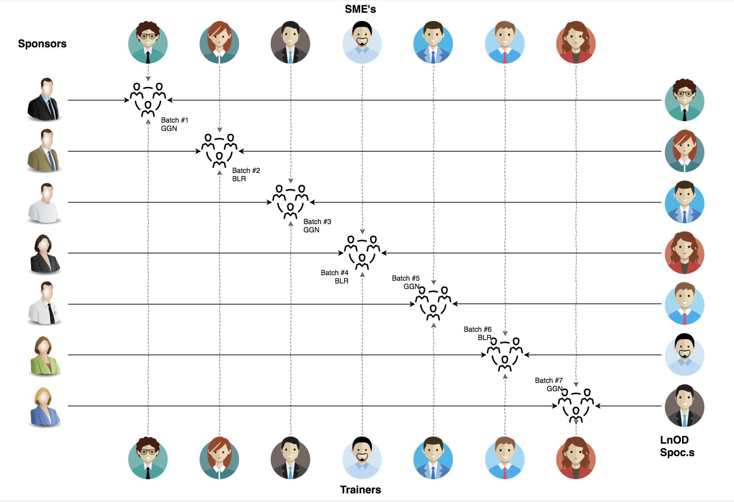
Stakeholders
Sponsors
LTI
2. SME’s
Amit Balyan
Srividya Macherla

Slide 5
Our next starts
NOW
Notes:
Time – 1 min

Slide 6

Agenda
01
Our Journey
02
Our Team
03
Project Goals
04
Engineering Practices
05
Tech Stack
06
Development
07
Roadblocks
08
Demo
09
Questions
Notes:
Time – 1 min

Slide 7

Our Journey
Notes:
Time - 2 mins

Slide 8

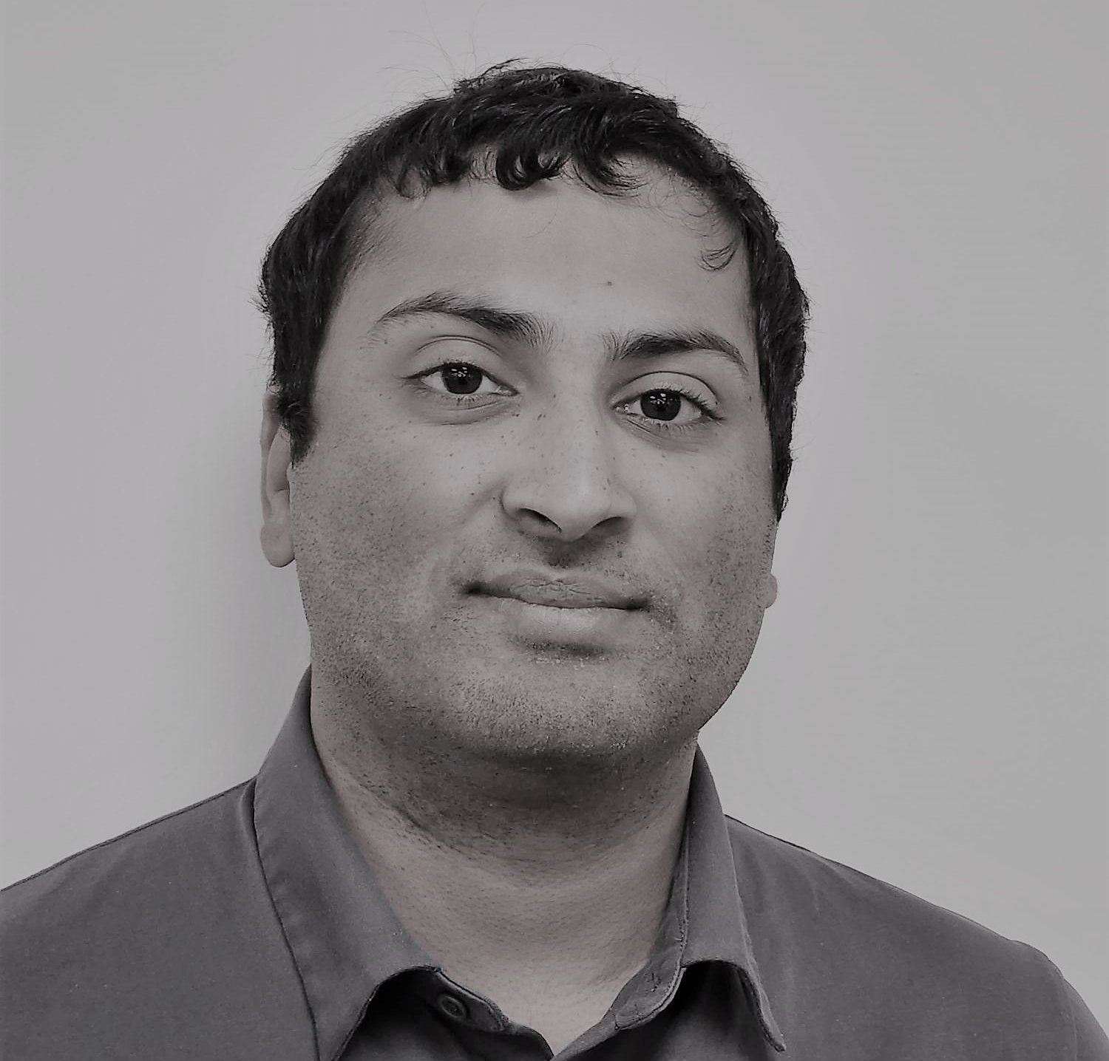

Our Team
Nikhil Shah
Luca Mastrofini
Notes:
Time – 2 mins

Slide 9




Our Vision
To create a Course Registration System using full stack development tools and technologies, where students and professors can enroll in different courses and perform various tasks with our admins creating tasks and approving users.
1
2
Quality
Security
3
4
Interactivity
Speed

Slide 10
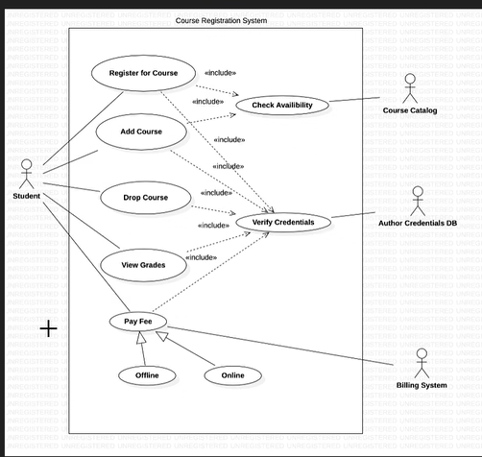
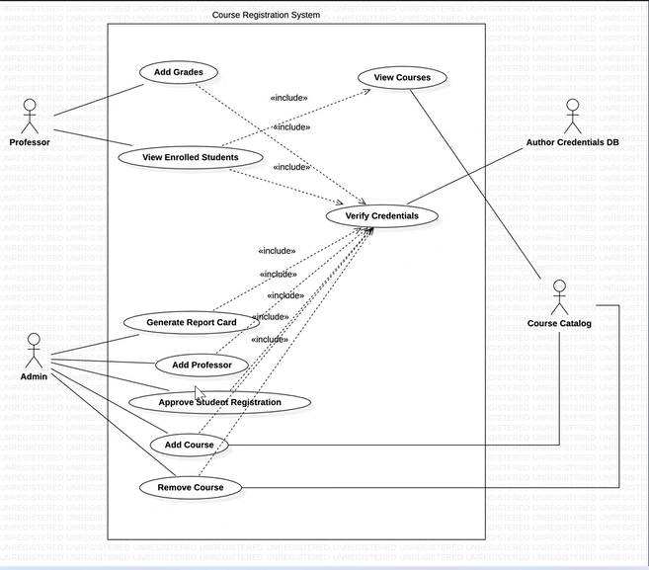
Project Outline

Slide 11

Engineering Practices
Object orienting programming
Single responsibility
Self-documenting code
Follow DRY Principle
Error Handling
Notes:
Time – 5 mins
Object oriented programming
Single responsibility -> Every package should have just one responsibility. Controller – Service - Dao
Self documenting code -> Java DOCS
DRY don't repeat your self
Error Handling -> try and catch blocks. Frontend and backend, Micro services.

Slide 12
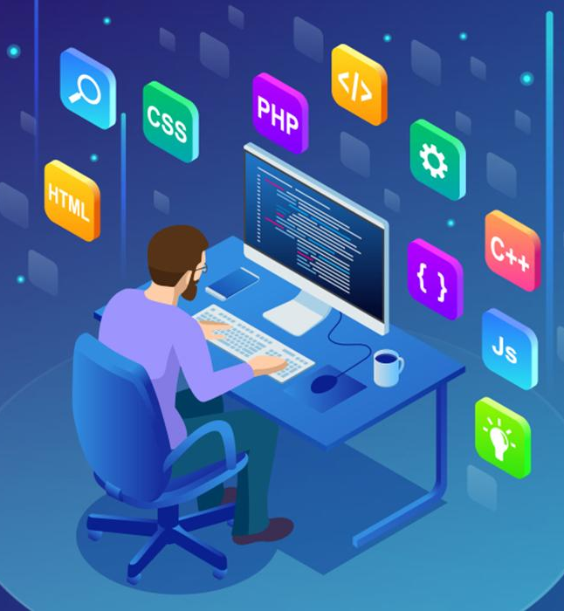
Tech Stack
Notes:
Time – 2 mins

Slide 13

















Backend
Data
Frontend
Version
Control
Core Language
SQL Database
Core Language
Framework
NoSQL Database
Application Server
Frameworks
Testing
Testing
Documentation
Notes:
Time – 1 min

Slide 14

Development
Notes:
Time – 1 min
Started with console based implementation
Moved to Spring Rest
Added JDBC Template
Switched to Microservices with Angular Front end
Switched login to Express API and MongoDB
Tried out React JS with small side project for exposure
Added testing with both backend and frontend

Slide 15
Lecture
Indvidual time to research
Apply learned concepts
Individual time to practice
Review
Learning a topic
Practical
Demo
Delivery and code review
Implemen-tation in the
project
Work in teams
Development
Code Review
Commit
Review of the work done
Testing
Refactoring if needed
Notes:
Time – 1 min

Slide 16

Challenges & Roadblocks
Notes:
Time – 2 mins

Slide 17
GitHub Repo

Slide 18

Demo
Notes:
Time –
Console POS – 5 mins
Basic Web REST – 3 mins
Microservices and Angular Front-end – 10 mins
React Trial – 2 mins

Slide 19

Questions
Notes:
Time - ?

Slide 20
Thank you

