Slide 1
CSE 508
Network Security (Lecture 7 – Core Protocol DNS and its Security)
Omar Haider Chowdhury
Empire Innovation Scholar and Associate Professor
Department of Computer Science
Stony Brook University

Slide 2
Modules
This class will have the following modules:
Background:
Cryptography
Introduction to Network and Protocols
Authentication
Access Control
Attacks and Defenses against protocols
Essential tools for attack and defense
Web Security
Privacy and Anonymity
Advanced Topics (Protocol Verification)

Slide 3
Modules
This class will have the following modules:
Background:
Cryptography
Introduction to Network and Protocols
Authentication
Access Control
Attacks and Defenses against protocols
Essential tools for attack and defense
Web Security
Privacy and Anonymity
Advanced Topics (Protocol Verification)

Slide 5
So far, we have only seen attacks.

Slide 6
So far, we have only seen attacks.
Our next focus will be on defenses that increase the entropy of the DNS response

Slide 7
Source Port Randomization (Defense -1)
Use a random source port for each out-going DNS query
Entropy: 16-bit (from TXID) + 11-bit (from source port) = 27-bit entropy
To win, the attacker has a much bigger space of possible IDs to forge a valid response
Limitation: When the resolver is behind a NAT device, the additional entropy provided by source port randomization is low (e.g., 2 bits)

Slide 8
0x20 Randomization (Defense -2)
Domain names are case-insensitive
www.google.com and WWW.GOOGLE.COM resolves to the same IP address
Randomly change some of the characters in the domain name to upper case letters
The expectation is that the resolver responding will copy the domain name in the response from the query
Limitations:
Attacker can query: www.123.com
Some of the resolvers always return domain name in all lower-case
Some of the resolvers use a case-sensitive matching
70% resolvers support 0x20 randomization

Slide 9
WSEC DNS (Defense -3)
While querying root or TLD DNS servers, preprend random prefix
Ddsj030gojfd.www.google.com and www.google.com returns the same RRs (not IP)
Limitations:
Domain names can be maximum 255-byte length
Attackers can query 255-byte domains
This is applicable to referrals not A queries
Some resolvers exclude long domain names as they are uncommon

Slide 10
Randomizing Destination IP (Defense -4)
Multiple IP addresses for a DNS server
Choose one randomly from that list to query
Limitations:
The set of IP addresses are small
They are many times predictable
Attack it to make it more predictable

Slide 11
Randomizing Destination IP (Defense -4)
Multiple IP addresses for a DNS server
Choose one randomly from that list to query
Limitations:
The set of IP addresses are small
They are many times predictable
Attack it to make it more predictable
whoisthere.stonybrook.edu. IN A 129.49.7.250
mewho.stonybrook.edu. IN A 199.110.254.244
nocnoc.stonybrook.edu. IN A 129.49.7.3

Slide 12
Randomizing Destination IP (Defense -4)
Multiple IP addresses for a DNS server
Choose one randomly from that list to query
Limitations:
The set of IP addresses are small
They are many times predictable
Attack it to make it more predictable

Slide 13
Randomizing Source IP (Defense -5)
This is called the NAT-antidote
This is applicable when the resolver is behind a NAT
When NAT receives a query from the resolver, it randomly changes the source IP address to a random IP in that network
Limitations:
Extra entropy depends on the network size

Slide 15
Long-term Defenses

Slide 16
Adaptive Defense
Attack = Received a response for a query and the TXID of the response does not match with the query’s TXID
Can happen in benign cases as DNS runs on top of UDP

Slide 17
Sandwich Antidote (Defense -6)
Detect attack and apply sandwich antidote
For querying www.google.com
Query 1: dfjfdkjfhksdf.google.com
Query 2: www.google.com [REAL QUERY]
Query 3: jkjkjoiojohh.google.com
Observe whether the response arrive in-order

Slide 18
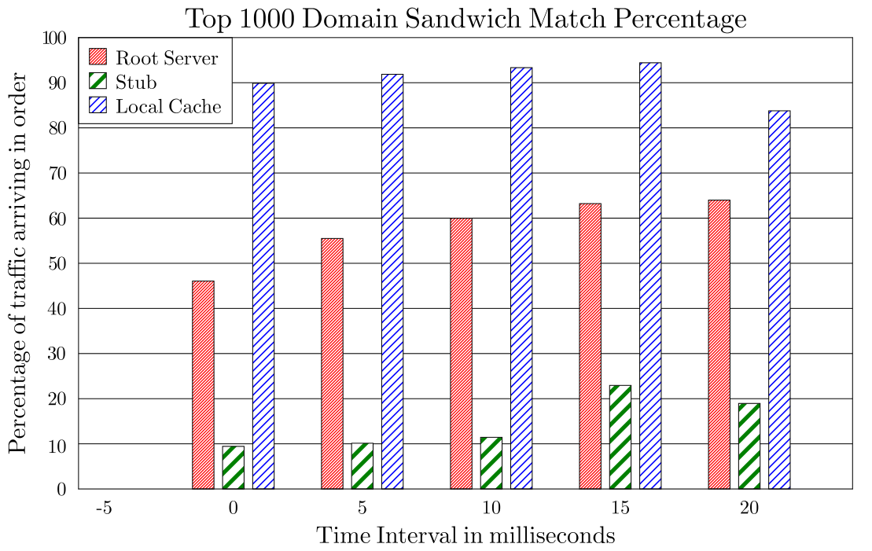


Sandwich Antidote (Defense -6)
UDP packets can arrive out of order

Slide 19
Sandwich Antidote (Defense -6)
Attacker can try to deliver a correct response to the original (2nd) request
After the first response has been received
This means sandwiching only shortens the window in which the forged response can arrive
As shown previously, one would want certain interval between sandwiched requests to obtain a higher inorder rate
Overhead concerns: attacker sending some mismatched response would trigger 3 requests

Slide 20
DNSSEC (Defense – 7)
Proposed as a long-term solution
Uses digitally signed responses
Prevents cache poisoning attacks
Limitations:
Adoption is very slow– 1% of all the .com and .net domains are secured by DNSSEC
Opens door for DoS attack due to large response size

Slide 21
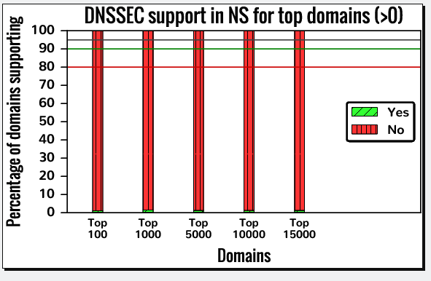
DNSSEC Adoption
About 1% of them supports DNSSEC

Slide 22
DNS over TCP (Defense – 8)
Run DNS protocol on top of TCP instead of UDP
Limitations:
High latency (almost 2X)
Resolver throughput rate (1/10th)
Not all resolvers support TCP
In our experiment with Alexa’s top 15K domains, 10% of their authoritative nameservers do not support TCP – includes Facebook

Slide 23
Adaptively use TCP (Defense – 9)
Run DNS protocol on top of TCP instead of UDP only when detected attack
Nominum implemented it in their product Vantio CacheServe
Limitations:
Attack detection is not fine-grained – benign cases will be considered as attack
Same as before
Susceptible to the new attack we have proposed

Slide 24

Hold-on (Defense – 10)
Main idea:
After receiving one matching response, keep waiting until reached some upper-bound of RTT
By holding on, even if a successful forged response arrived, by holding on, may still receive the genuine response
When more than one matching response can be accepted, use arrival time (expect to be close to RTT) to decide

Slide 25

Hold-on (Defense – 10)
Status: Not sure. Does not seem to be widely deployed?
However:
> 1 matching responses means under attack?
RTT can be estimated => not a good "trust anchor" for authentication
1 matching response means no attack?
Not really: packets could be dropped in transit, servers could be overwhelmed so that queries could not be processed, some servers do not respond to non-existent domains

Slide 26
DNS over TLS/HTTPS (Defense – 11)
There is a proposal of using DNS over TLS or HTTPS
Provides security against DNS cache poisoning attack
Limitations:
Deployment is low
Overhead is high
kdig -d @1.1.1.1 +tls-ca +tls-host=one.one.one.one example.com

