Slide 1
CSE 508
Network Security (Lecture 8- Introduction to SSL/TLS)
Omar Haider Chowdhury
Empire Innovation Scholar and Associate Professor
Department of Computer Science
Stony Brook University

Slide 2
Modules
This class will have the following modules:
Background:
Cryptography
Introduction to Network and Protocols
Authentication
Access Control
Attacks and Defenses against protocols
Essential tools for attack and defense
Web Security
Privacy and Anonymity
Advanced Topics (Protocol Verification)

Slide 3
Modules
This class will have the following modules:
Background:
Cryptography
Introduction to Network and Protocols
Authentication
Access Control
Attacks and Defenses against protocols
Essential tools for attack and defense
Web Security
Privacy and Anonymity
Advanced Topics (Protocol Verification)

Slide 4
Slide Sources
Many slides courtesy of Cristina Nita-Rotaru, Christo Wilson, Wil Robertson, and Joyanta Debnath
Analysis of the HTTPS Certificate Ecosystem, IMC 2013: https://jhalderm.com/pub/papers/https-imc13.pdf
Analysis of SSL certificate reissues and revocations in the wake of Heartbleed, IMC 2014: http://www.ccs.neu.edu/home/cbw/pdf/imc254-zhang.pdf

Slide 6
We are going to focus on Transport Layer Security (TLS), which is arguably the most widely used security protocol

Slide 7
Applications of TLS
HTTPS, ICCP, MQTT
EAP-TLS
VPN
SIP
DNS
FTP
SMTP, IMAP, XMPP
NNTP

Slide 8
What is Transport Layer Security (TLS)?
Protocol that allows one to establish an end-to-end secure channel
Provides: confidentiality, integrity, and authentication
Defines how the characteristics of the channel are negotiated: key establishment, encryption cipher, authentication mechanism
Requires reliable end-to-end protocol, so it runs on top of TCP
It can be used by other session protocols (such as HTTPS)
Several open-source implementations: OpenSSL, GNUTLS, BoringSSL, s2n, mbedTLS, wolfSSL, …

Slide 9
TLS Goals
Confidentiality: Achieved by encryption
Integrity: Achieved by computing a MAC and send it with the message;
Key exchange: Relies mainly on public key encryption
Several version algorithms changed with versions;
TLS 1.2:
Replaced the use of MD5-SHA1 with SHA-256
AES CCM and GCM modes
TLS 1.3:
Enhanced handshake process, reducing latency and speeding up connections via fewer round trips
Zero Round-Trip resumption (0-RTT)
Supports only cipher suite with Perfect-Forward Secrecy

Slide 10
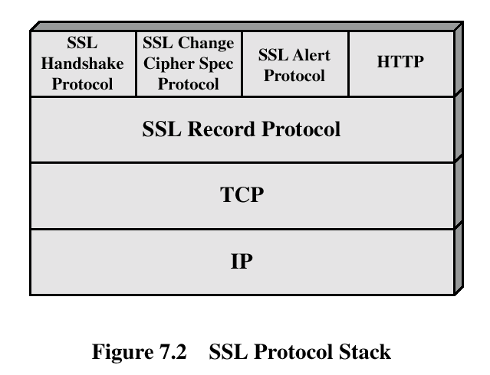
TLS Protocol Architecture

Slide 11
Abstraction (Session and Connection)
Session:
Association between a client and a server;
Created by the Handshake Protocol;
Defines secure cryptographic parameters that can be shared by multiple connections.
Connection:
End-to-end reliable secure communication;
Every connection is associated with a session.

Slide 12
Session
Session identifier:
Generated by the server to identify an active or resumable session.
Peer certificate:
X 509v3 certificate.
Compression method:
Algorithm used to compress the data before encryption.
Cipher spec:
Encryption and hash algorithm, including hash size.
Master secret:
48-byte secret shared between the client and server.
Is resumable:
Indicates if the session can be used to initiate new connections.

Slide 13
Connection
Server and client random: chosen for each connection.
Server write MAC secret: shared key used to compute MAC on data sent by the server.
Client write MAC secret: same as above for the client
Server write key: shared key used by encryption when server sends data.
Client write key: same as above for the client.
Initialization vector: initialization vectors required by encryption.
Sequence numbers: both server and client maintains such a counter to prevent replay, cycle is 2⁶⁴ - 1.

Slide 14
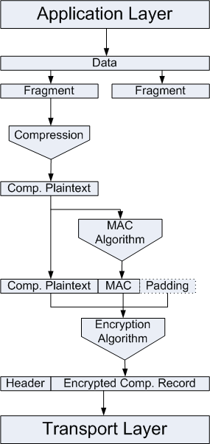
TLS: Record Protocol
Provides confidentiality and message integrity using shared keys established by the handshake protocol

Slide 15
TLS: Record Protocol
Assumes underlying reliable communication (TCP)
Fragmentation, compression, authentication, encryption
Message sent by the application, e.g., HTTP request
<16KB
<16KB
<16KB
Fragment
Message sent by th
he application, e.g.
HTTP request
Compress
MAC
Pad (if needed)
Encrypt
Header
Finally, send each (processed) fragment via TCP

Slide 16
TLS Alert Protocol
Used to send TLS related alerts to peers
Alert messages are compressed and encrypted
Message: two bytes, one defines fatal/warnings, other defines the code of alert
Fatal errors: decryption_failed, record_overflow, unknown_ca, access_denied, decode_error, export_restriction, protocol_version, insufficient_security, internal_error
Other errors: decrypt_error, user_cancelled, no_renegotiation

Slide 17
TLS: Handshake Protocol
Negotiate Cipher-Suite Algorithms
Symmetric cipher to use
Key exchange method
Message digest function
Negotiate protocol version
Establish the shared master secret
Optionally, authenticate server and/or client

Slide 18






TLS 1.2 Handshake Protocol
^{S}BofA
BofA
ClientHello(Version, Prefs, Nonce_{c}) ServerHello(Version, Prefs, Nonce_{s}) Certificates({C_{BofA}, C_{Verisign}}) ServerHelloDone
)
ClientKeyExchange({PreMasterKey}_{PBofA}
ChangeCipherSpec
{Finished}_{K}
ChangeCipherSpec
{Finished}_{K}
Certificate chain
Both sides derive
symmetric session key K
from the PreMasterKey
Encrypted using server’s public key
Encrypted using symmetric session key

Slide 19
^{S}BofA
BofA
ClientHello(Version, Prefs, Nonce_{c}) ServerHello(Version, Prefs, Nonce_{s}) Certificates({C_{BofA}, C_{Verisign}}) ServerHelloDone
)
ClientKeyExchange({PreMasterKey}_{PBofA}
ChangeCipherSpec
{Finished}_{K}
ChangeCipherSpec
{Finished}_{K}
Certificate chain
Encrypted using server’s public key
Encrypted using symmetric session key
ClientHello
ServerHello
ServerCert
ServerHelloDone

Slide 20
seed = "master secret" + client_random + server_random
a0 = seed
a1 = HMAC-SHA256(key=PreMasterSecret, data=a0)
a2 = HMAC-SHA256(key=PreMasterSecret, data=a1)
p1 = HMAC-SHA256(key=PreMasterSecret, data=a1 + seed)
p2 = HMAC-SHA256(key=PreMasterSecret, data=a2 + seed)
MasterSecret = p1[all 32 bytes] + p2[first 16 bytes]
seed = "key expansion" + server_random + client_random
a0 = seed
a1 = HMAC-SHA256(key=MasterSecret, data=a0)
a2 = HMAC-SHA256(key=MasterSecret, data=a1)
a3 = HMAC-SHA256(key=MasterSecret, data=a2)
a4 = ...
p1 = HMAC-SHA256(key=MasterSecret, data=a1 + seed)
p2 = HMAC-SHA256(key=MasterSecret, data=a2 + seed)
p3 = HMAC-SHA256(key=MasterSecret, data=a3 + seed)
p4 = ...
p = p1 + p2 + p3 + p4 ...
client write mac key = [first 20 bytes of p]
server write mac key = [next 20 bytes of p]
client write key = [next 16 bytes of p]
server write key = [next 16 bytes of p]
client write IV = [next 16 bytes of p]
server write IV = [next 16 bytes of p]
^{S}BofA
BofA
ClientHello(Version, Prefs, Nonce_{c}) ServerHello(Version, Prefs, Nonce_{s}) Certificates({C_{BofA}, C_{Verisign}}) ServerHelloDone
)
ClientKeyExchange({PreMasterKey}_{PBofA}
ChangeCipherSpec
{Finished}_{K}
ChangeCipherSpec
{Finished}_{K}
Certificate chain
Encrypted using server’s public key
Encrypted using symmetric session key
ClientHello
ServerHello
ServerCert
ServerHelloDone

Slide 21
Handshake Protocol: Hello Message
Client_hello_message has the following parameters:
Version
Random: timestamp + 28-bytes random
Session ID
CipherSuite: cipher algorithms supported by the client, first is key exchange
Compression method
Server responds with the same
Client may request use of cached session
Server chooses whether to accept or not

Slide 22
Supported Key Exchange
RSA:
Shared key encrypted with RSA public key
Fixed Diffie-Hellman:
Public parameters provided in a certificate
Ephemeral Diffie-Hellman:
The best; Diffie-Hellman with temporary secret key, messages signed using RSA or DSS
Anonymous Diffie-Hellman:
Vulnerable to man-in-the-middle
PSK with ephemeral (EC)DHE
PSK without ephemeral DH

Slide 23
TLS Authentication
Verify identities of the participants
Client authentication is optional
X.509 version 3 certificates are used to associate identity with public key and other attributes
We have covered X.509 version 3 certificates and certificate chain validation in the PKI lecture

Slide 24
TLS Change Cipher Spec/Finished
Change Cipher Spec completes the setup of the connections.
Announce switch to negotiated algorithms and values
The client sends a message under the new algorithms, allows verification of that the handshake was successful.
CCS message is optional in TLS 1.3

Slide 25


CCS Message (TLS 1.2)
ClientHello
ServerHello
Certificate
ServerHelloDone
ClientKeyExchange
ClientCCS
Finished
ServerCCS
Finished
Application Data

Slide 26
CCS Message (TLS 1.2)
seed = "master secret" + client_random + server_random
a0 = seed
a1 = HMAC-SHA256(key=PreMasterSecret, data=a0)
a2 = HMAC-SHA256(key=PreMasterSecret, data=a1)
p1 = HMAC-SHA256(key=PreMasterSecret, data=a1 + seed)
p2 = HMAC-SHA256(key=PreMasterSecret, data=a2 + seed)
MasterSecret = p1[all 32 bytes] + p2[first 16 bytes]
seed = "key expansion" + server_random + client_random
a0 = seed
a1 = HMAC-SHA256(key=MasterSecret, data=a0)
a2 = HMAC-SHA256(key=MasterSecret, data=a1)
a3 = HMAC-SHA256(key=MasterSecret, data=a2)
a4 = ...
p1 = HMAC-SHA256(key=MasterSecret, data=a1 + seed)
p2 = HMAC-SHA256(key=MasterSecret, data=a2 + seed)
p3 = HMAC-SHA256(key=MasterSecret, data=a3 + seed)
p4 = ...
p = p1 + p2 + p3 + p4 ...
client write mac key = [first 20 bytes of p]
server write mac key = [next 20 bytes of p]
client write key = [next 16 bytes of p]
server write key = [next 16 bytes of p]
client write IV = [next 16 bytes of p]
server write IV = [next 16 bytes of p]
ClientHello
ServerHello
Certificate
ServerHelloDone
ClientKeyExchange
ClientCCS
Finished
ServerCCS
Finished
Application Data

Slide 27

EarlyCCS Bug
How can we exploit this bug ?
Attacker
ServerHello
Alice
Bob

Slide 28
EarlyCCS Bug
How can we exploit this bug ?
1. Attacker injects CCS to both after ServerHello
2. Alice and Bob both generate predictable encryption and MAC keys from empty shared secret
Attacker
ServerHello
Alice
Bob

Slide 29
EarlyCCS Bug
How can we exploit this bug ?
1. Attacker injects CCS to both after ServerHello
2. Alice and Bob both generate predictable encryption and MAC keys from empty shared secret
Attacker
3. Attacker drops regular CCS messages to prevent generation of new encryption and MAC keys
ServerHello
Alice
Bob

Slide 30
EarlyCCS Bug
How can we exploit this bug ?
1. Attacker injects CCS to both after ServerHello
2. Alice and Bob both generate predictable encryption and MAC keys from empty shared secret
Attacker
3. Attacker drops regular CCS messages to prevent generation of new encryption and MAC keys
4. Now, Attacker will try to predict the weak encryption and MAC keys
ServerHello
Alice
Bob

Slide 31
EarlyCCS Bug
How can we exploit this bug ?
1. Attacker injects CCS to both after ServerHello
2. Alice and Bob both generate predictable encryption and MAC keys from empty shared secret
Attacker
3. Attacker drops regular CCS messages to prevent generation of new encryption and MAC keys
4. Now, Attacker will try to predict the weak encryption and MAC keys
ServerHello
Alice
Bob
CCS messgaes are not included in Finished messages for handshake integrity check

Slide 32
TLS Certificate Authentication
During the TLS handshake, the client receives a certificate chain, i.e. the server’s cert, as well as the certs of the signing CA(s)
The client must validate the certificate chain to establish trust
Does the server’s DNS name match the common name in the cert?
E.g., example.com cannot serve a cert with common name google.com
Are any certs in the chain expired?
Is the CA’s signature cryptographically valid?
Is the cert of the root CA in the chain present in the client’s trusted key store?
Is any cert in the chain revoked?

Slide 33
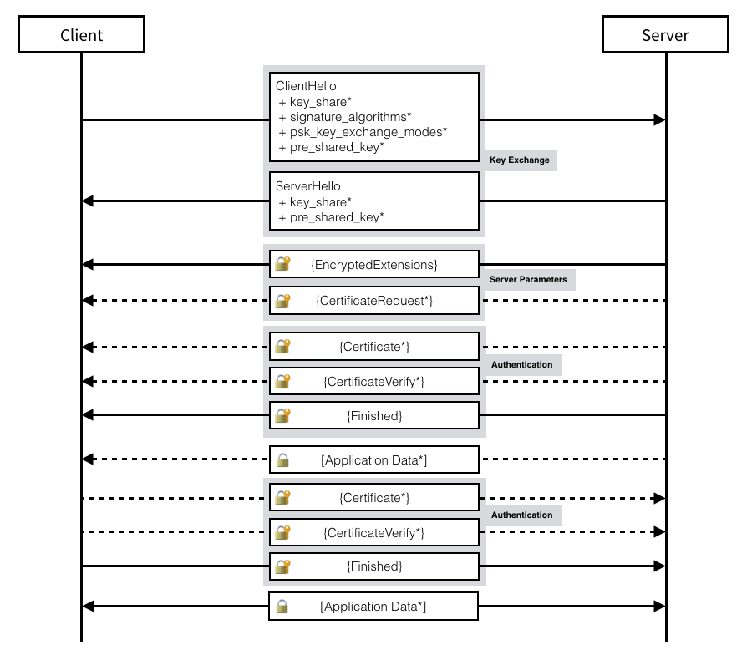
TLS 1.3 Handshake Protocol
+ Indicates noteworthy extensions sent in the previously noted message.
* Indicates optional or situation-dependent messages/extensions that are not always sent.
{} Indicates messages protected using keys derived from a [sender]_handshake_traffic_secret.
[] Indicates messages protected using keys derived from [sender]_application_traffic_secret_N.
Source: https://davidwong.fr/tls13/

Slide 34
TLS 1.3 ‘Full handshake’: 1-RTT
No RSA: only DH + signature by server
1-RTT: client sends key-share in Hello !
So: a key-share per each cipher-suite option sent by client
Client
Server
ClientHello (cipher-suites, $\left\{{g_{1},g}_{1}^{a1},g_{2},g_{2}^{a2}…\right\}$, Client_random)
ServerHello: Server_random, cipher-suite,$g_{1}$, $g_{i}^{b}, E\left(extensions\right), cert, Sign(Hello)$ )
Finished (Confirmation -MAC of handshake messages)
Finished (Confirmation -MAC of handshake messages)
Application data (protected)

Slide 35
TLS 1.3 Key Derivation
Uses a HKDF which is a HMAC based key derivation function
HKDF has two modules:
HKDF-Extract:
Inputs are a “input key material” (IKM) such as DH shared secret and an optional “salt”
Output is a cryptographic key called the PRK (pseudorandom key)
HKDF-Expand:
Inputs are PRK, some information info, and a length l
Outputs a pseudorandom value of length l
Using different values in the info field generate different pseudorandom values

Slide 36
TLS 1.3 Key Derivation
Shared secret (SS) :
SS := Diffie-Hellman Shared secret
Early secret (ES):
ES := HKDF-Extract(0, SS)
Derived secret (DS):
DS := HKDF-Expand(ES, “derived”, “”)
Handshake secret (HS):
HS := HKDF-Extract(DS, SS)
Client Handshake Traffic Key (CHTK):
CHTK := HKDF-Expand(HS, “c hs traffic”, Transcript Hash)
Server Handshake Traffic Key (SHTK):
SHTK := HKDF-Expand(HS, “s hs traffic”, Transcript Hash)
Finished Key (FK):
FK := HKDF-Expand(HS, “finished”, Transcript Hash)
Master Secret (MS):
MS = HKDF-Extract (HS, SS)
Client Application Traffic Key (CATK):
CATK := HKDF-Expand(MS, “c ap traffic”, Transcript Hash)
Server Application Traffic Key (SATK):
SATK := HKDF-Expand(MS, “s ap traffic”, Transcript Hash)

Slide 37
TLS 1.3 Key Derivation and Protocol Flow
Step 1: ClientHello (Client → Server) [Plaintext] – TLS version, Supported Ciphersuites, Client random, supported extensions
Step 2: ServerHello (Server → Client) [Plaintext] - selected TLS version, selected ciphersuites, Server random
Both parties set up SS → ES → DS → HS → CHTK and SHTK
Step 3: Encrypted Extensions (Server → Client): Encrypted with SHTK
Step 4: Server Certificate (Server → Client): Encrypted with SHTK
Step 5: Certificate Verify (Server → Client): Server signs the transcript hash with private key encrypted using SHTK
Step 6: Server Finished (Server → Client): Finished_Hash := HMAC(FK, Transcript Hash) where Finished_Hash is encrypted with SHTK
Step 7: Client Finished (Client → Server): Finished_Hash := HMAC(FK, Transcript Hash) where Finished_Hash is encrypted with CHTK
Both parties derive MS --> CATK and SATK

Slide 38
TLS 1.3 Record Layer
AEAD: Authenticated Encryption with Additional Data
After fragmentation – but no compression
Message sent by the application, e.g., HTTP request
<16KB
<16KB
<16KB
Fragment
Message sent by th
he application, e.g.
HTTP request
Headers
AD
AD
AD
AEAD
AEAD
AEAD
Ciphertext
Ciphertext
Ciphertext

Slide 40
Historical problems with TLS

Slide 41
Problems!
TLS is a widely deployed and extremely successful protocol
… but its not perfect
Problems with TLS:
CA trustworthiness
Weak ciphers and keys
Protocol attacks
Man-in-the-middle attacks
Secret key compromise
Implementation bugs

Slide 42
Weak Cipher Suites
TLS allows, for interoperability, the use of different cryptographic algorithms
It allowed encryption and hash algorithms with known weaknesses (e.g., RC4, MD5)
Cipher Suite | Usage in Certs (as of 2013)
RC4-MD5 | 2.8%
RC4- SHA1 | 48.9%
AES128- SHA1 | 1.2%
AES256- SHA1 | 46.3%

Slide 43
Weak Keys
The ZMap team constantly collects all TLS certificates visible in the IPv4 address space
http://zmap.io/ (data at https://scans.io/)
Currently, around 8.3 million certs being served on the Internet
Observed repeated keys in-the-wild due to low entropy
Some systems auto-generate TLS keys at boot
Low boot-time entropy results in duplicate keys
Default TLS keys often shipped in network devices
Attackers can extract private keys from firmware!

Slide 44
Protocol Attacks
Renegotiation attacks
Allows attacker to renegotiate a connection to the NULL algorithm and inject plaintext data
Fixed by requiring cryptographic verification of previous TLS handshakes
Version downgrade attacks
False Start TLS extension allows attackers to modify the cipher suite list the client sends to server during handshake
Can force the usage of a known insecure cipher

Slide 45
Protocol Attacks (2)
Padding Oracle On Downgraded Legacy Encryption (POODLE)
Cryptographic attack against CBC-mode cyphers when used with SSL 3.0
Attacker can use a downgrade attack to force TLS connections into SSL 3.0
Allowing security degradation for the sake of interoperability is dangerous

Slide 46



TLS MITM
Does C_{e} validate?
S_{e}
^{S}BofA
e
BofA
ClientHello
ClientHello
e BofA
If C_{e} is self-signed, the user will be shown a warning
If the attacker steals C_{BofA} and S_{BofA}, then this attack will succeed unless:
Bank of America revokes the stolen cert
The client checks to see if the cert has been revoked
If the attacker manages to buy a valid BofA cert from a CA, then the
only defense against this attack is certificate pinning

Slide 47
Certificate Pinning
Certificate pinning is a technique for detecting sophisticated MitM attacks
Browser includes certs from well-known websites in the trusted key store by default
Usually, only certs from root CAs are included in the trusted key store
Example: Chrome ships with pinned copies of the *.google.com certificate
Pinning isn’t just for browsers
Many Android and iPhone apps now include pinned certificates
E.g., Facebook’s apps include a pinned cert

Slide 48
Secret Key Compromise
Secret key compromise leads to many devastating attacks
Attacker can successfully MitM TLS connections (i.e. future connections)
Attacker can decrypt historical TLS packets encrypted using the stolen key
Changing to a new keypair/cert does not solve the problem!
The old, stolen key is still valid!
Attacker can still MitM connections!

Slide 49
Certificate Expiration
Certificate expiration is the simplest, most fundamental defense against secret key compromise
All certificates have an expiration date
A stolen key is only useful before it expires
All certs should have a short lifetime
Months, weeks, or even days
In reality, most certs have a one-year lifetime
This gives an attacker plenty of time to abuse a stolen key

Slide 50
Perfect Forward Secrecy
Perfect Forward Secrecy (PFS) addresses the issue of an attacker decrypting past TLS sessions after a secret key compromise
Uses Diffie-Hellman to compute the TLS session key
Session key is never sent over the wire, and is discarded after the session completes
Since the session key cannot be recovered, the attacker cannot decrypt historical TLS packets, even if they hold the secret key
PFS does not prevent MiTM attacks; future TLS sessions are still in danger

Slide 51


PFS-insecure Key Exchange
If at some point in the future Bob’s long term private key S_{k} gets compromised, then the attacker can decrypt E(P_{k} K) and get session key K and then decrypt all messages encrypted with K
B
B,
B A B,
E(P_{k} , K)||Sign(S_{k} , E(P_{k} K))
A A
P_{k} , S_{k}
B B
P_{k} , S_{k}

Slide 52
https://weakdh.org
Imperfect Forward Secrecy: How Diffie-Hellman Fails in Practice, D.Adrian, K. Bhargavan, Z. Durumeric, P. Gaudry, M. Green,A. Halderman, N. Heninger, D. Springall, E.Thomé, L. Valenta, B.VanderSloot, E.Wustrow, S. Zanella-Béguelin, and P. Zimmermann, (Best Paper Award CCS 2015)
Summary: Logjam, active MITM attack that downgrades TLS to 512-bit DHE export-grade cipher suites. They broke a 512 prime (many sites use the same one), estimate that an academic team can break a 768-bit prime and that a nation- state can break a 1024-bit prime.
Impact: TLS with support for export cipher and any protocol using DH with 1024 or less and reusing the prime.
What to do: Disable support for export cipher suites and use a 2048-bit Diffie-Hellman group

Slide 53
Implementation Bugs
Cryptography often assumed to be perfect
Usually the math is solid, but the implementation is found inadequate at times
Two major recent examples of security vulnerabilities due to TLS implementation bugs
Apple's Double Fail
Heartbleed

Slide 54
Apple’s Goto Fail
What’s wrong with this code?
// ...
if ((err = SSLHashSHA1.update(&hashCtx, &serverRandom)) != 0)
goto fail;
if ((err = SSLHashSHA1.update(&hashCtx,
&signedParams)) != 0)
goto fail;
Example of an implementation vulnerability in TLS signature verification
Found in February 2014, present in iOS 6 and OS X
goto if ((err
fail;
= SSLHashSHA1.final(&hashCtx,
&hashOut)) != 0)
goto fail;
// ...
fail:
SSLFreeBuffer(&signedHashes); SSLFreeBuffer(&hashCtx); return err;
}

Slide 55
HeartBleed
Serious vulnerability OpenSSL versions 1.0.1 – 1.0.1f
Publicly revealed April 7, 2014
Exploits a bug in the TLS heartbeat extension
Allows adversaries to read memory of vulnerable services
i.e., buffer over-read vulnerability
Discloses addresses, sensitive data, potentially TLS secret keys
Major impact
OpenSSL is the de facto standard implementation of TLS, so used everywhere
Many exposed services, often on difficult-to-patch devices
Trivial to exploit

Slide 56
HeartBleed Exploit
Heartbeat(str=“Hello”, len=5)
Echo(“Hello”)
_{BofA} ^{S}BofA
Heartbeat(str=“”, len=65535)
Echo(“A$fskndvknla… CERTIFICATE – PRIVATE KEY 234nwlkw3rFAF … *$DvdsaeE”)

Slide 57
HeartBleed
Secret keys could have been stolen from all Heartbleed- vulnerable servers
We know that administrators should have done three things on April 7, 2014:
Patch their copy of OpenSSL
Reissue their certificate with a new asymmetric keypair
Revoke their old (potentially compromised) certificate
Question: did administrators do these things?
If so, how quickly did they respond?

Slide 58
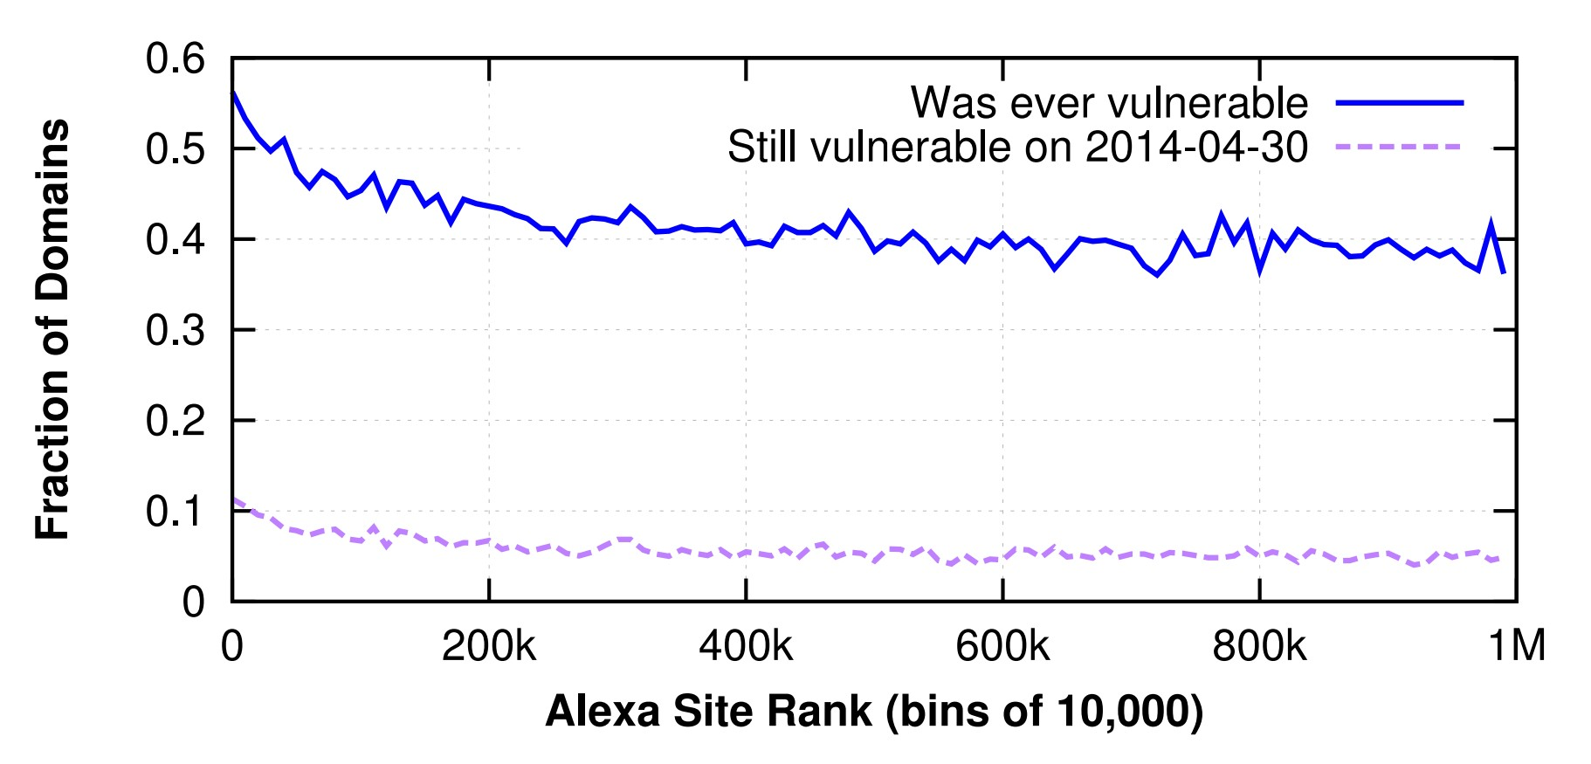
HeartBleed
23 days after
Heartbleed, 5% of servers still unpatched

Slide 59
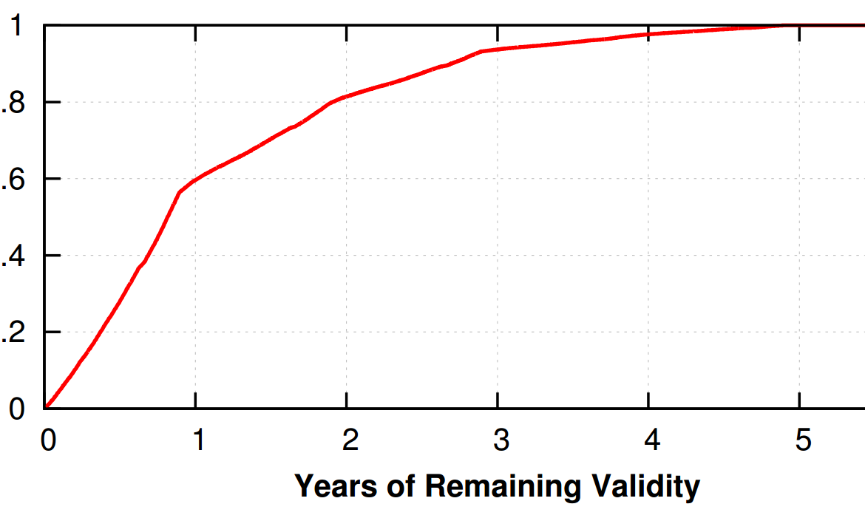
HeartBleed
40% of vulnerable certs won’t expire for year :(

Slide 60
Other TLS Attacks
Other interesting attacks on TLS
TLS stripping
BEAST
CRIME
BREACH
Lucky Thirteen

Slide 61
How can the MITM attacker read the secret message ?
TLS Interception
Client
Attacker
Server

Slide 62

TLS Interception
Attacker prevents Client from TLS session establishment with Server
Creates TLS session 1 with Client impersonating Server
At the same, establishes TLS session 2 with the Server
Client
Attacker
Server

Slide 63
TLS Interception
Attacker prevents Client from TLS session establishment with Server
Creates TLS session 1 with Client impersonating Server
At the same, establishes TLS session 2 with the Server
Client
Attacker
Server

Slide 64

TLS Interception
Attacker prevents Client from TLS session establishment with Server
Creates TLS session 1 with Client impersonating Server
At the same, establishes TLS session 2 with the Server
Client
TLS Session 1
Attacker
Server

Slide 65
TLS Interception
Attacker prevents Client from TLS session establishment with Server
Creates TLS session 1 with Client impersonating Server
At the same, establishes TLS session 2 with the Server
Client
TLS Session 1
Attacker
TLS Session 2
Server

Slide 66
TLS Interception
What happens when client sends an encrypted message to server ?
Enc(1234)
Client
TLS Session 1
Attacker
TLS Session 2
Server

Slide 67
TLS Interception
What happens when client sends an encrypted message to server ?
Enc(1234)
Client
TLS Session 1
Attacker
TLS Session 2
Server

Slide 68
TLS Interception
What happens when client sends an encrypted message to server ?
Dec(Enc(1234))
Client
TLS Session 1
Attacker
TLS Session 2
Server

Slide 69
TLS Interception
What happens when client sends an encrypted message to server ?
1234
Client
TLS Session 1
Attacker
TLS Session 2
Server
Attacker reads the message successfully

Slide 70
TLS Interception
What happens when client sends an encrypted message to server ?
Enc(1234)
Client
TLS Session 1
Attacker
TLS Session 2
Server
Attacker reads the message successfully

Slide 71
TLS Interception
What happens when client sends an encrypted message to server ?
Enc(1234)
Client
TLS Session 1
Attacker
TLS Session 2
Server
Attacker reads the message successfully
Attacker re-encrypts and forwards the message to server

Slide 72
TLS Interception
How did attacker able to authenticate itself as Server to the Client ?

Slide 73
TLS Interception
How did attacker able to authenticate itself as Server to the Client ?
Attacker somehow bypassed the certificate-based authentication

Slide 74
How does client trust a server certificate ?
Subject: www.g.com
Issuer : CA1
ValidTo : 3/13/20
PublicKey : **********
Signature : @@@@@
Client
Notes:
Both root certificate and public key are installed
Pinning for serve certificate
Other semantic checking also happens

Slide 75
How does client trust a server certificate ?
Subject: CA1
Issuer : CA1
ValidTo : 3/13/40
PublicKey : @@@@
Signature : #$!(#$
Subject: www.g.com
Issuer : CA1
ValidTo : 3/13/20
PublicKey : **********
Signature : @@@@@
Client
Notes:
Both root certificate and public key are installed
Pinning for serve certificate
Other semantic checking also happens

Slide 76
How does client trust a server certificate ?
Subject: CA1
Issuer : CA1
ValidTo : 3/13/40
PublicKey : @@@@
Signature : #$!(#$
Subject: www.g.com
Issuer : CA1
ValidTo : 3/13/20
PublicKey : **********
Signature : @@@@@
Who is the root CA ?
Client
Notes:
Both root certificate and public key are installed
Pinning for serve certificate
Other semantic checking also happens

Slide 77
How does client trust a server certificate ?
Subject: CA1
Issuer : CA1
ValidTo : 3/13/40
PublicKey : @@@@
Signature : #$!(#$
Subject: www.g.com
Issuer : CA1
ValidTo : 3/13/20
PublicKey : **********
Signature : @@@@@
Who is the root CA ?
Client
Notes:
Both root certificate and public key are installed
Pinning for serve certificate
Other semantic checking also happens

Slide 78
How does client trust a server certificate ?
Subject: CA1
Issuer : CA1
ValidTo : 3/13/40
PublicKey : @@@@
Signature : #$!(#$
Subject: www.g.com
Issuer : CA1
ValidTo : 3/13/20
PublicKey : **********
Signature : @@@@@
Okay. CA1 is in my trusted CA store.
Who is the root CA ?
Client
Notes:
Both root certificate and public key are installed
Pinning for serve certificate
Other semantic checking also happens

Slide 79
How does client trust a server certificate ?
Subject: CA1
Issuer : CA1
ValidTo : 3/13/40
PublicKey : @@@@
Signature : #$!(#$
Subject: www.g.com
Issuer : CA1
ValidTo : 3/13/20
PublicKey : **********
Signature : @@@@@
Okay. CA1 is in my trusted CA store.
Client
Notes:
Both root certificate and public key are installed
Pinning for serve certificate
Other semantic checking also happens

Slide 80

How does client trust a server certificate ?
Subject: CA1
Issuer : CA1
ValidTo : 3/13/40
PublicKey : @@@@
Signature : #$!(#$
Subject: www.g.com
Issuer : CA1
ValidTo : 3/13/20
PublicKey : **********
Signature : @@@@@
Okay. CA1 is in my trusted CA store.
Client
Notes:
Both root certificate and public key are installed
Pinning for serve certificate
Other semantic checking also happens

Slide 81

How does client trust a server certificate ?
Subject: CA1
Issuer : CA1
ValidTo : 3/13/40
PublicKey : @@@@
Signature : #$!(#$
Subject: www.g.com
Issuer : CA1
ValidTo : 3/13/20
PublicKey : **********
Signature : @@@@@
Looks okay. I trust the server certificate.
Client
Notes:
Both root certificate and public key are installed
Pinning for serve certificate
Other semantic checking also happens

Slide 82
How can the attacker bypass this CA trust model?

Slide 83
Attacker can send a fake certificate to the client
signed by client’s trusted CA

Slide 84
But, it’s difficult to compromise a trusted CA

Slide 85
Alternatively, attacker may install its own root CA certificate to clients trusted store
and
send a self-signed certificate to client

Slide 86
How can attacker install its own root certificate to client’s trusted CA store ?
Using Malware
Users are the weakest link
Organizational/corporate system
Other software (Antivirus, parental-control, etc.)

Slide 87
How can attacker install its own root certificate to client’s trusted CA store ?
Using Malware
Users are the weakest link
Organizational/corporate system
Other software (Antivirus, parental-control, etc.)

Slide 88
How can attacker install its own root certificate to client’s trusted CA store ?
Using Malware
Users are the weakest link
Organizational/corporate system
Other software (Antivirus, parental-control, etc.)

Slide 89
How can attacker install its own root certificate to client’s trusted CA store ?
Using Malware
Users are the weakest link
Organizational/corporate system
Other software (Antivirus, parental-control, etc.)

Slide 90
How can attacker install its own root certificate to client’s trusted CA store ?
Using Malware
Users are the weakest link
Organizational/corporate system
Other software (Antivirus, parental-control, etc.)

Slide 91
TLS Interception
TLS interception breaks end-to-end security of TLS
This technique is used for both good and bad purposes
For example,
Good : to inspect encrypted traffic and block malicious contents
Bad : to steal secret information

Slide 92

TLS Interception: Security Impact
Historically, due to TLS interception overall security of the connection reduces
For example,
What if the middlebox doesn’t validate server certificate in TLS session 2 ?
What if the middle box uses weak encryption algorithms in TLS session 2 ?
Client
TLS Session 1
MiddleBox
TLS Session 2
Server

Slide 93
TLS Interception: Security Impact
In 2017, Durumeric et. al. did security analysis of HTTPS Interception *
5%-10% of all HTTPS connections are intercepted
Investigated 12 Middle-boxes and 20 client-side interception products
Most of the tested products significantly severely decrease security
Notes:
Read the heuristic, how did they do https interception

Slide 94
TLS Interception: Security Impact
In 2017, Durumeric et. al. did security analysis of HTTPS Interception *
5%-10% of all HTTPS connections are intercepted
Investigated 12 Middle-boxes and 20 client-side interception products
Most of the tested products significantly severely decrease security
Notes:
Read the heuristic, how did they do https interception

Slide 95
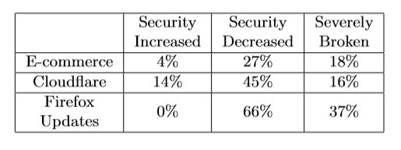
TLS Interception: Security Impact
In 2017, Durumeric et. al. did security analysis of HTTPS Interception *
5%-10% of all HTTPS connections are intercepted
Investigated 12 Middle-boxes and 20 client-side interception products
Most of the tested products significantly severely decrease security
[*] Zakir Durumeric, Zane Ma, Drew Springall, Richard Barnes, Nick Sullivan, Elie Bursztein, Michael Bailey, J Alex Halderman, and Vern Paxson. The security impact of https interception. In NDSS Symposium. NDSS, 2017.
Notes:
Read the heuristic, how did they do https interception

Slide 96
TLS Interception: Security Impact
In 2017, Durumeric et. al. did security analysis of HTTPS Interception *
5%-10% of all HTTPS connections are intercepted
Investigated 12 Middle-boxes and 20 client-side interception products
Most of the tested products significantly severely decrease security
[*] Zakir Durumeric, Zane Ma, Drew Springall, Richard Barnes, Nick Sullivan, Elie Bursztein, Michael Bailey, J Alex Halderman, and Vern Paxson. The security impact of https interception. In NDSS Symposium. NDSS, 2017.
Notes:
Read the heuristic, how did they do https interception

Slide 97
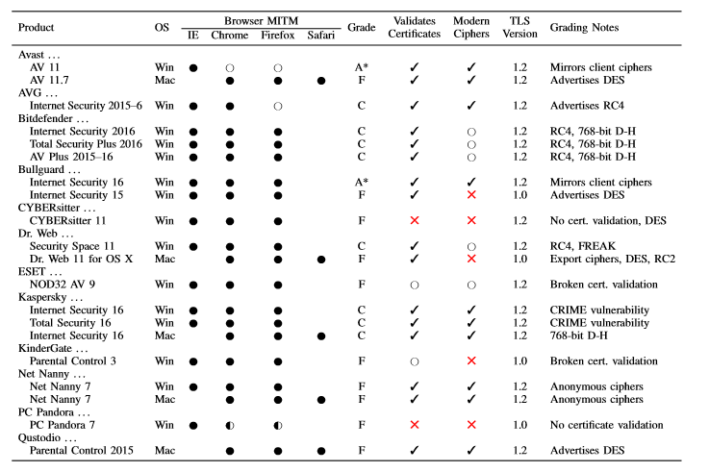
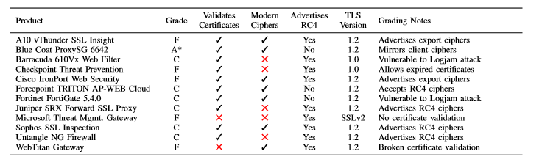
TLS Interception: Security Impact
Detailed results for the tested Interception products
[*] Zakir Durumeric, Zane Ma, Drew Springall, Richard Barnes, Nick Sullivan, Elie Bursztein, Michael Bailey, J Alex Halderman, and Vern Paxson. The security impact of https interception. In NDSS Symposium. NDSS, 2017.
Notes:
Deep packet inspector

Slide 98
What weaknesses of certificate-based authentication does TLS interception exploit?

Slide 99
What weaknesses of certificate-based authentication does TLS interception exploit?
CA trust is breakable
Library developers can be careless

Slide 100
There are some existing solutions
DNS based authentication
Certificate pinning, etc.
Notes:
DANE enables the administrator of a domain name to certify the keys used in that domain's TLS clients or servers by storing them in the Domain Name System (DNS). DANE needs the DNS records to be signed with DNSSEC for its security model to work.
Additionally DANE allows a domain owner to specify which CA is allowed to issue certificates for a particular resource, which solves the problem of any CA being able to issue certificates for any domain.
DNSSEC provide to DNS clients (resolvers) cryptographic authentication of DNS data, authenticated denial of existence, and data integrity, but not availability or confidentiality. // digital signatures
A host or service’s certificate or public key can be added to an application at development time, or it can be added upon first encountering the certificate or public key.
App communicating with a particular server

Slide 101
There are some existing solutions
DNS based authentication
Certificate pinning, etc.
But again, we have to rely on DNS servers and application developers
Notes:
DANE enables the administrator of a domain name to certify the keys used in that domain's TLS clients or servers by storing them in the Domain Name System (DNS). DANE needs the DNS records to be signed with DNSSEC for its security model to work.
Additionally DANE allows a domain owner to specify which CA is allowed to issue certificates for a particular resource, which solves the problem of any CA being able to issue certificates for any domain.
DNSSEC provide to DNS clients (resolvers) cryptographic authentication of DNS data, authenticated denial of existence, and data integrity, but not availability or confidentiality. // digital signatures
A host or service’s certificate or public key can be added to an application at development time, or it can be added upon first encountering the certificate or public key.
App communicating with a particular server

Slide 102
There are some existing solutions
DNS based authentication
Certificate pinning, etc.
But again, we have to rely on DNS servers and application developers
Alternative option : TrustBase architecture
Notes:
DANE enables the administrator of a domain name to certify the keys used in that domain's TLS clients or servers by storing them in the Domain Name System (DNS). DANE needs the DNS records to be signed with DNSSEC for its security model to work.
Additionally DANE allows a domain owner to specify which CA is allowed to issue certificates for a particular resource, which solves the problem of any CA being able to issue certificates for any domain.
DNSSEC provide to DNS clients (resolvers) cryptographic authentication of DNS data, authenticated denial of existence, and data integrity, but not availability or confidentiality. // digital signatures
A host or service’s certificate or public key can be added to an application at development time, or it can be added upon first encountering the certificate or public key.
App communicating with a particular server

Slide 103
TrustBase Architecture
An architecture to strengthen certificate-based authentication *
As an operating system service
With user’s control over authentication policies
[*] Mark O’Neill, Scott Heidbrink, Scott Ruoti, Jordan Whitehead, Dan Bunker, Luke Dickinson, Travis Hendershot, Joshua Reynolds, Kent Seamons, and Daniel Zappala. Trustbase: an architecture to repair and strengthen certificate-based authentication. In USENIX Security Symposium. USENIX, 2017
Notes:
More about trustbase

Slide 104
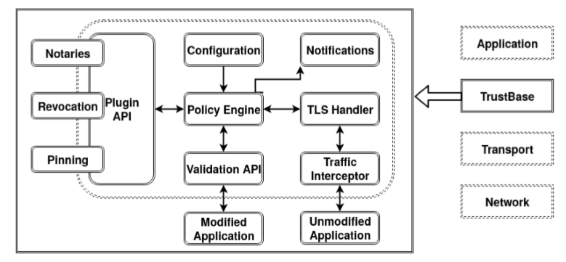
TrustBase Architecture
An architecture to strengthen certificate-based authentication *
As an operating system service
With user’s control over authentication policies
[*] Mark O’Neill, Scott Heidbrink, Scott Ruoti, Jordan Whitehead, Dan Bunker, Luke Dickinson, Travis Hendershot, Joshua Reynolds, Kent Seamons, and Daniel Zappala. Trustbase: an architecture to repair and strengthen certificate-based authentication. In USENIX Security Symposium. USENIX, 2017
Notes:
More about trustbase

Slide 105
TrustBase Architecture
An architecture to strengthen certificate-based authentication *
As an operating system service
With user’s control over authentication policies
[*] Mark O’Neill, Scott Heidbrink, Scott Ruoti, Jordan Whitehead, Dan Bunker, Luke Dickinson, Travis Hendershot, Joshua Reynolds, Kent Seamons, and Daniel Zappala. Trustbase: an architecture to repair and strengthen certificate-based authentication. In USENIX Security Symposium. USENIX, 2017
Notes:
More about trustbase

Slide 106
TrustBase Architecture
An architecture to strengthen certificate-based authentication *
As an operating system service
With user’s control over authentication policies
[*] Mark O’Neill, Scott Heidbrink, Scott Ruoti, Jordan Whitehead, Dan Bunker, Luke Dickinson, Travis Hendershot, Joshua Reynolds, Kent Seamons, and Daniel Zappala. Trustbase: an architecture to repair and strengthen certificate-based authentication. In USENIX Security Symposium. USENIX, 2017
Notes:
More about trustbase

Slide 107
TrustBase Architecture
An architecture to strengthen certificate-based authentication *
As an operating system service
With user’s control over authentication policies
[*] Mark O’Neill, Scott Heidbrink, Scott Ruoti, Jordan Whitehead, Dan Bunker, Luke Dickinson, Travis Hendershot, Joshua Reynolds, Kent Seamons, and Daniel Zappala. Trustbase: an architecture to repair and strengthen certificate-based authentication. In USENIX Security Symposium. USENIX, 2017
Notes:
More about trustbase

Slide 108

Take-home Lessons
TLS is crucial for maintaining security and privacy on the Web
Mature, well supported protocol
Its security was proven as of 2014
Unfortunately,TLS is plagued by many issues
Many different protocol-level issues that enable MitM attacks
TLS implementations are buggy
Human beings fail to reissue/revoke certificates properly
Browsers fail to perform revocation checks

Slide 109
Backup Slides

Slide 110

TLS 1.3 Session Resumption: PSK
Resume only using Pre-Shared Key (PSK)
Essentially, build-in ticket mechanism
Optional use of DH for PFS (ephemeral key)
Add $\left\{g_{1}^{a1},g_{2}^{a2}…\right\}$ to client-hello
Use PSK to authenticate key-shares and derive key
ClientHello (cipher-suites,, PSK-ticket, Client_random)
Client
Server
ServerHello: Server_random, $g_{i}^{b}, E\left(extensions, new−ticket\right), cert, Sign(Hello)$ )
Finished (Confirmation -MAC of handshake messages)
Finished (Confirmation -MAC of handshake messages)
Application data (protected)
Notes:
Contents of PSK-ticket are handled by server: could be keys to lookup in DB (like session ID) or, more likely, send-encrypted-and-authenticated keys (like session tickets). Keys are used to authenticate exchange – and derive master key!

Slide 111
TLS 1.3 Session Resumption: PSK
Resume only using Pre-Shared Key (PSK)
Essentially, build-in ticket mechanism
Optional use of DH for PFS (ephemeral key)
Add $\left\{g_{1}^{a1},g_{2}^{a2}…\right\}$ to client-hello
Use PSK to authenticate key-shares and derive key
ClientHello (cipher-suites,, PSK-ticket, Client_random)
Client
Server
ServerHello: Server_random, $g_{i}^{b}, E\left(extensions, new−ticket\right), cert, Sign(Hello)$ )
Finished (Confirmation -MAC of handshake messages)
Finished (Confirmation -MAC of handshake messages)
Application data (protected)
Notes:
Contents of PSK-ticket are handled by server: could be keys to lookup in DB (like session ID) or, more likely, send-encrypted-and-authenticated keys (like session tickets). Keys are used to authenticate exchange – and derive master key!

Slide 112
TLS 1.3 Session Resumption: O-RTT
TLS 1.3 even supports 0-RTT!
ClientHello (cipher-suites,, PSK/key-shares, E(request), Client_random)
Client
Server
ServerHello: Server_random, $g_{i}^{b}, E\left(extensions\right), cert, Sign(Hello)$ )
Finished + (protected) response
Finished
More protected requests, responses
Notes:
Contents of PSK-ticket are handled by server: could be keys to lookup in DB (like session ID) or, more likely, send-encrypted-and-authenticated keys (like session tickets). Keys are used to authenticate exchange – and derive master key!

