Slide 1
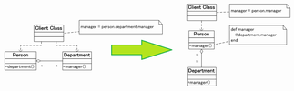
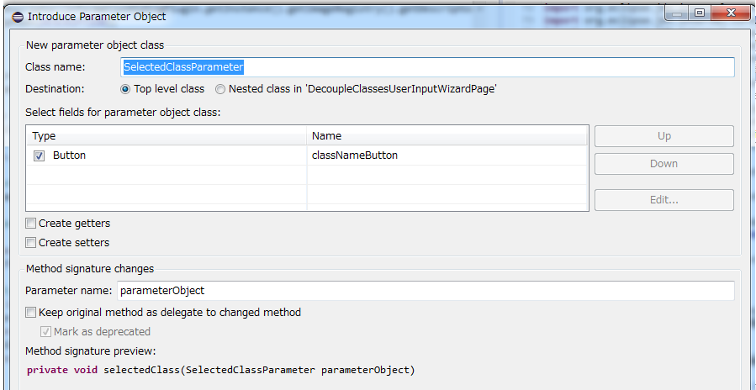
x
Decouple Classes
x
Nothing found to decouple
Name for new class:
Package name:
Browse...
Classes to decouple
Target class:
Browse...
Client classes:
A
B
Finish
Cancel

