Slide 1
INGESTIOn SOLUTION
KASIKORNBANK
Copyright © 2023 Accenture confidential. All Rights Reserved

Slide 2
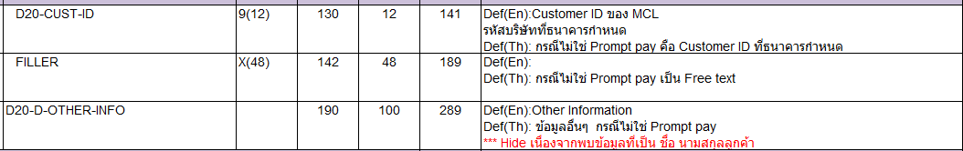
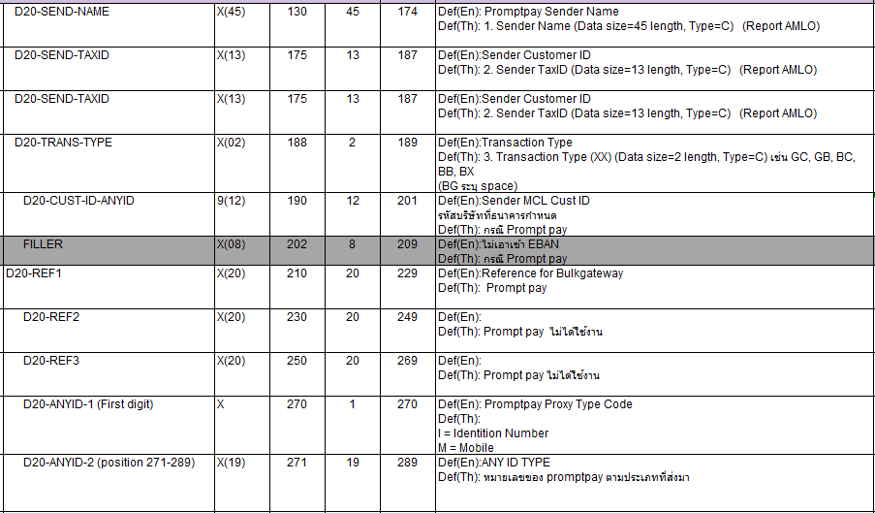
mainframe redefined fields
Ingestion solution
There are MCL_HOST files and CARDLINK Streaming tables that have redefined fields as example below:
File: SHARE.MCL1D20.SAMEDAY.Dddmmyy.TXT
Condition 1 (3 fields): NOT Promptpay >> D20-ANYID-SOURCE-FLAG (Position Start = 291) <>A
Condition 2 (10 fields): Promptpay only >> D20-ANYID-SOURCE-FLAG (Position Start = 291) = A

Slide 3
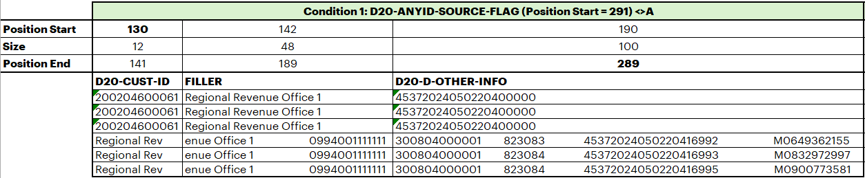
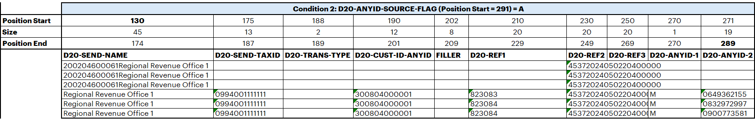
mainframe redefined fields
Ingestion solution
Proposed solution for ingestion to persist table: persist_mcl_host.mcl_host_share_mcl1d20_sameday
For length 130 – 289, persist table will have 13 fields (condition 1: 3 fields + condition 2: 10 fields).
For those fields in red boxes that not matched with condition, they will be overwritten to NULL value.
These fields will be set to NULL value
These fields will be set to NULL value

Slide 4
DQ Transform
Ingestion design
Agenda
Submit Run
option #1 same as curate - 1 table, 1 job control-m (มีหลาย rules ได้ e.g. not null, not dup)
option #2 - 1 job control-m, 1 rule (มีหลาย table ได้) จะได้ไม่เปลือง control-m
Audit config Standard naming
"data_source": { "asset": "csm_custxformxconsentderived", "context_root_dir": "/Volumes/mdp{{env}}/artifact/data_quality/gx", "index_column_names": [ "custfcdr_cust_id", "custfcdr_formappr_cd", ], "name": "mdp" },
Standard naming
asset : <table_name>
name : <app_name> e.g. cis, cardlink
rule_id => <type>_0000
Technical validation =
TECH_VLD_0001 (unique)
TECH_VLD_0002 (not null)
Note Value will show in log audit result table

Slide 5
DQ Transform
Ingestion design
"expectation_suites": { "expectation_suite_name": "com_suite_persist_csm_csm_custxformxconsentderived", "expectations": [ { "expectation_type": "expect_column_values_to_not_be_null", "kwargs": { "column": "custfcdr_cust_id" }, "meta": { "level": "WARNING", "rule_id": "COM_0001" } }, { "expectation_type": "expect_column_values_to_be_unique", "kwargs": { "column": "custfcdr_cust_id" }, "meta": { "level": "WARNING", "rule_id": "COM_0002" } }, ... } ] }, "validators": [ { "expectation_suite_name": "com_suite_persist_csm_csm_custxformxconsentderived", "validator_name": "persist_csm_csm_custxformxconsentderived_checkpoint" }
expectation_suite_name : <type>_suite_<schema>_<table>
rule_id => <type>_0000
Technical validation =
TECH_VLD_0001 (unique)
TECH_VLD_0002 (not null)
validator_name: <schema>_<table>_checkpoint

Slide 6
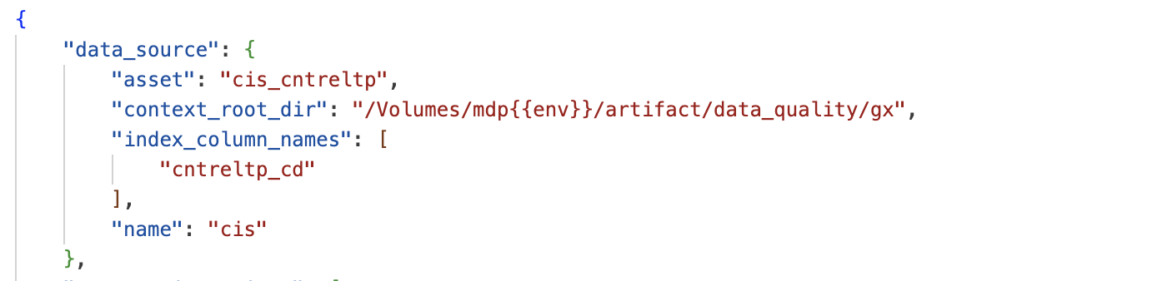
AUDIT CONFIGURATION
Transition FOUNDATION ingestion
{ "data_source": { "asset": "cis_cntreltp", "context_root_dir": "/Volumes/mdp{{env}}/artifact/data_quality/gx", "index_column_names": [ "cntreltp_cd", ], "name": "cis" },
Standard naming
asset : <table_name>
name : <src_sys> e.g. cis, cardlink
rule_id => <type>_0000
Technical validation =
TECH_VLD_0001 (unique)
TECH_VLD_0002 (not null)
Note: Index Column Name : List of Primary key (PK)
"expectation_suites": { "expectation_suite_name": "com_suite_persist_csm_csm_custxformxconsentderived", "expectations": [ { "expectation_type": "expect_column_values_to_not_be_null", "kwargs": { "column": "custfcdr_cust_id" }, "meta": { "level": "WARNING", "rule_id": "COM_0001" } }, { "expectation_type": "expect_column_values_to_be_unique", "kwargs": { "column": "custfcdr_cust_id" }, "meta": { "level": "WARNING", "rule_id": "COM_0002" } }, ... } ] }, "validators": [ { "expectation_suite_name": "com_suite_persist_csm_csm_custxformxconsentderived", "validator_name": "persist_csm_csm_custxformxconsentderived_checkpoint" }
Name : Source system name
Index Column Name : List of Primary key (PK)
Asset : Table Name

Slide 7
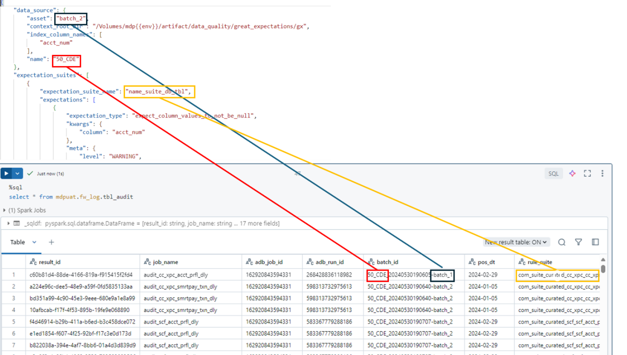
DQ Transform
Ingestion design

Slide 8


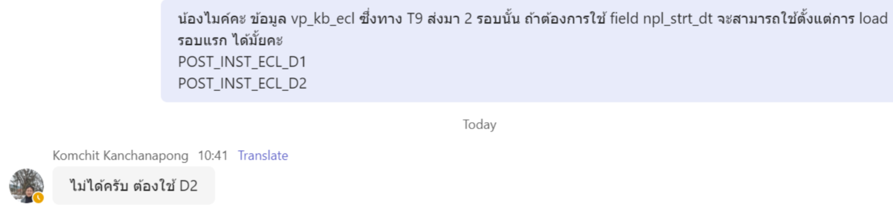
Solution discussion for TFRS9: 2 files 1 table
Ingestion design
TFRS9
EBAN Landing Zone
EBAN Datalake & Datatank
3rd of month
POST_INST_ECL_D1_20240731.txt
POST_INST_ECL_D1_20240731.txt
U71802IMM510
Load Replace
Load Replace (PTN_YYYY, PTN_MM)
4th of month
POST_INST_ECL_D2_20240731.txt
POST_INST_ECL_D2_20240731.txt
U71802IMM511
DATALAKE.IN_KB_ECL
DATALAKE.P_KB_ECL
Control-M FT (MDP pulls files)
MDP Use Case:
MDP On-Prem → Inbound
MDP Foundation Raw & Persist Zone
POST_INST_ECL_D1_20240731.txt
Job: ingest_ tfrs9_post_inst_ecl _d1_m
Options for Discussion:
Ingest POST_INST_ECL_D2_20240731.txt only – 1 file, 1 job per 1 table (used by curate: NPL Start Date as confirmed by source)
Ingest both POST_INST_ECL_D1_20240731.txt and POST_INST_ECL_D2_20240731.txt – 2 files, 2 jobs per 1 table – confirmed this option in solution on 6-Aug
POST_INST_ECL_D2_20240731.txt
Job: ingest_ tfrs9_post_inst_ecl _d2_m
raw_tfrs9.
tfrs9_post_inst_ecl
persist_tfrs9.
tfrs9_post_inst_ecl
Notes:
Processing Logic : Load data 2 times per month -1st Round : Load data from file:POST_INST_ECL_D1_YYYYMMDD.txt (draft version of ECL) -2nd Round 2 : Load replace data by using file:POST_INST_ECL_D2_YYYYMMDD.txt

Slide 9

Foundation phase#2 : TFRS9
Ingestion design
EBAN-IN (DATALAKE.IN_KB_ECL)
MDP
POST_INST_ECL_D1_YYYYMMDD.txt
Job Config : ingest_ tfrs9_post_inst_ecl _d1_m
Job name: U71802IMM510
รันวันที่ 3 ของเดือน ใช้ date วันสิ้นเดือนของเดือนก่อนหน้า โดยรันต่อจาก job U71802FTM507
Table : tfrs9_post_inst_ecl
POST_INST_ECL_D2_YYYYMMDD.txt
Job name: U71802IMM511
รันวันที่ 4 ของเดือน ใช้ date วันส้นเดือนของเดือนก่อนหน้า โดยรันต่อจาก job U71802FTM508
Job Config : ingest_ tfrs9_post_inst_ecl _d2_m
EBAN-OUT (DATALAKE.P_KB_ECL)
POST_INST_ECL_D2
Notes:
Processing Logic : Load data 2 times per month -1st Round : Load data from file:POST_INST_ECL_D1_YYYYMMDD.txt (draft version of ECL) -2nd Round 2 : Load replace data by using file:POST_INST_ECL_D2_YYYYMMDD.txt

Slide 10
MDF Source Extraction flow – CARDLINK
Discussion on Fri.12-Dec.2023
v
Proposed Integration
Cardlink
Streaming Hub
100%
MQ Online
Kafka Subscription
100%
Cardlink
Same as source
7 days retention
AUTHLOG2: CCV2_JCB
MDF
ONLINE
80%
100%
AUTH1
AUTHLOG2: CCV2_JCB
Filter only required data
DIH
EBAN
Filename
ODSCC.CCV2_JCB

Slide 11
MDF Source Extraction flow – PCB
Discussion on Fri.12-Dec.2023
v
Proposed Integration
PCB
Streaming Hub
100%
MQ Online
Kafka Subscription
PCB
Same as source
xx days retention
MDF
ONLINE
DIH
EBAN
Filename
PCB_DEPTXN_DB

Slide 12
Streaming ingestion
Ingestion design
Extraction Config: extrct_<table_name>_r
Job Config: ingest_<table_name>_streaming_<freq>
Kafka Subscription
Streaming Hub
Streaming table
Raw/Persist table
streaming_<src_sys>.<tbl_name>
raw_<src_sys>.<tbl_name>
persist_<src_sys>.<tbl_name>
Ingestion Team
Object | Naming | Description
Extraction Configuration | extrct_<table_name>_r (extrct_<table_name>.json)
Streaming Certificate | streaming_hub_certificate.jks
Streaming Mapping | ingest_spec_<table name>_copybook.txt
Ingestion Team
Object | Naming | Description
Job Configuration | ingest_<table_name>_streaming_<freq> (job_config_<job_name>.json )
Ingestion Spec (Mapping) | ingest_spec_<table name>.json

Slide 13
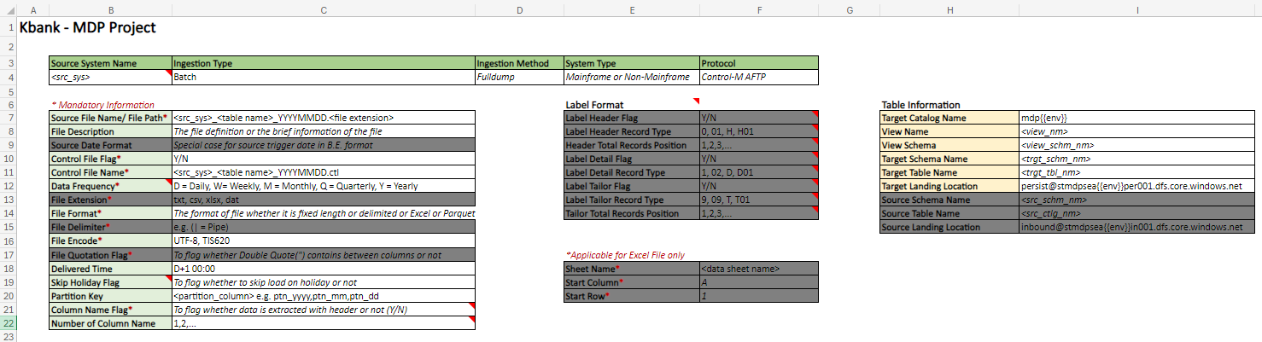
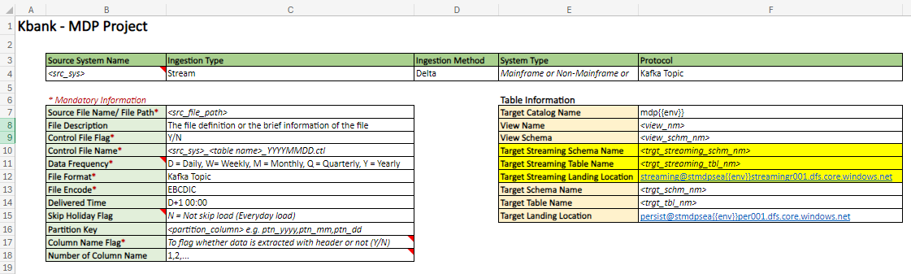
Comparing CBR batch-ingest and streaming-ingest Part 1/4
Ingestion design
CBR Batch-Ingestion
CBR Streaming-Ingestion

Slide 14
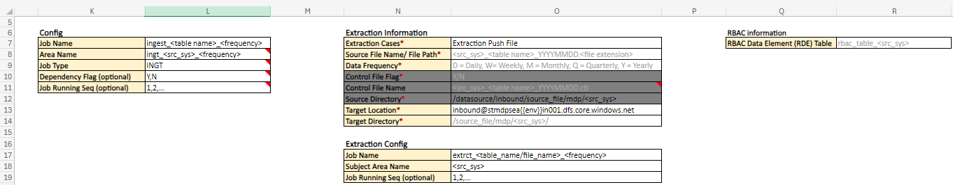
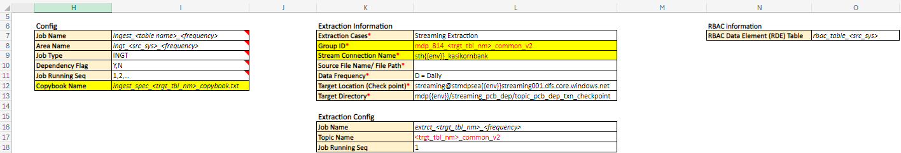
Comparing CBR batch-ingest and streaming-ingest Part 2/4
Ingestion design
CBR Batch-Ingestion
CBR Streaming-Ingestion

Slide 15
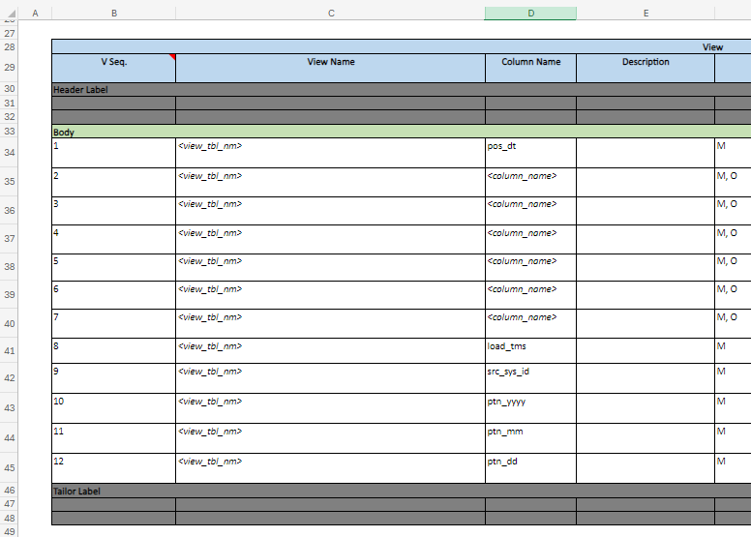
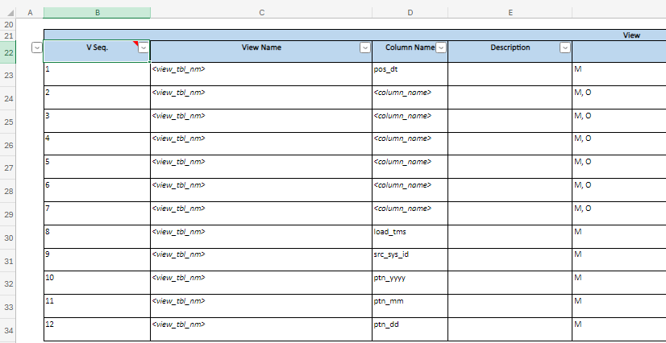
Comparing CBR batch-ingest and streaming-ingest Part 3/4
Ingestion design
CBR Batch-Ingestion
CBR Streaming-Ingestion

Slide 16
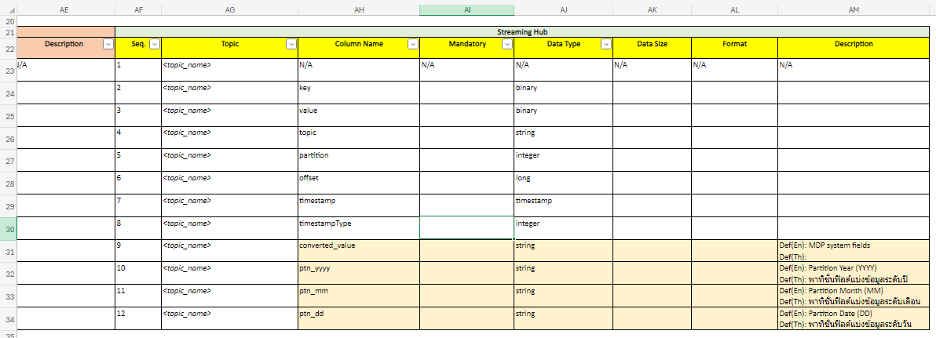
Comparing CBR batch-ingest and streaming-ingest Part 4/4
Ingestion design
CBR Streaming-Ingestion

Slide 17
Table name and group id alignment
Ingestion design
Streaming table name
No. | streaming table | persist table | Spec No. of columns | persist table #phase 1 | No. of columns
1 | streaming_cardlink.cardlink_authlog2_jms | persist_cardlink. cardlink_authlog2_jms | 1362 columns | persist_cardlink.cardlink_odscc_ccv2_jcb | source : 122 columns
2 | streaming_pcb_dep.pcb_dep_pcb_deptxn_common | persist_pcb_dep. pcb_dep_pcb_deptxn_common | 38 columns | persist_pcb_dep.pcb_dep_deptxn_db | source : 37 columns
Streaming group ID name
No. | Area name | Group ID | Topic name | Example
1 | pcb_dep | mdp_814_<topic_name> | PCB_DEPTXN_COMMON_V2 | mdp_814_pcb_deptxn_common_v2
2 | cardlink |  | CARDLINK_AUTHLOG2_JMS | mdp_814_cardlink_authlog2_jms

Slide 18
Ingestion design
Standard naming and location storage
Standard Naming Convention
No | Items | Value | Name Format | Sample Name | Directory
1 | Database | Name | Raw: raw_<src_sys> Persist Table: persist_<src_sys> Persist View: persist_<src_sys>_view Streaming: streaming_<src_sys> | raw_cis persist_cis persist_cis_view streaming_cis | -
 |  | Object Name (Init) | db_init_<zone>_<src_sys>.sql | db_init_raw_cis.sql db_init_persist_cis.sql db_init_persist_view_cis.sql db_init_streaming_cis.sql | /ddl/mdp/db_init/ingest/<area>/*.sql
2 | Table: Persist | Name | <src_sys>_<source_file_name/source_table_name> | cis_ipxar | -
 |  | Object Name (Init) | tbl_init_<zone>_<table_name>.sql | tbl_init_persist_cis_ipxar.sql | /ddl/mdp/tbl_init/ingest/<area>/persist/*.sql
3 | Table: Raw | Name | <src_sys>_<source_file_name/source_table_name> | cis_ipxar | -
 |  | Object Name (Init) | tbl_init_<zone>_<table_name>.sql | tbl_init_raw_cis_ipxar.sql | /ddl/mdp/tbl_init/ingest/<area>/raw/*.sql
4 | Persist View | Object Name | view_init_v_<table_name>.sql | view_init_v_cis_cst_acct_rel_prfl.sql | /ddl/mdp/view_init/<area>/*.sql
5 | RBAC Tagging | Object Name | Persist Table: set_tag_<table_name>.sql Persist View: set_tag_<view_name>.sql | set_tag_cis_ipxar.sql set_tag_v_cis_cst_acct_rel_prfl.sql | /ddl/mdp/table_property/<area>/persist/*.sql
6 | Job | Name | Normal : ingest_<table_name>_<freq> Incremental load initial : ingest_<table_name>_<freq>_initial Incremental (normal job) : ingest_<table_name>_<freq> Streaming : Load to raw/persist : ingest_<table_name>_streaming_<freq> Extraction to streaming : extrct_<table_name>_r | Load initial : ingest_cis_ipxar_d_initial Normal job : ingest_cis_ipxar_d Streaming : ingest_cis_ipxar_streaming_d | -
7 | Ingestion Spec (Mapping) | Object Name | ingest_spec_<table name>.json | ingest_spec_cis_ipxar.json | /mapping/mdp/ingest/<area>/*.json

Slide 19
Ingestion design
Standard naming and location storage
Standard Naming Convention
No | Items | Value | Name Format | Sample Name | Directory
8 | Job Config | Object Name | job_config_<job_name>.json Incremental load initial : job_config_<initial_job_name>json Incremental (normal job) : job_config_<job_name>.json | Load initial : job_config_ingest_cis_ipxar_d_initial.json Normal job : job_config_ingest_cis_ipxar_d.json Streaming job: job_config_ingest_cis_ipxar_streaming_d.json | /config/mdp/ingest/<area>/ *.json
9 | Config mapping (Fix Length Config) | Object Name | ingest_spec_<table name>_fixed_length.json | ingest_spec_cardlink_kb1dh011_cc1d2027_fixed_length.json | /mapping/mdp/ingest/<area>/*.json
10 | Dpnd Config | Object Name | dpnd_ingest_<job name>.json | dpnd_ingest_csm_custxformxconsentderived_d | /config/mdp/dpnd/ingest/<area>/*.json
11 | Audit Configuration | Object Name | audit_config_<schema_name>_<table_name>.json | audit_config_persist_cardlink_cardlink_kb1dh011_cc1d2027.json | /config/mdp/audit/ingest/<area>/*.json
12 | Extraction Config | Object Name | extrct_<table_name>.json | extrct_cis_ipxar.json | /app/mdp/config/extraction/<area>/*.json
13 | Unit Test | Object Name | MDP_Ingestion_<env>_Test_<baseline no.>_<schema>_<table_name>_v01_00_00.html | MDP_Ingestion_Unit_Test_MDP_INGESTION_BSL_0001_persist_cis_cis_ipxar _v01_00_00.html | /test/mdp/<test_type>/ingest/<area>/<baseline no>/*.html e.g. /test/mdp/unit/ingest/cis/MDP_INGESTION_BSL_0001/*.html
14 | CBR | Object Name | CBR_814_<schema>_<view name>_v00.xlsx | CBR_814_persist_cis_view_v_cis_cst_acct_rel_prfl_v05.xlsx | /test/mdp/<test_type>/ingest/<area>/cbr/*.xlsx
15 | Streaming Certificate | Object Name | streaming_hub_certificate.jks |  | /certificate / mdp / extraction /<src_sys>/ streaming_hub_certificate.jks Repo: workspace-proc
16 | Streaming Mapping | Object Name | Streaming Load to Raw: ingest_spec_<table name>_copybook.txt |  | /mapping/mdp/ingest/<area>/*.txt

Slide 20
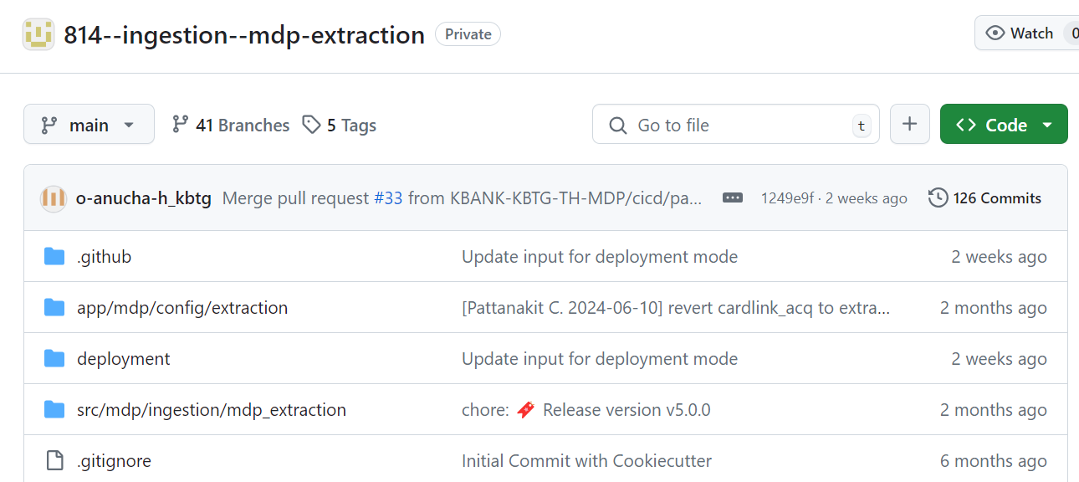
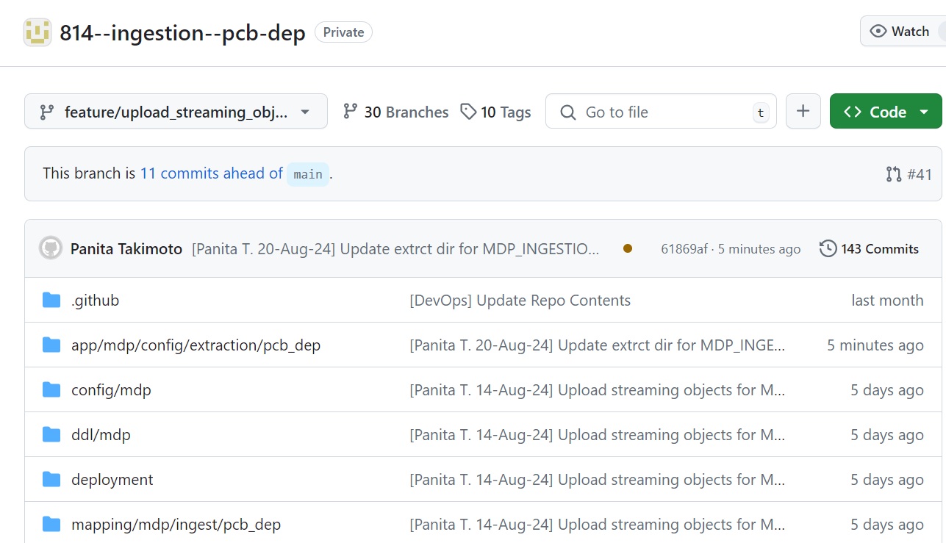
Ingestion design
Job extraction

