Slide 1
Project update
04/10/2024

Slide 2
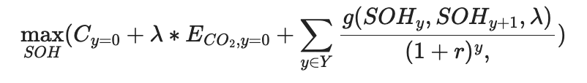
Optimization problem
Primary goals: same as project goals
Secondary goals: Accurately modeling battery degradation’s impact on operational constraints
Two stage optimization:
Yearly optimization to build a function of revenues and loss of SOH of current year
Multi-year NPV optimization

Slide 3
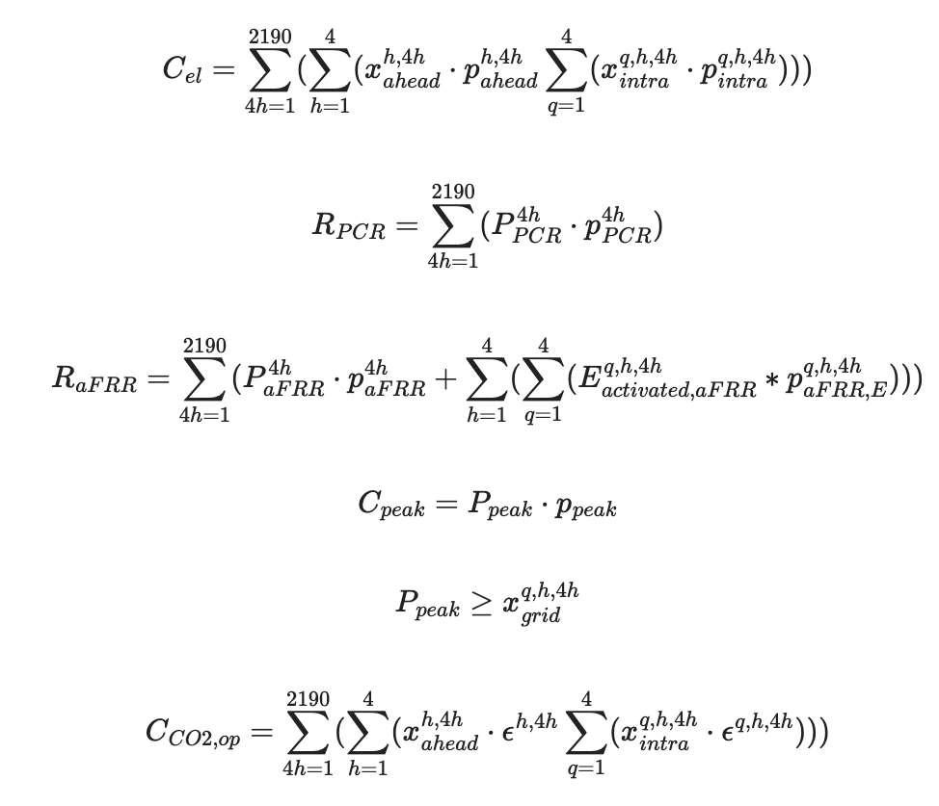
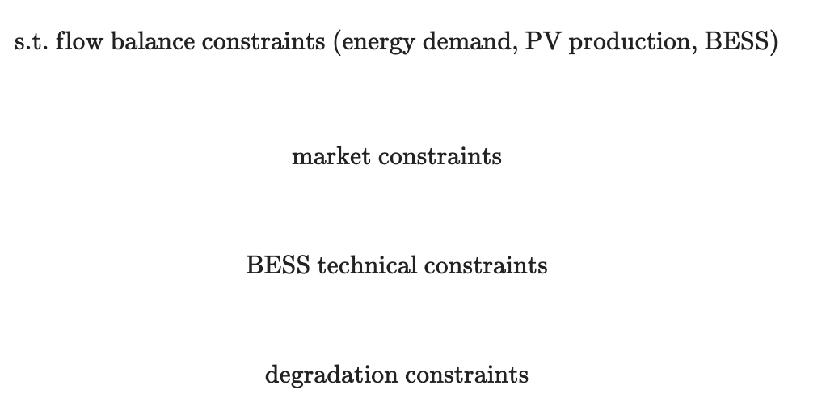
First stage Operation optimization
SOH_{end} may be modulated by either a fixed constraint or by a constraint on maximum wholesale trading activities.
Outputs a regression for SOH at the start and end of the year

Slide 4
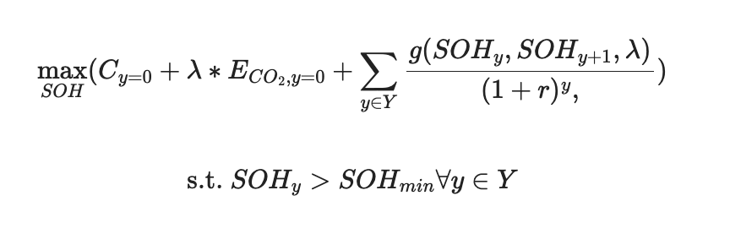
Second stage NPV calculation

Slide 5
Agenda
Background
Literature
Research objectives
Data (data required and data management plan)
Project planning

