Slide 1
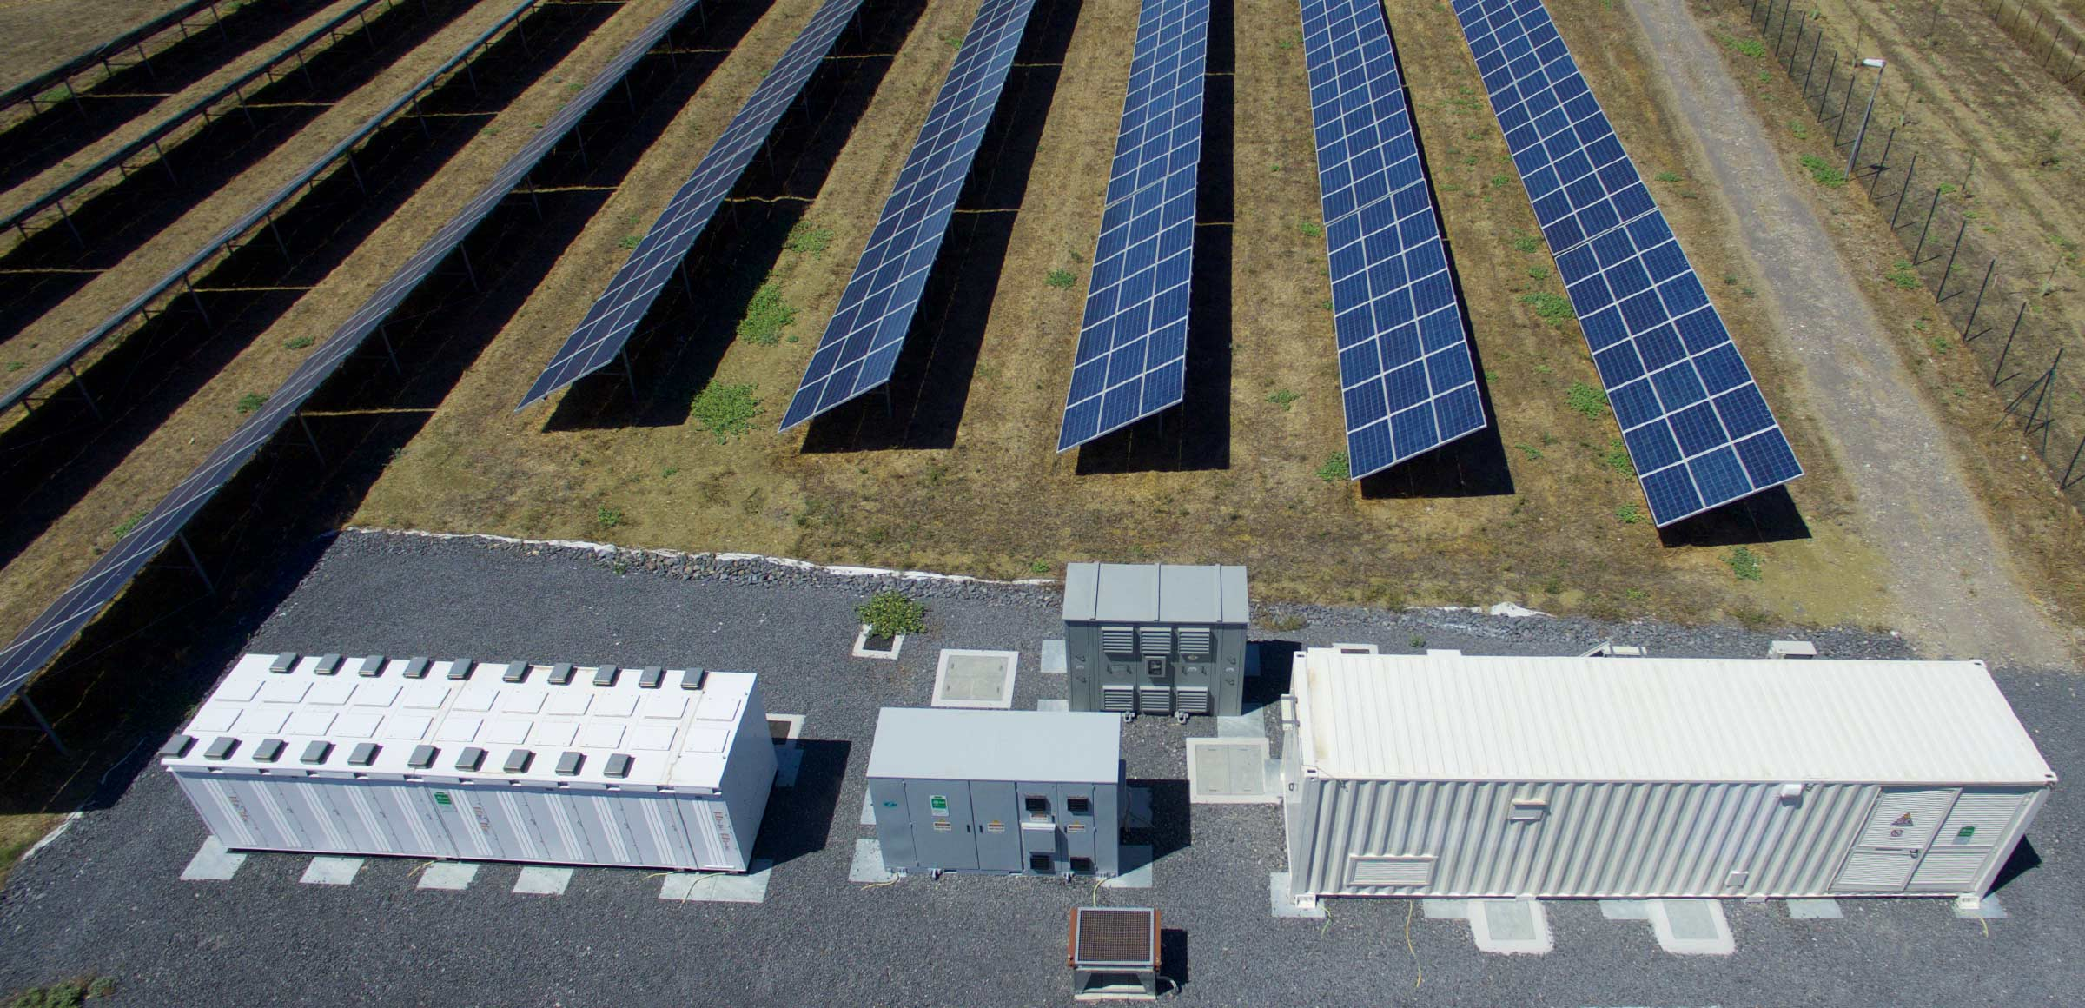
Economic and environmental evaluation of parallel revenue streams for hybrid energy storage systems
Project proposal
Nicolas Seemann-Ricard
16.10.2024

Slide 2
Agenda
Research gaps addressed
Research objectives
Problem formulation
Markets data and analysis
Optimization problem
Evaluation of results
Project planning

Slide 3
Research gaps addressed
Revenue stacking with hybrid energy storage systems (HESS)
Revenues: peak shaving, wholesale markets, ancillary services
HESS: battery, supercapacitor, (heat storage)
CO₂-aware modelling of revenue stacking
Changes and trends in market conditions:
Shorter term products (4hr PCR, 15min aFRR activation)
Changes in market volatility, average prices
Notes:
There has already been a good amount of work done in this area, particularly in evaluating potential revenues from BESS in certain markets and in different type cases (e.g. C&I, utility-scale).
However, the main research gaps are three folds:
Extensiveness: comparison of technology and revenue mixes.
CO₂ awareness
Market conditions elements: trends in market conditions.

Slide 4
Research objectives
Investigate the impact of participating in different electricity markets with HESS (revenue stacking), including uncertainty of activation and regulatory constraints, under varying market conditions
Day-ahead and intraday wholesale (DA, ID)
Primary control reserve (PCR)
Secondary control (aFRR)
Peak shaving
Investigate different system configurations: PV vs. PV + BESS vs. PV + HESS
Evaluation based on profit-maximization and profit-CO₂ multiobjective optimization
Case study for German industrial plants with PV production.
Detailed degradation modelling ex-post

Slide 5






Problem formulation: market and technology mixes
Industrial load
PV
Technology mixes:
PV only,
PV + BESS,
PV + BESS + supercap + (thermal storage)
Markets:
Peak shaving (PS)
PS + DA & ID
PS + DA & ID + PCR & aFRR
Supercap
Grid
Thermal storage
BESS

Slide 6

Problem formulation: system operation
Aggregated capacity
SOC
Supercap
FCR (30min)
Capacity markets (FCR, aFRR)
aFRR up (1h)
Thermal storage
Arbitrage and peak shaving
Wholesale markets (Day-ahead, intraday)
Peak shaving
PV production
SOC
SOC
Degradation
aFRR down (1h)
SOC
FCR (30min)
Battery

Slide 7
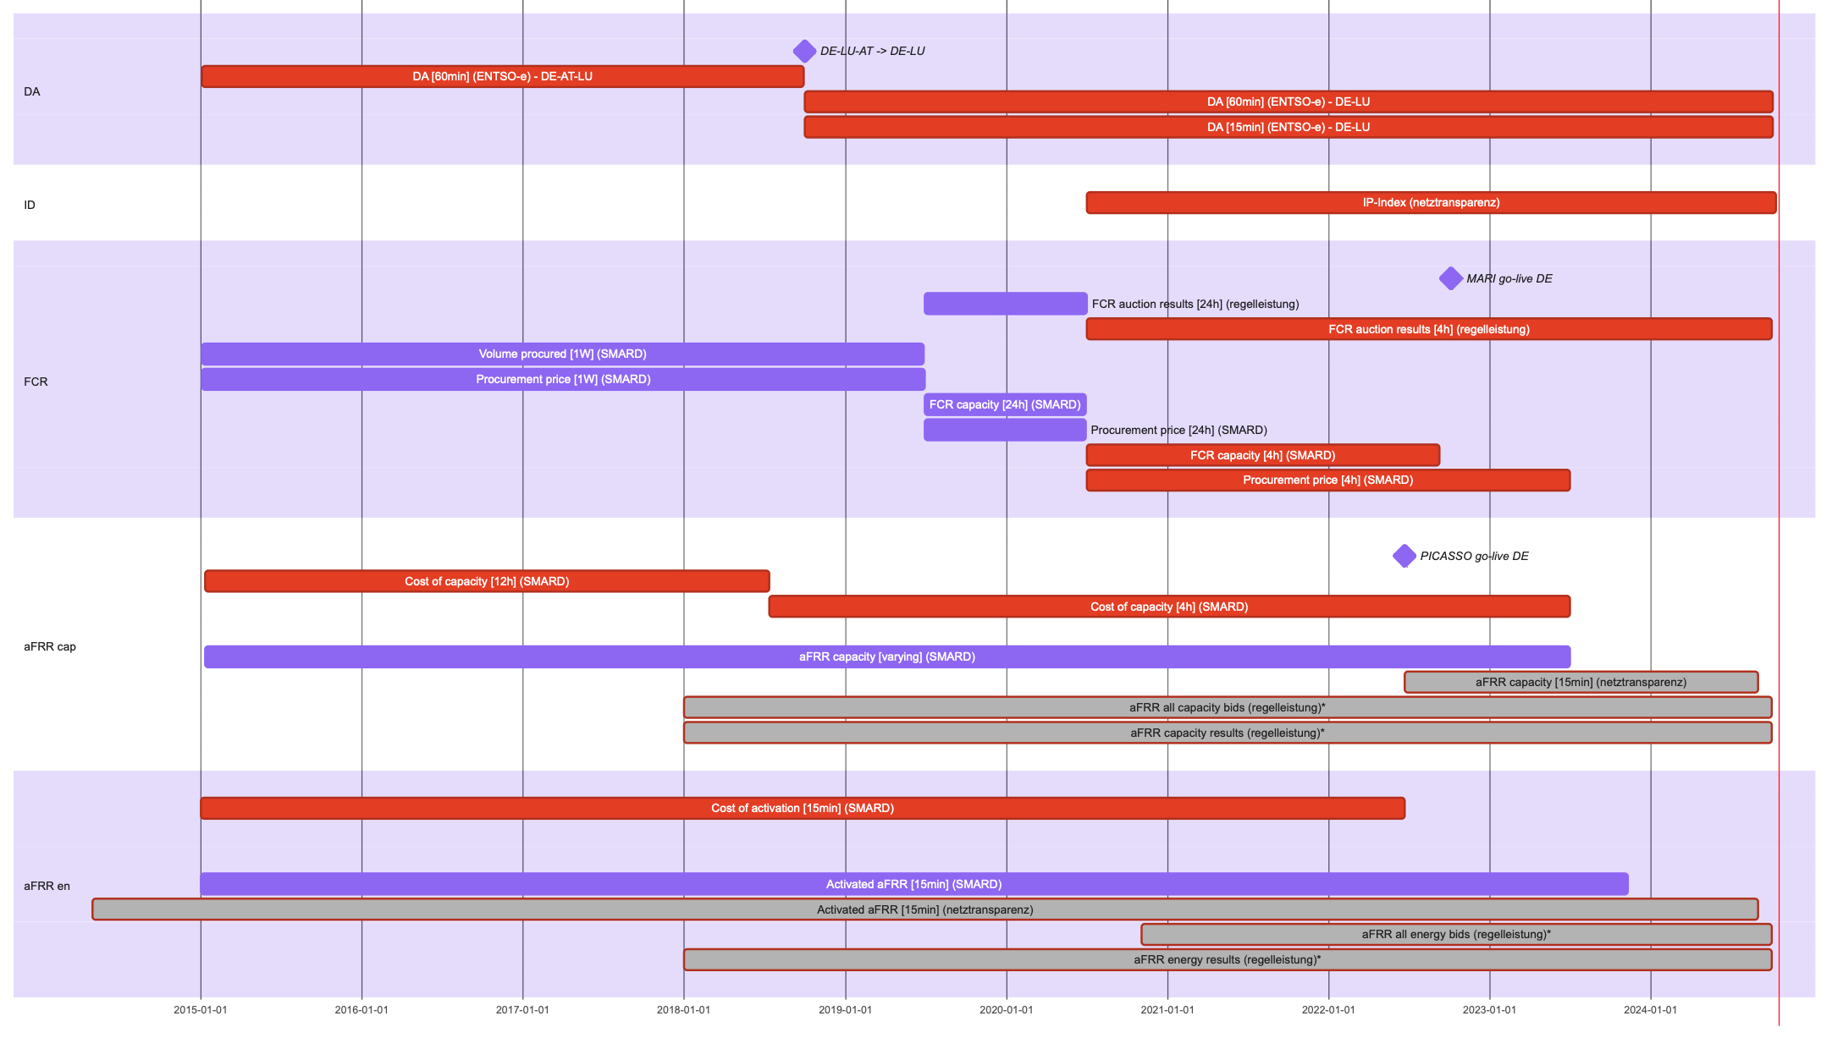
Today
Notes:
AND 15min day ahead starting next year

Slide 8
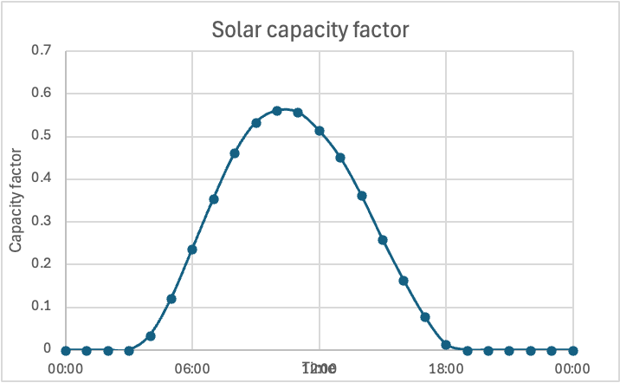
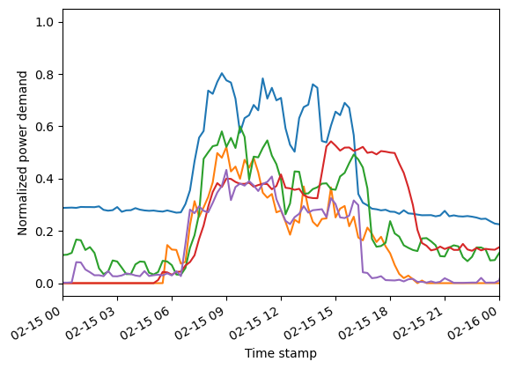
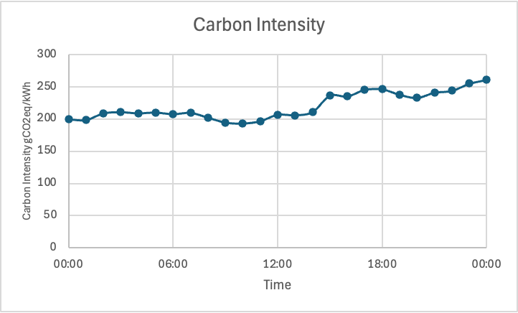
Analysis and modelling of varying market conditions
Characterize market months (market rules, average prices, volatility)
Pair with PV production, local load, carbon intensity
→ Will allow to analyse potential revenues under specific market conditions to make predictions about future trends
Industrial loads

Slide 9

Optimization problem: main features
Operational objective function:
Constraints:
Flow, technical
Regulatory constraints of markets (e.g. volume ticks, minimum SOC)
Solving will heavily depend on problem complexity once implemented
Single-stage (month-long) with variable storage capacities might be too complex
Possibly implement a two-stage optimization:
1st stage on shorter timescales builds a surrogate model for system configuration
2nd stage solves for longer timescales
Optimization problem: solving

Slide 10
Evaluation of results
System costs with different market participation (peak shaving, arbitrage, balancing services)
System costs with different systems (PV, BESS, HESS)
System costs vs market conditions and characteristics
System costs vs emissions costs
Expected lifetime (degradation) vs market conditions
NPV of the system

Slide 11
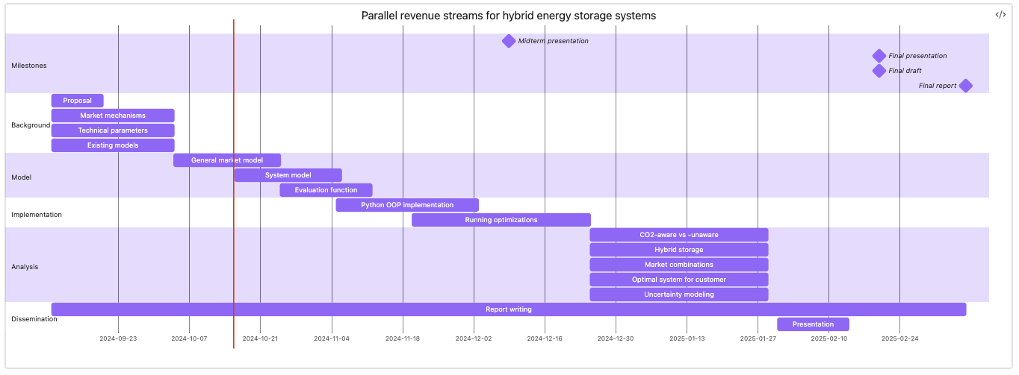
Project planning
Market data analysis
Today

