Slide 1
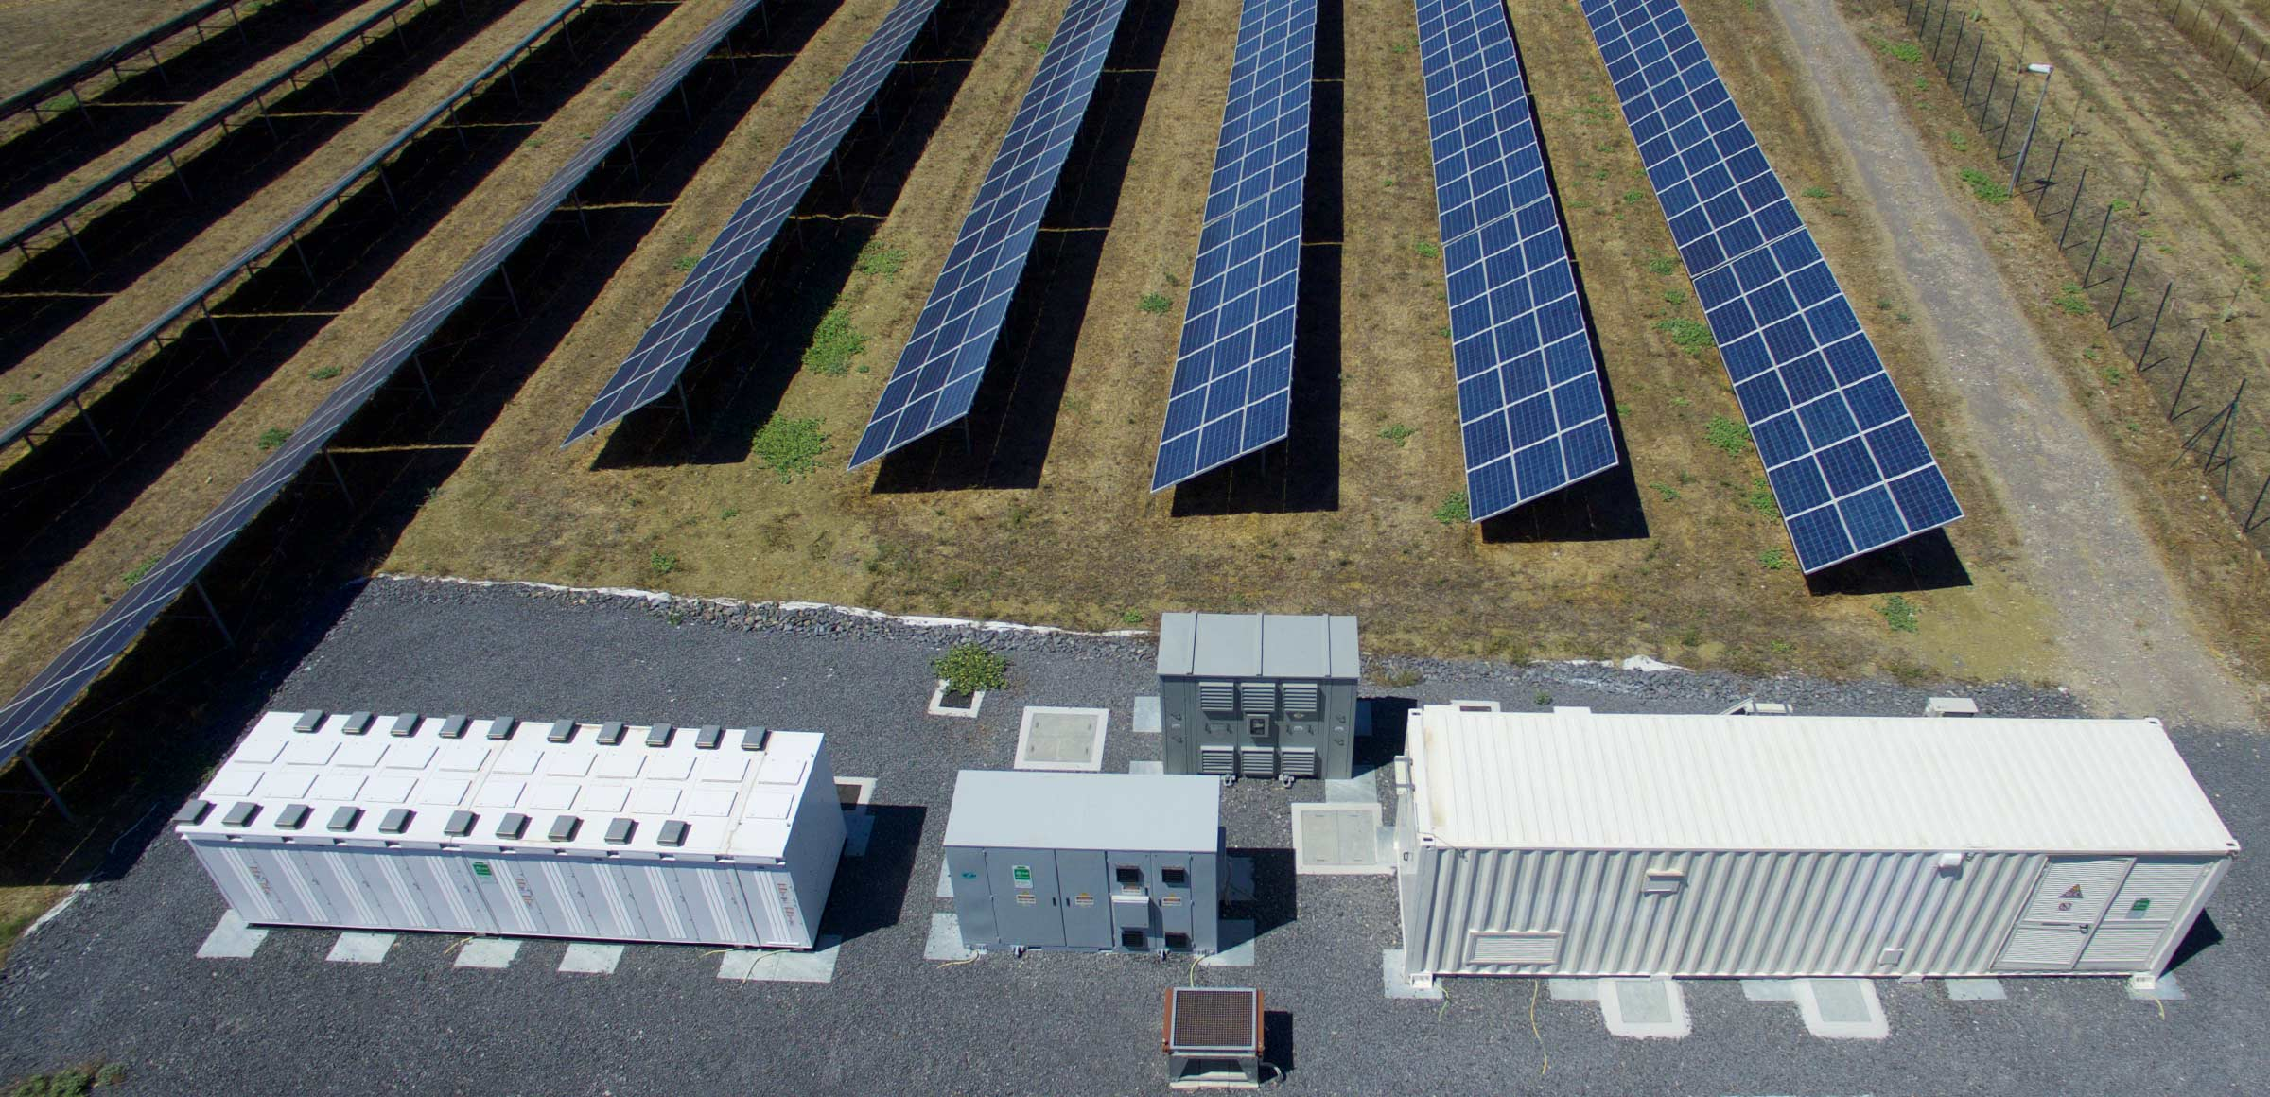
Economic and environmental evaluation of parallel revenue streams for hybrid energy storage systems
Project update (Nov 2024)
Nicolas Seemann-Ricard
16.10.2024

Slide 2
Agenda
Refining research question and goals
Structure and progress
Preliminary results

Slide 3
Refining scope and objectives
Current literature:
High sensitivity to quickly changing parameters (market products, CAPEX)
Many case studies, most with outdated market structure → abstraction of products
Objectives:
Investigate the impact of participating in different electricity markets with HESS (revenue stacking)
Investigate different system configurations: PV vs. PV + BESS vs. PV + HESS
Evaluation based on profit-maximization and profit-CO₂ multiobjective optimization
Evaluate impact of market indicators on performance/profitability/CO2

Slide 4
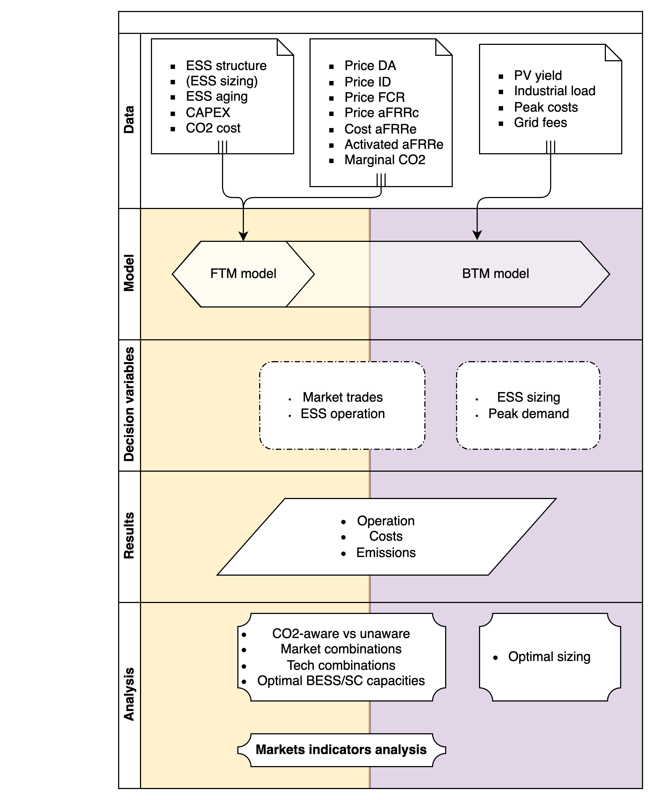
Structure and progress
Done
Most of the data is clean and imported
Scalable HESS modelling with cycling and calendar degradation costs but without CO2 emissions
Preliminary analysis market data
Next tasks
Wrap up literature review
Settle on technological parameters and grid fees
Implement CO2 accounting
Implement stochasticity for aFRR activation

Slide 5
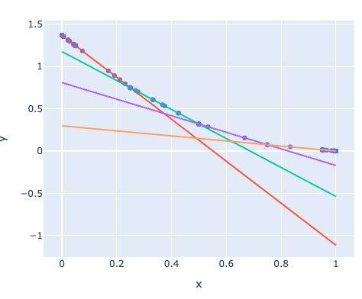
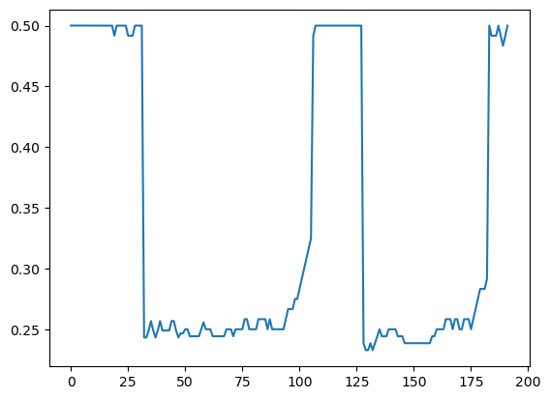
Proof of concept
Battery SOC over 48h
Linearized degradation function (psi vs SOC)

Slide 6
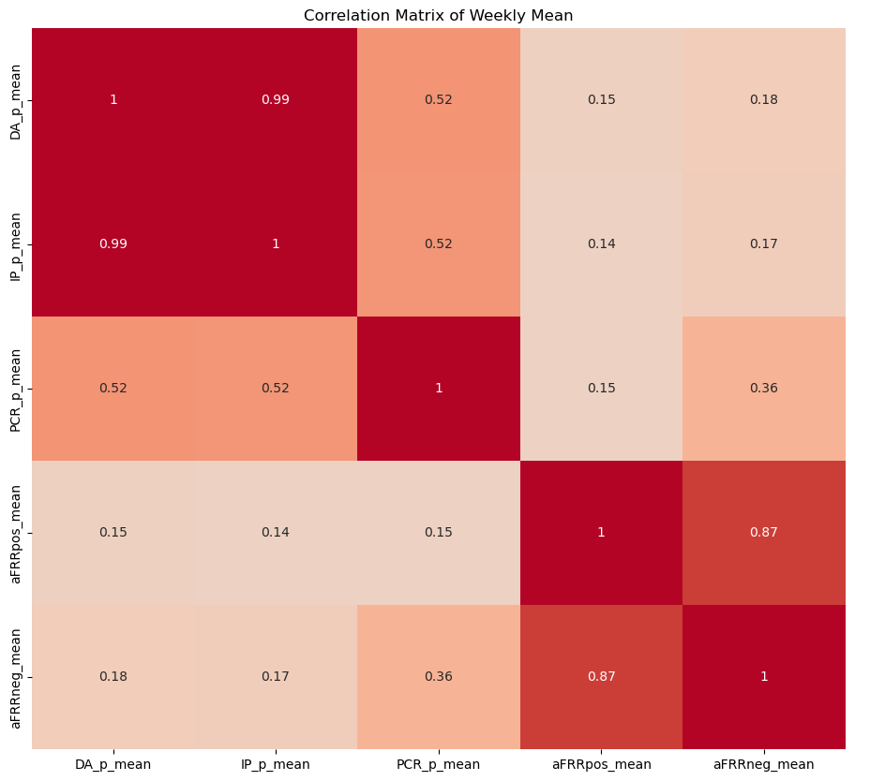
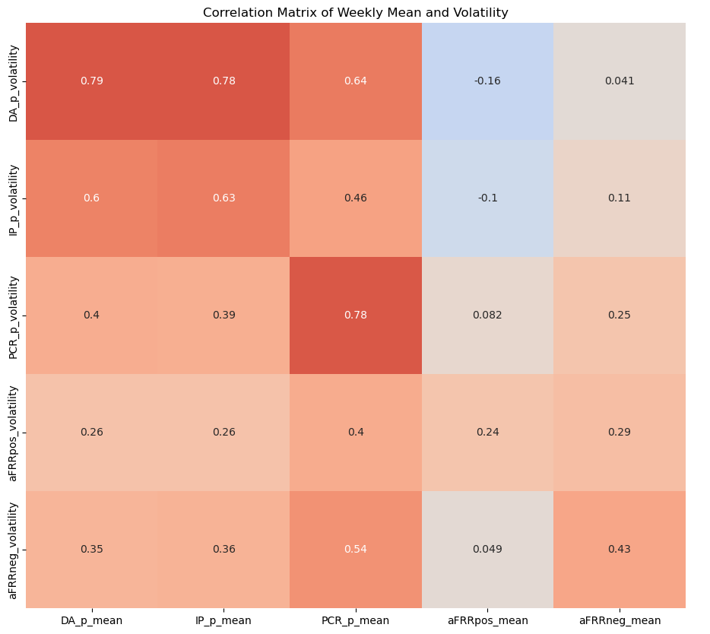
Correlating results with market metrics: mean prices and price volatility

Slide 7
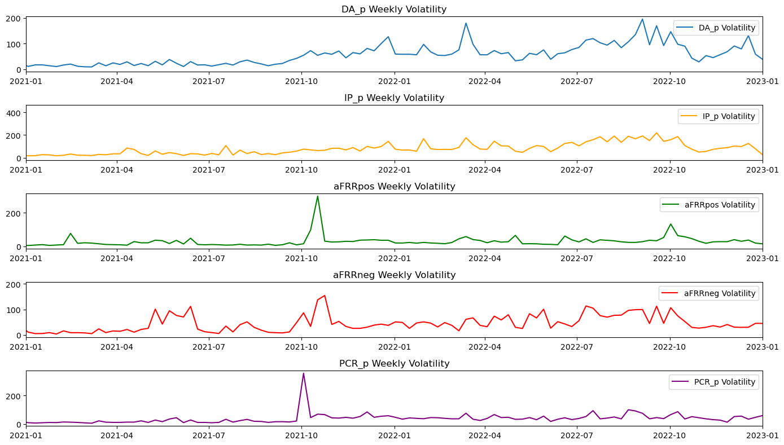

Slide 8
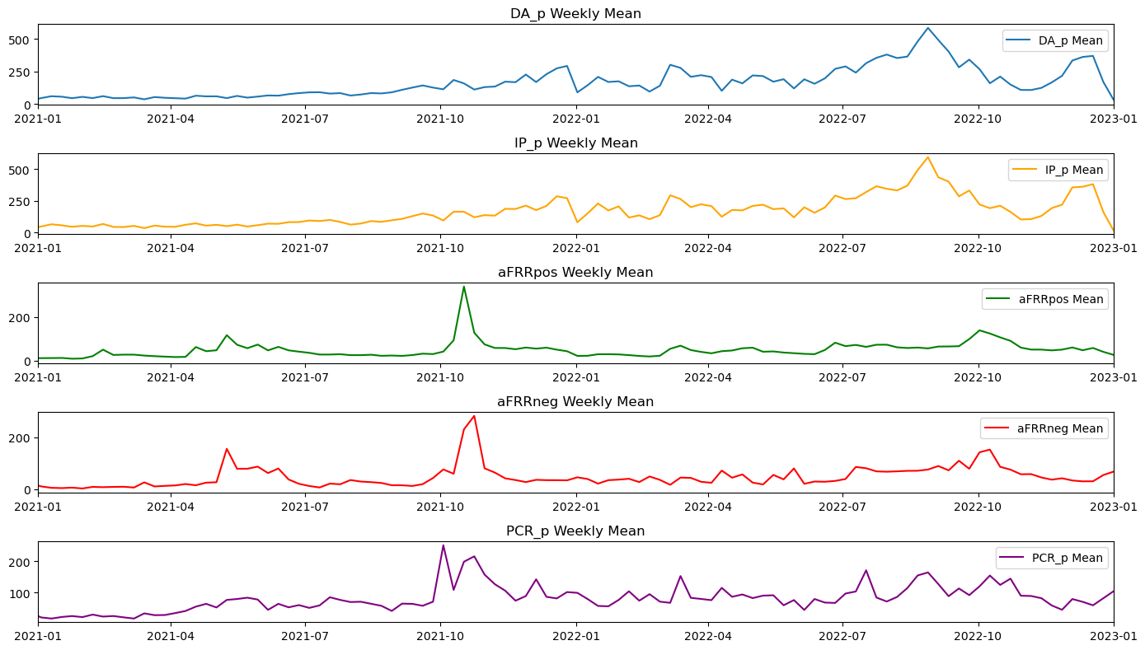

Slide 9
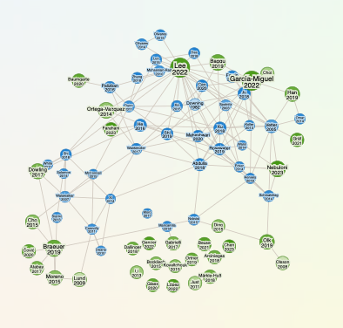
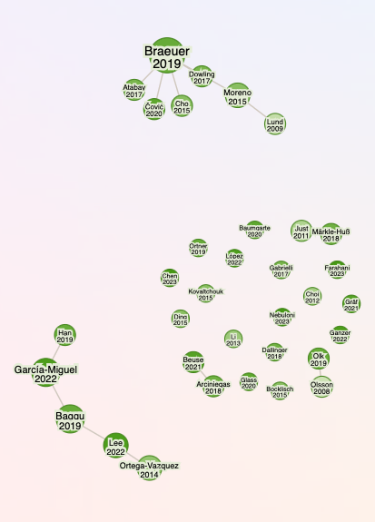
This week:
Lit!

Slide 10
This week:
Energy activation modelling
Case studies
Update for McKenna
Markets, model, results, next steps

Slide 11
Refining research question and goal
Investigate the impact of participating in different electricity markets with HESS (revenue stacking), including uncertainty of activation and regulatory constraints, under varying market conditions
Day-ahead and intraday wholesale (DA, ID)
Primary control reserve (PCR)
Secondary control (aFRR)
Peak shaving
Investigate different system configurations: PV vs. PV + BESS vs. PV + HESS
Evaluation based on profit-maximization and profit-CO₂ multiobjective optimization
Case study for German industrial plants with PV production.
Detailed degradation modelling ex-post

Slide 12






Problem formulation: market and technology mixes
Industrial load
PV
Technology mixes:
PV only,
PV + BESS,
PV + BESS + supercap + (thermal storage)
Markets:
Peak shaving (PS)
PS + DA & ID
PS + DA & ID + PCR & aFRR
Supercap
Grid
Thermal storage
BESS

Slide 13

Problem formulation: system operation
Aggregated capacity
SOC
Supercap
FCR (30min)
Capacity markets (FCR, aFRR)
aFRR up (1h)
Thermal storage
Arbitrage and peak shaving
Wholesale markets (Day-ahead, intraday)
Peak shaving
PV production
SOC
SOC
Degradation
aFRR down (1h)
SOC
FCR (30min)
Battery

Slide 14
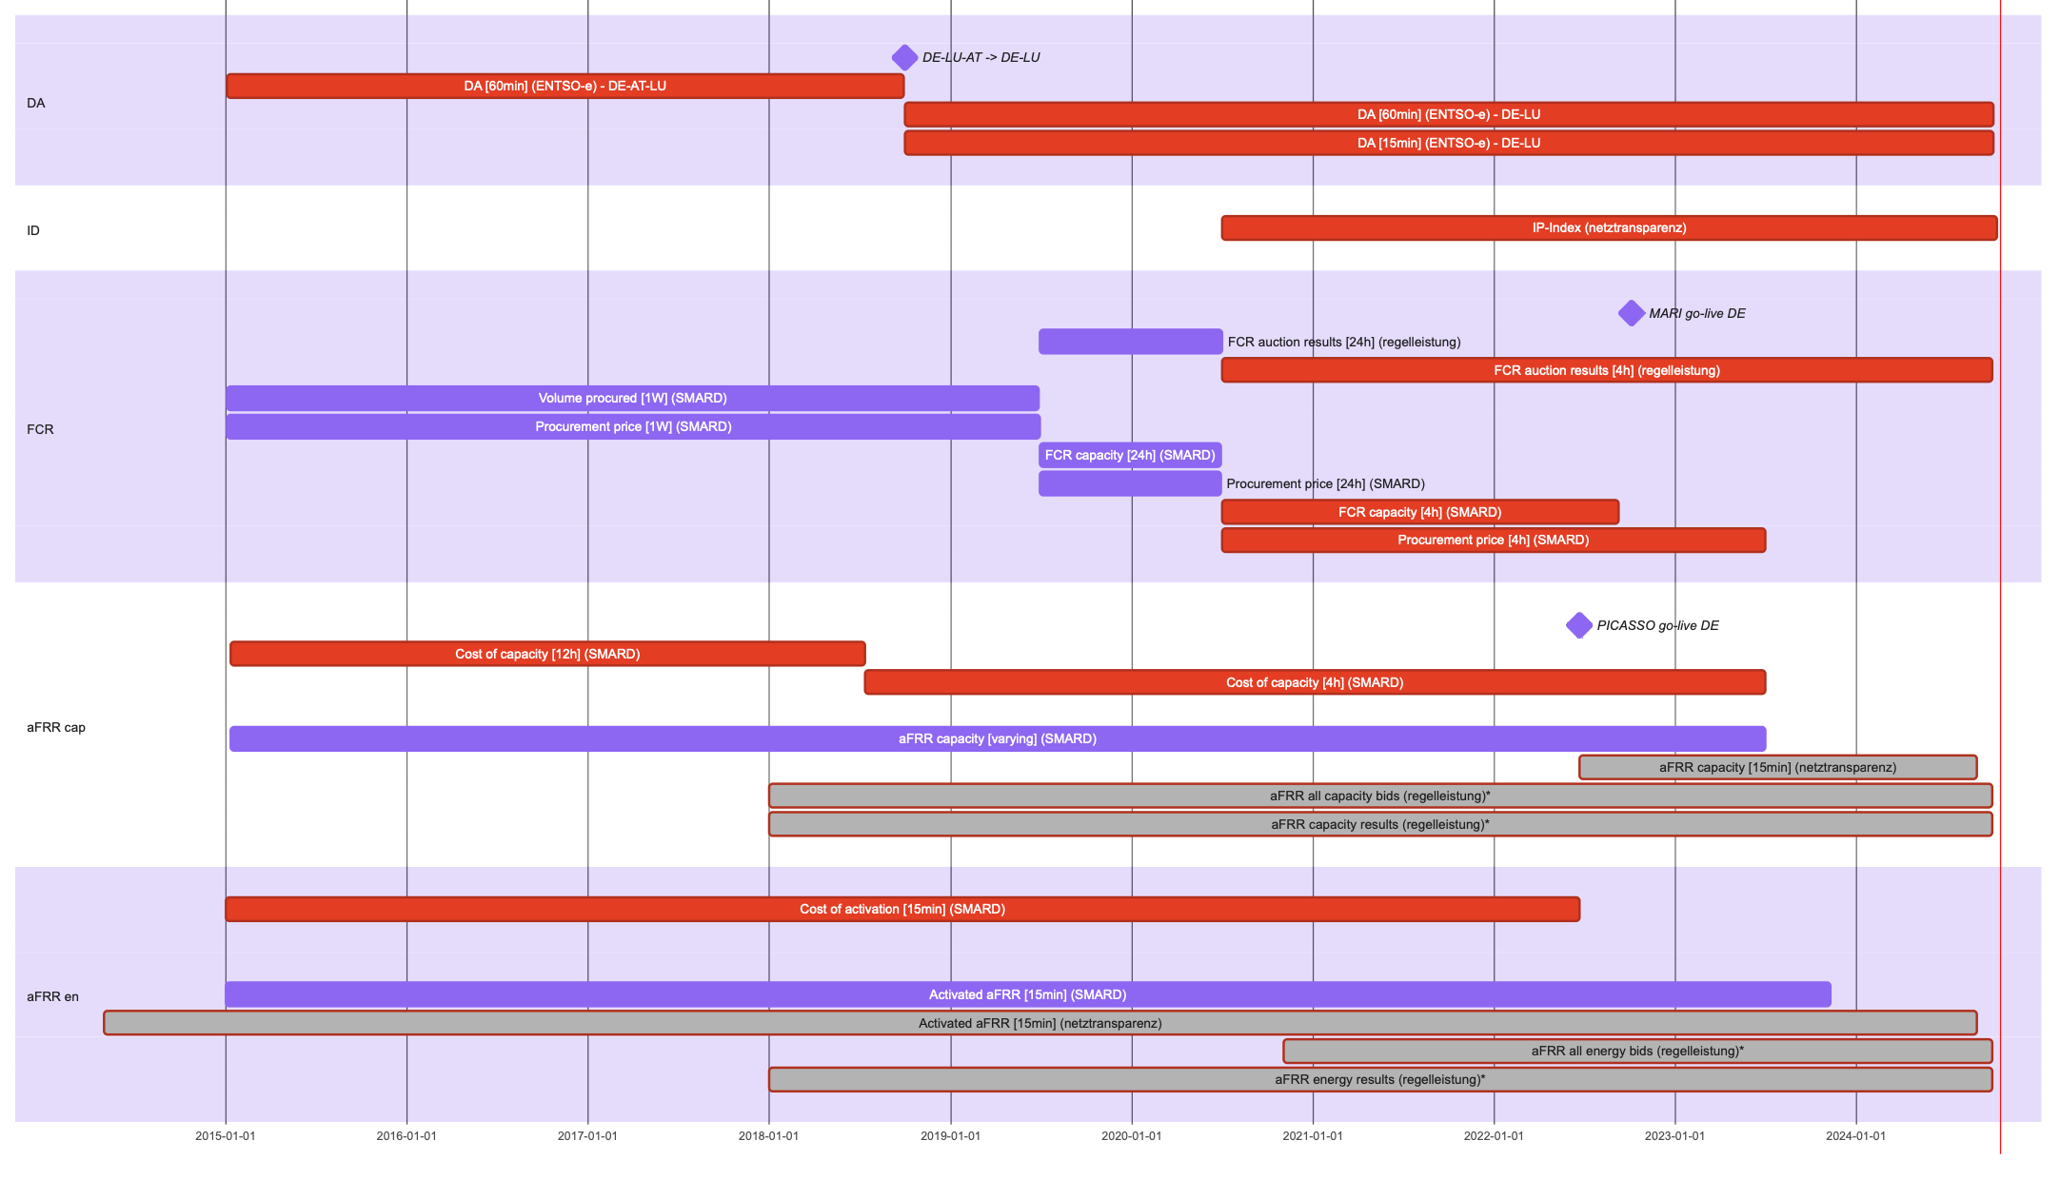
Today
Notes:
AND 15min day ahead starting next year

Slide 15
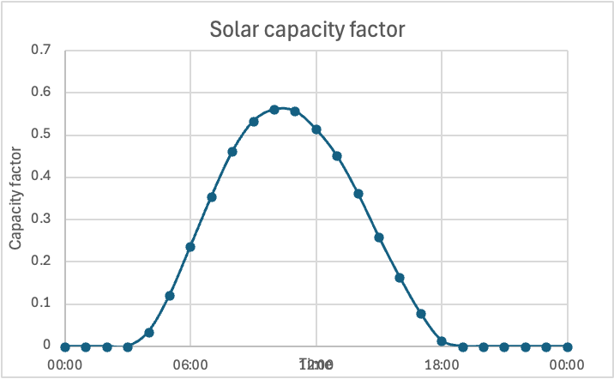
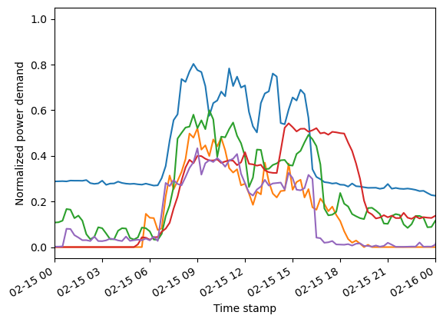
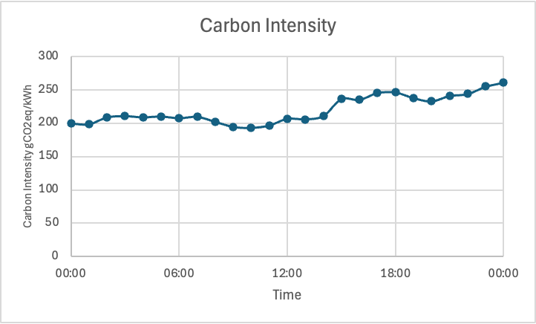
Analysis and modelling of varying market conditions
Characterize market months (market rules, average prices, volatility)
Pair with PV production, local load, carbon intensity
→ Will allow to analyse potential revenues under specific market conditions to make predictions about future trends
Industrial loads

Slide 16

Optimization problem: main features
Operational objective function:
Constraints:
Flow, technical
Regulatory constraints of markets (e.g. volume ticks, minimum SOC)
Solving will heavily depend on problem complexity once implemented
Single-stage (month-long) with variable storage capacities might be too complex
Possibly implement a two-stage optimization:
1st stage on shorter timescales builds a surrogate model for system configuration
2nd stage solves for longer timescales
Optimization problem: solving

Slide 17
Evaluation of results
System costs with different market participation (peak shaving, arbitrage, balancing services)
System costs with different systems (PV, BESS, HESS)
System costs vs market conditions and characteristics
System costs vs emissions costs
Expected lifetime (degradation) vs market conditions
NPV of the system

Slide 18
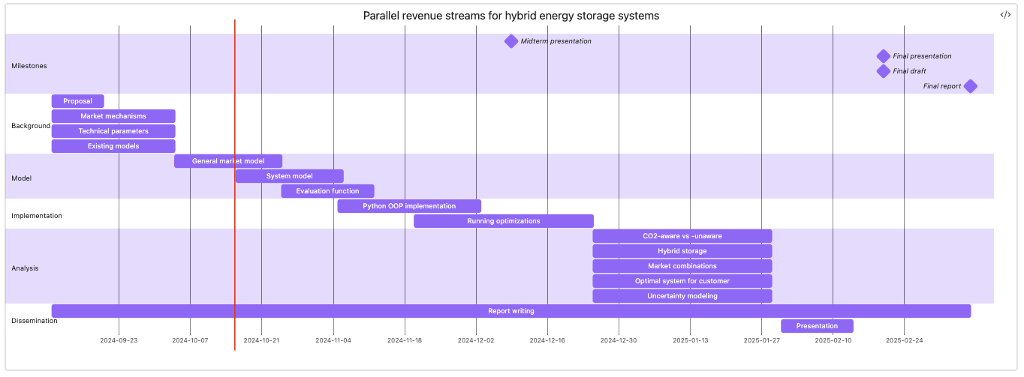
Project planning
Market data analysis
Today

